Slide 1
Mechanical Update
Kevin Duel
Booster 2nd Harmonic Cavity
07 December 2017

Slide 2
PA Upper Assembly Weld
Specified ID weld but welded externally

Slide 3
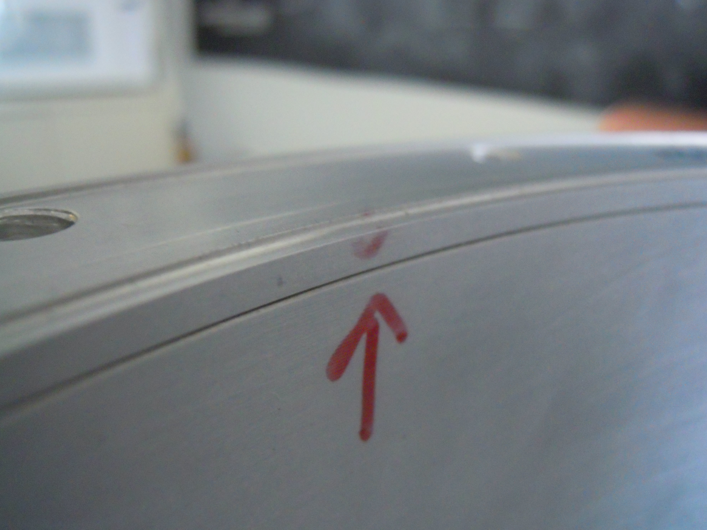
PA Upper Assembly Weld
Is ID weld necessary here?

