Slide 1
Mechanical Update
Kevin Duel
Booster 2nd Harmonic Cavity
21 December 2017

Slide 2
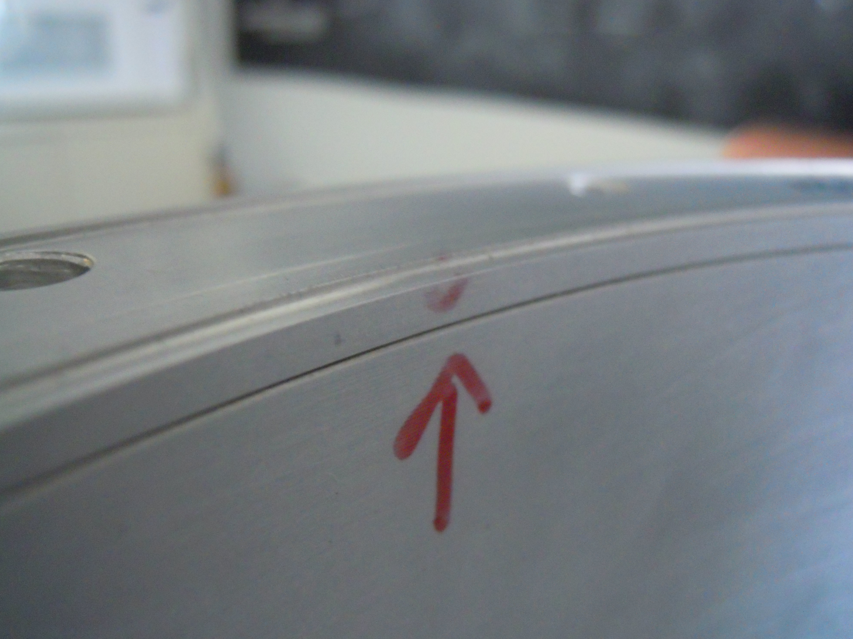
PA Upper Assembly Weld – Part Rejected

Slide 3
HOM Damper Progress
Welded and leak checking now
More welding (non-vacuum) to be done after plating

Slide 4
Cavity ID Wall Waviness
Decision is to polish light scratches with fine sandpaper and radius sharp corners of ports
Will not be polishing with Scotchbrite and power tool
Although common practice for existing cavities, there’s potential to imbed material in copper
Waviness shouldn’t have much effect
Estimate waviness of less than .005”

Slide 5
Installation
Install

Slide 6
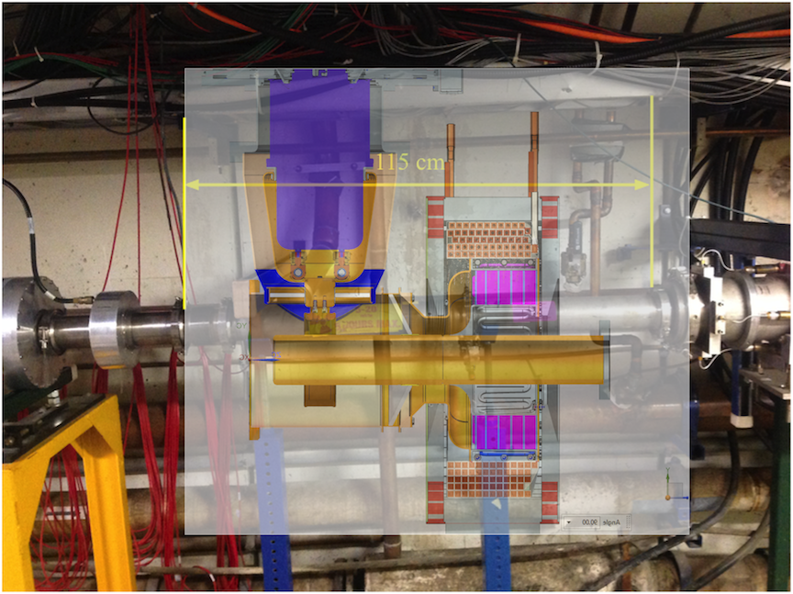
Installation
Toroid?
DCCT?
Damper?
Replace adapter
?
?
Can we flip upstream for downstream?

