Slide 1
Mechanical Update
Kevin Duel
Booster 2nd Harmonic Cavity
18 January 2018

Slide 2
Garnet
5x rings are enroute here
Will return chipped assembly after receiving and use same packaging
Witness samples will be shipped sometime next week

Slide 3
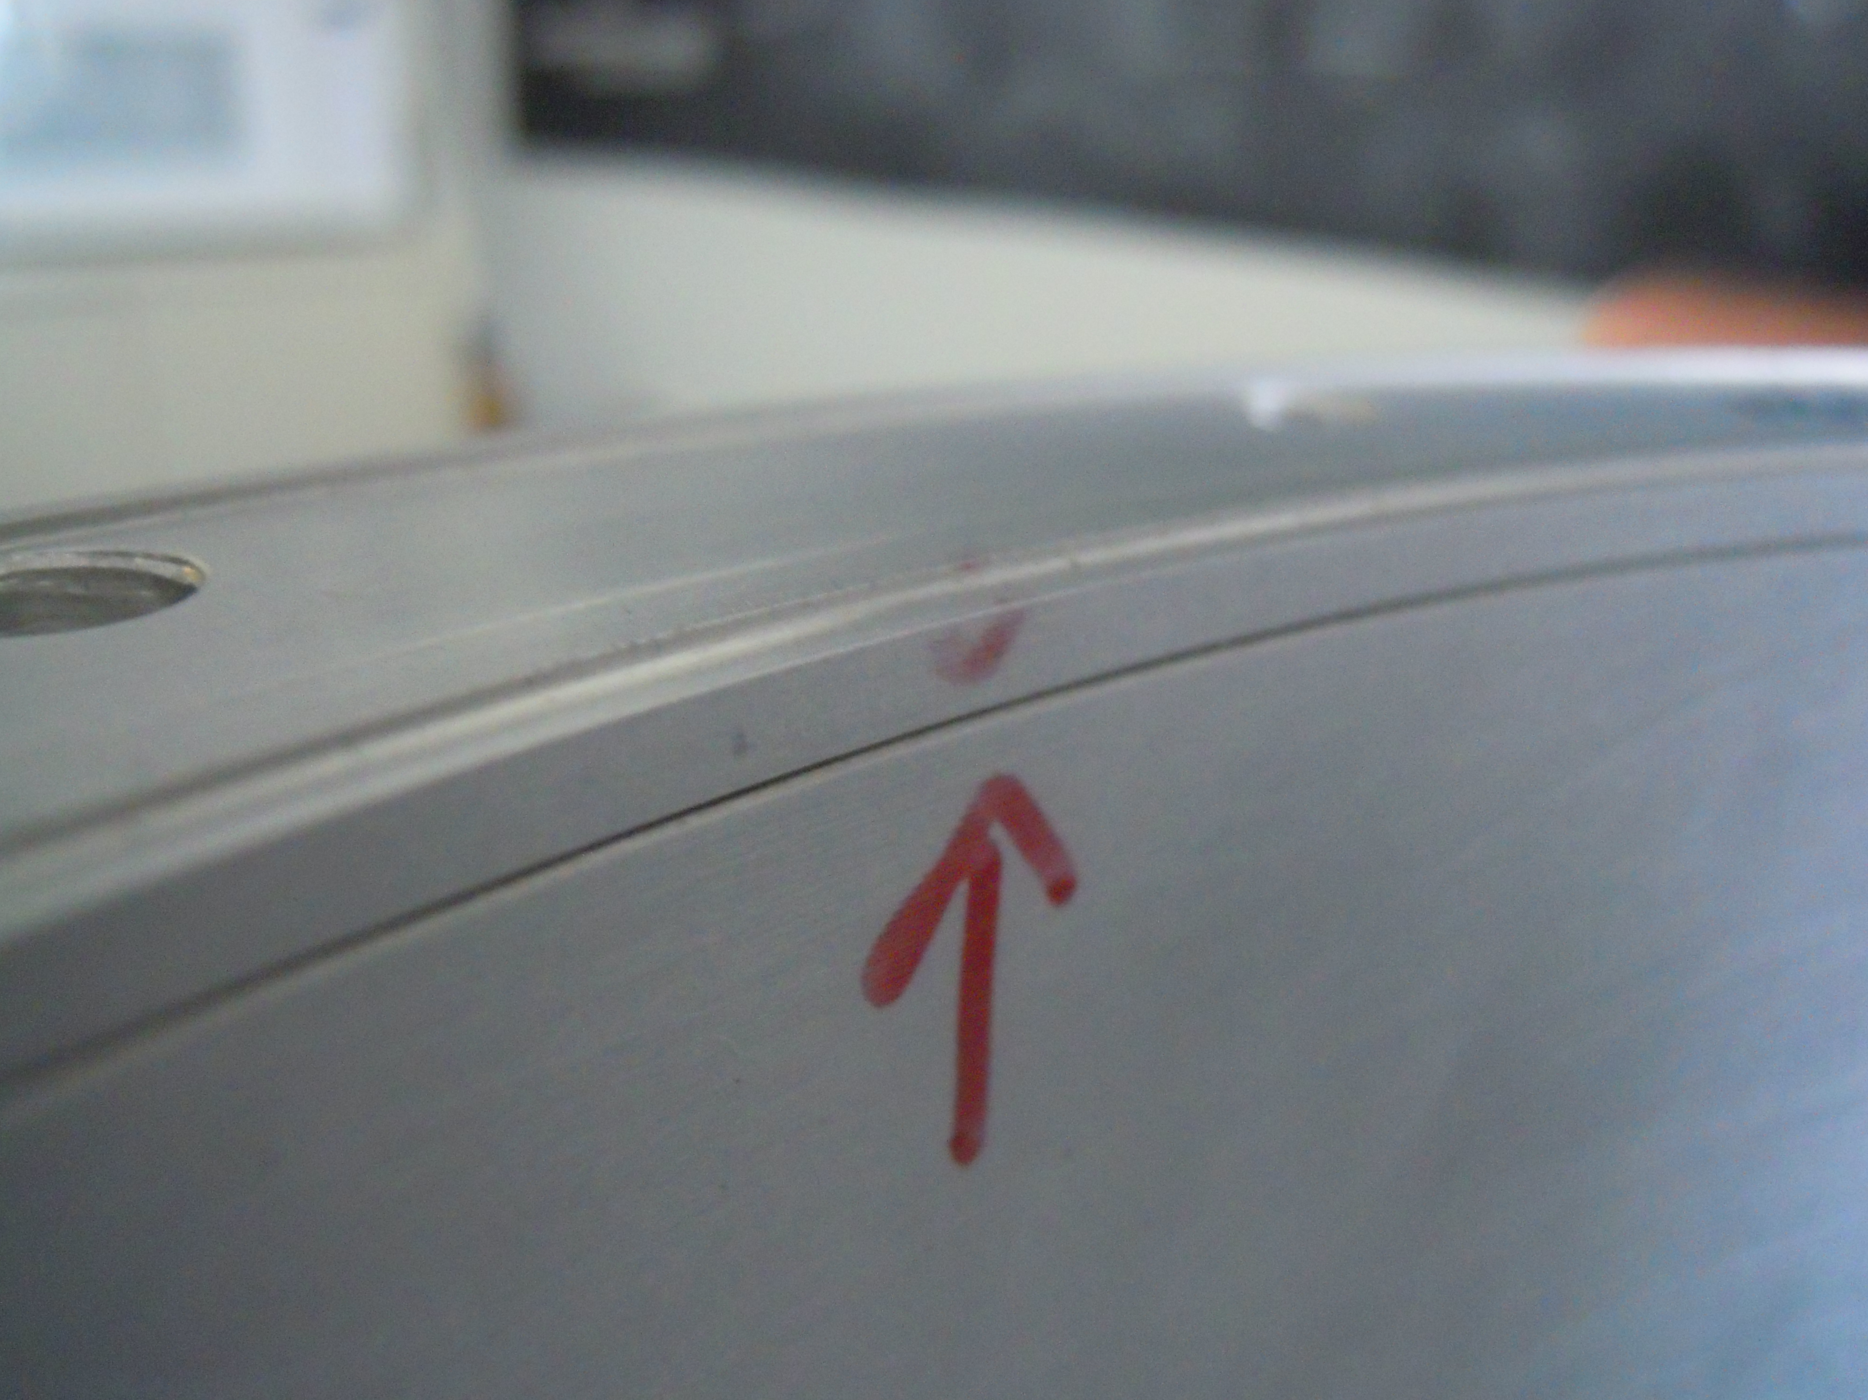
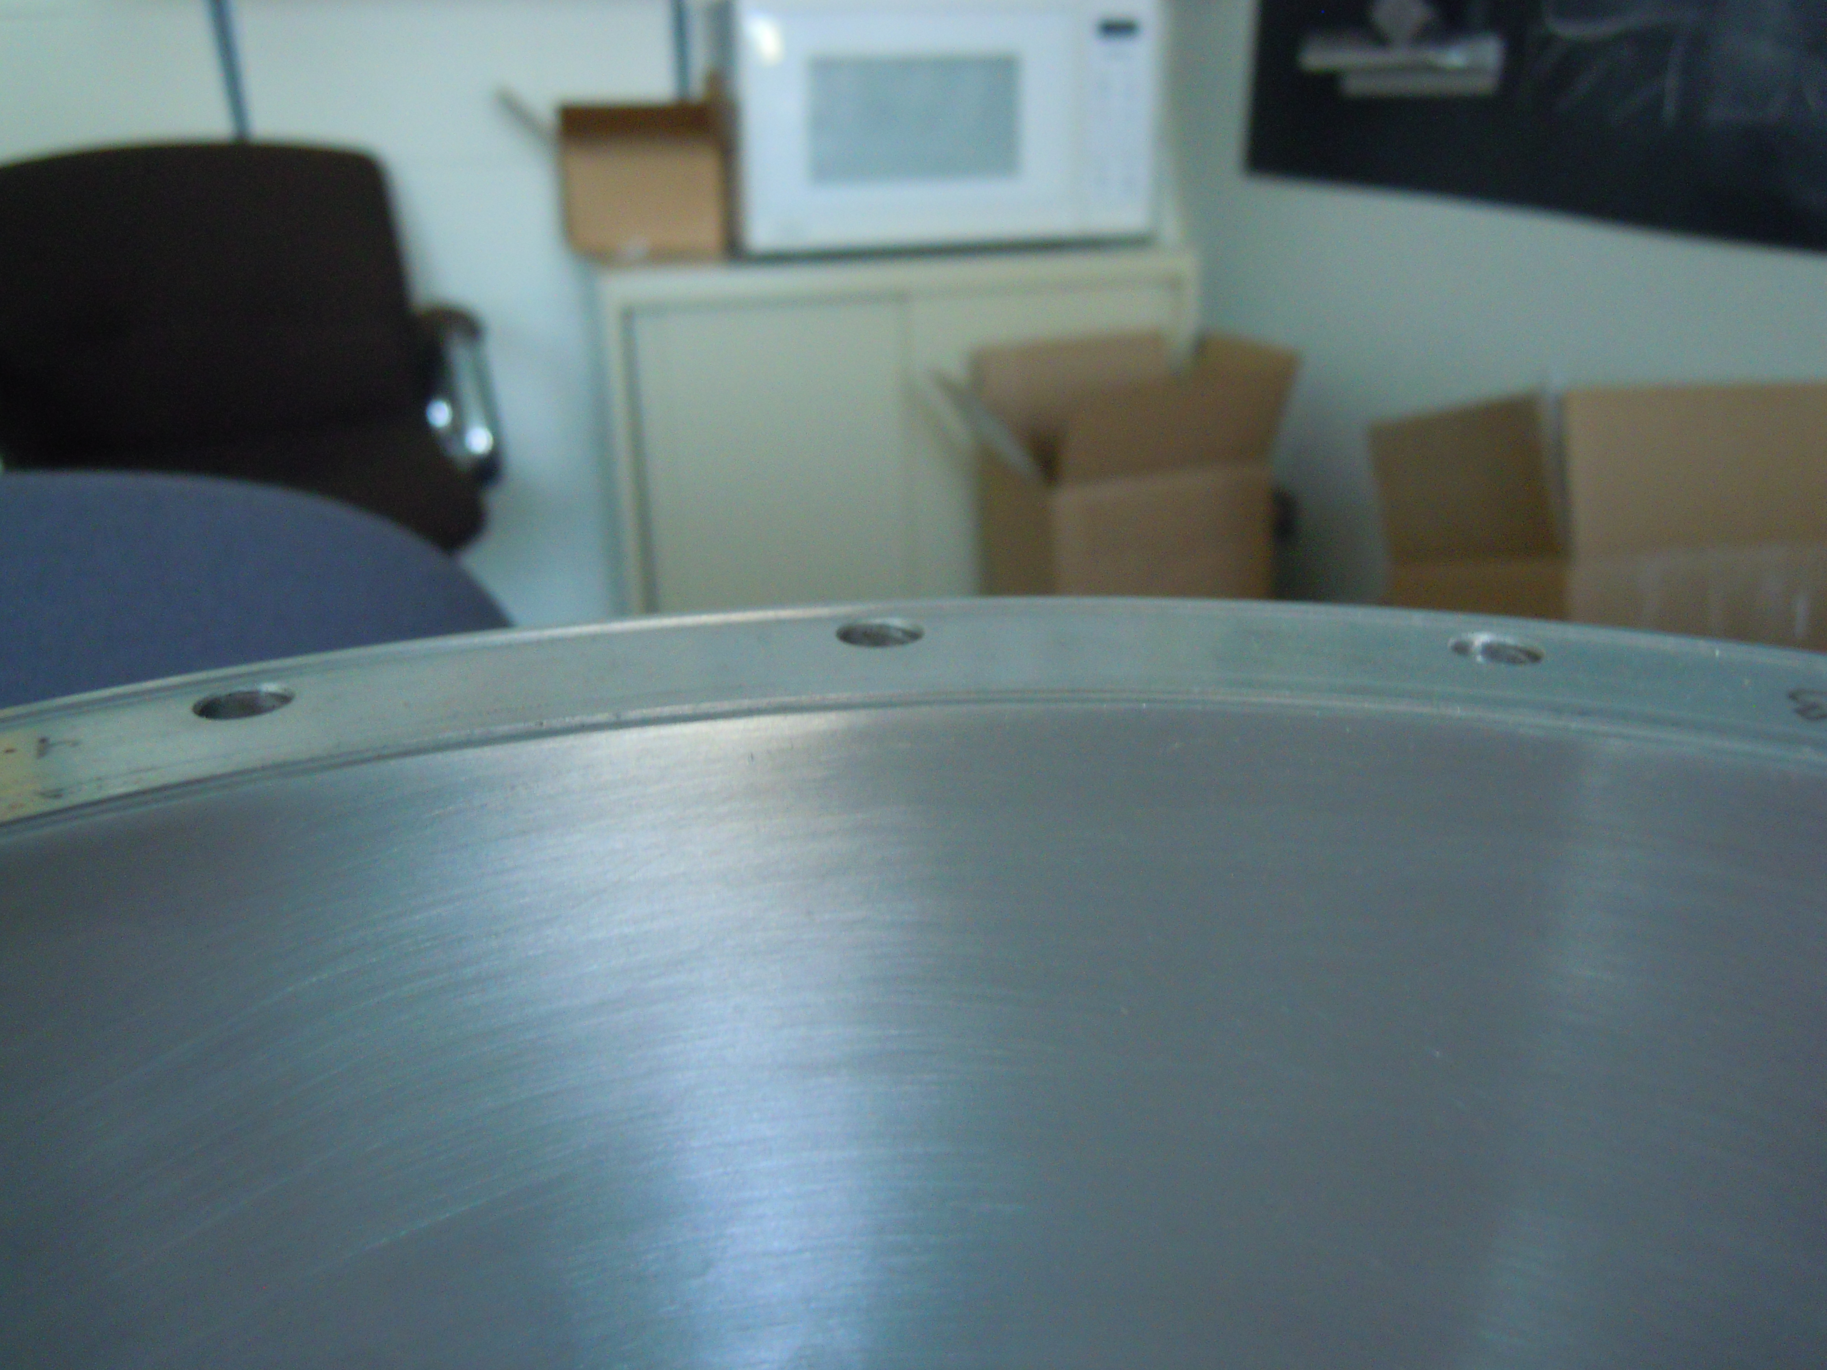
PA Upper Assembly Weld – Part Reworked

Slide 4
Y567 Tube “Fruit Bowl”
Will start welding and wiring the slots

Slide 5
PA Outer Shell
Waiting for other parts to start welding

Slide 6
Fabrication and Assembly Status

