Slide 1
Mechanical Update
Kevin Duel
Booster 2nd Harmonic Cavity
29 March 2018

Slide 2
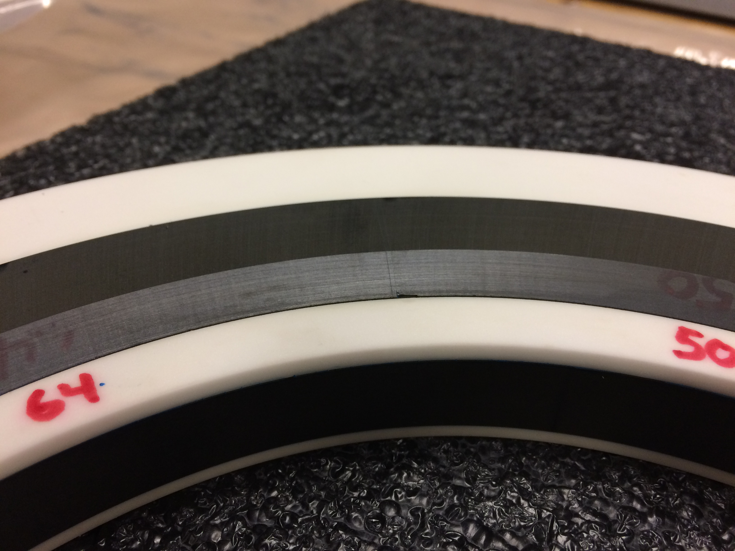
Garnet
Received last ring and witness pieces
Extra witness piece to fill chips

Slide 3
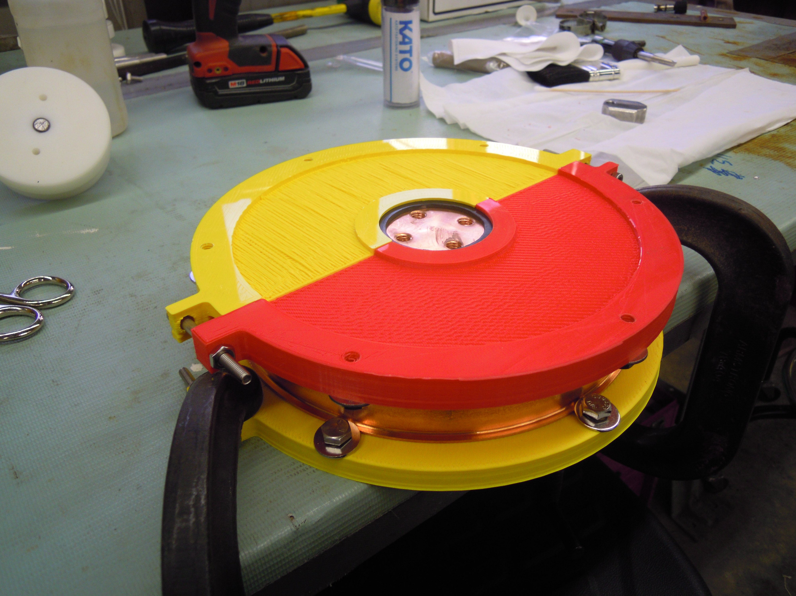
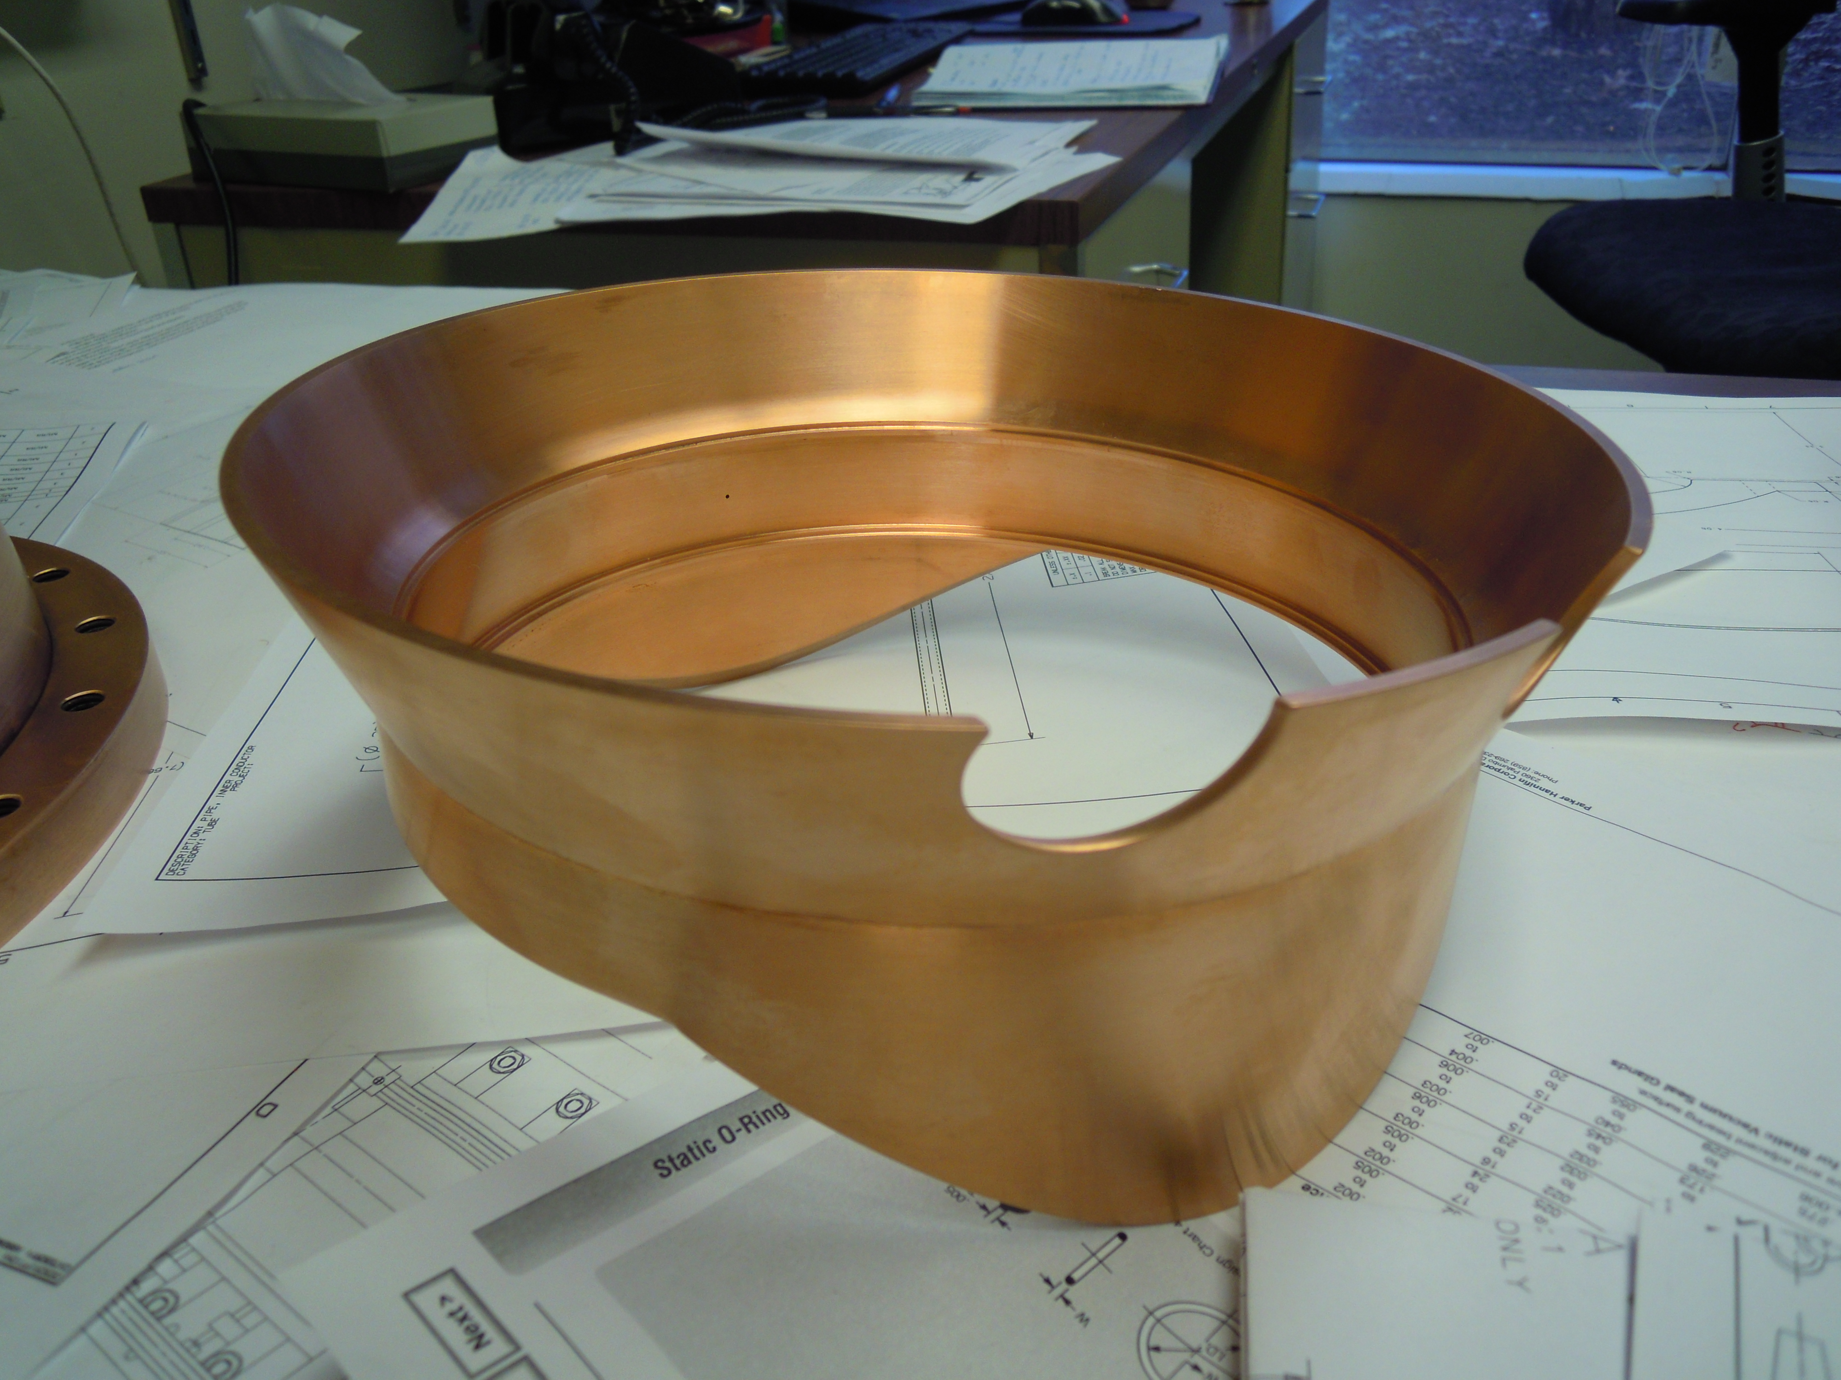
Vertical Window
Installing Inserts
Welding Friday or early next week

Slide 4
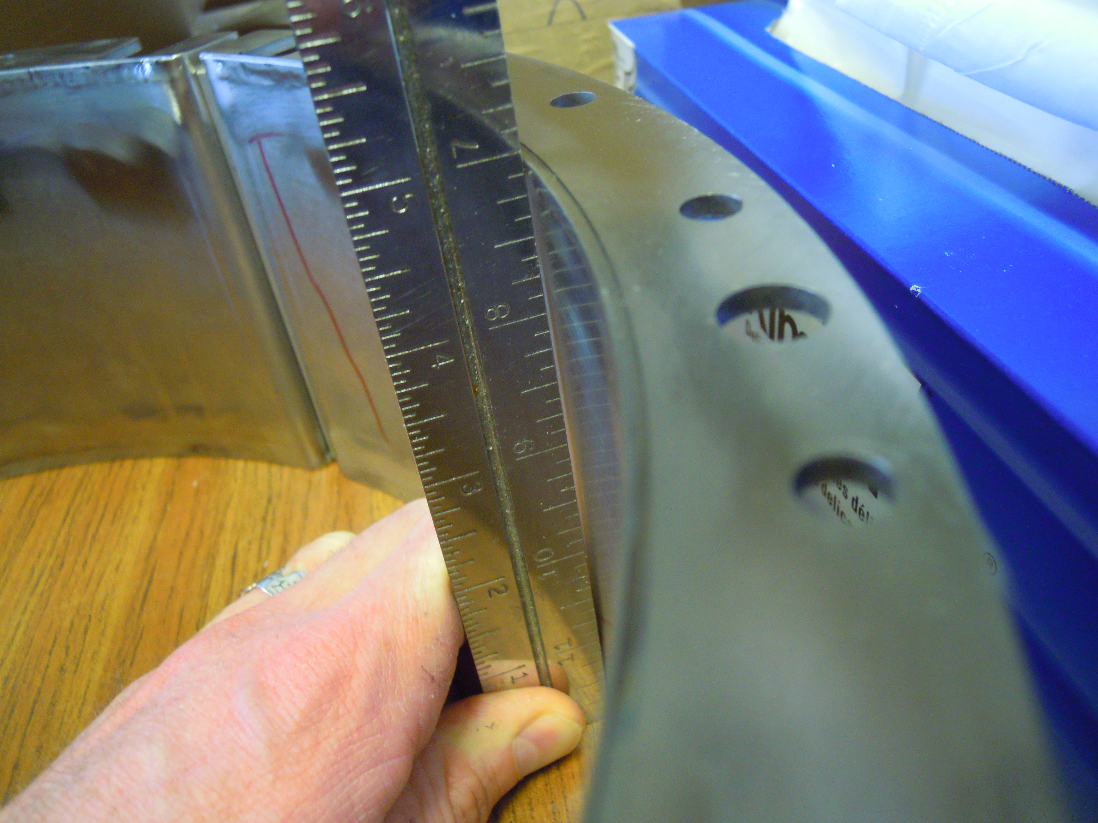
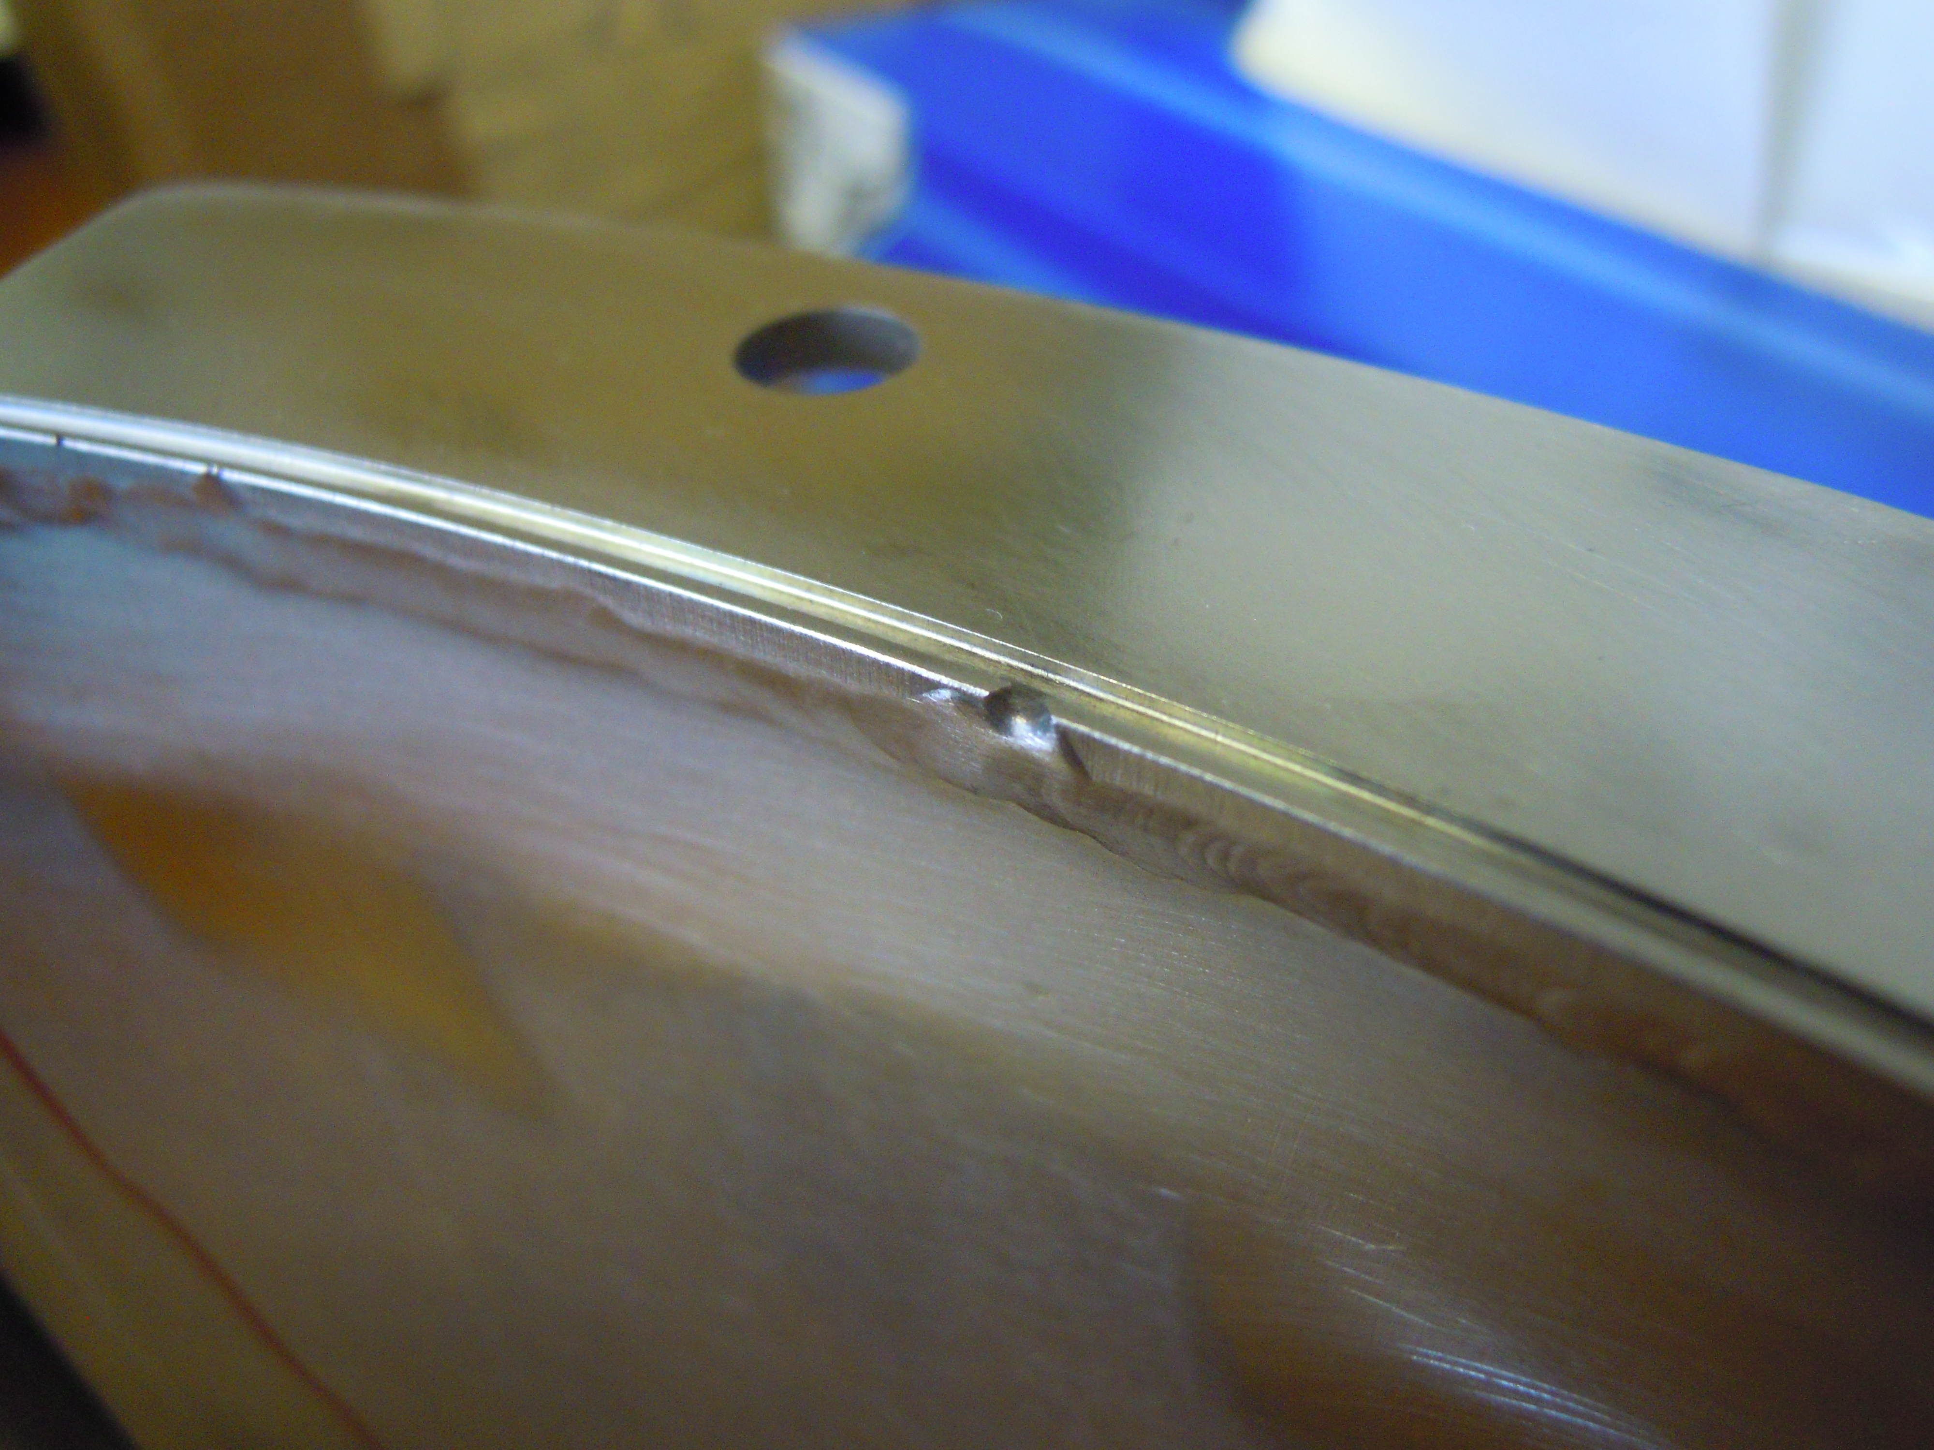
Tuner Outer Conductor Cooling Jacket Welded
To be sent to outside machine shop Monday
.020-.030” bow in center
Need to clean up edges

Slide 5
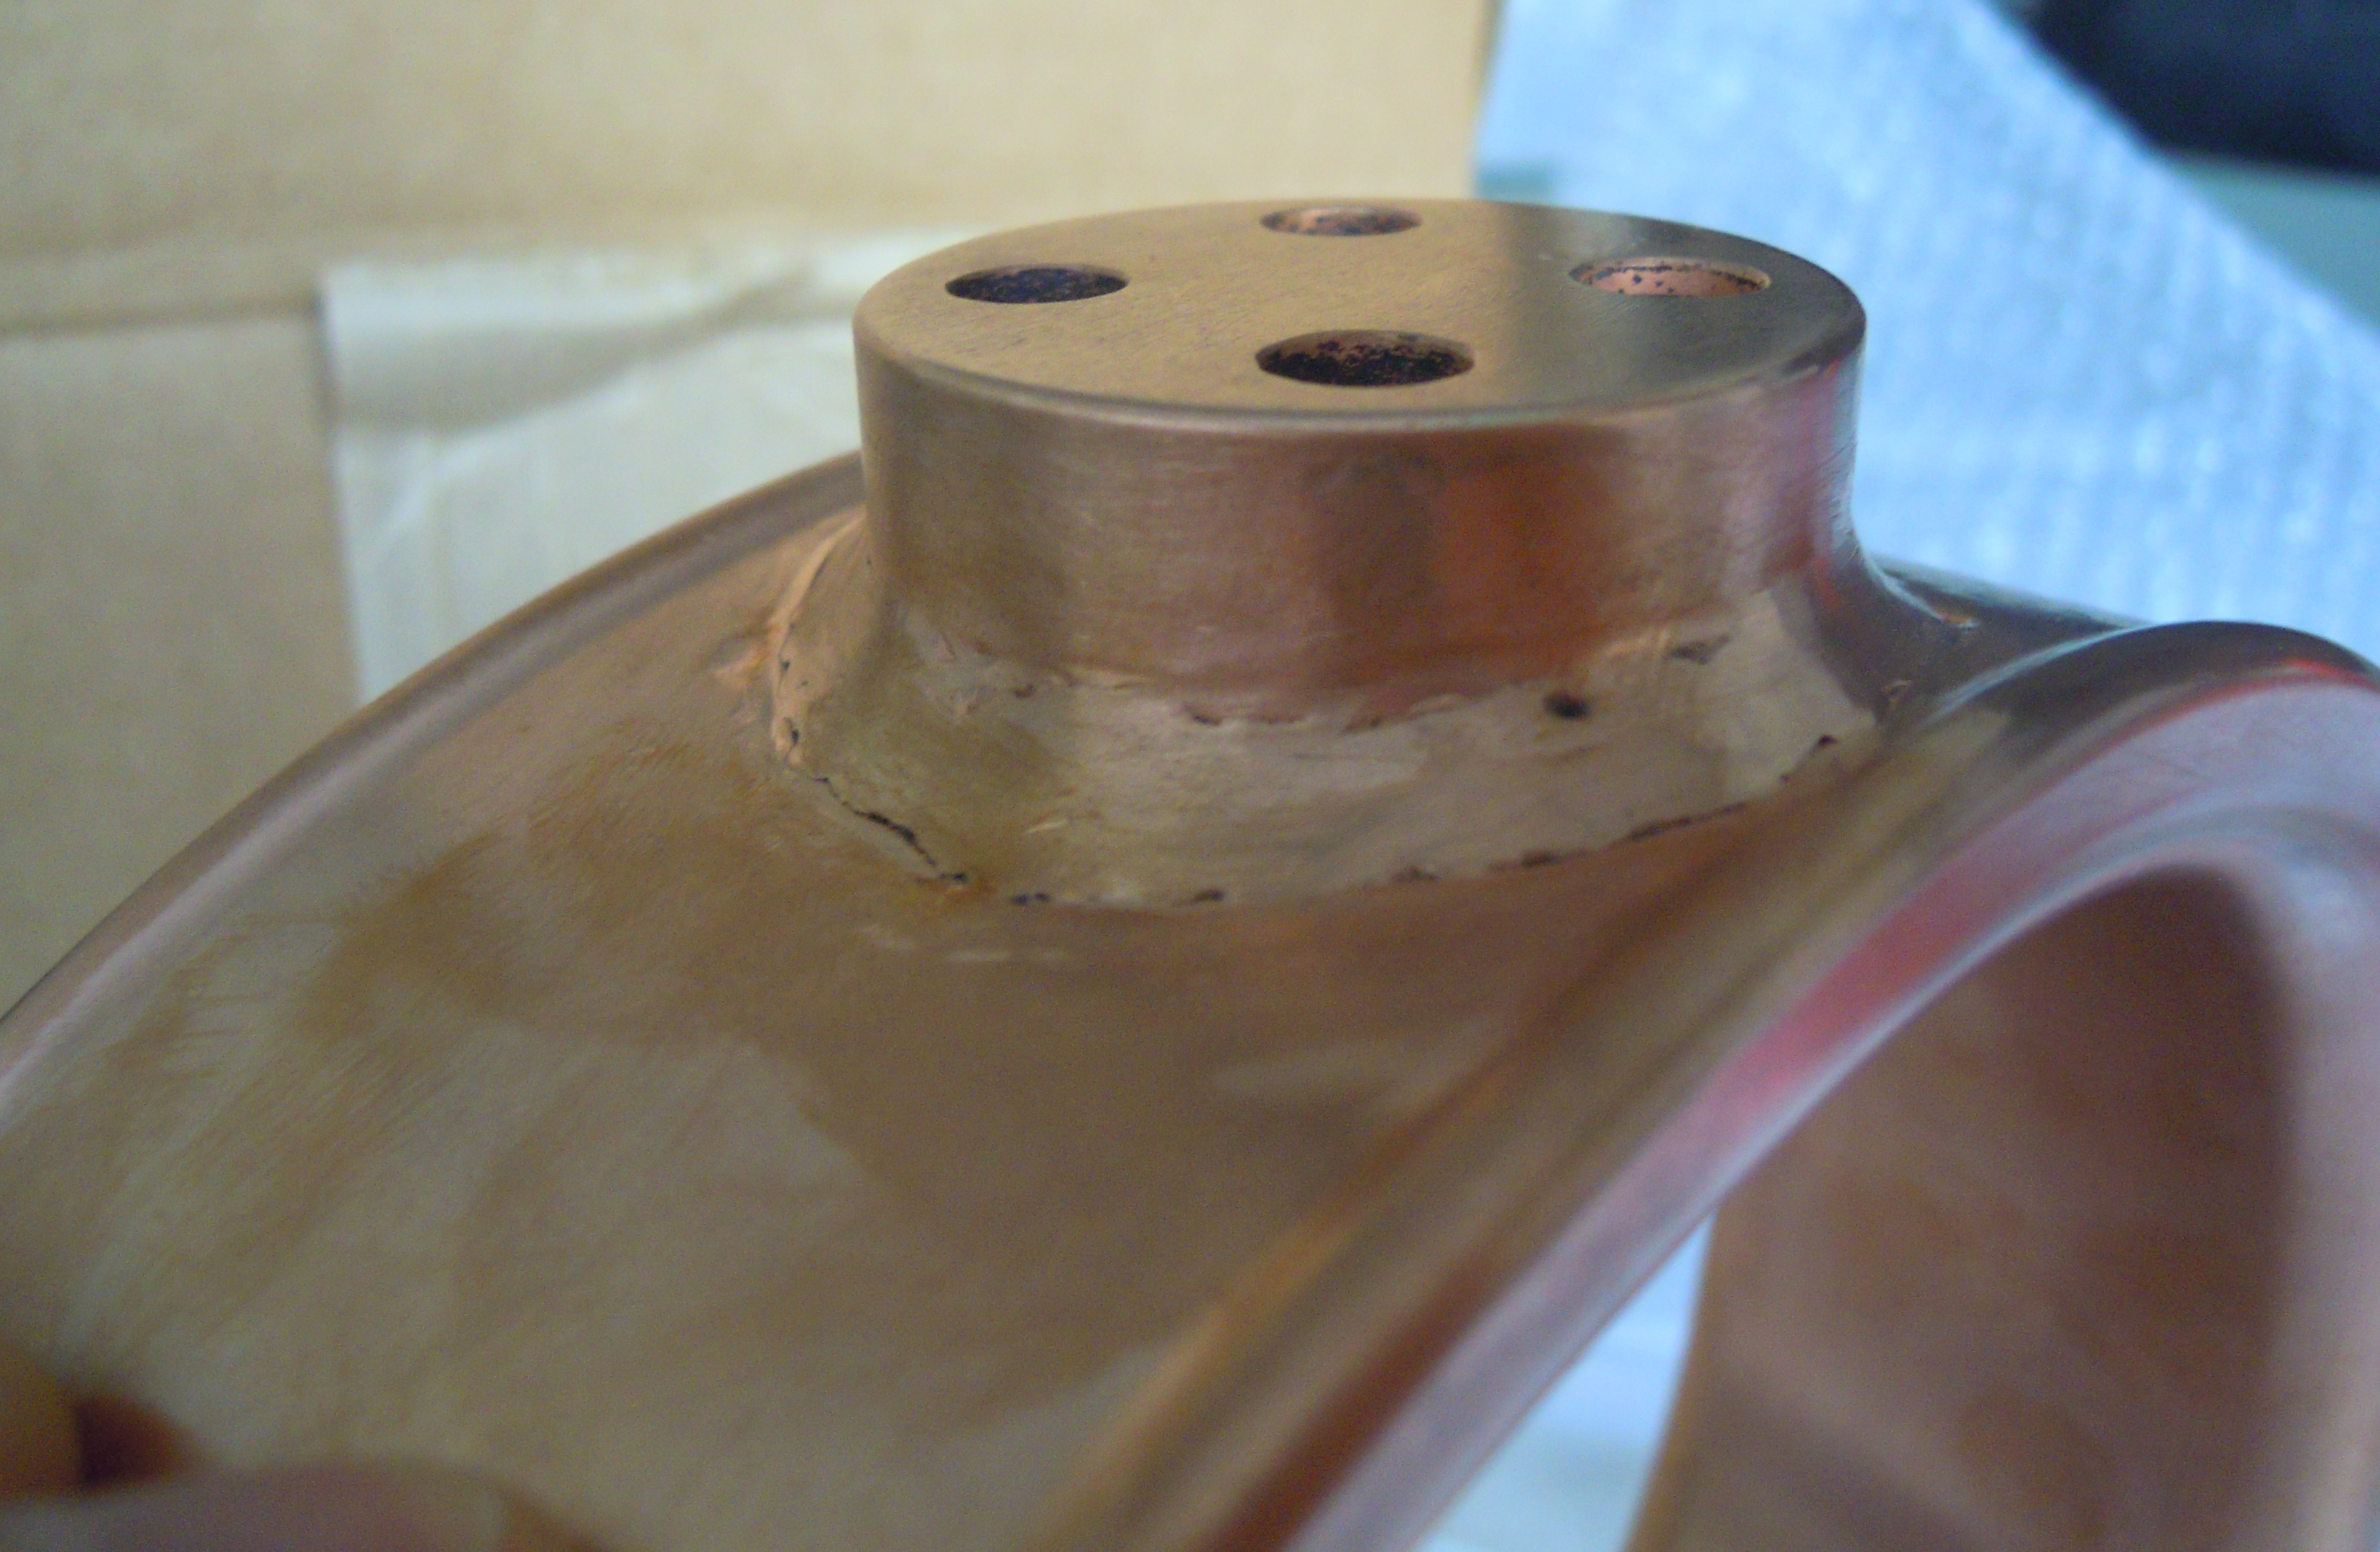
Coupler Ring Received
Weld
Machine shop will clean up

Slide 6
Inner Conductor Cooling Tube Soldering Progress
Needs further machining before welding

