Slide 1
Booster Replacement Cavity- Prototype status update
Matt Slabaugh 4/4/18

Slide 2
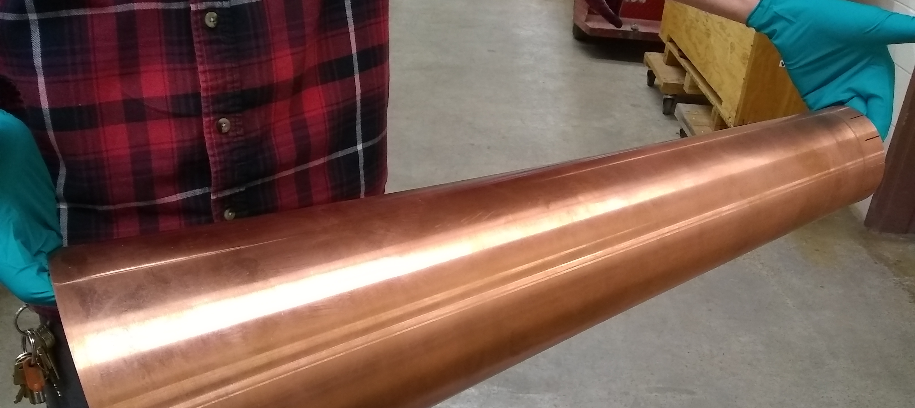
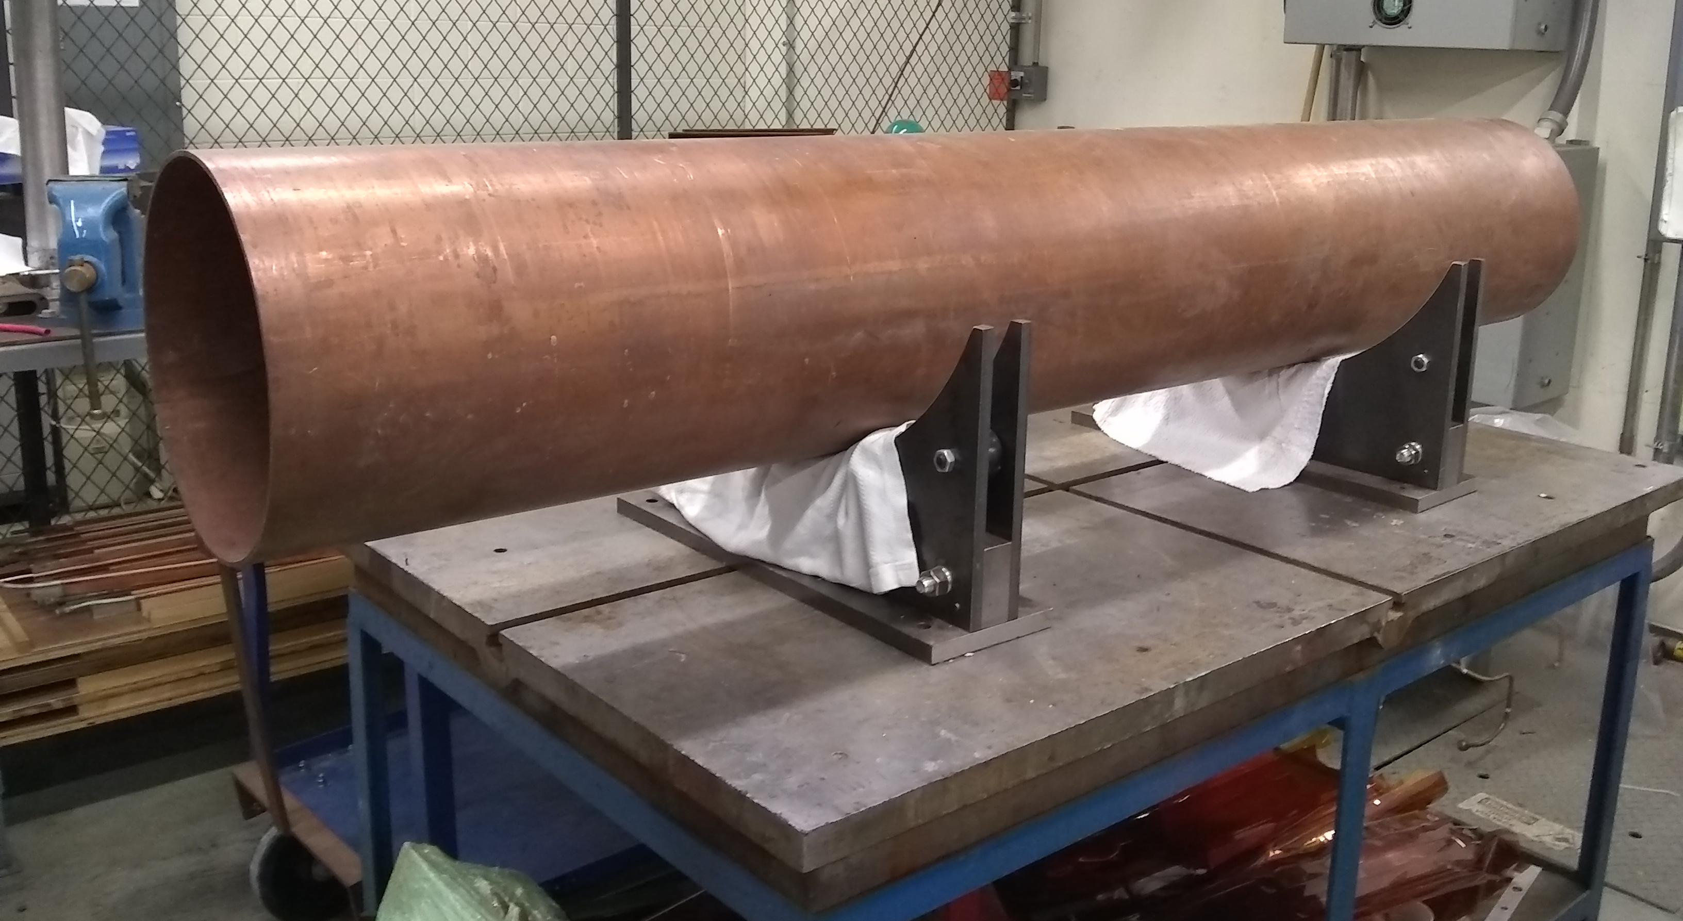
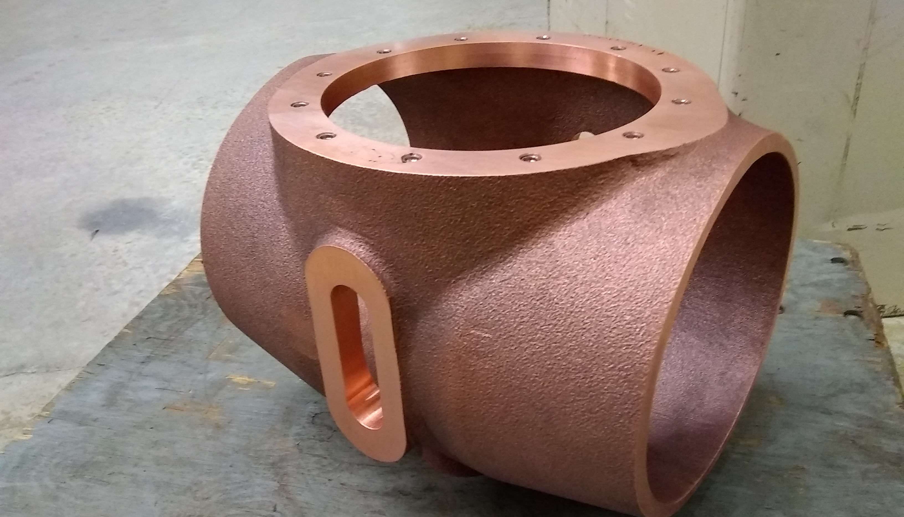
Parts and processes
Have all but one major component on hand
Conference call with vendor this afternoon to discuss status/delivery
Tentatively scheduled village machine shop end of next week for drift tube work
One tuner assembled, beginning to cut apart two more for modification

Slide 3
Schedule estimate
Aggressive goal: prepare cavity for testing by June 1
Receive all parts by ~4/18 (TBD)
Complete drift tube sub-assembly 4/27
Complete tuner assemblies ~5/4 (begin testing)
Begin whole cavity assembly ~5/4
Allows ~ 4 weeks for vacuum certification, final machining, and tuner fit-up
Assumes:
Parts are delivered on schedule and on spec
Machine shop is responsive within ~1 week for requests
No significant re-work or repairs (broken ceramics, warped flanges, etc.)

