Slide 1
Witness Sample Measurements
John Kuharik
April 11, 2017

Slide 2
Reanalyzed the Set of Witness Samples
Samples 1-16, measured on 6-28-17, previously reported. (group 1)
Samples 17-24 measured on 9-3-17. (group 2)
Samples 25 – 67 measured 3-18. 3 samples in this group remain to be tested. (group 3)
An additional 20 samples remain to be tested. (group 4)
The analysis was modified to account for the specific length and diameter of each individual sample.
Previous analysis used the excitation coil length and an average diameter in the calculations.

Slide 3
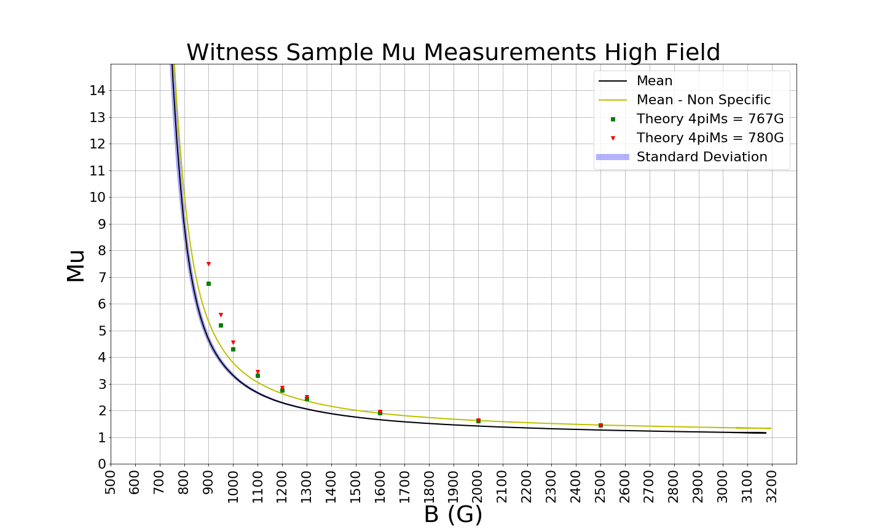

Slide 4
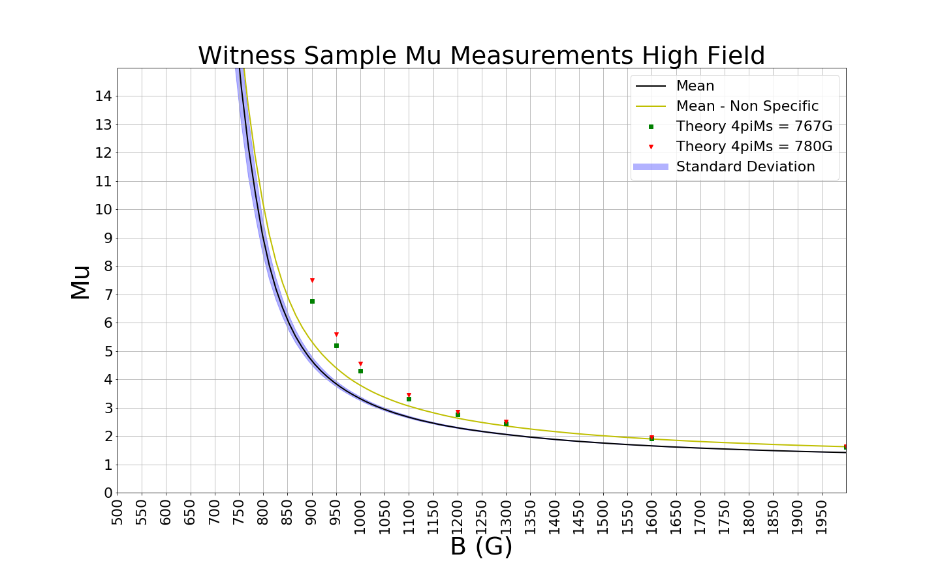

Slide 5
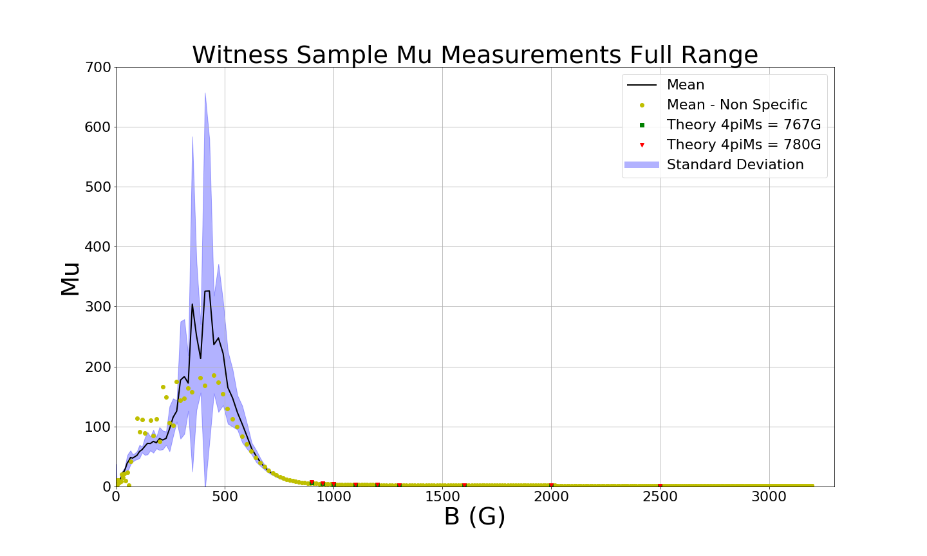

Slide 6
Sample Lot Number Confusion
Lot numbers from the manufacturer do not seem consistent.
Sample group 1 was labeled lot #62800 and samples 1-16
Sample group 2 was not labeled with a lot #, and samples ‘A’-’D’
Sample group 3 was not labeled with a lot #, and sample labeled 1-43 (5, 24, and 43 missing)
Sample group 4 was labeled #67916, samples 44-72 (non sequential, also includes 5, 24, 43)
We have the follow data from the vendor:
Lot # | Segment Number | E' | Dielectric loss | 4pM_{s}Gauss | LW Oe
66747 | 1 to 17 | 13.76 | 0.0001 | 765 | 28.6
66962 | 18 to 43 | 13.78 | 0.0001 | 780 | 29.0
67232 | 44 to 67 | 13.93 | 0.0001 | 776 | 21.3
67366 | 68 to 72 | 13.81 | 0.0001 | 778 | 19.98

