Slide 1
The Booster Replacement Cavity Program
Matt Slabaugh
Fermilab Workshop on Megawatt Rings & IOTA/FAST Collaboration Meeting
7 May 2018

Slide 2
Outline
Recap
Reduced losses at RF cavities
Aperture limitations
What diameter
Reliability
More beam for PIP-II (PIP-III ?)
Decision
3.25” Beam Pipe
RF design
Related issues
Manufacture
Status

Slide 3
Why?
While the existing cavities have been refurbished, they are nearly 50 years old.
Future operations will leave no extra operating margin.
Uncertain operational impact of needing to run all cavities at maximum performance 24/7.
Plan to run Booster till 2035.

Slide 4
Cavity Voltage
Present
830 kV – 950 kV, present operating range depending upon beam requirements and cavity repair status.
< 850 kV, losses increase for 4.2E12/pulse.
requires a minimum of 17 cavities at the nominal voltage 50 kV or 25 kV/gap.
Future requirement
1.2 MV ( 1.1 MV total + 0.1 MV overhead )
Plan to run similar to MI, all cavities on, voltage fixed/regulated as needed.
 | Voltage per Cavity
# of cavities | Pre PIP 870 kV | Present 1005 kV | Replacement 1200 kV
19 | 45.8 kV
20 |  | 50.3 kV | 60 kV
21 |  | 47.8 kV | 57 kV
22 |  | 45.7 kV | 55 kV

Slide 5
Other cavity performance factors
Beam Loading and Power Requirements
Each cavity must meet the specified voltage while accelerating up to 1A of beam at a synchronous phase of ~40 degrees (synchrotron definition, 90 degrees at crest) with 2-3 of the 84 buckets empty.
The loaded cavity shall be designed to operate with up to 150 kW RF power from a CPI (EIMAC) Y-567B tetrode power tube. Although rated to operate at higher power up to 200 kW, for lifetime considerations operating at a lower power is preferable.
Cavity Impedance and Spurious Modes
The cavity shall be designed for R/Q = 50 ohms and the impedance of all higher order and spurious modes shall be ≤ 1000 ohms.
Multipacting
The cavity must be able to turn on and run at any voltage between 25% and 100% of the specified operating voltage over the full frequency range without operationally significant multipacting at the nominal operating vacuum pressure.

Slide 6
Aperture
2.25 Inch Cavity Aperture
Vertical aperture limited by magnets
Horizontal aperture limited by cavities
57.17mm
57.17mm
Inside view of Booster gradient magnet

Slide 7
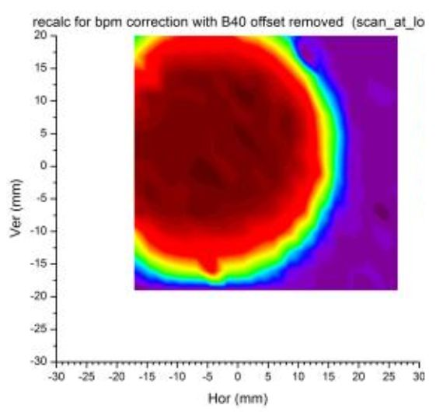
Aperture - Magnets and RF
Aperture Scan data
at Long 14
2.25" diam. aperture
RF and D Magnet

Slide 8
Aperture - Conclusion
Ellipse | a (inch) | b (inch) | area (in²)
average | 0.9113 | 0.6519 | 1.87
max | 1.24 | 0.75 | 2.92
Ratio (max/ave) | 1.36 | 1.15 | 1.57
New aperture radius | 1.53 | 1.29 | 6.22
Equivalent Circle Radius = 1.4 in
3” beam pipe will provide 0.1” to 0.2” margin

Slide 9
Aperture - Decision
Aperture Options
Existing aperture 2.25”
Minimum aperture from study 3”
Aperture chosen 3.25”

Slide 10
Aperture - Magnets and RF
3.25” diameter
2.25” diameter

Slide 11
Aperture – Lattice

Slide 12
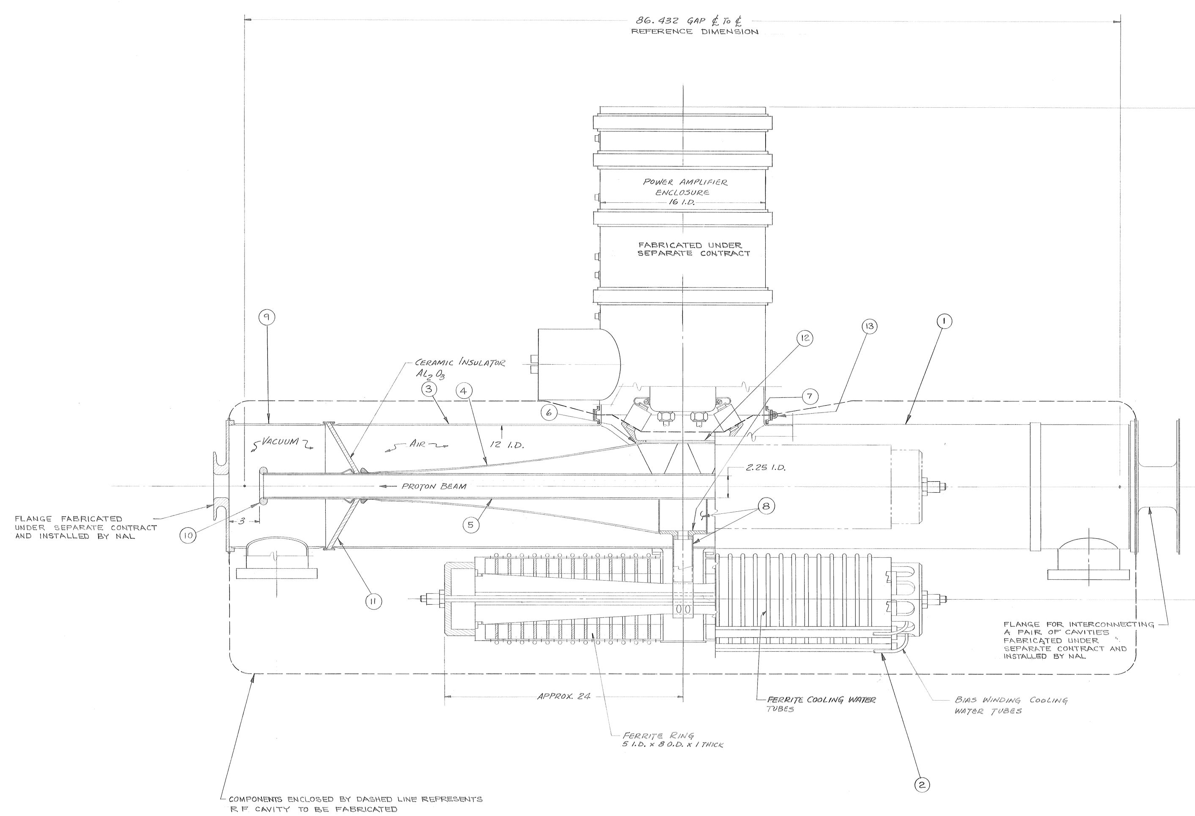
RF Design
With new aperture decided
Maintain physical design
Adapt RF to give
Needed voltage
Frequency sweep

Slide 13
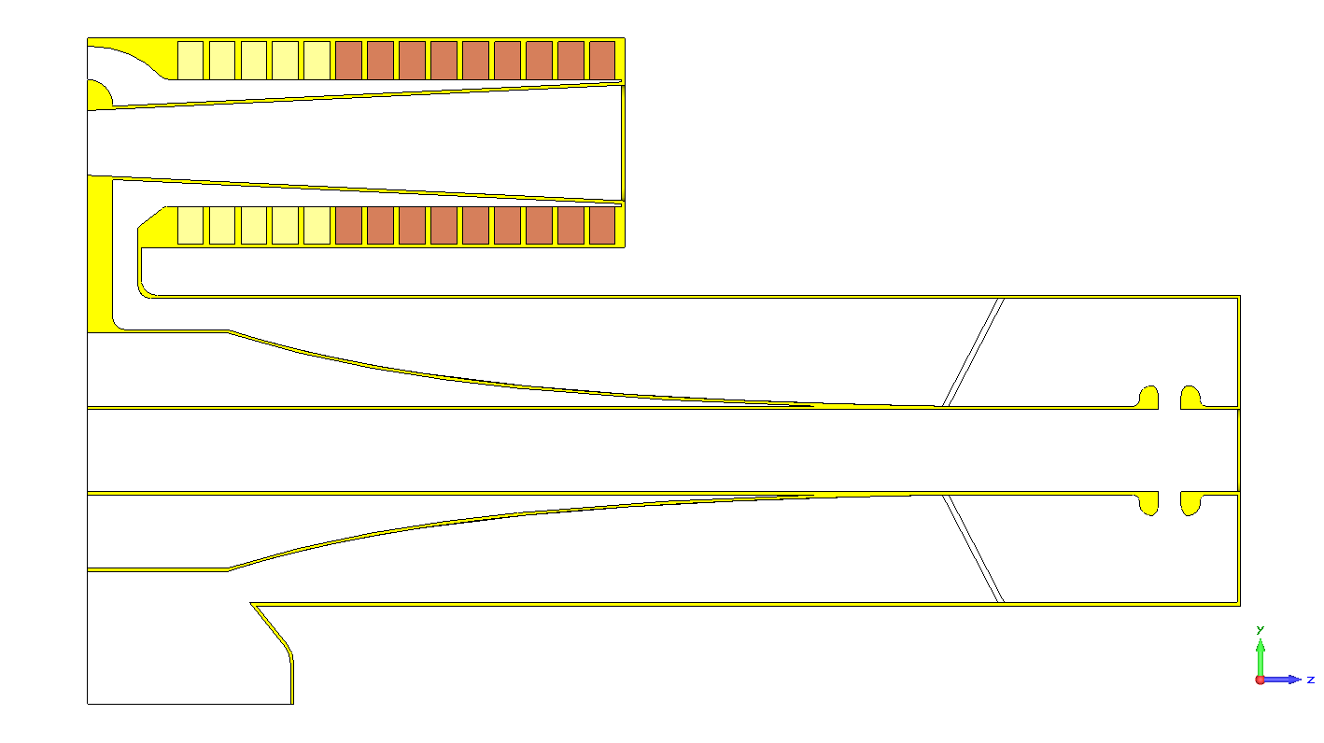
Adjustable parameters
Stem length
# of ferrite and choice
Steeper Taper
Diameter
at center
3.25”
Bore

Slide 14
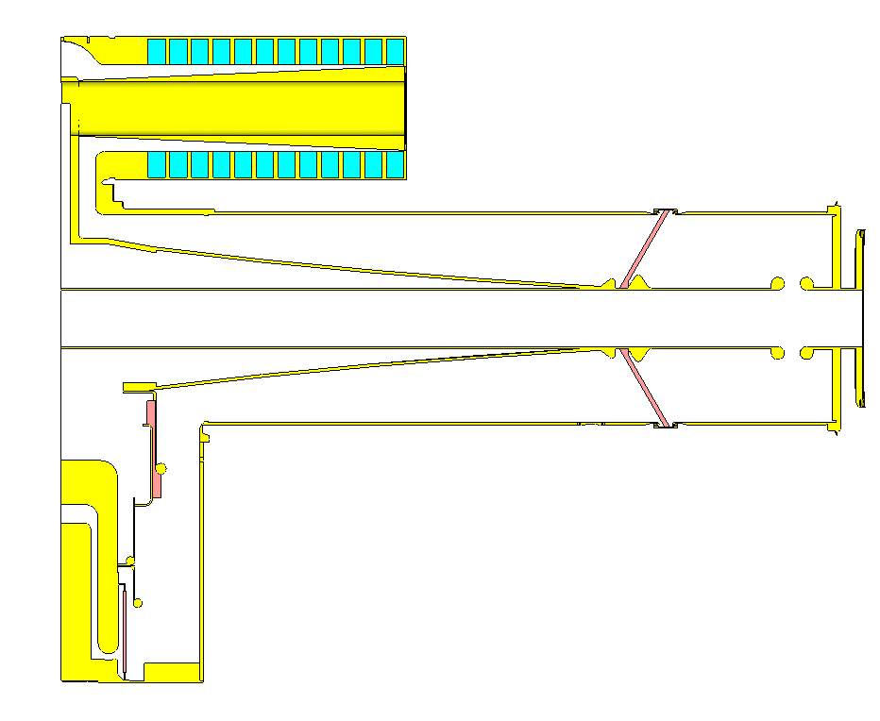
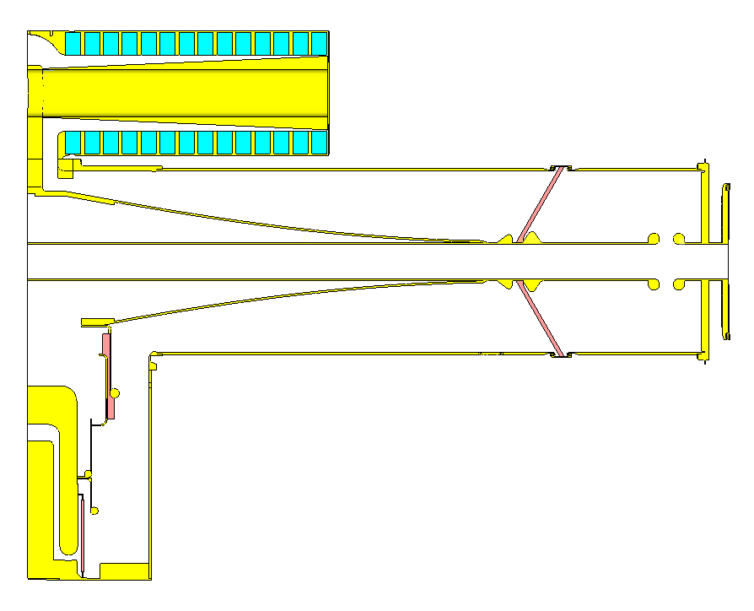
Changes to Optimize Design
Minor changes to the taper, central part of tuner, and ferrite selection

Slide 15
Replacement vs Current Booster Cavities
 | Current Booster |  | Replacement Cavity
mu | 6.6 | 2.1 | 7.35 | 2.1
Freq [MHz] | 37.7 | 52.9 | 37.7 | 53.2
Adjusted Q | 208 | 1128 | 407 | 1544
E[mJ]-60kV | 243.80 | 98.32 | 283.53 | 104.93
R/Q | 31.17 | 55.08 | 26.80 | 51.32
Eave [mJ] | 171.06 |  | 194.23
Ecycle [mJ] | 118.03 |  | 134.02

Slide 16
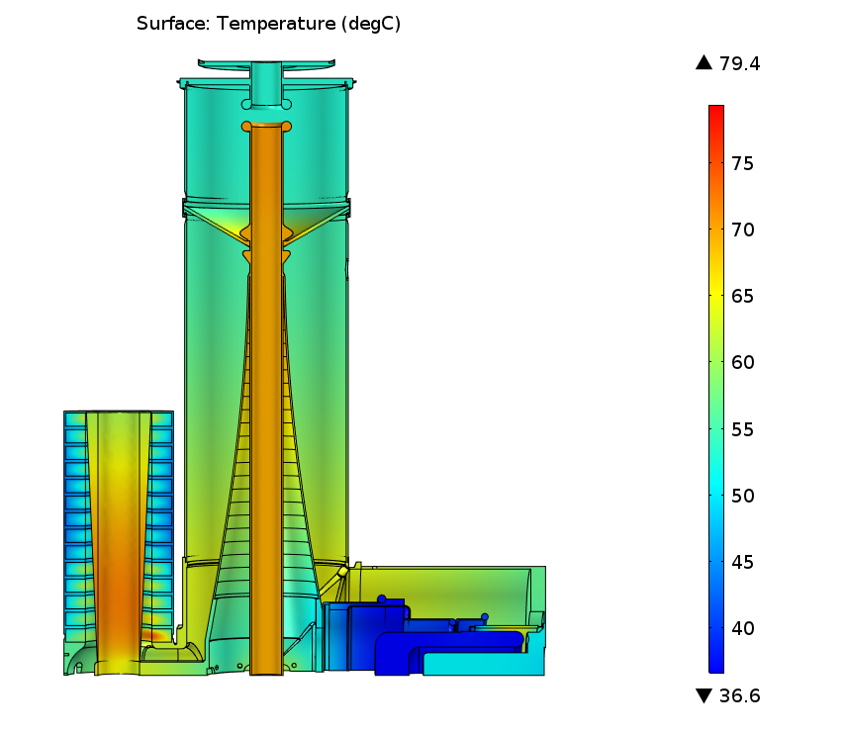
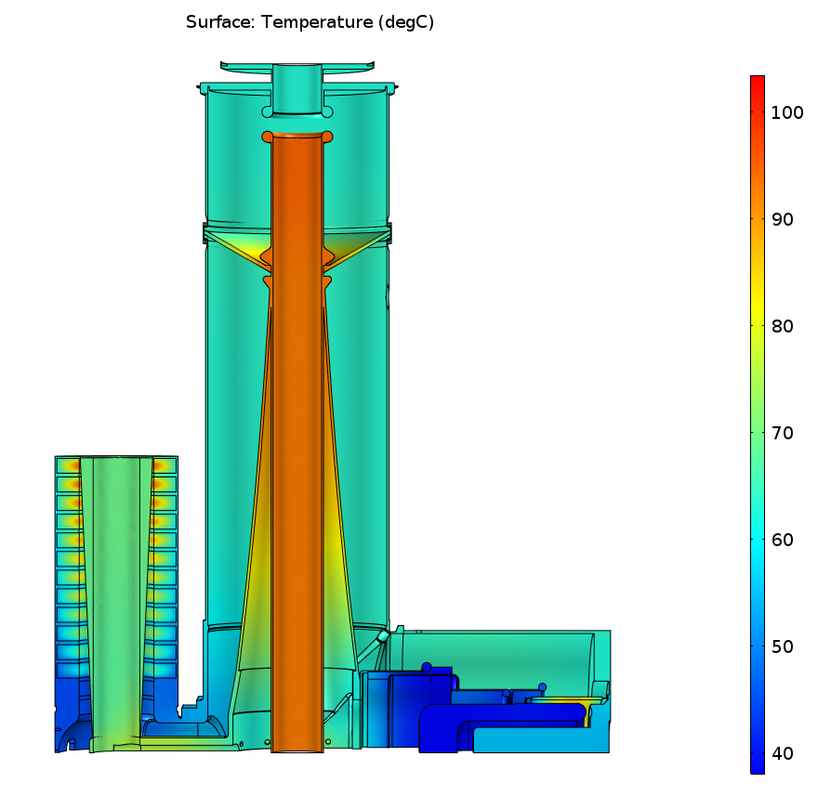
Modeling of Booster Cavity Temperatures – Max T up ~ 20%
Booster Cavity
Replacement Cavity
With Convective Cooling Boundaries
Simulations: Mohamed Hassan (TD)
Slabaugh | Booster Replacement Cavities

Slide 17
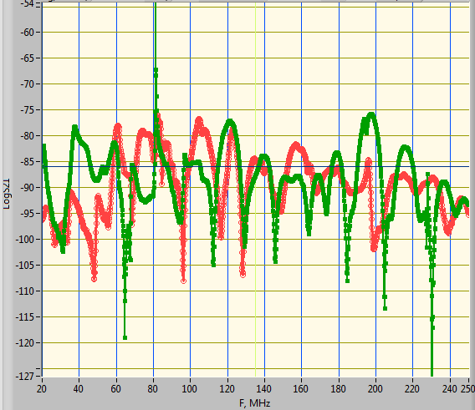
Validation of higher order mode calculations (measured on Booster cavity and compared to simulated)
S21 Gap Probe (US) to 165 Port (DS)
Q-undamped (84 MHz) ~2700
Q-damped (84 MHz)~115
Simulated Q0 (84 MHz)=75000
Simulated Q-damped (84 MHz) =116
84 MHz Large HOM
Green: 84 MHz Port is open
Red: 84 MHz Port is matched

Slide 18
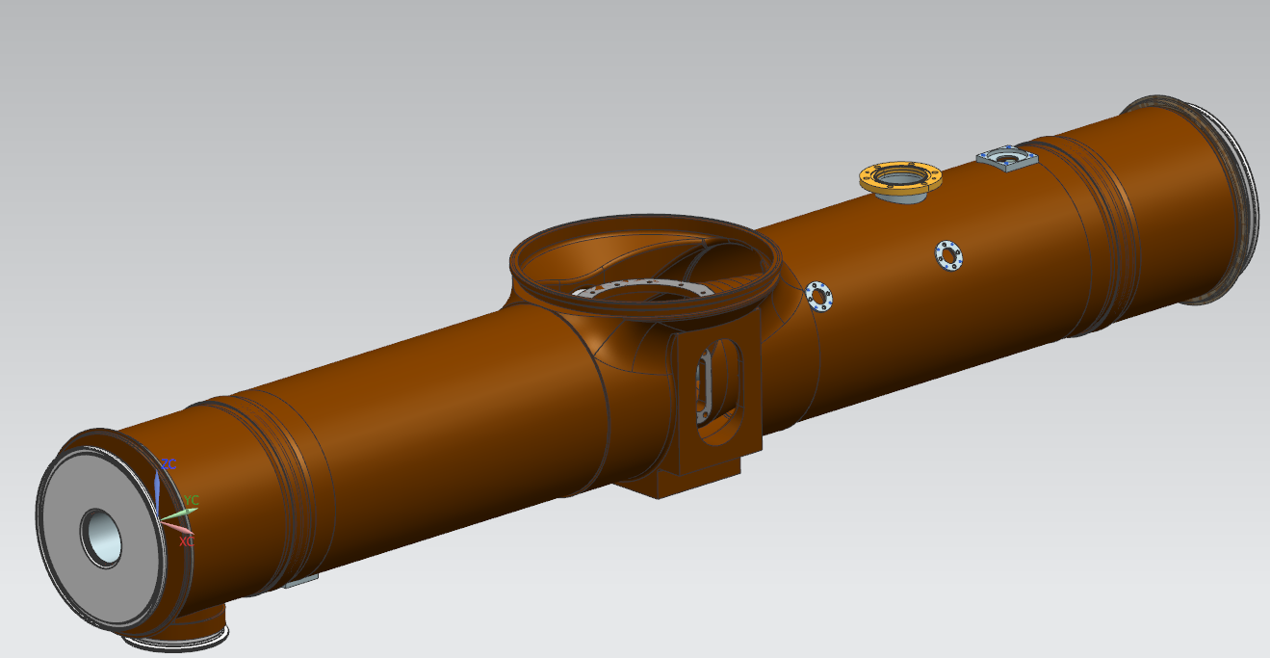

Slide 19
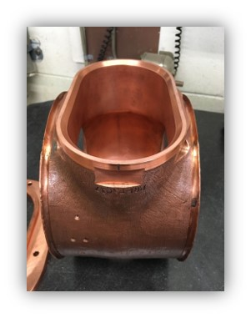
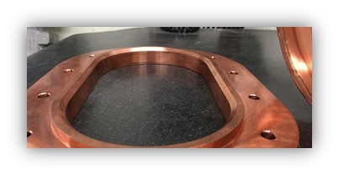
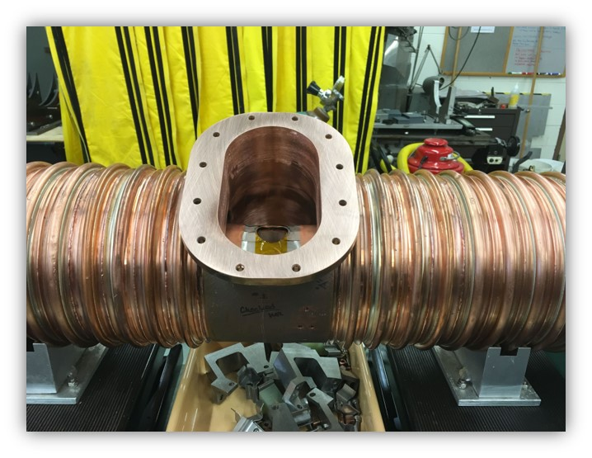
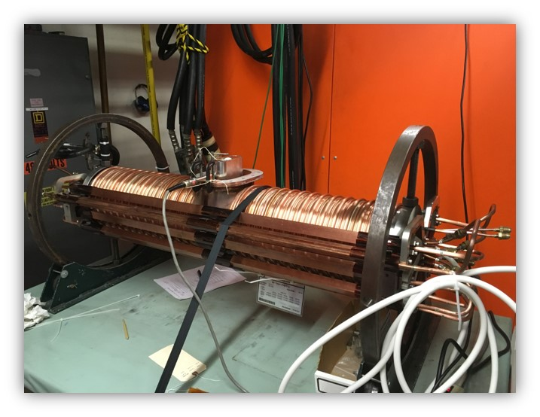
Booster RF Cavity Tuner Modification

Slide 20
Booster RF Cavity replacement girder
Plumbing and mounting reconfiguration complete

Slide 21
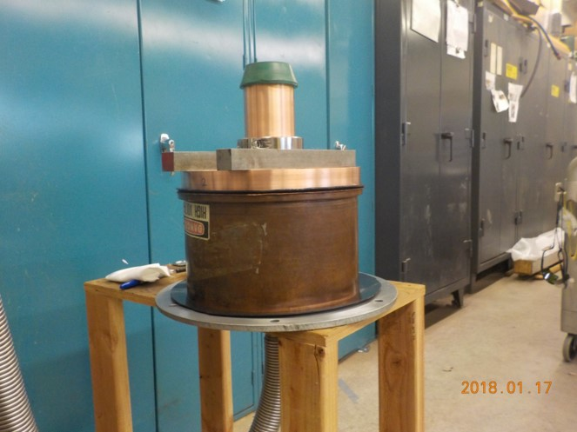
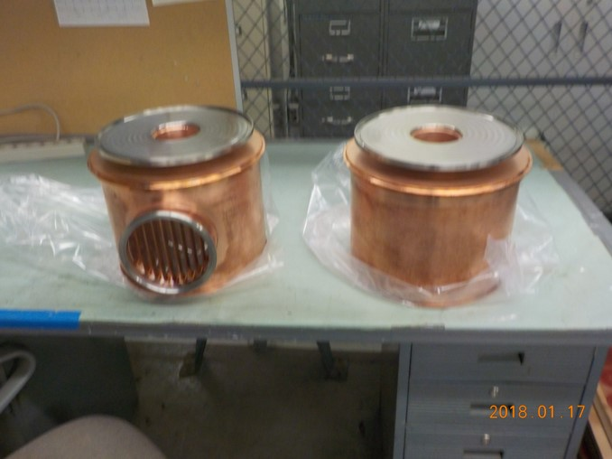
Booster RF Cavity vacuum parts
Ceramic leak check
Completed vacuum end shell assemblies

Slide 22
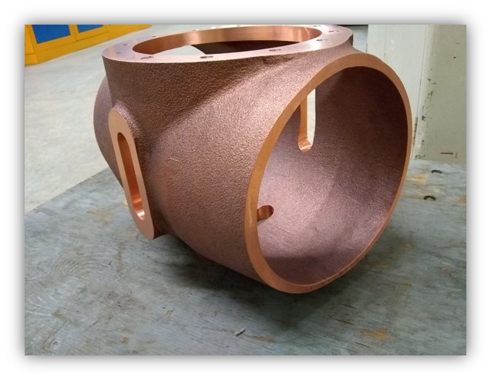
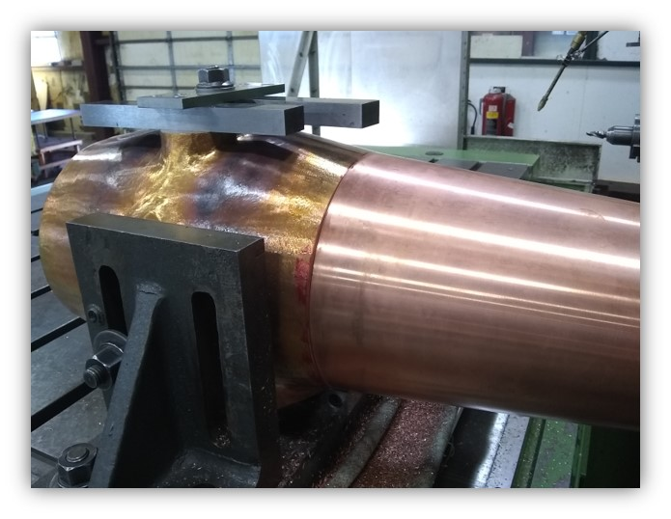
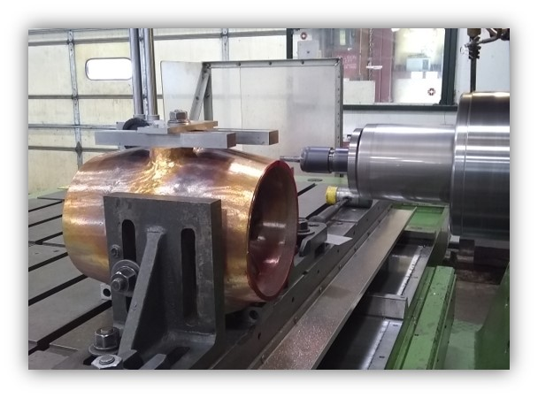
Booster RF Cavity Components

Slide 23
Summary
Voltage – 60 kV
Frequency range – 37.7 to 52.9 MHz (39.2 to 53.2 with different bias)
Stem length: added 1”
Type and number of ferrite: Total of 4 ferrite replaced with aluminum, and all remaining ferrite are low-mu variety
12 “Stackpole”
The cavity is being assembled and is scheduled to be completed in June. There will be 2 to 3 weeks of testing prior to installation. The possibility of installation before the summer shutdown is good and will provide run time before shutting off for the summer.

Slide 24
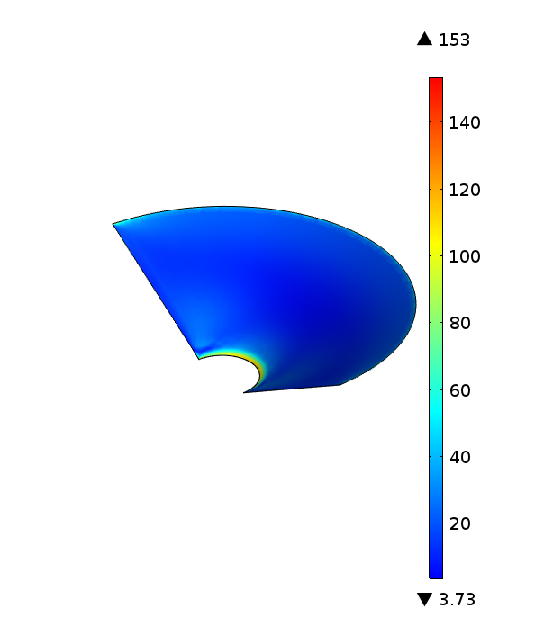
Ceramic Stresses

Slide 25
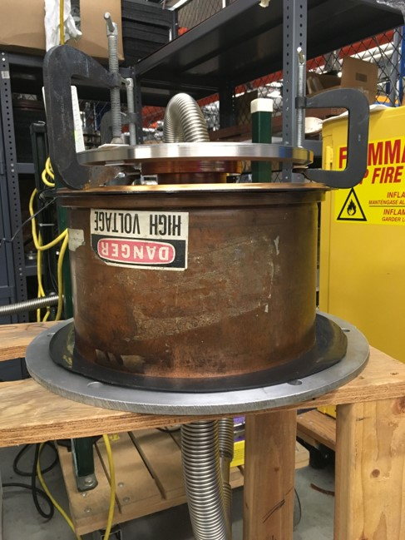
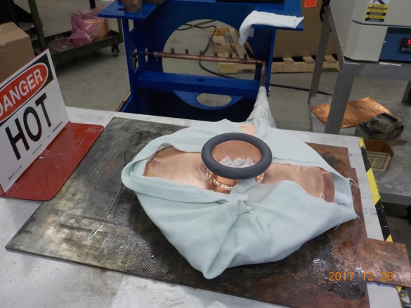
Booster RF Cavity vacuum parts

Slide 26
Replacement Cavity solid model

Slide 27
