Slide 1
Empty cavity.
Gennady Romanov
2nd Harmonic cavity meeting
May 24, 2018

Slide 2
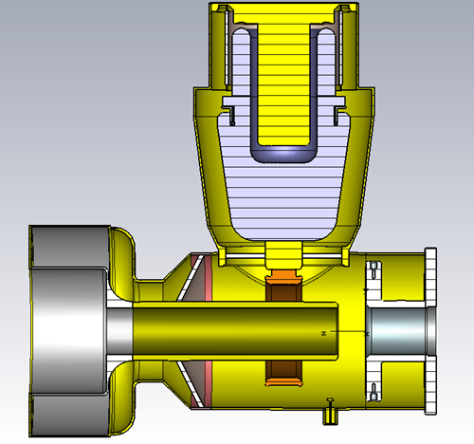
Empty cavity without ports
Model without HOM ports, all is copper except Al₂O₃
Mode | F, MHz | Q
1 | 120.5 | 6070
2 | 171.1 | 5242
3 | 268.1 | 5632
|E|
|H|
Mode 1

Slide 3
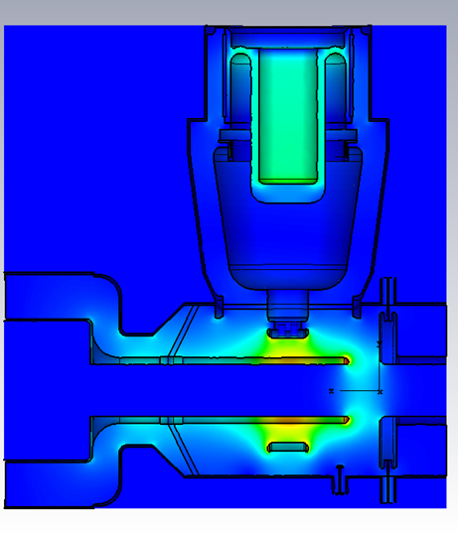
Empty cavity with HOM ports
Model with HOM ports, all is copper except Al₂O₃
Mode | F, MHz | Q | Q_ext
1 | 120.4 | 6079 | 1392
2 | 170.7 | 5225 | 0.6449
4 | 268.3 | 5807 | 862.3
|E|
|H|
Mode 1

Slide 4
Q_{load} of HOM1
Eigenmode solver – no non-linear materials, no discrete resistors.
Time domain – the same drawbacks.
Frequency domain – no automatic
correct calculation of Q. More or less accurate Q can be calculated via resonance curve or via S –parameters manually at each I_sol value. It was done once for operating mode.
Model is outdated (Nov.2016) and must be re-built.

