Slide 1
Cavity Test Plan
Robyn Madrak and C. Y. Tan
Booster 2nd Harmonic Cavity Meeting
24 May 2018

Slide 2
Timeline and Plans
Cavity complete WITHOUT garnet. (Measurement should take 1 day)
Put on PA (Bottleneck is here. Requires RF tech)
No vacuum
Measure f and Q using 2 gap monitors for S21
Longer wires may be used in gap monitor ports to get a bigger signal
Compare to simulation to check quality of shorting gasket
This is where problems can come in. Prepare to tighten like crazy. Check with Kevin about torque value.
Could do stretched wire measurement to get shunt impedance too (optional at this time, depends on time)
Solenoid delivered to MI-60 (bias supply is working as of 11 May)
We need a dolly. (Kevin says that he will check that the dollies 1200 lbs will work)
Bias supply for solenoid delivered and hooked up at MI60
Test bias supply with solenoid (bias supply should be done by Friday 18 May, see Sasha email dated 10 May)
See if we can get to larger currents in pulsed mode with low duty factor; if we can do this we can test cavity at higher frequency (test cannot happen until we get solenoid)
Do we want to do this? The bias supplies don’t work as expected and maybe we want to be absolutely conservative and just try to make things work at 76 MHz.

Slide 3
Timeline and Plans, Cont’d
Cavity assembled with tuner rings and PA. (Bottleneck here. Requires techs). Roll to cave. (Can this be done outside cave? Location, location, location!)
At first not under vacuum, for low power tests
Make connections (cables to PA, cavity, solenoid) (depends on location)
Add HOM damper resistors
Need to get these. (globar resistors)
Install temperature sensors inside solenoid/outside RF volume
Must be readout in cave – short cables by nature
Remote desktop to laptop/computer in cave; may need to set up ethernet since wireless may not make it into there. (Check with Steve Conlon. If we are working inside the cave. Needs to be done before high power testing. Don Poll for laptop.)
Once solenoid is connected to power supply, low power tests can proceed

Slide 4
Low power tests (Day 1 of 2)
Field probe calibration
Measure simultaneously with network analyzer the response at the gap and the response at the field probes
Directly across gap use high frequency probe
Gap monitors directly into network analyzer
High frequency probe on gap will detune cavity so it is necessary to do these simultaneously and measure exactly at the peak
Do this most importantly near 76 MHz. If there is a way to get to 104 or 106 MHz (pulsed with lower duty factor than we will have in reality) it would be beneficial for the future
Compare to simulation
Drive cavity at some spare port in PA; hopefully we can get enough power in (for the above experiments and following ones)
Otherwise remove one cavity gap probe and drive with longer wire sticking further in (Note: we only have 2 probe ports)

Slide 5
Low power tests cont’d (Day 2 of 2)
Using two gap monitors, measure f and Q as a function of bias
If there is time, do stretched wire measurement
This is just another network analyzer measurement with some matching resistors and a wire stretched through the beampipe
Setup probably takes ½ a day assuming we have gathered the needed parts
I did this on the mock cavity
Measurements probably also ½ a day
This will tell us the shunt impedance, not just the Q
Would be nice to do at a few bias settings if possible
Attach phase detector to anode and cathode and zero
Do we have phase detector yet? Check with Rene. We should have it already.
Testing of feedback circuit?
This will probably take longer than 1 day. (I’ll look at the network analyzer measurements, open loop transfer)

Slide 6
Timeline and Plans, cont’d
Once low power measurements are complete, cavity can be pumped down
Need a ion pump, turbo pump, tee, adapter, ion gauge?
If all cabling/cable connections are not done, proceed with that while pumping down

Slide 7
Racks / Cabling / Instrumentation (Takes 1 week)
Temperature sensors – go to laptop. Connect to it remotely
Everything else – use old TeV/RR cavity test station
Gap probes – cables exist
Anode and cathode monitors – cables exist
Heliax cables from SSD to cave for PA – need to run these. Bottle neck here.
Water connections. Hoses, plumbing etc.
Some cables for ion gauge or vacuum pump readout probably exist
We have a vacuum pump controller from the RR cavities
Some ACNET datalogging capabilities exist

Slide 8
Racks / Cabling / Instrumentation
Interlocks
Before we ever think of high power testing we need an interlock that shuts off the RF if the solenoid bias is below a certain level. (There should be a DCCT in the bias supply. This was already discussed. Need to check with Matt to get it working in PLC. Value determined after low power testing).
We have an interlock summing box which can look at TTL levels from other (slow) systems and shut off the RF through the cavity spark detector
Water to solenoid and cavity
Vacuum level
PA fan is on
….
It would be nice to integrate the temp sensors into this, but I don’t see how
And a scary to not be doing it. Use low duty factor to see. Have to talk to controls guys, or Brian Schupbach.
Anything else we need to interlock on?

Slide 9
Racks / Cabling / Instrumentation, cont’d
Interlocks cont’d
We have a ‘cavity spark detector’. Different scheme from what we will use in Booster racks but may work.
Or we can bring out the real module which will be used – IS THIS AVAILABLE? (Check with Rene or Bob)
Spark detector shuts off RF if it observes that gap voltage is dropping at a certain rate during the RF gate
Spark detector is also a mixer which sends LLRF to SSD only during RF gate
RF supplied by HP synthesizer/small amplifier
RF gate by pulser
Spark detector also looks at outputs of other interlock summing box to shut RF of in case of bad vacuum, no water, no PA fan, etc.

Slide 10
High Power RF Testing
Before high power RF testing
Need interlock for low bias on solenoid
Need to test bias supply with solenoid and come up with a plan for which bias levels we can get to and which ones we want to test at (This should be decided after low power tests. This is when we will know what the resonant frequencies are as a function of bias current)
Establish confidence in temperature sensors. (Initial trip point should be 90 degC because there seems to be a delta T of 10 degC from bench experiments. Simple back of the envelope calculation shows problems at hotspots will be about 100degC integrated by IR sensor. Calculate the expected temperature by scaling …).
Brainstorm about any other things we can monitor which would indicate a problem in the garnet
Will interlock on water systems. How many separate systems/turbines to monitor? We have to monitor solenoid in/out and cavity in/out. Temperature sensors in/out should indicate problem. Plus temperature probes on the solenoid. Klixons on cavity shell and solenoid (Eddy currents, not now but later a problem?)

Slide 11
High Power Testing
Proceed slowly and with caution
Start with very low duty factor/pulse width (decide on what)
Set solenoid bias
Set modulator voltage for expected tube output power, based on tests
Increase drive to SSD
Monitor screen current
Tune drive frequency by hand for max gap voltage or zero phase on phase detector
Measure gap voltage on field probes
Measure anode voltage, current, screen current
dissipation in anode ? (calorimetric)
Does gap voltage on cavity make sense given power in?

Slide 12
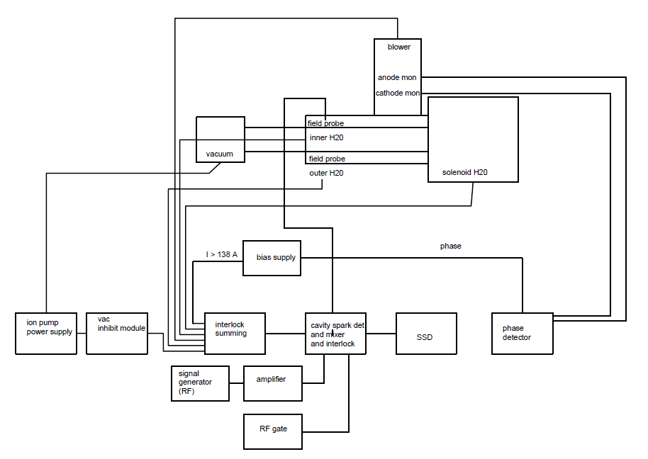
Interlocks/controls
Need
PLL filter box
Have?
How many separate flow turbines/
Water interlocks?
Cavity inner
Cavity outer
solenoid
Or something else?
(will have something else
Real Booster setup)

