Slide 1
Bunch length comparisons between operational, Bill’s and adiabatic paraphase curves
C.Y. Tan, C. Bhat, V. Grzelak
25 Jul 2018

Slide 2
Goals
After a lot of effort was made to balance out the RF phase between cavities at injection
  The question still remains as to whether the RF phases are truly balanced because we don’t know the calibration of the amplitude of each RF station.
Can we now do adiabatic capture?
  Create new adiabatic capture curves
  Remove waist (or “neck”) from RF sum
    The waist is anomalous! It shouldn’t exist for good capture!
    We want to make the waist anachronistic if possible.
Everything I’m presenting is PRELIMINARY! Subject to change without notice ☺

Slide 3
Different RF cavities OFF than on 30 Jun 2018
We applied phase corrected scheme for these experiments (*except* for the data for normal operations). 20 stations to maintain phase cancelation at injection.
Before 30 June
  OFF: A2 and B11
After 30 June
  A20, and B10.
We only measured the phase error for B11 and we don’t have the correction for A2.
    Therefore, there can be some phase error for the data taken after 30 June.

Slide 4
Timings and curves normal HEP (Reminder)
Has negative phase and then goes through 0

Slide 5
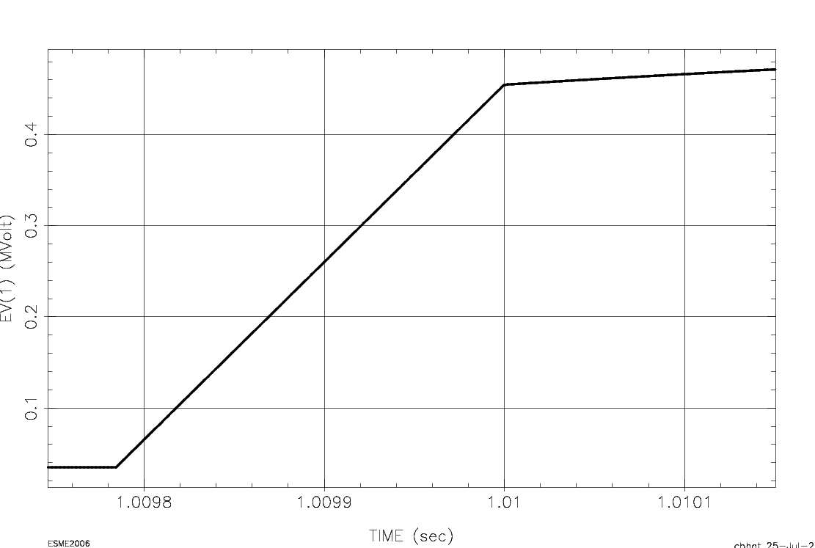
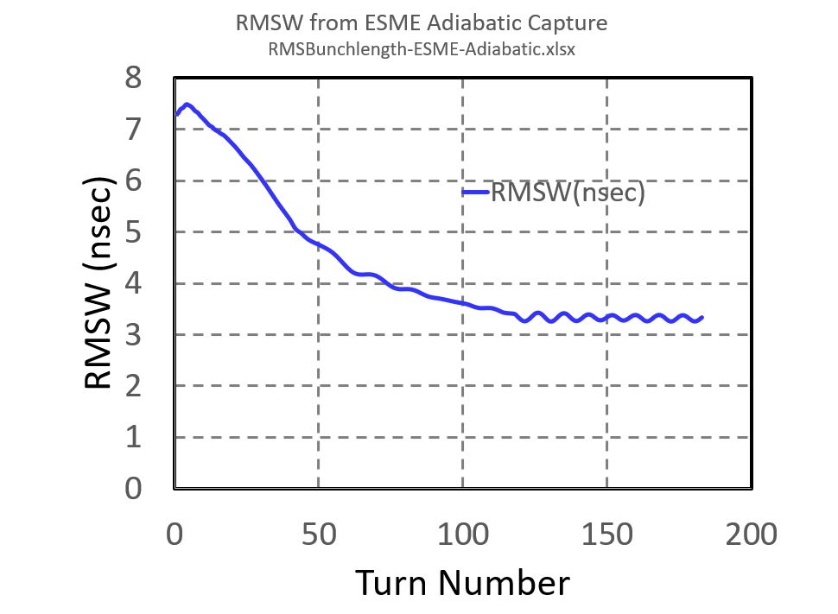
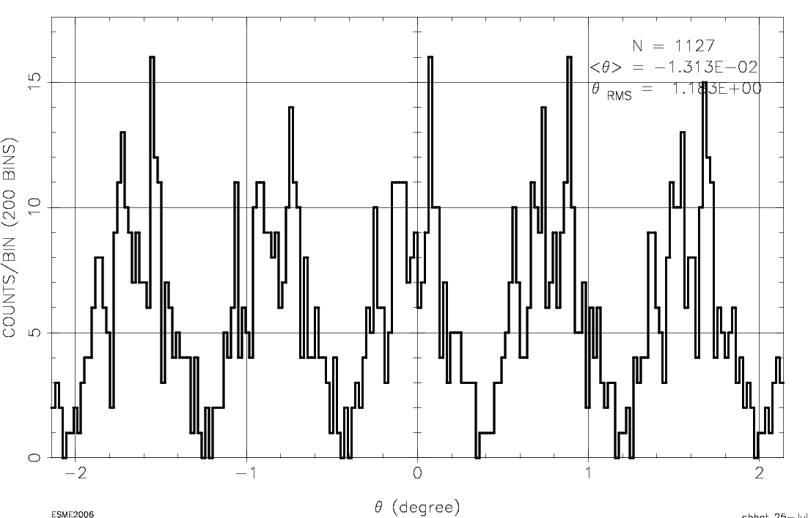
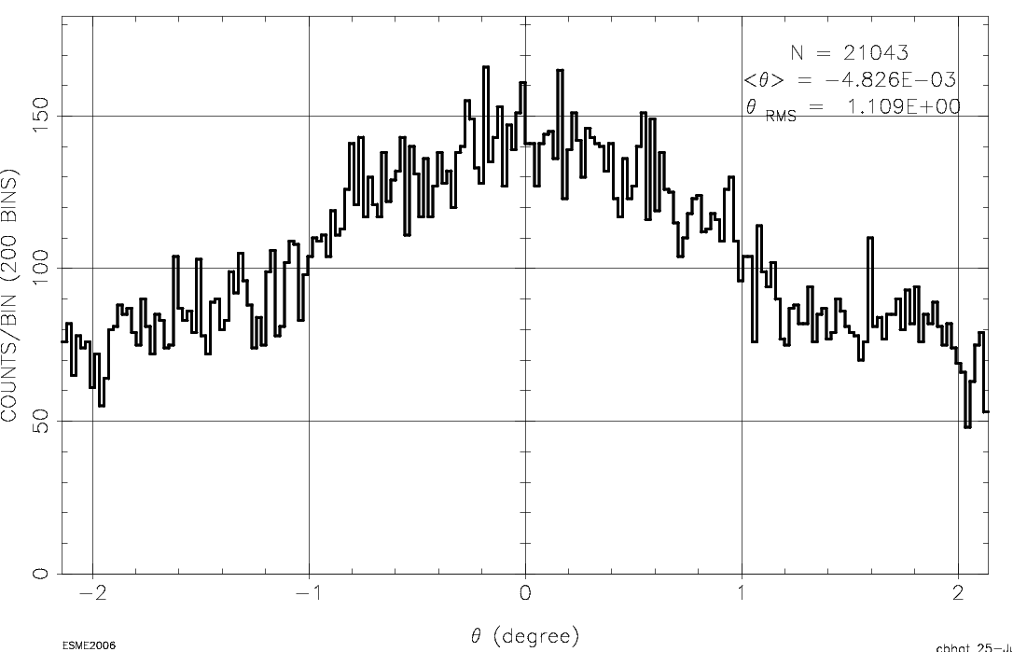
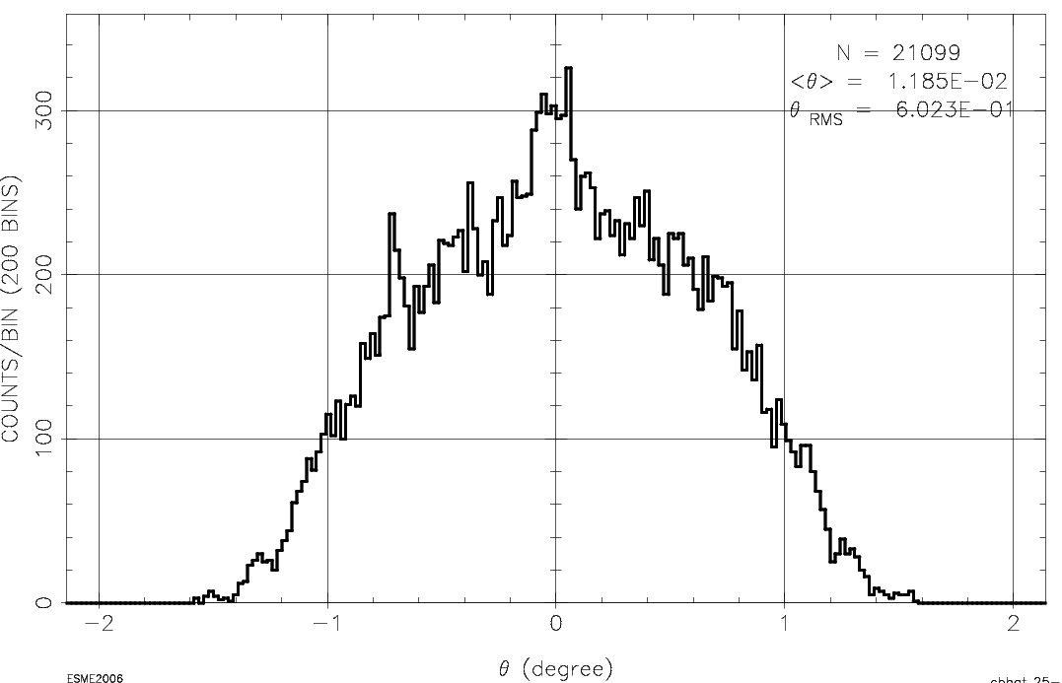
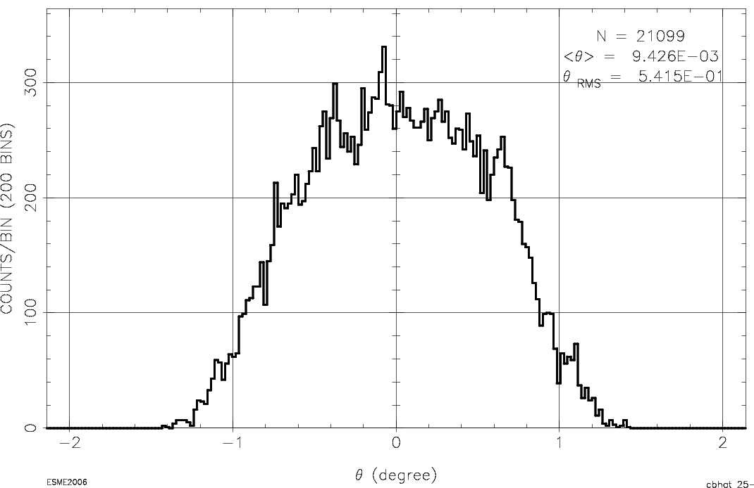
Esme simulations for 18 turn beam
RF Voltage (MV)
Simulation Start point
1.009744 sec
215 us
1st turn
18th turn
91st turn
183rd turn

Slide 6
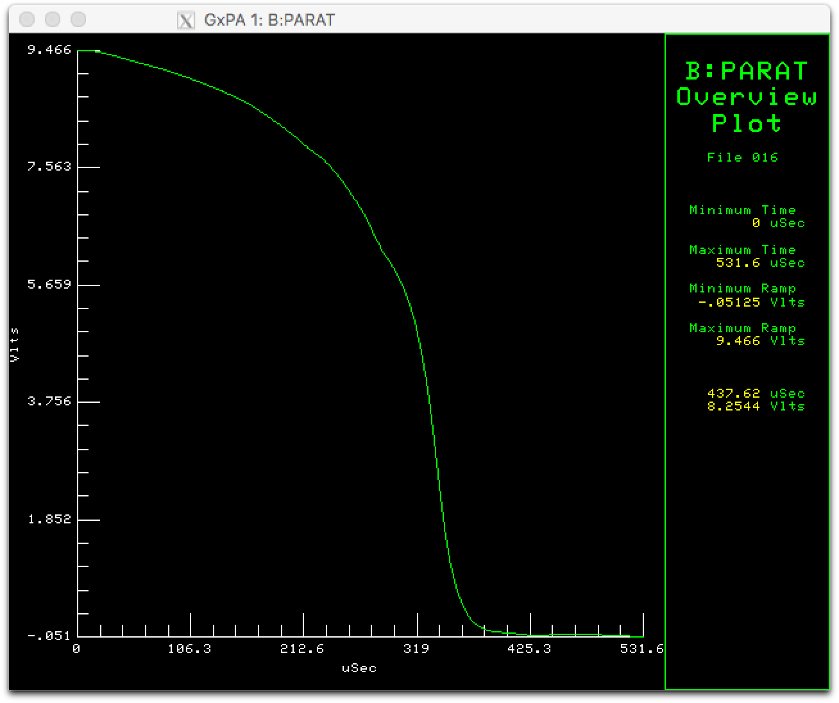
Paraphase curve used for studies
Map is not linear and is actually multiply valued!
Note: There is a very non-linear map between the paraphase curve shown here and reality.
The RF sum envelope with this curve is more or less linear compared to this curve.

Slide 7
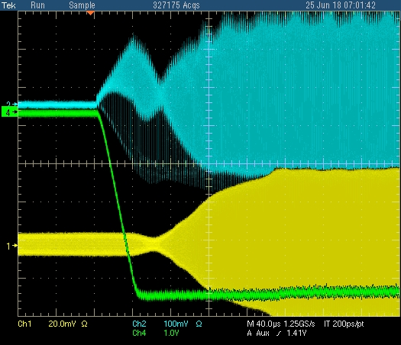
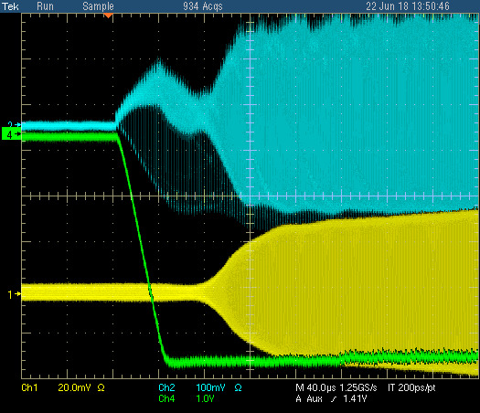
Before and after (25 Jun 2018)
Resistive wall
Quad oscillations still remain. Have to tune this out!
Waist
RF sum
CH0
Normal HEP with 20 stations.
Clearly a waist that comes from paraphrasing going to zero *after* the beam is captured, i.e. there is a re-capture! Huh????
Waist is gone! (Bill’s curve)
However quadrupole oscillations remain. There’s also a longitudinal instability later in the cycle. Shorter bunches?

Slide 8
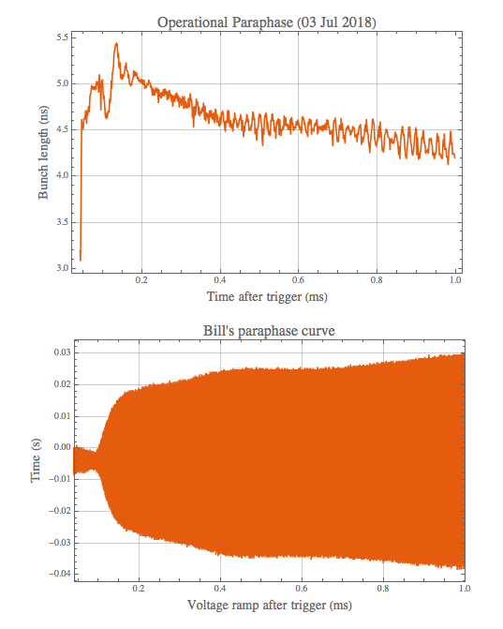
Consistency of data (Bill’s paraphase curve)
There are 3 bunch lengths on the left which look very similar taken on 02 Jul.
The operational bunch lengths are again very similar on 02 and 03 July.
Therefore, bunch lengths are very reproducible.

Slide 9
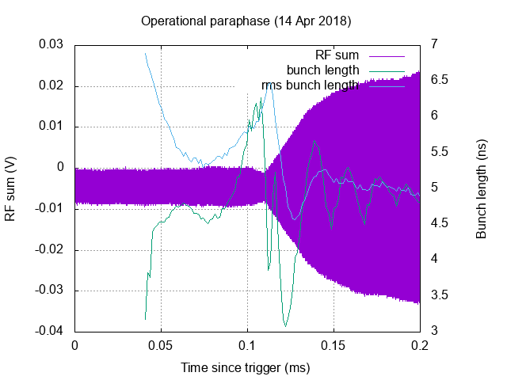
There is a difference between rms and gaussian fit! (Why?)
Why does rms think that the beam is large when looking at the data, the beam is short?
For gaussian fit, the peak of the debunching happens *before* the waist.
Mystery! Need to understand this.
Continue with gaussian sigma for rest of talk.

Slide 10
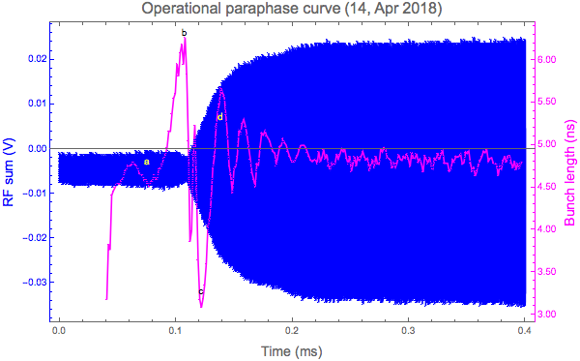
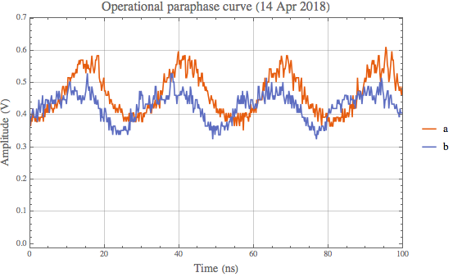
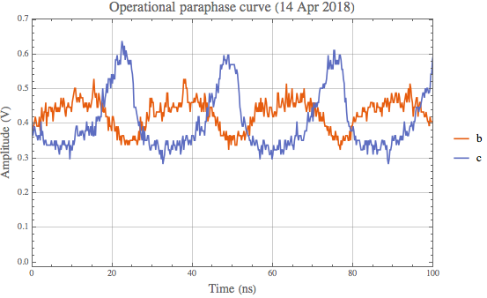
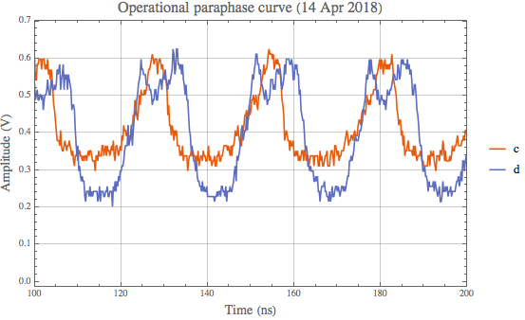
Close examination of operational curve (14 Apr 2018)

Slide 11
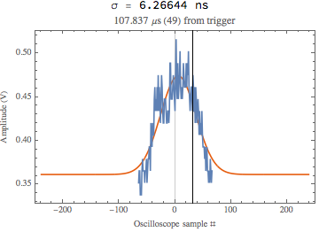
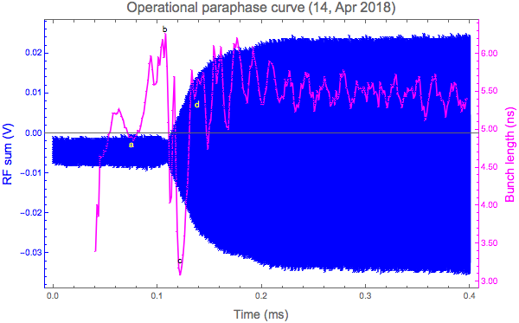
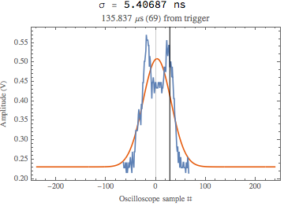
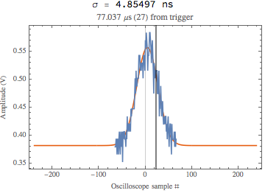
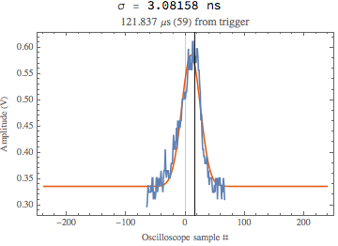
Check fits
Not great fit but here but clearly there is tumbling

Slide 12
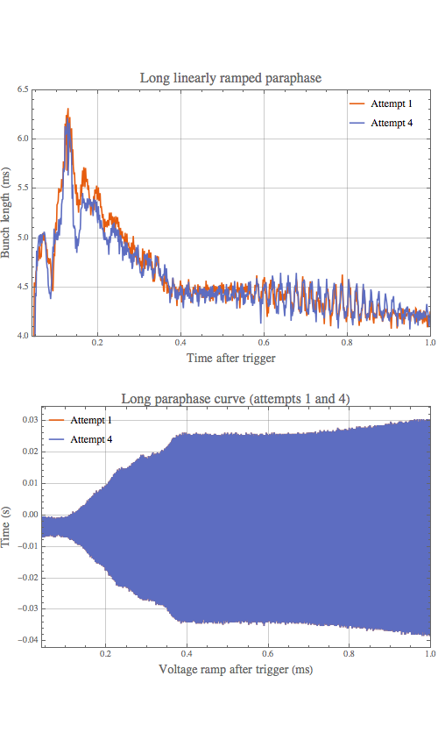
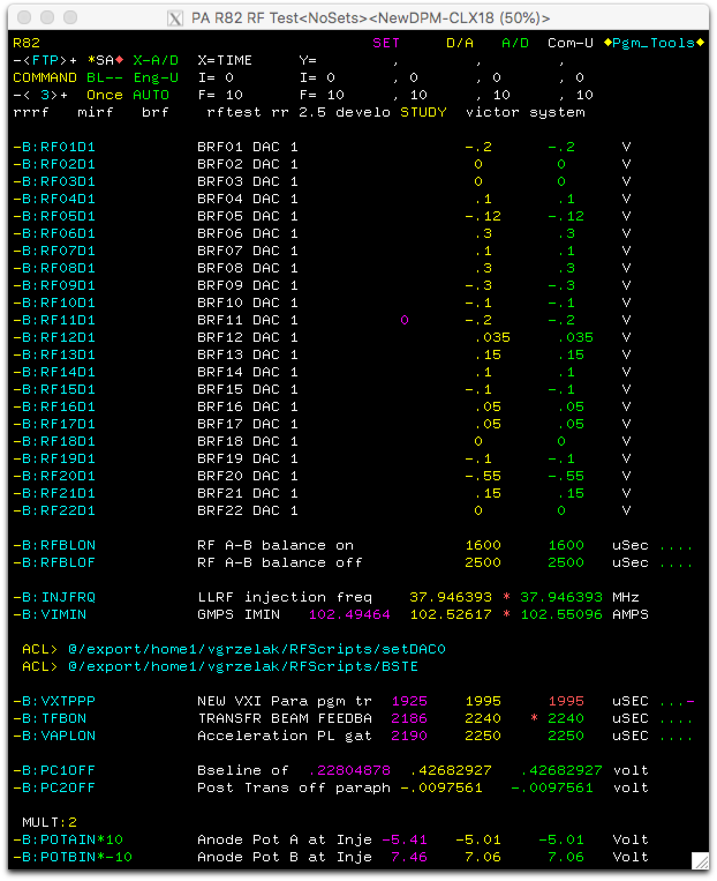

First and 4th attempts to get rid of the waist
Attempt 1
Attempt 4 has less waist (small change in VXTPP: 13 us and PC1off
Note: none of the attempts gave good efficiencies in Booster.
Clearly, in attempt 1, the oscillations are quite large compared to attempt 4 right after debunching.
Why are we debunching??? And this debunching is very fast, ~ 50 us!!!!

Slide 13
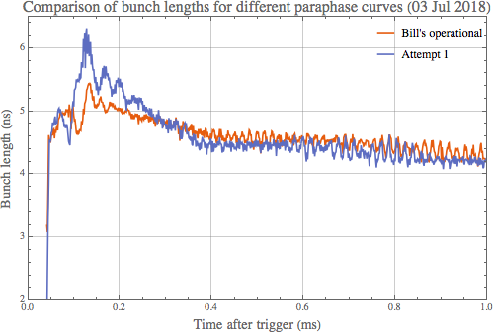
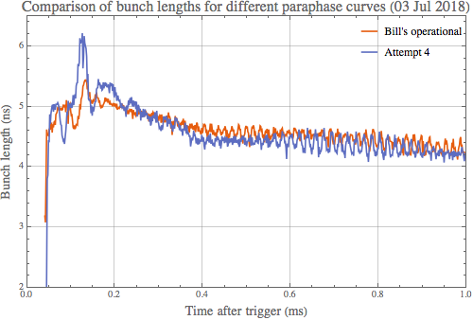
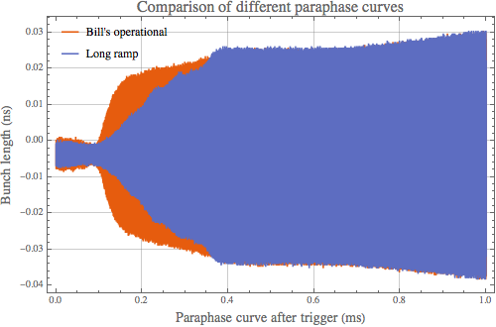
Comparing operational to attempts 1 & 4
Both attempts yielded about the same bunch lengths after 0.5 ms. However, the debunching in both attempts is problematic. Why are we debunching?
And they seem to be fully debunched at nearly the same time! The amount debunching is dependent on the phase change rate???!!!! Debunching occurs when there is volts! Bunch rotation?

Slide 14
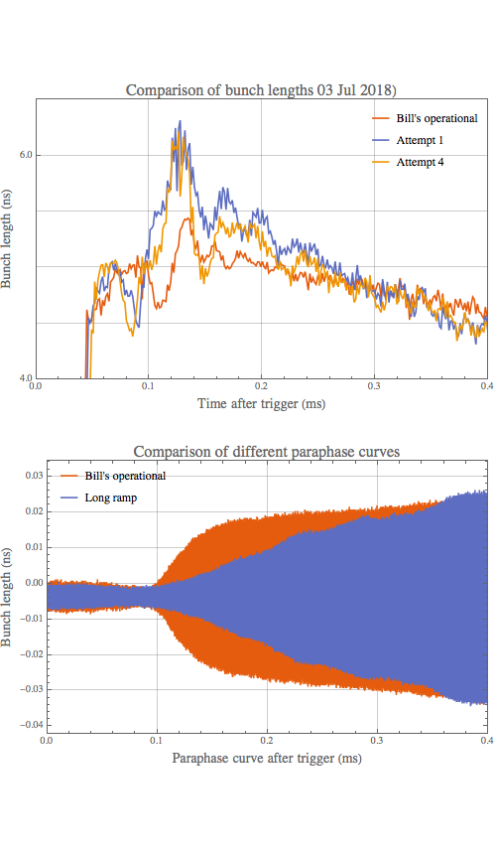
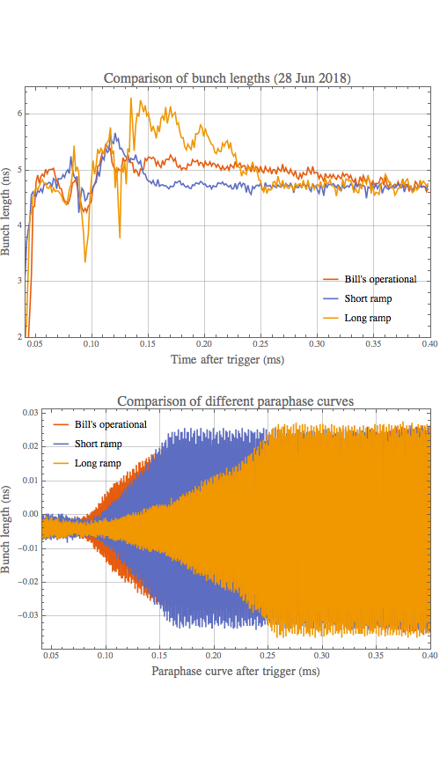
Zoom in to compare with 28 Jun and 03 Jul data
Seems to be at the same point!
Does this show that there is another V=0 point and that the time spent going through it gives a different abount of debunching?
If you believe the RF sum curve, then it is IMPOSSIBLE for there to be zero volts!

Slide 15
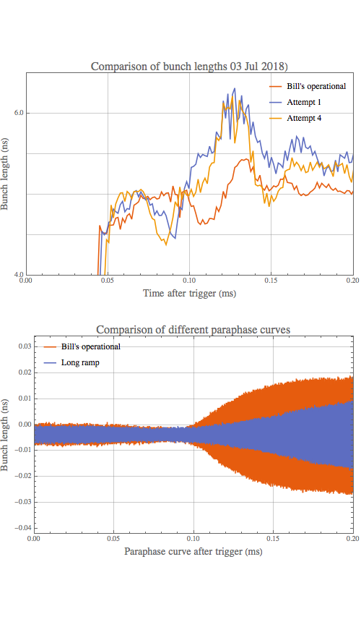
Even more zoomed in
Since beam is debunching, the voltage the bunch sees is actually getting *smaller* despite the RFSUM saying it is growing!
Injection completed

Slide 16
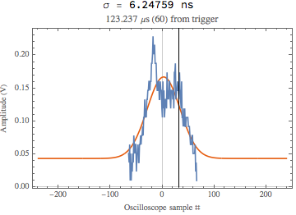
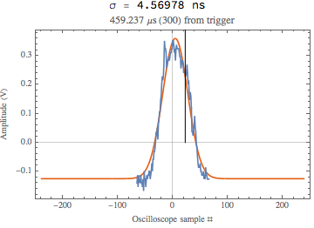
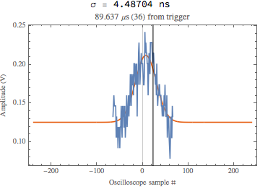
Check 1st attempt (03 Jul 2018)

Slide 17
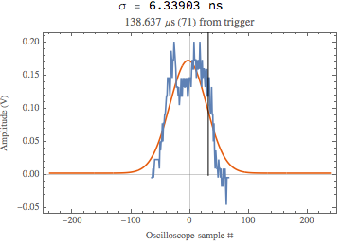
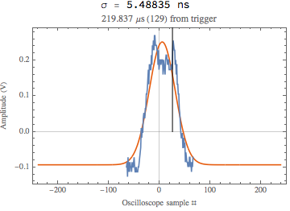
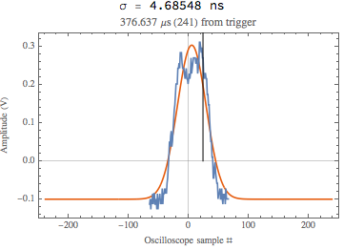
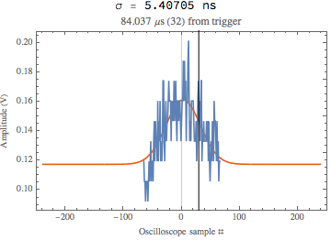
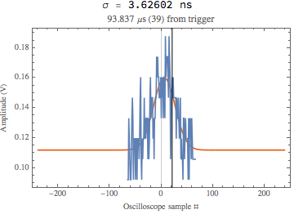
Long ramp (28 Jun 2018)

Slide 18
No conclusion for now but mysteries remain (Preliminary observations)
RMS and Gaussian sigma don’t match.
  The gaussian fits are good by eye-ball.
If we believe the Gaussian sigma, the purpose of the waist (or neck) is to actually over-focus the beam to compensate for beam debunching later on.
  Longer adiabatic curve seems to mean that the bunches are staying longer at debunching. This could be the reason why we have always have *fast* paraphase curves and not slow paraphase curves.
  If you believe RF sum, debunching should not occur (perhaps bunch rotation is happening??)

Slide 19
Backup

Slide 20
Comparing the operations measured bunch lengths (ratio of 3rd to fundamental method)
There are 3 bunch lengths on the left which look very similar taken on 02 Jul. So average, shown on right.
The operational bunch lengths are again very similar on 02 and 03 July.
Therefore, bunch lengths are very reproducible.

Slide 21
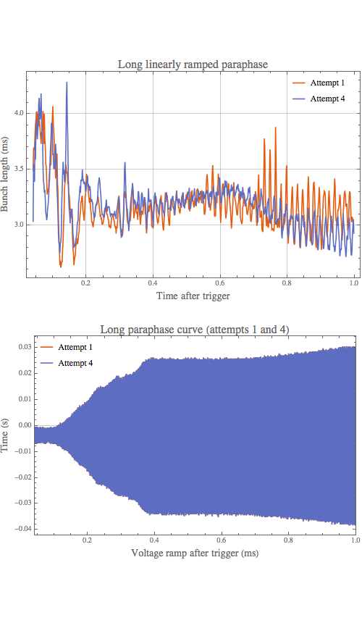
First and 4th attempts to get rid of the waist
Attempt 1
Attempt 4 has less waist
Note: none of the attempts gave good efficiencies in Booster.
Clearly, in attempt 1, the oscillations are quite large compared to attempt 4.

Slide 22
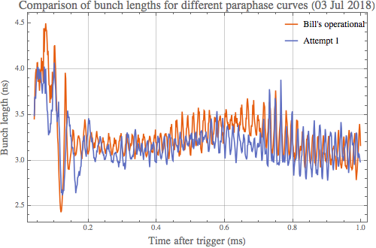
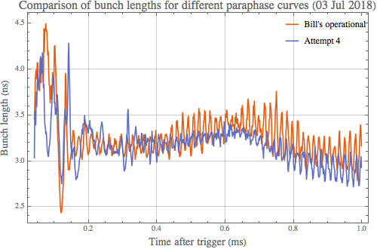
Comparing operational to attempts 1 & 4
Clearly, attempt 4 yielded the best bunch length with the smallest oscillations.

Slide 23
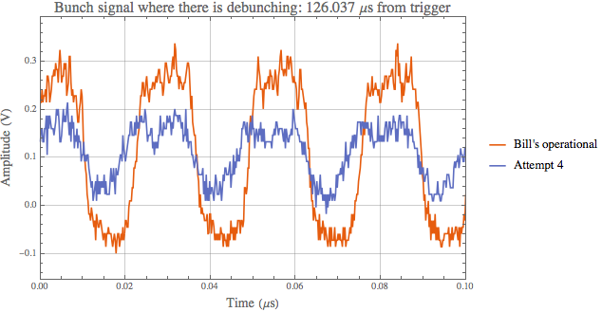
Clear debunching (why??)
Clearly beam has debunched in attempt 4 compared to Bill’s operational. More DC beam! This is taken where the debunching is maximum in the previous graph.
Bunch length (obviously not Gaussian, but use it anyway to get sigma)
Bill’s operational: 6.7 ns.
Attempt 4: 13 ns.

Slide 24
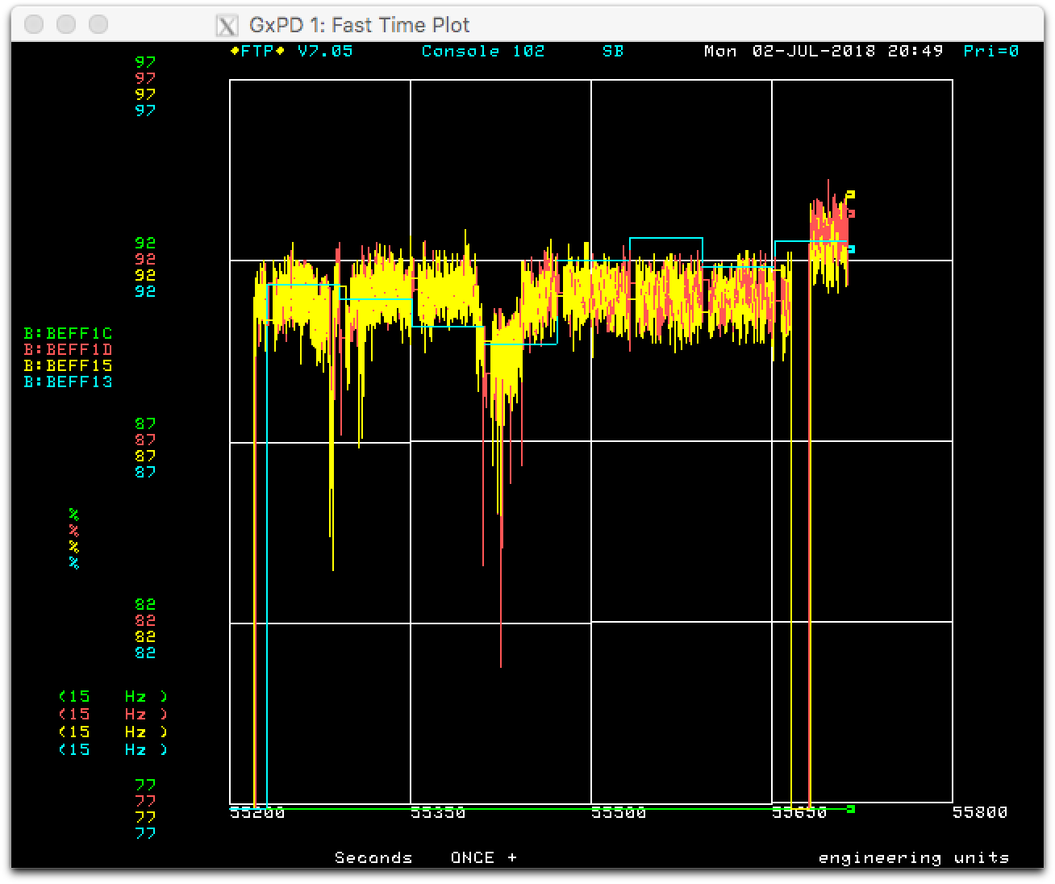
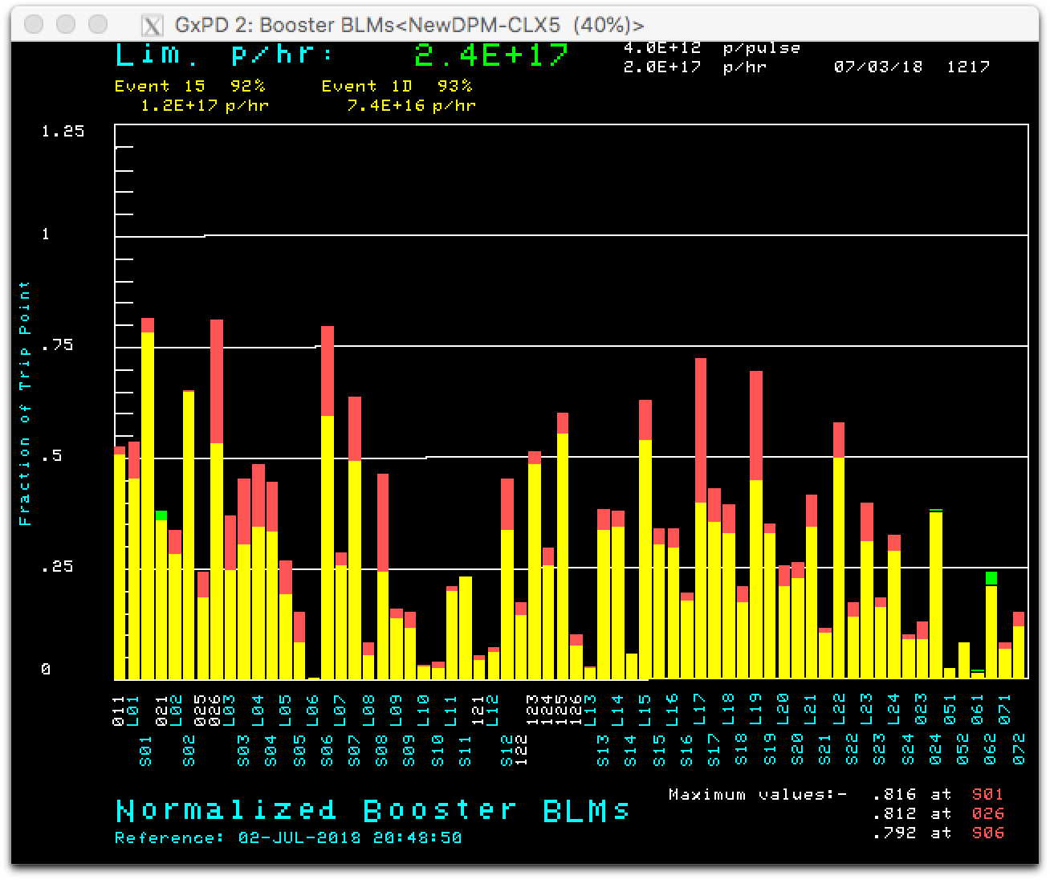
Losses during the experiment shows that operational curve is better
After restoration to Bill’s operational paraphase curve, efficiencies and losses are better.

