Slide 1
Assembly of cavity (and all the problems)
K. Duel & C.Y. Tan
30 Aug 2018

Slide 2
Many difficulties during assembly
Neck assembly did not meet specifications. This meant that problems compound from this.
Good that neck assembly is a little flexible to accommodate incorrect manufactured length.
Water pipes had to be moved because they hit the solenoid end plate preventing assembly.
Neck assembly became hardened steel from spinning and so extremely difficult to cut or drill.
Modifications required to allow maneuverability.
Extra holes made to close up gaps to prevent RF leakage.
Added wires to act as RF lips.
Moved wires on end plate because they don’t contact outer shell or inner conductor.
Bad weld joints on outer shell assembly because EDM removed too much weld material.
EDM was required to correct bends from welding.
The cracks have been left as is because of lack of time to fix.
Had to add turn buckle to hold up end plate because aluminum “square” not stiff enough.
Grease: it is hard to control the amount of grease.
Had to restack garnet because did not put on enough the first time.
Extremely difficult to separate garnet rings because of suction from the grease.
We damaged one ring from this exercise.

Slide 3
Modifications to the neck assembly
Slot had to be cut. Tubing moved
Wires added for RF seals.

Slide 4
Outer shell assembly cracks
Removed bow by EDM
Grease leaked from cracks

Slide 5
Moved wires on end plates
During assembly, we noticed that the original wires either touched the inner conductor or the outer conductor but not both.
Soldered on new wires to guarantee contact.

Slide 6
Turn buckle added
Turn buckle added to prevent end plate from flopping. This is because the aluminum frame is not stiff enough.

Slide 7
Hard to control amount of grease
Not enough grease
We had to disassemble the stack (very difficult) and damaged 1 ring from garnet flaking.

Slide 8
Add more grease and squeeze
We added more grease this time and always checking that the grease over flowed out from the seams. This meant that too much grease was applied. We squeezed the excess out.

Slide 9
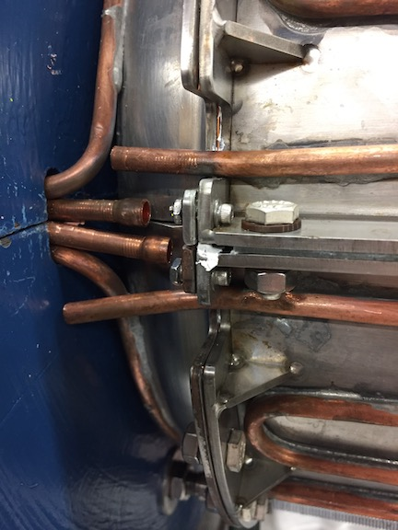
Assemble outer shell
We had to make a fixture to push the tuner stack inwards while keeping it from falling into the tuner.
Due to the neck assembly not being manufactured correctly, the relative positions of the tuner stack are not even. We tried to keep the position of the tuner stack at 10 mils w.r.t. the inner conductor.
Closed gap with 8-32 screw

Slide 10
Assemble end plates
The slots for the wires on the end plates was just too close to the edges of the outer shell and inner conductor. We had to solder wires instead of using slots to guarantee contact.
We made a tool to spread the grease consistently. We made sure that the contact surfaces did not have any grease. Goal is to get 80% fill after the bolts are tightened.

Slide 11
Installing the solenoid
We had to be careful slinging the solenoid because it was unbalanced (back heavy) because the end plates is removed
Surprisingly, this was the smoothest of the entire assembly process. The solenoid fits!

Slide 12
Cavity with tuner and solenoid assembled
Stuff left to do:
Water pipes need to be soldered together.
HOM cavity to be installed.

Slide 13
Lessons learnt
Very difficult to separate rings after stacking because of stacking. Danger of chipping is always present. Ring #13 had chips and was changed to Ring #1.
Spinning is not precise enough for the neck assembly which led to many problems during assembly. Hardened the metal and made it difficult to modify as well. Machine next time.
Outer shell also needs to be machined with no welding.

Slide 14
Thanks to the techs who assembled this nearly impossible to build cavity
Thanks to Ryan, Rocky and Ken.
Thanks to Ding for great suggestions during the assembly process.
Assembly started in March 2018 and took 5 months to complete. Many modifications and slow downs from welding and plating along the way.

