Slide 1
Phase Measurements For Booster RF
V. Grzelak
C. Y Tan
C. Bhat
Notes:
Good Afternoon Everyone, If you don’t know me my name is Victor Grzelak and I am a RF engineer that works mostly with Booster, Main injector and Recycler.
Recently, I have been working with Tan and Chandra into analyzing potential RF driven losses.
I’ll Jump right in

Slide 2
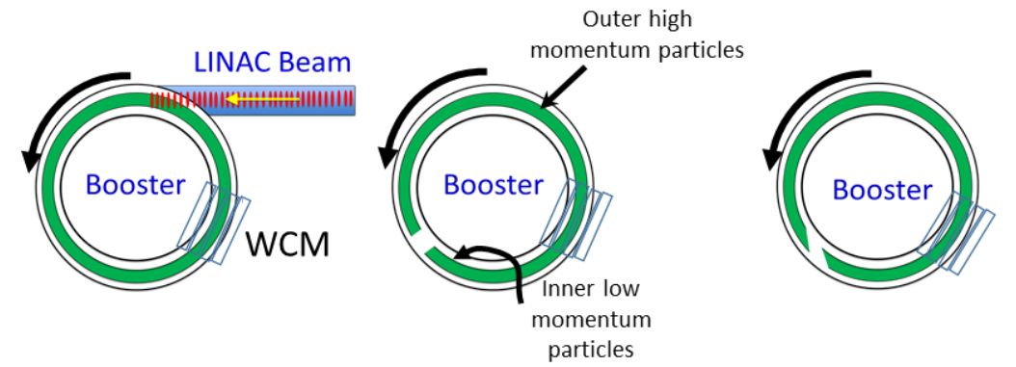
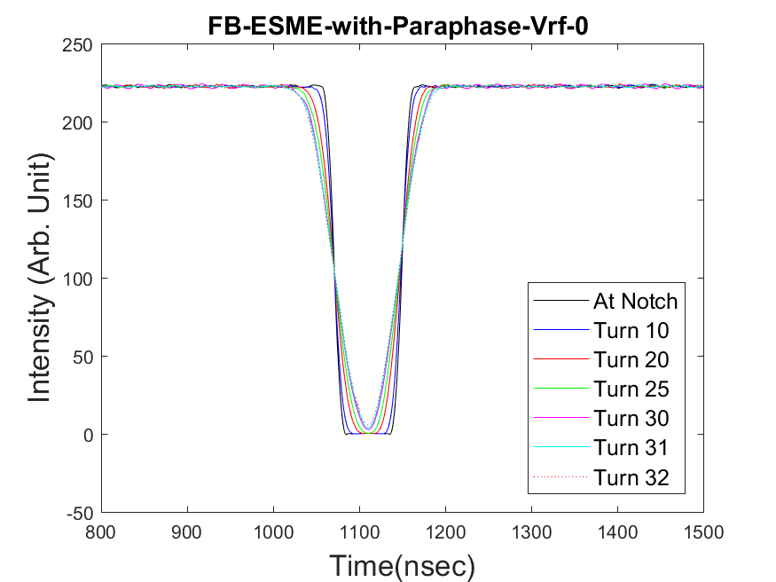
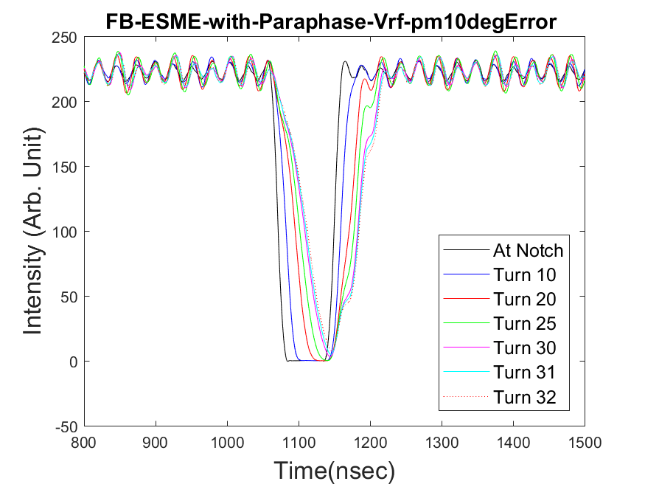
Introduction
Phase Measurements For Booster RF
  Within first 5mS of capture we lose ~5% efficiency
    Capture isn’t completely efficient
  Decrease happens at low intensities (BD6153)
  Longitudinal emittance calculated with notching method
    RFON – asymmetric filling
    RFOFF – symmetric filling
Notes:
Within the first 5 milliseconds Booster looses 5% of efficiency. This seems to be the case at varying intensities as was seen in BD6153.
One potential cause for this is a longitudinal growth during the paraphrase process.
One method of measuring longitudinal growth was via the now referred to “notch method”. Where the structure and duration of the momentum allows for calculation of emittance and RF imparted upon the beam.
In simulations the RF off should amount to a symmetric filling. The Right is zero RF and the Left is 10 degrees of phase error.

Slide 3
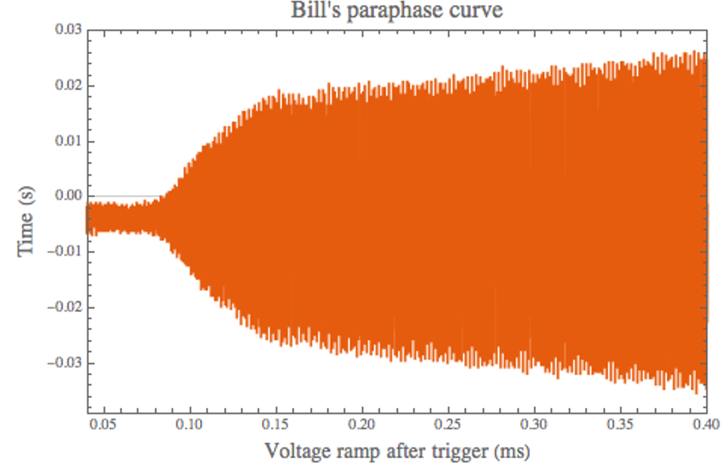
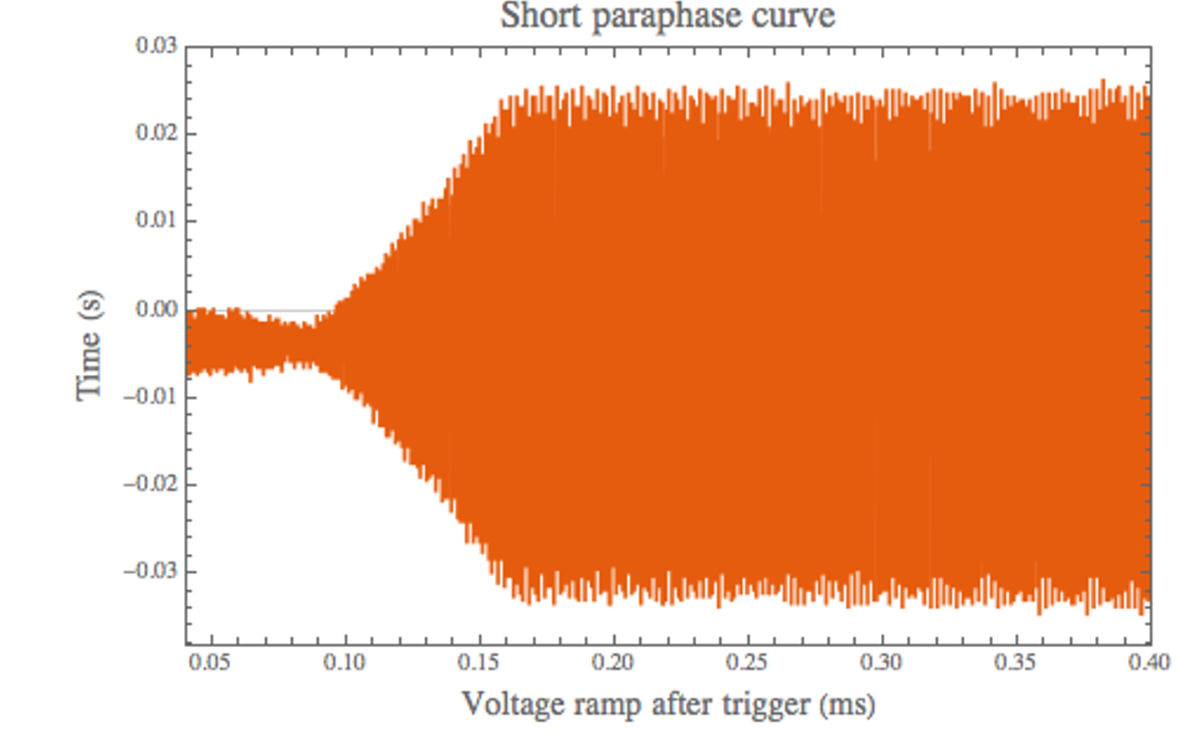
Introduction
Phase Measurements For Booster RF
  RF Sum before paraphase is not zero
  Intentional
    Current paraphase magnitude 10.72
    RF Zero at 9.71
    Beam Zero 9.71
  Unintentional
    Gap monitor deviations
    Passive phase shifter creation minorly inconsistent
    Minor group delay errors
Notes:
Pre-paraphase RF Vectoring is not set not set to cancel in operational curves, bifrocated as intentional and unintentional.
Paraphase value is constructed of an offset, PC1OFF, and the PARAT curve .
The true-paraphase as we refered to it in our notes is the summation of these two values.

Slide 4
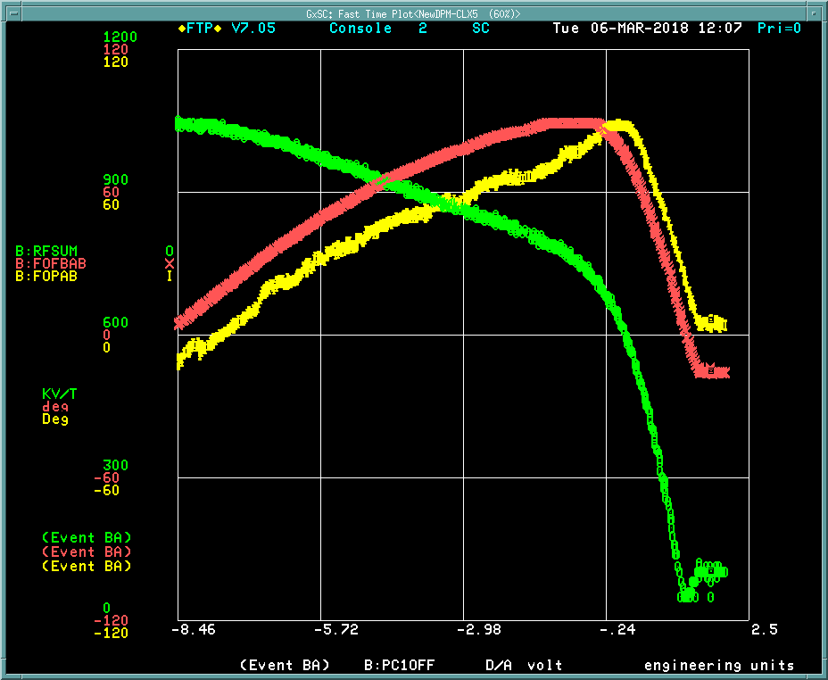
PC1OFF
Phase Measurements For Booster RF
  Phase errors in the Booster RF
  RF SUM Green
  Fan Out Yellow
  Fan Back Red
  Paraphase after 9.71 is in excess of 180
Notes:
The transfer function of the paraphase module is a strange one.
X axis- Paraphase value
Yelow and Red traces are fan out and fan back respectively
Green trace is the RF Sum magnitude.
As you can see after the zero point it is possible for the curve to go past 180 degrees.
This point confirmed the RF sum of zero was 9.71

Slide 5
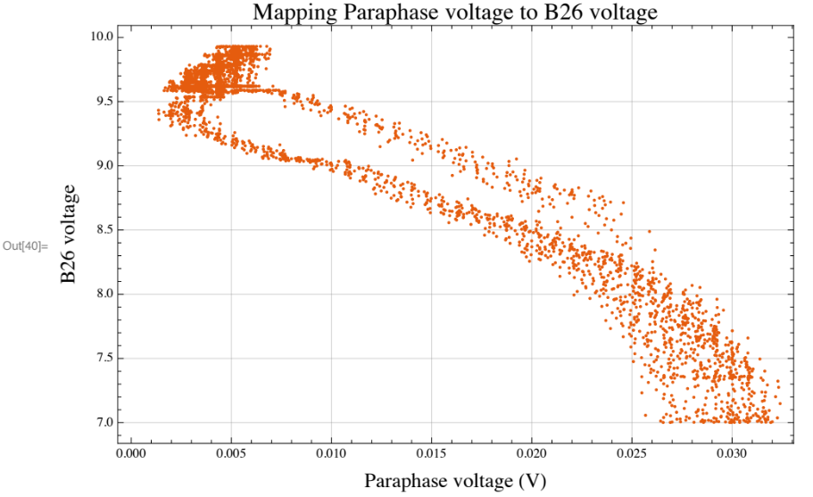
PC1OFF
Phase Measurements For Booster RF
Notes:
Again mapping the RF sum vs the paraphase magnitude allowed us to approximate the transfer function for later use.

Slide 6
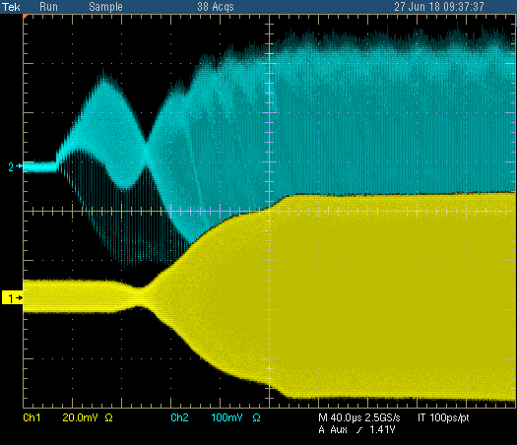
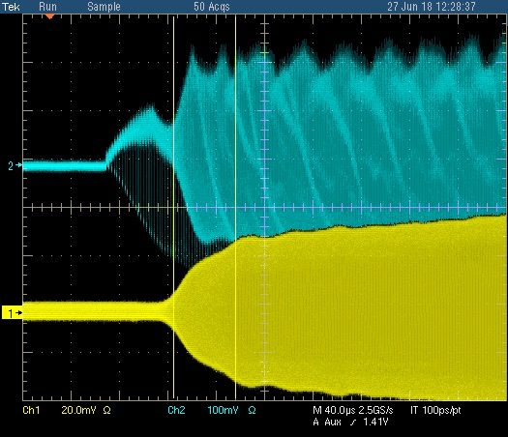
PC1OFF
Phase Measurements For Booster RF
  RF Sum goes through a waist
  RWM mirrors waist
Notes:
Beam also Mirrors this RF waist as is shown on the resistive wall monitor, the green trace.

Slide 7
1st Experiment Setup
Phase Measurements For Booster RF
  Purpose: To remove bunch structure given two balanced stations
  Matched amplitudes of all stations
  Two stations on at a time
    Station 3&4 used as reference
  Sum A+B module inserted DC offset in phase shifter
    1V=45 Degrees
  PC1OF fixed at 9.72
  Normal frequency curve
  Balancer off
  Flattened APG before capture
Notes:
To remove global errors from the equation we developed a simple experiment to measure the imparted RF on the beam using 2 stations at a time.
With matched magnitudes and a fixed paraphase.

Slide 8
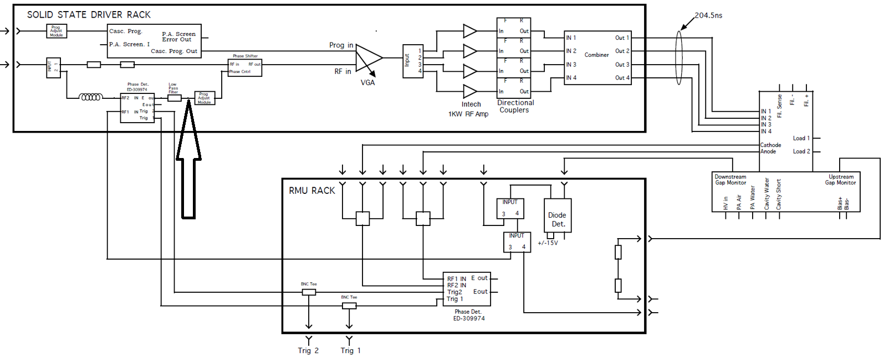
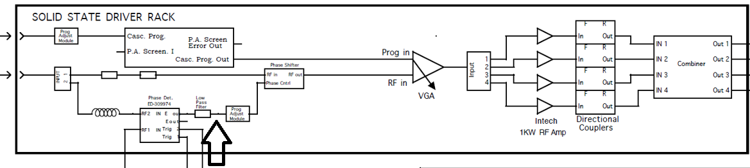
First Experiment
Phase Measurements For Booster RF
Notes:
There is a closed loop in our operation that guarentees the FB to be in phase with the fanout.
We inserted the Offset at this point.

Slide 9
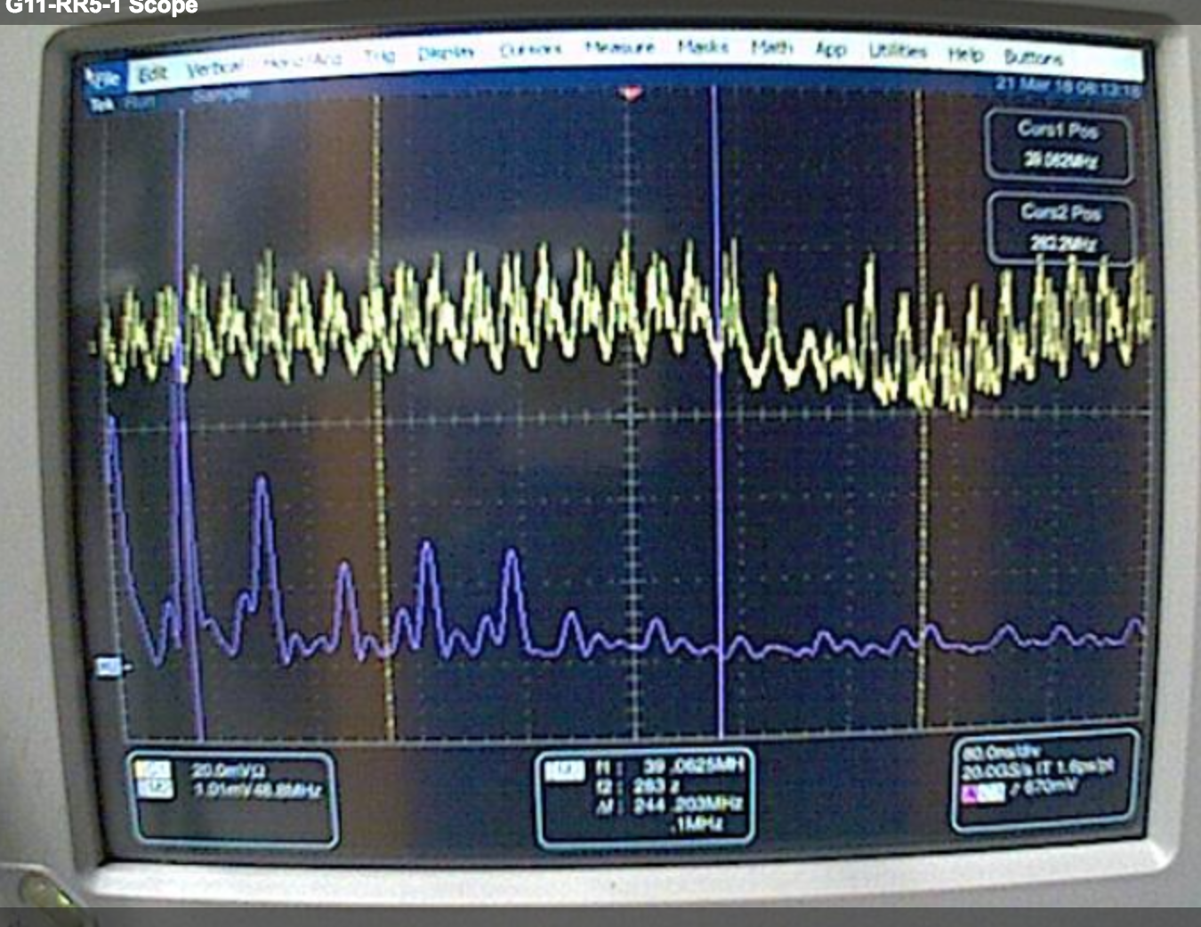
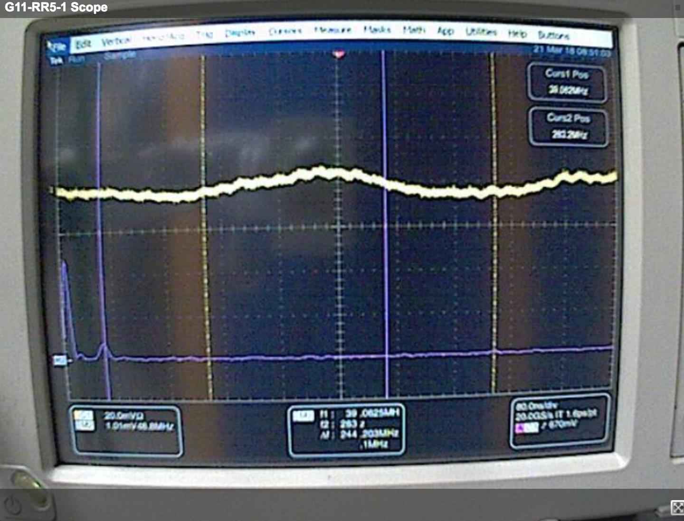
First Experiment
Phase Measurements For Booster RF
  Before paraphase bunch structure removal
  PC1OF 10.133 Left
  PC1OF 9.72 Right (with station corrections)
  Green- RWM(Time), Blue(FT)
Notes:
The scope traces here are showing what happens with respect to time and frequency with station 3 and 4 on.

Slide 10
First Experiment Results
Phase Measurements For Booster RF
  Too many large errors
  Investigation Needed

Slide 11
Methods of Error
Phase Measurements For Booster RF
  Longitudinal alignment - Negligible
  Fanout Errors – Addressed
    Passive phase shifters
    Fan out cable lengths
  Closed Loop Errors - Addressed
    Delay line cable lengths
    Gap monitor pickups
  Global errors - Pending

Slide 12
Alignment measurements
Phase Measurements For Booster RF
  Longitudinal alignment
  Fanout Errors
  Closed Loop Errors
 |  |  | Degrees
Station | Centerline (in) | Deviation | 37.7MHz | 52.8MHz
1 | 56.741 | 0.151 | 0.24 | 0.173
3 | 56.859 | 0.269 | 0.43 | 0.309
5 | 56.644 | 0.054 | 0.09 | 0.062
7 | 56.085 | -0.505 | -0.82 | -0.581
9 | 57.010 | 0.420 | 0.68 | 0.483
11 | 56.962 | 0.372 | 0.60 | 0.427
13 | 56.625 | 0.035 | 0.06 | 0.040
15 | 56.690 | 0.100 | 0.16 | 0.115
17 | 56.688 | 0.098 | 0.16 | 0.112
19 | 56.047 | -0.543 | -0.88 | -0.625
21 | 56.143 | -0.447 | -0.72 | -0.515
Average | 56.59036
2 | 84.871 | -0.323 | -0.52 | -0.372
4 | 85.154 | -0.040 | -0.06 | -0.046
6 | 85.212 | 0.018 | 0.03 | 0.021
8 | 85.659 | 0.465 | 0.75 | 0.535
10 | 85.164 | -0.030 | -0.05 | -0.035
12 | 84.544 | -0.650 | -1.05 | -0.748
14 | 85.037 | -0.157 | -0.25 | -0.181
16 | 85.119 | -0.075 | -0.12 | -0.086
18 | 85.222 | 0.028 | 0.05 | 0.032
20 | 85.705 | 0.511 | 0.82 | 0.588
22 | 85.451 | 0.257 | 0.41 | 0.296
Average | 85.194
Deviation in Degrees |  | Sum | Absolute Value sum
52.8MHz |  | 0.007 | 8.945
37.7MHz |  | 0.005 | 6.379

Slide 13
Alignment Changes
Phase Measurements For Booster RF
  Longitudinal alignment
  Fanout Errors
  Closed Loop Errors
  Longitudinal alignment typically not conducted in Z direction
  Period 16, 18 & 20 have other beam elements downstream, forcing the cavity upstream
  Errors were negligible

Slide 14
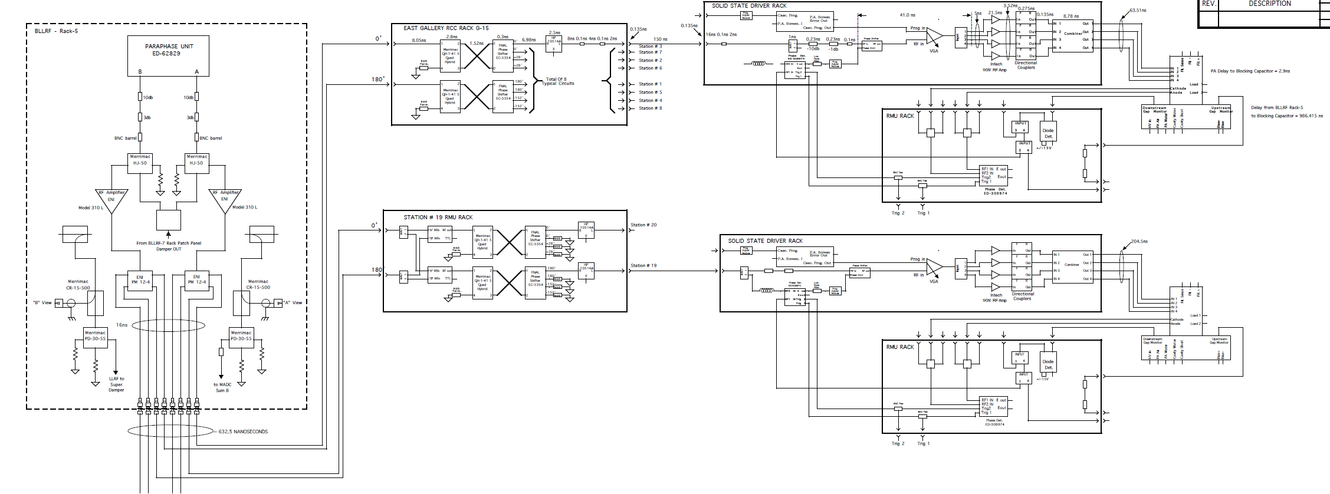
Booster Fanout System
Phase Measurements For Booster RF
  Longitudinal alignment
  Fanout Errors
  Closed Loop Errors
Notes:
This is a partial image of the Booster fanout system. At each junction there is the possibility of deleterious phase deviations.

Slide 15
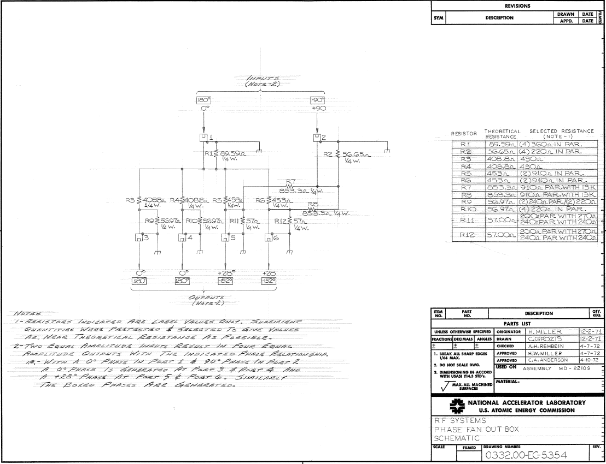
Brass Box
Phase Measurements For Booster RF
  Longitudinal alignment
  Fanout Errors
  Closed Loop Errors

Slide 16
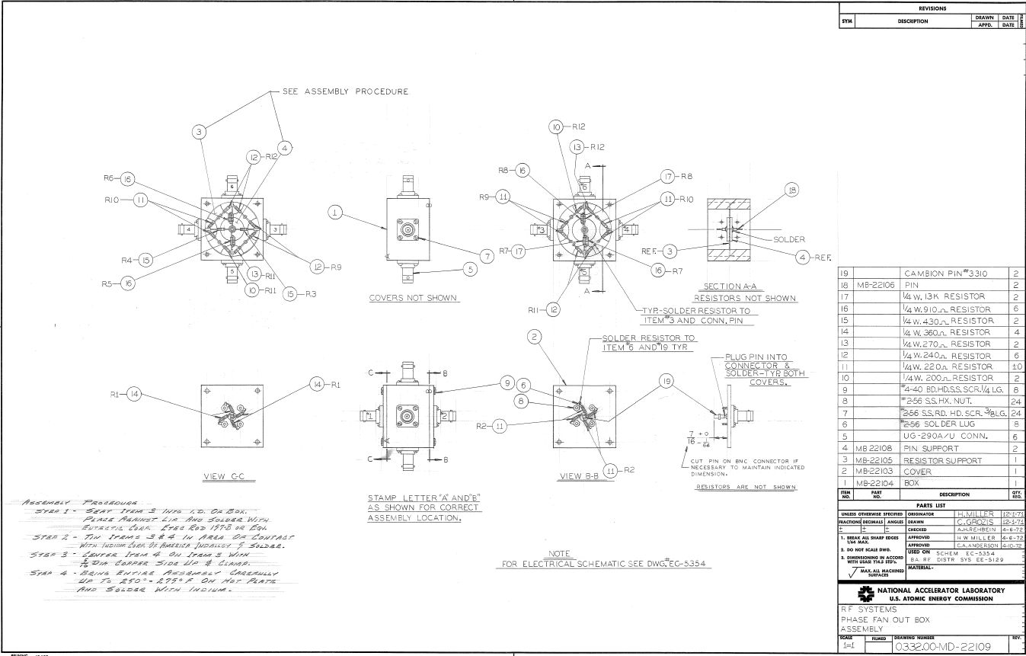
Brass Box
Phase Measurements For Booster RF
  Longitudinal alignment
  Fanout Errors
  Closed Loop Errors

Slide 17
Brass Box Measurements
Phase Measurements For Booster RF
  Longitudinal alignment
  Fanout Errors
  Closed Loop Errors
  Phase shifter was replaced this shutdown with an original era spare
  New fabrications can’t be made the same way due to use of indium

Slide 18
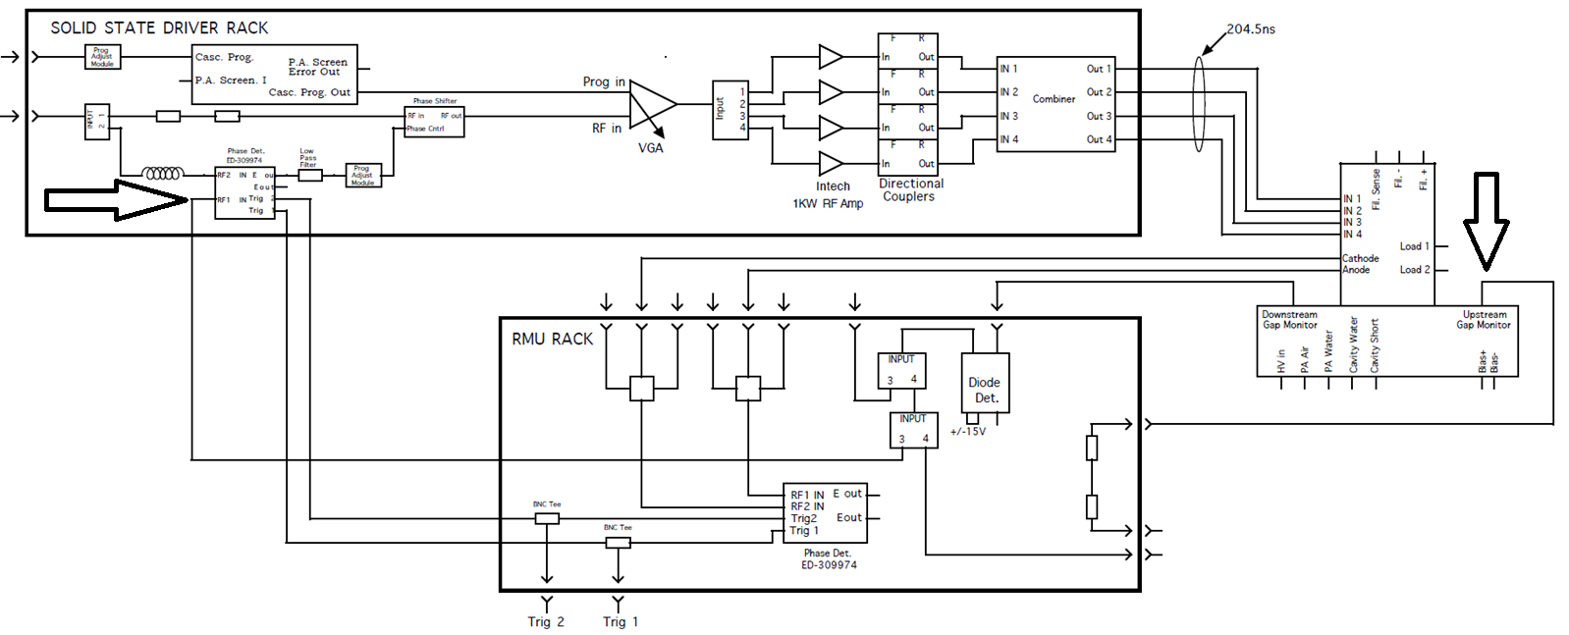
Closed Loop Errors
Phase Measurements For Booster RF
  Longitudinal alignment
  Fanout Errors
  Closed Loop Errors
  Gap Monitor
  Delay Line

Slide 19
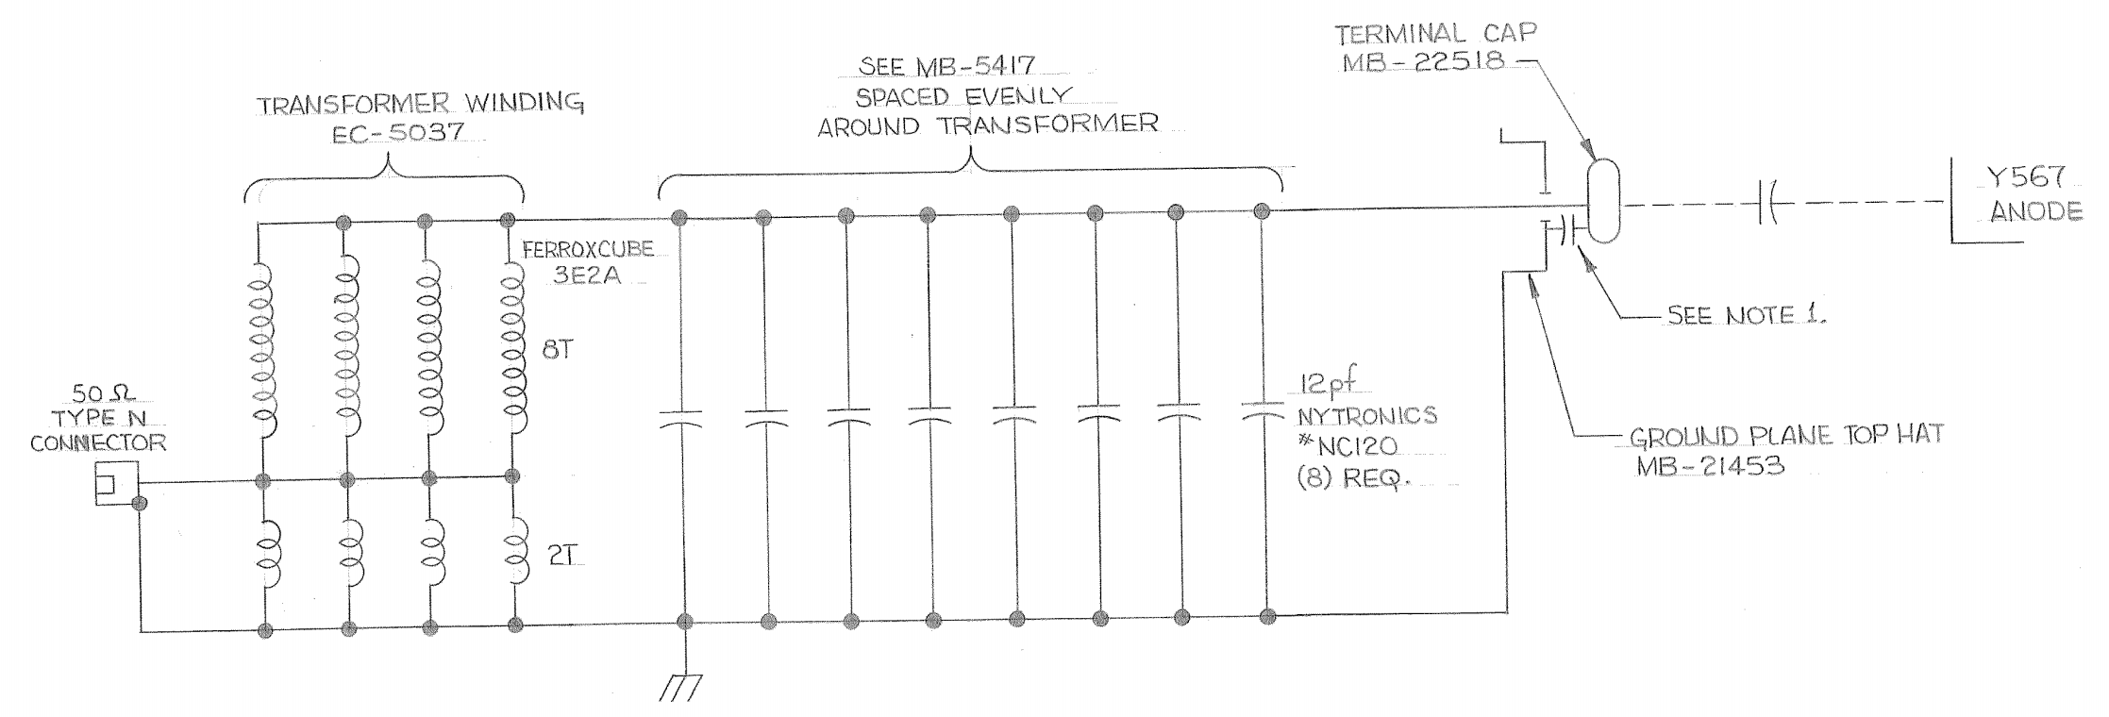
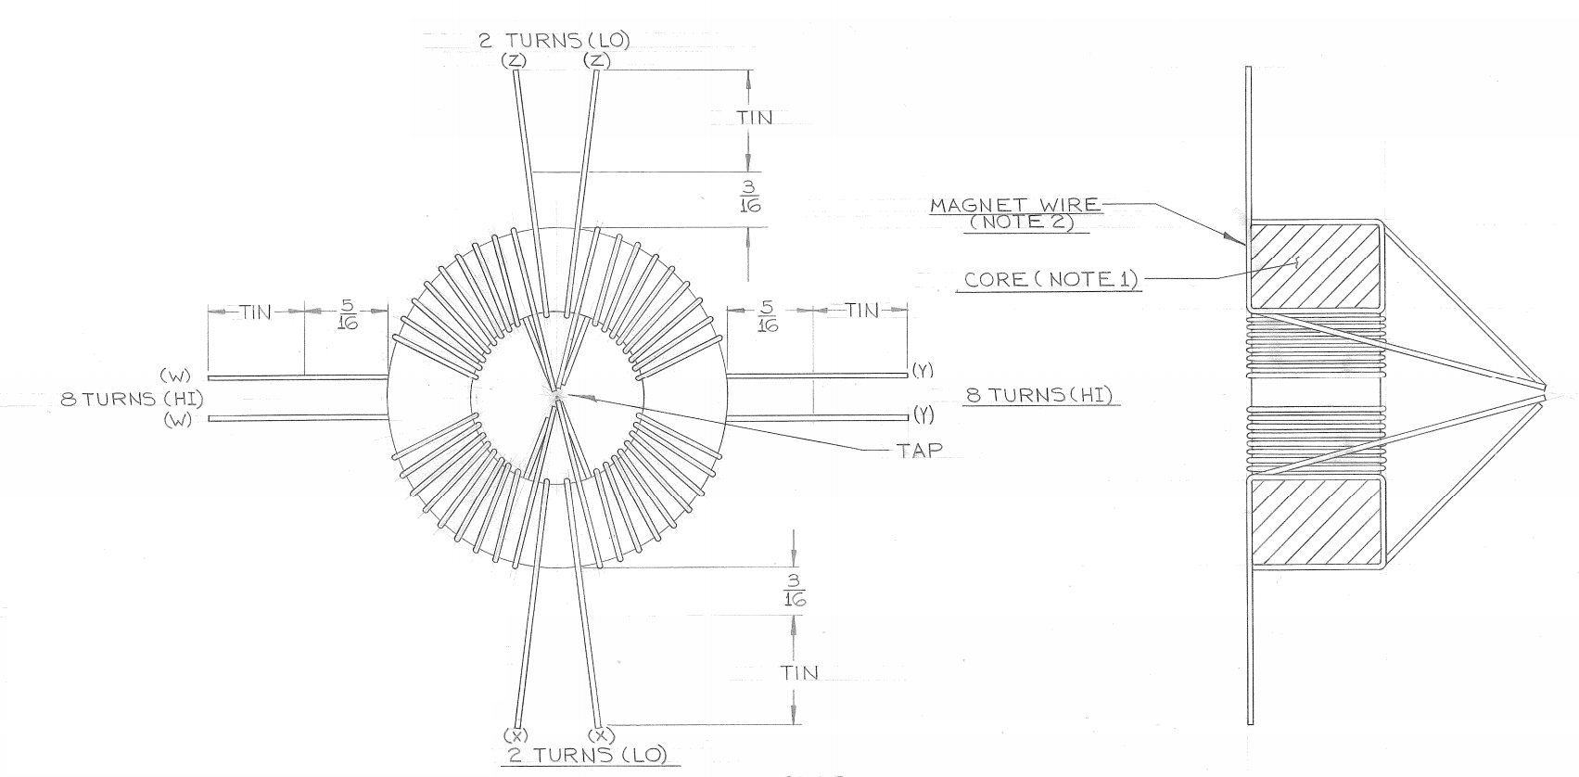
Gap monitor
Phase Measurements For Booster RF
  Longitudinal alignment
  Fanout Errors
  Closed Loop Errors

Slide 20
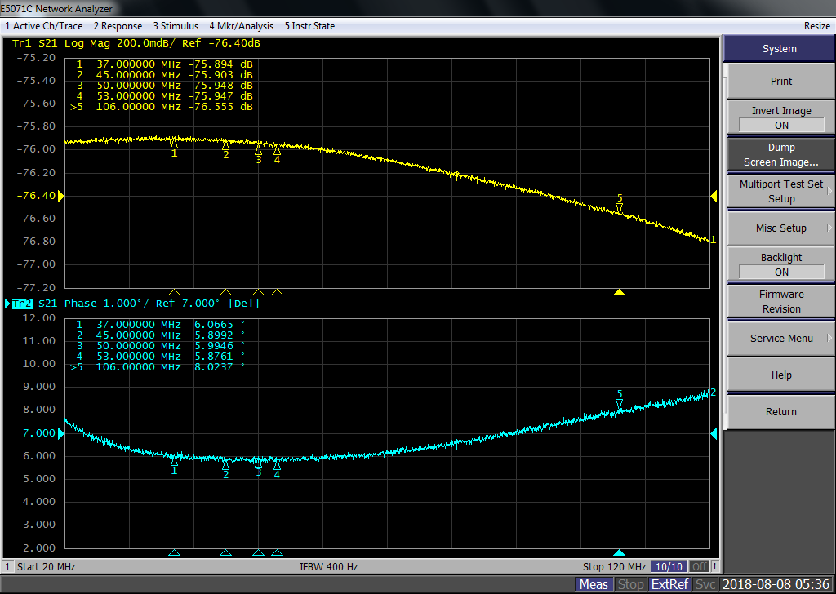
Normal Gap monitor
Phase Measurements For Booster RF
  Longitudinal alignment
  Fanout Errors
  Closed Loop Errors

Slide 21
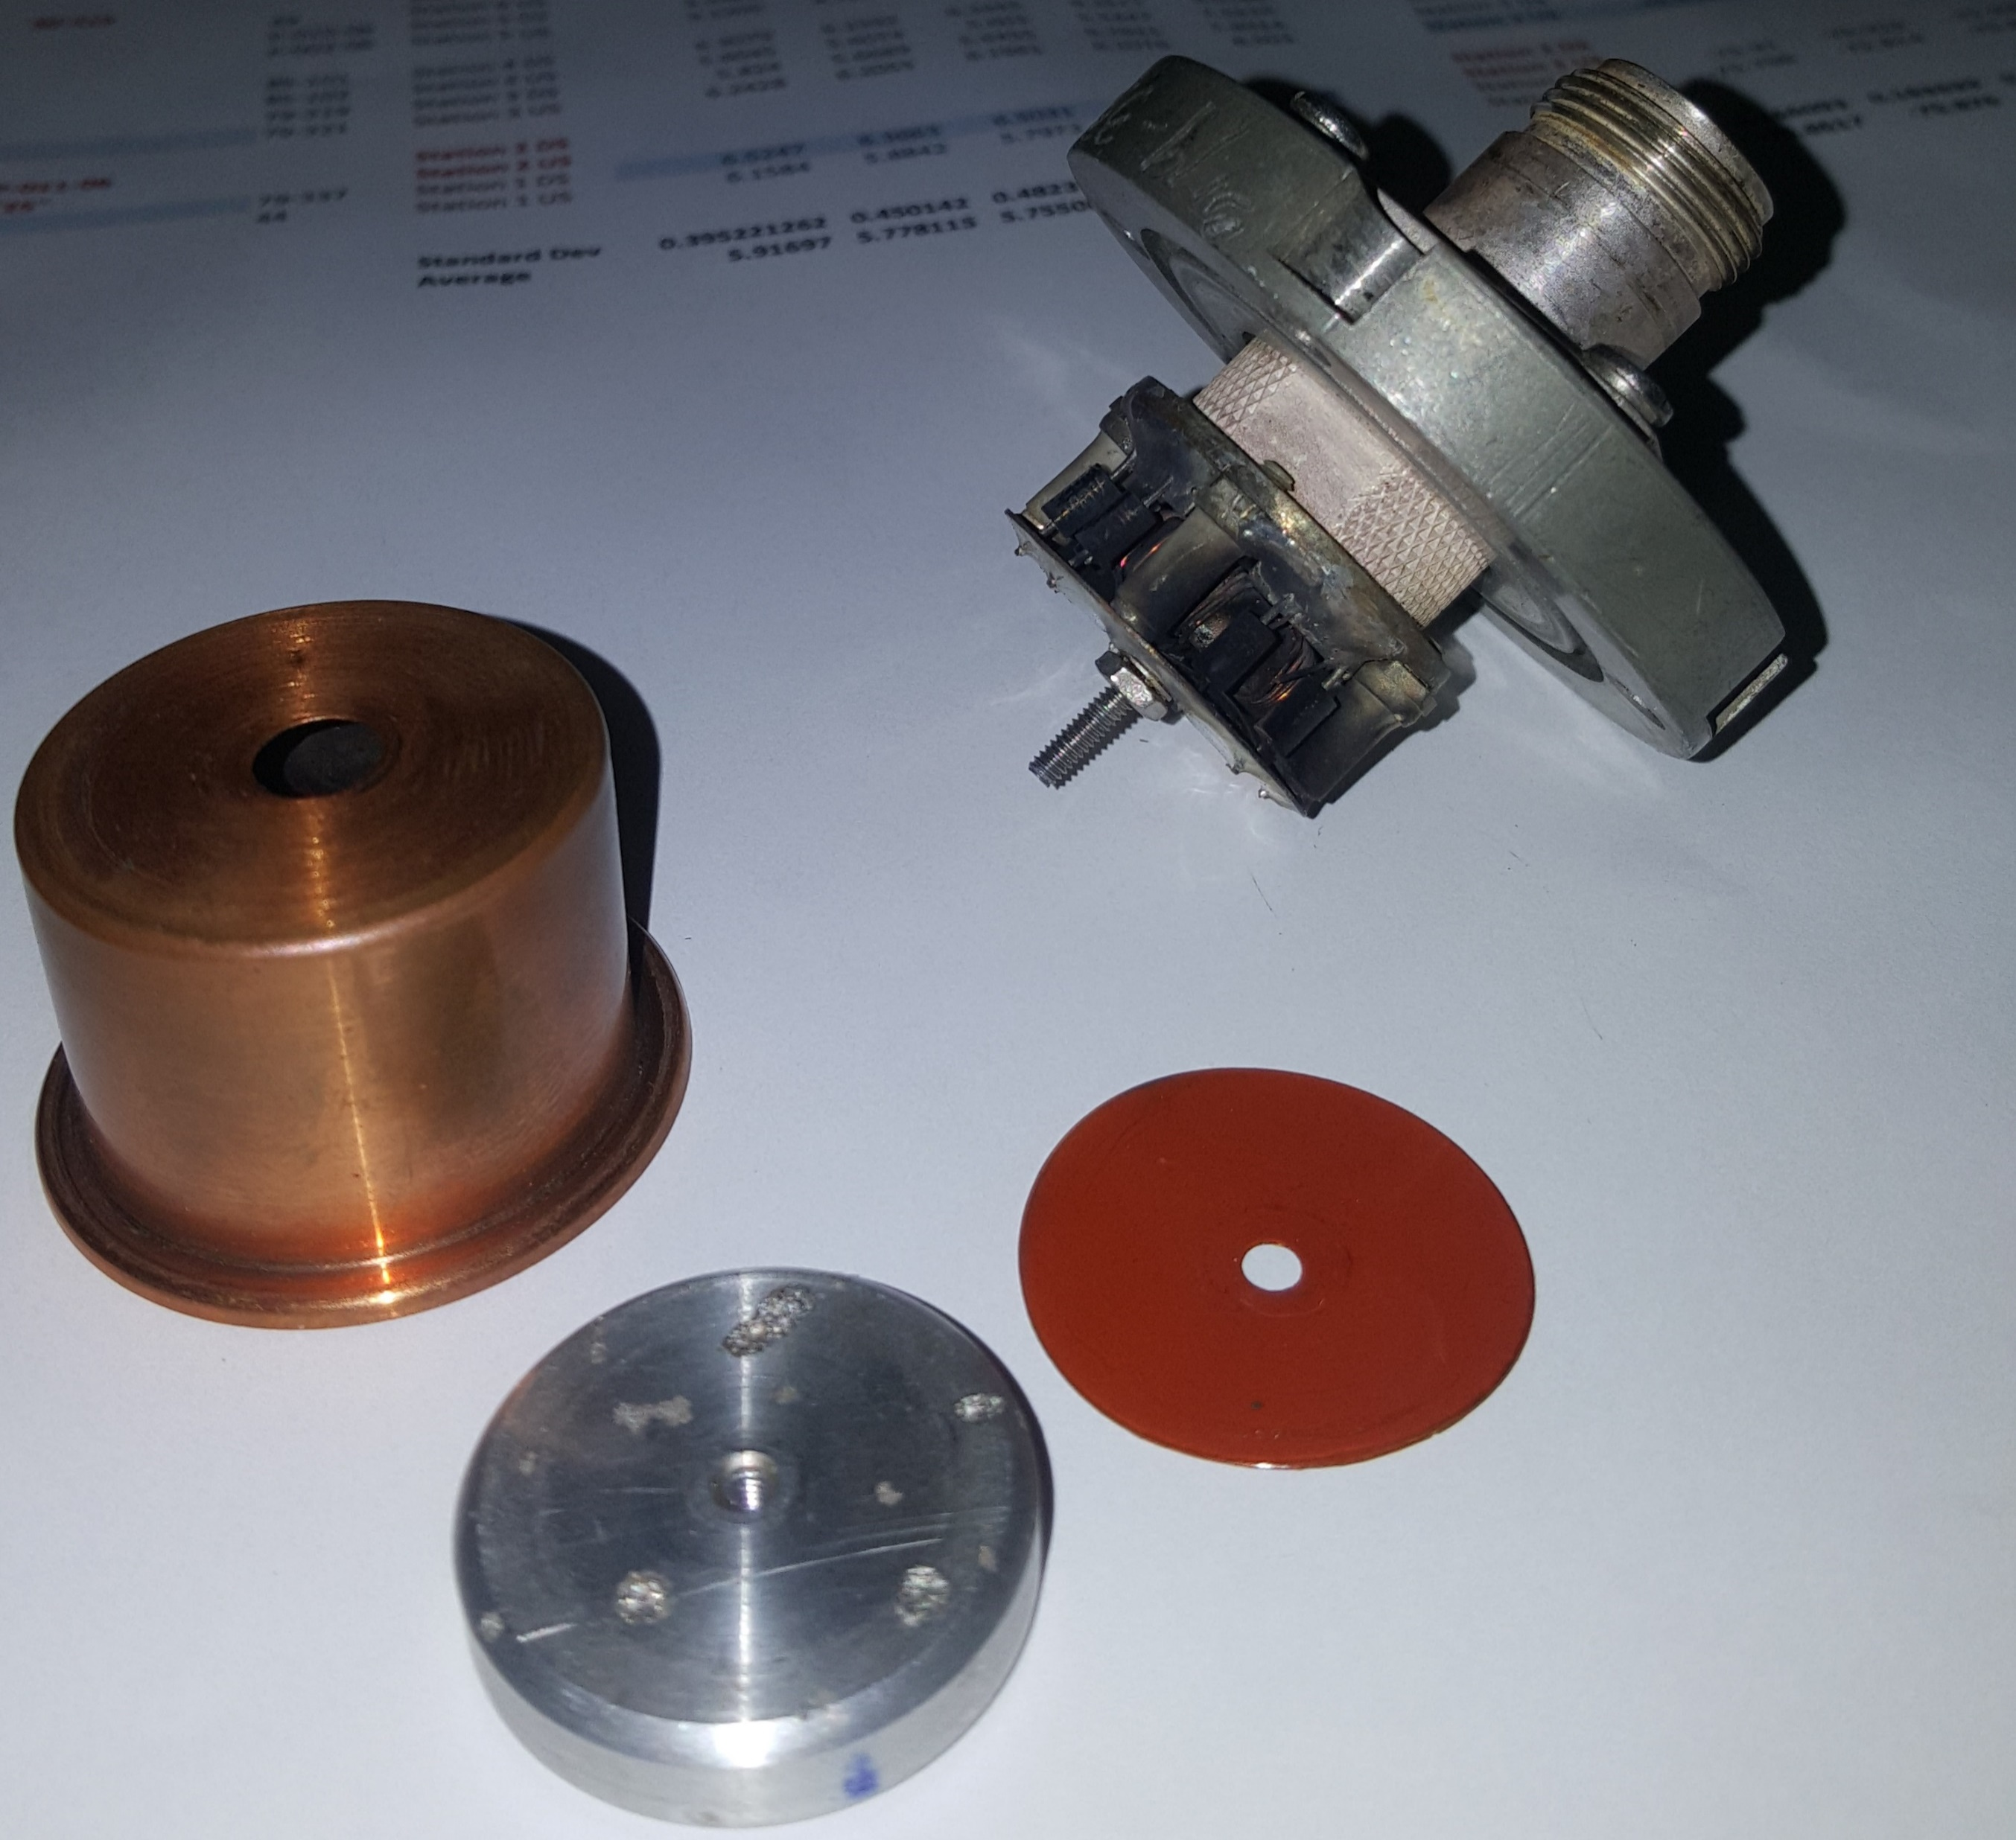
Blown Gap monitor
Phase Measurements For Booster RF
  Longitudinal alignment
  Fanout Errors
  Closed Loop Errors
  Station 9 DS gap monitor was blown

Slide 22
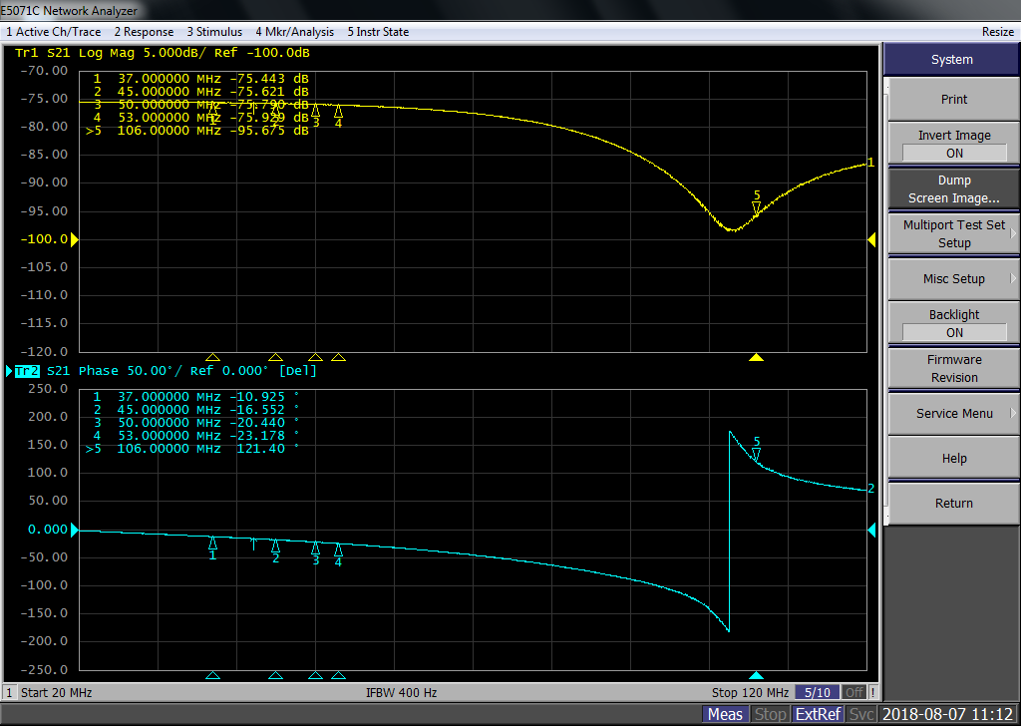
BRF09DS Gap monitor
Phase Measurements For Booster RF
  Longitudinal alignment
  Fanout Errors
  Closed Loop Errors

Slide 23
Gap Monitor Measurements
Before
Phase Measurements For Booster RF
  Longitudinal alignment
  Fanout Errors
  Closed Loop Errors

Slide 24
After Changes
Phase Measurements For Booster RF
  Longitudinal alignment
  Fanout Errors
  Closed Loop Errors
  Longitudinal alignment
  Fanout Errors
  Closed Loop Errors

Slide 25
Gap Monitor Changes
Phase Measurements For Booster RF
  Longitudinal alignment
  Fanout Errors
  Closed Loop Errors
  12 changes made
  Amplitude +/- .2db
  Phase +/- .5 degrees

Slide 26
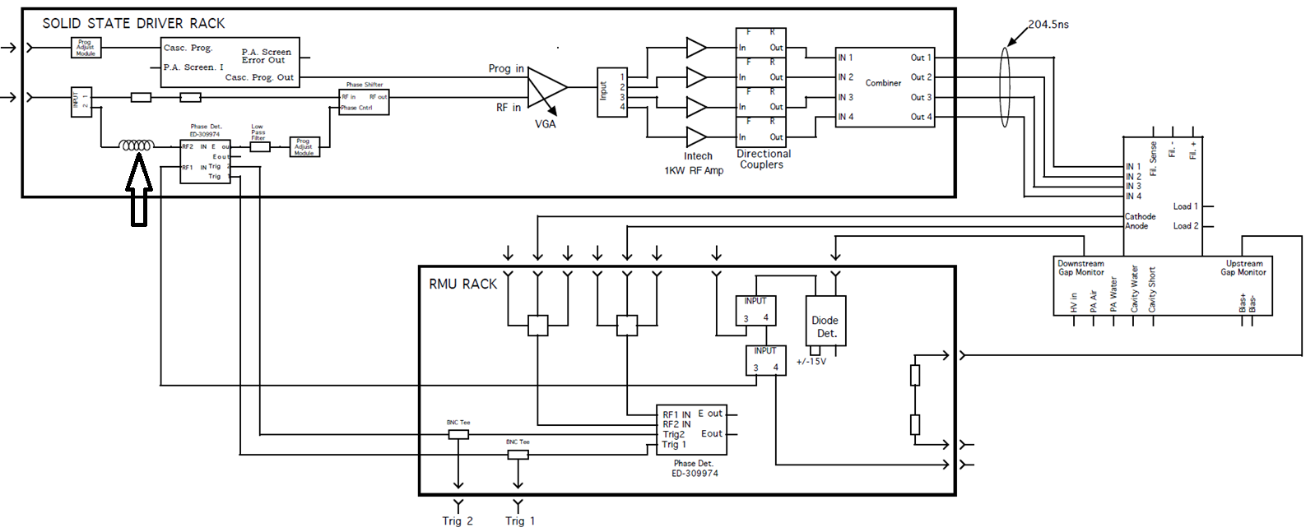
Delay Line
Phase Measurements For Booster RF
  Longitudinal alignment
  Fanout Errors
  Closed Loop Errors

Slide 27
Delay Line
Phase Measurements For Booster RF
  Longitudinal alignment
  Fanout Errors
  Closed Loop Errors

Slide 28
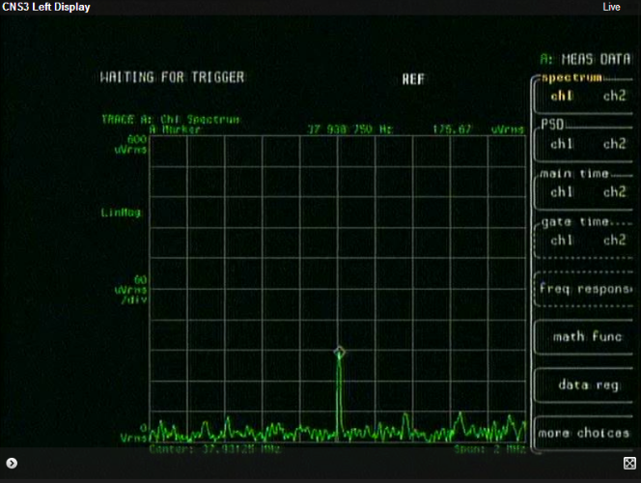
2nd Experiment Setup
Phase Measurements For Booster RF
  DC Ramp with fixed frequency
  Two stations on at a time
  PC1OF set to remove bunch structure
  Used VSA(Left) and Scope with FT( Right Blue)
  uVRMS Green- RWM(Time), Blue(FT)

Slide 29
Fanout changes
Phase Measurements For Booster RF

Slide 30
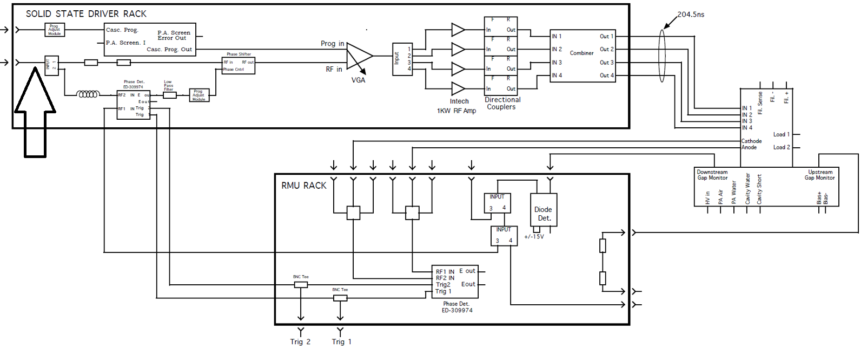
Experiment Setup
Phase Measurements For Booster RF
  Added lengths before loops
  Changes in group delay to account for delay errors not accounted for in superposition

Slide 31
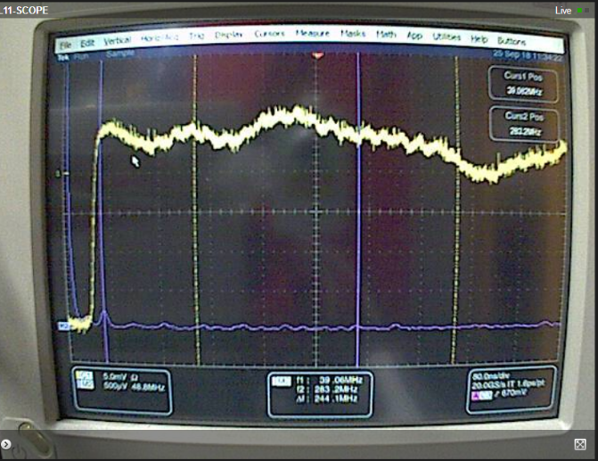
20 Stations on after corrections
Phase Measurements For Booster RF
  No Bunch Structure!
  Green- (Time),
  Blue-
  (Freq)

Slide 32
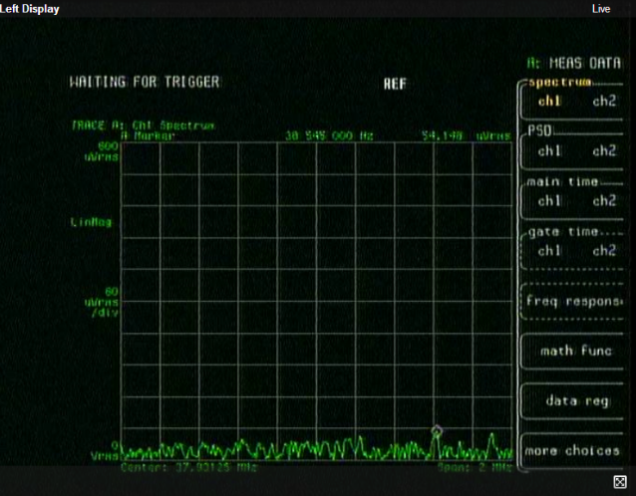
20 Stations on after corrections
Phase Measurements For Booster RF
  No Bunch Structure!

Slide 33
Conclusions
Phase Measurements For Booster RF
  Current Status
  All 10+ degree errors have been corrected
  Stations are within 5 degrees of design
  Looking ahead
  Global phase and amplitude loops are necessary
    Magnitude circuit is in the works
    We are looking into phase shifters
  Paraphase angle and injection remains unexplained
  Present curves are not adiabatic

