Slide 1
201 MHz Linac Marx Modulator
Proton Improvement Plan
Trevor Butler
PSP Meeting
06 Dec 2018

Slide 2
Agenda
Overview of LE Linac RF Systems
Description of Previous Modulator
Type of Modulators
Type of Modulator Switches
Specifications of New Modulator
Overview of Design Proposals
  Continental Electronics Proposal
  DTI Proposal
  SLAC National Accelerator Laboratory
  Fermilab National Accelerator Laboratory
EE Support Modulator Design Theory
Overview of Development Stages
Modulator Subsystems
  Marx Cell
  Charging Power Supply
  Gate Power Supply
  Lumina Charing Power Supply
  Controls Rack
  Modulator Cabinet
  Spark Resistor Box
Marx Cell Power Flow
Marx Modulator Layout
Marx Modulator Waveforms
Design Challenges
Project Timeline

Slide 3
Fermilab Linac Topology
35keV
750keV
750keV
116MeV
400MeV
H-
RFQ
buncher
DTL
SCCL - Transition
SCCL
magnetron ion
source
35 kV
extractor
Radio
Frequency
Quadrupole
201.24 MHz
1.2 m
1 Tetrode
175 kW
Buncher
dual-gap
cavity
201.24 MHz
0.2 m
1 SSRF Amp
6 kW
Drift Tube
Linac
201.25 MHz
75 m
5 tanks
5 Triodes
5 MW
200 EMQ
Side-Coupled Cavity
Linac
805 MHz
4 m
2 modules
2 klystrons
200 kW
4 EMQ
Side Coupled Cavity
Linac
805 MHz
60 m
7 modules
7 klystrons
12 MW
28 EMQ
Duty cycle:
0.5% RF
0.04% beam
3 different structures
(RFQ, DTL, SCCL)
2 frequencies
Total Linac: 145 m
5 Triodes
10 klystrons
Beam current:
25 mA (avg. in pulse)

Slide 4
LE Linac RF Overview
5 LE (201.25 MHz) Linac RF Stations
(0.75–116.5 MeV)
First 200 MeV Beam – Nov 30th 1970
LLRF System 2 mW
Solid State TOMCO RF Amplifier 6 kW
  Pre-Amplifier 4W
  IPA1 – Solid State Amplifier 400 W
  IPA2 – Photonis 7651 Tetrode 4 kW
Driver – Photonis 4616 Tetrode 175 kW
PA – Photonis 7835 Triode 4 MW
HV power
Low Level RF
Transmission line
Accelerating
Cavity
vacuum
system
water cooling

Slide 5
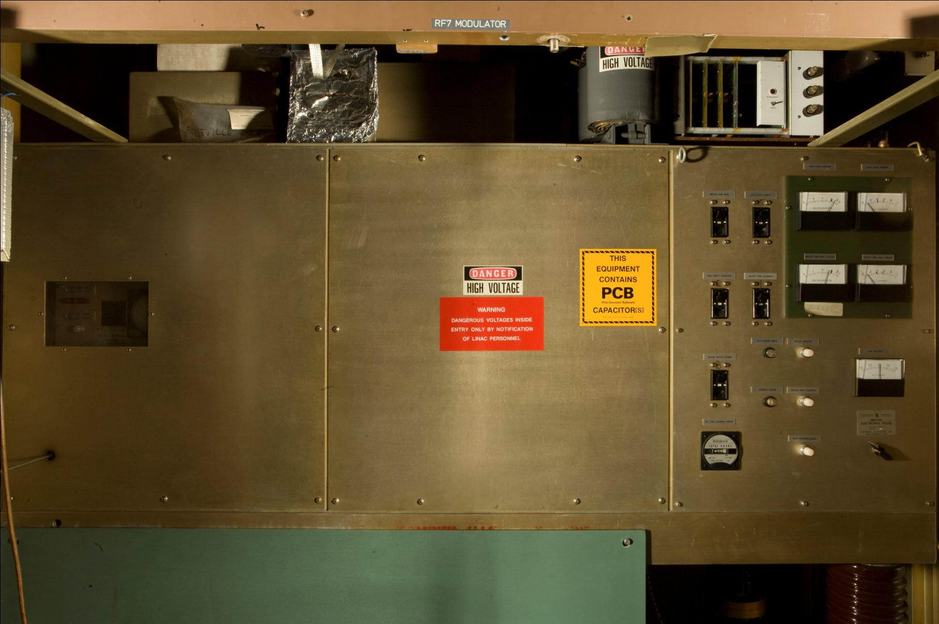
LE Linac Station Overview
Modulator provides pulsed power to the anode of the 7835 triode
The 7835 is operated with a grounded grid (cathode driven)
The PA tube is unstable with low or no RF drive
The anode/plate voltage is modulated instead of the RF driver amplitude to regulate the cavity accelerating field.
The modulator requires linear operation of the “switch” tubes to set the accelerating field anywhere from 0.5 to 4 MW.
The main series regulator tube, (F1123) was discontinued over 10 years ago.

Slide 6
Types of Modulators
What is a modulator?
  Merriam Webster: to vary the amplitude, frequency, or phase of for the transmission of information
  Electrical: Convert an available form of power to desired form of power (AC, DC, or pulsed)
  Fermilab: Convert available 480 VAC power to desired 40 kV Pulsed power
Typical modulators used in accelerators for powering RF devices (Klystrons, Triode, Tetrode, etc.)
  PFN (LE Linac Klystron)
  Series Switch / Bouncer (EE Support Design from ~20 years ago)
  Hard Tube (LE Linac Old Design)
  Marx (LE Linac New Design)

Slide 7
Types of Modulator Switching Devices
Switches used in typical high power modulators
  Spark gaps (Limited repetition rate and lifetime)
  Gas tubes (Have pulse rate limitations & average current limitations)
  Vacuum tubes (limited lifetime, availability, and high power loss)
  Solid-state switches have been available for some time but have their own limitations.
    Thyristors (SCRs) have a dI/dT limit, which make them difficult to use in high power modulator applications.
    Gate Turn-off Thyristors (GTOs) have high dI/dT limits and can turn off, but have limits in turn-on times.
    Insulated Gate Bipolar Transistor (IGBTs), until recently, have been limited by their voltage ratings.
    IGBTs have a high dI/dT rating and are capable of turning off thousands of amps
New higher voltage (>1 kV), higher current (>100 Amp), IGBTs have increased the possibilities of new modulator designs.

Slide 8
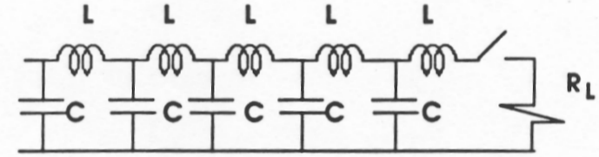
PFN (HE Linac Klystron)
PFN is an electric circuit that accumulates electrical energy over a comparatively long time, then releases the stored energy in the form of a relatively square pulse of comparatively brief duration for various pulsed power applications.
Essential, they are a lumped element transmission line
Energy storage components such as capacitors, inductors or transmission lines are charged by means of a high voltage power source, then rapidly discharged into a load via a high voltage switch.
Limited to fixed impedance load
PFN have fixed pulse width, rise & fall time
The longer the pulse desired, the more lumped elements are needed, increasing the size and cost of using the PFN modulator
No ability to wave shape after lumped network original tuning

Slide 9
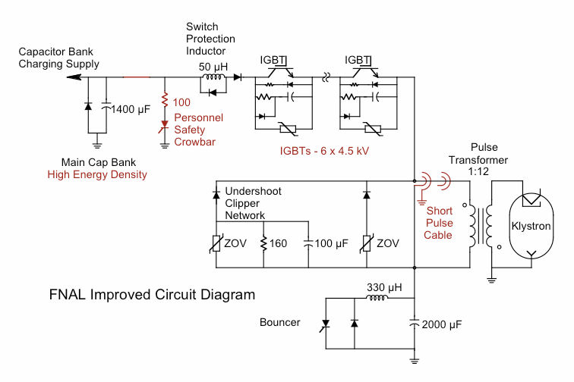
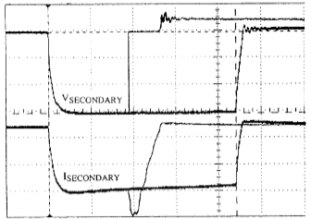
Series Switch / Bouncer
Developed by EE Support (H. Pfeffer, L. Bartelson, K. Bourkland et. al)
A series switch design uses a single large capacitor(s), incorporating many times the energy derived in a pulse, to keep the droop low since the switch cannot regulate the output voltage as was possible with the hard tube modulator
Adding a “Bouncer” section reduces the stored energy requirement by compensating for the voltage drop in the main capacitor
The Bouncer circuit is a resonant inductor and capacitor, which is fired in series with the load to cancel the voltage droop by timing the linear section of the oscillating bouncer voltage to coincided with the timing of the main, reducing voltage droop from >10% to <1%
Unfortunately, no real time amplitude control

Slide 10
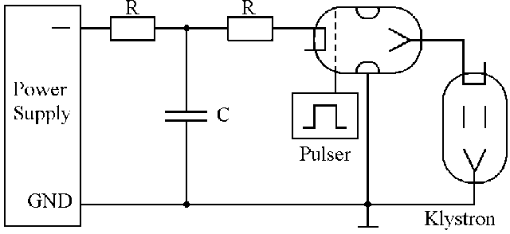
Hard Tube (Old Modulator Design)
We presently use, along with other laboratories, to power the 7835 triode
Hard Tube modulator use a high voltage capacitor bank which switches thru a grid-controlled electron tube to regulate the anode on the triode (or any tube amplifiers, such as a klystron).
Can be run in feedback or feed forward, since they act essentially as a high voltage operation amplifier
Unfortunately they the modulator controls needs to be operated on a high voltage “floating deck” making the controls complex and hard to maintain.
Electron tubes have current limitations and have high losses making them very inefficient.
Very few manufacturer still make these tubes and are typically only used in legacy designs and typically never used in new designs unless it is the only option for the voltage and current response
Could be converted for use on a Klystron with the appropriate step up transformer

Slide 11
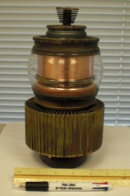
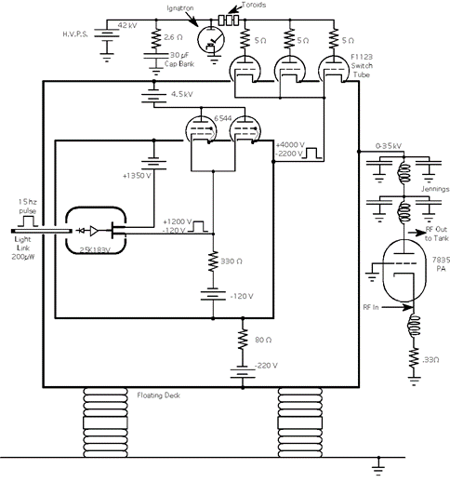
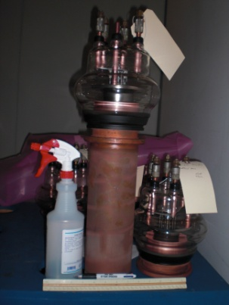
LRF7 Hard Tube Modulator
CPI-Eimac
ML-6544
Power Triode
Maximum (20 kV, 75 Amp, 1 kW )
2.8 kV Typical
Uses 2 per modulator and 1 per driver screen modulator (5+1 Stations)
18 tubes total
High Production Tube for CPI
Used in multiple radar and science applications
Not expected to be discontinued anytime soon
CPI F1123
“Switch” Tubes
operated as
linear amplifiers
50 kV Standoff
~100 Amps each
~350 Amps Total
Manufactured by Westinghouse, ITT, Richardson, Varian, CPI, now nobody
Use 3 per station (5+1) = 18 total
Series-pass regulator between the capacitor bank and Photonis 7835 Power Triode anode
No replacement part available
Rebuilt by Kennetron & Econco
Econco* – Can’t Rebuild Grids
*Problem – Bad grids are a typical type of failure in these tubes. Therefore, they need two tubes (one as a donor) to rebuild a tube with a bad grid

Slide 12
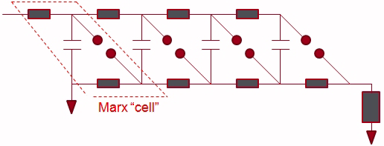
Marx (New Design)
The pulsed modulator has evolved over the past 90 years, starting with the spark gap modulators patented by Erwin Marx in 1923.
A “Marx” modulator is a topology in which capacitors are charged in parallel during the recharge period and discharged in series during the output pulse.
The output voltage becomes the charging voltage multiplied by the number of capacitors.
Without compensation, the voltage on the load will droop due to capacitor discharge.
High voltage Marx generators have historically used gas switching elements for the main high voltage operation, but with the advent of modern high voltage / hight current solid-state switches, this topology has become more desirable in replacing standard modulator designs.
Could also be converted for use on a Klystron with the appropriate step up transformer.

Slide 13
Advantages of Upgrading to a Solid State Modulator
Eliminate problem of discontinued switch tubes.
Removal of point to point wiring – Long downtimes to troubleshoot.
Lower power consumption of new design.
Elimination of HV Rectifier, HV Transformer, Capacitor bank.
Elimination of HV crowbar circuit (contains mercury).
Ideally better uptime due to solid state design.
Lower cost of employee labor to fix and maintain modulators.
Increase operational lifetime of Linac 7835 RF Systems.
Adaptable to Klystron with pulse transformer.

Slide 14
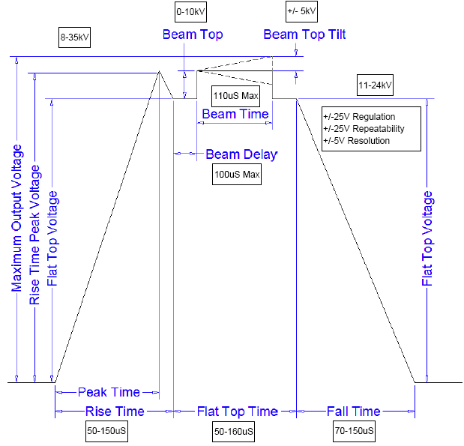
Design Specifications
Modulator specifications developed (collaboration between AD/EE support and AD/PS/Linac personnel)
Hard specs: 375 amp current, 15 kV/usec slew rate and 1.5 kV steps
Initially thought feedback would not be required to keep gradient waveform flat
Studied effect and found feedback important in compensation for pulse to pulse variation in the 7835 triode tube and accelerating cavity
Note - Challenging specifications listed in bold

Slide 15
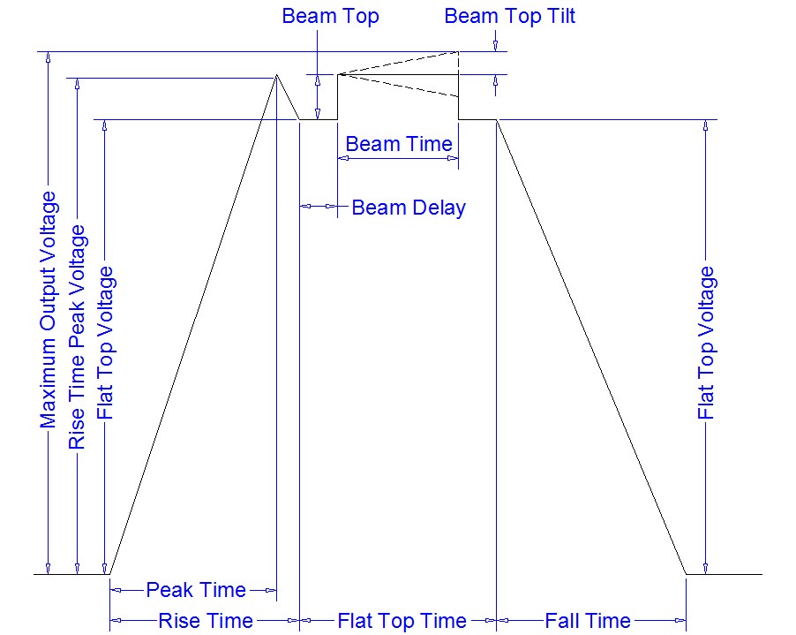
Challenging Design Specifications
Looked at the specifications and determined the most difficult parameters
  Beam Top Tilt Adjustment:
    +/- 5 kV
  Beam Voltage Step Slew Rate:
    15 kV/usec
  Flattop/Beam Regulation:
    +/-25 V
  Repeatability:
    +/- 10 V
  Maximum spark Energy:
    < 5 Joules

Slide 16
Four Modulator Replacement Options Considered
Continental Electronics Corp (original manufacture of modulator)
  Modify existing transformer coupled, solid state switch modulator
Diversified Technologies Inc.
  No bid on regulating modulator
  Proposed changing the tube bias voltage in real time to perform amplitude regulation
  Use one solid state switch to power the anode without any regulation and variable resistor circuit to change gain of 7835 to achieve waveform regulation
SLAC Power Conversion Group
  Modify existing Marx P2 Modulator developed for ILC
Fermilab EE Support Group
  New Marx Modulator Development

Slide 17
Determination of Modulator Design Options
Continental Electronics Corp (transformer coupled, solid state switched)
  Performed one engineering study to determine if design could meet specification and it passed
  Decided to hold on further effort due to higher cost than other proposed designs
Diversified Technologies (change to cathode biasing)
  Completed test on development station to show that this unique solution will probably not work with our 7835 triode load, so passed on further development of cathode biasing
SLAC Power Conversion Group (modify P2 Marx developed for ILC)
  Performed three engineering studies test the feasibly, create two cell model, and then simulate control system.
  Modulator passed all specifications except feedback – more study needed
Fermilab EE Support Group (new Marx modulator design)
  Created new design, then performed engineering studies to test the feasibly, create a 3 cell model, then a 9 cell, then a 28 cell, & finally a 54 cell modulator

Slide 18

Continental Electronics Proposal
Original Manufacturer of the Fermilab Linac Modulator
Solid State Modulator Design & Architecture
Similar to Marx modulator except cells receive power via one large isolation transformer
Presently manufacturer a similar modulator, but with a larger average power then we require.
CEC decided to modify the standard modulator design to included IGBT rated for the full peak load current (400 Amps)
Lower average power reduces the size of the transformer, decreasing the parasitic in the transformer, increasing the speed of the modulator
Engineering Study Completed
  IGBT Thermal Cycling Reliability
  Capacitor Reliability
  Corona
  Single Point Failure Design
  Fault Energy
  Pulse Response & Regulation
  15kV/us Slew Rate (Remove filtering on each stage, which would allow for 625 MHz ripple @ 2 MHz giving 18 kV/us)
  +/- 25 Volts is the ripple specification (reduced to +/- 50 Volts)
Designed to work in with real time feedback, but some hesitation by EE Support staff about modulator patristic effects, such as inter-winding capacitance, stored energy, and slew rate.

Slide 19

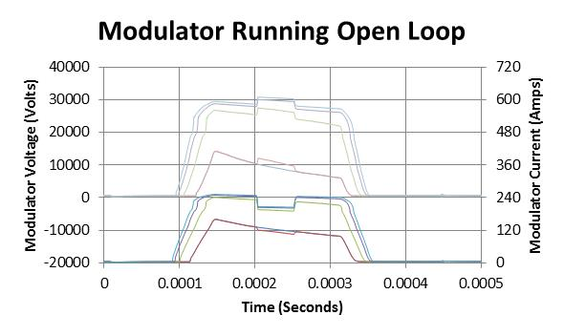
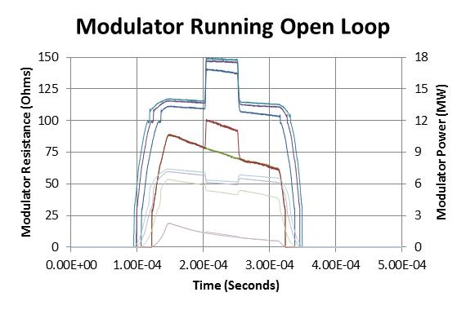
Diversified Tech Inc. Proposal
Running the 7835 in the mode is never been attempted before
We are unsure of the long term stability of this mode of operation
Unsure of the effects on tube lifetime
The early papers about the modulator describe this concern and state that it was the reason that they had to build the modulator as it currently is.
DTI gave a study plan
  Run the modulator in open regulation
  Add with a “notch” in the middle of the pulse to replicate driver modulation
Problem- the tube impedance changes based on the applied voltage
As the tube impedance increased (when changing the bias voltage between cathode and grid) the power delivered by a constant voltage modulator can drop power by 24 %.
The increase in gain when changing the bias increases the power by 22%
This gives a net loss of power 2%.
The design would also suffer from large capacitor droop, unless the capacitor bank size is increased
Therefore, using a single high voltage switch while performing cathode modulation will not be an effect strategy to mitigate the problems with our present modulator and for these reasons, we eliminated the proposed DTI topology from consideration.
Perhaps cathode modulation could be used as a secondary path to adjust for tube gain changes on a pulse to pulse basis?

Slide 20

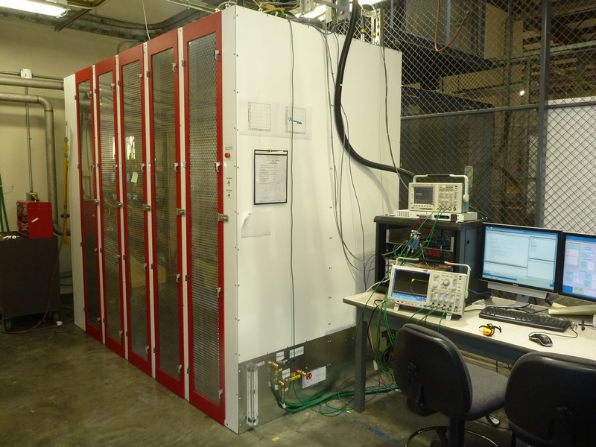
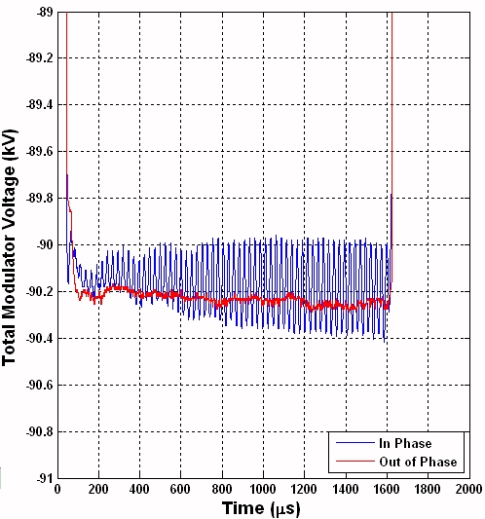
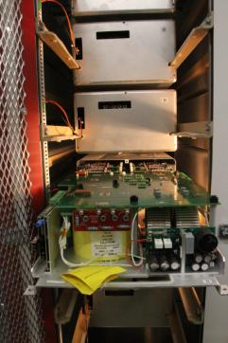
SLAC P2 Marx Proposal
Developed for the ILC Program
  -120 kV / 140 amp with 1.7 ms pulse length
  32 Marx cells each with -4 kV supply per cell
Hardware & Control Developed
Desire to utilize technology for additional applications
Number of cells, cell capacitance, and component selection can be optimized for different applications
Challenge modifying SLAC P2 Marx Modulator for use at Fermilab
  SLAC Marx modulator created for the ILC
  Designed to create flat pulses for the klystron
  Challenges to convert from flat pulse to arbitrary waveform modulator

Slide 21
EE Support Marx Modulator Proposal
Design based on R.L. Cassel patent for Marx modulator configuration using IGBT, capacitors & diodes
Design modified to meet key Linac Modulator Specifications
  Beam Top Tilt Adjustment: +/- 5 kV
  Beam Voltage Step Slew Rate: 15 kV/usec
  Flattop/Beam Regulation: +/-25 V
  Repeatability: +/- 10 V
  Maximum spark Energy: < 5 Joules
Design requires a fast slew rate to compensate for beam loading
Design also has a stringent ripple requirement for gradient stability
Marx Cells divided into 2 main groups
Switching cells (41 + 1 Special)
  which are used to create the basic waveform
  produce fast beam pulse rise/fall time
  Not Filtered
Regulating cells (12 cells)
  compensate for capacitor droop
  provide the necessary beam top tilt.
  Filtered by low pass filter
54 cells total, 1kV max per cell
  Used 1.7 kV IGBT, 600 Amp
  Infineon # FF300R17KE4

Slide 22
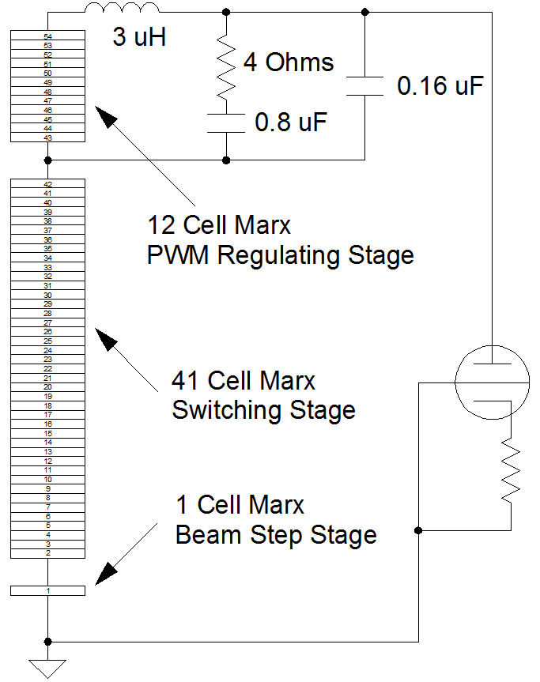
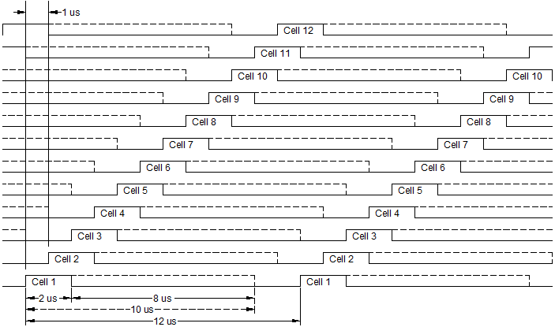
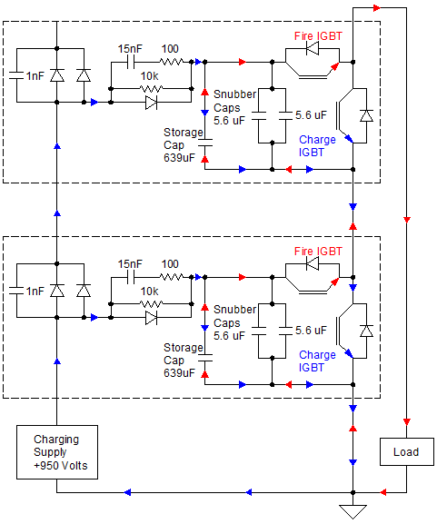
EE Support Marx Modulator Block Diagram
Q) Why not filter all of the cells?
A) Too much stored energy would be delivered to 7835 during spark

Slide 23
Modulator Design Top Three Decision
Continental Electronics Corporation Solid State Modulator
Initial studies indicate that the design may work
SLAC F1 Marx Modulator
Fermilab EE Support Marx Modulator
Designed using the Linac specifications, leading to a different chosen cell voltage and topology.
More studies would need to be performed to test hardware and controls ideas before considering as a viable option.
Advantage - the ability too do direct feedback.
Has been and still is being studied as a possible replacement.
Both computer modeling and hardware development has been done modifying the ILC base P2 Marx Modulator to work with the voltage slew rate and peak current required in the Fermilab Linac.
This design is cost competitive since much of the development work has already been done for ILC.
Advantage – most of the cell and controls development completed
Disadvantage – added complexity to do feedback
Using a lower cell voltage than the SLAC design, create the ability to limit the step size turning ramping
Using three types of Marx sections enables control of the waveform more suited to the critical parameters of the desired voltage waveform.
Design is cost competitive to the SLAC design and meets all parameters.
Advantage – The ability to add feed-forward/feedback signals and local knowledge of modulator design details will add in testing and integrating into existing control infrastructure.
Disadvantage - Has a higher cost then other proposals.
Disadvantage – would take considerable design effort

Slide 24
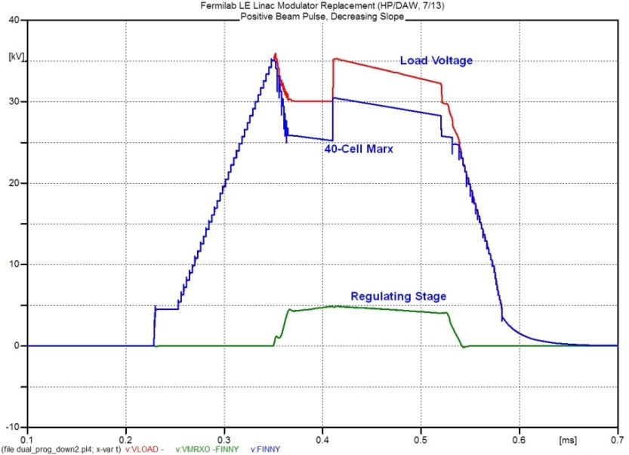
EE Support Original Marx Design Theory
40-Cell Marx Stages (950 Volts each)
Only used on Peak overshoot and rising/falling edges,
There is no compensation for capacitor droop during these times.
To achieve the large beam step, one or more are used.
12-Cell Marx Stages (950 Volts each & Filtered together)
Used for precise control of flat top and beam tilt
Compensates for known capacitor droop & the rising/falling tilt on beam with the ~ 11.4 kV of voltage for these Marx Stages providing the required overhead
During flattop, these cell are switched at a ~1 MHz
Assuming the voltage of the one extra adjustable 0-950 Volt Marx cell is set properly, this regulating stage does not have any jumps during the beam time pulse start
Required slope compensation calculated using desired waveform and cell capacitance.
Program uses a desired cavity gradient waveform as a reference.
1-Cell Marx Stage (Adjustable 0-950 Volts)
Since it is desired to set the beam step to accuracy greater than the 950 Volt charge of each cell, an extra adjustable 0-950 Volt Marx cell will be required to set this voltage

Slide 25
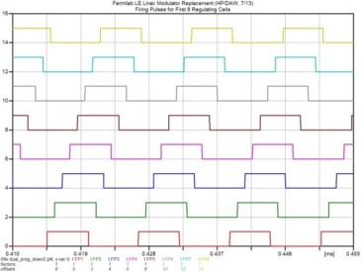
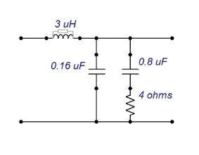
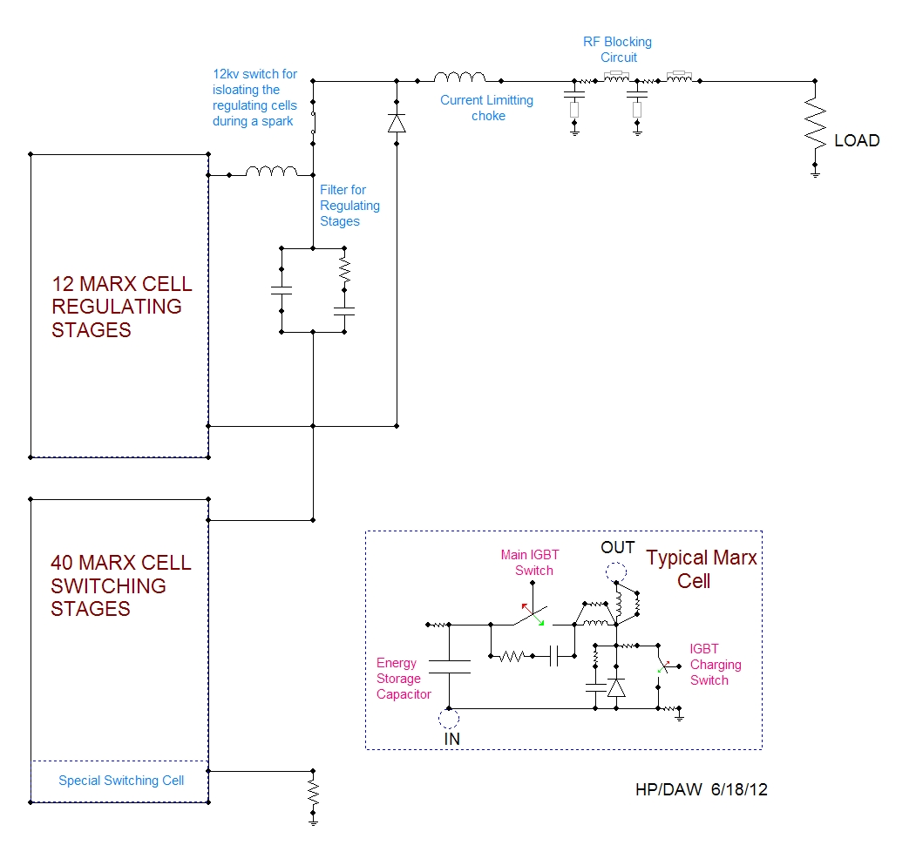
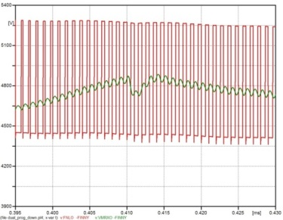
EE Support Original Marx Design Theory

Slide 26

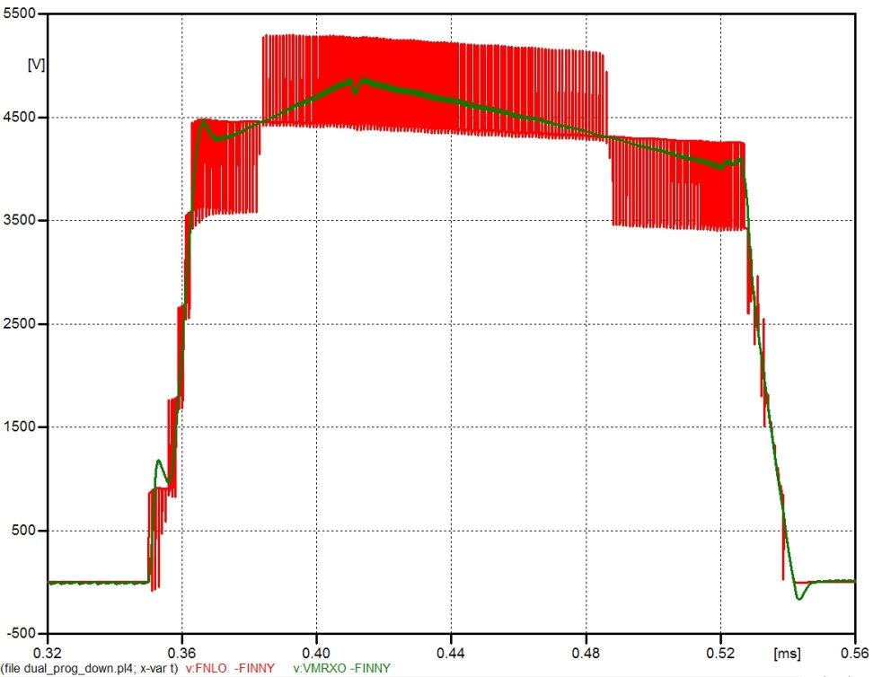
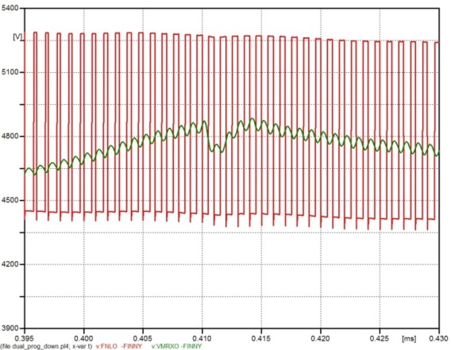
EE Support Marx Regulator Stage
900 Volts Marx Stages – 12 Cells total
All cells operated using the same pulse-width modulated waveform
Individual Cells are fired at a 80 kHz Rate
Cell are interleaved / staggered in phase by 360° / 12 cells = 30° per cell
After interleaving, the cell are collectively running at 12*80 kHz = 960 kHz ~ 1 MHz Rate
To minimize IGBT stress, each cell is held on for a minimum of 2 usec and at most for 10 usec’s to set the voltage output
Regulating cells are only activated during flattop and beam pulse to reduce switching loses.
Minimum “on” voltage = voltage of two cells
Maximum “on” voltage = voltage of ten cells
Cell maximum voltage output range is 8 x 900 ~ 7.2 kV
Typically run near ½ maximum to increase the tilt adjustment range
Filtered
Unfiltered

Slide 27
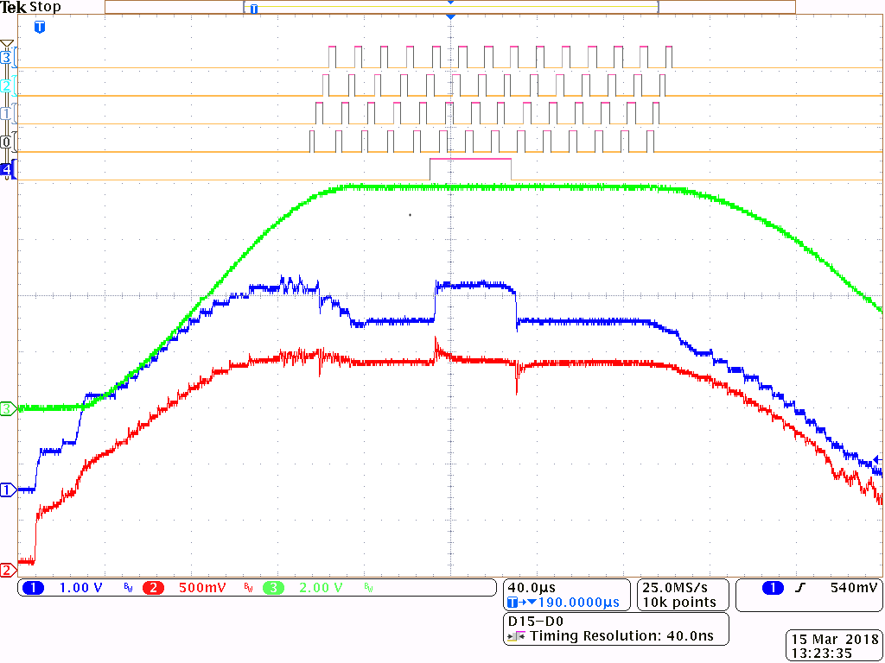
Typical RF System Waveforms
Analog Channel 1
Modulator Voltage
Analog Channel 2
Modulator Current
Analog Channel 3
Cavity Gradient
Digital Channel 0-3
First 4 PWM
Digital Channel 4
Special Cell Firing

Slide 28
EE Support System Summary
Switching Cells – 41 @ 950 Volts each
On the peak overshoot and rising/falling edges, only the 44 cell Marx is used
No compensation for capacitor droop
Beam Step - one or more of these 40 cells is used.
Use feed-forward learning in the final system
Regulating Cells – 12 @ 950 Volts each & Filtered
Precise control of flat top and beam tilt
Capacitor droop compensation using desired waveform and cell capacitance
Cells are switched at a 1 MHz to create the regulating stage
Feedback driven – using gradient error between the ideal and actual waveform
Special Switching Cell - Adjustable 0-950 Volts
Set level of beam step with < 950 Volts accuracy
Needed to add large bleeding resistor in order to quickly lower the voltage on this cell.
Slow Power Up
Predict cavity response
R & L Parameter
Feedforward Learning
Adjust for repeatable effect,
Gradient wave-shaping
Feedback
Adjust for cavity frequency shifts
Compensate for tube gain changes
Limited bandwidth

Slide 29
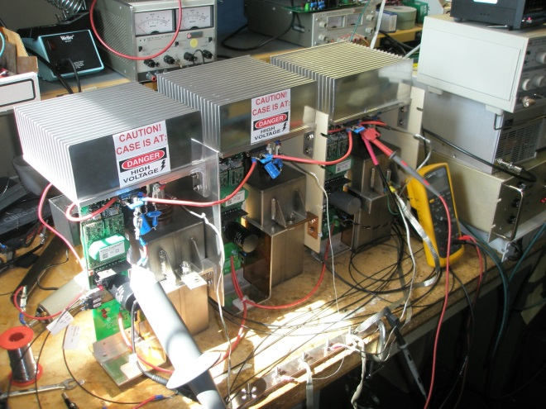
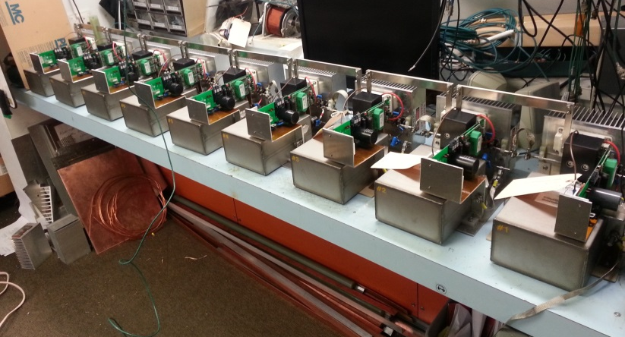
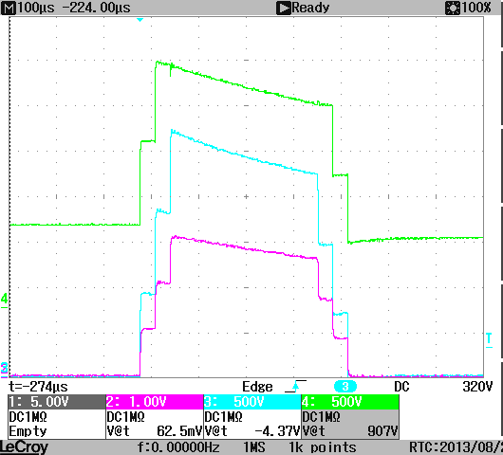
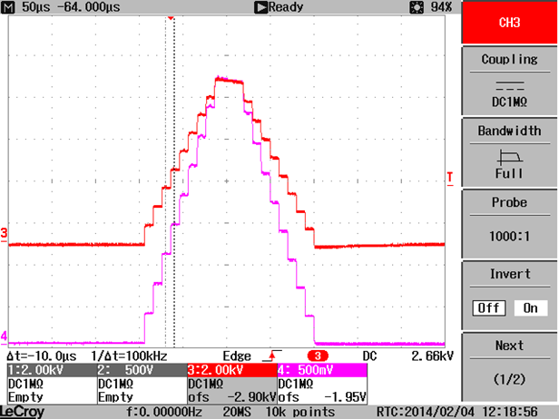
EE Support Marx Modulator Early Prototypes
3 Cell Prototype Design
9 Cell Prototype Design

Slide 30
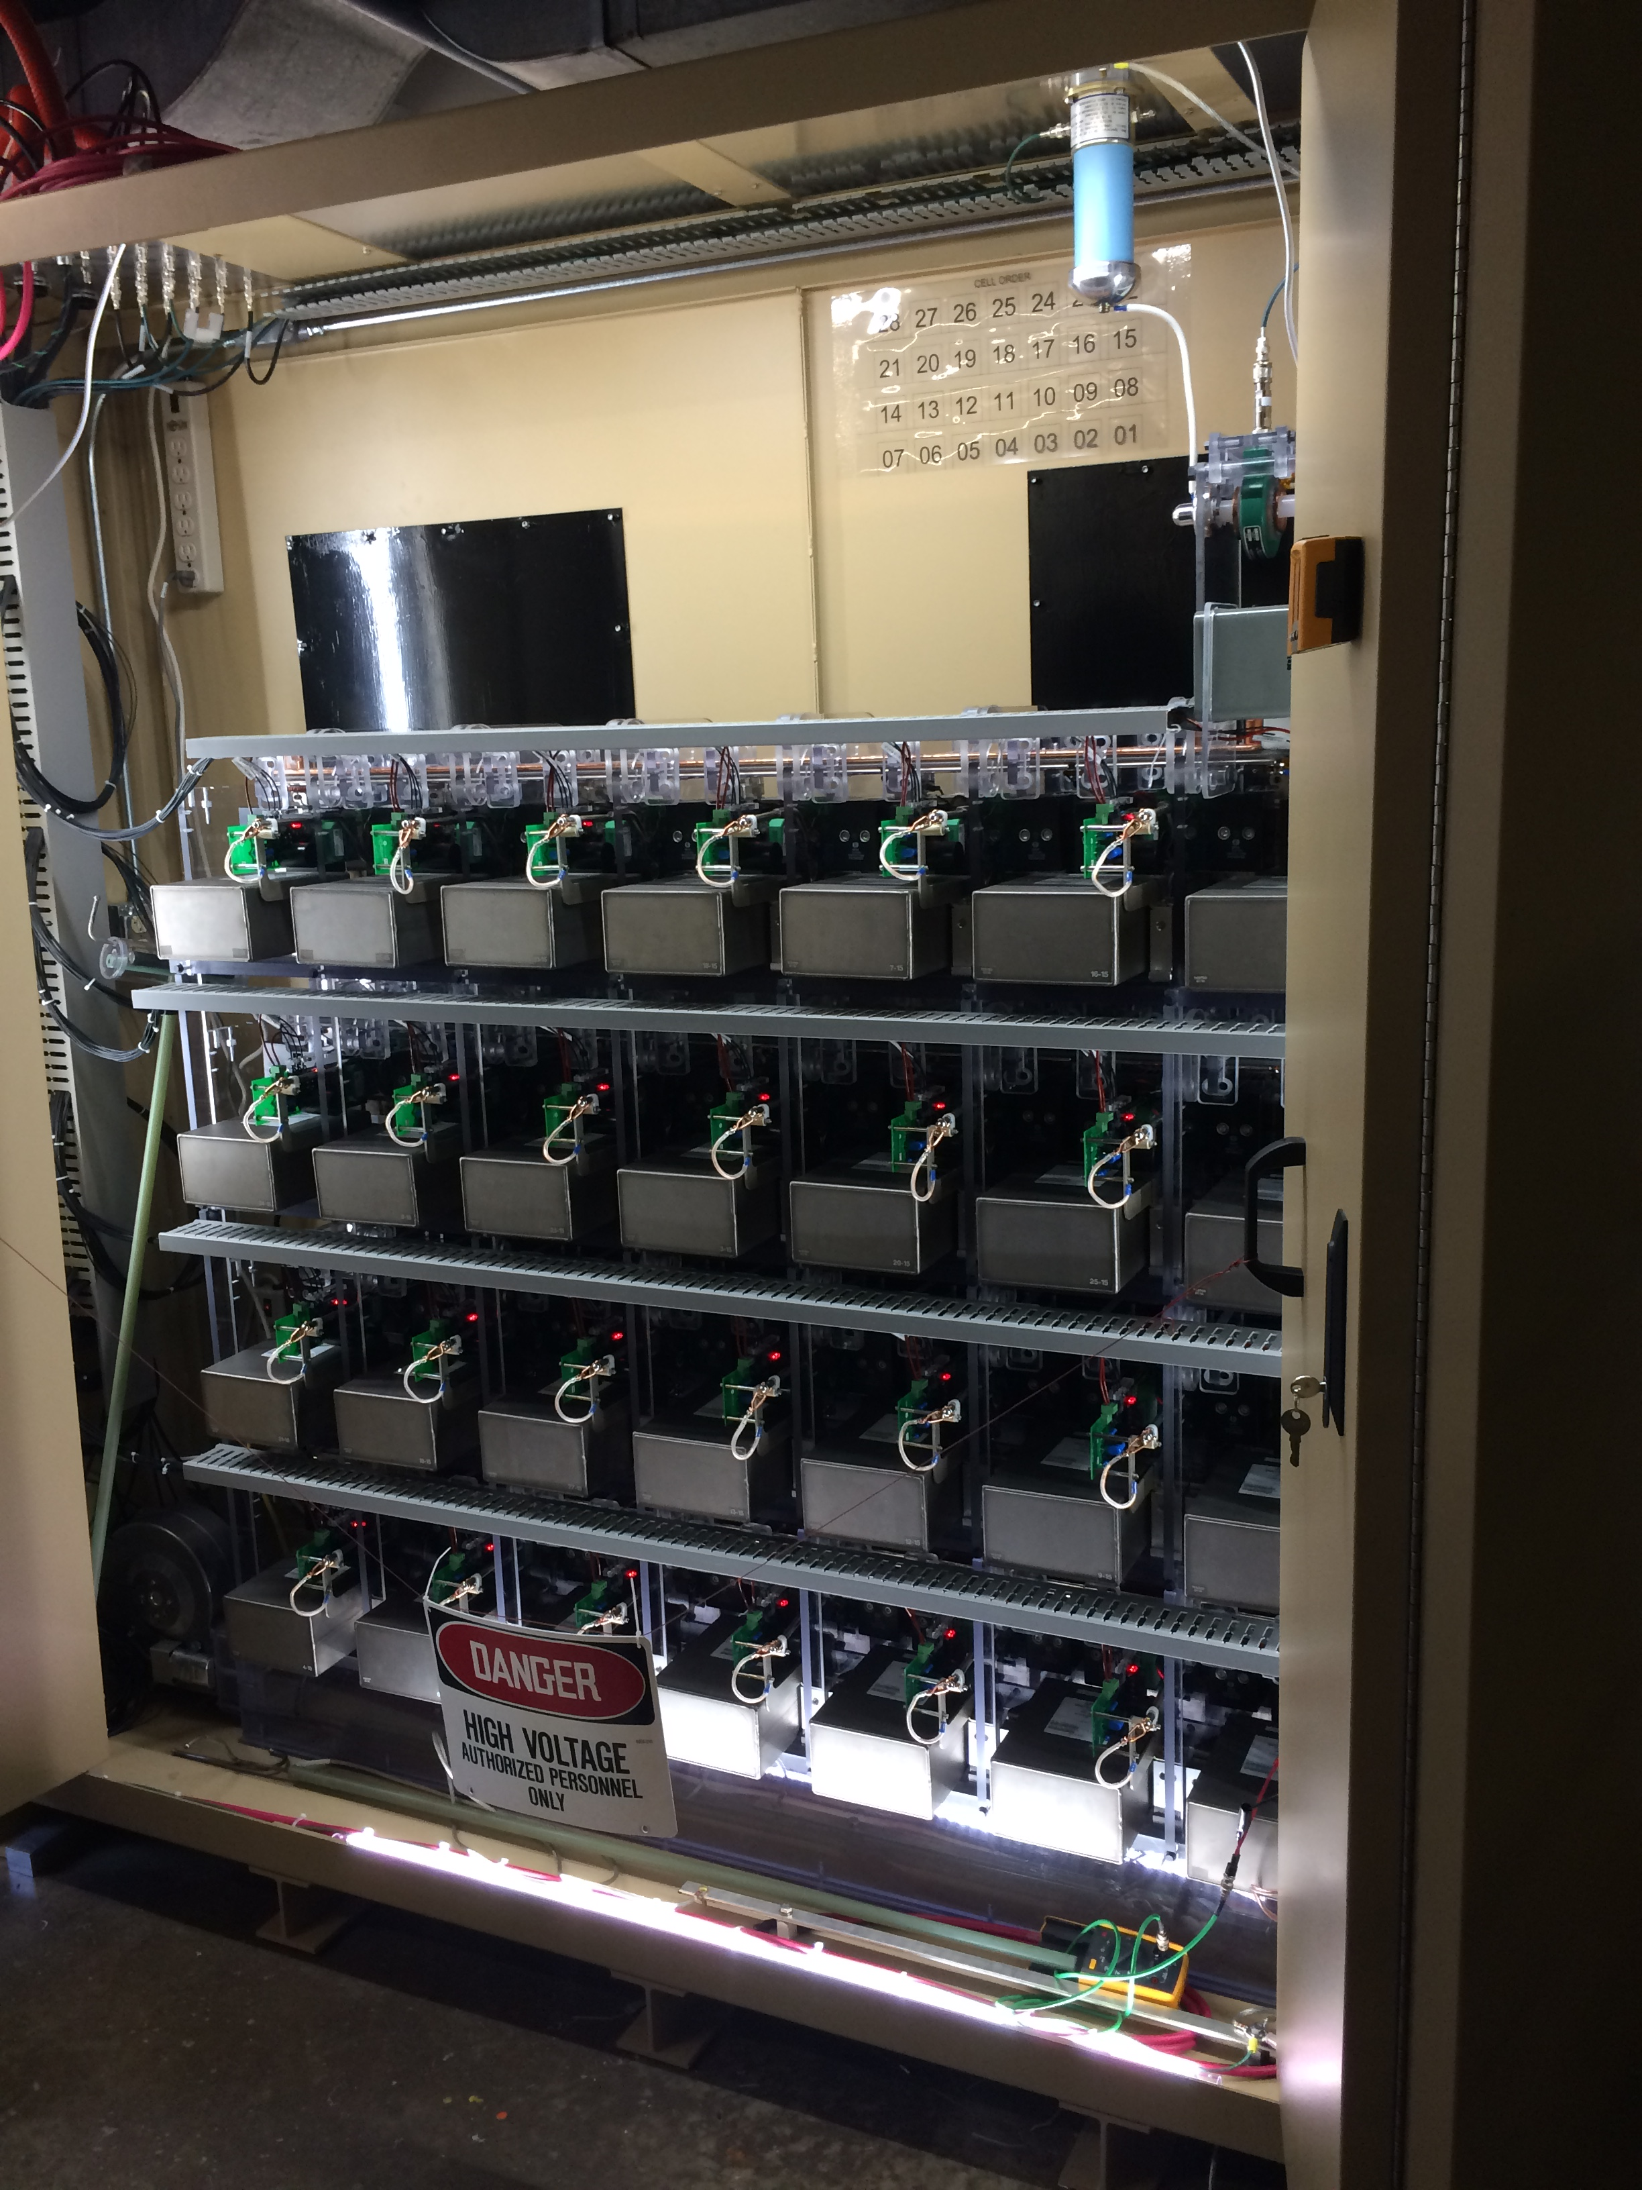
EE Support Marx Modulator 28 Cell Prototype
After 3 cell and 9 cell testing, the first 28 cell version was built
Tested in EE Support area for about a year
  Tested switching speed
  Voltage standoff / corona
  Controls
  Power Supplies
  Et cetera
Started testing on LRF1
After many months of design changes and code changes, the Marx Modulator was left operational since it has enough power to meet LRF1 7835 demands.

Slide 31
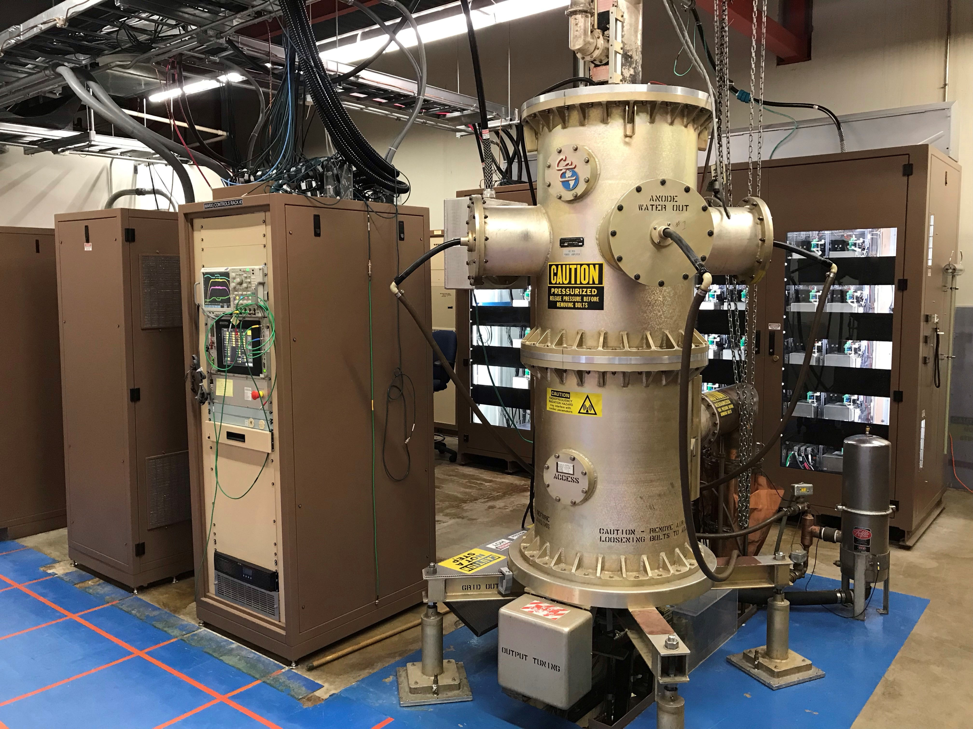
Marx Modulator Complete System
CPS Rack
Controls Rack
Marx Modulator
7835 Tube

Slide 32
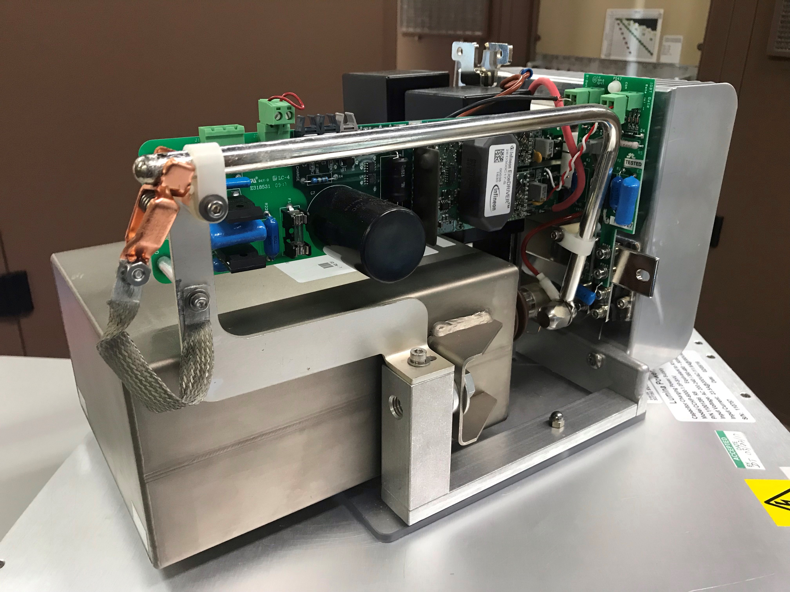
Marx Cell with Gate Driver Card
Used to turn on / turn off both fire and charge IGBT’s
Each cell receives a charge and fire fiber optic input and sends back fiber optic status output to/from the Marx controls rack
When modulator is firing, the gate card is floating and must hold enough energy to power controls input and output
Cards are charged back up between pulses with the charging IGBT’s
Each Marx cell has 30 uF, 600 Cap used to store energy
This stored energy is converted to +15V and +5V via DC-to-DC converter on each cell (Powerex M57184N)
The DC-to-DC converter only operates from 140 Volts – 360 Volts on the input
Due to voltage drops, which come from cell to cell diodes and each cells charging IGBT’s, the voltage on each successive cell decreases

Slide 33
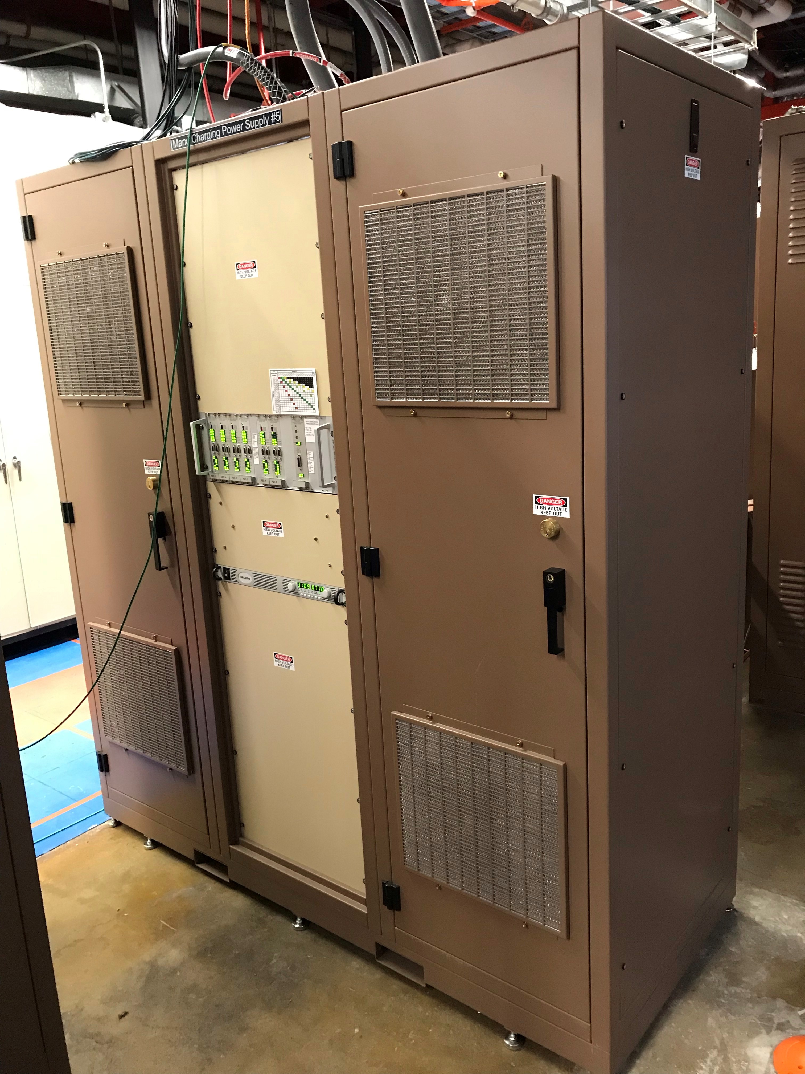
Marx Modulator Charging Power Supply (CPS)
Uses 20 individual capacitor charging power supplies to provide enough energy to recharge the 54 Marx cells.
Special Cell needs separate voltage in order to create precise beam step
  1 CPS to power special cell
  19 CPS’s tied in parallel to feed remaining 53 cells
Power Supplies split in two types
  10 Delta
  10 Wye
Summing Plate
  19 of the supplies
Power Supply Controls
Gate Power Supply
Gate PS Current Limiting Resistors
Breaker Panels
Designed to provide 120 kJ of power
Typically only 25-35 kJ is required

Slide 34
CPS Electrical
20 Lumina CPS
  19 Standard
  1 Special
Summing Plate
Grounding Relays
Delta Wye Split
Grounding Bus
Individual Supply Internal Breakers (30 Amp, 10 AWG)
RG8 Output Cables (1 kV, 6 Amps)
Current Transformers (CT) for each CPS

Slide 35
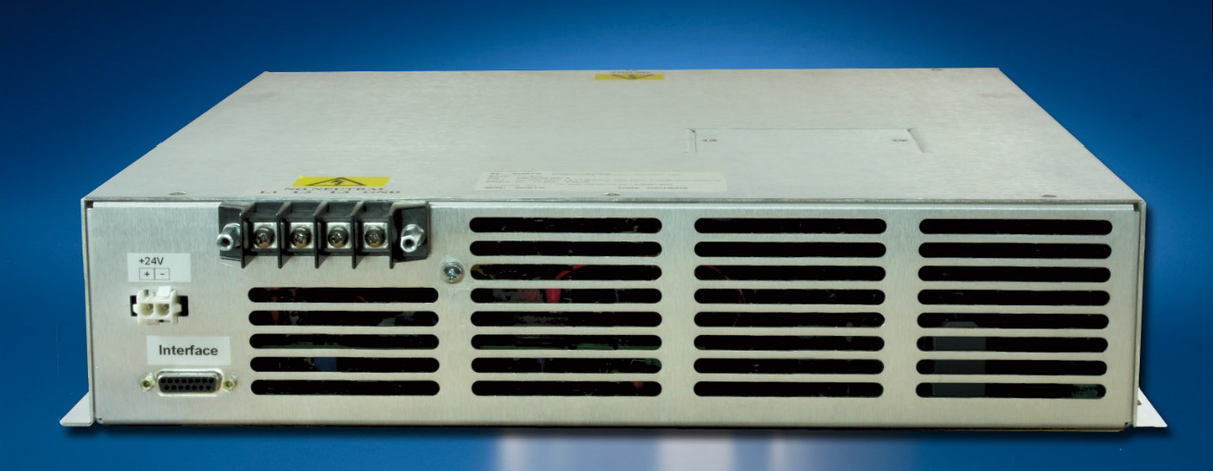
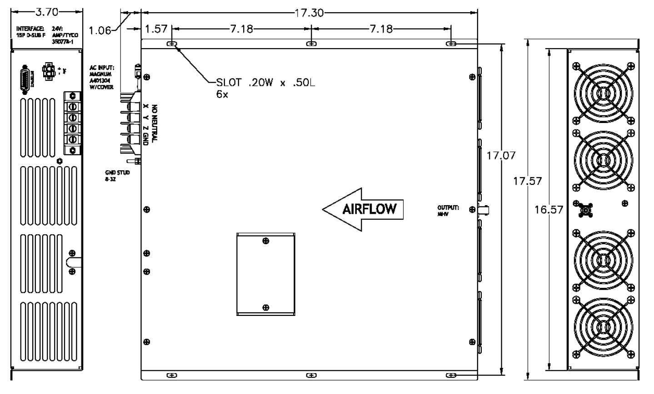
Marx Modulator CPS Lumina PS
Manufactured by Lumina
  Model: CCHP-6000
  6 kJ/s
  0-1 kV, 6 Amp
  208 VAC 3 Phase (Use transformer to bring 480 VAC to 208 VAC)
Designed to efficiently charge capacitive loads to high voltages with excellent pulse to pulse repeatability at very high repetition rates.
Differ from conventional DC supplies in that the output current is fixed and not variable
Allowing the load capacitor to be charged in the fastest possible time
No requirement for series current limiting resistors.

Slide 36
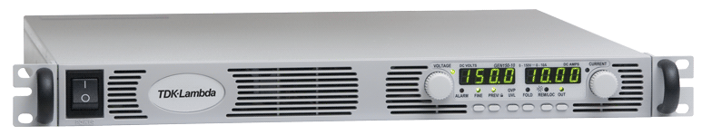
Marx Modulator CPS Gate Power Supply
Gate power supplies
  Used to power each cell gate control cards
  Need to provide ~330 Volts, .7 Amps continous
  First used 300 Volt, 5 Amp
  Determined with diode & IGBT drops
  Upgraded to 600 Volt, 2.6 Amps
Installed inline resistor to limit inrush current on 30 uF, 600 Cap on each driver card after installing fuses on each Marx cell

Slide 37
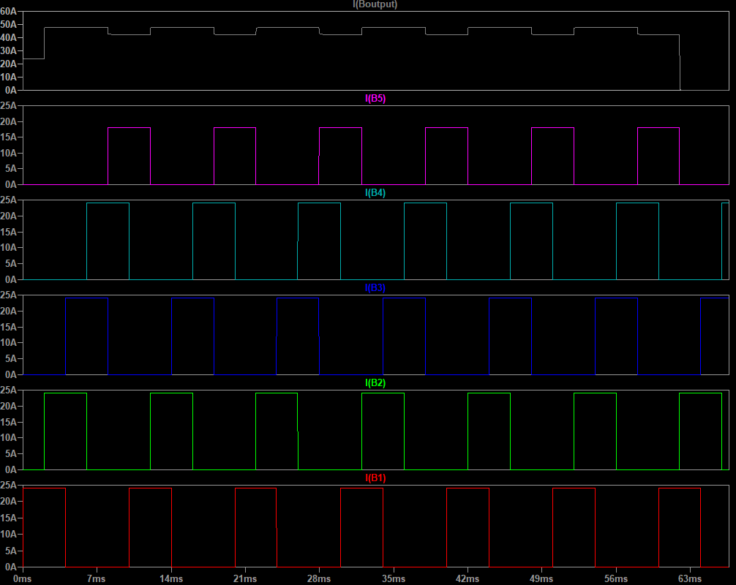
Marx Modulator CPS Interleaving Technique
19 Power Supplies (6 Amp each) into 5 Groups
  4 sets 4 supplies (24 Amps)
  1 set of 3 supplies (18 Amps)
Power supplies are staggered in delay & width
½ of the supplies are Delta and ½ are on Wye
Less Line Loading when staggered & when Δ/Y used
Simulation for Width (C = 4 ms) & Delay (D = 2ms)

Slide 38
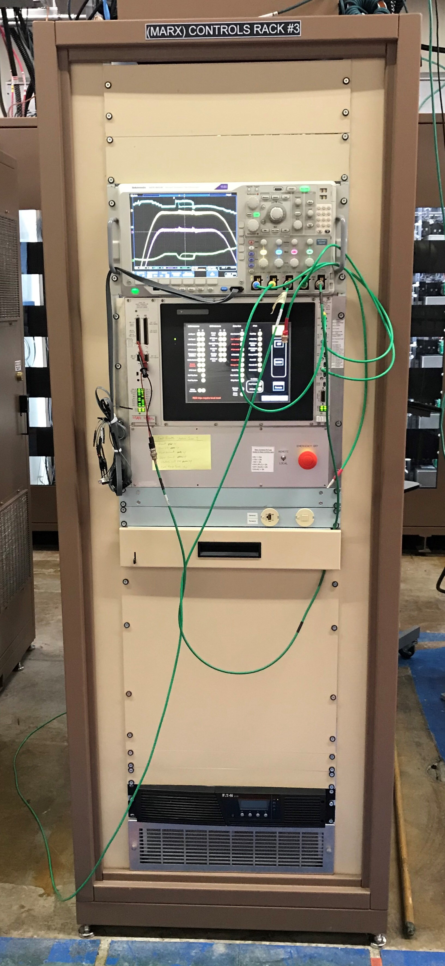
Marx Modulator Controls Rack
Inputs from all sub-system enter on top plate
Digital Oscilloscope for measure both analog waveforms and digital information
FPGA Based Control System
  Altera Cyclone V FPGA based MitySOM-5CSx System-On-Module (SOM)
  Custom designed base board that implements all the IO needed for the Marx Modulator Controller.
  The SOM provides the complex Memory, CPU/FPGA, and PS integration.
  The Altera Cyclone V FPGA has a Hard Processor System (HPS) integrated into the same silicon with the FPGA.
  The HPS is a dual core ARM Cortex-A9 CPU clocked at 925MHz.
Multiple Control Cards
  Analog Interlock & Interface
  Charge, Fire, & Status Cards
  FPGA Interface
Touch Screen Controls
Local/Remote Switch
Emergency Off Button
Laptop Network Connections
UPS – Used in both Controls and CPS too keep controls active during short power outages
Cooling Inlets

Slide 39
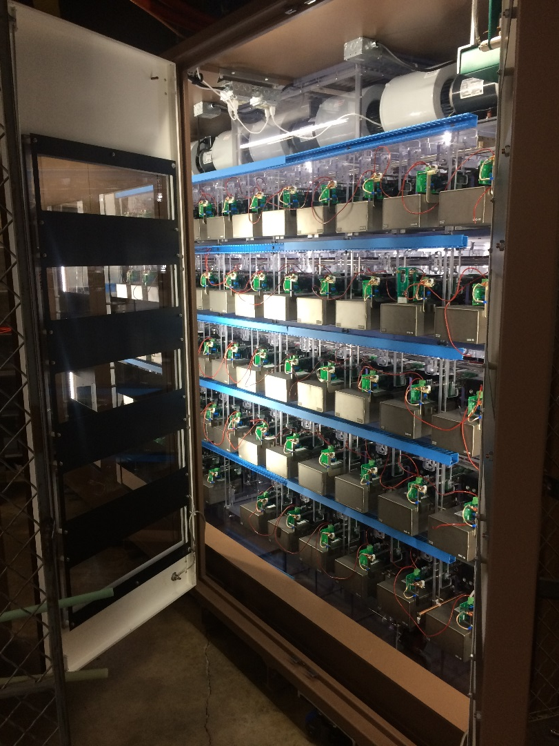
Marx Modulator Cabinet
Consists of 54 cells, arranged in 5 rows with a maximum of 12 cell in each row
Uses both resistive and standard grounding sticks to remove energy
  Discharge all cells first with floating resistor stick with built in LED for voltage detection after 15 min hold
  Then, sequentially ground out all cells with solid ground stick
Marx Modulator Components
  Air Flow Meters
  Ross High Voltage Divider
  Smoke Detectors
  Ross Grounding Relays
  Modulator Current Monitor
  Charging and special voltage divider
  Door Interlocks
Uses wide stripline across each cell to pass high current pulse while minimizing inductance
Uses large blower motors to cool each cell

Slide 40
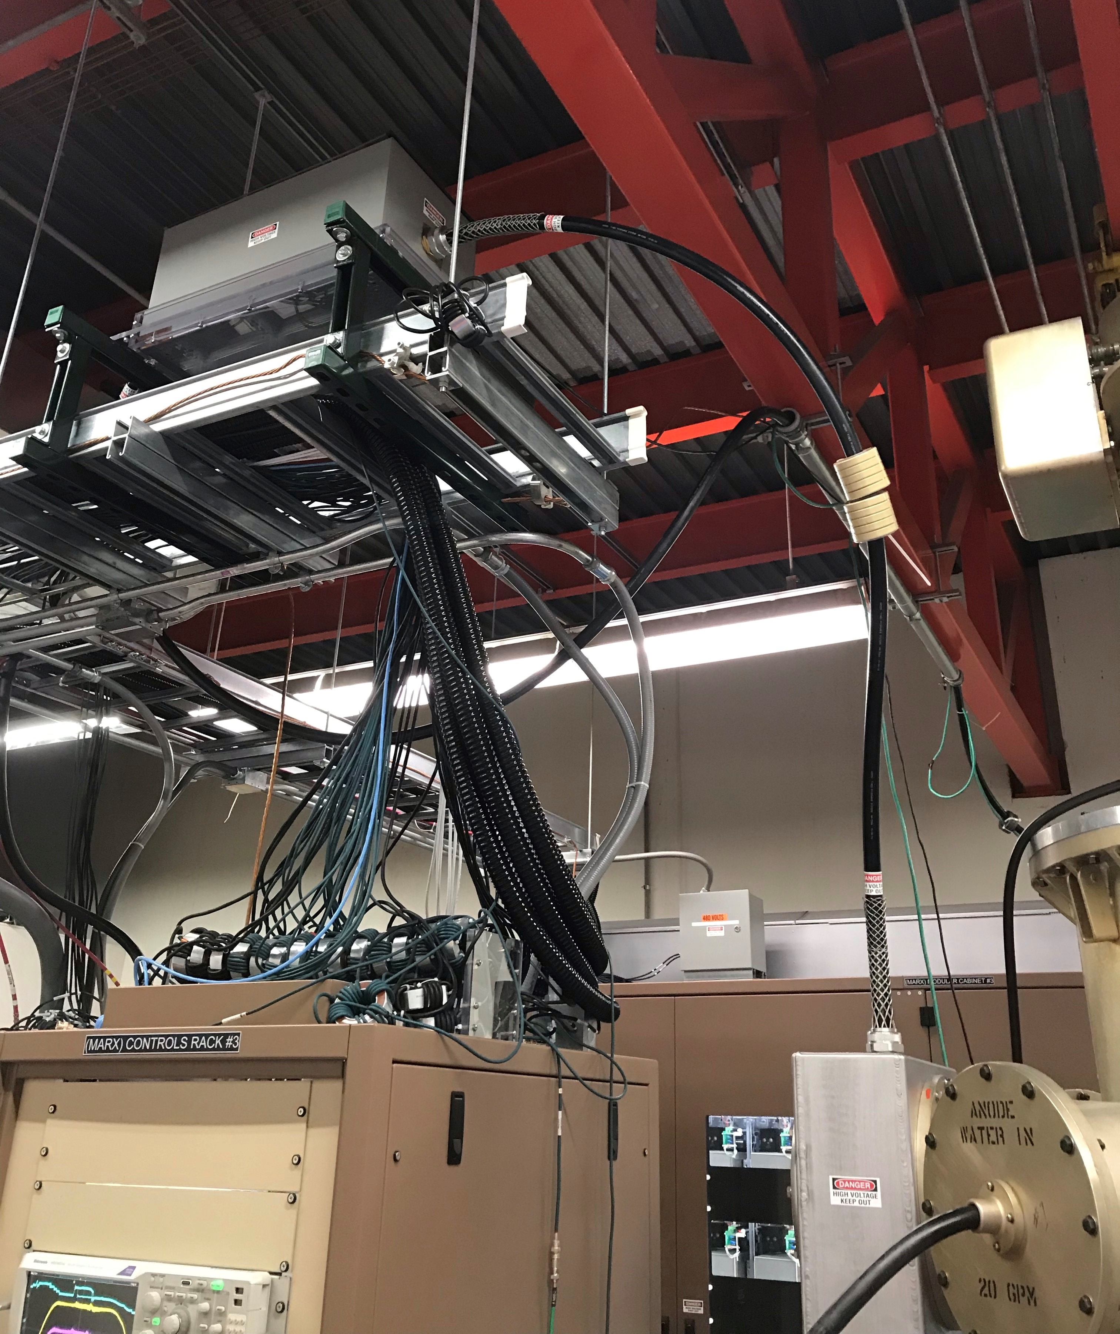
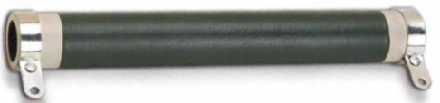
Surge/Spark Resistor Box
During cavity spark, the stored energy in the HV output cable during the pulse is delivered to the tube.
Times Microwave RG220 cable
  30.8 pF/ft
  ~33 feet of cable
  1000 pF of stored energy
  35 kV peak
  0.6 Joules of energy
Use 4 resistors (5 Ohms) in parallel to absorb the energy during a tube spark.
  Kanthal Globar Non-Inductive, High Voltage, High Power Tubular Resistors
  Part Number: 887SP5R0KG
  Note: Kanthal’s electronic components business has been acquired by Ohmite from November 1, 2018
Notice the Common Mode Chokes used to reduce ground currents for the high frequency components of modulator waveform

Slide 41
Marx Modulator Charging and Firing
Charging Path
Arrows in Blue
First Cell is ground referenced
Second Cell needs the first cell’s charge IGBT to turn on to charge itself (Cascaded)
In order to turn on the charge IGBT for the first time, the controls circuit needs to be powered up first
Not shown on drawing, but since charging path is the same to power up the controls circuit for each cell, cells have to be staggered on, one by one, to turn on for the first time
Firing Path
Arrows in Red
Circuity (XOR) prevents fire and charge from occurring at the same time
If the cell is being fired, the power flows through the capacitor and voltage is added to output
If the cell is not being fired, then the signal passes through the free-wheeling diode

Slide 42
Marx Modulator Basic 54 Cell Layout
PWM Cells (Blue)
Marx Cells (Black)
Special Cell (Orange)

Slide 43
Marx Modulator Complete 54 Cell Layout

Slide 44
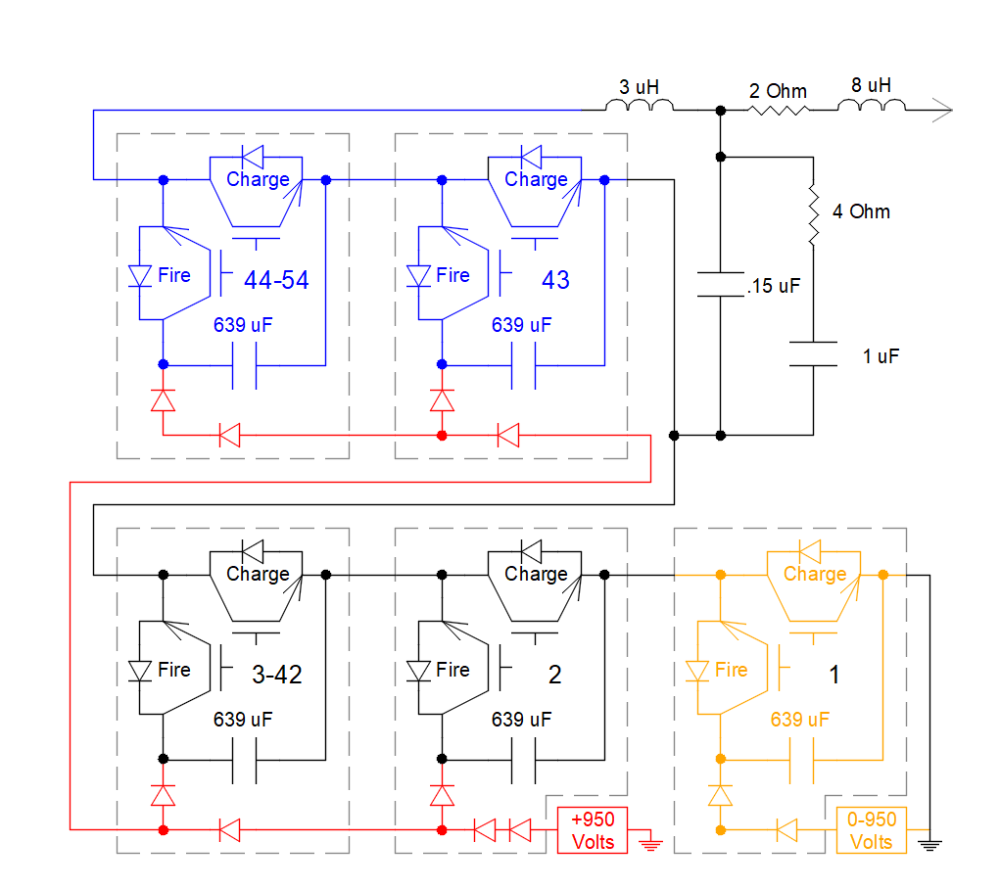
Marx Modulator Simplified Layout
PWM Cells (Blue)
Marx Cells (Black)
Special Cell (Orange)
CPS Charging (Red)
Note that Gate Driver Control Card and is powering is not shown in this layout
If a Marx cell is not being fired, then the output power goes though the Charge IGBT free-wheeling diode
If the cell is being fired, the current passes through the 639 uF capacitor and the voltage of the capacitor is added to the output voltage

Slide 45
Marx Modulator Waveform on LRF5

Slide 46
Marx Modulator Waveform on LRF5

Slide 47
Marx Modulator Design Challenges
Determining maximum waveform step voltage that will minimize reverse power during ramp up and ramp down.
Interfacing existing station interlocks to Marx modulator via PLC and touch screen interfaces.
Designing a Marx cell to operate at high dV/dt while maintaining safe operational overhead on voltage for component safety.
Cabling the entire system, including over 170 fiber optic connectors, without any mistakes.
Finding path for electrical power wiring without effecting operations.
Building a structure to hold 54 Marx Cells, maintain low cell to cell capacitive effects, minimize inductance between cells and rows, build PWM filter, and minimize corona.
Designing and coding brand new Control system using FPGA based System-On-Module.

Slide 48
Linac Marx Modulator Project Timeline
Project was completed one time and achieved all necessary specifications to achieve beam flatness and gradient regulation
2011 – Original Specifications complete
2012 – Worked with SLAC and Continental Electronics to complete engineering feasibility studies on each prospective design.
2013 – Fermilab started cell design and 3 cell tests
2014 – Developed 9 Cell test and started 28 cell design
2015 – Design Milestone → Fermilab proposal was selected for production and started designing, building, and testing 28 cell version
2016 – Developed and installed on LRF1
2017 – Developed on LRF5, then installed on LRF2 & LRF3
2018 – Installed LRF4 & LRF5
2019 – Install final production system to work in parallel with LRF7 modulator for testing 7835 and Marx components.
Completed with the support of many people in Linac, Pre-Acc, Booster & EE Support and would not be a success without all your help.

Slide 49
Thanks! Any Questions?

