Slide 1
PIP-II DAQ Specification Effort
Craig Drennan
18 February 2019

Slide 2
PIP-II DAQ Specification Efforts
The PIP-II Project has been building a large spreadsheet of interfaces.
As a follow-up to the initial BOEs Paul Derwent will be asking people to consider ways to address the scope of
  High Power RF, Low Level RF, Machine Protection, Magnets & Power Supplies, Instrumentation, Controls, Vacuum
Controls Modernization Working Group

Slide 3
Flow of Specification for Data Acquisition
Physics & Machine Requirements for Data
Control System Specification
Category 1 Data Rates
Category 2 Data Rates
ooo
RF Systems
Instr. Systems
Pwr Sup Systems
Cryo Systems

Slide 4
Flow of Specification for Data Acquisition
Physics & Machine Requirements for Data
RF Systems
Instr. Systems
Pwr Sup Systems
Cryo Systems
Category 1 Data Rates
Category 2 Data Rates
ooo
Control System Specification

Slide 5
Flow of Specification for Data Acquisition
Physics & Machine Requirements for Data
Machine Protection System Specification
MPS Data Rates
RF Systems
Instr. Systems
Pwr Sup Systems
Cryo Systems

Slide 6
Instrumentation Data to Control System Requirements
Analog FE
Signal Bandwidth
SNR
Resolution
Dynamic Rng.
Signal Processing
Bandwidth
Digitizer SPS Word Size, bits
Data Decimation
Latency
Data Transfer
Bits per Word
Words per Chan.
Chans. per Update
Updates. per Sec.
(Bits per Second)

Slide 7
Machine Protection System Data Latency Requirements
Analog FE
Cable Delay + Analog Circuit Delay
Digital Signal Processing
Sample Period
ADC Pipeline Clocks x ADC Clk Period
ADC Serial Link Bits x ADC Serial Clk Period
FPGA Computation Clks x FPGA Clk Period
High Speed Serial Link
Data Packet Bytes x 8 x Serial Link Clk Period
MPS Signal Processing
MPS Computation Clks x MPS FPGA Clk Period

Slide 8
Agenda for Next Meetings
Determine which specifications will be common to multiple systems.
Assign people to work out specification details and begin a draft specification.
Arrange presentations for specification and hardware proposals.
Arrange presentations by vendors to educate ourselves on technology and product availability.

Slide 9
Hardware Proposals
Show what specification the architecture would provide.
Present pricing data and quotes
Determine the level of in-house design required.
Estimate the man-hours to develop and test a prototype system.

Slide 10
Introduction
Initial Models for Instrumentation / MPS Interfaces
==== proposal ====
  MPS system diagrams
  Three possible implementations.
  Example of a communications model
Who will the next level of detail come from ?
Charting a path to design and document an MPS System.
==== discussion ====
  One more review of the FRS ?
  Timeline for the development of TRS and Interface documents.

Slide 11
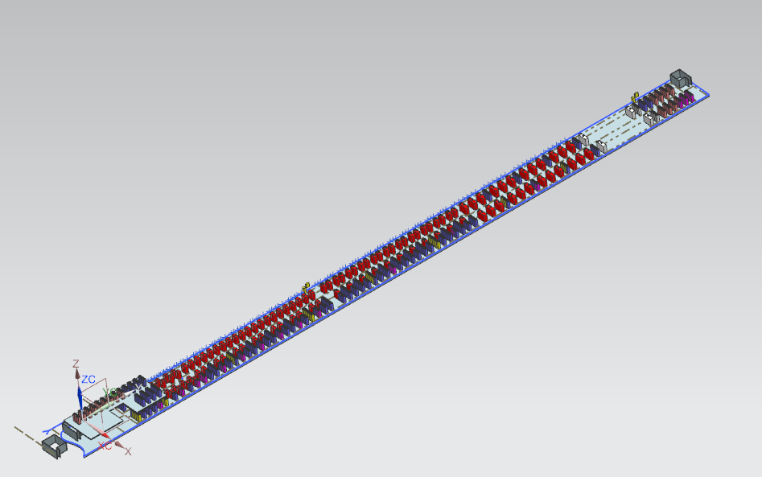
Proposed Gallery Layout: F10092530 (from C. Baffes)
~ 150 meters long
Downstream
Upstream

Slide 12
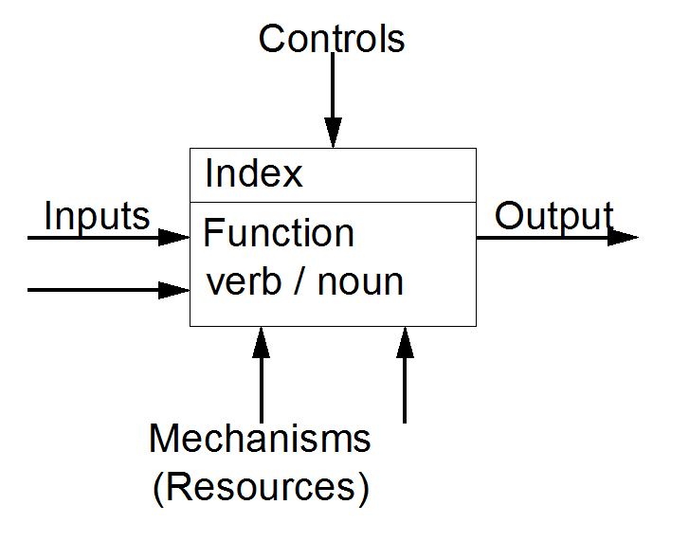
Functional Flow Block Diagrams
I have kluged my own format for now from the FFBD version and the IDEF0 version. Still on the learning curve.
https://en.wikipedia.org/wiki/Functional_flow_block_diagram
https://en.wikipedia.org/wiki/IDEF0

Slide 13
Machine Protection System PIP-II FRS ED0004250

Slide 14
Beam Instrumentation System

Slide 15
Beam Instrumentation MPS

Slide 16
Digitize Beam Parameter

Slide 17
Three Possible Implementations Examined
Signal digitization, Operations data processing and MPS Test Logic in same module.
  MPS permit output is two state signal to MPS summation.
Signal digitization, Operations data processing in same module. Digitized data is transmitted to a separate MPS module.
Signal digitization and processing in one module. Data is transmitted to separate Operations and MPS modules.

Slide 18
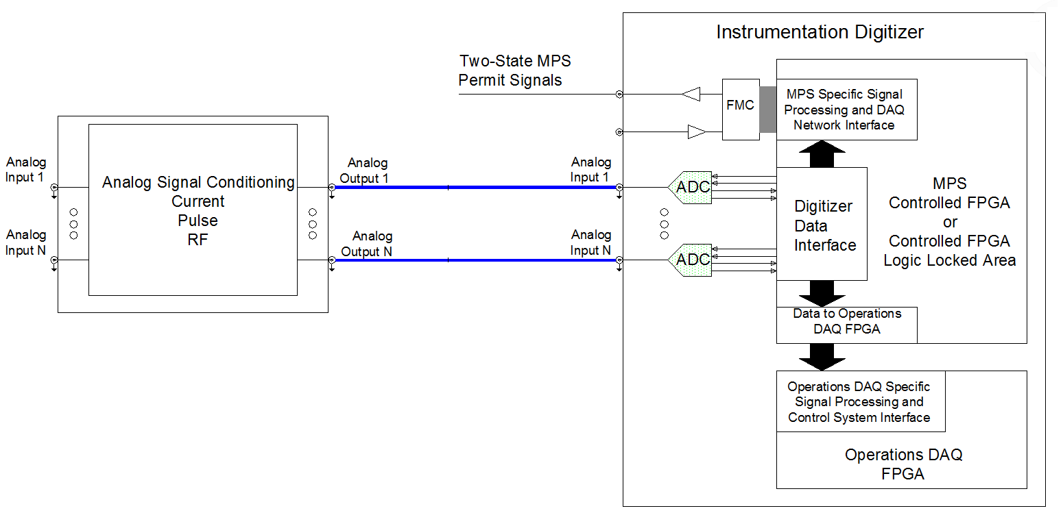
MPS “Creative” Diagram ‘1’
Instrumentation Digitizer with
Specific MPS Logic and
Two-State Permit Outputs

Slide 19
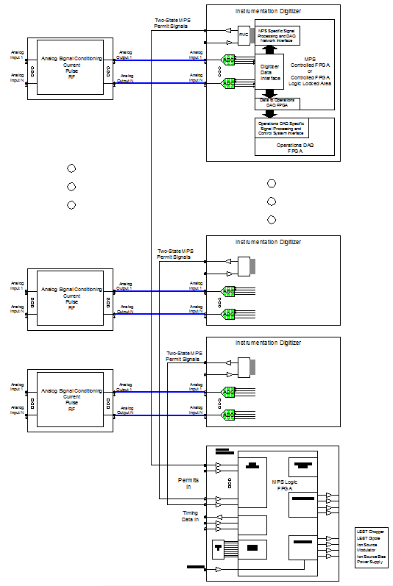
MPS “Creative” Diagram ‘1’ (cont.)

Slide 20
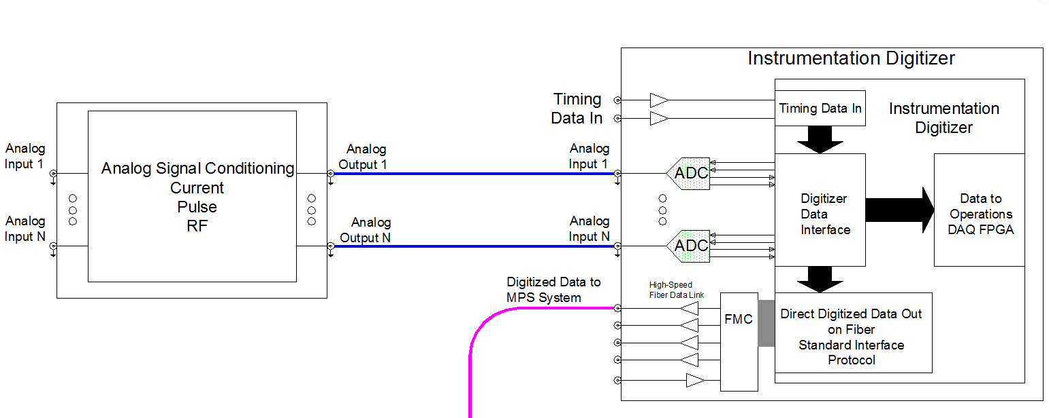
MPS “Creative” Diagram ‘2’
Instrumentation Digitizer with
Standardized Digitized Data Transmitted Out on Fiber

Slide 21
MPS “Creative” Diagram ‘2’ (cont.)

Slide 22
MPS “Creative” Diagram ‘3’
Diagram ‘3’ uses a Standard Digitizer to Fiber Data Link Module

Slide 23
MPS “Creative” Diagram ‘3’ (cont.)
Diagram ‘3’ uses a Standard Data Receiver, Logic Module

Slide 24
MPS “Creative” Diagram ‘3’ (cont.)

Slide 25
Documents to Collect and Study
PIP-II Interface Spreadsheet.
List of Instrumentation for PIP-II
Basis of Estimates for different systems.
Maps for estimating the physical equipment distribution. Where are the upstairs components going to be located?
List of MPS Inputs.
Location of MPS electronics.
What else will help us start outlining the parameters and architectures to be specified ?

Slide 26
What are the “Common” Elements
What are the common elements between systems?
  High-speed data to MPS
  Status bits to MPS
  Machine Timing and Clocks
  Machine Timing and Clock receiver hardware
  Machine Timing and Clock decoding firmware IP
  Common transmitter / receiver hardware
  Common transmitter / receiver firmware IP
  Common hardware / sub-systems ?

Slide 27
Description of OSI
https://en.wikipedia.org/wiki/OSI_model

Slide 28
MPS Permit / Inhibit Action Table
TRS#___
TRS#___
TRS#___
TRS#___
TRS#___
TRS#___
TRS#___

Slide 29
Example of the Sub System Design Outline
RF System
  RF System Overview
    Introduction
    Design requirements
    Scope
  RF System Design
    HP RF
    Amplifiers
    …
    Safety considerations
    Quality Assurance
    Risks and vulnerabilities
  Production and assembly
    Production plan
    Verification and testing
  Interfaces
  Installation, Integration and Commissioning
  Quality control
  Safety
  Organization and management
    Fermilab and collaboration
    Planning assumptions
From: | Ioanis Kourbanis <ioanis@fnal.gov>

Slide 30
One more review of the FRS ?
PIP-II MPS, FRS -- ED0004250
One more review of the FRS ?
Iterate as needed for TRS effort ?

Slide 31
Example of the Sub System Design Outline
RF System
  RF System Overview
    Introduction
    Design requirements
    Scope
  RF System Design
    HP RF
    Amplifiers
    …
    Safety considerations
    Quality Assurance
    Risks and vulnerabilities
  Production and assembly
    Production plan
    Verification and testing
  Interfaces
  Installation, Integration and Commissioning
  Quality control
  Safety
  Organization and management
    Fermilab and collaboration
    Planning assumptions
From: | Ioanis Kourbanis <ioanis@fnal.gov>

Slide 32
Questions
Shall we have a TRS for each MPS
  category: primary, secondary
  device
  fault detection input
  fault detection method
(RPUs, Scrapers, BLM, …)
? Pattern deviation MPS permit : Can there be similar beam currents with different pulse patterns ? The specification is in micro-amps. If losses down stream will trip things off, how important is the pattern deviation measurement, if it is a big driver of the design? i.e. tight timing and complex pattern phasing vs. a pattern matching interlock.

Slide 33
Skip this slide ?
PIP-II MPS, FRS -- ED0004250
Specification 4.1
  A drop of the beam permit shall inhibit the Linac beam at the entrance of the RFQ within 10 us after the PIP-II MPS receives the signal. MPS Interaction with the broader Fermilab Accelerator Complex:
  A separate interface document shall describe interaction with the MPS of Fermilab Accelerator Complex, including time requirements and protocols.

Slide 34
The End

Slide 35
Description of OSI layers (cont.)
At each level N, two entities at the communicating devices (layer N peers) exchange protocol data units (PDUs) by means of a layer N protocol. Each PDU contains a payload, called the service data unit (SDU), along with protocol-related headers or footers.
Data processing by two communicating OSI-compatible devices is done as such:
The data to be transmitted is composed at the topmost layer of the transmitting device (layer N) into a protocol data unit (PDU).
The PDU is passed to layer N-1, where it is known as the service data unit (SDU).
At layer N-1 the SDU is concatenated with a header, a footer, or both, producing a layer N-1 PDU. It is then passed to layer N-2.
The process continues until reaching the lowermost level, from which the data is transmitted to the receiving device.
At the receiving device the data is passed from the lowest to the highest layer as a series of SDUs while being successively stripped from each layer's header or footer, until reaching the topmost layer, where the last of the data is consumed.

Slide 36
MPS Function Flow Diagram ‘A’

Slide 37
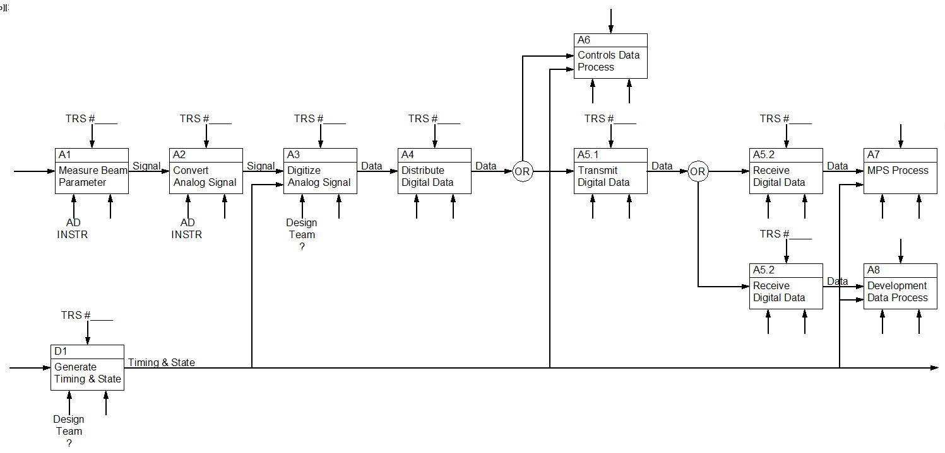
MPS Function Flow Diagram ‘B’

Slide 38
