Slide 1
Longitudinal Beam Dynamics Issues
at the Fermilab Booster
Acknowledgements
C. Y. Tan
W. Pellico
S. Chaurize
F. Garcia
K. Seiya
T. Sullivan
K. Triplett
J. Reid
D. Johnson
T. Johnson
B. Hendrick,
S. Bhat
A. Waller
C. Drennan
N. Eddy
V. Grzelak
Chandra Bhat, Fermilab
J-PARC, Japan
20190307

Slide 2
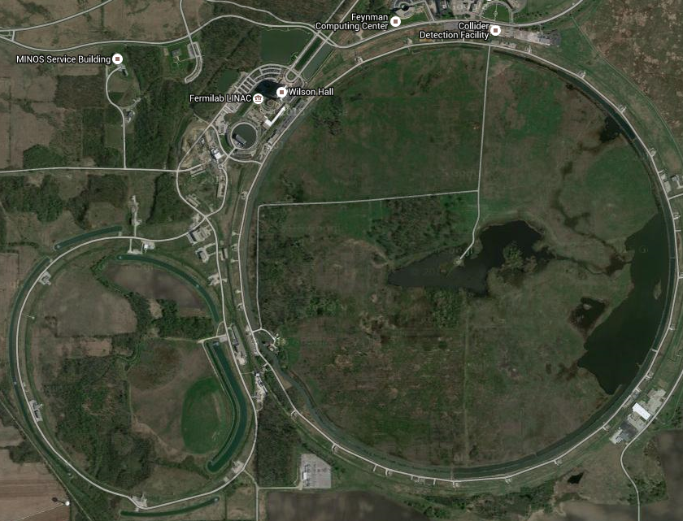
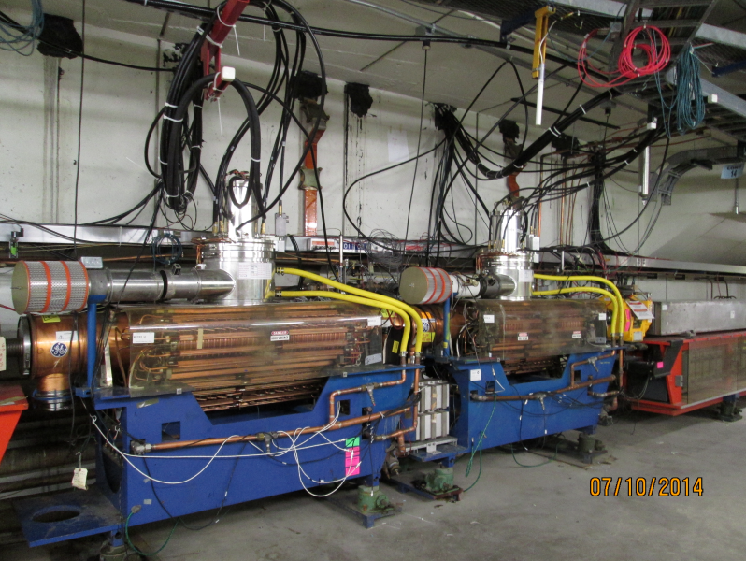
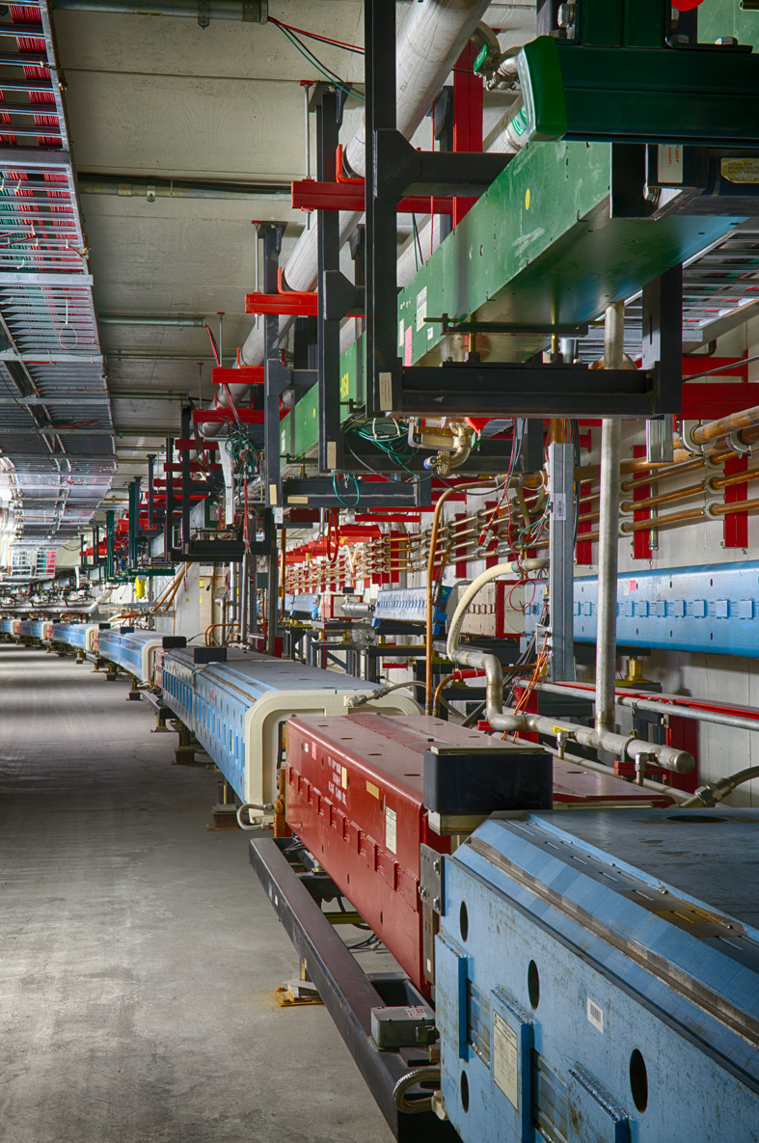
Fermilab, US Premier Particle Physics Laboratory
NuMI:
MINOS+
MINERvA
NOvA
LINAC
MIPP
Test Beam
SeaQuest
M-Center
Muon:
g-2
Mu2e
Booster:
0.4-8 GeV Accelerator
MiniBooNE
MicroBooNE
Aerial
view of Fermilab
Site
Booster
LBNF
Accumulator/
(Muon-ring)
Recycler:
8 GeV Permanent
Magnet Storage Ring
Recycler
&
Main Injector
Tevatron
Main Injector:
8 -120 GeV Accelerator

Slide 3
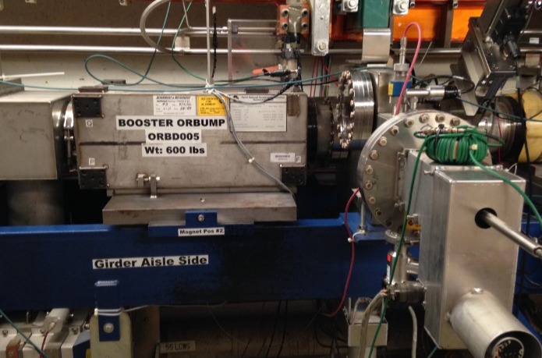
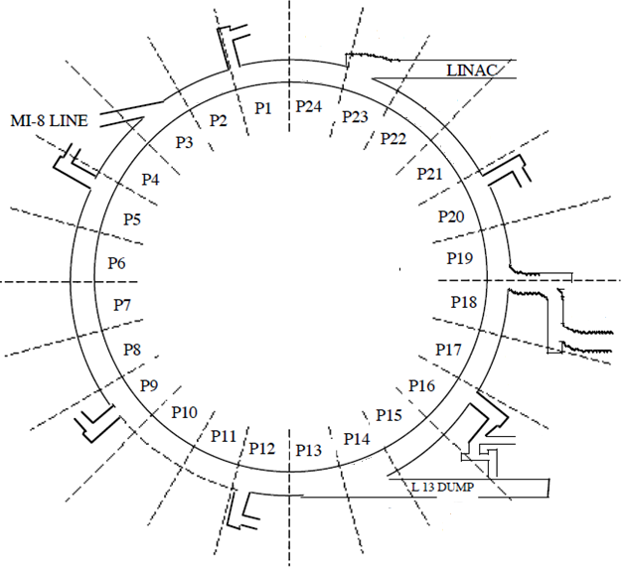
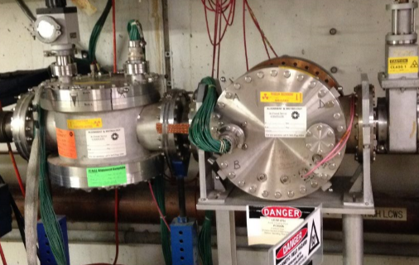
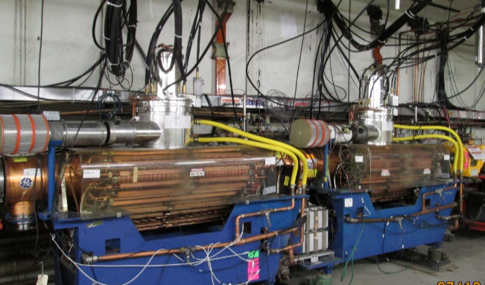
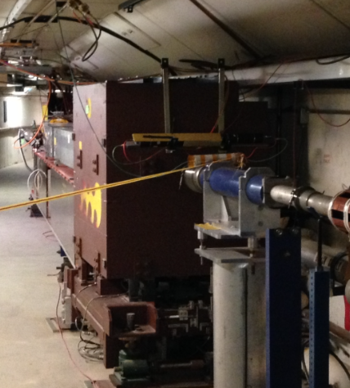
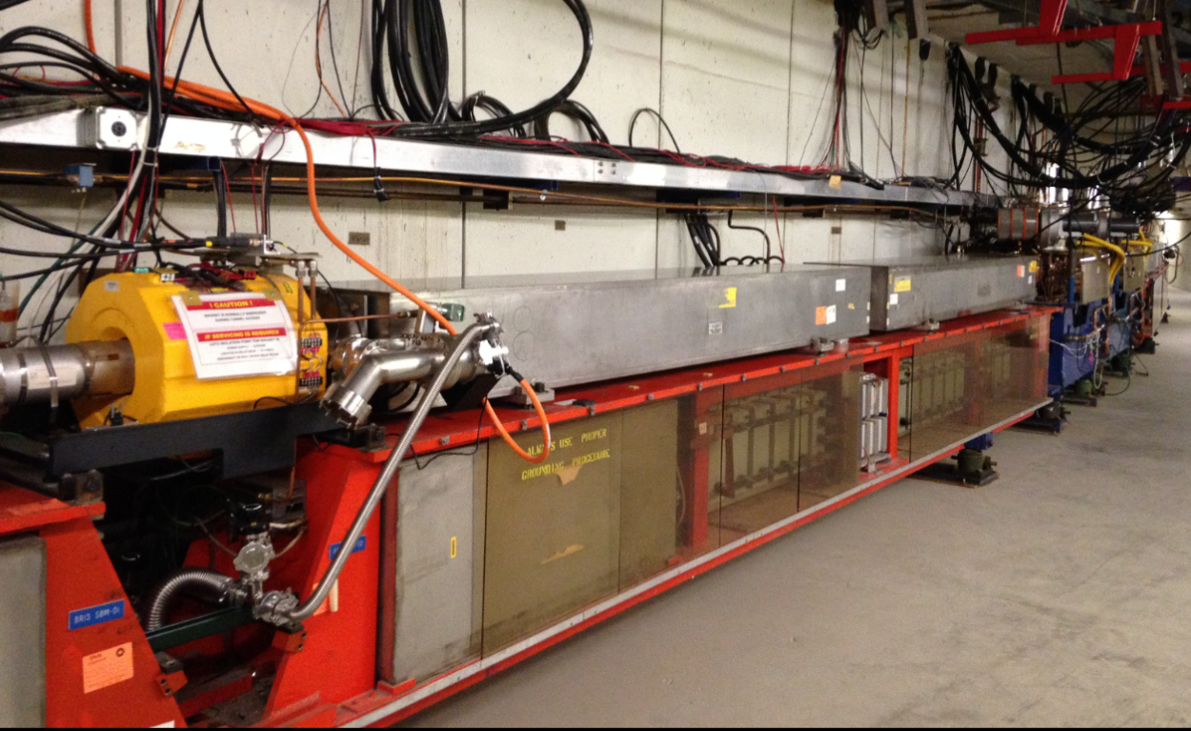
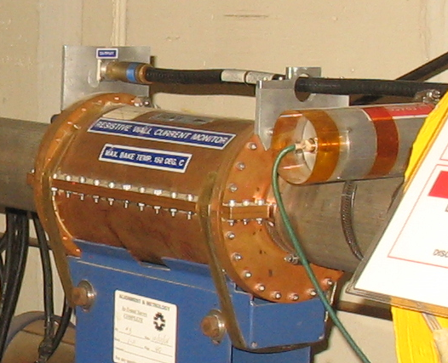
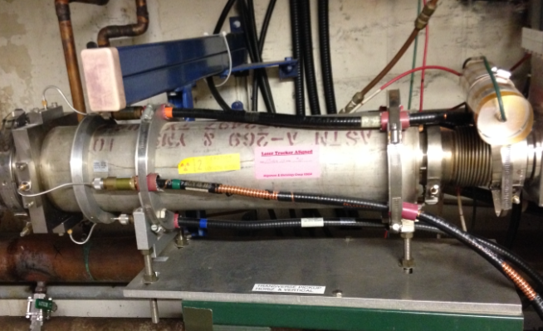
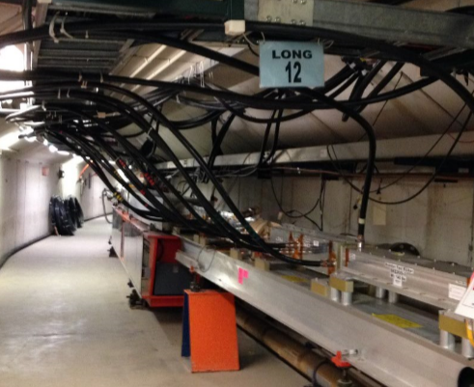
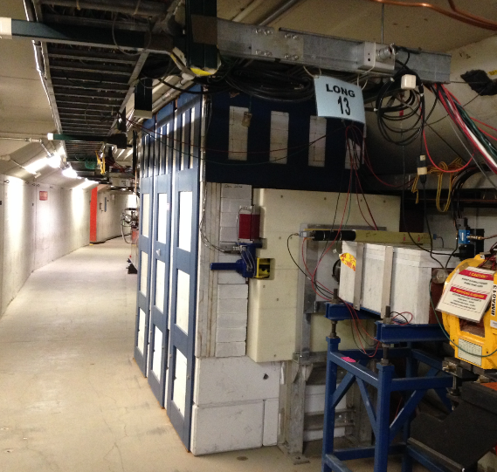
Booster Layout
Inj. ORBUMP
H&V IPMs
RF
15-16
RF
13-14
Extra. Dogleg
LINAC 400 MeV p Beam
RF
11-12
8 GeV Beam
RF
9-10
C= 475 Meter
# of RF Cavities= 22
Vrf (Volt)/Cavity= 50 KV
R/Q = 20 Ω, Rs= 15 KΩ
C=475 m, T_{rev}=2.2-1.59μs
h=84
24 Sectors
Basically
These are Independent
of one another
FOFDOOD (DOODFOF)
RF
21-22
Collimators
PIP Specification
f_{RF}=37.8 MHz-52.8 MHz
Vrf(total) = 1 MV
RF
19-20
RF
17-18
Do we have a total of 22 RF cavities with 50kV/cavity
RF
7-8
WCM
RF
5,6
RF
1-2
RF
3-4
H&V Trans. Dampers
Notcher
Absorber

Slide 4
Proton Improvement Plans at Fermilab (Past, Present and Future)
PIP: Goal was
Extract 2.25E17 protons/hr (@15 Hz) from the Fermilab Booster
12 batches of 4.26E12ppBp to RR/MI with for every 1.33 sec
ε_{L}<0.1 eVs/bunch &
ε_{T}<16 π-mm-mr
LINAC/Booster efficiency >85%
To achieve beam power on NuMI target 700kW using RR&MI
Provide 4.26E12ppBc to Booster Neutrino Program
PIP-I+: Goal prepare the Booster for PIP-II & also
Extract 2.66E17 protons/hr (@15 Hz) from the Fermilab Booster
12 batches of ~5E12ppBp to RR/MI with for every 1.2 sec
Out put beam properties same as above
LINAC/Booster efficiency >85%
To achieve beam power on NuMI target 900kW using RR&MI
Provide ~5E12ppBc to Booster Neutrino Program
PIP-II: Goal send 1.2MW proton beam power on the LBNF target, using newly built SC-LINAC and existing RR and MI
But, ~4.63E17 protons/hr (@20 Hz) from the Fermilab Booster
Achieved ~1 year ahead of
Scheduled date 2018
working
To be completed
by 2023

Slide 5
Injection Scheme in the Booster
Improved Scheme for Adiabatic Beam Capture
“Early Injection Scheme”
Bmax
(8 GeV)
(since Dec. 2015)
This scheme gave us
an ability to inject ~30% more Beam
an additional 200 μs for adiabatic beam capture …
Prior to 2016
Booster
Magnet Ramp
15 Hz
CBhat, HB2016
Begin Inj.
~200μs
Since January 2019,
Flat bottom
Bmin (400 MeV)
400 MeV LINAC Beam
Bmin (400 MeV)
>40μs
Inj.
~260μs
for Capture
Beam Acceleration
using 37-52 MHz
RF system
Booster
≈ 40μs
injection
Capture & Acceleration
using 37-52 MHz RF
system in ≈360μs
Booster
Synchrotron
pseudo front-porch
~60μs-200 μs debunching
Energy Acceptance ~5MeV
Beam ΔE(95%)≈ 1.5MeV
1/30Hz ≈ 0.0333 s

Slide 6
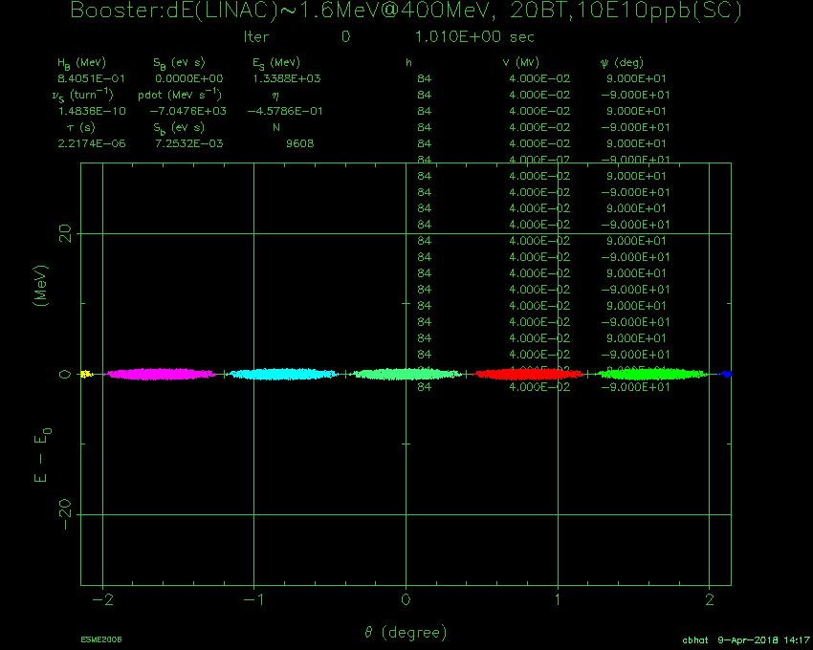
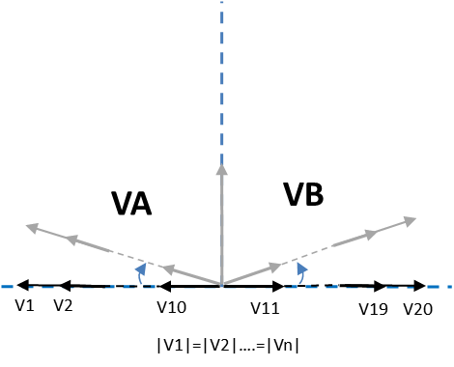
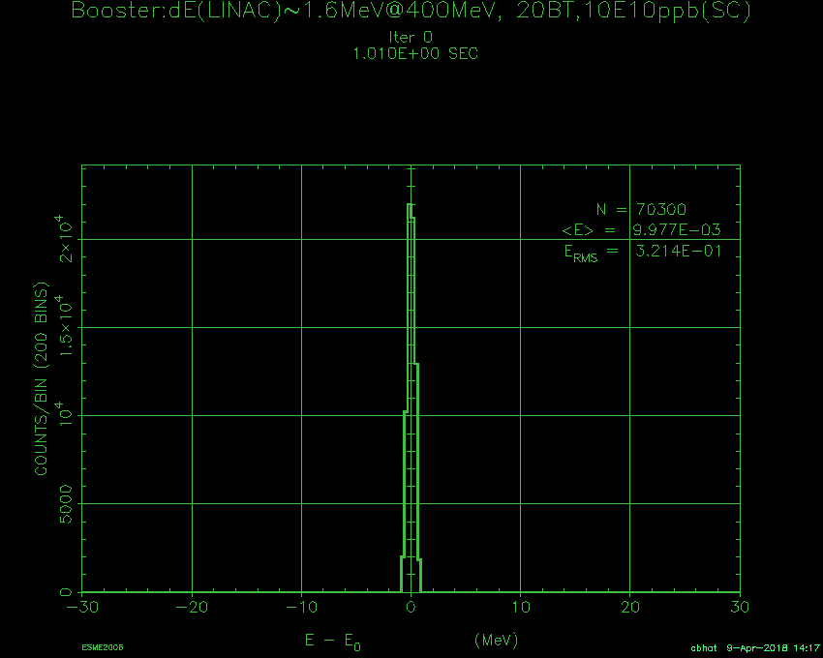
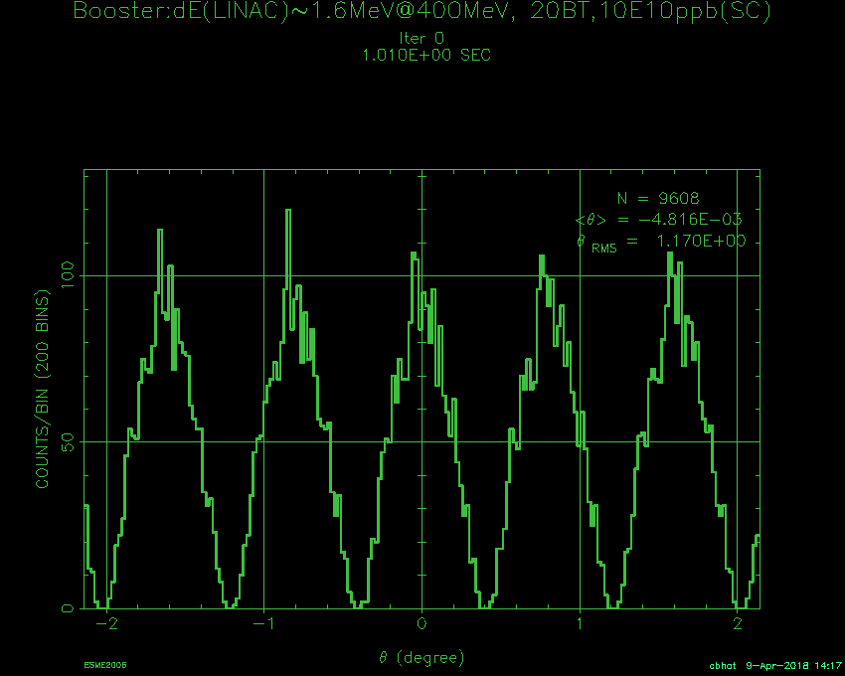
Longitudinal Beam Dynamics Simulations Beam Injection to extraction
Simulation Parameters: with SC
1. LINAC Beam ΔE = 1.2 to 1.6 MeV,
2. Beam Int.= 2-12E12ppBc, beam capture with RF paraphase
3. Snap Bunch Rotation
ΔE Dist.
30
Vrf=0 @ Injection
ΔE-Δt Phase space (8.2E12ppc)
Vrf during
Capture
ΔE (MeV)
0
ΔE@Inj
= 1.5 MeV
-30
Line-Charge Dist.
Simulations suggest
one can achieve <20% emittance growth during capture.
ε_{L}@Exit ~0.06 eVs (95%)
No particle losses
σ_{E} @Exit< 2.75 MeV
-2
0
2
Azimuthal Angle(deg)

Slide 7
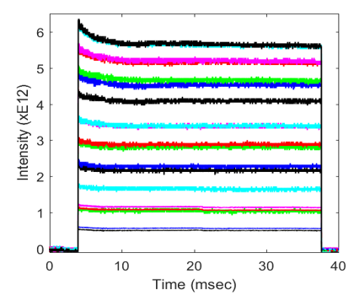
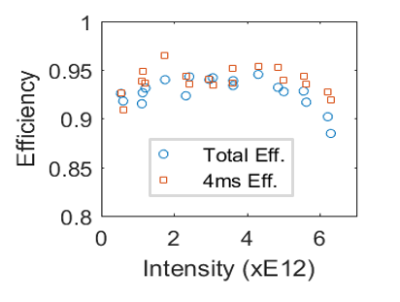
Measured Beam Transmission from Injection to Extraction in the Booster
Injection at 400MeV & Extraction at 8 GeV
One can achieve with
12 out of 15 Booster Batches
20 Booster Turn
1 MW (1.2sec/MI cycle)
0.92MW (1.33sec/MI cycle)
5.56E12ppBc
18
5.2E12ppBc
16
Operational Beam Intensity
0.94MW (1.2sec/MI cycle) or
0.85MW (1.33sec/MI cycle)
14
12
0.70 MW (1.33sec/MI cycle)
Intensity (xE12 ppBc)
10
But!
8
Booster Magnet Ramp
(schematic)
Beam power loss of
1W/m
6
4
~2W/m
2
Transition Crossing
(γ_{T}=5.47)
Inj. to Ext. Efficiency
All the losses are in the first 4 msec of the cycle
Not due to Transverse dynamics.
Many indications suggest this might be due to longitudinal beam dynamics induced by HLRF and LLRF.
Trans.Dynamics ←→ Long. Beam dynamics issues.
(xE12ppBc)

Slide 8
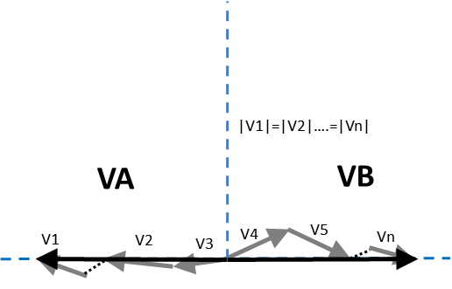
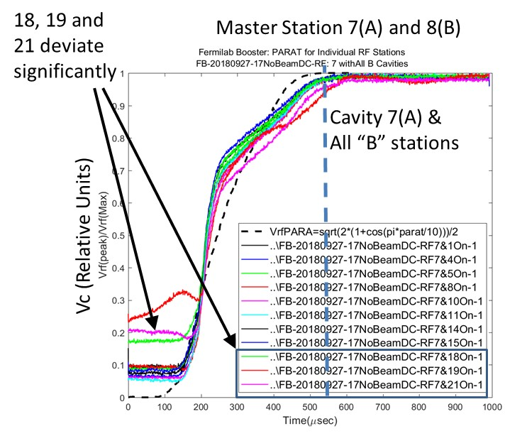
Identification of the Issues and Mitigation
DC Studies
I
II
RF responses to paraphase are not identical among 22 RF stations.
These phase errors were as large as 20deg
In 2018 these are fixed to better than 5 deg

Slide 9
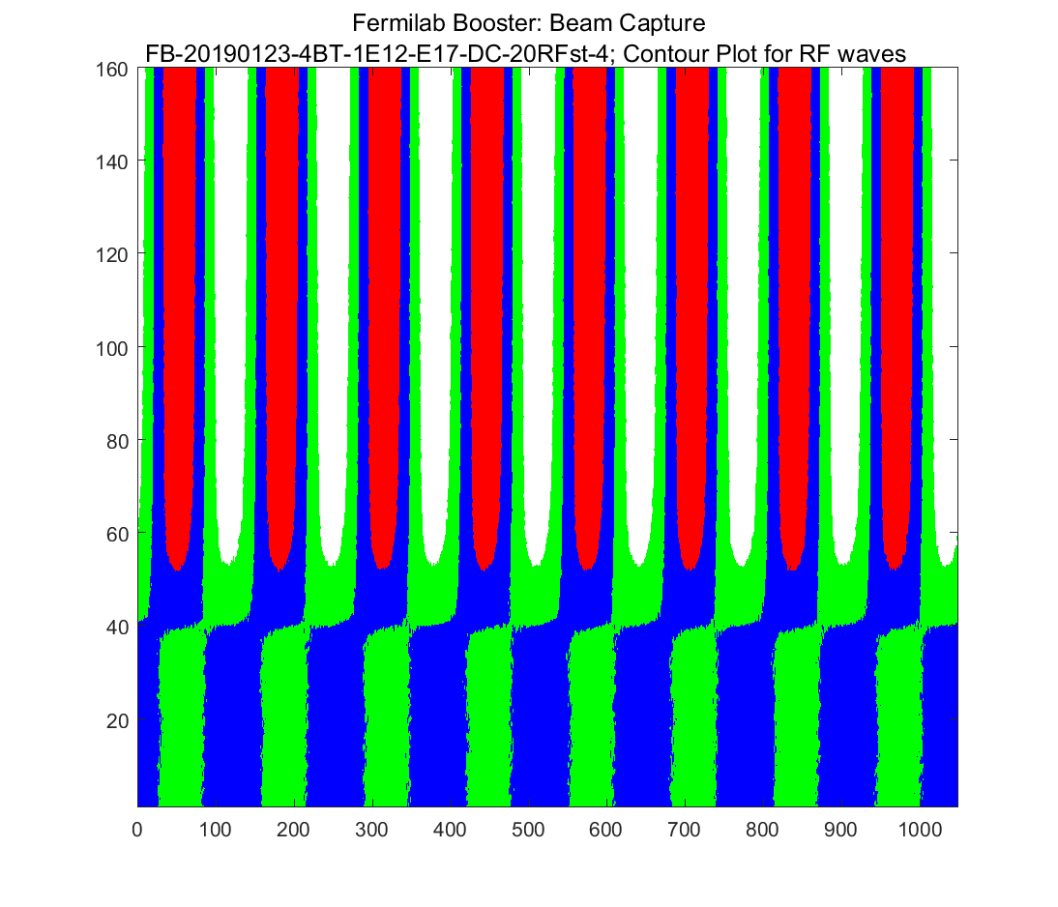
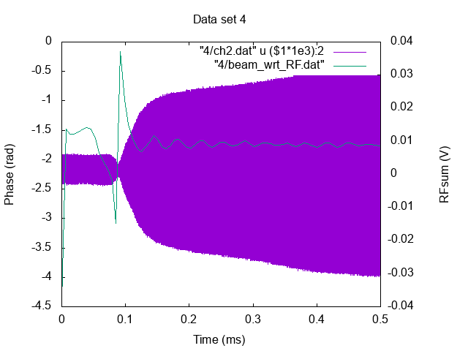
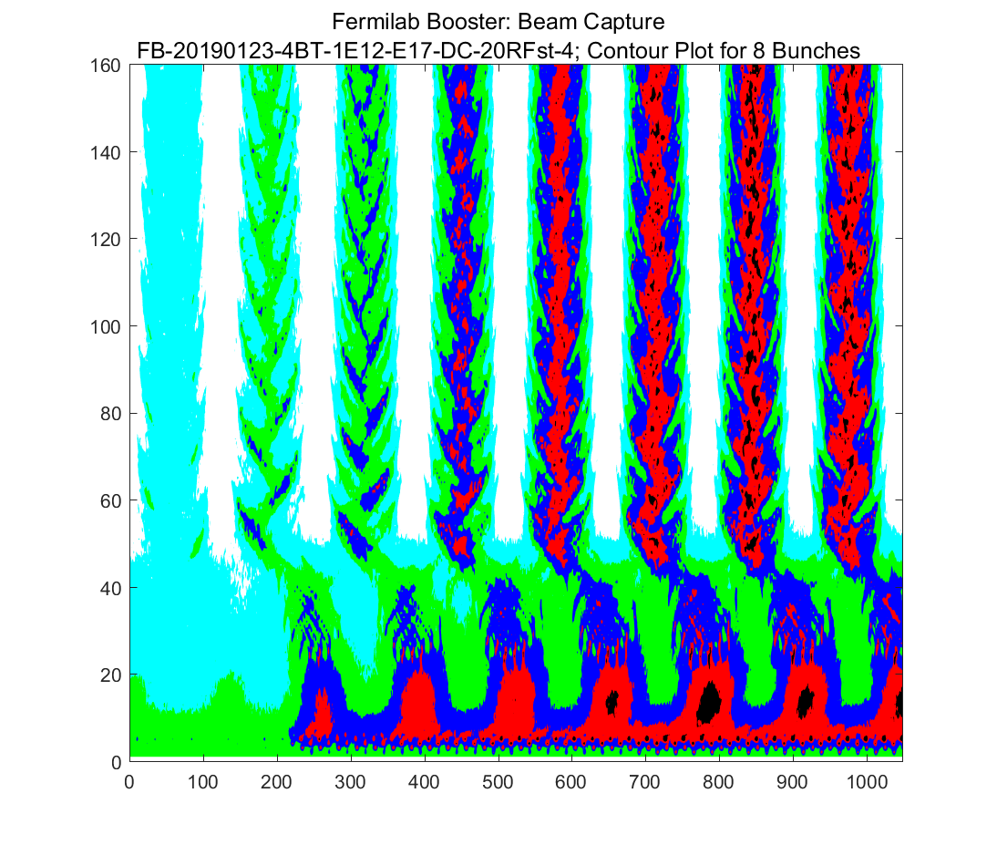
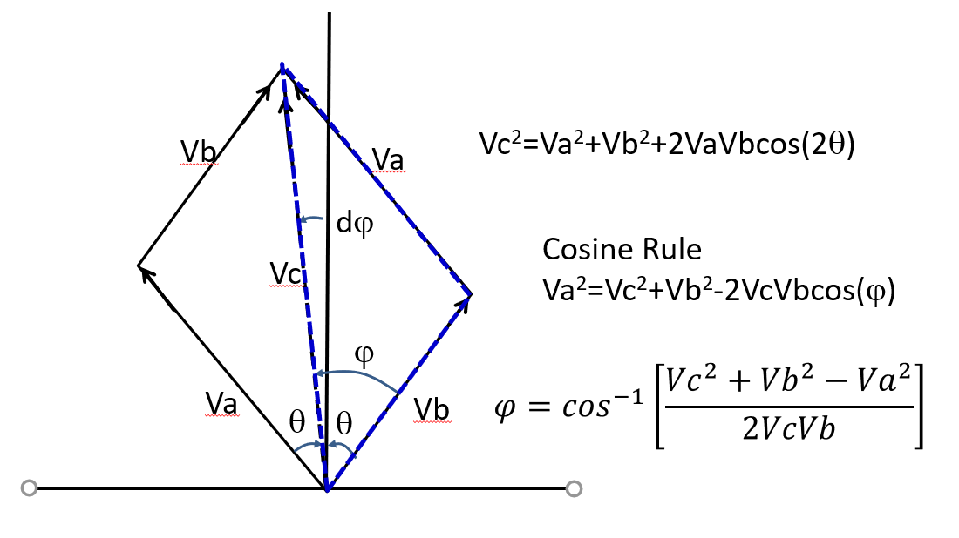
Identification of the issues and Fixes (cont.)
DC & 0.4-8 GeV Studies
III
Phase jump
Vrf
Sum RF Waveform
Global balance OFF/ON
WCM
Phase jump
Va#Vb introduces phase slip

Slide 10
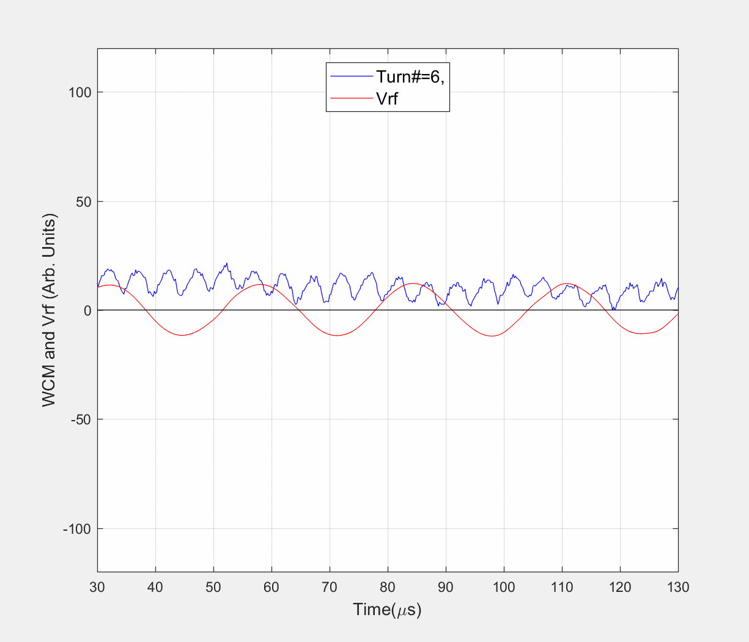
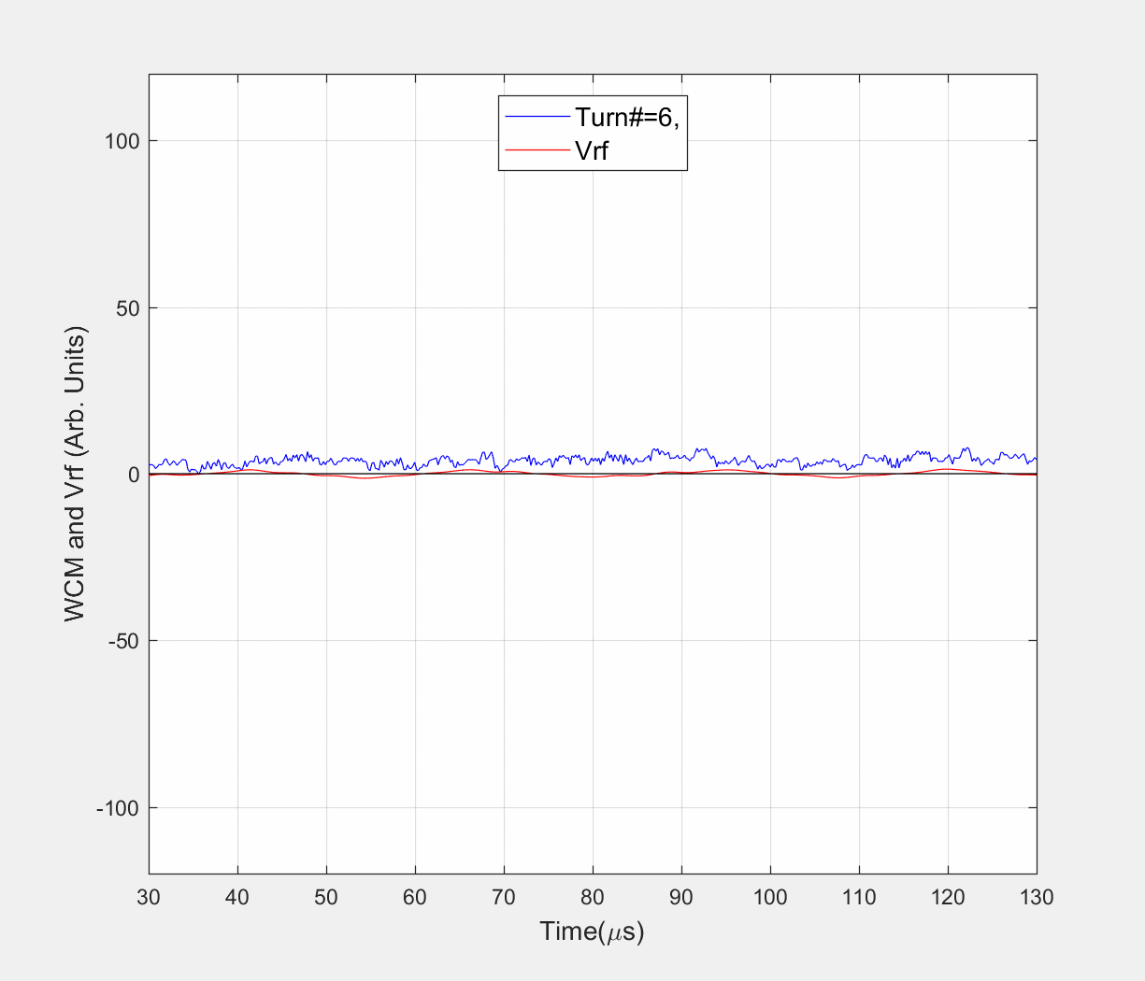
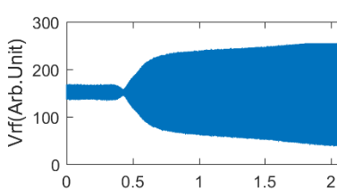
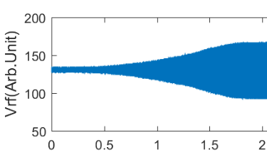
What is going on during the Beam Capture?
Capture with Operational Paraphase Curve
Capture with Adiabatic Paraphase Curve
FB-20190123-4BT-1E12-E17-DC-20RFst-4
FB-20181114-DC-6
No “NECK”
Vrf
Vrf
Time(ns)
Time(ns)
What was Expected?: In an ideal situation beam capture in DC mode the RF phase should not slip relative to bunch centroid.
Observations: We see two types of RF phase slip relative to the bunch centroid
fast and
slow
← How are these possible?

Slide 11
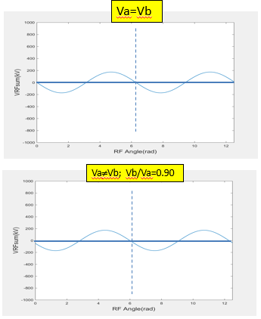
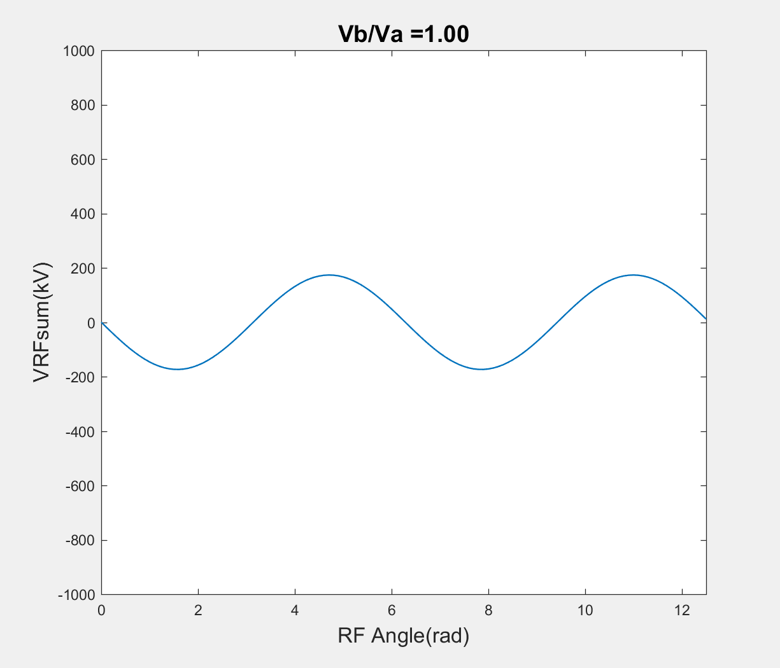
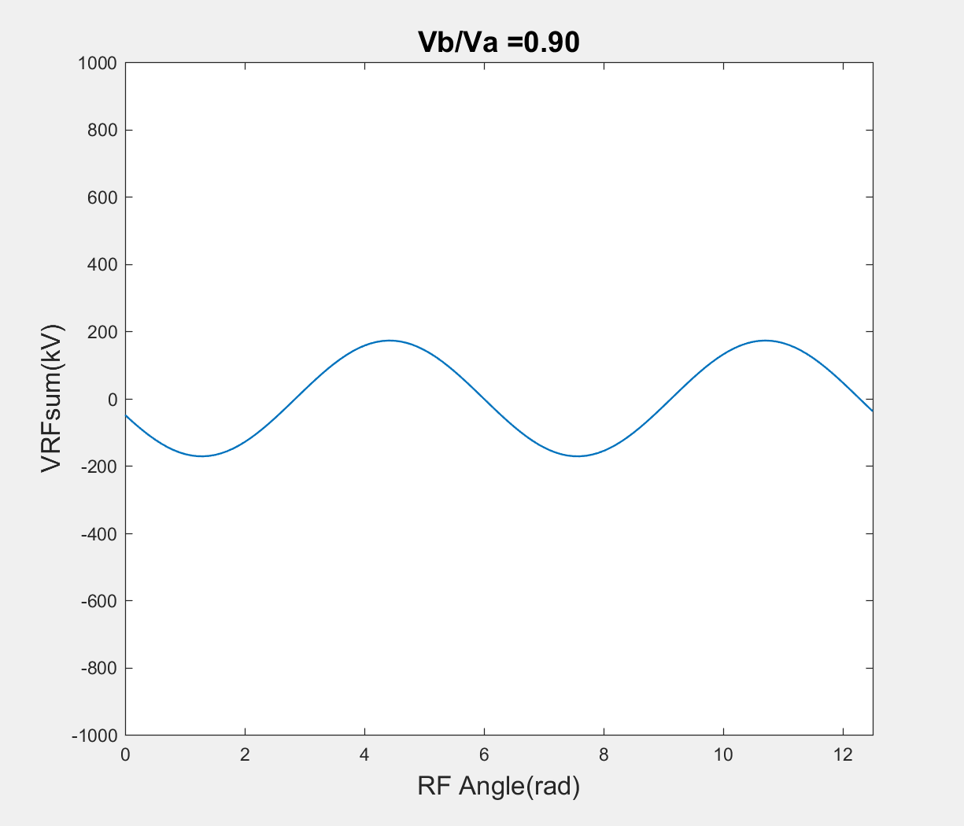
Possible Explanations
Va=Vb
Flipping Phase
Slipping Phase
&
Plipping Phase
If Va=Vb and |θ(start)| >90 deg then RF phase slips by 180 deg.
If Va≠Vb |θ(start)|=90 deg then the RF phase slips slowly by 90 deg and occurs till the end of the capture.
If Va≠Vb |θ(start)|>90 deg then both of these slips happens.
Va≠Vb; Vb/Va=0.90
This undesirable feature has a consequence during early part of the beam capture

Slide 12
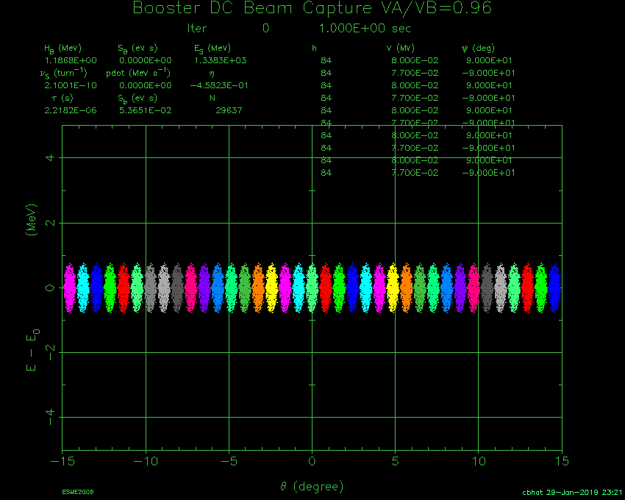
Simulations for Va=Vb and Va#Vb
Va/Vb=1
Currently working on
Better phase control
Digital system to control amplitudes
Try to go for much earlier injection to finish beam capture by Bmin
Snap bunch rotation
Add 2-harmonic RF system at injection and extraction.
Beam acceleration
Va/Vb=0.96

