Slide 1
Booster Beam phase w.r.t. RFSUM_asfound-on DC and Operational Cycles (preliminary)
Chandra Bhat & C.Y. Tan
20190408

Slide 2
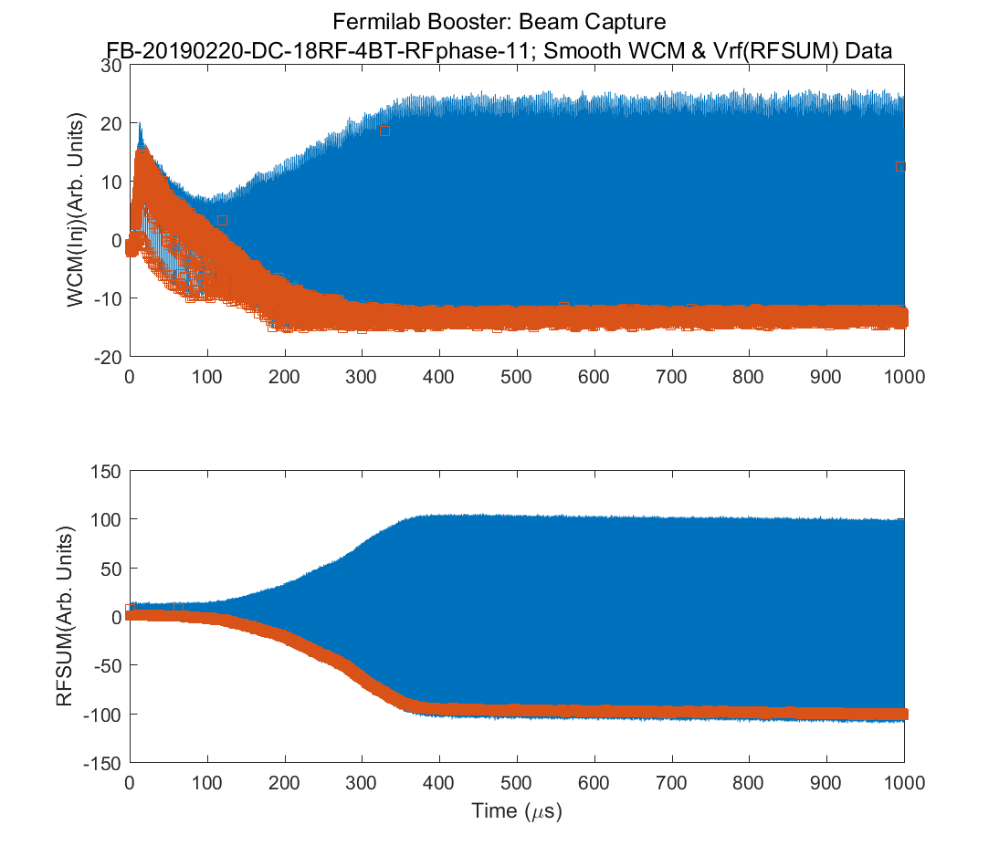
DC Raw Data (1msec around Injection)

Slide 3
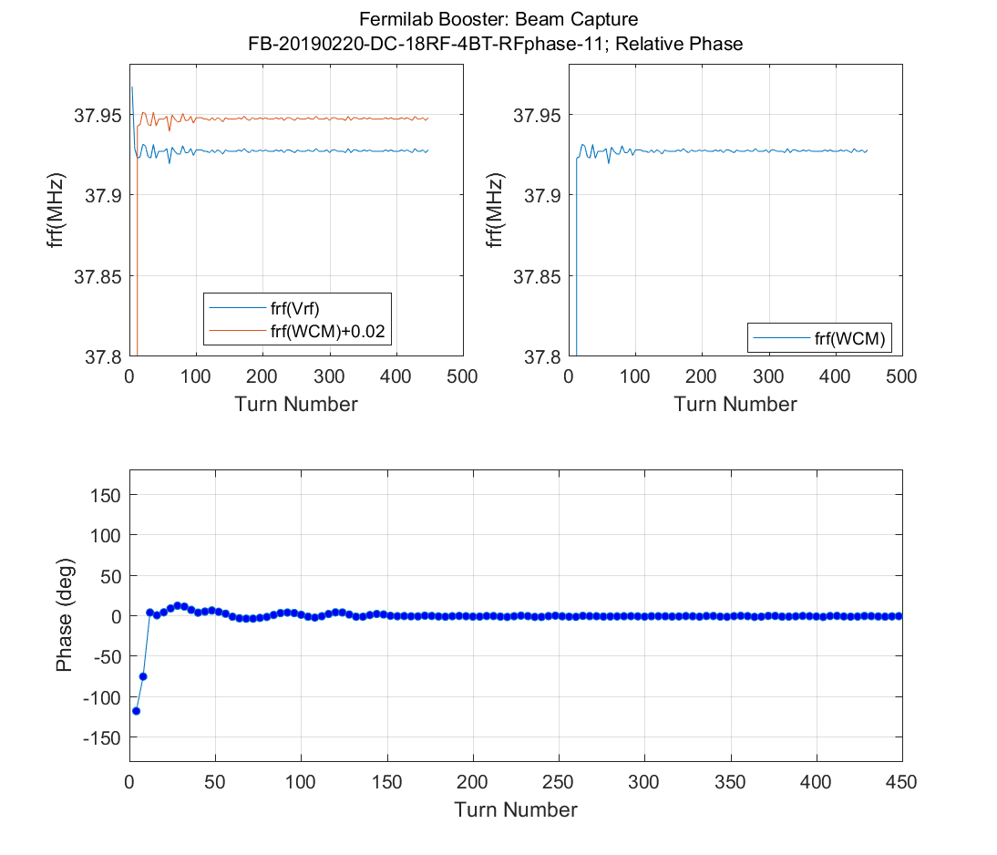
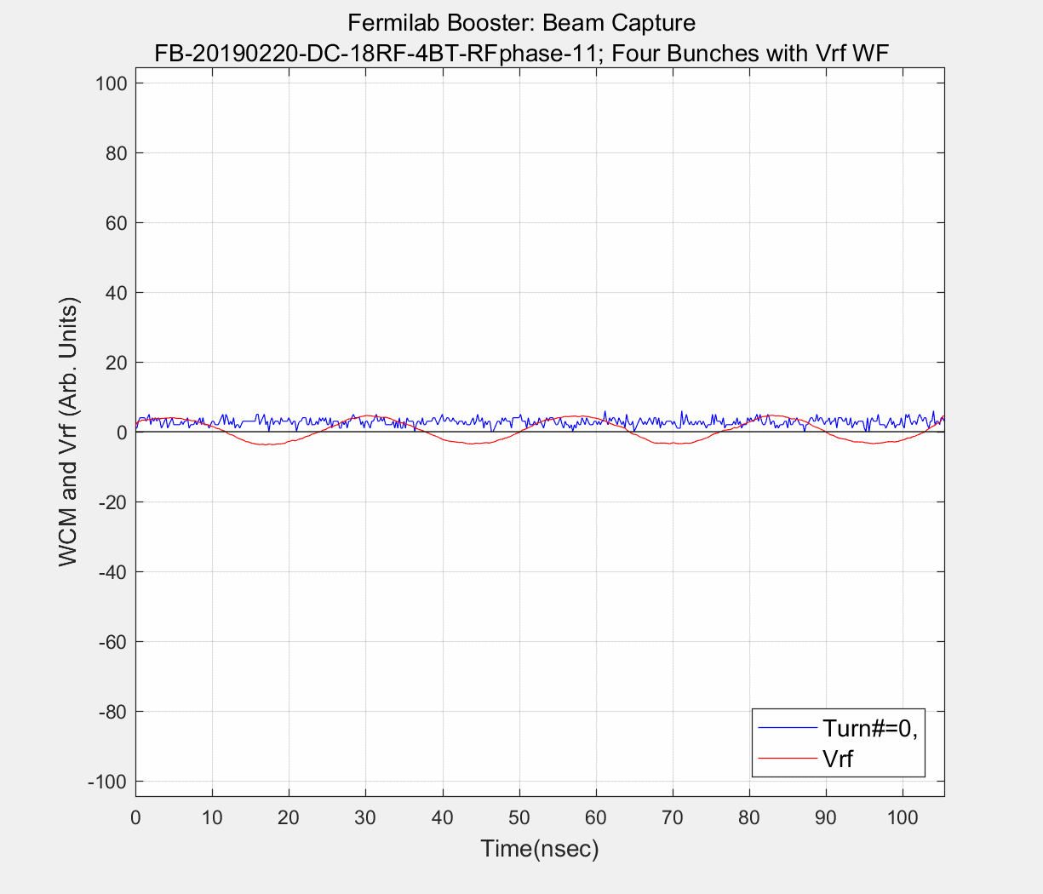
DC Raw Data (1msec around Injection)

Slide 4
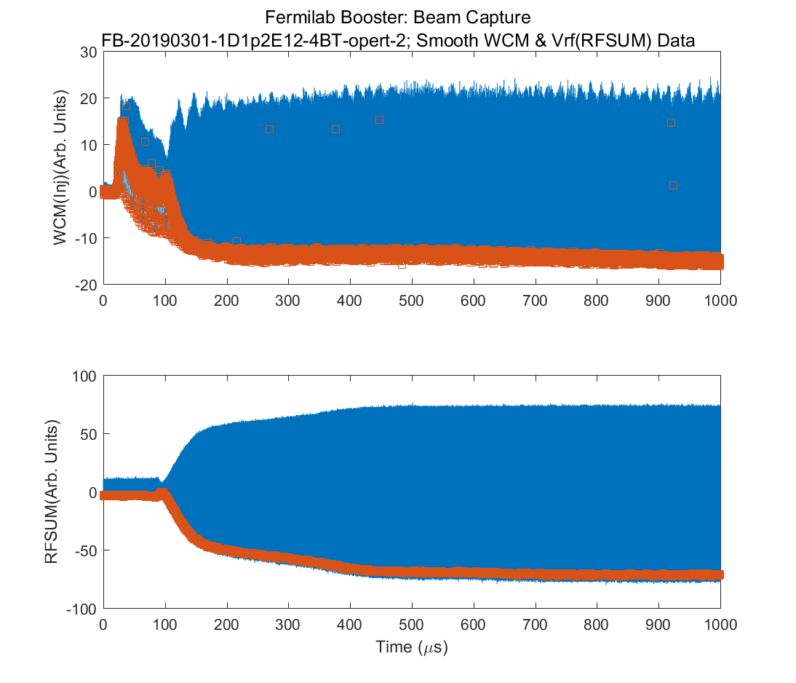
Raw Data (1msec around Injection)

Slide 5
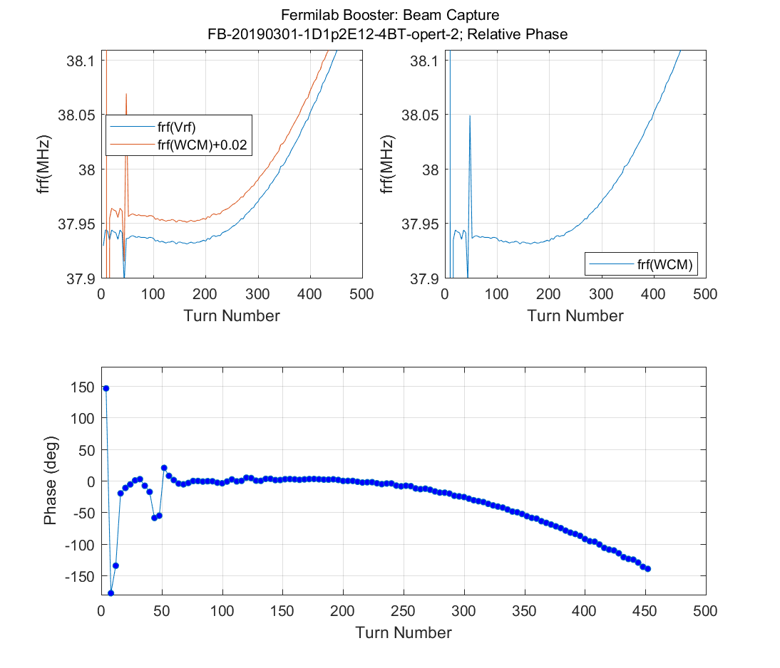
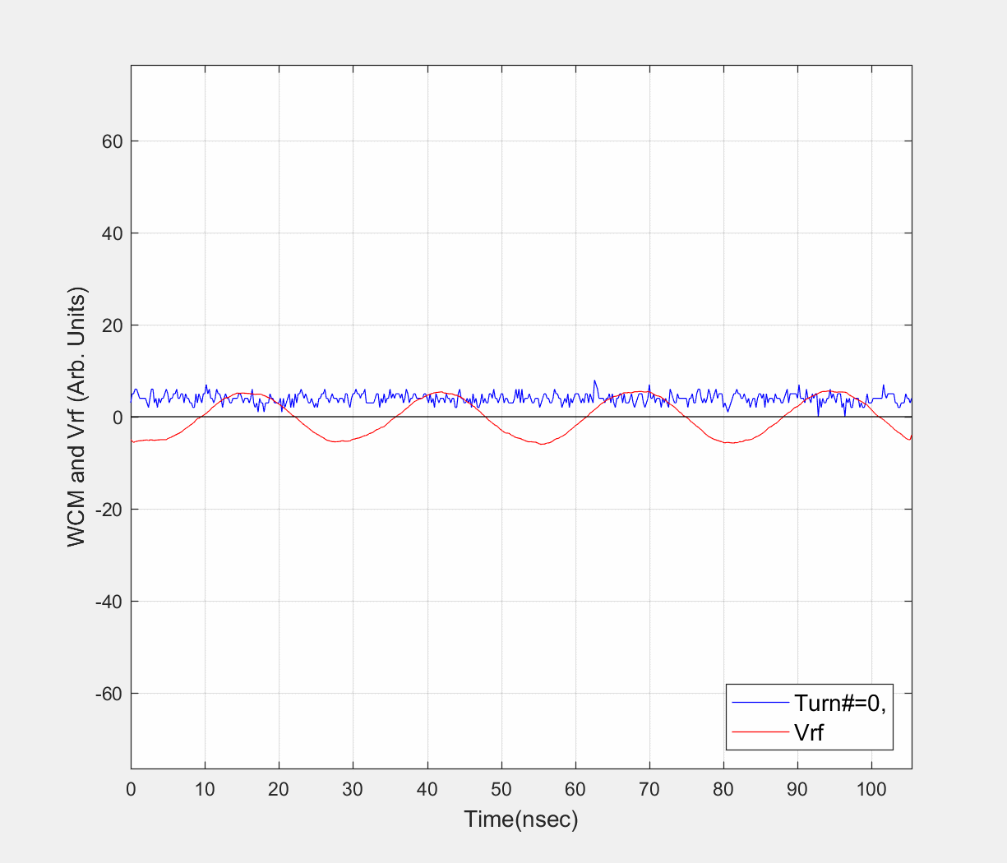
Raw Data (1msec around Injection)
End of Capture
Beam Phase = 0 deg relative to RF

Slide 6
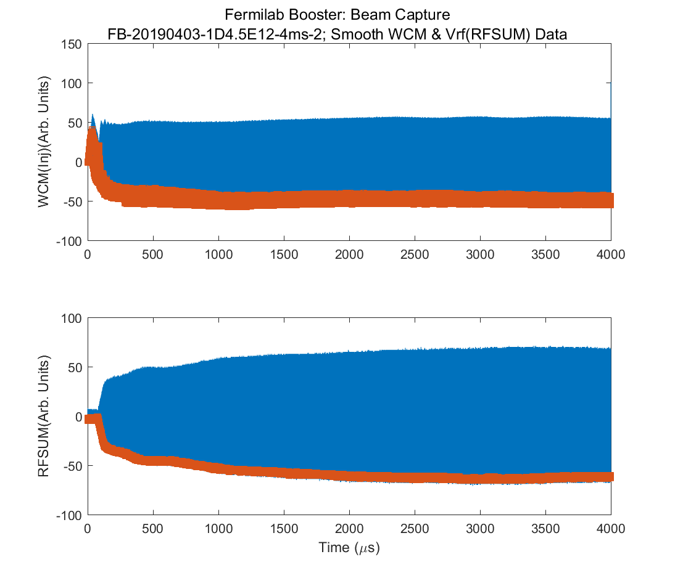
Raw Data (4ms around Injection)

Slide 7
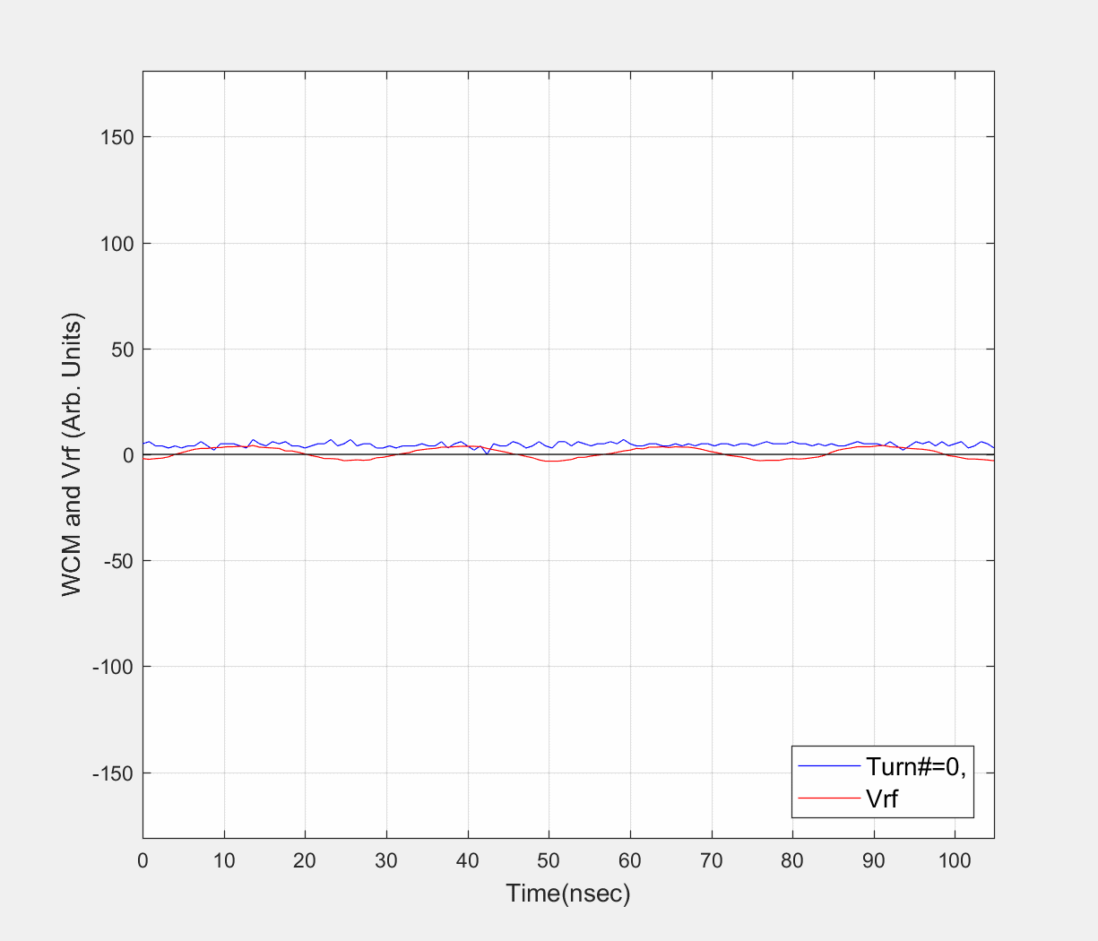
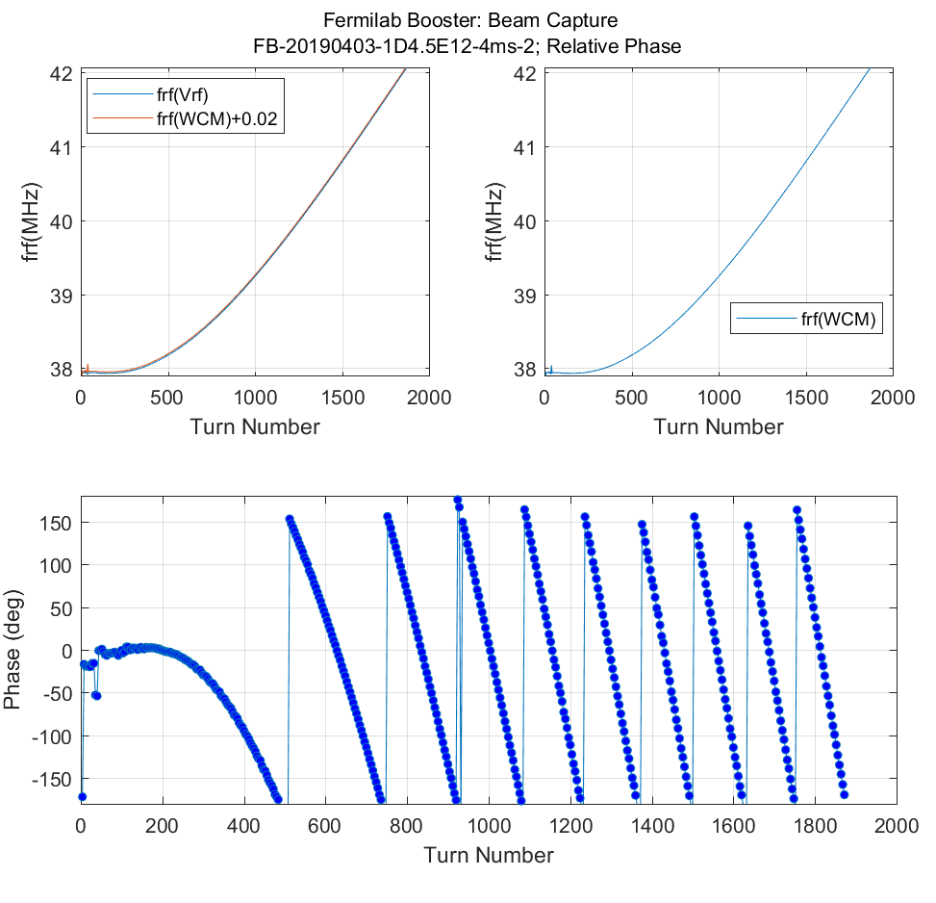
Raw Data (4ms around Injection)

