Slide 1
Fermilab Main Injector:
Promises Kept and More
Bruce C. Brown
2019 Fermilab Users Meeting
12 June 2019

Slide 2
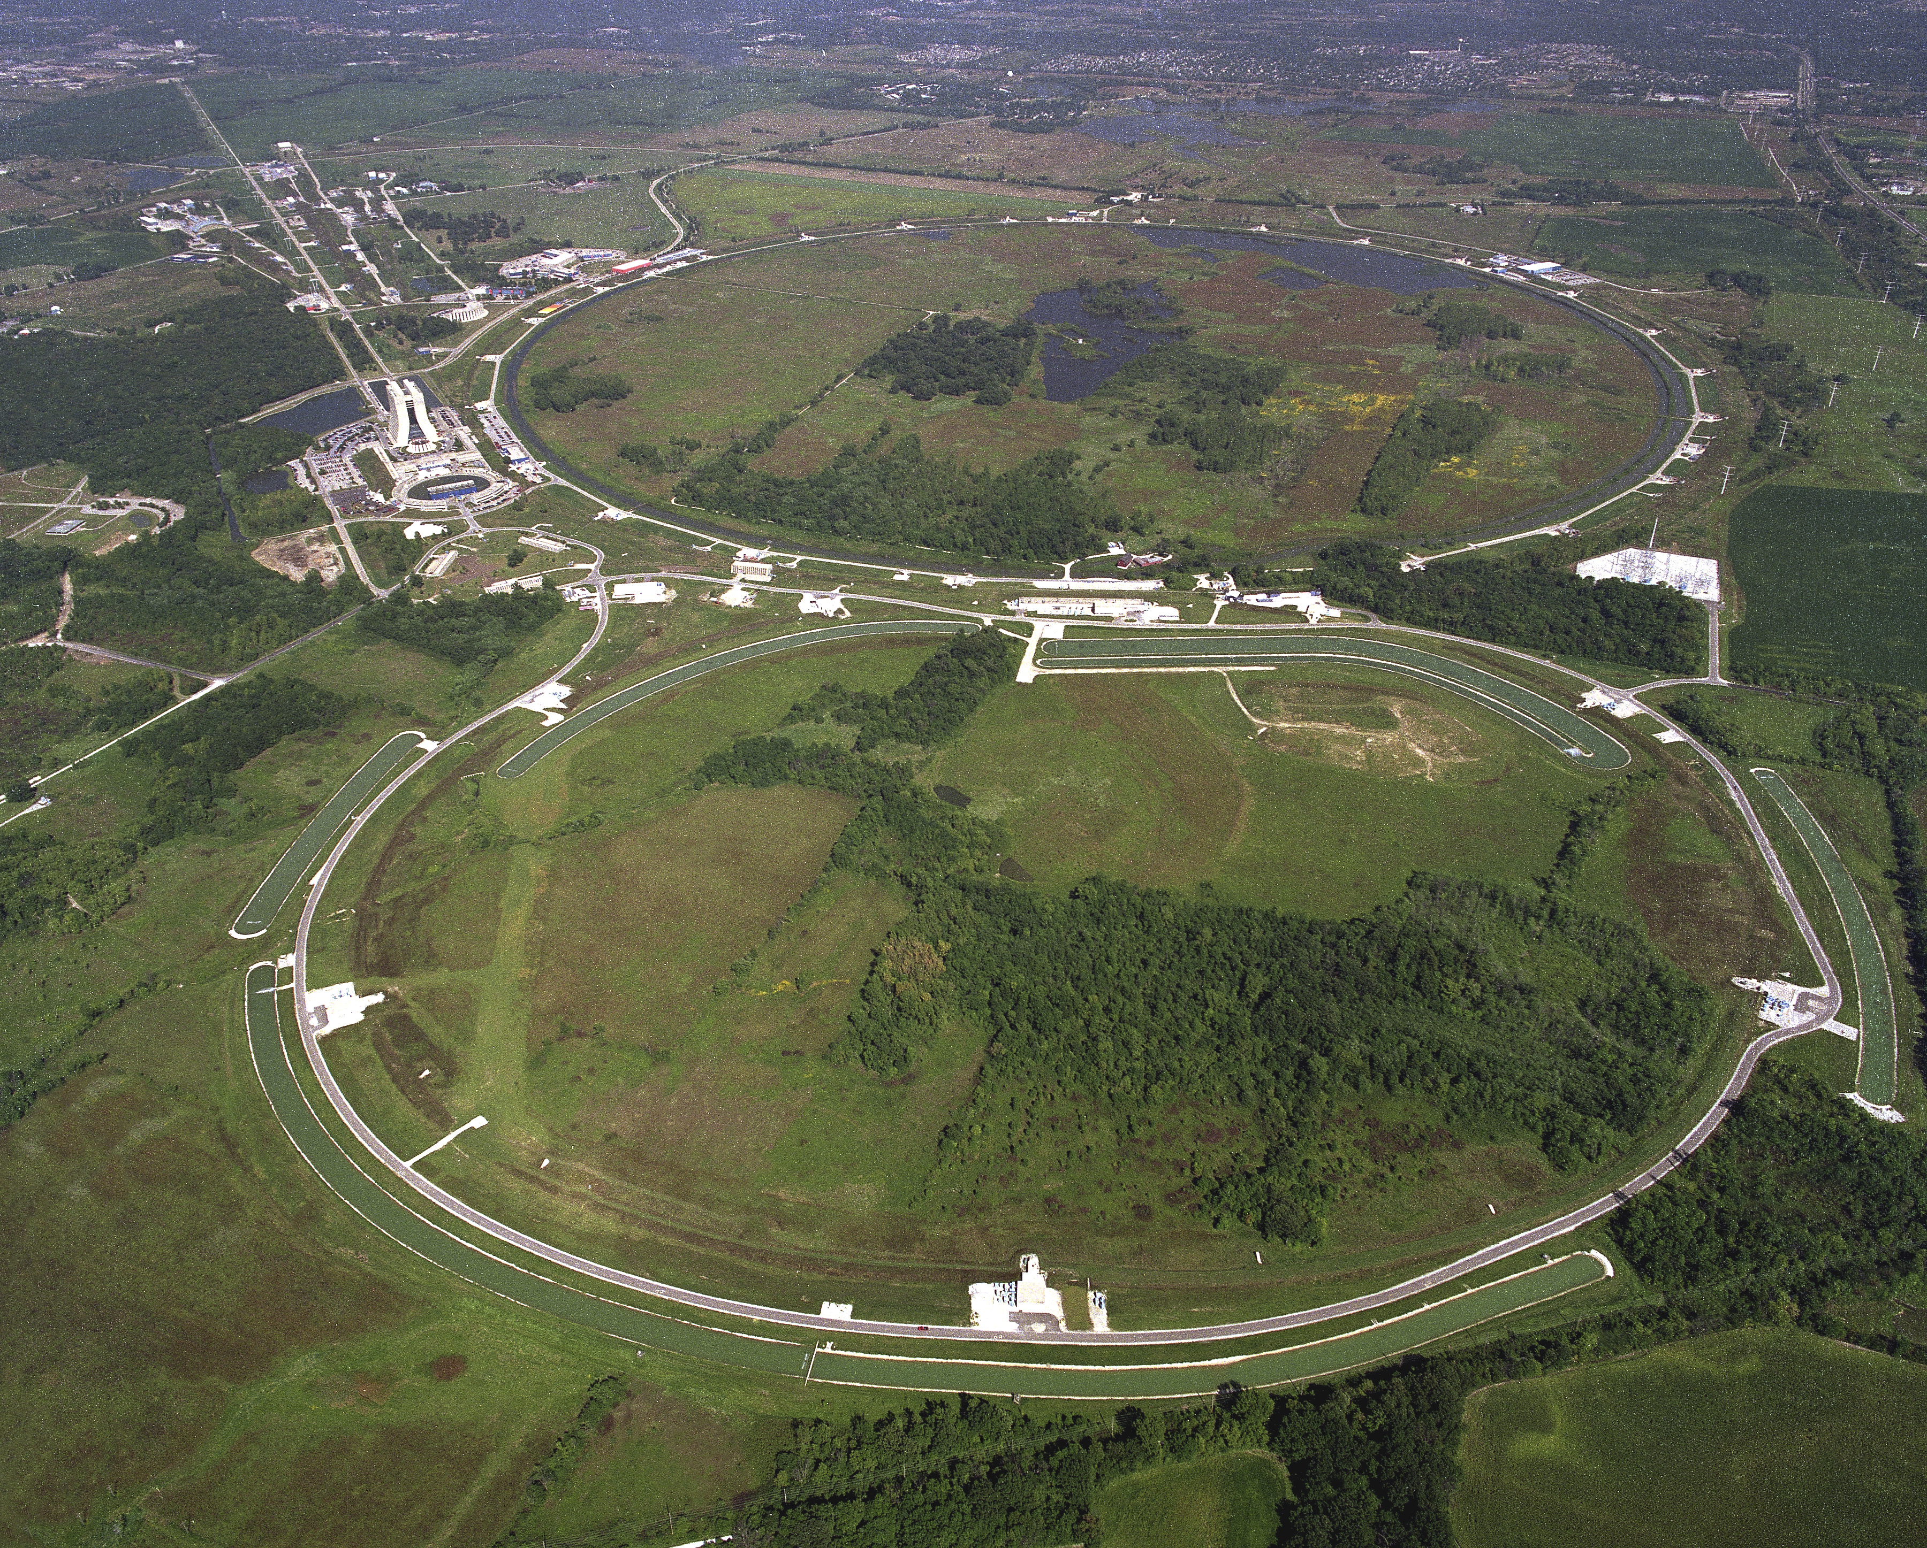
Fermilab Main Injector:
Promises Kept
And More
Your
Picture
Here
Dedication of
Fermilab
Main Injector
June 1999
20th Anniversary of
Fermilab
Main Injector
June 2019

Slide 3
Main Injector Project – Promises Kept and More
Create Fermilab
Main Injector
Project
1989
Accelerator Upgrades
For NOνA
2012 – 2013
Dedication of
Fermilab
Main Injector
June 1999
20th Anniversary of
Fermilab
Main Injector
June 2019

Slide 4
Main Injector Project – Promises
Tevatron Luminosity
More AntiProtons Collected
Better Proton and AntiProton Beam Quality
Improved Beam Transfers
x20 Integrated Luminosity
Fixed Target Operations
Protons at 120 GeV for Neutrino Production
Slow Spill at High Intensity
Year Around Test Beam Facilities

Slide 5
Magnet Designs for Main Injector and Recycler
Stan Snowdon
Main Ring Dipoles and Quads
Tevatron Dipoles and Quads
Pbar Dipoles and Quads
Main Injector Dipole
The Card Punches and Card Readers for computer input were kept around so Stan could use them !!!

Slide 6
Creating the Main Injector Project

Slide 7
Creating the Main Injector Project
"Workshop on the Design of Permanent Magnet Synchrotrons" held at the Lawrence Berkeley Laboratory in October of 1994
DOE Insisted
That Magnet Cost
Estimate was LOW: Add $15 million
Design Recycler Ring
Consider Options for MORE PBARS
Recycler Ring Added to Fermilab Main Injector Project

Slide 8
Magnet Designs for Main Injector and Recycler
G. W. Foster
January 1998
Bill Foster: RR Magnets
Gradient Magnets
Dipoles and Quads
Lambertsons

Slide 9
Booster to Main Injector Transfer Line 2000 Energy Management Achievement Award
Fermilab Recycler Team

Slide 10
Main Injector and Recycler As Commissioned
Here we are in the tunnel at MI52 with the Recycler above the Main Injector. The beamline to the right transfers beam toward the Tevatron and brings PBars from the PBar source

Slide 11
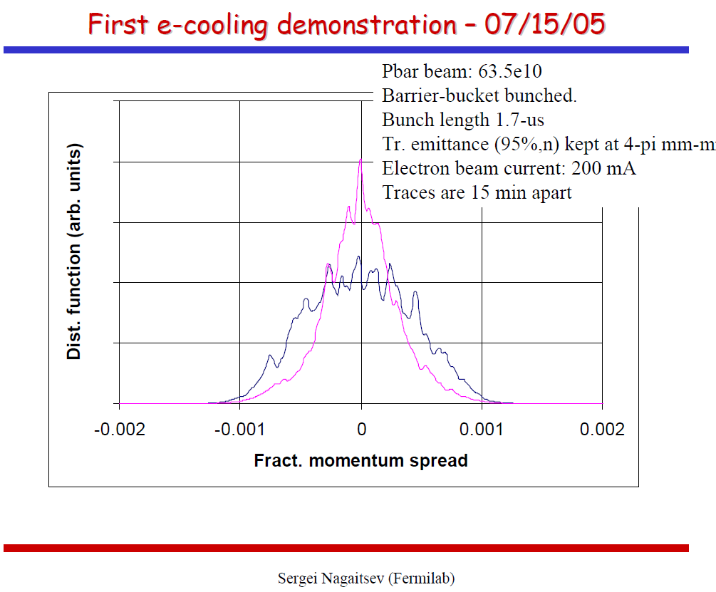
Tevatron Run II Era – Recycler Completion
New Cooling Lattice
New Quadrupoles
& Replace End Shims
Replace Bake-out
Heater Strips
And Bake Out Recycler Vacuum
Perfect Accumulator to Recycler and Recycler/MI/Tevatron Transfers
Improve Lattice
By New Gradient End Shims
Cool 8 GeV Pbars with Electron Cooling
July 2005
Tevatron Fixed Target
End Tevatron Run
30 September 2011
First Beam to NuMI for Neutrinos

Slide 12
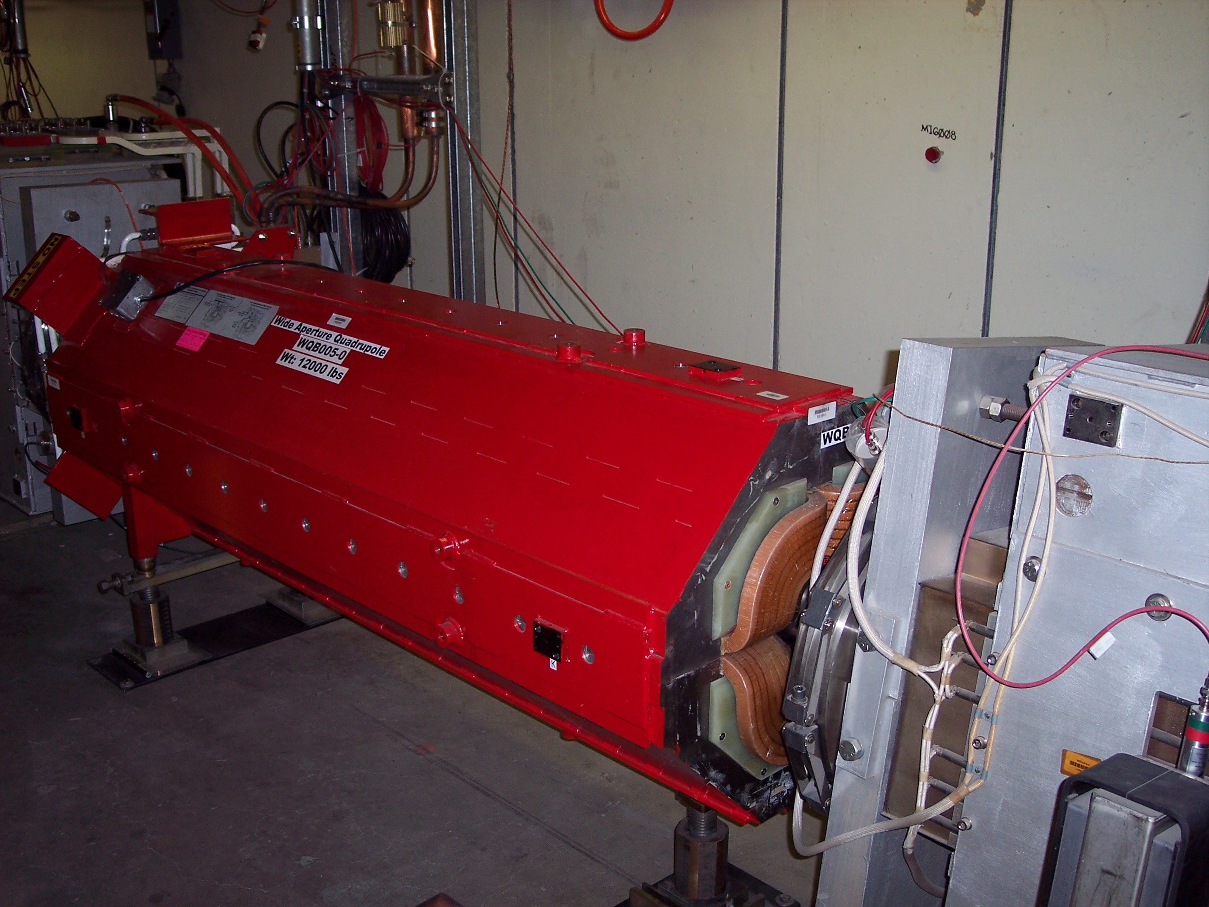
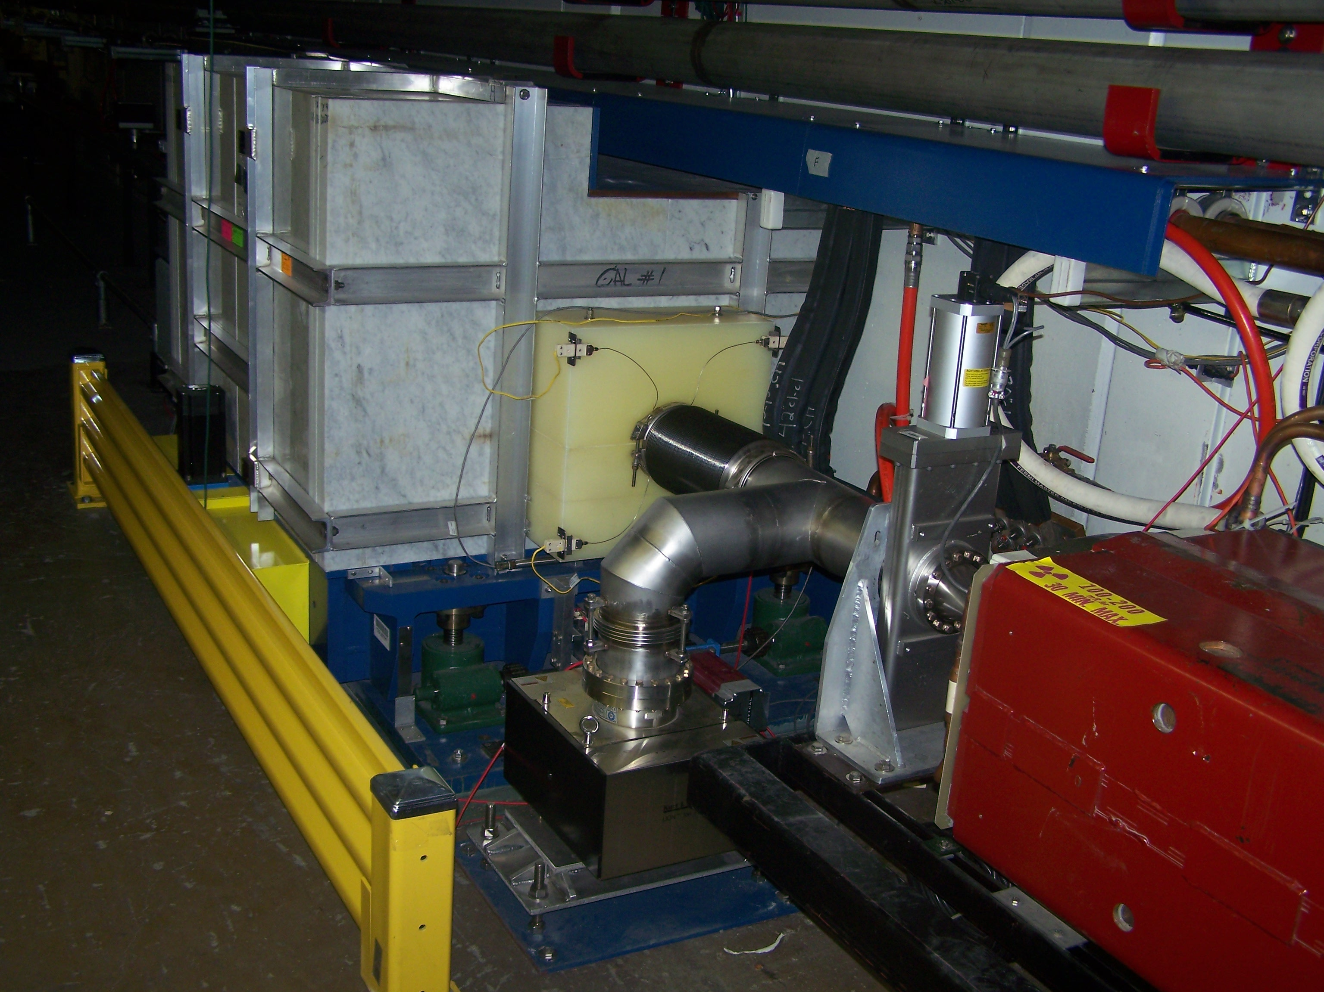
Tevatron Run II Era – Main Injector Upgrades
Instrumentation Upgrades:
BLM and BPM
2005-6
Large Aperture Quadrupole at Transfer Points
2006
Main Injector Collimation at MI30
2007
Dampers:
Slow Dampers
Bunch-by-Bunch
Dampers
2004
Gap-Clearing Kickers
2009-2010
Slip Stacking
2002-2007

Slide 13
Tevatron Run II Era
Numerous Enhancements to
Booster
Pbar Source
Beam Transfer
Tevatron
Operational Sequences
Tevatron Fixed Target
End Tevatron Run
30 September 2011

Slide 14
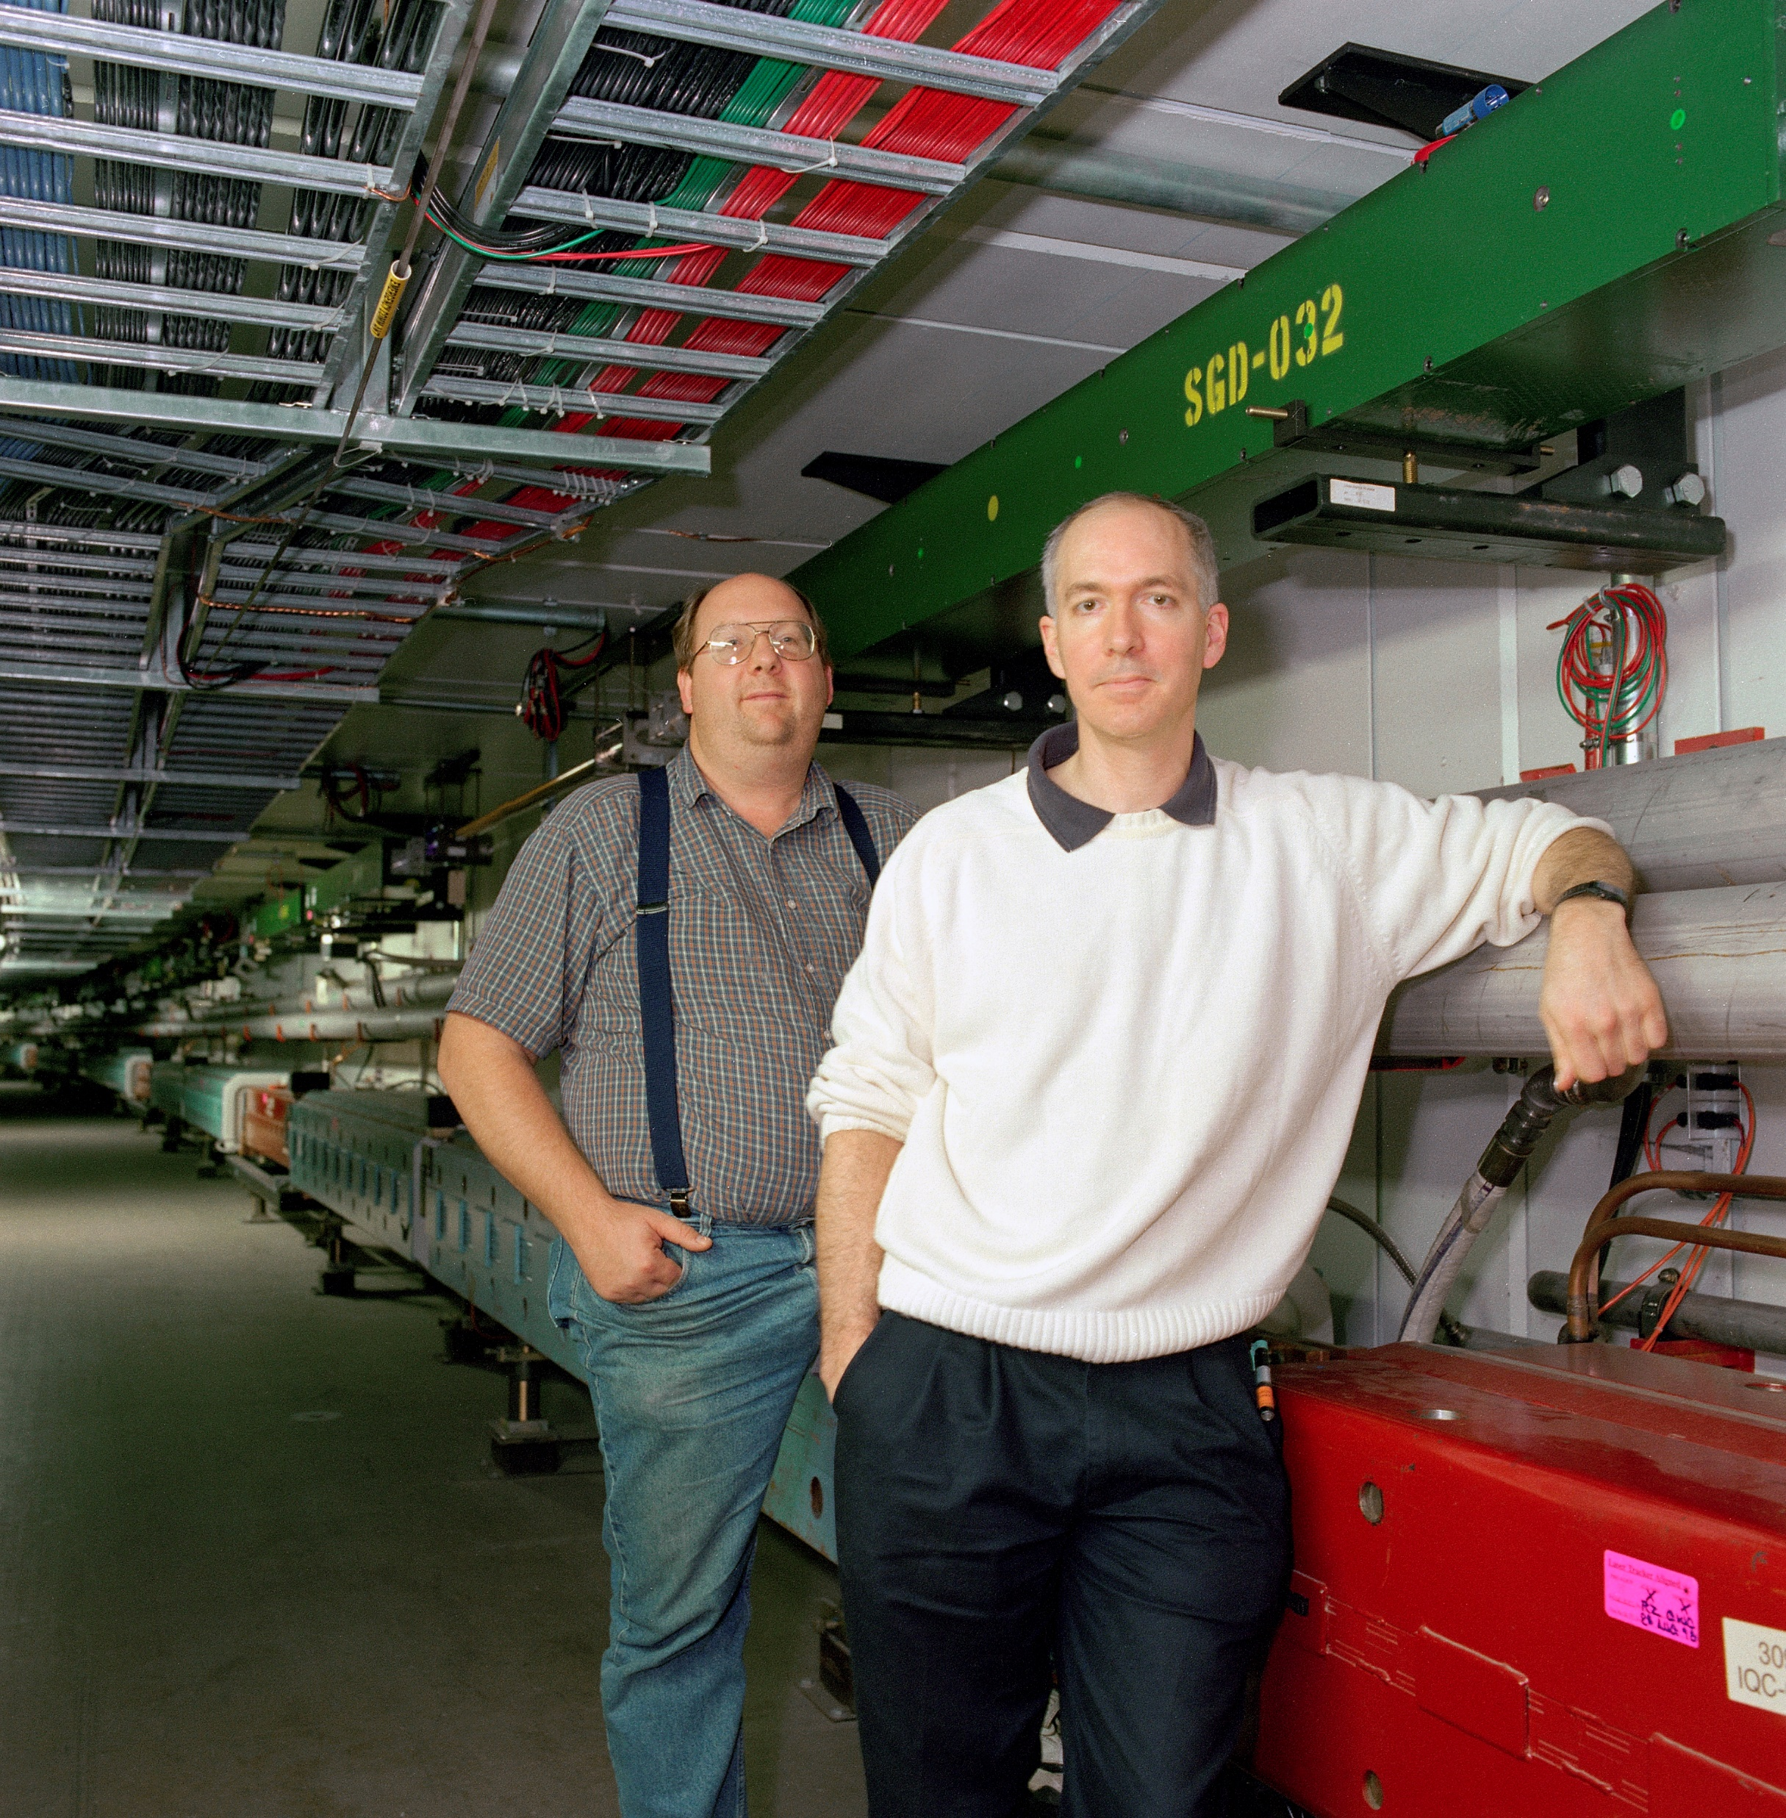
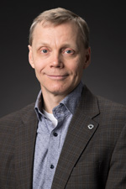
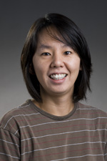
Prizes Awarded for Our Colleagues
1999 IEEE Nuclear and Plasma Sciences
Particle Accelerator Science and Technology Award
G William Foster and Gerald P. Jackson,
Fermi National Accelerator Laboratory
For their leading roles in the conceptualization, design, and development of the first large-scale application of permanent magnet technology for beam transport, in the forms of the 8 GEV Booster to Main Injector transfer line and the Recycler Ring at Fermilab.
2007 US Particle Accelerator School Prize
for Achievement in Accelerator Science and Technology
Sergei Nagaitsev
Fermi National Accelerator Laboratory
For his outstanding scientific leadership in the demonstration of non-magnetized relativistic electron cooling of hadron beams to improve collider luminosity.
2009 IEEE Nuclear and Plasma Sciences
Particle Accelerator Science and Technology Award
Kiyomi Seiya,
Fermi National Accelerator Laboratory
For developing and successfully implementing slip stacking of proton batches injected into the Fermilab Main Injector resulting in a significant increase beam intensity.

Slide 15
What is needed for High Intensity Proton Delivery
We need Many, Many Protons per Main Injector Ramp Cycle
The Main Injector is 7 times the Booster circumference
With a gap for Injection and can stack 6 Booster Batches
With Slip Stacking we can Stack 12 Booster Batches.
Main Injector Cycle consists of Injection Dwell Time Plus Acceleration Ramp
Slip Stacking in the Main Injector employed 2.2 Second repetitions limited by the time to accumulate PBars in the Accumulator.
By using the Recycler Ring to slip stack high intensity proton batches, we essentially eliminate the Injection Dwell Time.
Achieved 1.33 Second repetitions for Main Injector Cycles for 2013-19
Will Run with 1.2 Second repetitions starting in Fall 2019

Slide 16
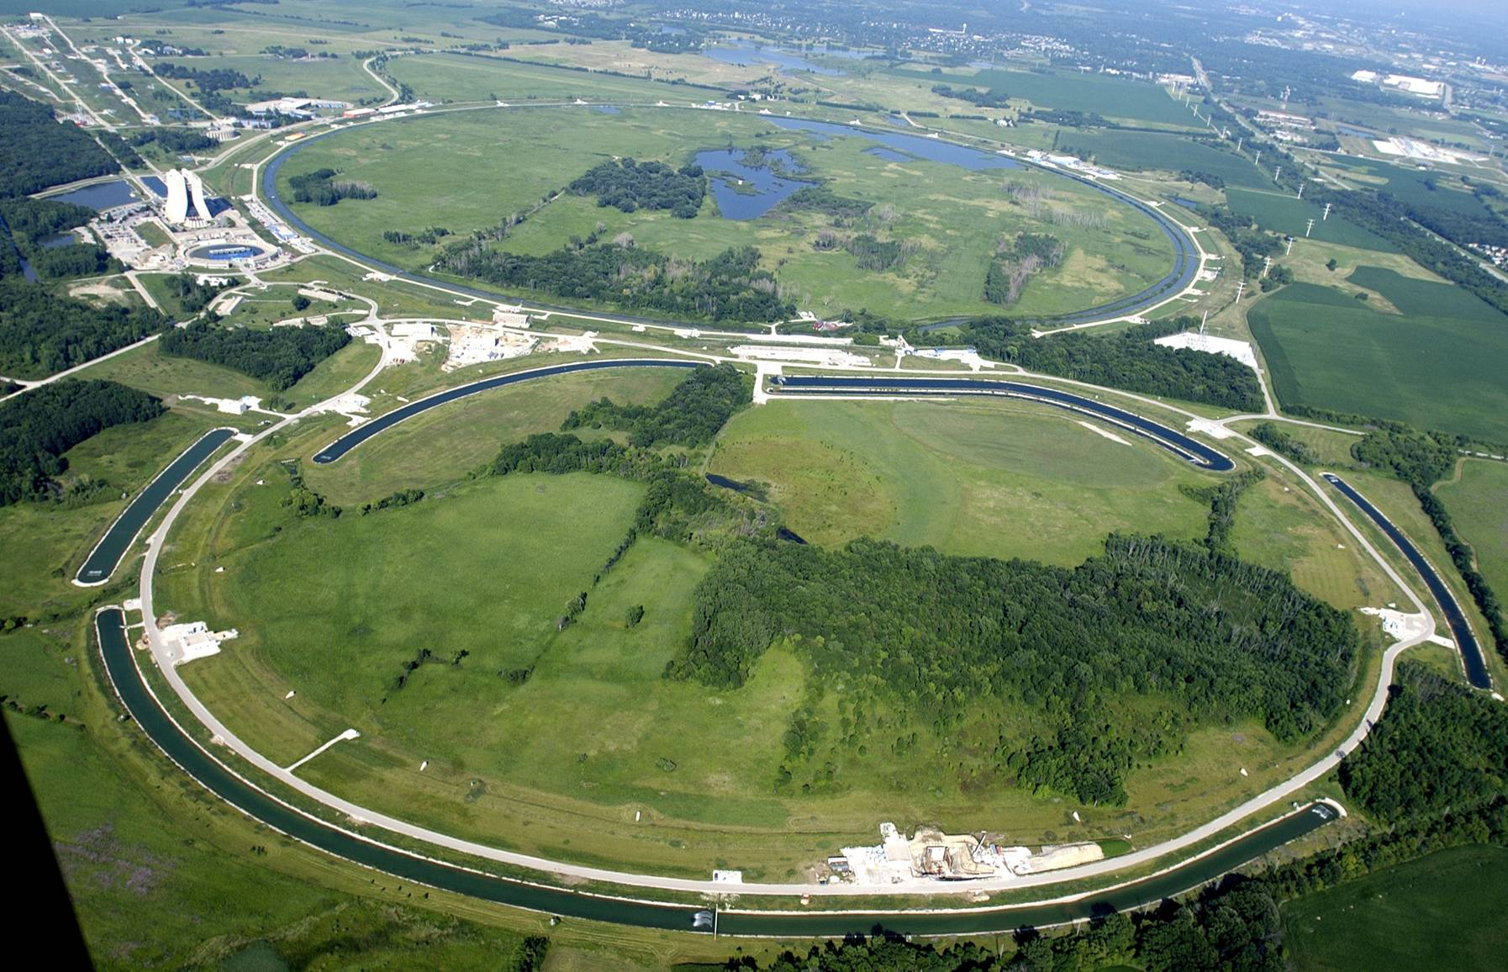
Main Injector High Power Operation (Mixed Mode)
Provides high power, 120 GeV proton beam
Takes 11 batches from the 8 GeV Booster @ 15 Hz
4-5 × 10¹² protons per Booster batch
Total cycle time ≥ 1.4 s + batches/15
Booster
NuMI
(Double) Batch 1 (PBar)
Batch 2 (Double)
Batch 6 (Single)
Main Injector
Batch 3 (Double)
Batch 5 (Double)
Batch 4 (Double)
16

Slide 17
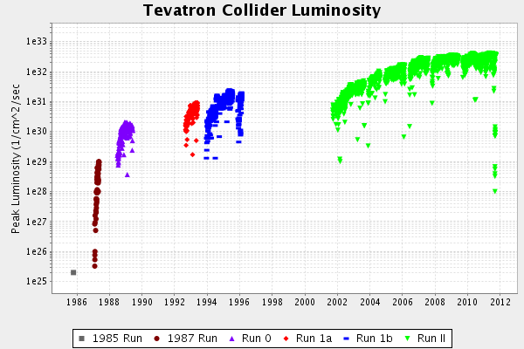
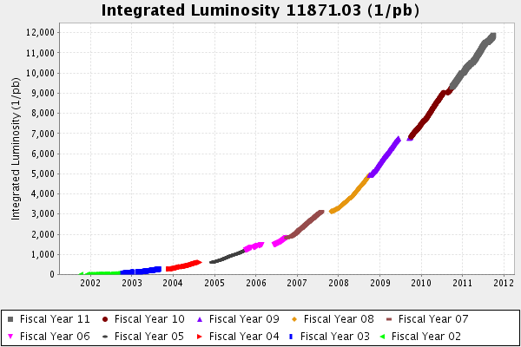
Tevatron Run II – 2002 - 2011
Run II Luminosity 11871 pb⁻¹
Run Ia + Run 1b Luminosity 178.7 pb⁻¹
x66.4
Tevatron Fixed Target
End Tevatron Run
30 September 2011
Run II

Slide 18
NOνA Project: ANU(Accelerator & NuMI Upgrades) Prepare for Stacking Protons in the Recycler Ring
New Transfer Line from Recycler to Main Injector at MI30
MI8 Transfer Line Extension for Recycler Injection from Booster
New Recycler Lattice for Transfers => New Gradient End Shims
Faster MI Magnet Ramps
Two More 53 MHz RF Cavities for Main Injector
53 MHz RF System (3 cavities) for Recycler Ring
Move Gap-Clearing Kickers MI=>RR
New Instrumentation (esp. BPM’s]
[2.5 MHz => 53 MHz]
Shutdown 2012-13

Slide 19
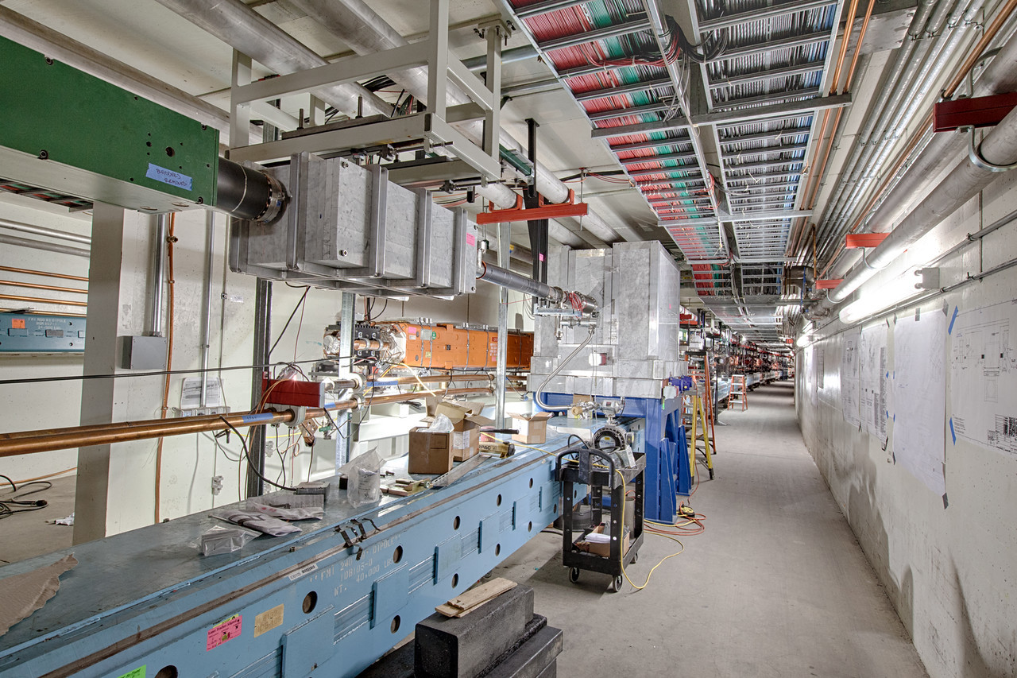
Recycler Upgrades for High Intensity Slip Stacking
Lattice Control to Reduce Vertical Beam Size Excursions plus
Beam Pipe Replacements
Recycler Collimation
Vacuum Upgrade: Sublimation Pumps => Ion Pumps
(3 Shutdowns Needed)
Electron Cloud Instabilities
(‘Scrub’ Beam Pipe for Reduced Secondary Emission)
Diode (Multibunch) Dampers

Slide 20
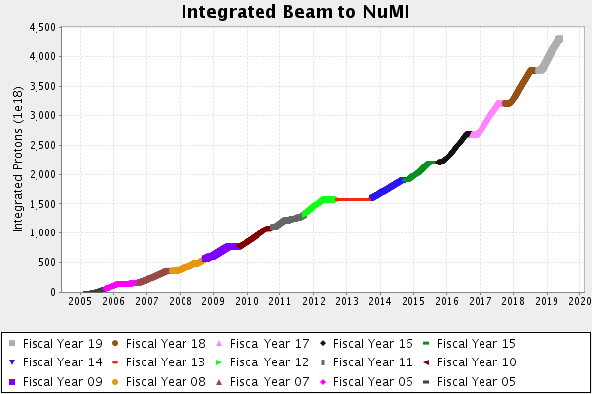
Performance of Main Injector
The Main Injector reached a record beam power average of 757.75 kW for one hour on April 04, 2019.
NuMI Target Limits Reached:
2005-11 Configuration:
44E12 p/pulse
2013-19 Configuration:
54E12 p/pulse
2019 --- Configuration
73E12 p/pulse

Slide 21
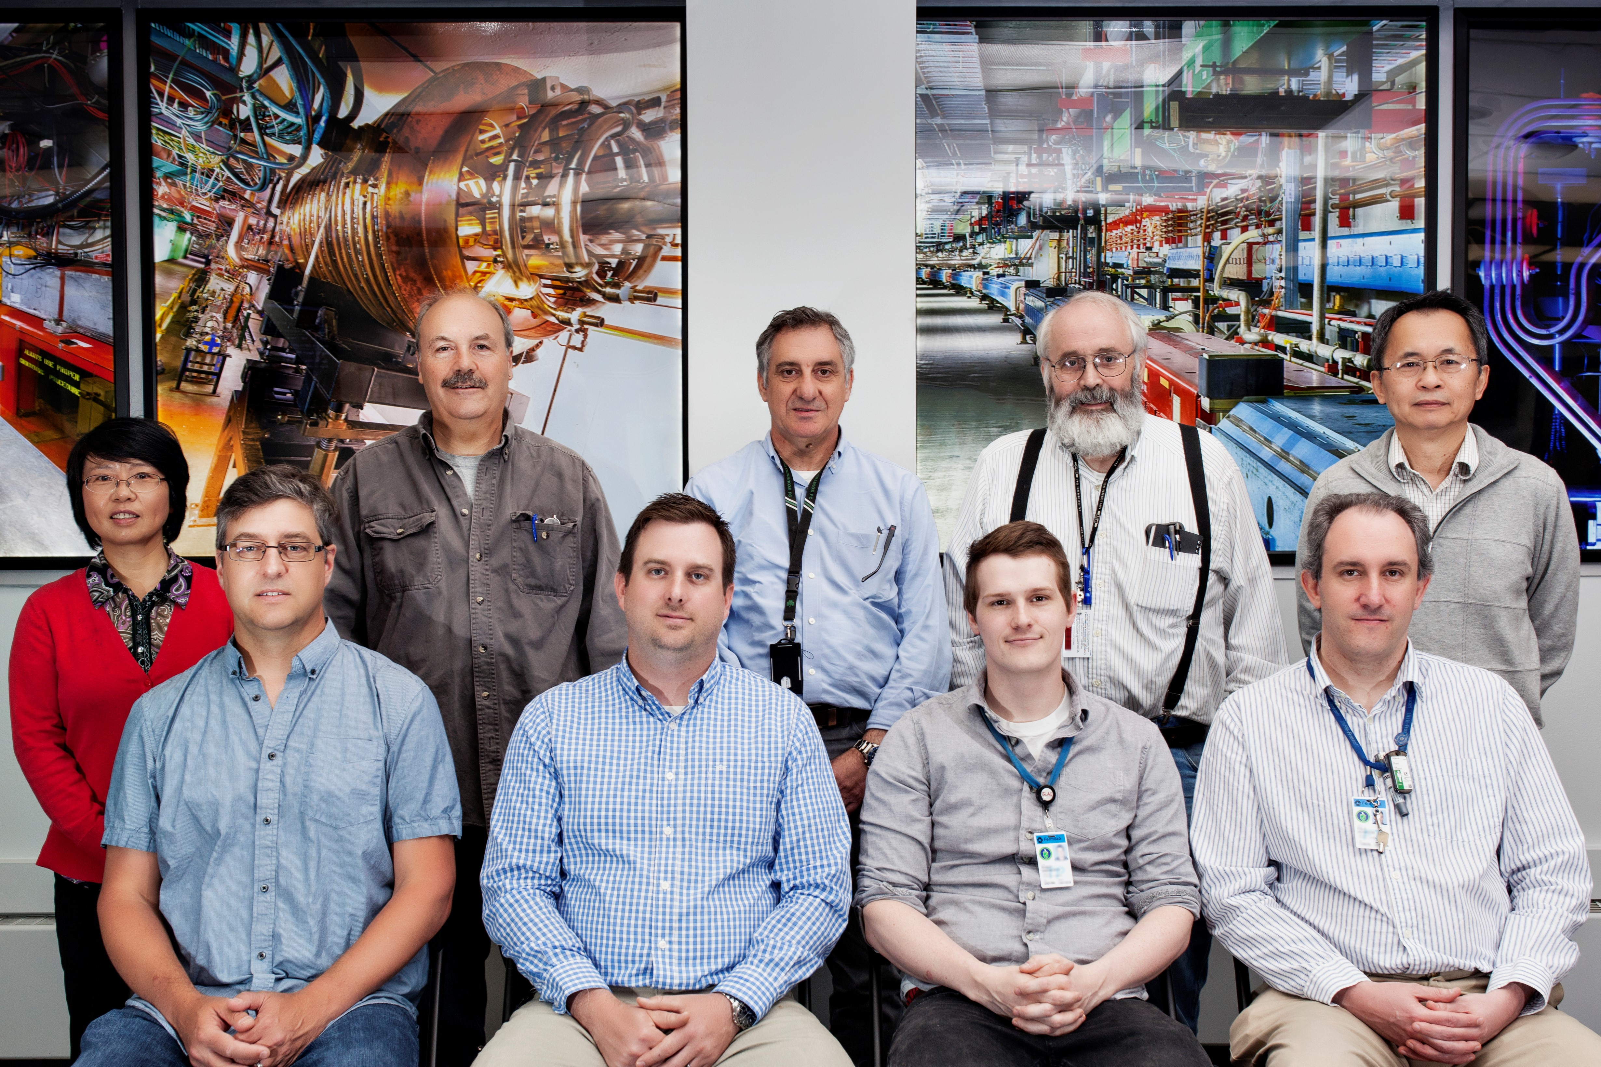
Main Injector Department - 2019
Meiqin Xiao, David Capista, Ioanis Kourbanis, Bruce Brown, Ming-Jen Yang
Denton Morris, Kyle Hazelwood, Robert Ainsworth, Phil Adamson

Slide 22
Main Injector Project – Promises Kept and More
Many Talents – Much Dedication – Lasting Results

Slide 23
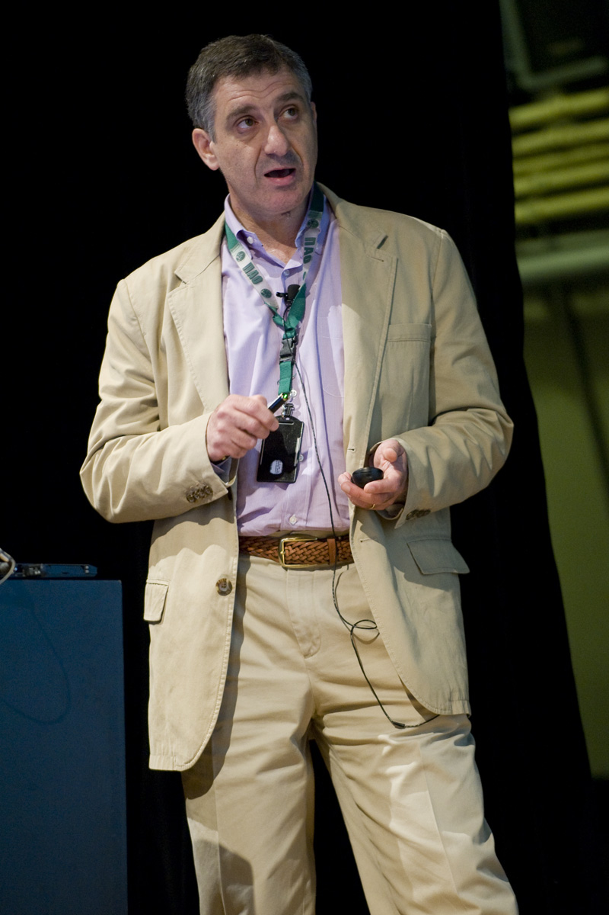
Main Injector Project – Promises Kept and More
Acknowledgments:
Lab Directors:
John Peoples, Michael Witherell, Piermaria Oddone, Nigel Lockyer
Accelerator Division Heads: Steve Holmes, David Finley, John Marriner, Roger Dixon, Sergei Nagaitsev, Mike Lindgren
Main Injector Project Head: Steve Holmes
Main Injector Department Head: Phil Martin, Shekhar Mishra, Ioanis Kourbanis, David Capista
Accelerator Division, Technical Division
and The Rest of The Fermilab Staff
Fermilab Users
Special Thanks Today to the Organizers of the 2019 Fermilab Users Mtg

Slide 24
Backup Slides

