Slide 1
PSA: There is evidence of a mouse in my office in Linac Gallery

Slide 2
Initial neutralization studies with mass flow controller

Slide 3
The case for the need for increased LEBT pressure:
The LEBT turbos run at their minimum speed
When doing LEBT pressure scans, we stop when turbos reach their minimum speed
We tested running with only 1 LEBT turbo in the past, it needed to run at max speed.
Previous BNL experience

Slide 4
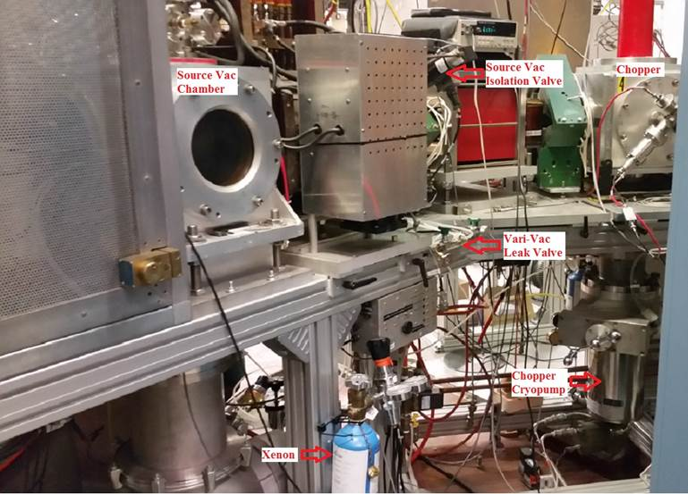
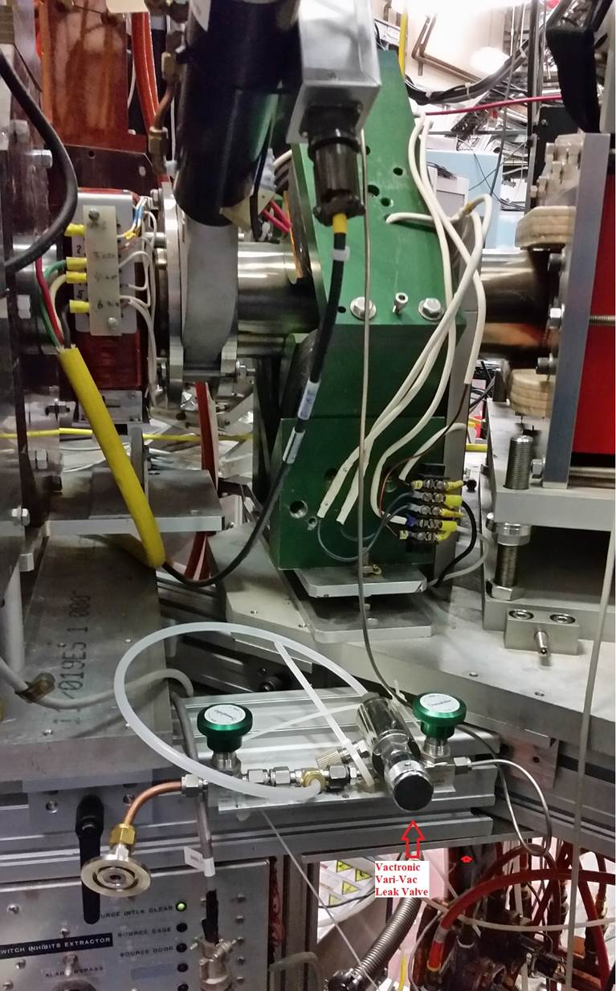
BNL neutralization line and experience
BNL started using Xenon around 2012 and used it for several years, then ran with N2 and finally air bleeding in. They are no longer bleeding in any gas. They used around 25L of Xenon over a several year span. Gas line is around 40cm from the source. (Tim Lehn, BNL)
Note:
Cost of 25L of Xenon and a regulator is around $2250.00

Slide 5
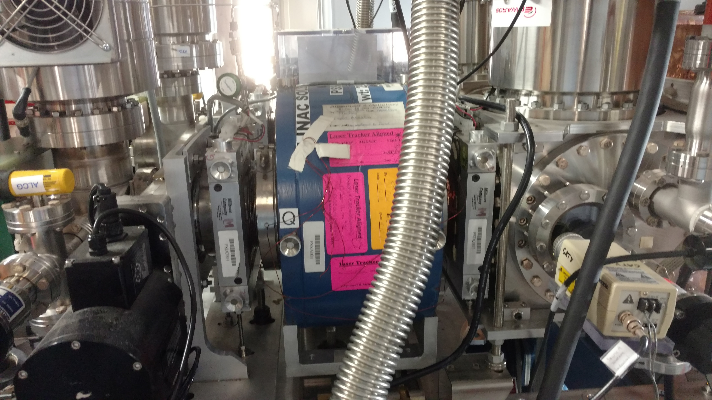
Location of our neutralization line
~32cm

Slide 6
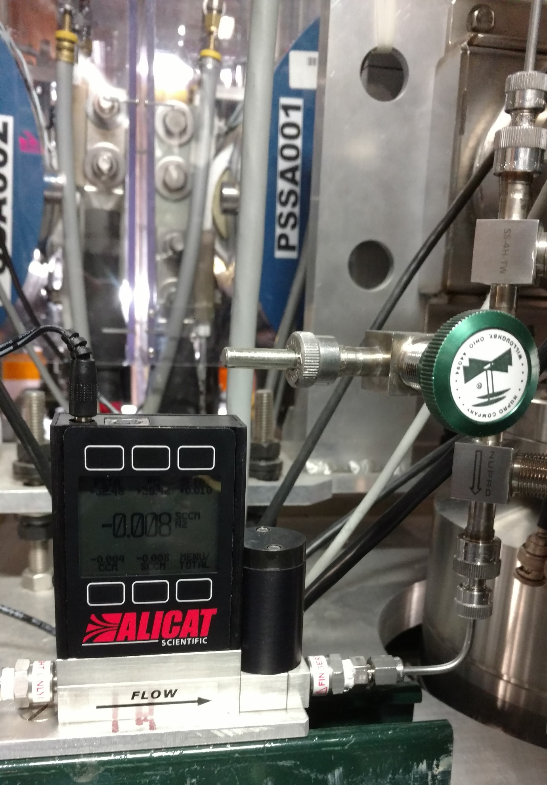
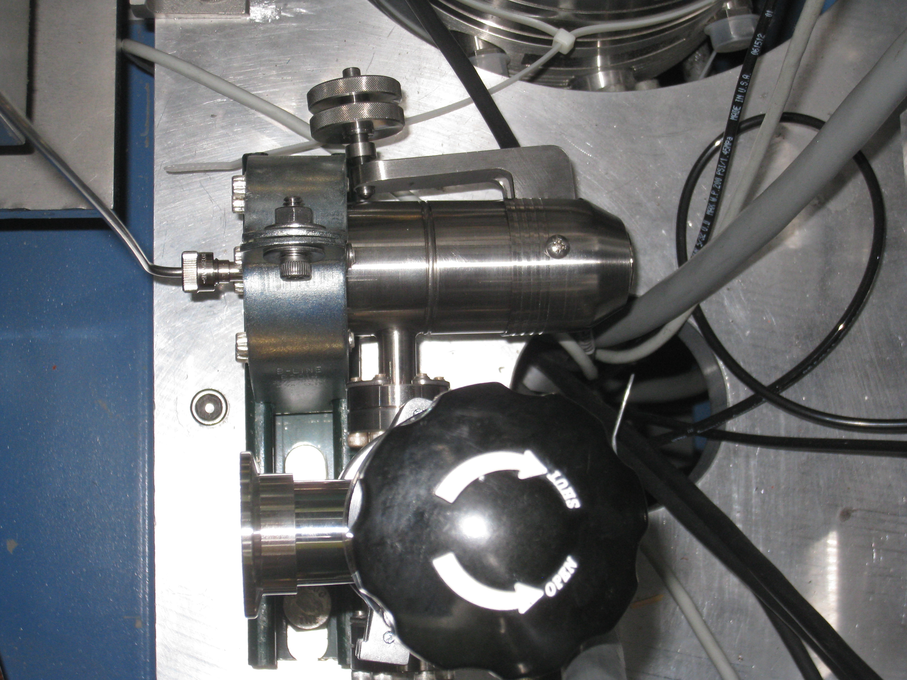
Nitrogen flow control
Initially used manual leak valve, hard to control flow
Recently installed mass flow controller

Slide 7
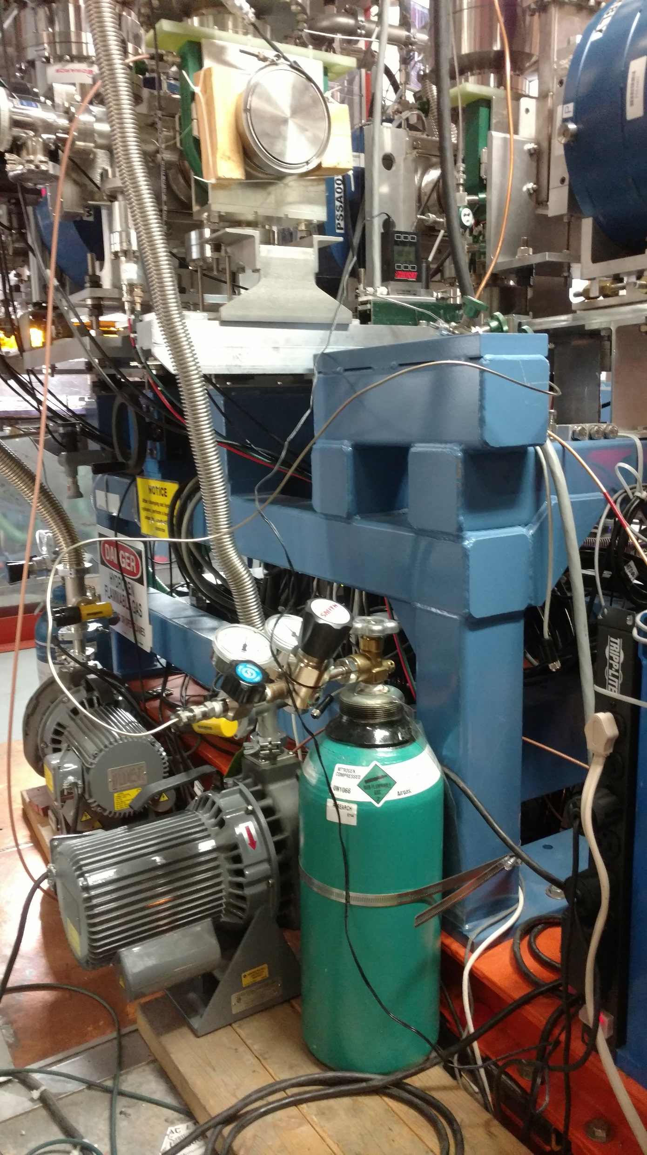
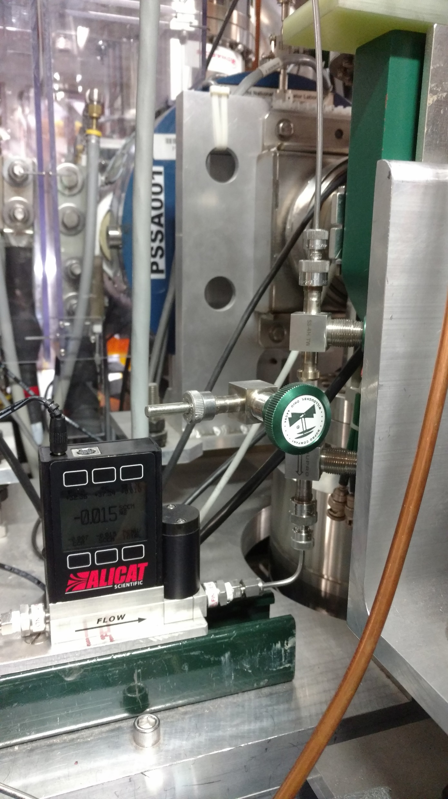
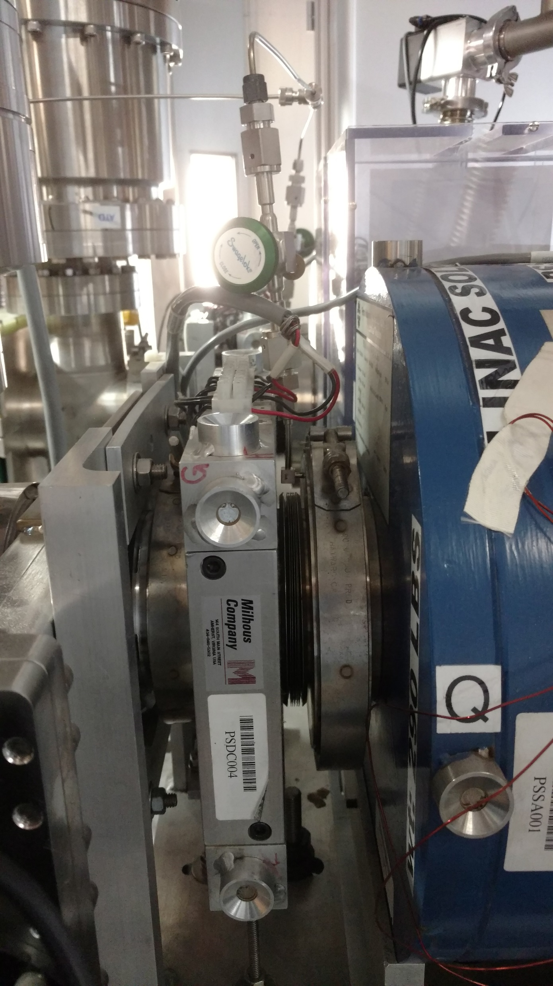
Overall N₂ injection
N₂ injected into special made flange

Slide 8
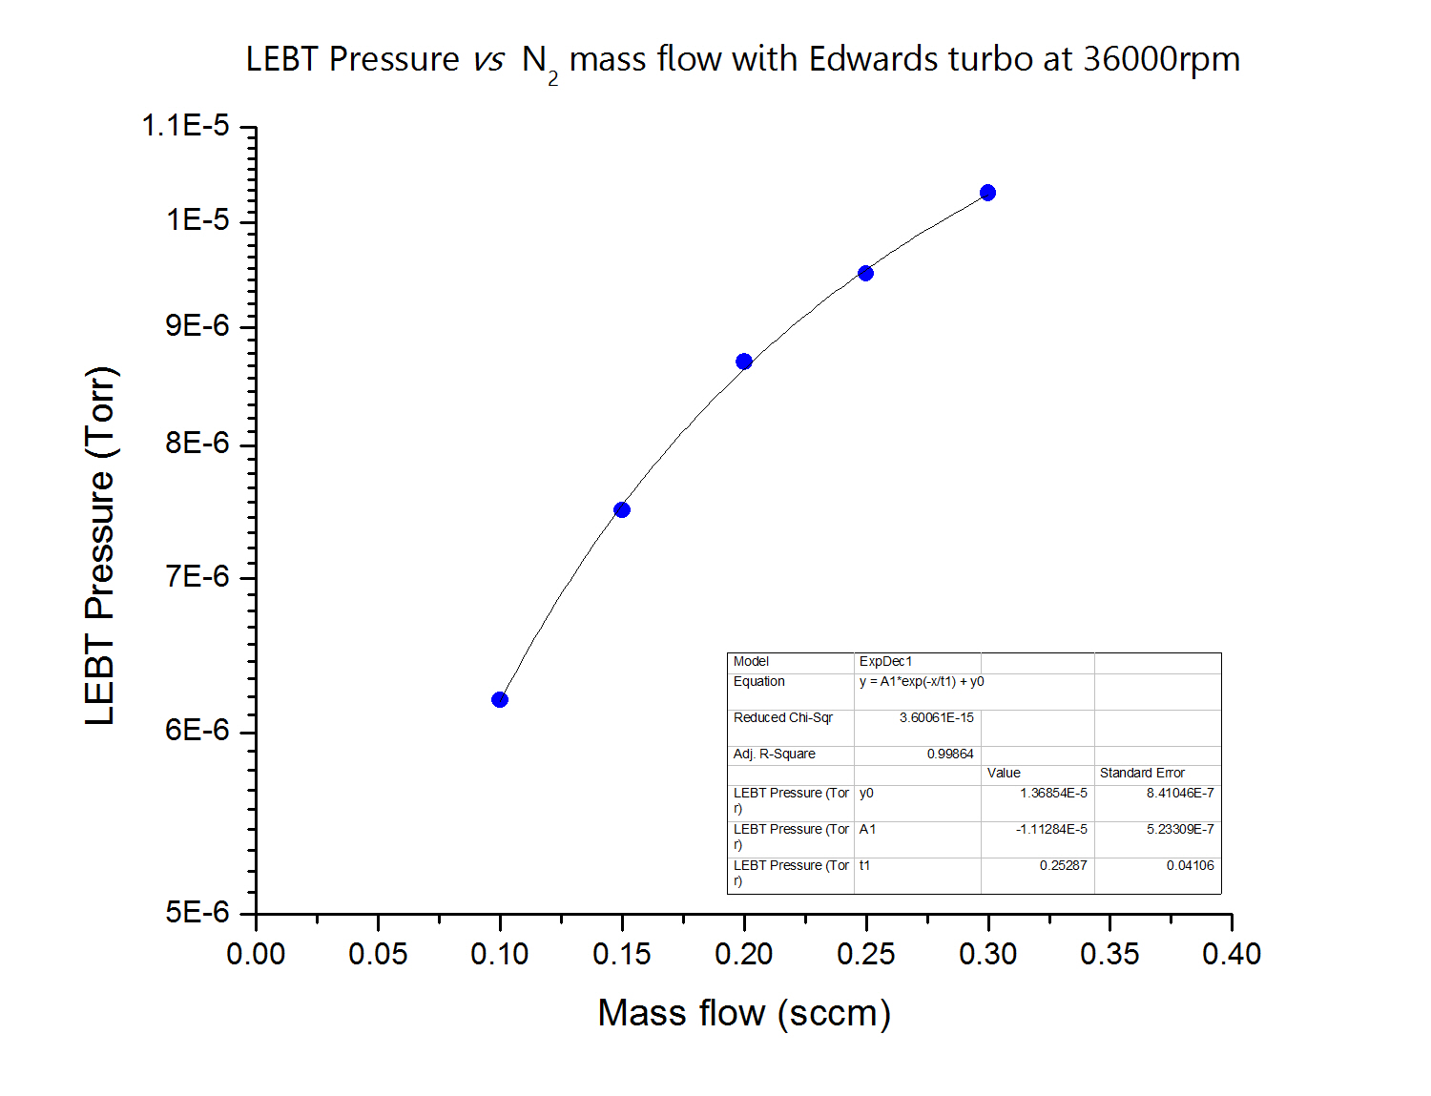
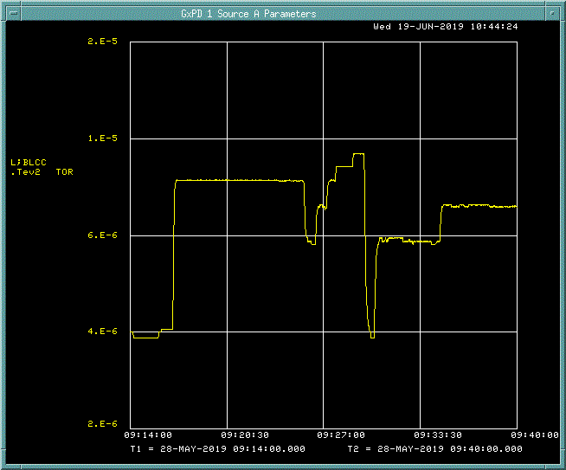
Initial mass flow controller tests on Source B LEBT
Using the mass flow controller allows discrete and predictable changes in LEBT pressure

Slide 9
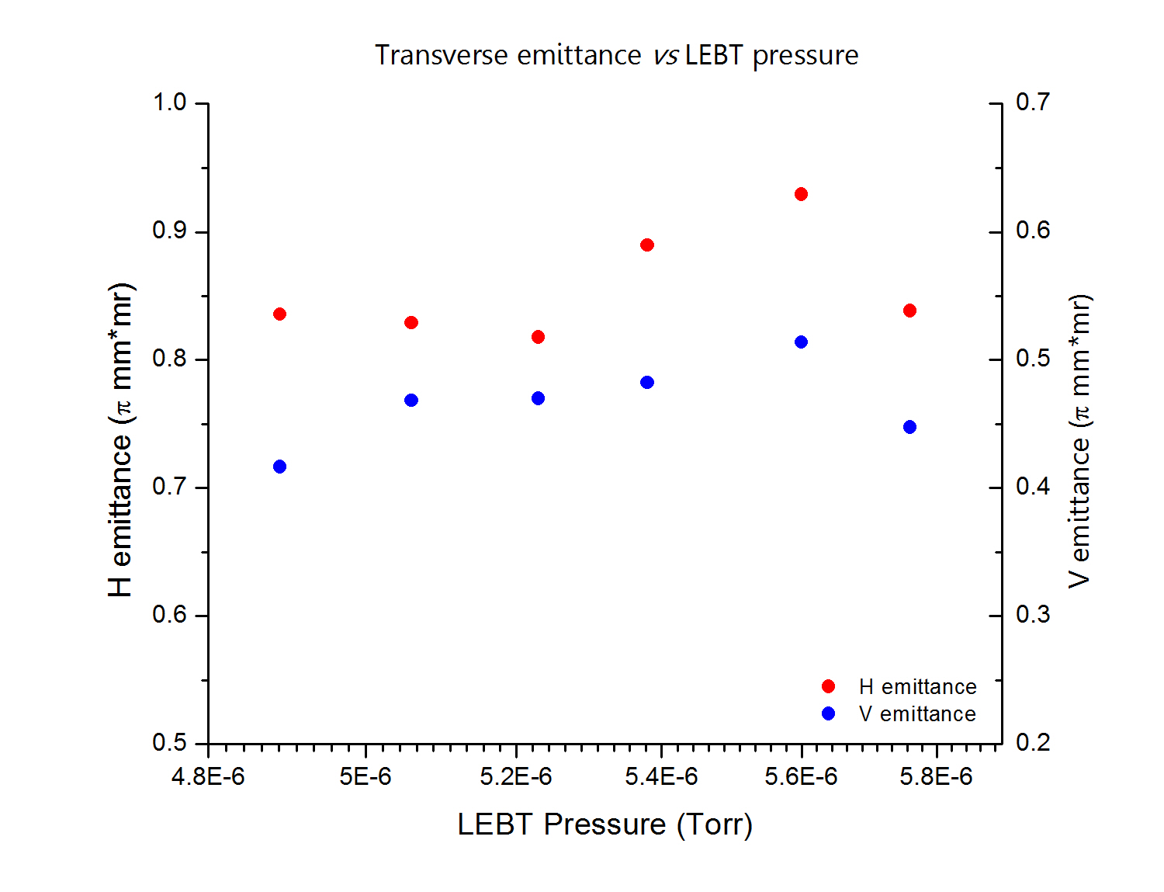
First study with source A (5/29/2019)
No N₂ flow
Stopped at 5.6 x 10⁻⁶ Torr because beam current into tank 1 was decreasing.
Did not tune the LEBT solenoids for these scans
I believe that H and V numbers are swapped

Slide 10
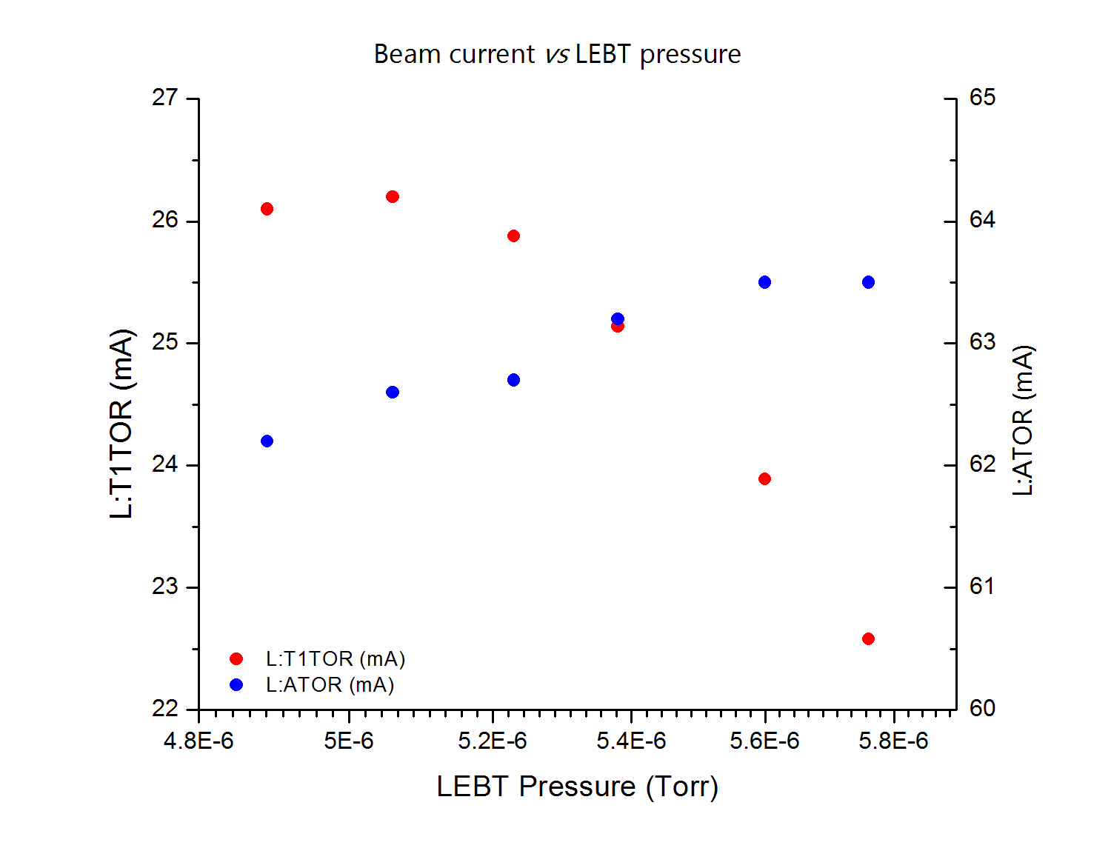
First study with source A (5/29/2019)
Beam current a the tank 1 entrance decreased with increasing LEBT pressure.
Does not appear to be caused by H- stripping

Slide 11
Next Study:
Increase turbo speed prior to injecting nitrogen
Tune the solenoids for each pressure
Check for repeatability
Try changing the S&H timing to sample different part of the beam
Next steps for test stand emittance studies:
Working with mechanical engineering to build new LEBT with increased pumping (currently 200 L/S compared to 400 L/s 940 L/S on operational LEBT’s)
Explore LEBT neutralization (detailed studies)
Effects of different source tuning on emittance
Cancel out magnetic field just DS of extractor

