Slide 1
A gram of protons
PIP And Beyond
William Pellico
APS

Slide 2
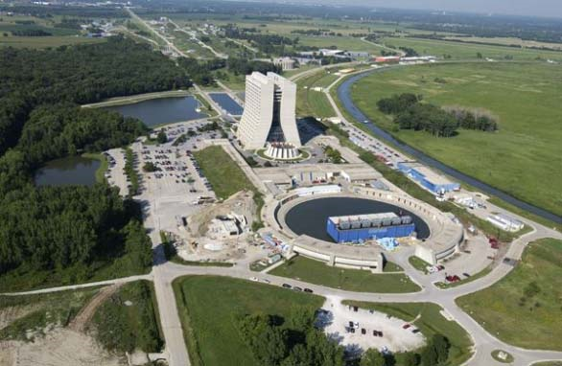
Outline
PIP – Proton Improvement Plan (Pre-Acc, Linac and Booster)
  What were the reasons PIP was begun
  The goals or pillars of PIP
  Success in meeting objectives
  Lessons Learned
PIP 1+ PIP II PIP III
  Issues with higher rep rates
  Issues with higher Flux
    Peak pulse intensities
Conclusion
Pic of Linac, Booster & MI-8 Line

Slide 3
Why?
In 2010 the Proton Source (PS) was not part of the future plan.
  Tevatron was still on but the next phase of FNAL took center stage
    We would be moving from Energy to Intensity but also staging for the next energy frontier option
  Project ‘X’ (ILC based SRF) was/is being planned as the solution
  Other Technologies – Wakefield, ILC (SRF), NML, Muon facility were all being pushed.
However, the planned projects and those already approved were going to need a PS until the large replacement accelerators upgrades were completed.
  NOvA was due to come on line in 2013 (700 KW)
  MicroBooNE (CD-1) was to start taking beam in 2015
  Talk/Plans about G-2 and Mu2e as our rare process program

Slide 4
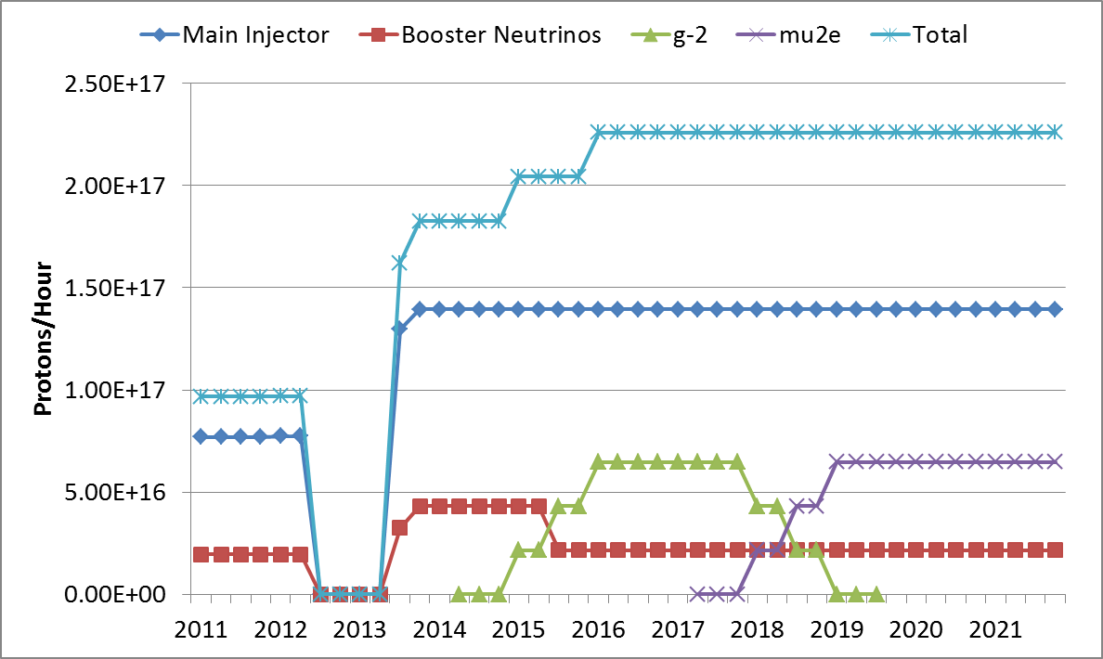
PIP: HEP needs as of Nov 2011 (Required a doubling of flux)
120 GeV ν
LBNE
NOvA Shutdown
g-2
Mu2e
8 GeV ν
Start of PIP – Did not leave much time

Slide 5
BNB started ops in ‘02
Expectations of 1E17 pph
PS was not capable

Slide 6
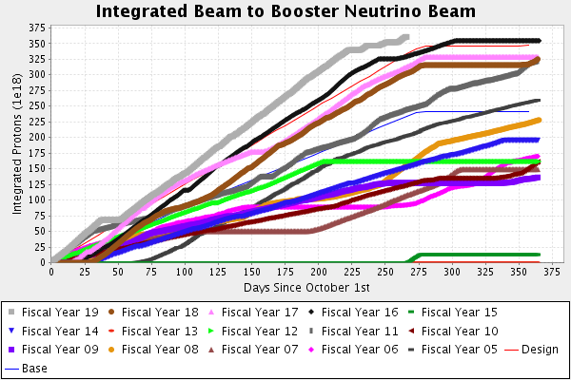
Record Flux to BNB FY19 – Even with reduced run time and more users

Slide 7
Initial Steps – Get PIP going
Convince management/DOE it was a good and necessary use of $$
Workshop to discuss Proton Source
Reviews/Talks
  Accelerator Advisory Committee – very supportive
Because it was a campaign and not an official project – very rapid ramp up
Proton Source Workshop 2010
Proton Source Task Force Report 2010
Proton Improvement Plan (PIP) Outline Document 2011
PIP Handbook and PIP Baselined with Labor and Budget Profile 2012

Slide 8
2011 Goals for the Proton Improvement Plan
The Proton Improvement Plan should enable Linac/Booster operation capable of
  Delivering 2.25E17 protons/hour (Beam cycle rate of 15 Hz) in 2016
while
  Maintaining Linac/Booster availability > 85%, and
  Maintaining residual activation at acceptable levels
and also ensuring a useful operating life of the proton source through 2025. (modified later to “Linac 2025 and Booster 2030”)
The scope of the Proton Improvement Plan includes
  Upgrading/Replacing components to increase the Booster repetition rate
  Replacing components that have (or will have) poor reliability
  Replacing components that are (or will soon become) obsolete
  Studying beam dynamics to diagnose performance limitations
  Implementing operational changes to reduce beam loss
Several important activities were well underway (started under ops)

Slide 9

PIP Development
Approval from DOE and Laboratory with signoff on PIP 2011
PIP was not a DOE Project – but a ‘campaign’ that used project like tools for control
A baseline RLS with WBS was created in 2012 with 30 tasks
  Change and Control document approved (Project Structure)
  PIP was to be carved out of operations and embedded in AD
    Cost initially did not include labor
  2.25E17 pph – Increased to 2.4E17 - margin
  Beam @15 Hz - Booster was limited to 7 Hz
  Viability/Reliability of >85% through 2025
This Photo by Unknown Author is licensed under CC BY-NC-SA

Slide 10
PIP – Lab project
Although focused on upgrading the lab’s AD Proton Source –
This effort, like previous lab efforts, was accomplished with help from across the lab.
  TD: Magnets and RF cavities
  SCD: Booster lattice modeling
  PPD: Booster collimator
  FESS: Power and LCW
  We also had a lot of support from outside review committees –

Slide 11
PIP: Task Structure Nov 2011
Proton Improvement Plan
Bill Pellico
Bob Zwaska, Deputy
Elmie Peoples-Evans, Project Controls
Mary Convery, Installation Coordinator
Valeri Lebedev, Free Agent
Booster
Keith Gollwitzer
Linac
Fernanda G. Garcia
RFQ Injector
C. Y. Tan
200 MHz Accelerating System
Fernanda G. Garcia
HLRF
???
Linac Modulator
Trevor Butler
7835 Procurement Fernanda G. Garcia
Instrumentation
Craig Drennan
Utilities
Patrick Karns
Power Distribution
Steve Hayes
Booster RF
John Reid
Anode PS
Rene Padilla
Bias Supplies
Pat Sheahan
New Tuners
Matt Slabaugh
Ralph Pasquinelli
New Cavities
Valeri Lebedev
Cavity Test Stand
Pat Sheahan
John Reid
Cavity 20
Matt Slabaugh
John Reid
Accelerator Physics
Bob Zwaska
Booster Cogging
Kiyomi Seiya
Booster Instabilities & Feedback
Bob Zwaska
Injection Painting
Valeri Lebedev
Radiation Shielding
Peter Kasper
Alignment & Aperture
Kiyomi Seiya
Booster Notcher
Bruce Hanna
Power Distribution
Steve Hayes
95LCW System
Maurice Ball
Vacuum Systems
Dave Augustine
Solid State Upgrade
John Reid
Modulators
Rene Padilla
Driver Amplifiers
Tom Kubicki
Cavity & Tuner Refurb.
Matt Slabaugh
Mary Convery
Controls Upgrade Mike Kucera
Cooling System David Hixson
400 MeV Optics Matching & Collimation
Valeri Lebedev
Linac Notch Creation
Dave Johnson
Linac Lattice , Orbits and Collimation
Hyung Jin Kim
Accelerator Physics
Valeri Lebedev
Vacuum Systems
Dave Augustine
Power Amplifiers
Steve Kotz
Installation
Rene Padilla
Steve Kotz
Instrumentation
Craig Drennan
Dampers
Nathan Eddy
Controls
Craig Drennan
Utilities
Todd Sullivan
Booster Collimation
Valeri Lebedev
BPM Upgrade
Nathan Eddy
Task structure developed as PIP looked to meet HEP needs and AD resources. Some tasks were dropped others added: 30 to 33

Slide 12
Proton Improvement Plan
Bill Pellico, Project Manager
Fernanda G. Garcia, Deputy Project Manager
Kenneth Domann, Project Controls
C.Y. Tan, Senior Scientist
Booster
Salah Chaurize
200 MHz RF Power System
Fernanda G. Garcia
High-Level RF
Fernanda G. Garcia
Linac Modulator
Fernanda G. Garcia
7835 Procurement Fernanda G. Garcia
Instrumentation
Craig Drennan
Utilities
Matthew Gardner
Power Distribution
Ryan Crawford
RF
John Reid
Anode Supply
Ryan Crawford
Bias Supply
Pat Sheahan
New Tuners
Matt Slabaugh
Replacement Cavities
Tom Kroc
Cavity 1013
Matt Slabaugh
John Reid
Accelerator Physics
CY Tan
Booster Collimation
Valery Kapin
Radiation Shielding
Keith Gollwitzer
Alignment & Aperture
Kiyomi Seiya
Booster Notcher
Salah Chaurize
Low-Conductivity Water System
David Hixson
Power Distribution
Ryan Crawford
Vacuum System
Dave Augustine
Solid State Upgrade
John Reid
Power Amplifier
Steve Kotz
Driver Module
Tom Kubicki
Cavity Test Stand
Pat Sheahan
Linac Notch Creation
Dave Johnson
Simulations & Studies
Valery Kapin
Accelerator Physics
Valeri Lebedev
Vacuum System
Dave Augustine
Modulator
Rene Padilla
Installation
Rene Padilla
Steve Kotz
Instrumentation
Craig Drennan
Dampers
Nathan Eddy
Utilities
Todd Sullivan
Booster Cogging
Kiyomi Seiya
Beam Position Monitors
Nathan Eddy
Simulation & Studies
CY Tan
Linac
Fernanda G. Garcia
Cavity & Tuner Refurb.
Matt Slabaugh
RFQ Injector
C. Y. Tan
Beam Position Monitors
Peter Prieto
Low-Cond. Water System
Matt Gardner
Perpendicular Cavity CY Tan
Cavities 21&22
Matt Slabaugh
Stations 21&22
Rene Padilla
Utility Pumps
Todd Sullivan
PIP Evolves: WBS Nov 2018
By the end – PIP WBS had morphed into 36 task: Aligned to PIP II in 2015
Driven by splitting RF work and alignment to PIP II

Slide 13
PIP: Funding and Labor Profile Constraints - RLS
Due to budget and labor constraints as well as needing time to engineer solutions, the RLS developed and prioritized:
  Get to 15 Hz to allow cycle flexibility thus beam to all users
  Reduce/control losses to allow an increase in flux
  Complete PIP by removing obsolete and unreliable hardware
  Usually these tasks shared benefits – to increase the rep rate often required removing obsolete/unreliable hardware.
Tasks (part of the consideration in planning work)
  Some were straight forward – a little engineering time and M&S
  But some were cutting edge with uncertain outcomes
    Laser Notching, Marx Modulators, RF Cavities

Slide 14
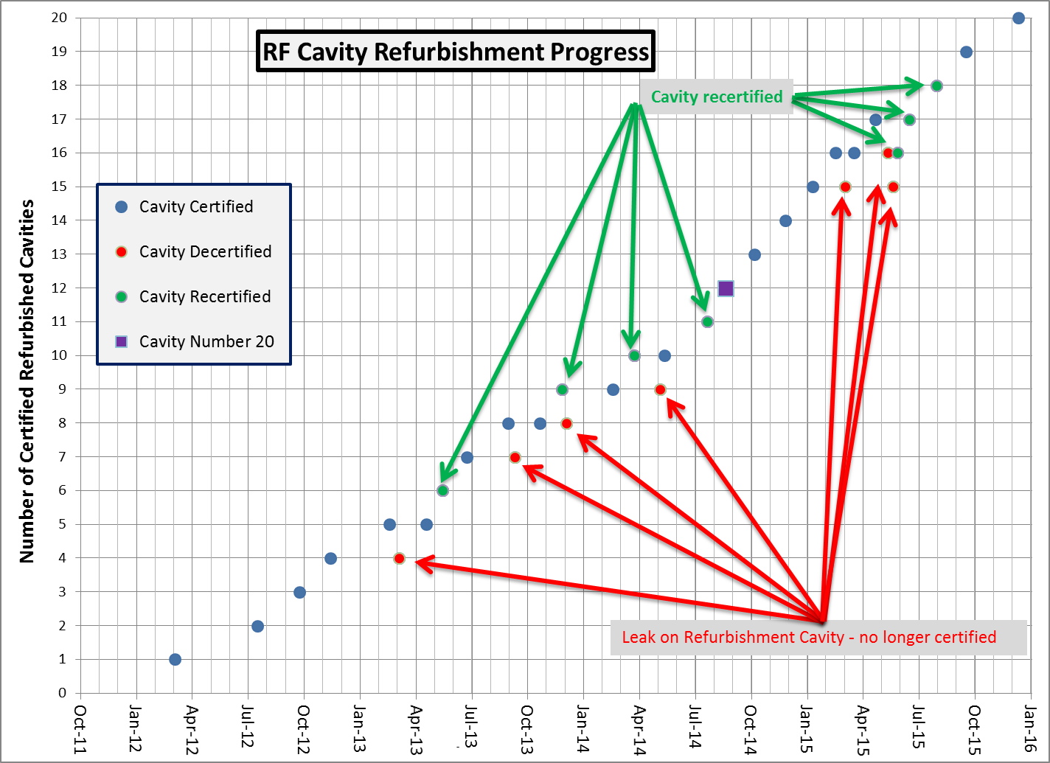
RF cavity WBS: A lesson in showing how a task often doesn’t go as planned - more time
Built ~ 1970!
To meet vastly different needs
15 Hz Capable
17 cavities done

Slide 15
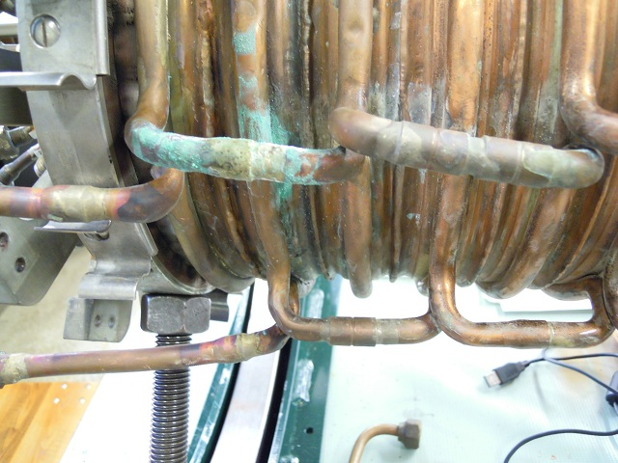
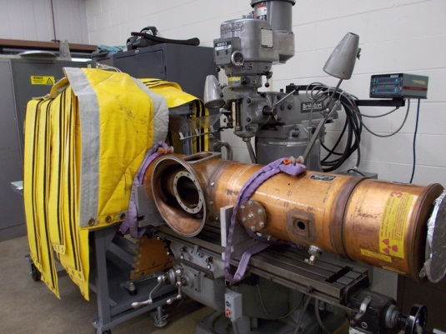
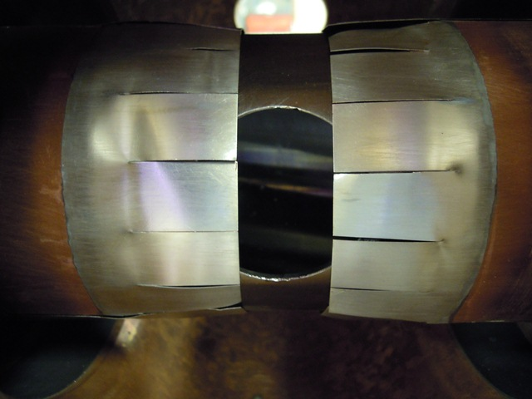
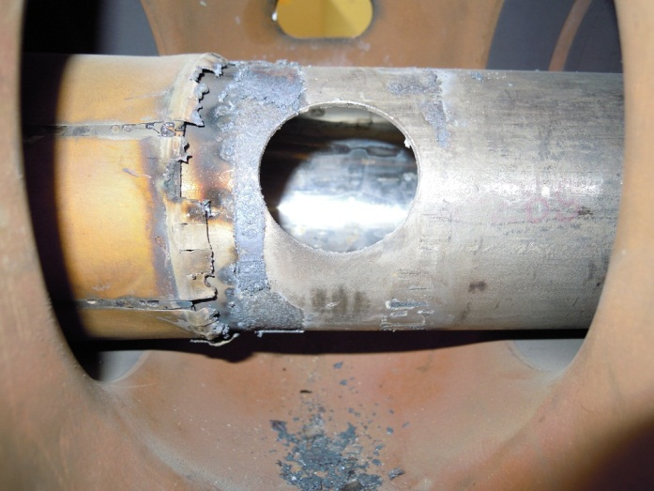
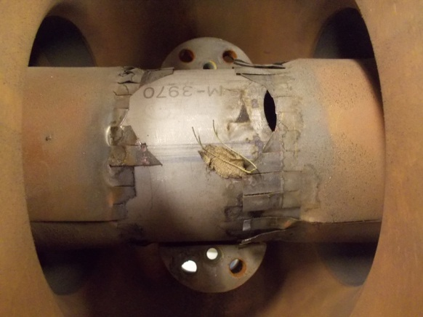
Refurbishment: Working on 40+ year old hot cavities
Did what was necessary to get to 15 Hz (still old cavities)
After Refurb

Slide 16
PIP: Beam Loss Reduction & Increase Flux 2.4E17 pph
Linac Laser Notching: create a notch at 750 KeV not in Booster
Linac Collimation
Upgraded Linac RF systems – better regulation
RFQ – entirely new injector line
Marx modulators: No more tubes & improved RF cavity voltage regulation
Booster Beam Physics
  Capture/ Lattice corrections/ Aperture Improvements/
  Reduction of Booster bend field timing jitter and Beam capture jitter
  Transition: Modifying Booster low level to provide improved jump
  Extraction: Improved Cogging (magnetic) and Phase lock jitter
Booster updated to Digital Dampers – both longitudinal and transverse
Booster Notching System: Shorter/Faster kickers and new beam dump absorber
Increased number of Booster RF stations – 4 more

Slide 17
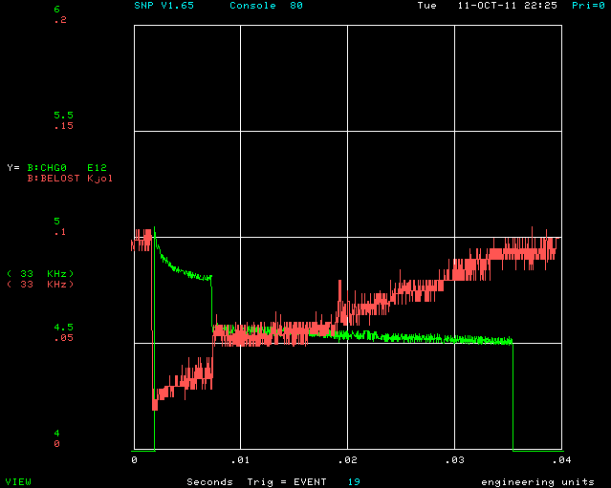
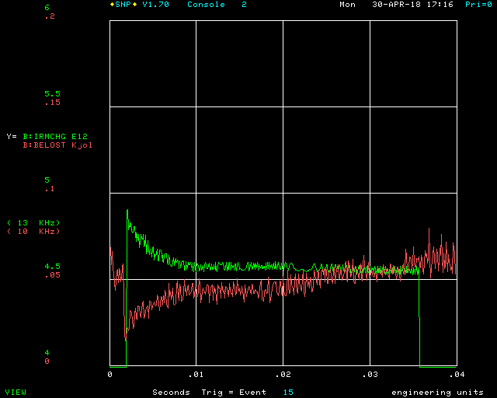
PIP: Highlights – Plots of Beam Charge and Calc Energy Loss
2011
2018
Joules loss cut in half
To double the flux but keep beam loss energy the same:
Reduce Booster cycle power loss by 50%
Do not exceed managerial set loss levels (activation level) at survey points
  - Control the loss point in critical areas -

Slide 18
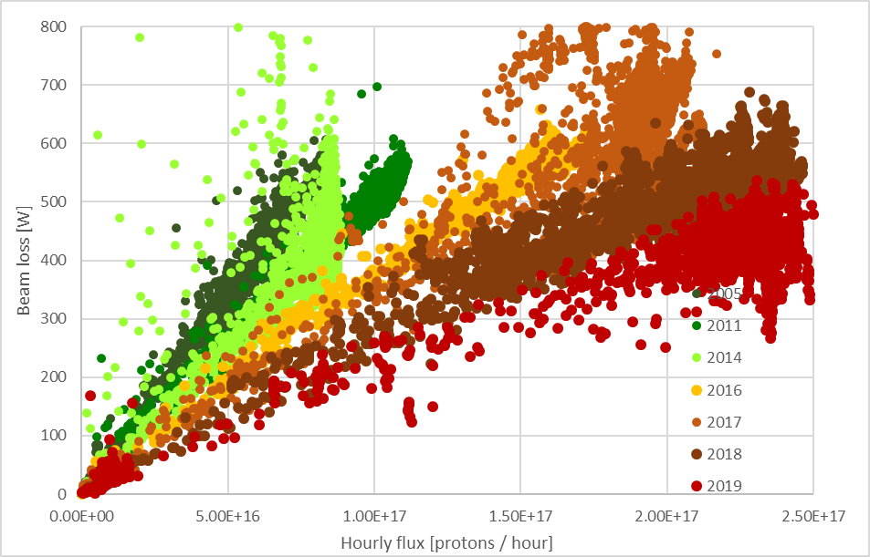
Loss Limit PIP goal of 2.4E17 pph – shielding assessment at 2.7 E17 pph
Management set total energy limit
550 then 600 W (averaged 1 hour)
New Beam Notch absorber
Not part of ring sum limit
PIP Goal
2.4E17 pph
Hourly flux [protons / hour]

Slide 19
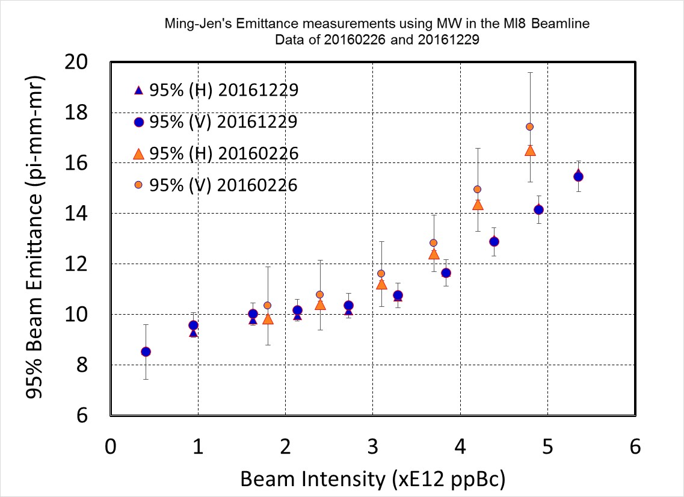
Going to PIP /PIP II
2005
2011
2016
PIP Now
PIPII
Beam Power Loss [W]
Protons per hour
Lots to do
Increasing flux 50%
Emittance Control for higher intensity

Slide 20
PIP: Viability and Reliability >85%
Shutdown
Shutdown
Shutdown
Shutdown
PS is running at about 94% uptime
Historically about 87%
Not all systems upgraded
Linac Klytrons
Infant mortality on some new systems

Slide 21
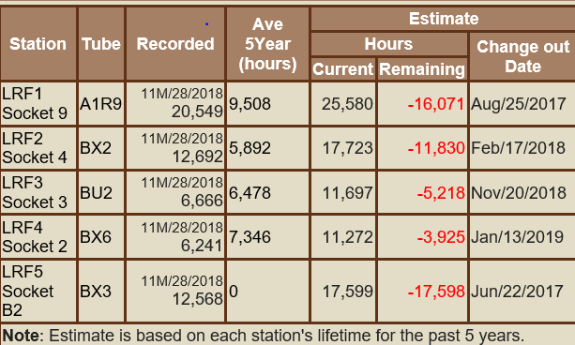
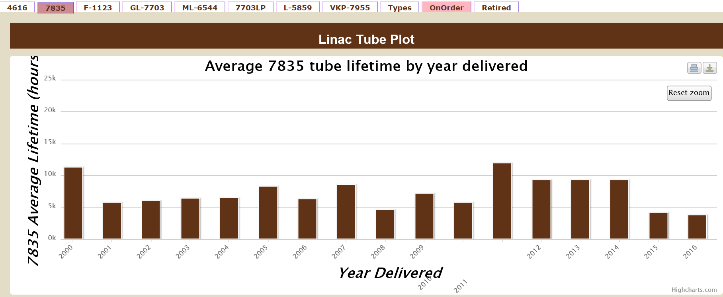
PIP: Viability and Reliability >85%
Linac low energy power tube – lifetime improvement
More Statistics needed to confirm these great numbers
$270K /new tube
97K -250K REBUILD
Big Savings!!!!
Average 7835 lifetime (Khours)
20
15
10
5
0

Slide 22
What’s Next – Near term beam flux testing
Running at 4.5E12/pulse for NoVA @ 10 Hz
Running at 4.7E12/pulse for BNB @ 2 Hz
Running at 4.5E12/pulse for g-2 @ 3 Hz
BNB capable of 5E12 @ 5 Hz
G-2 capable of 5E12 @ ? Hz
NoVA – target limited to 750 KW but could demonstrate higher power capability by reducing number of slip stacked bunches and increasing Booster batch intensity
  4.9E12 per batch (10 batches) equivalent to ~800 KW
  5.2E12 per batch (10 batches) equivalent to ~860 KW
  5.5E12 per batch (10 batches) equivalent to ~910 KW
Requested
After Shutdown

Slide 23
Preparing for PIP II – Booster Beam Physics underway
Flat injection
  To be implemented for present early injection scheme of ~200us
  Compensate for variations in Booster bend field fluctuations
Upgrading parts of low level – more digital control of system
Capture studies – balancing of RF cavities (phase & amp)
Foil studies – testing of new foils and system
GMPS regulation – using ML to implement better regulation
  LDRD (partnering with other divisions – ML experts)
Lattice work – need to understand impact of new injection
2nd Harmonic capture – test new cavity – impact on injection
New wide bore cavity to be operated at 60 KV
  10% move volts and 3 inch aperture (compared to 2.25 inch)

Slide 24
Preparing for PIP II (Hardware – M&S)
Items that were planned under PIP 1+ then moved to PIP II
  Collimators
    A true two stage collimation system
      Design nearly complete
  Damper upgrades for higher beam currents
    Transverse (consisting of new amps, front end – probably tank)
    Longitudinal (Mode 2 cavity, Amplifier)
  Low Level upgrades needed to sync to PIP II, new flat injection
  Booster gradient magnets – larger aperture but not sure
    Shorter magnets are required to accommodate 800 MeV injection
  Test of 20 Hz – complete girder setup

Slide 25
What’s next – difficult problems
Can we build lower loss conventional RF cavities?
  Working with vendor to make lower loss ferrite (LDRD)
  Cavities that tune over a large frequency > volts & aperture
Can we make new combined function magnets capable of operating at 20 Hz and 6 times more beam current?
  More aperture?

Slide 26
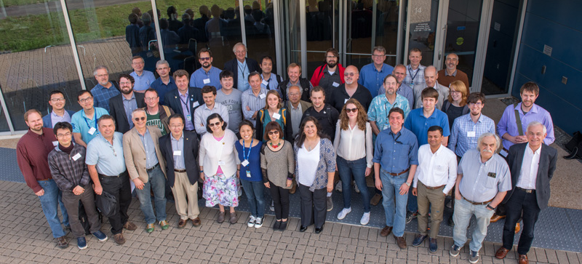
Fermilab Workshop on Megawatt Rings & IOTA / FAST Collaboration Meeting group photo
Useful discussion on MW rings
One day spent on high intensity rings –
Not intended to set lab goals or strategy

Slide 27
US-Japan
Another effort that is helping start discussions on future options
  Part of a wider US-Japan collaborative effort, this partnership is looking to share ideas through regular exchanges of personnel.
  Sharing knowledge on cavities, beam physics, collimation, dampers and lattice design
    Individuals from Japan (KEK, JPARC) and Fermilab spend time at each others facilities – participating in studies and discussion.
    Yearly discussions on difficult issues help to focus the work
    This is not a big effort but extremely helpful……(see Bob Z & Kiyomi S)
Project Title: Fermilab – Japan parametrization of a high intensity rapid cycling synchrotron RCS (PIP III) Doc Beams-doc-7097-v1

Slide 28
Summary
After 7 official and 2 planning years – PIP completed successful upgrade to the Proton Source. The benefits have been significant and have made possible the lab’s promise to deliver the protons needed for our HEP program until 2025+.
  Completing the project under budget.
  Developing new technologies for the community.
  Training technicians, engineers, and a scientist along the way
Next stages are progressing quickly
  PIP II has a challenging timeline and is focused
  AD/Lab needs to address areas not directly in PIP II but needed
  Some effort needs to address post PIP II (1.2 MW is not final goal)
    A workshop was held in 2018 did touch on future needs and ideas
    – more is needed

Slide 29
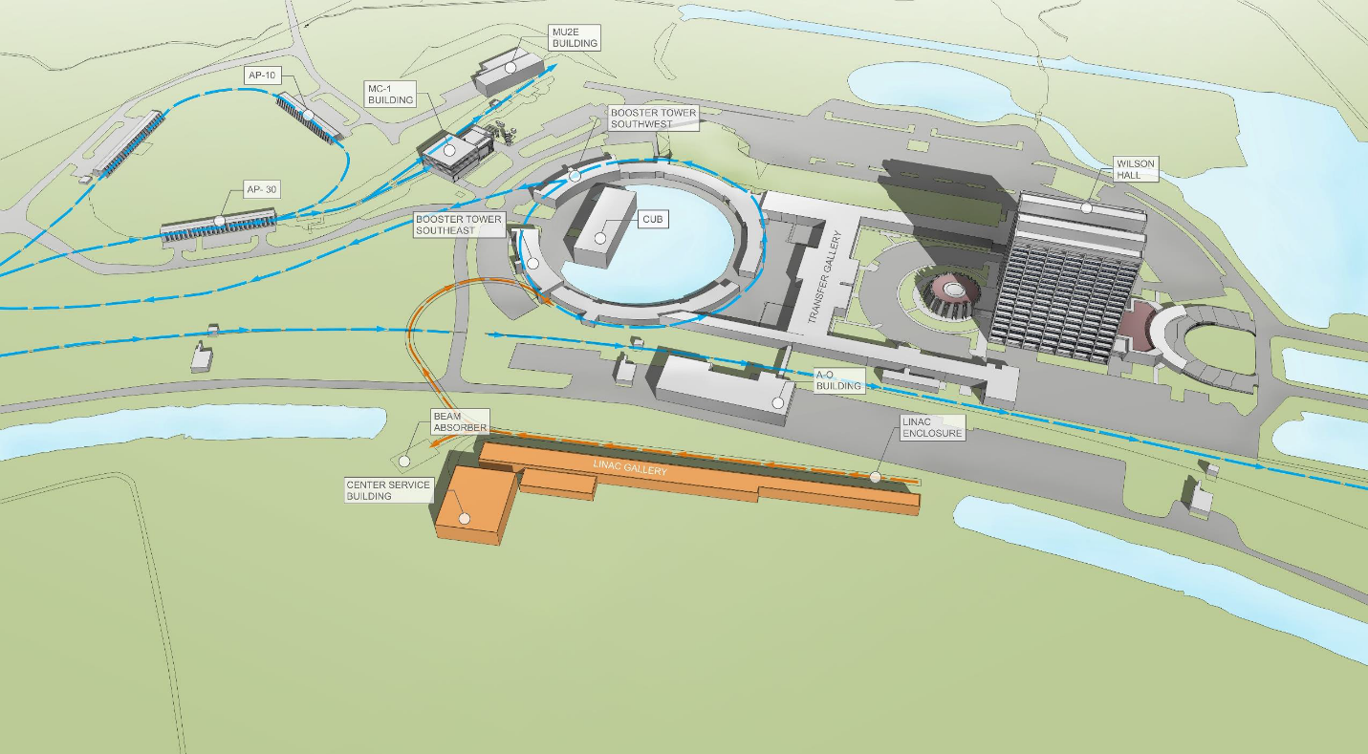
Final Thought
We have all seen the PIP III ring diagramed in as a plan – but with all that is going on – how does it happen?

Slide 30
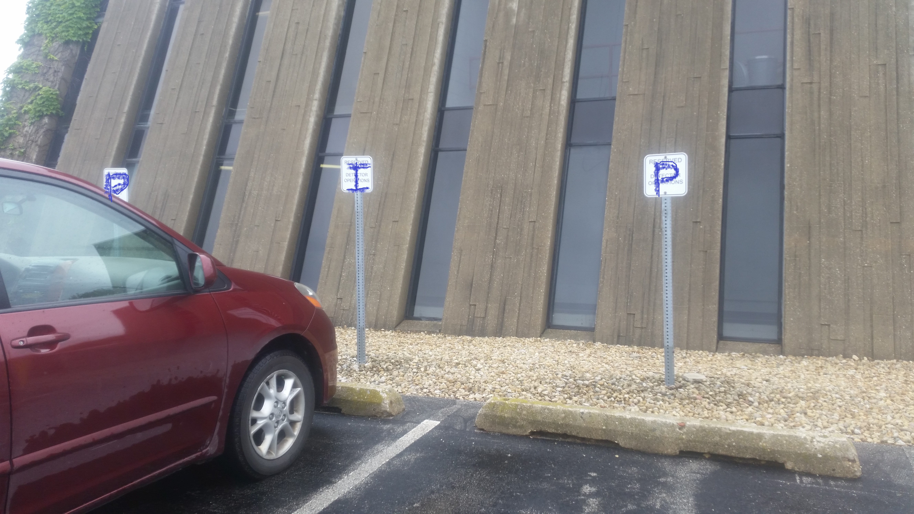
Success rewarded – With designated parking for PIP Managers

Slide 31

PS (PIP) has made the jump just in time to start the PIP II race.

Slide 32
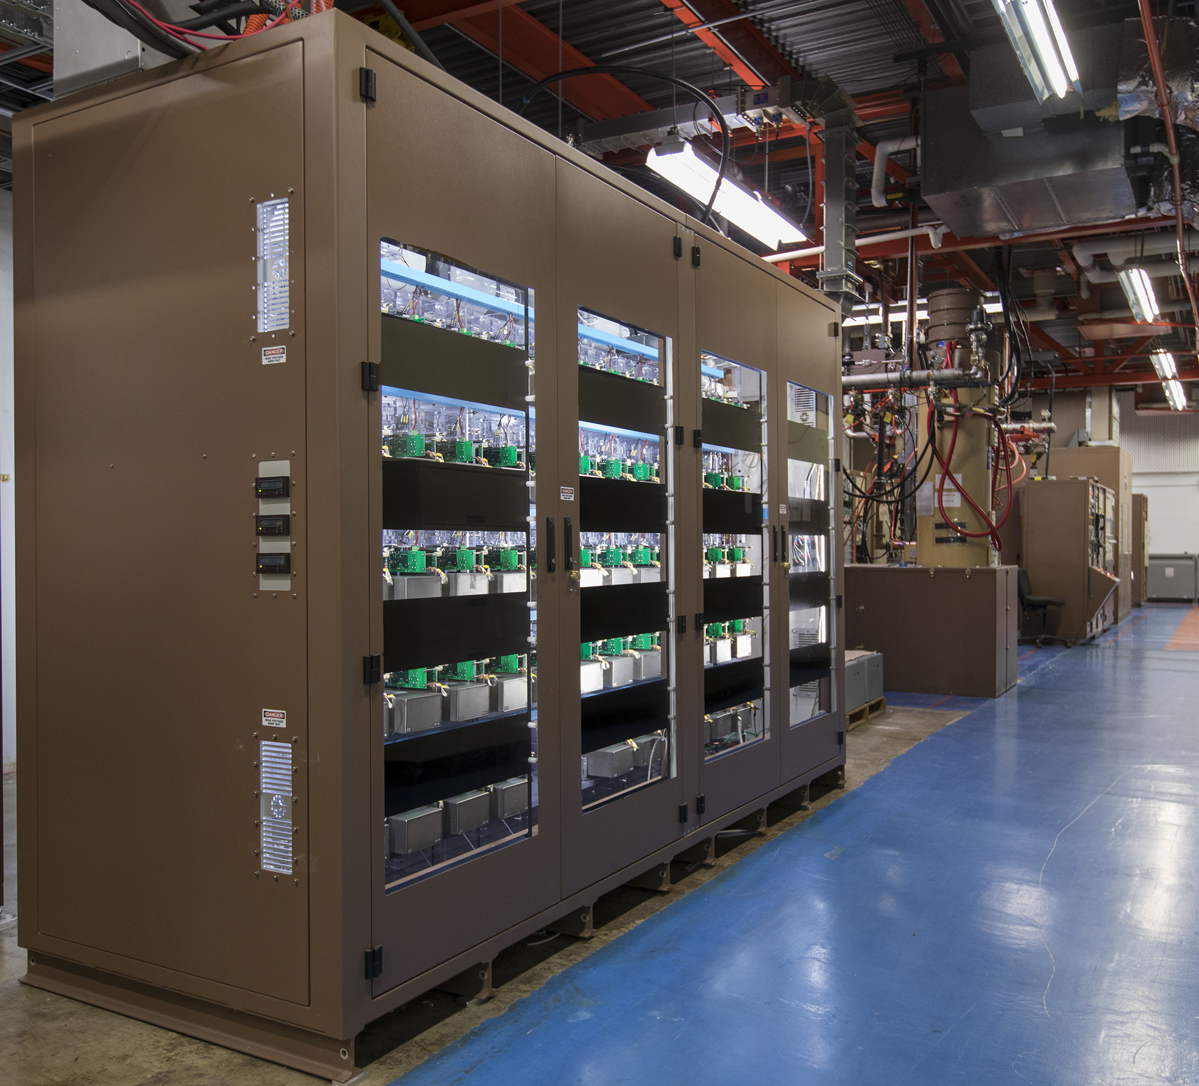
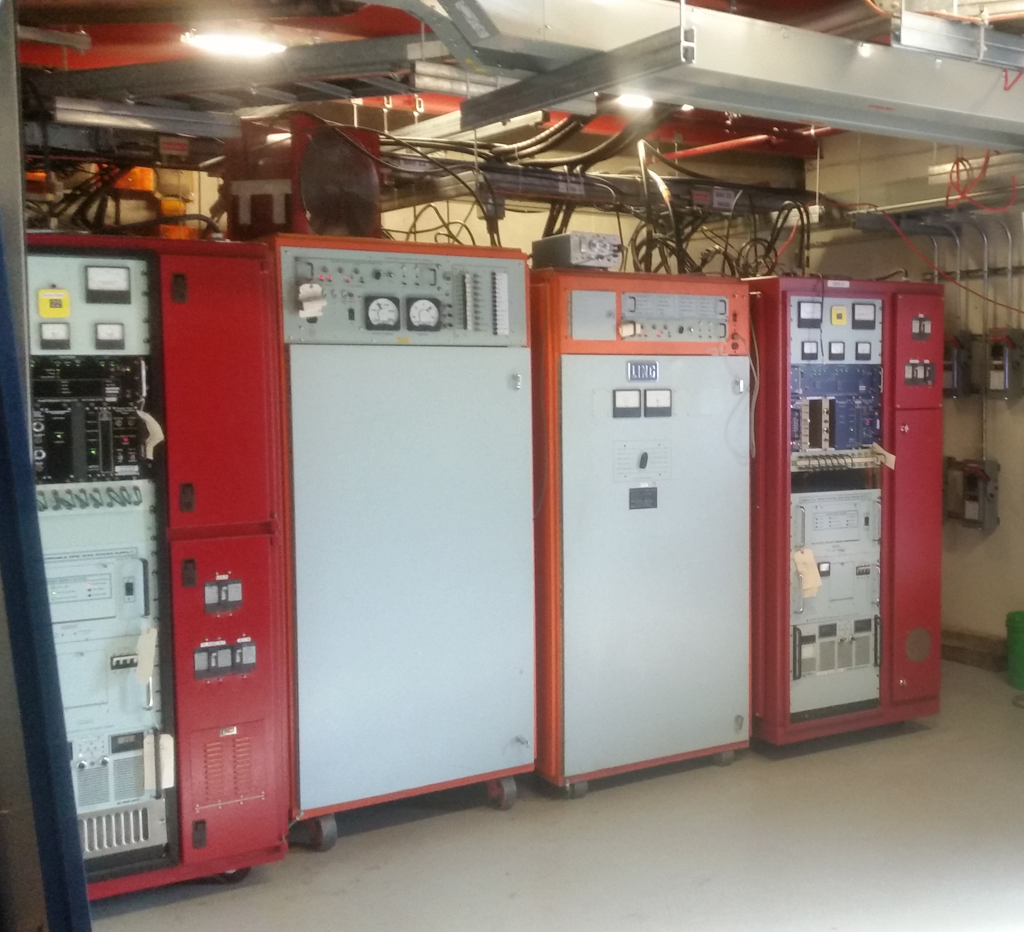
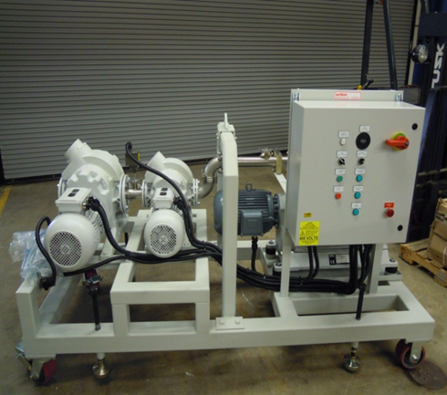
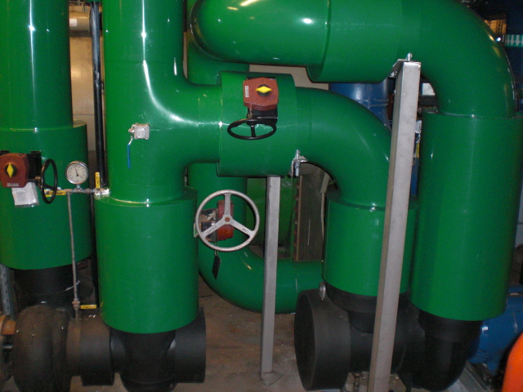
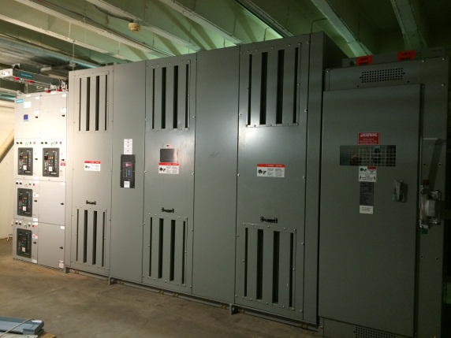
PIP: Viability and Reliability >85%
Hardware
Reliability
Examples
Station 21
Station 22
54 cell Linac Marx Modulator
2 more Booster RF stations
Upgraded LCW System
New Power Station
DTL roughing stations

Slide 33
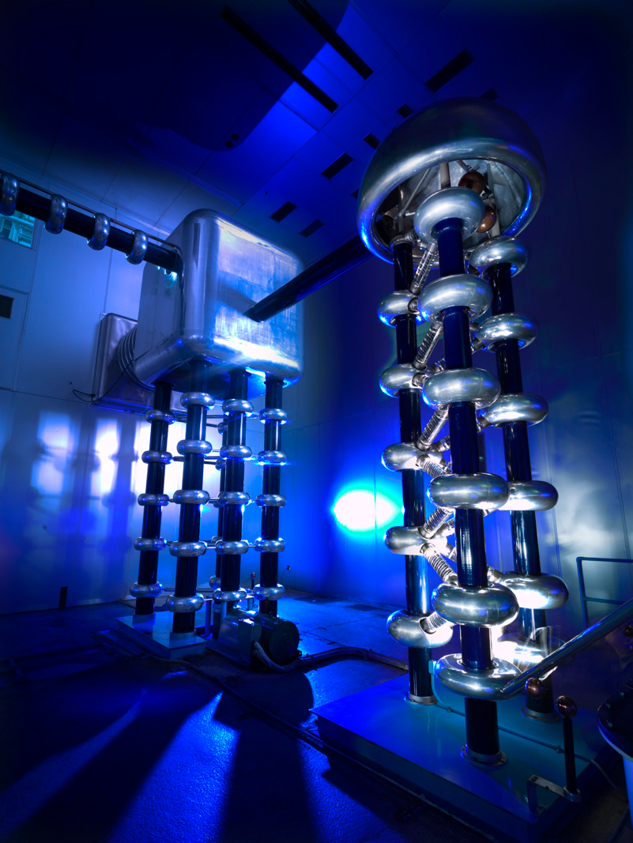
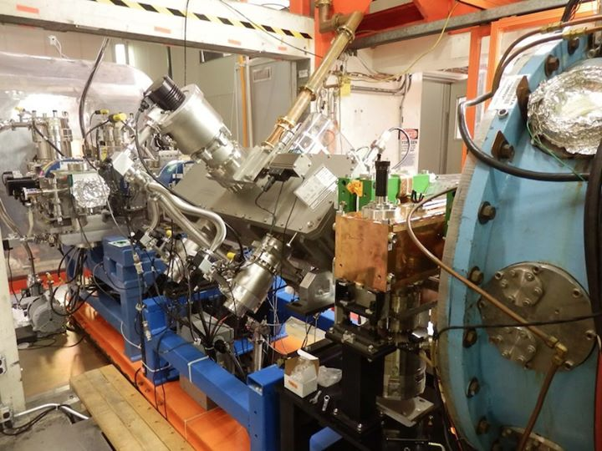
PIP: Injector Line Viability and Reliability >85%
Not as ‘cool’ looking
But great uptime!

