Slide 1
Instability Booster Studies July 1st, 2019
Burov, J. Eldred, V. Lebedev
Fermilab
Many thanks to all the participants!
Fermilab, August 7, 2019
AB

Slide 2
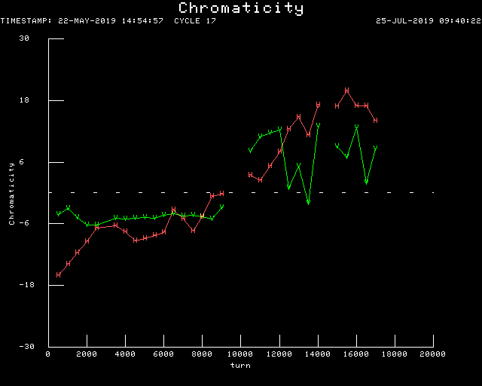
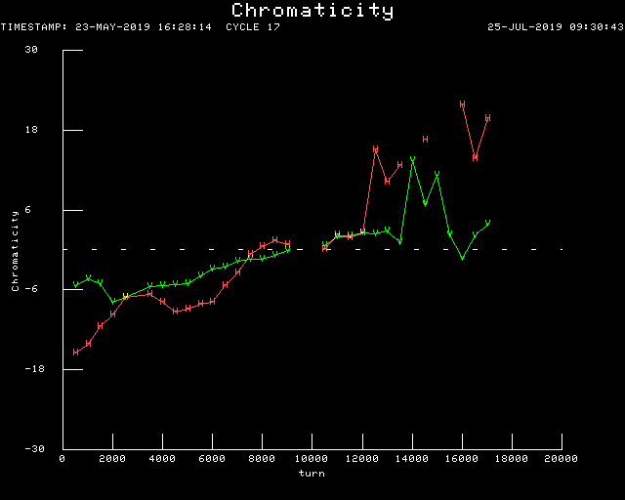
Nominal chromas
Green is vertical.
“Zero” chromas
AB

Slide 3
The data were taken by an oscilloscope, 10 Gsample/s,
sum and difference signals simultaneously,
80+80 Mpoints were saved as a binary file.
The data were analyzed with a Mathematica script.
It took just a few minutes to read the files and generate all the plots.
AB

Slide 4
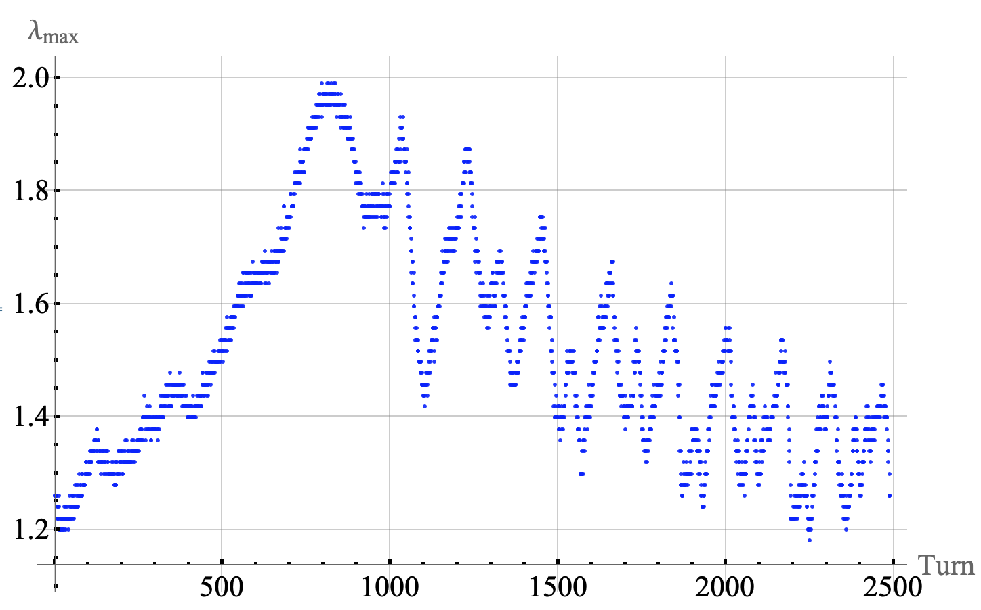
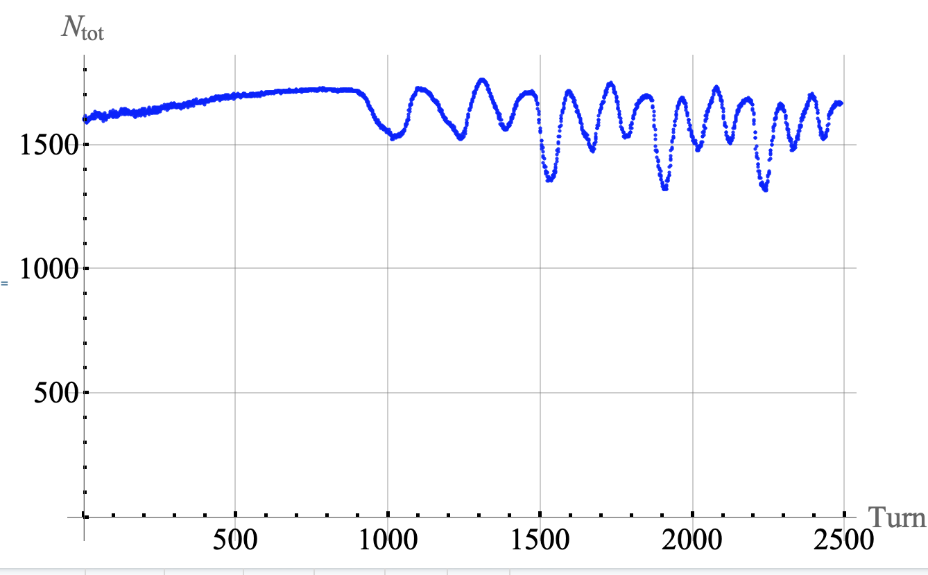
Peak and total currents, Nominal Settings
Max peak current
for an arbitrary chosen bunch
versus turn number.
July 1 Nom settings,
Intensity=13 Booster turns.
Mismatch oscillations: ~30%
Total current:
Losses < 10%
AB

Slide 5
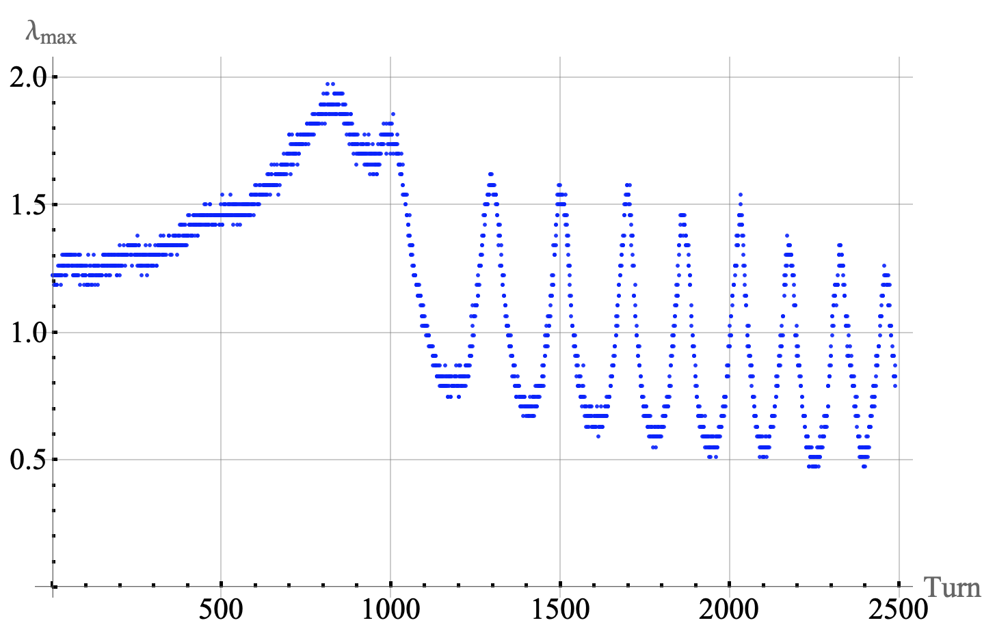
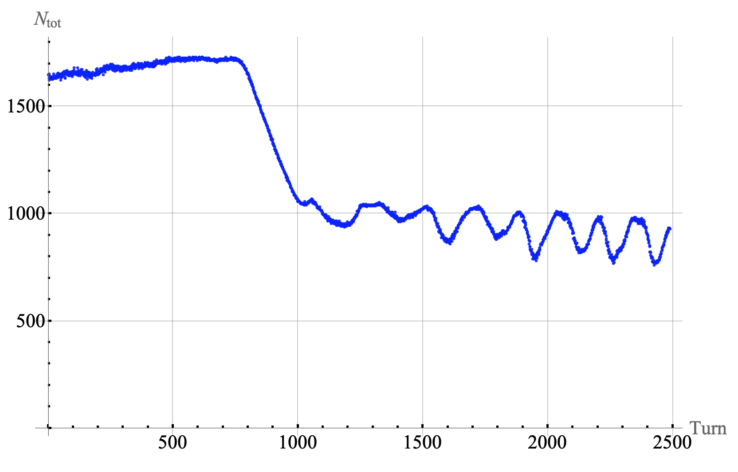
Same for zero chroma settings, vert
The same, for Zero Croma settings.
Huge mismatch: ~ 3 times.
Losses ~40%
AB

Slide 6
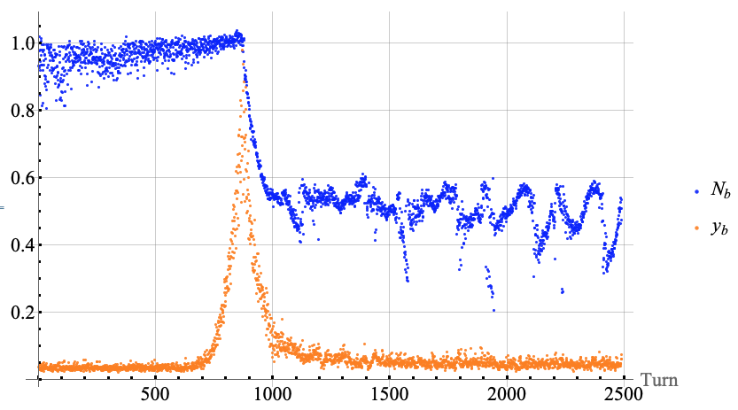
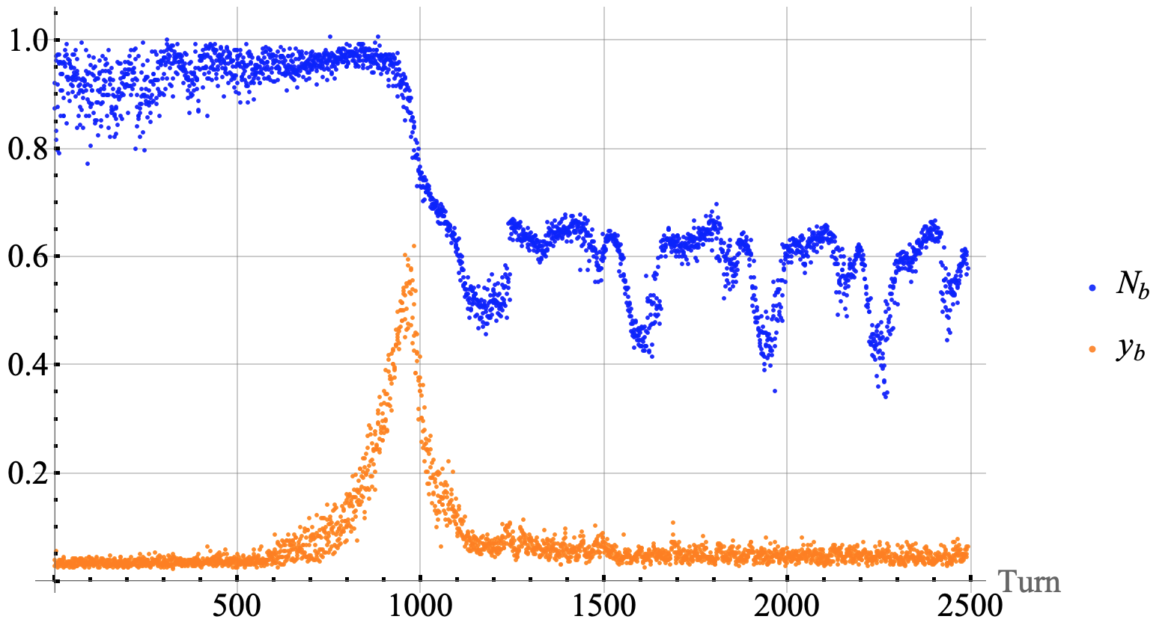
Zero Chroma: Vert Single-Bunch Instability
Intensity (blue) and
1.6*max vertical signal (orange)
for a bunch #36
same, for a bunch #37:
the oscillations reach max
~ 100 turns later.
AB

Slide 7
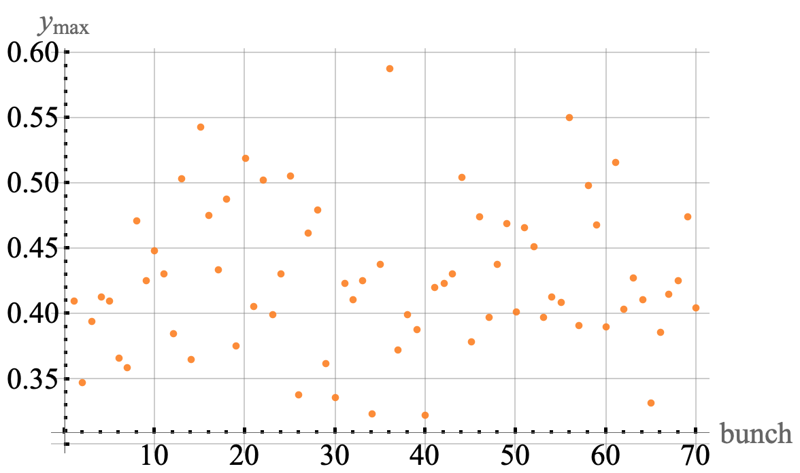
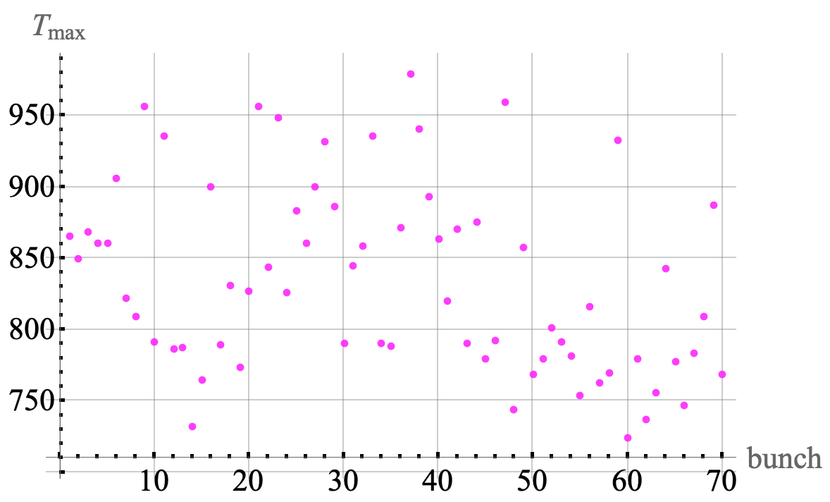
Max vert signal for each bunch
max vert signal for all time
for each bunch
turn number when the bunch vert signal was maximal,
for each bunch
Conclusion: the instability is single-bunch-type.
AB

Slide 8
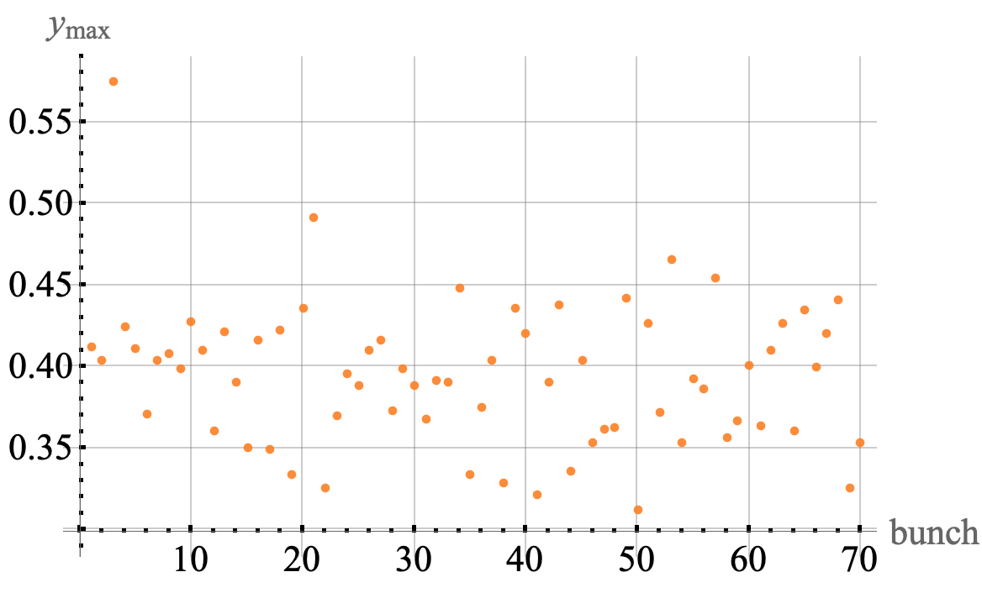
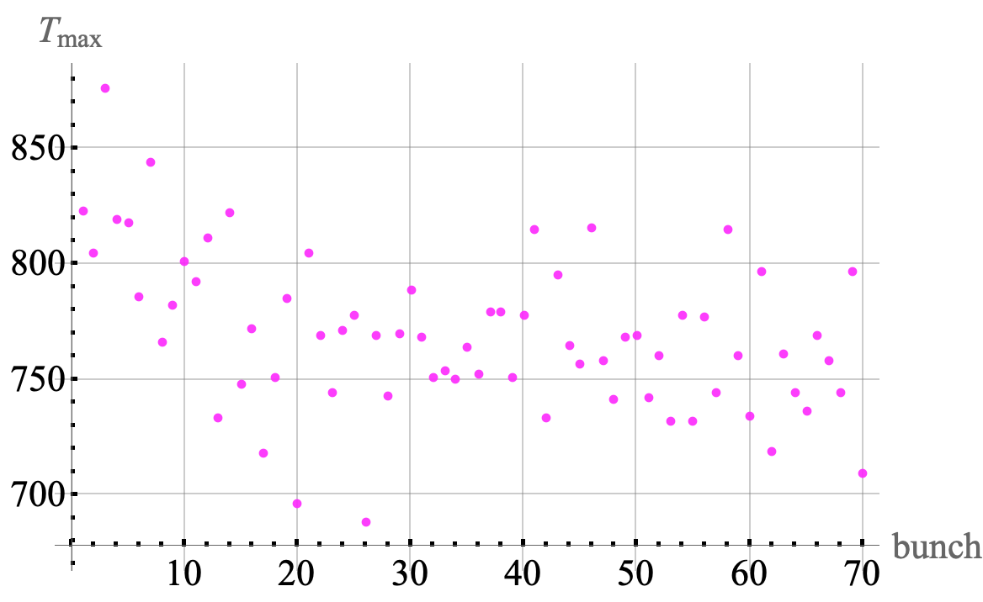
Reproducibility of the bunch pattern
case 1
case 2
General features of the ensemble are more or less reproduced.
Individual bunch features are not reproduced.
AB

Slide 9
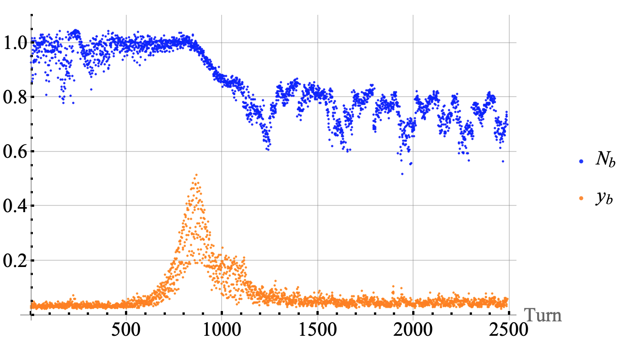
Zero Chroma: Vert Single-Bunch Instability
Intensity (blue) and
1.6*max vertical signal (orange)
for a bunch #36, which max is maximal
same, for a bunch #40, which max is minimal:
the losses are smaller as well.
AB

Slide 10
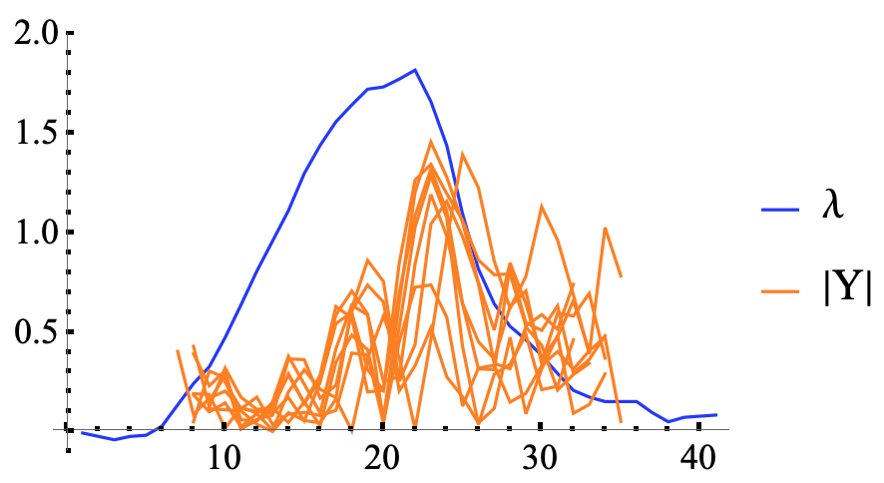
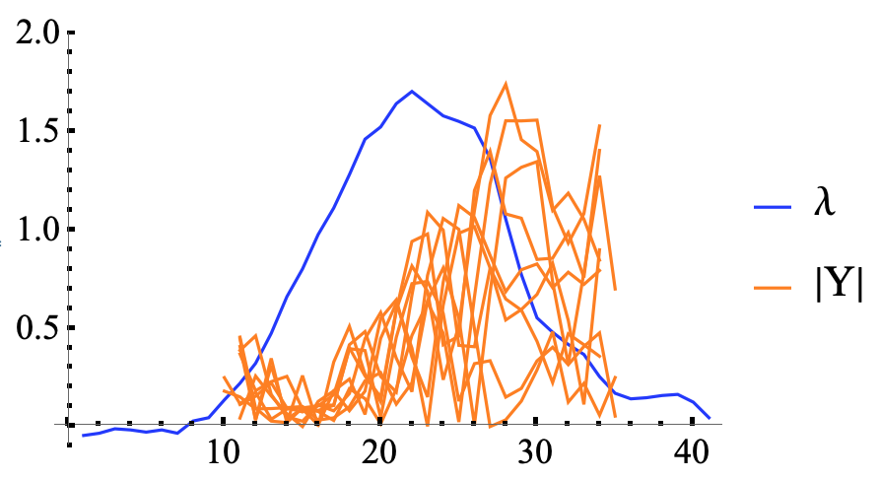
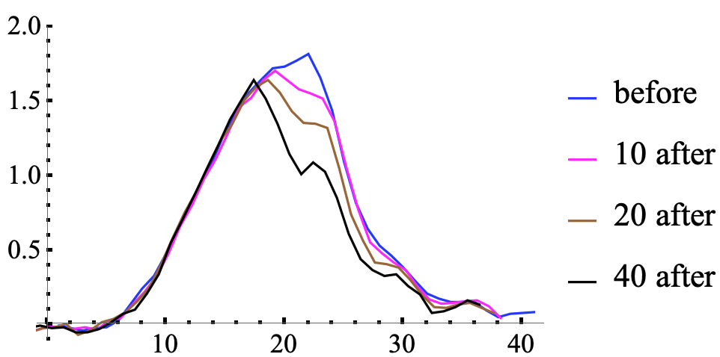
Intra-Bunch Details, vert, same intensity
Line density (blue) and
overlapped offset abs. value (orange),
8 next turns after the beam loss began,
bunch #36.
8 more turns after
Same bunch, just before and some turns after
the beam loss began.
AB

Slide 11
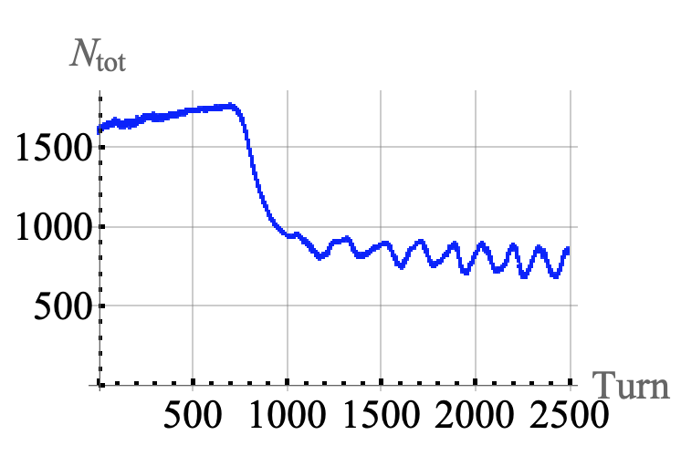
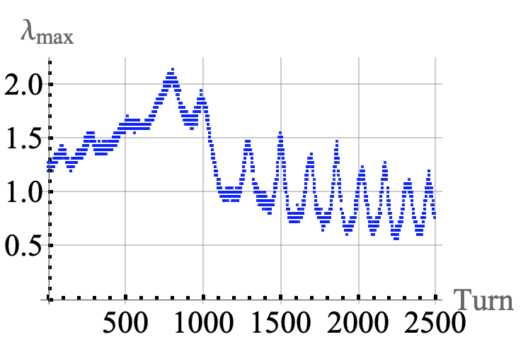
Zero Chroma, 13 turns, Horz Data
total current
peak current
AB

Slide 12
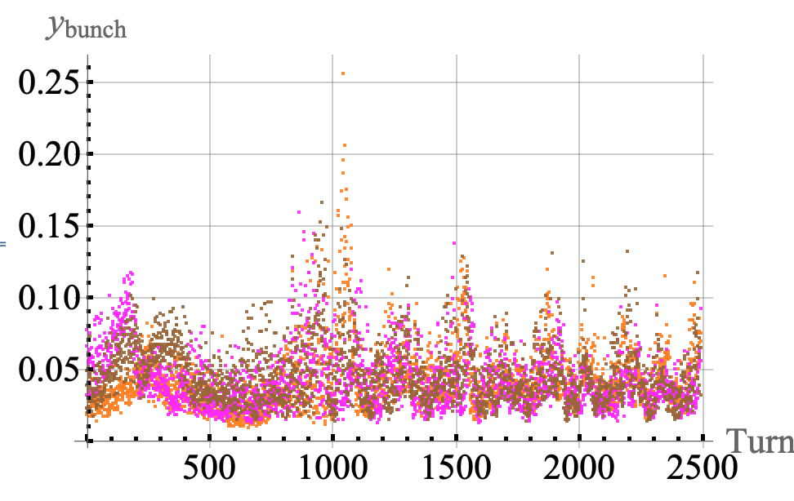
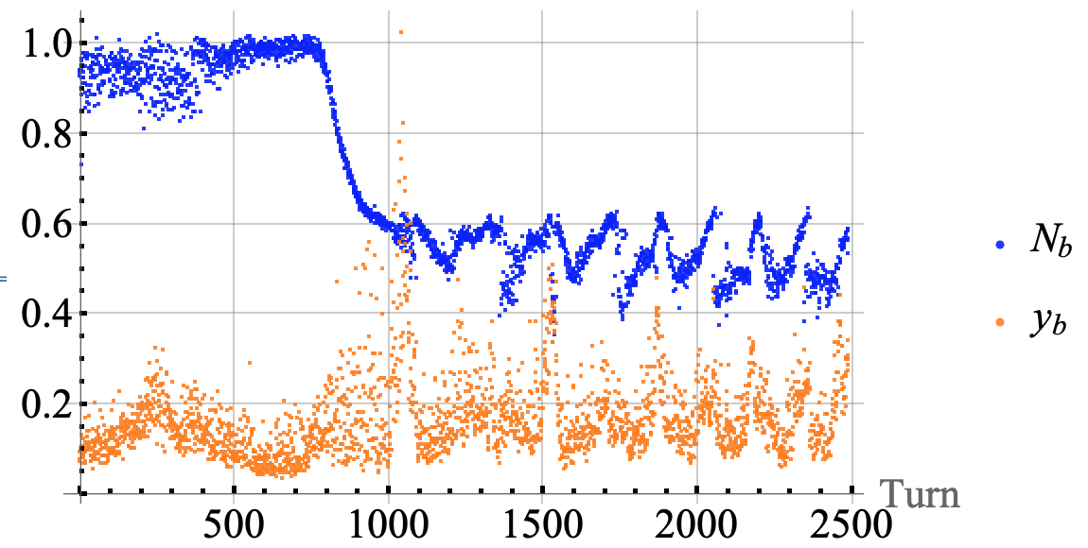
Horz oscillations are weaker
The most horz-unstable bunch
and 2 other randomly chosen bunches
The most horz-unstable bunch:
its intensity and 4*oscillations.
AB

Slide 13
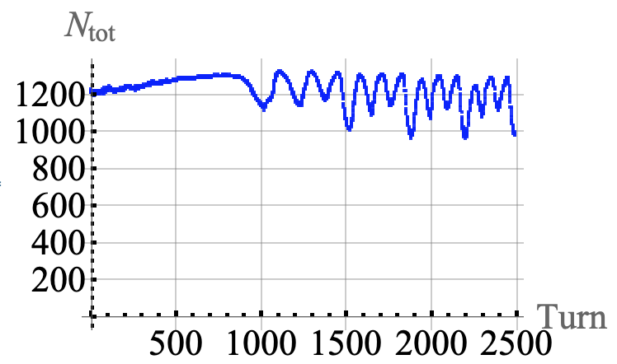
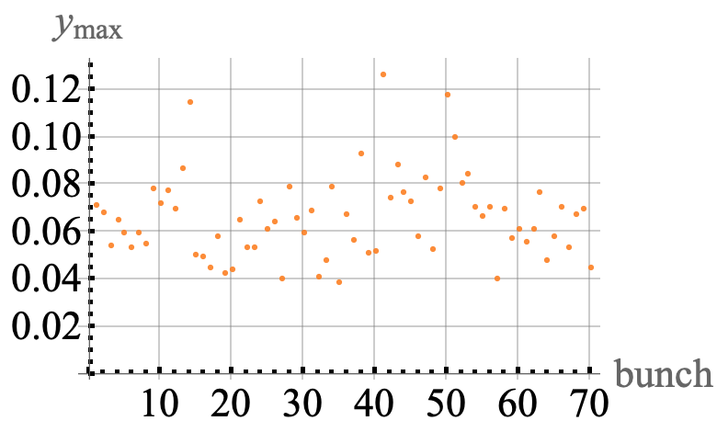
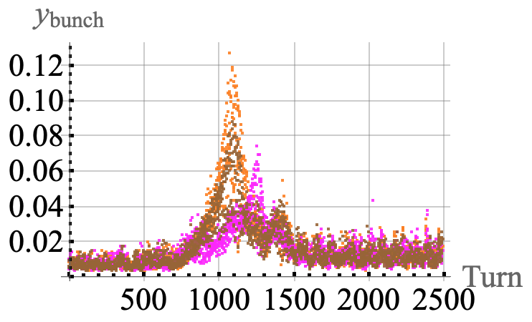
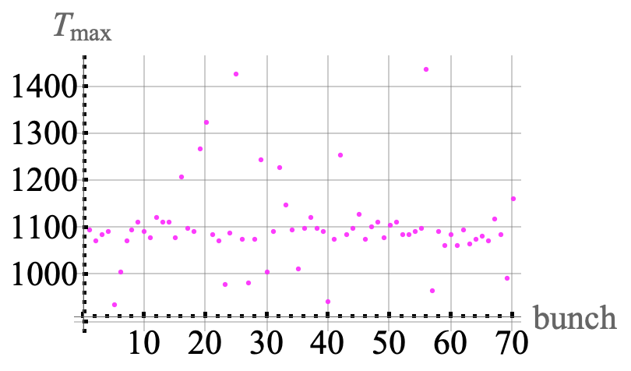
Zero Croma, 10 turns, vert
No visible losses.
Instability is visible, though, with max offset 5 times smaller than at 13 turns.
AB

Slide 14
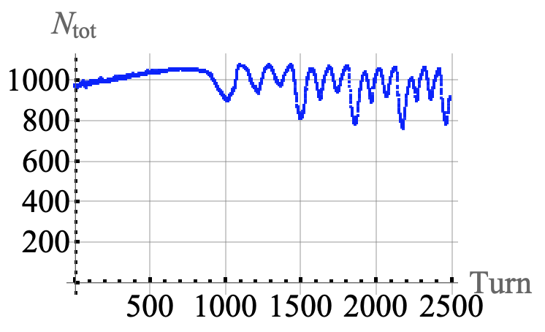
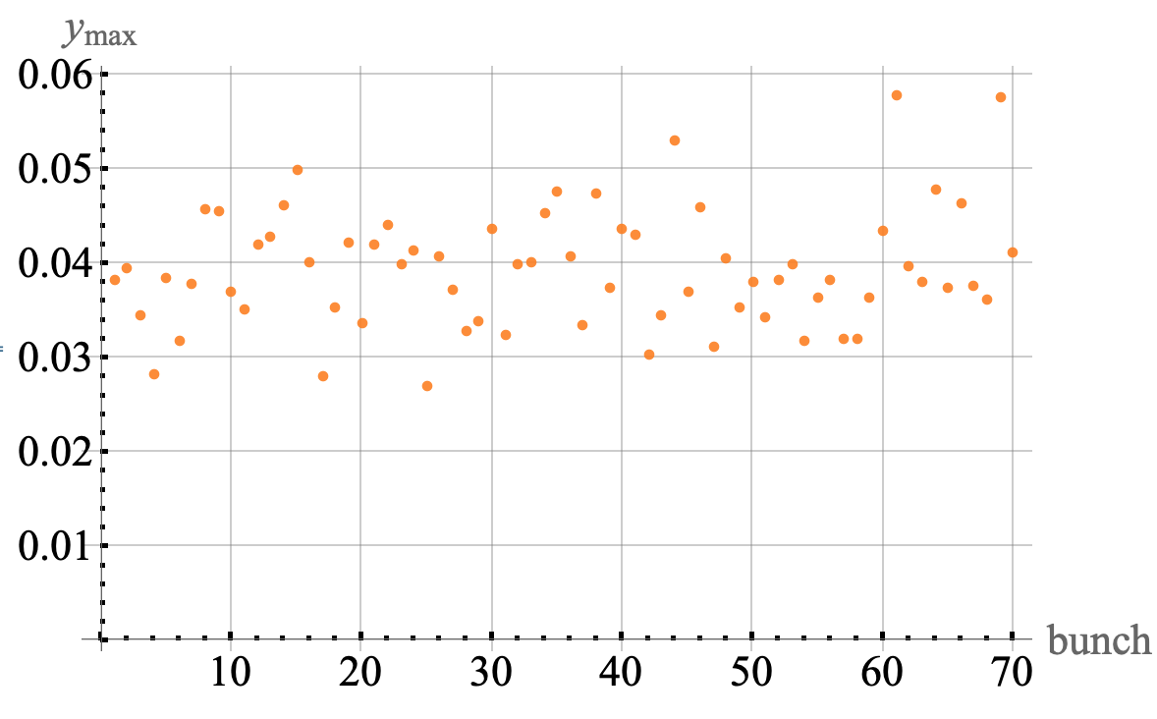
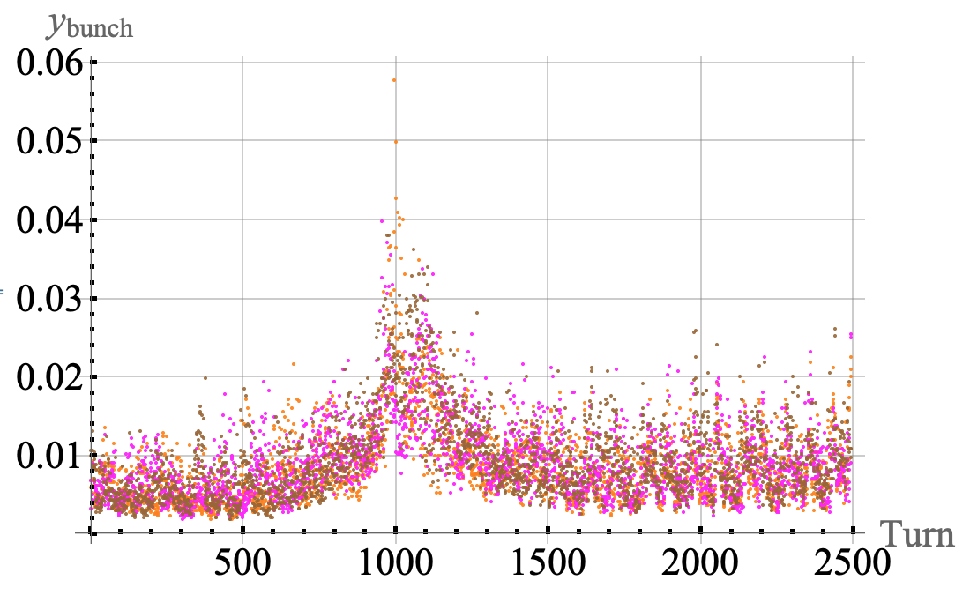
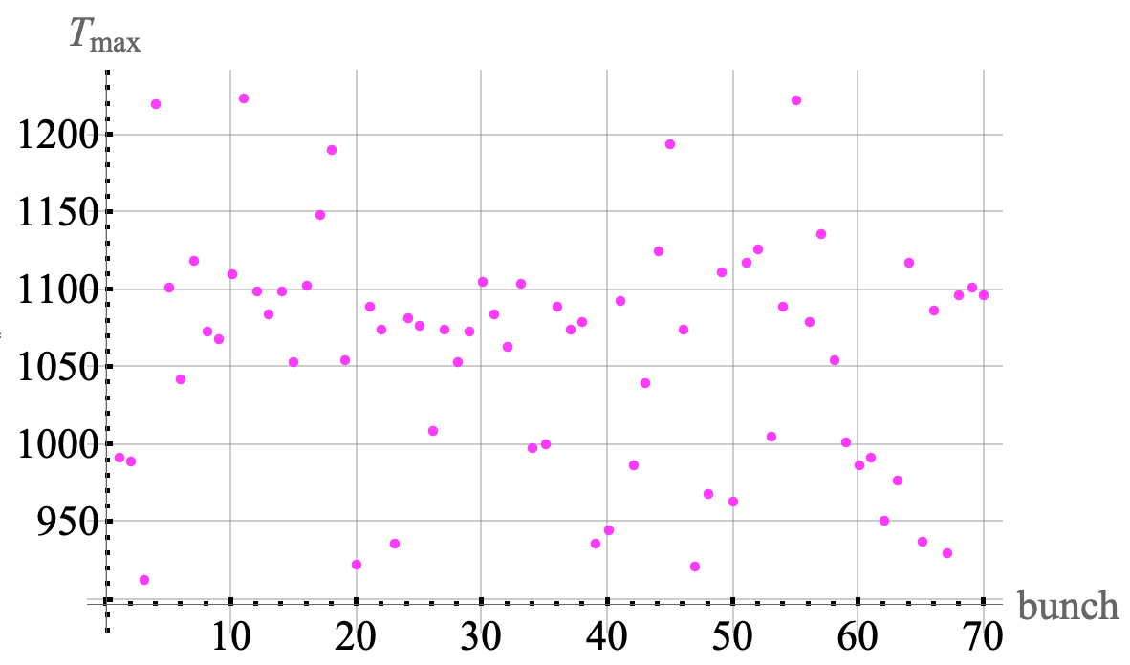
Zero Croma, 8 turns, vert
No visible losses.
Instability is still visible, with max offset 2-3 times smaller than at 10 turns.
AB

Slide 15
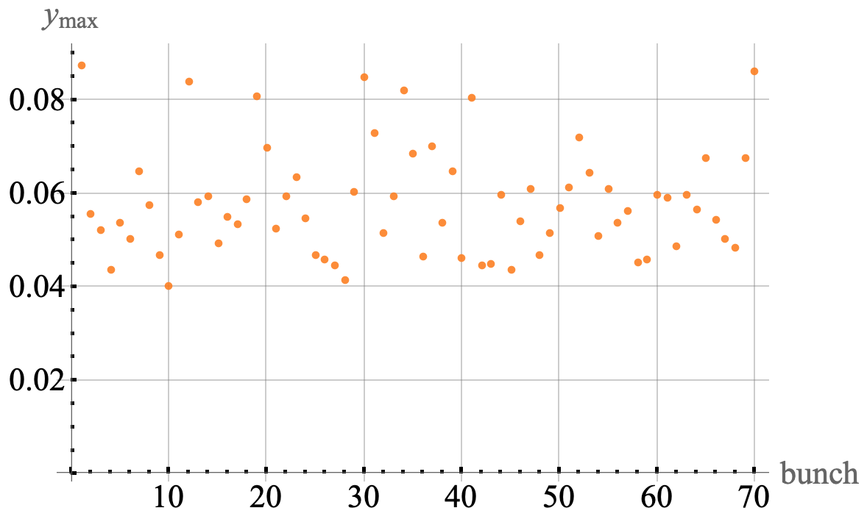
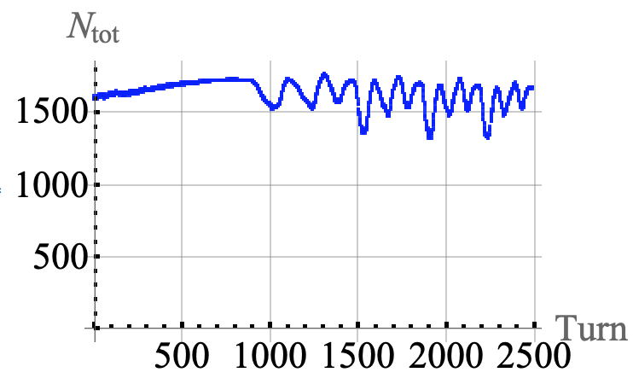
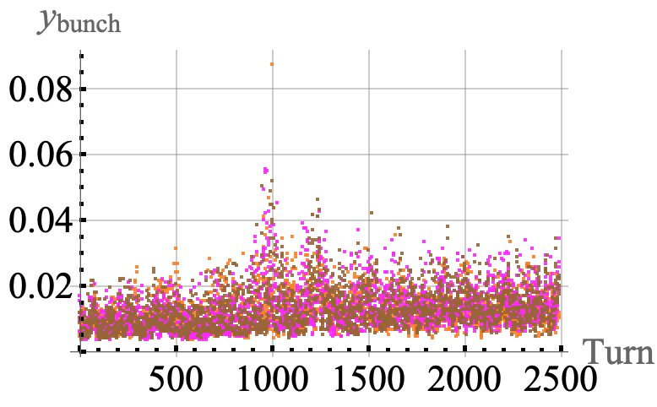
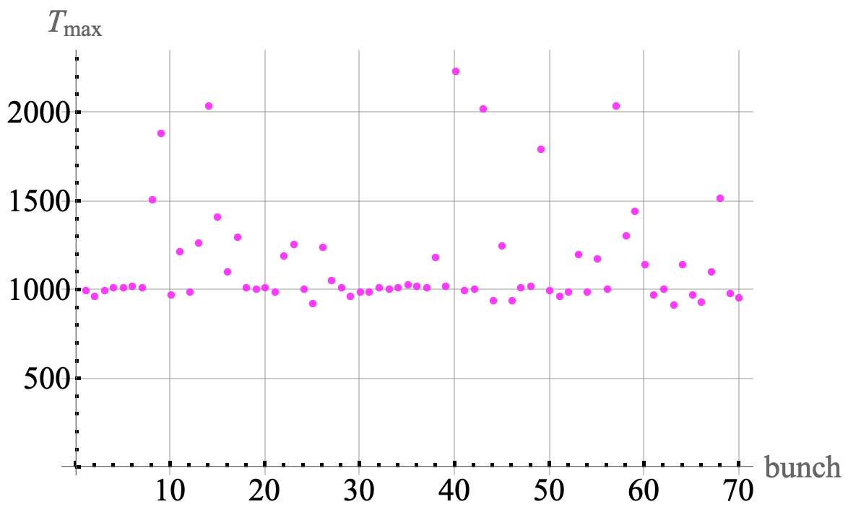
Nominal Chroma, 13 turns
No losses. The max offset is 7 times smaller than at 0 chroma.
AB

Slide 16
Summary
Both vert and horz instabilities are well seen at 0 chroma within +- 100 turns around the transition. The vert dominates.
For 13 Booster turns, 0 chroma, there is ~40% of the beam loss at the transition. For 10 and 8 turns, there are no visible losses, while the instabilities still can be seen at much smaller level.
For each bunch, its losses begin at a turn when its vert signal reaches max.
Each bunch has its peak at its own turn, within +- 100 turns. Details of the bunch pattern are not reproduced.
There is significant amplification of the oscillations along the bunch, ~10 times or more. All the losses are from the center and the tail parts of the bunches.
For the nominal chroma, the instability is still visible, with the amplitude ~7 times smaller than for 0 chroma. No visible losses.
All the observations confirm that the instabilities are convective ones, as it was predicted.
AB

Slide 17
What’s next?
The convective instability is suppressed by the chroma, which abs value has to be high enough around the transition, disrespectfully to the sign (to be confirmed by measurements). An important question is:
For a given beam intensity, what is a threshold chroma to prevent the losses?
Keeping in mind our plans to increase the Booster intensity, measurements of the threshold chromaticity vs the intensity are important.
An optimal chroma scenario looks to be the following:
rather small negative chroma below transition (to prevent weak HT),
then jump to sufficiently high abs[chroma] ~200 turns before the transition (to prevent SCI),
then, ~200 turns after transition, jump to a moderate positive chroma to prevent weak HT.
In the future measurements, the oscilloscope has to be used at highest possible Gs/s, since the wave oscillates several times along the bunch, and we need to see only +- 200 turns around the transition.
AB

Slide 18
Many thanks!
AB

