Slide 1
Lattice Periodicity &
Emittance Growth (part II)
Y. Alexahin, H. Bartosik, C. Bhat, D. Bruhwiler, M. Carlà, S. Chaurize, J. Edelen, J. Eldred, A. Huschauer, A. Saa Hernandez, V. Kapin, V. Kornilov, F. Schmidt, K. Seiya, V. Shiltsev, C.Y. Tan, K. Triplett, A. Valishev,
with support from the beam instrumentation group
Capstone event, 5 August 2019

Slide 2
Outline
Tune scans for different intensity and chromaticity conditions
  2D tune scans
  Transmission at different chromaticities
  Intensity effect on IPM measurements
Comparison between HEP and flat lattice
Additional observations and proposals
Data analysis framework

Slide 3
Outline
Tune scans for different intensity and chromaticity conditions
  2D tune scans
  Transmission at different chromaticities
  Intensity effect on IPM measurements
Comparison between HEP and flat lattice
Additional observations and proposals
Data analysis framework

Slide 4
Results from 2D tune scans I
A series of 2D tune scans were performed under different conditions
  At different intensities to investigate impact of direct space charge tune spread
  At different chromaticities to investigate impact of chromatic tune spread
  Results based on intensity measurements from the toroids and IPM data
  Measurement and data analysis principle:
    Automatic tune scan using Kiyomi’s application
    Allocating time stamps to the data stored by
    the application by aligning with intensity
    data from the logging
    Converting IPM binary data into CSV using the
    LabView application, further processing in
    Python
    Merging tune, intensity and IPM data
Tune scan at 14 BT and nominal chromaticity

Slide 5
Results from 2D tune scans II
In the following some results measured under these different conditions will be discussed
We will try to focus on the loss mechanism by investigating
  Transmission along the cycle
    Calculated from the intensity vector saved by the IPM application
  IPM measurements (beam size) at
    injection, i.e. after 1000 turns as this corresponds to the maximum space charge factor
    extraction, i.e. at 19400 turns

Slide 6
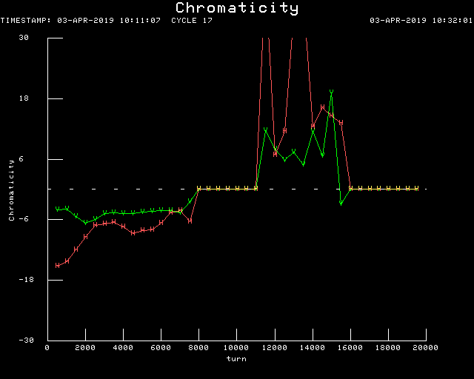
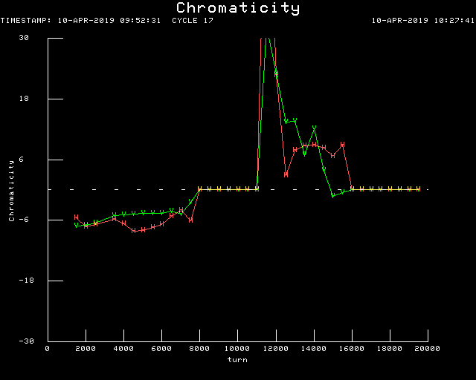
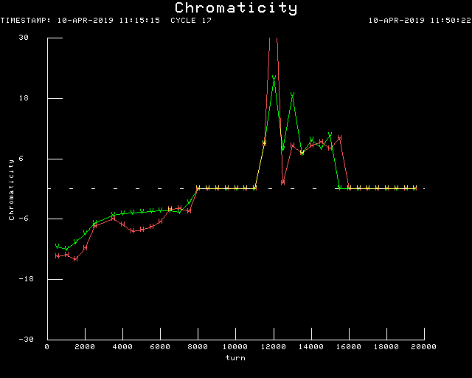
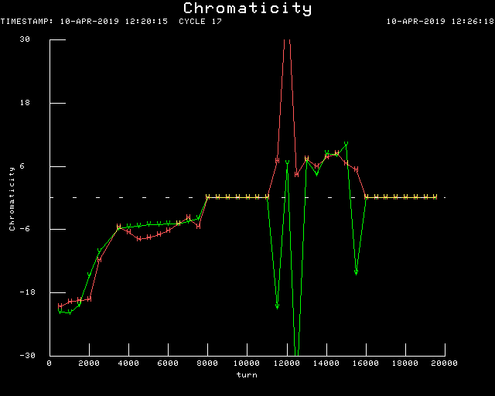
Different chromaticity conditions
Nominal chromaticity
Chromaticity -6
Reminder of the four different scenarios
Measurements provided by Jeff Eldred
Chromaticity -12
Chromaticity -20

Slide 7
Tune scan at 14BT, Q’ = -12
Nominal intensity, i.e. very high space charge
Measurements at injection indicate:
  Presence of half-integer resonance in both planes
  Vertical half-integer resonance appears very strong
Situation at extraction less clear
IPM data at injection (1000 turns)
IPM data at extraction

Slide 8
Tune scan at 14BT, Q’ = -20
Losses enhanced wrt. previous slide
  In agreement with enhanced chromatic tune spread due to Q’ settings
Measured beam size in very low transmission regime decreases significantly
  Hints at intensity-dependent effects in the IPM
IPM data at injection (1000 turns)
IPM data at extraction

Slide 9
Tune scan at 9BT, Q’ = -12
Resonance width decreased following the reduction in tune spread
Results at extraction still difficult to interpret
IPM data at injection (1000 turns)
IPM data at extraction

Slide 10
Tune scan at 4BT, Q’ = -6
Low-intensity allows to resolve resonance lines much better
Measured losses shift closer to the half-integer resonance following the tune spread reduction
Situation at extraction becomes clearer:
  Emittance exchange caused by crossing the coupling (probably Montague) resonance
  Results in both planes therefore very similar at extraction
IPM data at injection (1000 turns)
IPM data at extraction

Slide 11
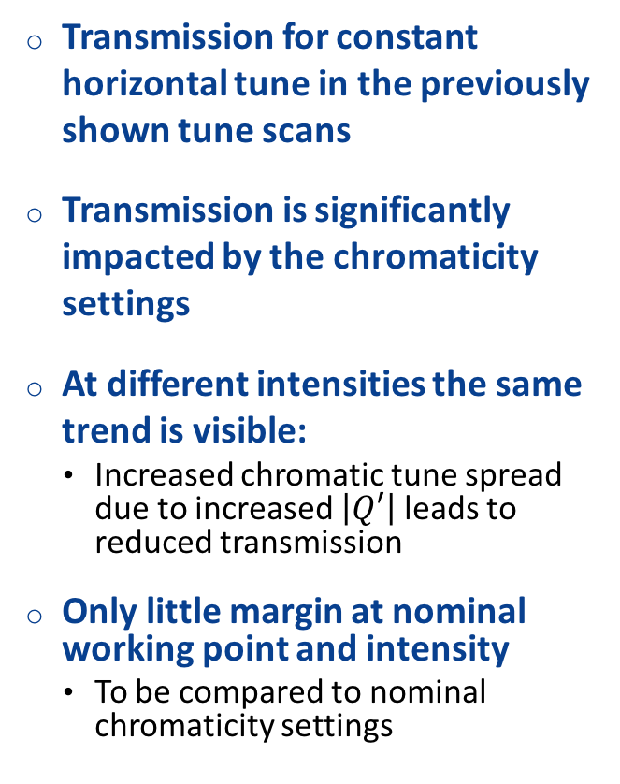
Transmission at different chromaticities
Transmission for constant horizontal tune in the previously shown tune scans
Transmission is significantly impacted by the chromaticity settings
At different intensities the same trend is visible:
  Increased chromatic tune spread due to increased $\left|Q′\right|$ leads to reduced transmission
Only little margin at nominal working point and intensity
  To be compared to nominal chromaticity settings

Slide 12
Intensity effect on IPM measurements
  Beam size data normalized to measurements at Q_{y} = 6.88
  Onset of emittance growth shifted to higher WP for higher intensity as expected
  However, beam size reduction in high loss regime at extraction unexpected → IPM intensity effect

Slide 13
Intensity scan for different Q’ settings
  Nominal setup appears to be best at operational and higher intensity
  Clear and drastic reduction for Q’ = -20

Slide 14
Outline
Tune scans for different intensity and chromaticity conditions
  2D tune scans
  Transmission at different chromaticities
  Intensity effect on IPM measurements
Comparison between HEP and flat lattice
Additional observations and proposals
Data analysis framework

Slide 15
Comparison between HEP and flat lattice I
  Vertical tune scan (nominal Q_{x} and Q’) to compare the two different configurations
    Grey points indicate IPM intensity effect
  Flat lattice appears worse in terms of transmission, even though beam size appears comparable

Slide 16
Comparison between HEP and flat lattice II
What are the reasons for the increased losses using the flat lattice?
  Important points could be:
    Handover between flat and HEP lattice after injection → implement flat lattice along the whole cycle
    Could it be that quadrupole settings for flat lattice in reality introduce additional quadrupole errors?

Slide 17
Outline
Tune scans for different intensity and chromaticity conditions
  2D tune scans
  Transmission at different chromaticities
  Intensity effect on IPM measurements
Comparison between HEP and flat lattice
Additional observations and proposals
Data analysis framework

Slide 18
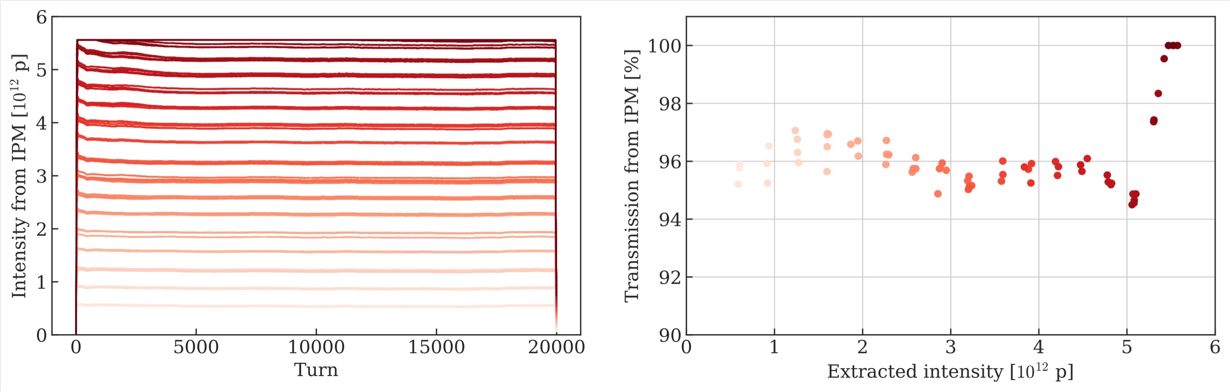
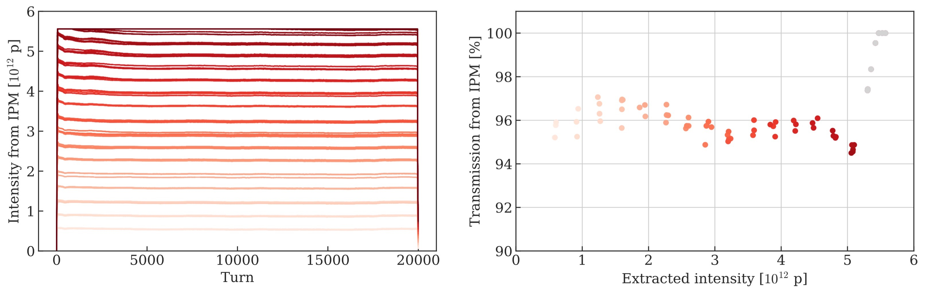
Additional observations and proposals I
IPM:
  Extremely powerful device that should be exploited on a regular basis
  Processing of measurement data very time consuming due to conversion from binary to csv-format
    We suggest to save the data immediately in a format useable for direct analysis
  Intensity effects on the beam size measurement need to be simulated and taken into account
  Intensity recorded with the IPM application saturates at 5.56 x 10¹² p

Slide 19
Additional observations and proposals II
In the CERN PS Booster, the vertical half-integer resonance could be successfully compensated
  Based on an automatic scan of quadrupole correctors
  Some information is available in the back-up slides and the following seminar provides more details
    https://indico.cern.ch/event/782453/
Correcting chromaticity and relying on the transverse damper could also help to improve the performance
Logging of critical data has significantly increased at CERN over the last years and is of fundamental importance to track the performance of our accelerators
  We suggest to improve the logging, especially in view of combining tune scan and IPM data

Slide 20
Outline
Tune scans for different intensity and chromaticity conditions
  2D tune scans
  Transmission at different chromaticities
  Intensity effect on IPM measurements
Comparison between HEP and flat lattice
Additional observations and proposals
Data analysis framework

Slide 21
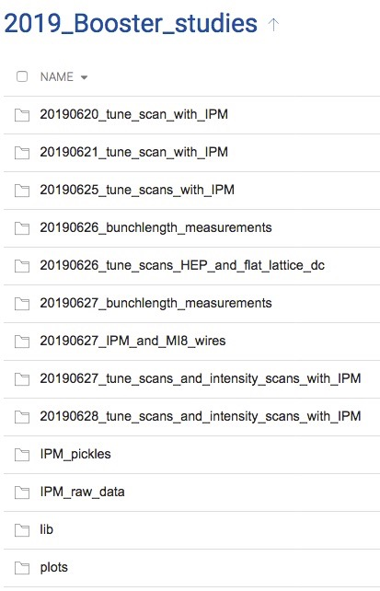
Data analysis framework
Data, library and analysis tools available at
  https://cernbox.cern.ch/index.php/s/SyiQP3LdMMstYX7
Folders containing measurement data, organized by date
Folders containing IPM raw data from LabView application (*.csv) and data processed in Python (*.pkl)
Library, which is called in the beginning of each analysis script

Slide 22
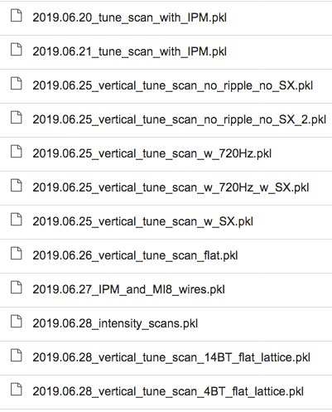
Data analysis framework
Data, library and analysis tools available at
  https://cernbox.cern.ch/index.php/s/SyiQP3LdMMstYX7
Processed measurement data saved in *.pkl format

Slide 23
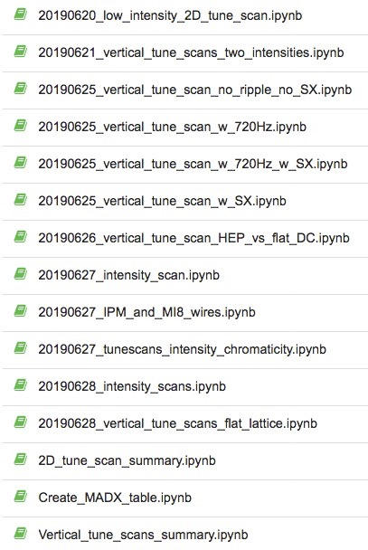
Data analysis framework
Data, library and analysis tools available at
  https://cernbox.cern.ch/index.php/s/SyiQP3LdMMstYX7
Analysis notebooks

Slide 24
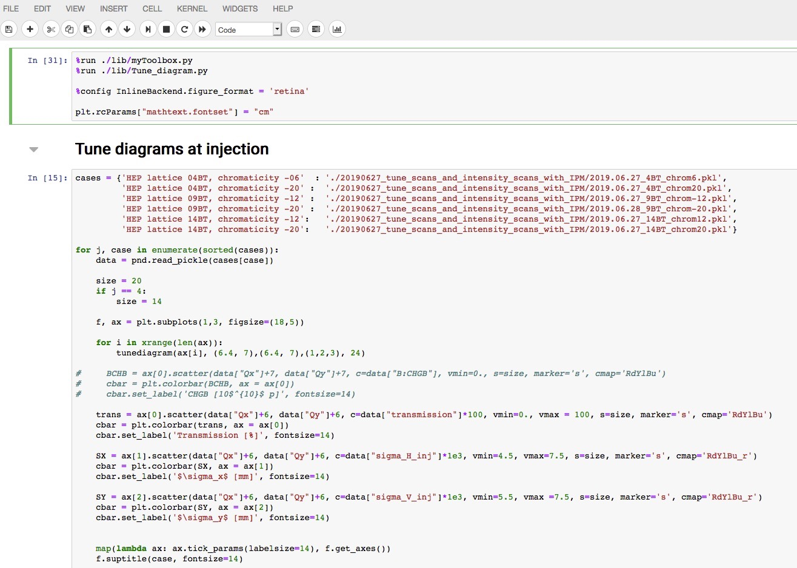
Notebook structure
Load library
Load processed measurement data
Create plots
Please download the data and the notebooks, and let us know if you experience troubles in running them!

Slide 25
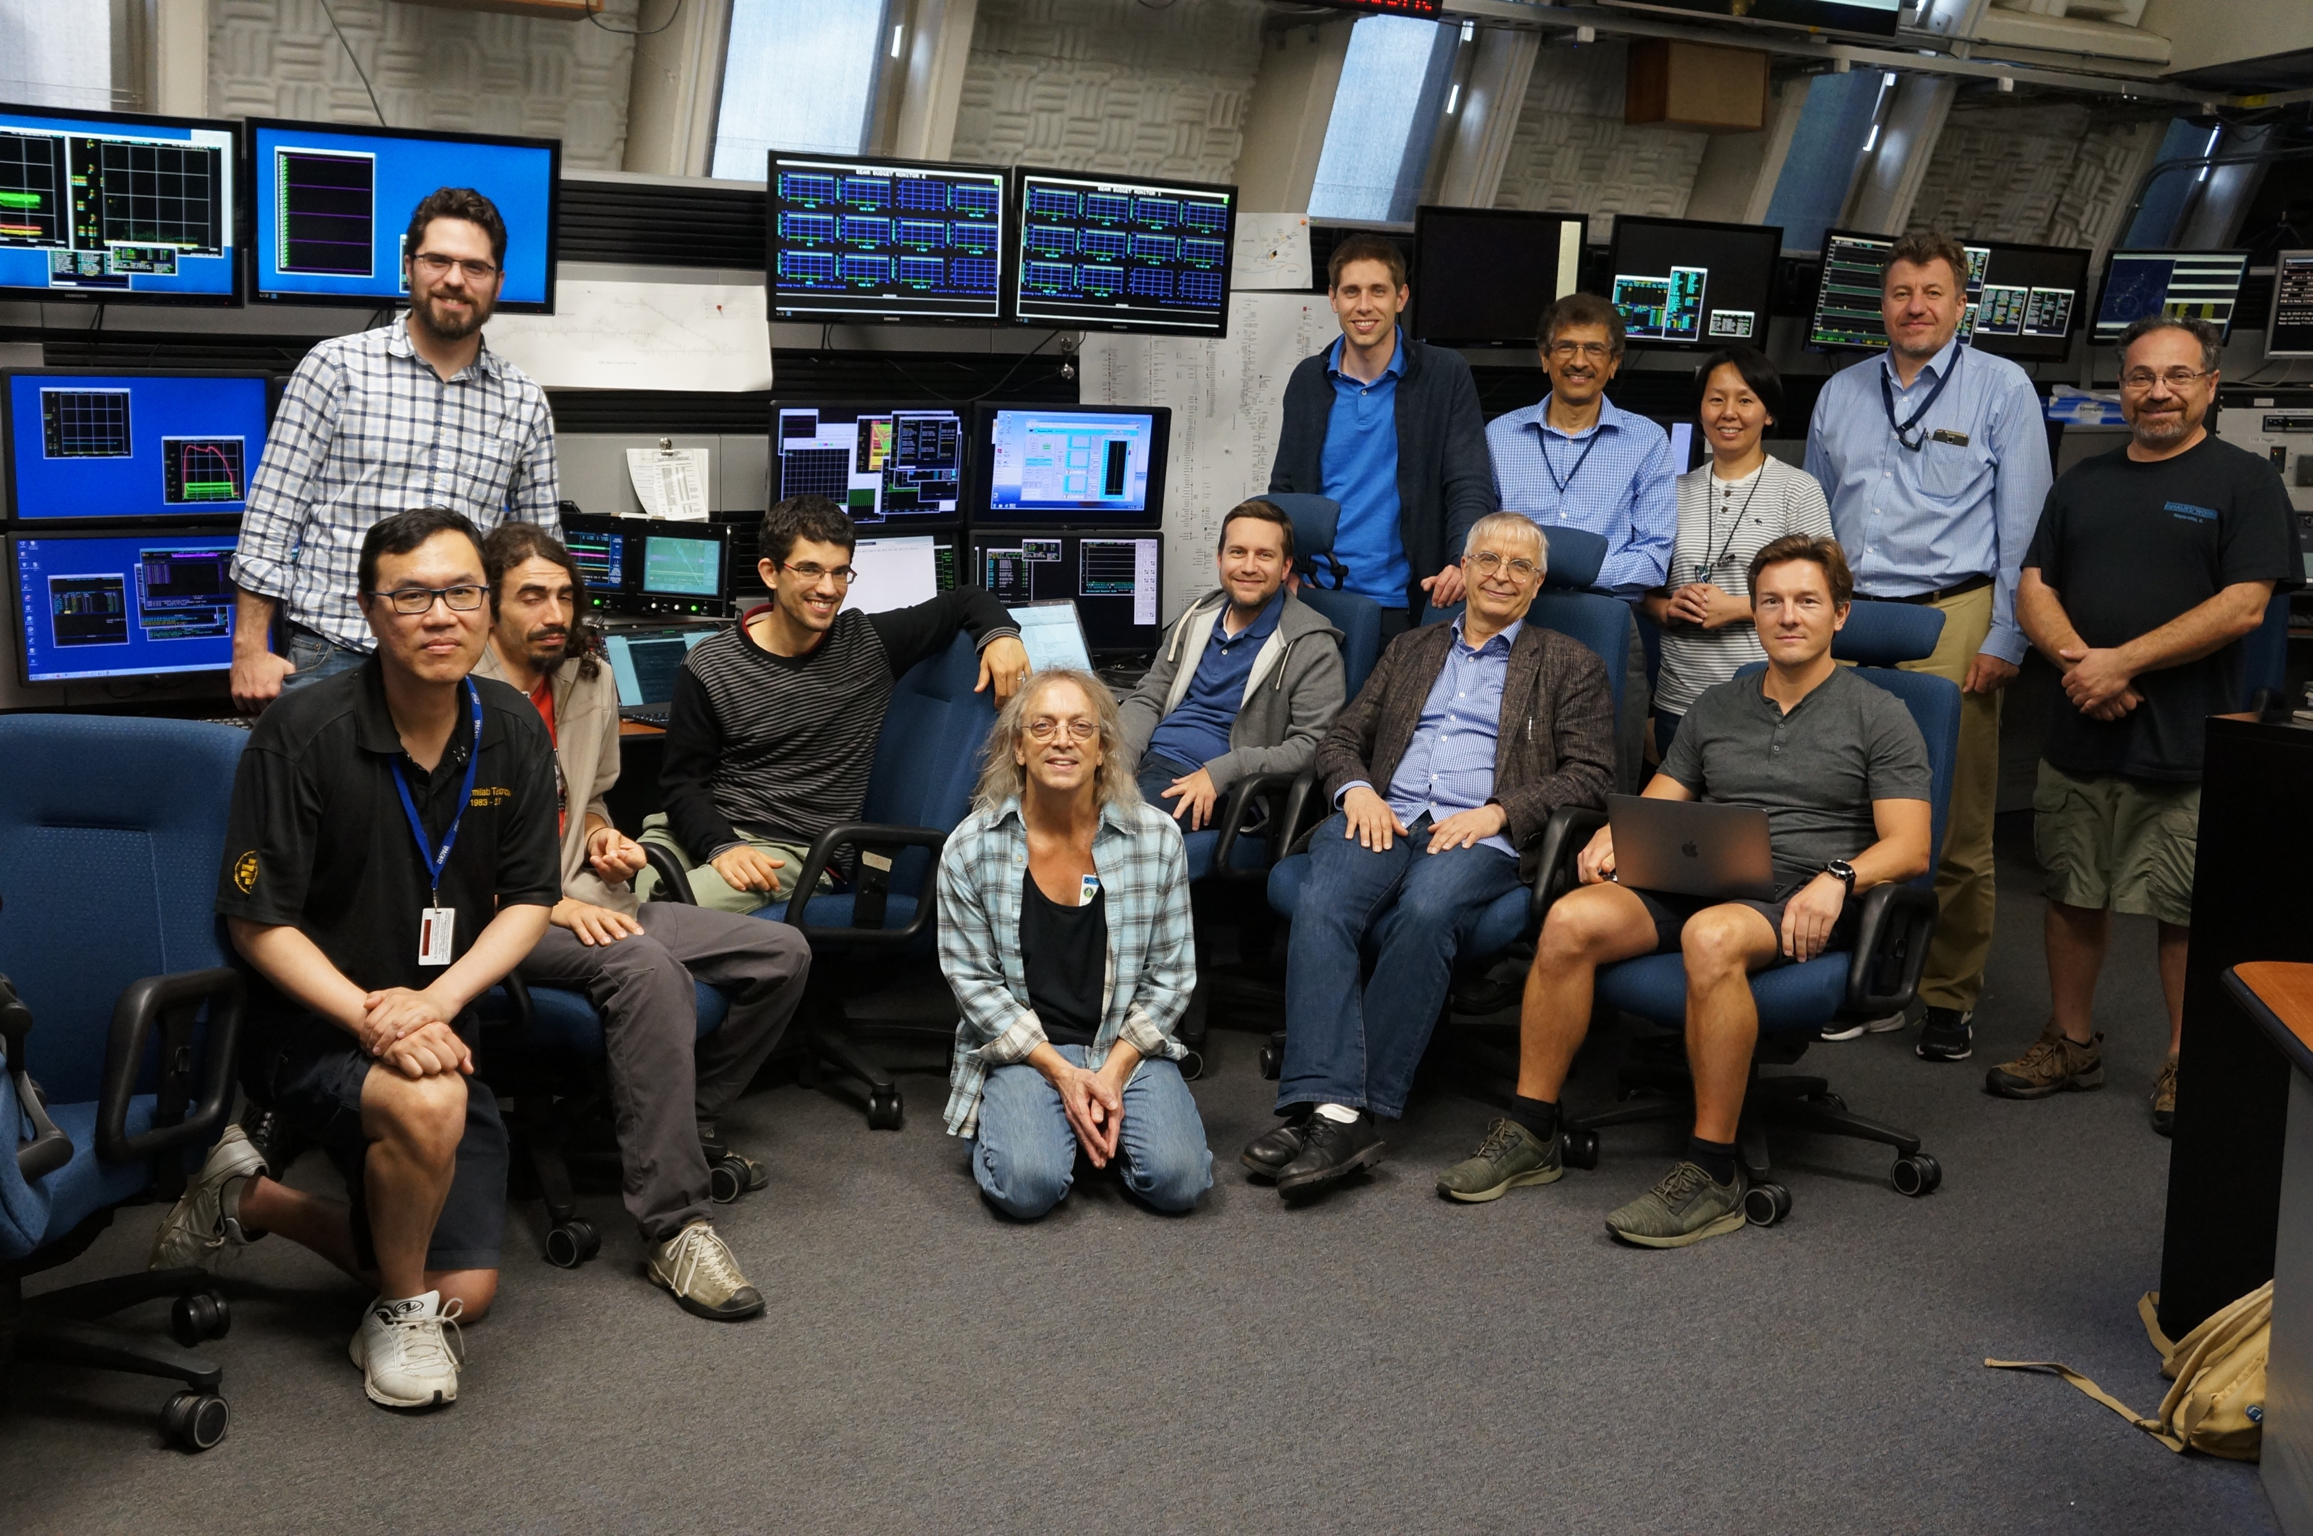
Thank you for exciting two weeks!

Slide 26
Back-up slides

Slide 27
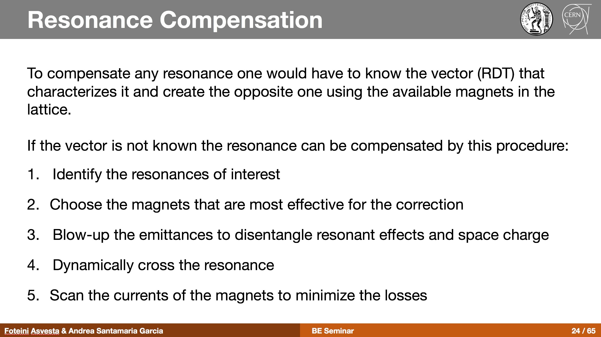
Resonance compensation in the CERN Proton Synchrotron Booster I
F. Asvesta, A. Santamaria Garcia (https://indico.cern.ch/event/782453/)

Slide 28
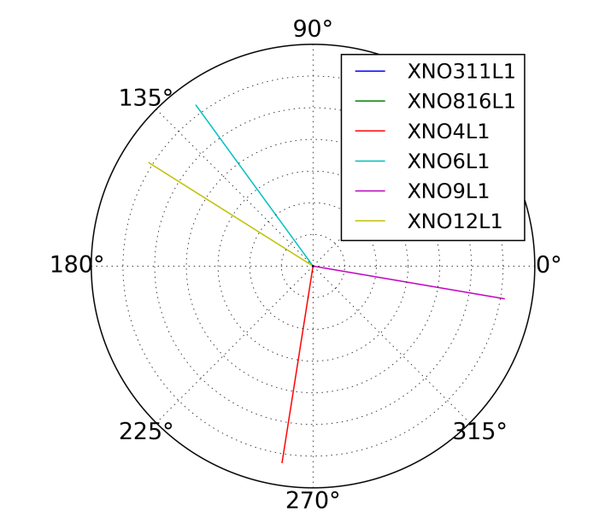
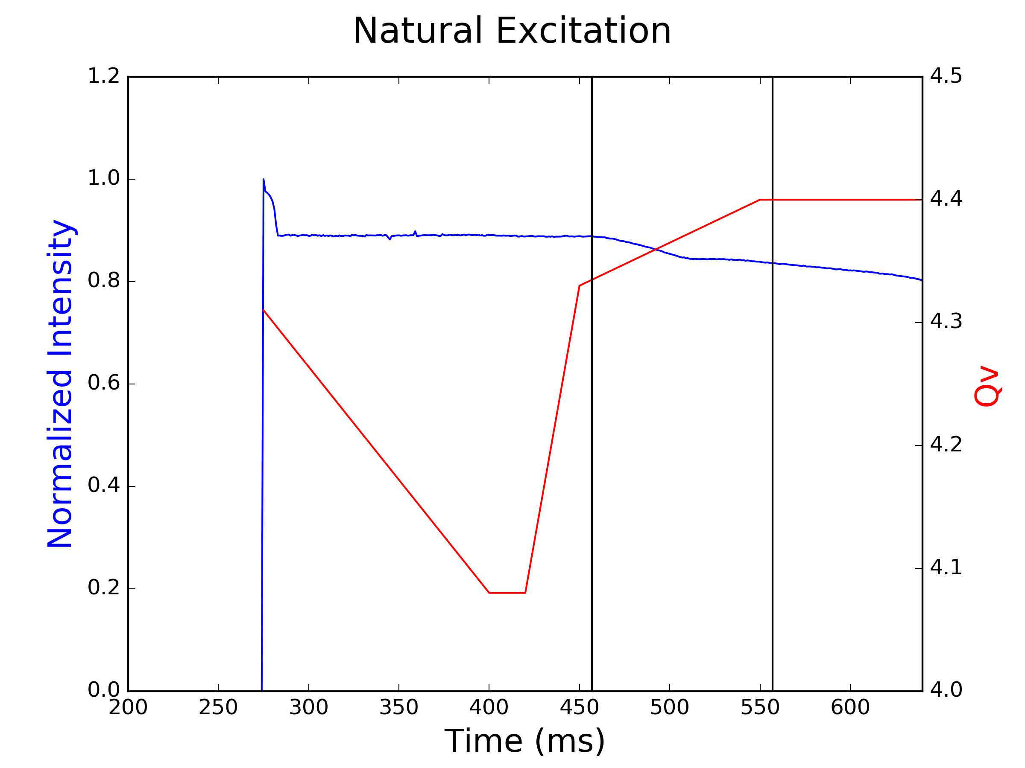

Resonance compensation in the CERN Proton Synchrotron Booster II
F. Asvesta, A. Santamaria Garcia (https://indico.cern.ch/event/782453/)
  Selection of the most effective elements for correction based on the evaluation of their resonance driving terms in PTC
  Dynamic resonance crossing to obtain a clear observable, usually measured in terms of beam loss
$$Q_{h}+2Q_{v}$$

Slide 29
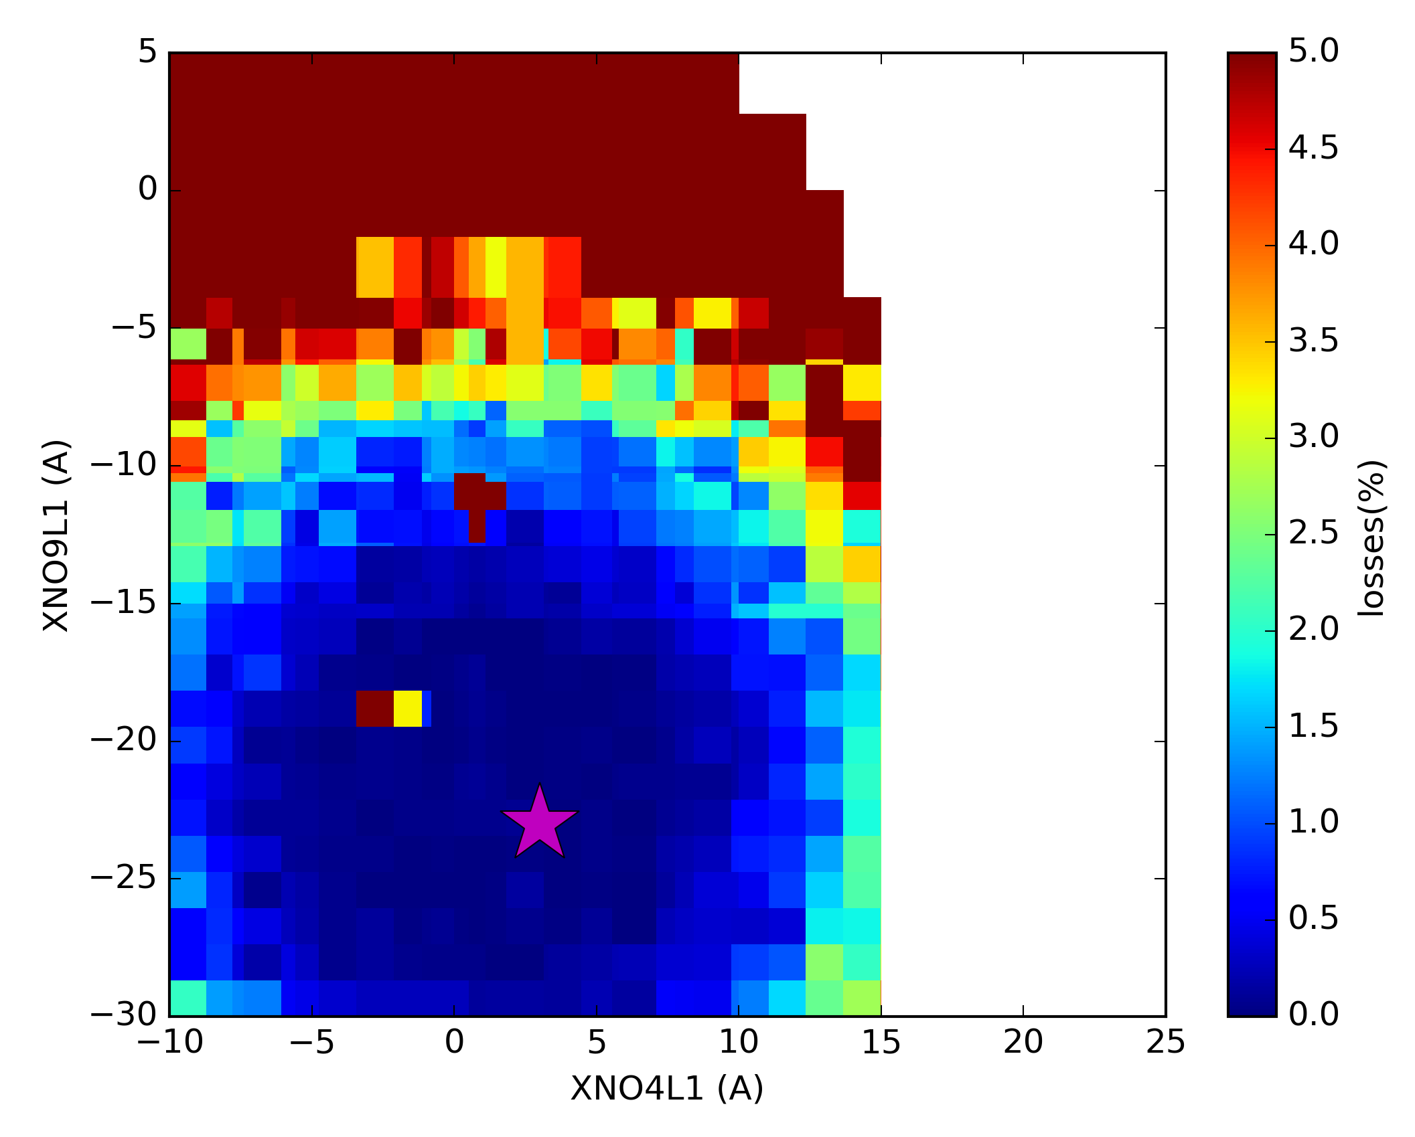
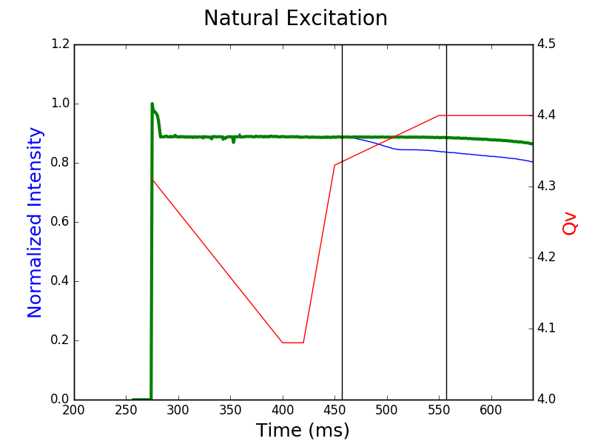
Resonance compensation in the CERN Proton Synchrotron Booster III
F. Asvesta, A. Santamaria Garcia (https://indico.cern.ch/event/782453/)
  Automatic scan of the strengths of the selected elements to minimize losses and therefore compensate the resonance

Slide 30
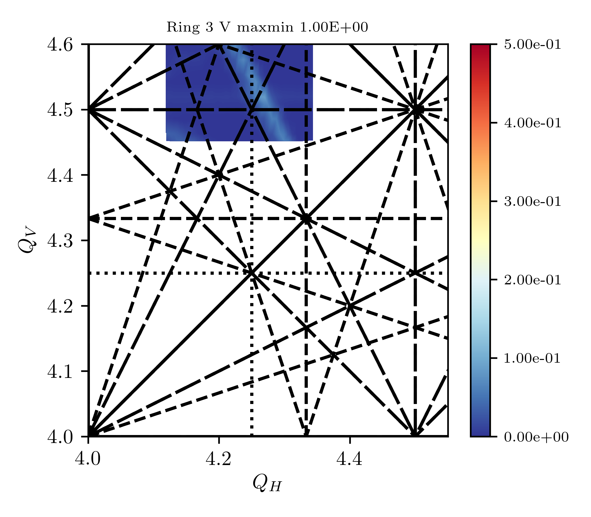
Resonance compensation in the CERN Proton Synchrotron Booster IV
F. Asvesta, A. Santamaria Garcia (https://indico.cern.ch/event/782453/)
  Experimental verification of effectiveness of compensation by means of tune scans
  Example of compensating the half-integer resonance 2Q_{y} = 9 in the PSB
  Many more examples available at the link above

Slide 31
Impact of ripple and skew sextupole I

Slide 32
Impact of ripple and skew sextupole II

