Slide 1
Physics Studies for High Intensity Proton Beams at the Fermilab Booster
J. Eldred, for Fermilab Booster Group
NAPAC 2019 - Lansing
Sept 5th, 2019

Slide 2
2
2
2
Jeffrey Eldred | Physics Studies for High Intensity Fermilab Booster
Notes:
2
2
2
2
2
2

Slide 3
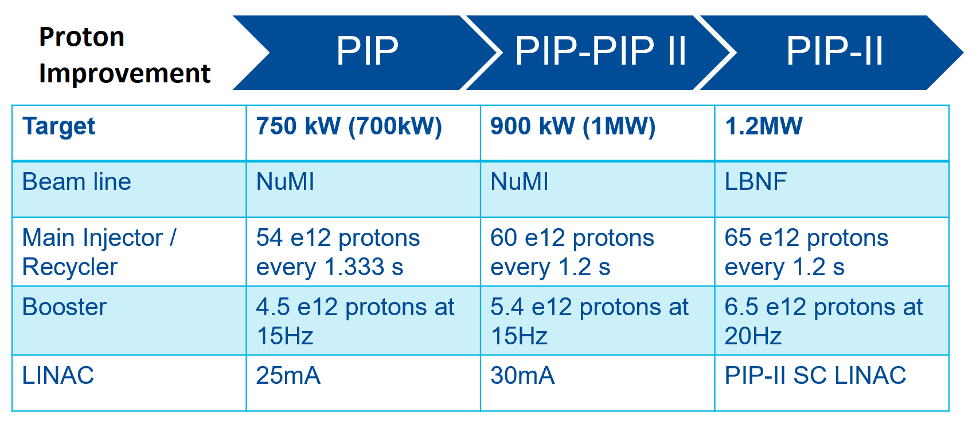
3
PIP-II Intensity Upgrades
2019 --> ~2021 --> ~2027
PIP-II intensity upgrade, and intermediate upgrades, will require increasing performance requirements for the Fermilab Booster.
3
Jeffrey Eldred | Physics Studies for High Intensity Fermilab Booster
Notes:
3
3
3

Slide 4
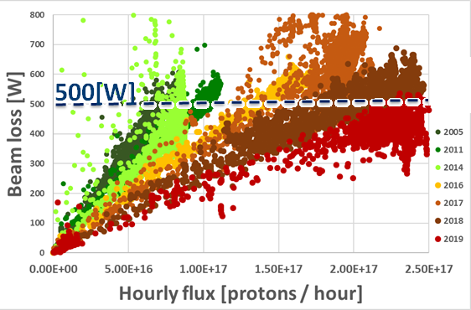
4
4
Losses per flux
Pellico
4
Jeffrey Eldred | Physics Studies for High Intensity Fermilab Booster
Notes:
4
4
4
4
4
4

Slide 5
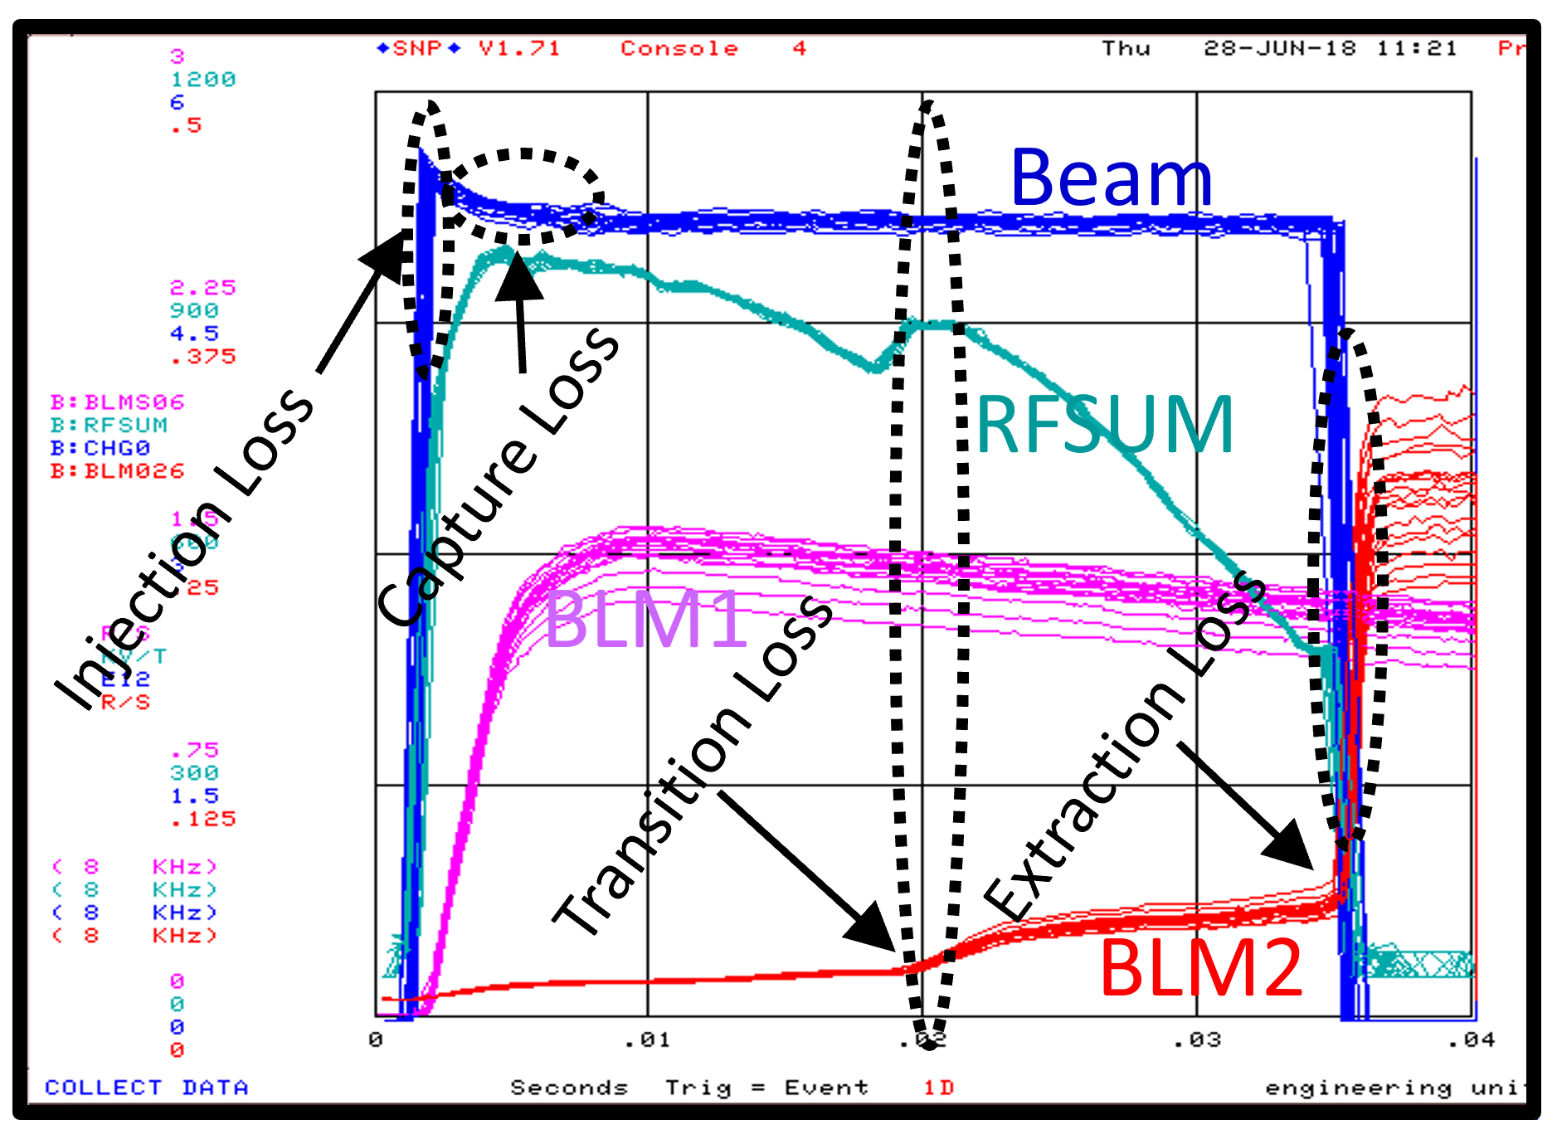
5
5
Losses over cycle
Bhat
At nominal intensity, about half the power loss is at inflection and about half at extraction.
5
Jeffrey Eldred | Physics Studies for High Intensity Fermilab Booster
Notes:
5
5
5
5
5
5

Slide 6
6
New Initatives for Booster Physics Studies
Starting this year, one day/month for dedicated PS development.
- In addition to everyday parasitic studies/tuning.
Annual US-Japan Collaboration - Mar 18-22
- Included one day of parasitic Booster studies focusing on
lattice measurement & resonance correction.
June Booster Studies – June 17- July 2nd
- Five dedicated study days, plus eight parasitic study days.
- Six separate study proposals.
- Nine visiting scientists – CERN, Radiasoft, GSI.
6
Jeffrey Eldred | Physics Studies for High Intensity Fermilab Booster
Notes:
6
6
6

Slide 7
7
Participants for June 2019 Studies
Fermilab
J. Eldred, Y. Alexahin, C. Bhat, A. Burov, S. Chaurize, N. Eddy,
C. Jensen, V. Kapin, J. Larson, V. Lebedev, H. Pfeffer, K. Seiya,
V. Shiltsev, CY Tan, K. Triplett
CERN
H. Bartosik, N. Biancacci, M. Carla, A. Saa Hernandez,
A. Huschauer, F. Schmidt
Radiasoft
D. Bruhwiler, J. Edelen
GSI
V. Kornilov
7
Jeffrey Eldred | Physics Studies for High Intensity Fermilab Booster
Notes:
7
7
7

Slide 8
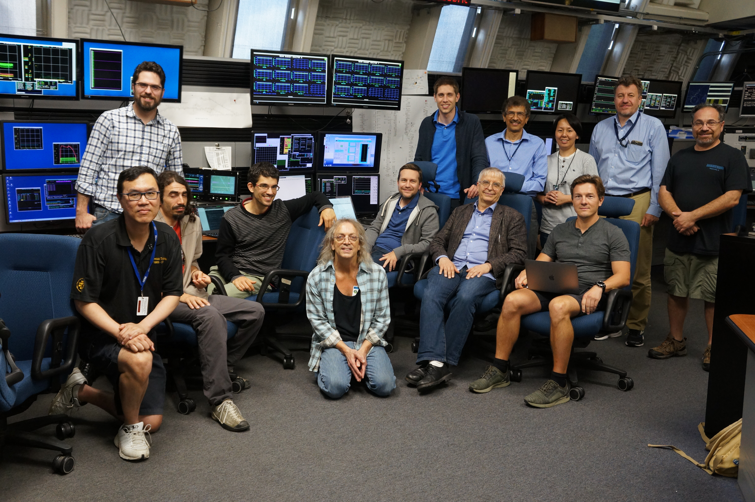
8
8
A Group Photo
(also Angela, David, Jon, and many key Fermilab participants.)
Jeffrey Eldred | Physics Studies for High Intensity Fermilab Booster
Notes:
8
8
8
8
8
8

Slide 9
9
9
Booster Physics Studies
9
Jeffrey Eldred | Physics Studies for High Intensity Fermilab Booster
Notes:
9
9
9
9
9
9

Slide 10
10
Booster Physics Studies
from Monthly Dedicated Studies:
1 Adiabatic Capture
2 Foil Scattering
- WEYBB3 “Foil Scattering Model for Fermilab Booster”
from June 2019 Studies Event:
3 Convective Instability
4 Space-charge Emittance Growth
5 Power-Supply Ripple
10
Jeffrey Eldred | Physics Studies for High Intensity Fermilab Booster
Notes:
10
10
10

Slide 11
11
11
1 Adiabatic Capture
Chandra Bhat, Salah Chaurize, Cheng-Yang Tan, Victor Grzelak, Bill Pellico, Brian Schupbach, Kiyomi Seiya, Kent Triplett
11
Jeffrey Eldred | Physics Studies for High Intensity Fermilab Booster
Notes:
11
11
11
11
11
11

Slide 12
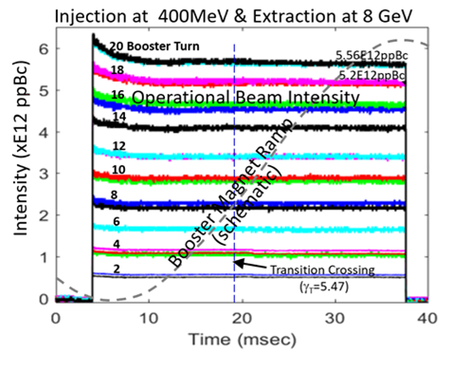
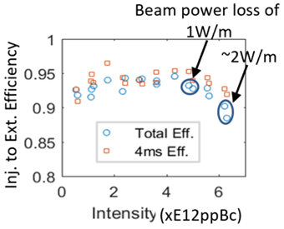
12
Losses with Intensity
Bhat
At or below nominal intensity, injection losses are at a few percent level and independent of beam intensity.
12
Jeffrey Eldred | Physics Studies for High Intensity Fermilab Booster
Notes:
12
12
12

Slide 13
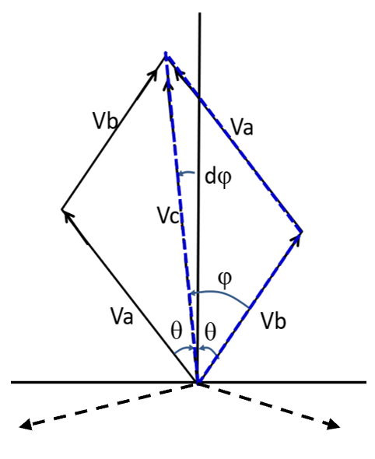
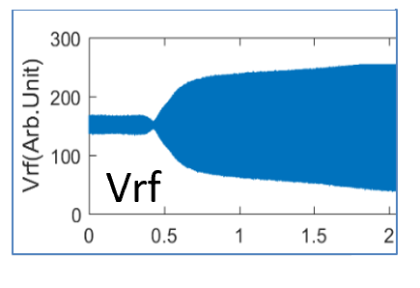
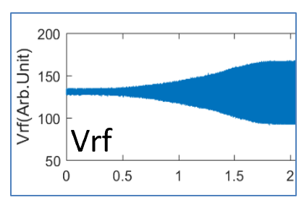
13
Longitudinal Capture
- Adiabatic capture by paraphasing
- A & B RF stations start out of phase and slowly phase in.
- Currently we implement a feature we call the “neck”
- RF starts greater than pi out of phase, then phases in.
- Is the effect of the neck to cover for energy mismatch errors?
- If we remove the neck, more time for paraphrasing normally.
- LLRF to be upgraded to a digital system, expected to improve amplitude and phase control.
with neck:
no neck:
13
Jeffrey Eldred | Physics Studies for High Intensity Fermilab Booster
Notes:
13
13
13

Slide 14
14
14
3 Convective Instability
Alexey Burov, Jeffrey Eldred, Valeri Lebedev
14
Jeffrey Eldred | Physics Studies for High Intensity Fermilab Booster
Notes:
14
14
14
14
14
14

Slide 15
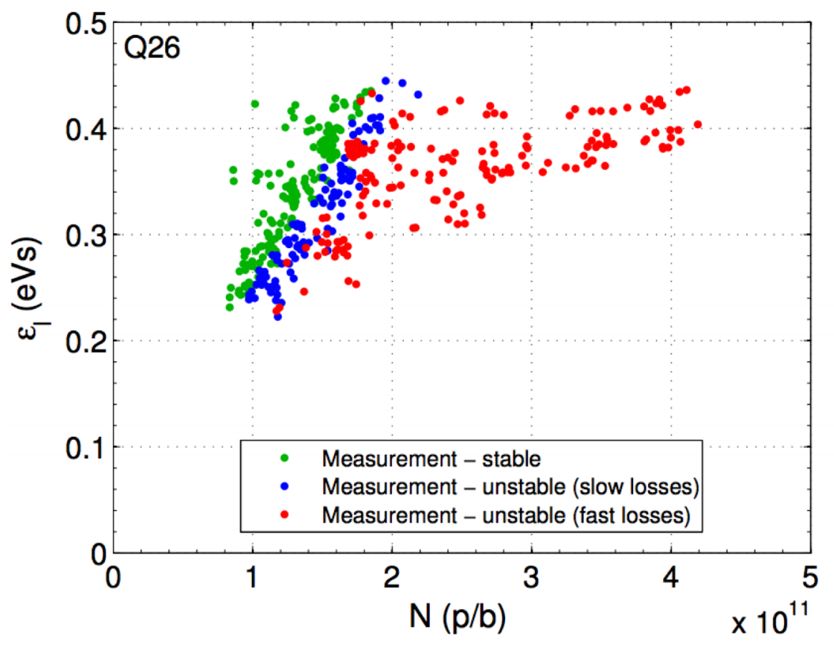
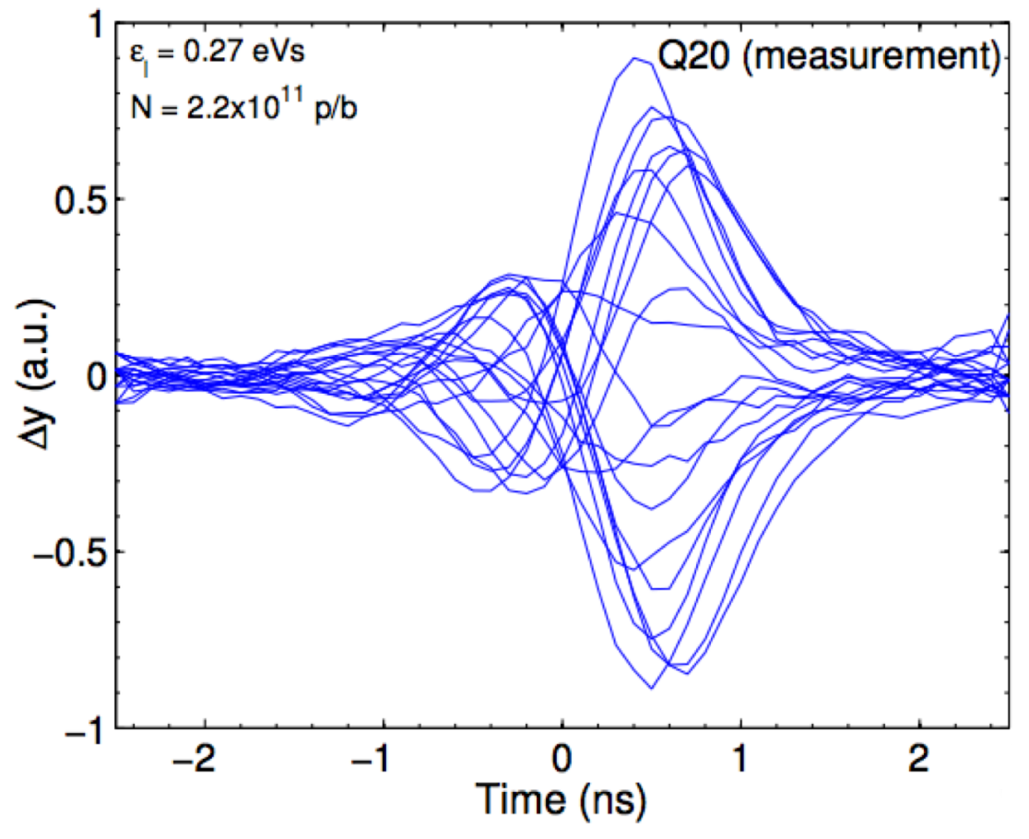
15
Convective Instability in SPS
SPS Instability:
Burov
Burov identified a CERN SPS instability as a convective instability, and derived the properties for the new instability.
15
Jeffrey Eldred | Summer Booster Studies Plan
Notes:
15
15
15

Slide 16
16
Convective Instability Study
A. Burov “Convective instabilities of bunched beams with space charge” PRAB 2019. link
The convective instability is a single-bunch collective instability with significant head-to-tail amplification, driven by strong wake forces in the presence of strong space-charge.
The instability is damped by synchrotron oscillations and chromaticity, therefore a ramp curve with a low-chromaticity transition-crossing was prepared.
We were able to confirm the existence of the convective instability in the Booster, with its predicted properties. New Physics!
16
Jeffrey Eldred | Physics Studies for High Intensity Fermilab Booster
Notes:
16
16
16

Slide 17
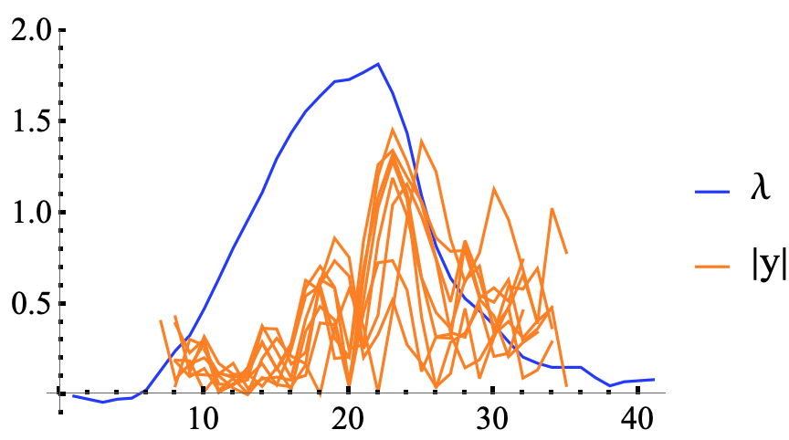
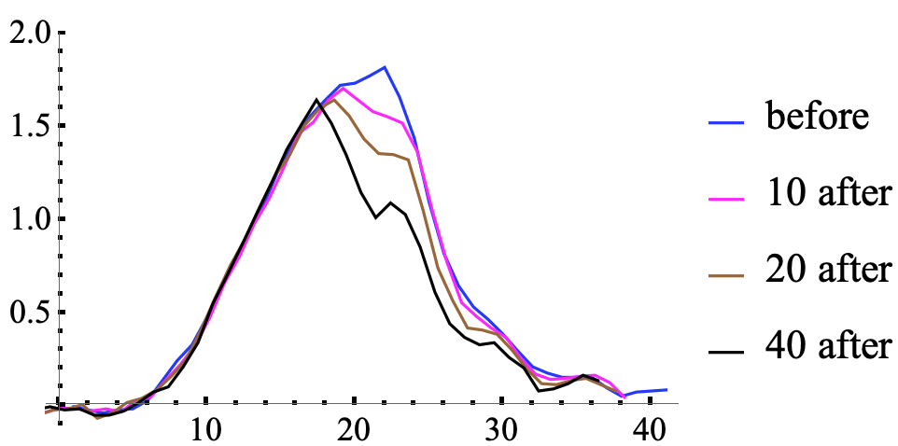
17
Signature of Convective Instability
Transverse intrabunch motion propagating from head to tail.
Each bunch blows up to a different amplitude and becomes unstable at a different time.
Massive beam loss rapidly occurs in tail-edge of the bunch.
head tail
Burov
17
Jeffrey Eldred | Physics Studies for High Intensity Fermilab Booster
Notes:
17
17
17

Slide 18
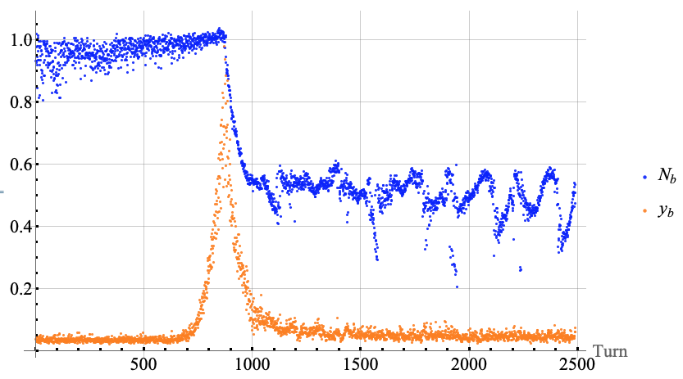
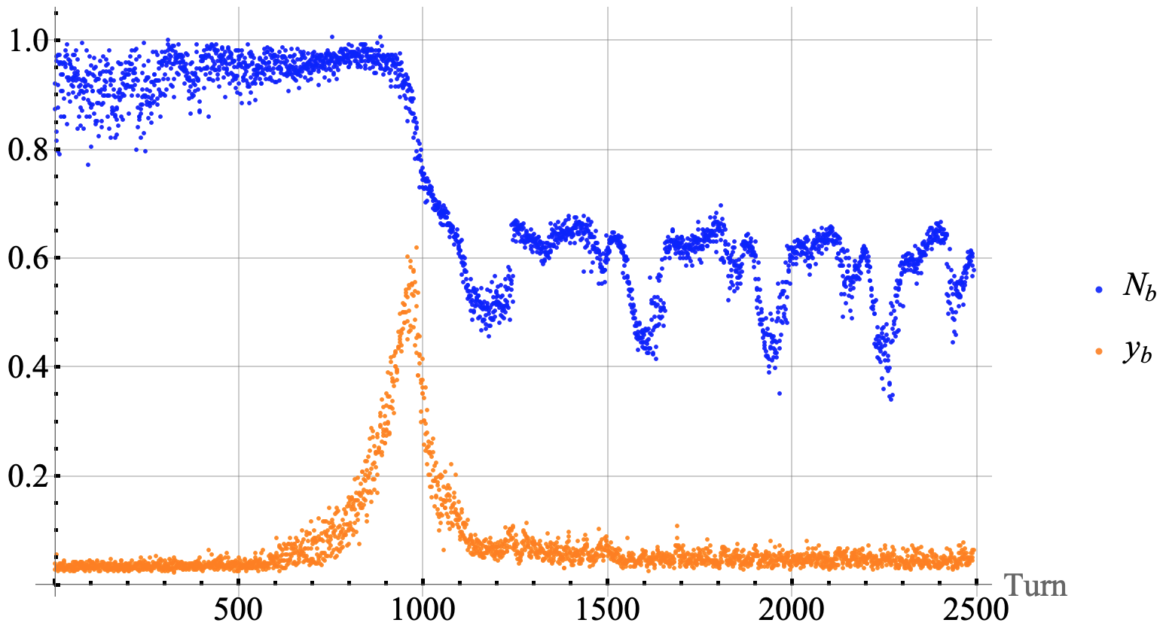
Vertical Instability for two neighboring bunches
Bunch # 36
Blue: Estimated Bunch Charge
Orange: Vertical Oscillation
Bunch # 37
Neighboring bunch
same instability,
~100 revolutions later.
Burov
18
Jeffrey Eldred | Physics Studies for High Intensity Fermilab Booster

Slide 19
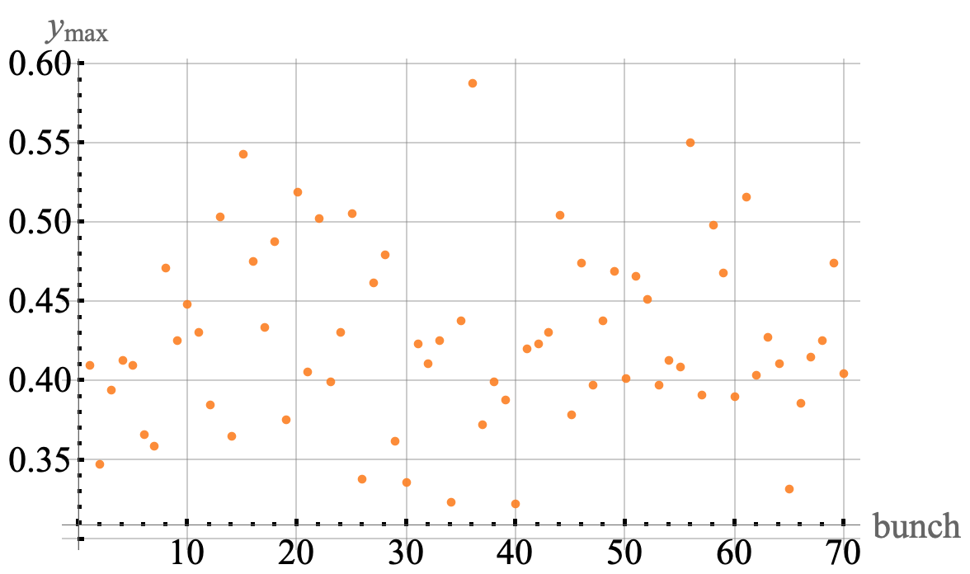
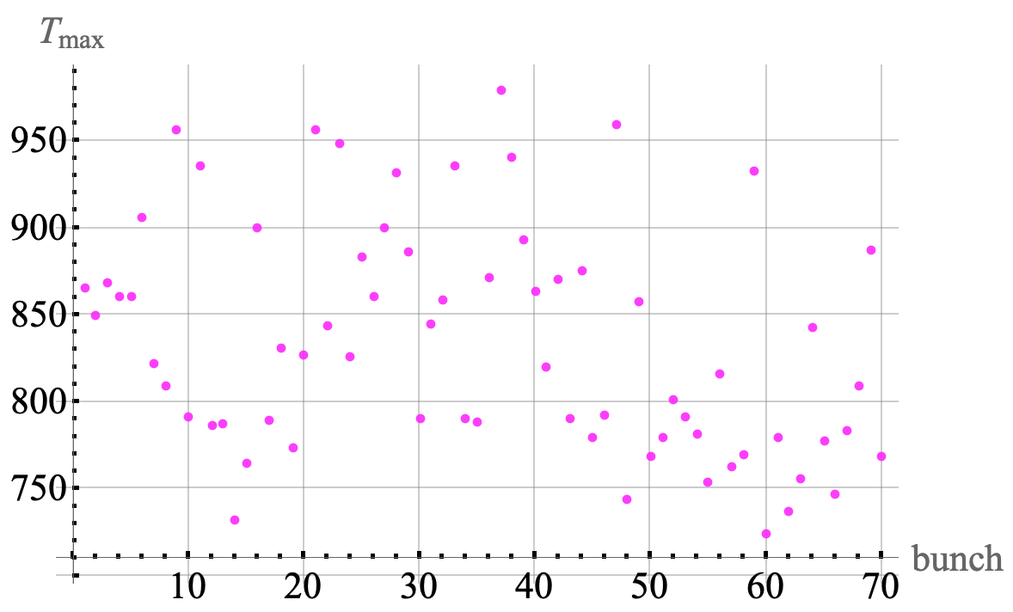
Intrabunch instability completely independent
Burov
Amplitude of
Maximum
Vertical Signal
Timing of
Maximum
Vertical Signal
19
Jeffrey Eldred | Physics Studies for High Intensity Fermilab Booster

Slide 20
20
Convective Instability – Outlook
Under nominal intensity and chromaticity, the instability is observable but has a negligible impact on the beam.
Critical Question:
What chromaticity is needed to mitigate the instability for PIP-II?
In present operation we switch from negative to positive chromaticity at transition – we should revise our approach.
Note: We have a bunch-by-bunch damper, but it does not have enough bandwidth to damp this intrabunch instability.
20
Jeffrey Eldred | Physics Studies for High Intensity Fermilab Booster
Notes:
20
20
20

Slide 21
21
21
4 Space-Charge
Emittance Growth
Vladimir Shiltsev, Hannes Bartosik, Salah Chaurize, Jeffrey Eldred, Alex Huschauer, Valery Kapin, Vladimir Kornilov, Frank Schmidt, Kiyomi Seiya, Cheng-Yang Tan, Kent Triplett
21
Jeffrey Eldred | Physics Studies for High Intensity Fermilab Booster
Notes:
21
21
21
21
21
21

Slide 22
22
Space-charge Emittance Growth Study
Loss Mechanism:
- After capture, space-charge tune-spread is very large.
- The tune-spread crosses resonances, leading to emittance growth.
- Until the emittance growth, and losses, reduce the tune-spread.
- Losses occur at injection, transition, extraction, and transfer.
Method:
- Scan betatron tune at injection, vary intensity, chromaticity.
- Measure losses after capture, losses by extraction.
- Measure emittance with multiwires by extraction.
- Measure emittance with IPMs throughout cycle.
22
Jeffrey Eldred | Physics Studies for High Intensity Fermilab Booster
Notes:
22
22
22

Slide 23
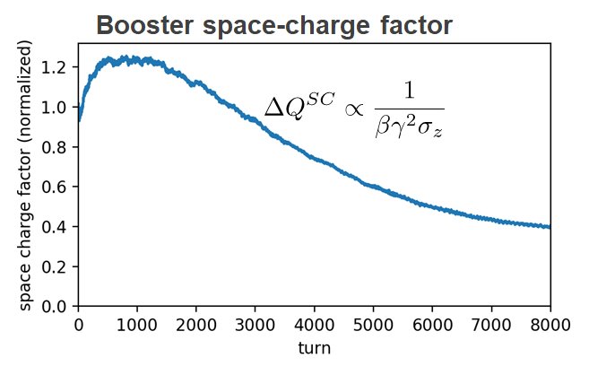
Evolution of space charge along the cycle
For fixed transverse emittance and intensity, space charge scales as
H. Bartosik, A. Huschauer
23
Jeffrey Eldred | Physics Studies for High Intensity Fermilab Booster

Slide 24
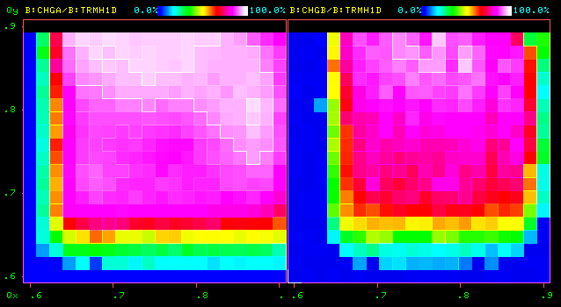
24
Intensity Reduces Tunespace
Losses at
Capture
Losses by
Extraction
4-turns intensity, chromaticity -20 at injection
24
Jeffrey Eldred | Physics Studies for High Intensity Fermilab Booster
Notes:
24
24
24

Slide 25
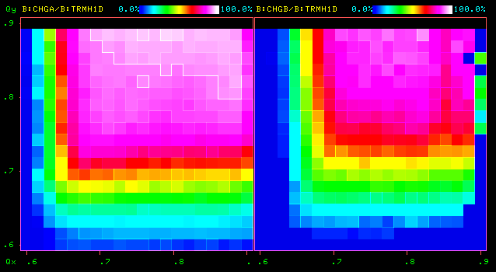
25
Intensity Reduces Tunespace
Losses at
Capture
Losses by
Extraction
9-turns intensity, chromaticity -20 at injection
25
Jeffrey Eldred | Physics Studies for High Intensity Fermilab Booster
Notes:
25
25
25

Slide 26
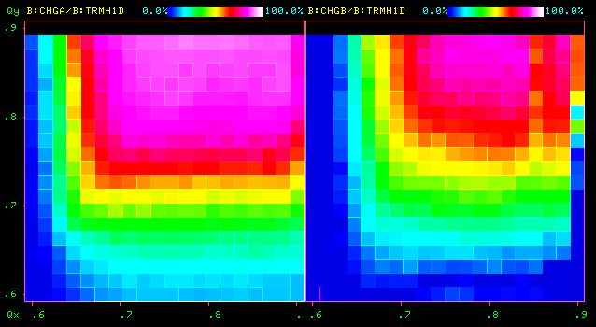
26
Intensity Reduces Tunespace
Losses at
Capture
Losses by
Extraction
14-turns intensity, chromaticity -20 at injection
26
Jeffrey Eldred | Physics Studies for High Intensity Fermilab Booster
Notes:
26
26
26

Slide 27
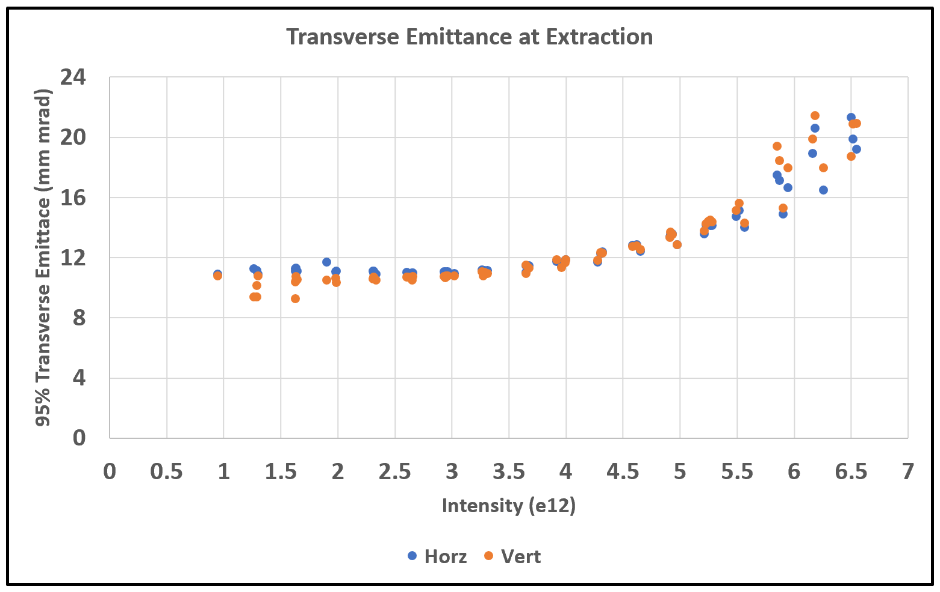
27
Emittance vs. Intensity
27
Jeffrey Eldred | Physics Studies for High Intensity Fermilab Booster
Notes:
27
27
27

Slide 28
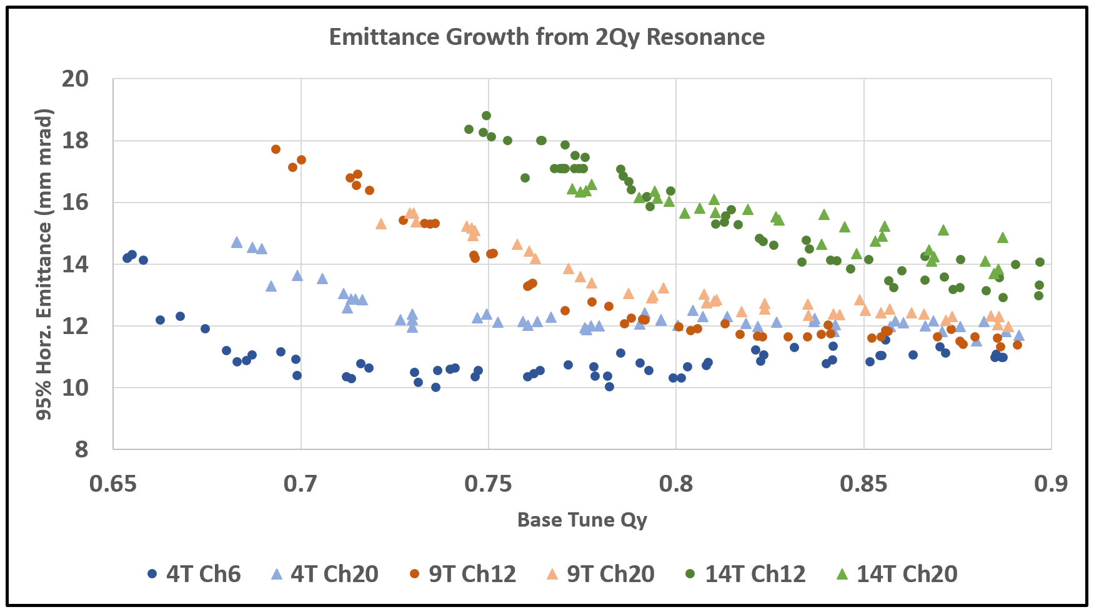
28
Emittance Growth from 2Qy Resonance
At highest intensity, emittance already connected to 2Qy resonance.
28
Jeffrey Eldred | Physics Studies for High Intensity Fermilab Booster
Notes:
28
28
28

Slide 29
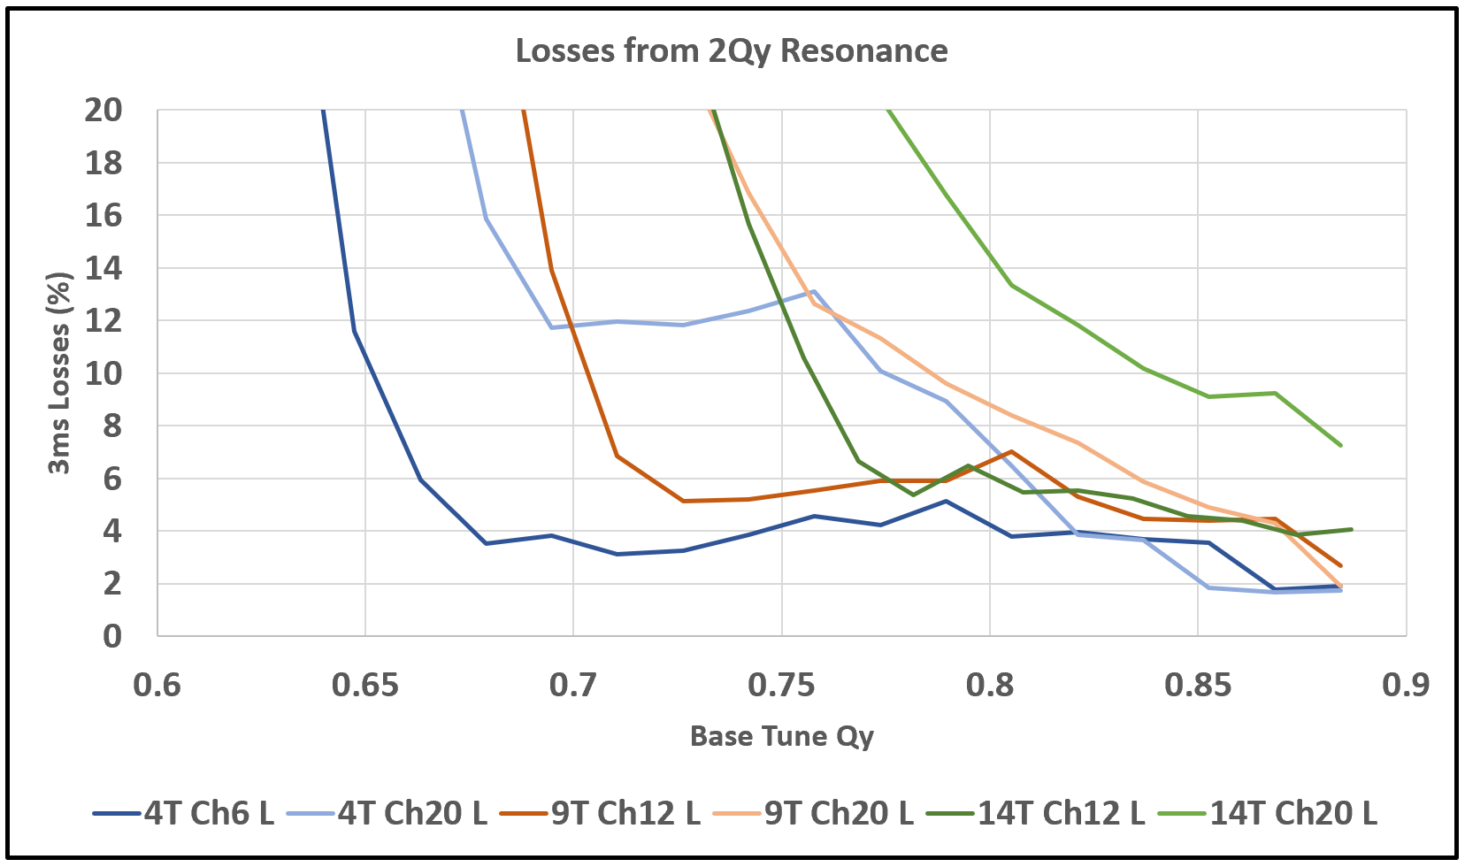
Losses from 2Qy Resonance
Practical loss limits are encountered immediately, dramatic losses follow.
Losses are much more sensitive to chromaticity.
29
Jeffrey Eldred | Physics Studies for High Intensity Fermilab Booster

Slide 30
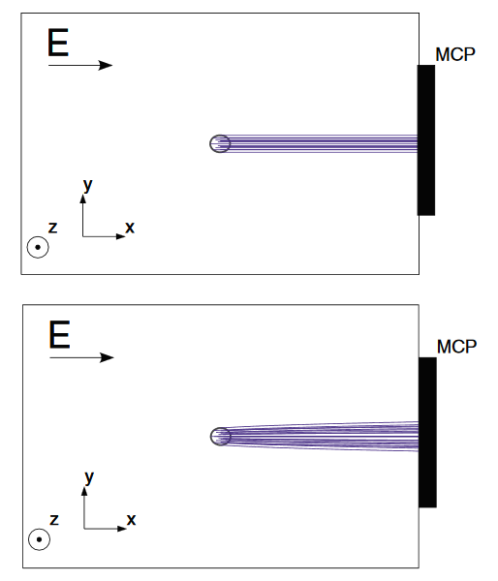
Ionization Profile Monitor Calibration
While AGS IPM (PAC1987):

Slide 31
31
31
Emittance Growth – Outlook
Results:
- The vertical half-integer resonance already drives emittance growth and loss at nominal intensity.
Next Steps:
- Calibrate ionization profile monitors vs. multiwire.
- Verify and improve Booster linear optics measurements.
- Implement harmonic-correction of 2Qy with a properly phased subset of quadrupoles.
Jeffrey Eldred | Physics Studies for High Intensity Fermilab Booster
Notes:
31
31
31
31
31
31

Slide 32
32
32
5 Booster Power
Supply Ripple
Frank Schmidt, Hannes Bartosik, Salah Chaurize, Jeffrey Eldred, Angela Saa Hernandez, C. Jensen, Jeff Larson, Howard Pfeffer, Kent Triplett
32
Jeffrey Eldred | Physics Studies for High Intensity Fermilab Booster
Notes:
32
32
32
32
32
32

Slide 33
33
33
Booster Power Supply Ripple
Any frequency ripple in the gradient magnet power supply would cause modulation of the betatron tune.
No apparent power supply ripple problem at the moment – beam was measured, gradient magnet power supply was measured, Booster resonant magnet circuit was modeled.
We induced a tune modulation effect to study the impact on the beam. One quadrupole was excited with a sinesoidal oscillation of 180 Hz or 720 Hz and a tune modulation depth of ~0.01.
Jeffrey Eldred | Physics Studies for High Intensity Fermilab Booster
Notes:
33
33
33
33
33
33

Slide 34
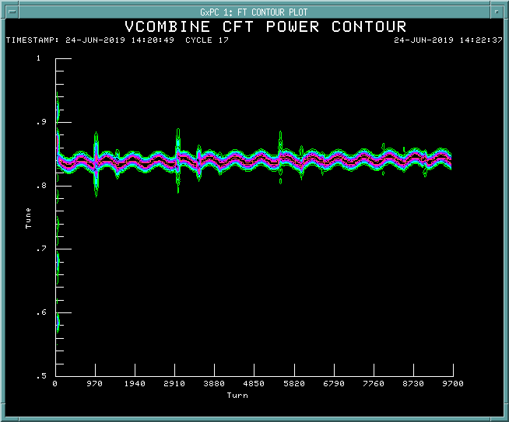
Tune Modulation
~0.01 Tune Modulation
34
Jeffrey Eldred | Physics Studies for High Intensity Fermilab Booster

Slide 35
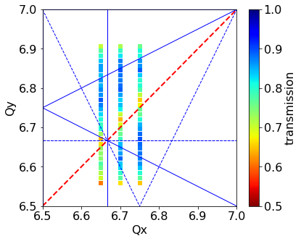
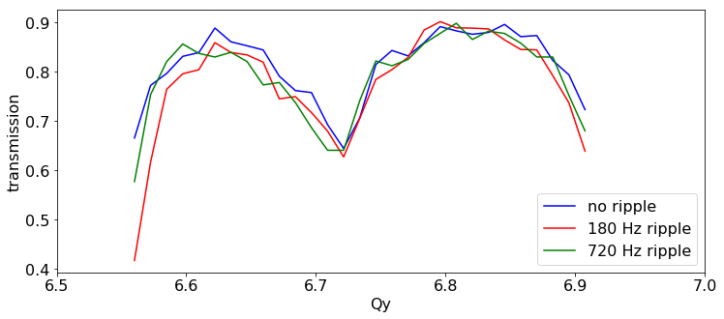
35
Losses induced by Tune Modulation
No Ripple
180Hz ±5A
720Hz ±5A
A. Saa Hendandez, F. Schmidt
35
Jeffrey Eldred | Physics Studies for High Intensity Fermilab Booster
Notes:
35
35
35

Slide 36
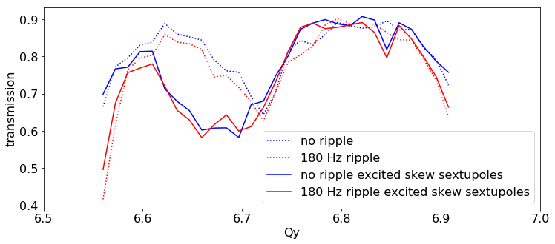
36
Losses induced by Tune Modulation & Skew Sextupole
A. Saa Hendandez, F. Schmidt
Tune-modulation broadens half-integer and integer resonances only.
Skew-sextupole resonance has no interaction with tune modulation.
36
Jeffrey Eldred | Physics Studies for High Intensity Fermilab Booster
Notes:
36
36
36

Slide 37
37
37
Booster Power Supply Ripple – Outlook
Results:
- No evidence of significant orbit or tune modulation in beam.
- No significant interaction was observed between the tune-modulation, nonlinear resonances, and/or space-charge.
Next Steps:
- Booster circuit model suggests that ripple may have a greater impact at frequencies about 1 kHz, need to measure the gradient magnet power-supply at higher frequencies.
Jeffrey Eldred | Physics Studies for High Intensity Fermilab Booster
Notes:
37
37
37
37
37
37

Slide 38
38
38
Booster Studies – Next Steps
Booster intensity upgrades motivate us to study the scope of the physics challenges and to mitigate known sources of beam loss.
Results:
1 Injection losses traced to adiabatic capture.
3 Space-charge emittance growth traced to 2Qy resonance.
4 First verification of convective instability.
5 Power supply ripple does not threaten Booster operation.
Upcoming focus:
Accurate characterization of Booster linear optics
Correction of the half-integer resonance
Calibration of ionization profile monitors
Measurement of convective instability at higher intensity with nonzero chromaticity
Investigation of transition crossing losses.
Jeffrey Eldred | Physics Studies for High Intensity Fermilab Booster
Notes:
38
38
38
38
38
38

Slide 39
39
39
Backup
39
Jeffrey Eldred | Physics Studies for High Intensity Fermilab Booster
Notes:
39
39
39
39
39
39

Slide 40
40
40
Losses over Cycle
40
Jeffrey Eldred | Physics Studies for High Intensity Fermilab Booster
Notes:
40
40
40
40
40
40

Slide 41
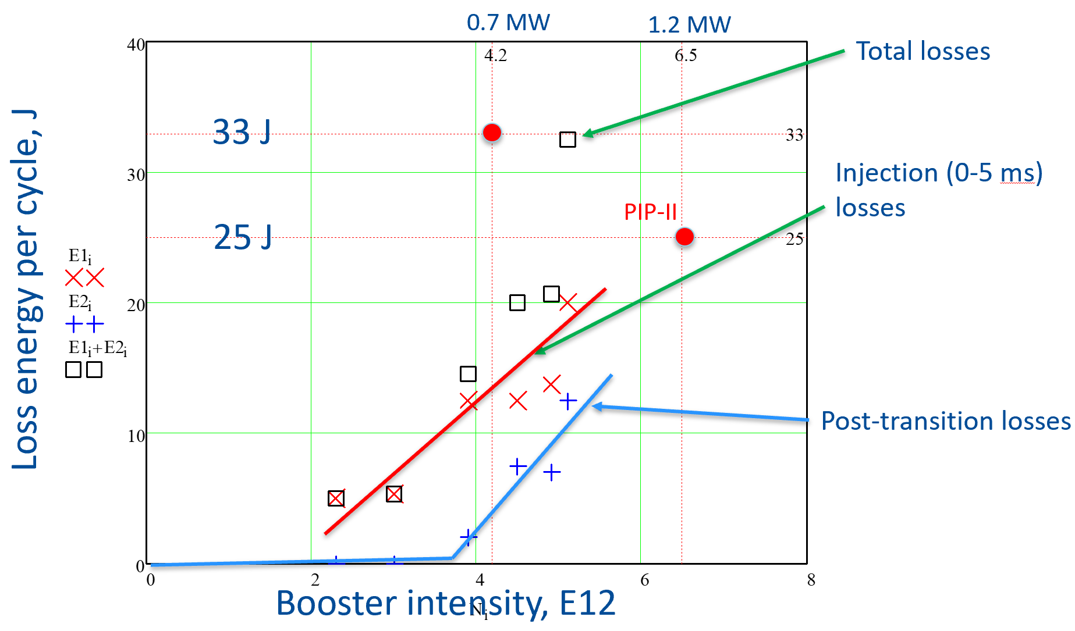
41
41
Injection & Transition Losses
Pellico
Nagaitsev
41
Jeffrey Eldred | Physics Studies for High Intensity Fermilab Booster
Notes:
41
41
41
41
41
41

Slide 42
42
PIP-II at 400 MeV
Two-stage collimators – conceptual design.
Wide-bore RF cavities, 60 kV and 3-inch aperture.
GMPS regulation using ML learning (LDRD).
Flat Injection – correct dipole ramp during injection.
LLRF system upgraded to digital.
Longitudinal & transverse damper amplifier upgrades.
Booster shielding assessment
Magnet girder test-stand for 20 Hz.
42
Jeffrey Eldred | Physics Studies for High Intensity Fermilab Booster
Notes:
42
42
42

