Slide 1
Road to Room-Temperature Superconductivity: Superhydrides under Pressure.
Maria Baldini
APS-TD
FNAL

Slide 2
outline
Introduction I – Pressure as a unique variable
Introduction II – Hydrogen metallization and Neil Aschroft’s predictions
Doped hydrogen – molecular compounds, hydrides and superhydrides
H₃S – Conventional superconductivity at 203 K
LaH_{x} – where all things seem to come together
Ternary systems and quest for reducing pressures
Acknowledgements

Slide 3
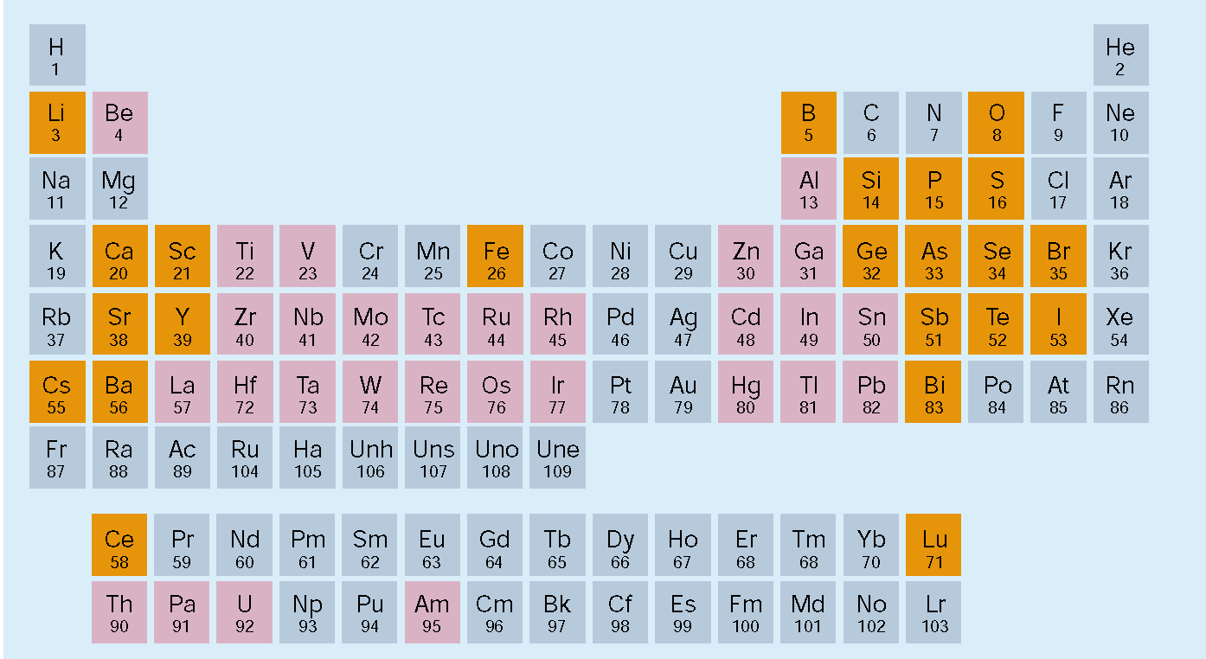
Superconductivity and high pressure
1925: 14 years after the discovery of superconductivity. First study on Sn and Sb: Commun. Phys. Lab. Univ. Leiden 180b
SUPERCONDUCTING ELEMENTS
23 produced under pressure;
e.g., O, S, B, Fe, Li, Ca

Slide 4
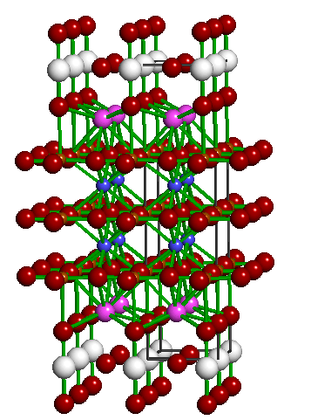
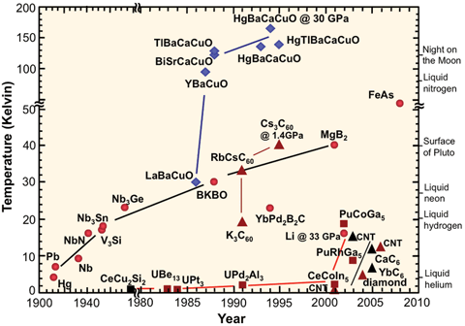
Superconductivity and high pressure
HgBa₂Ca₂Cu₃O_{8+d}
T_{c} = 164 K
(30 GPa)
[Gao et al., (1994); Lokshin et al. (2002)]
Pressure used to tune Tc
Highest Tc was observed at 30 GPa for many years

Slide 5
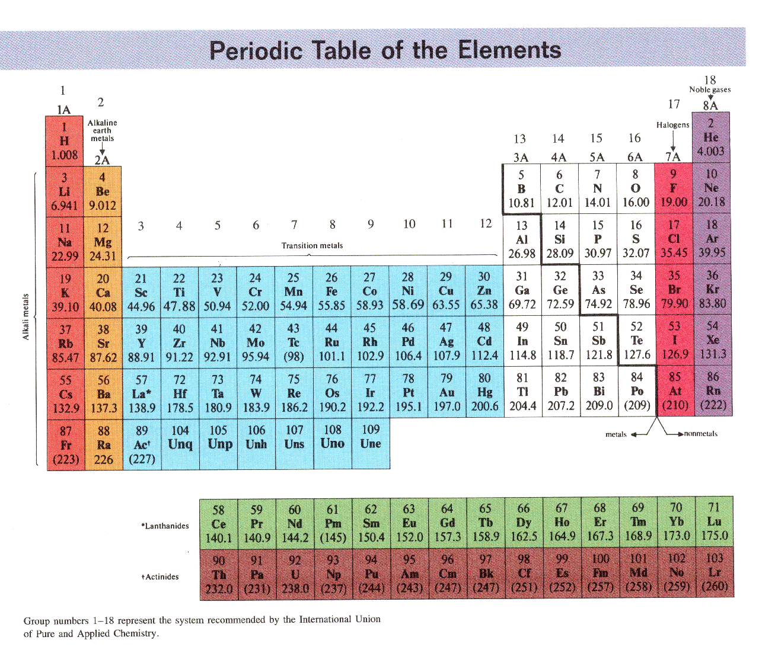
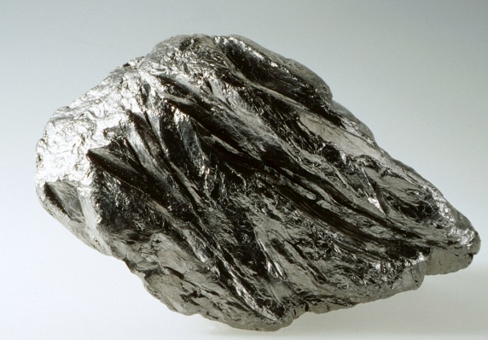

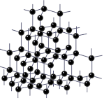
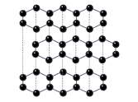
Pressure as a unique variable
Pressure changes everything
PRESSURE
Graphite
Diamond
PRESSURE
P
Extensive mixing of orbitals valence
Volume reduction of 1.5 %
pV term in Free energy is around 10 eV
Chemical bonds drastically altered= access to a forbidden chemistry
Carbon atoms
sp2 carbon
sp3 carbon
Pressure range 0-200 GPa
Notes:
Beginning of a new chemistry

Slide 6
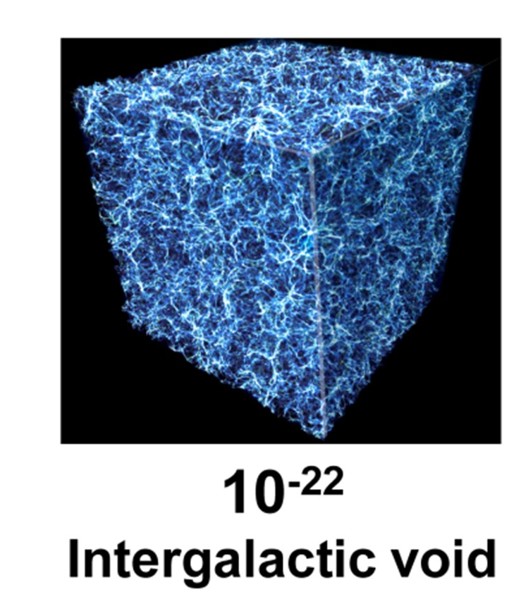
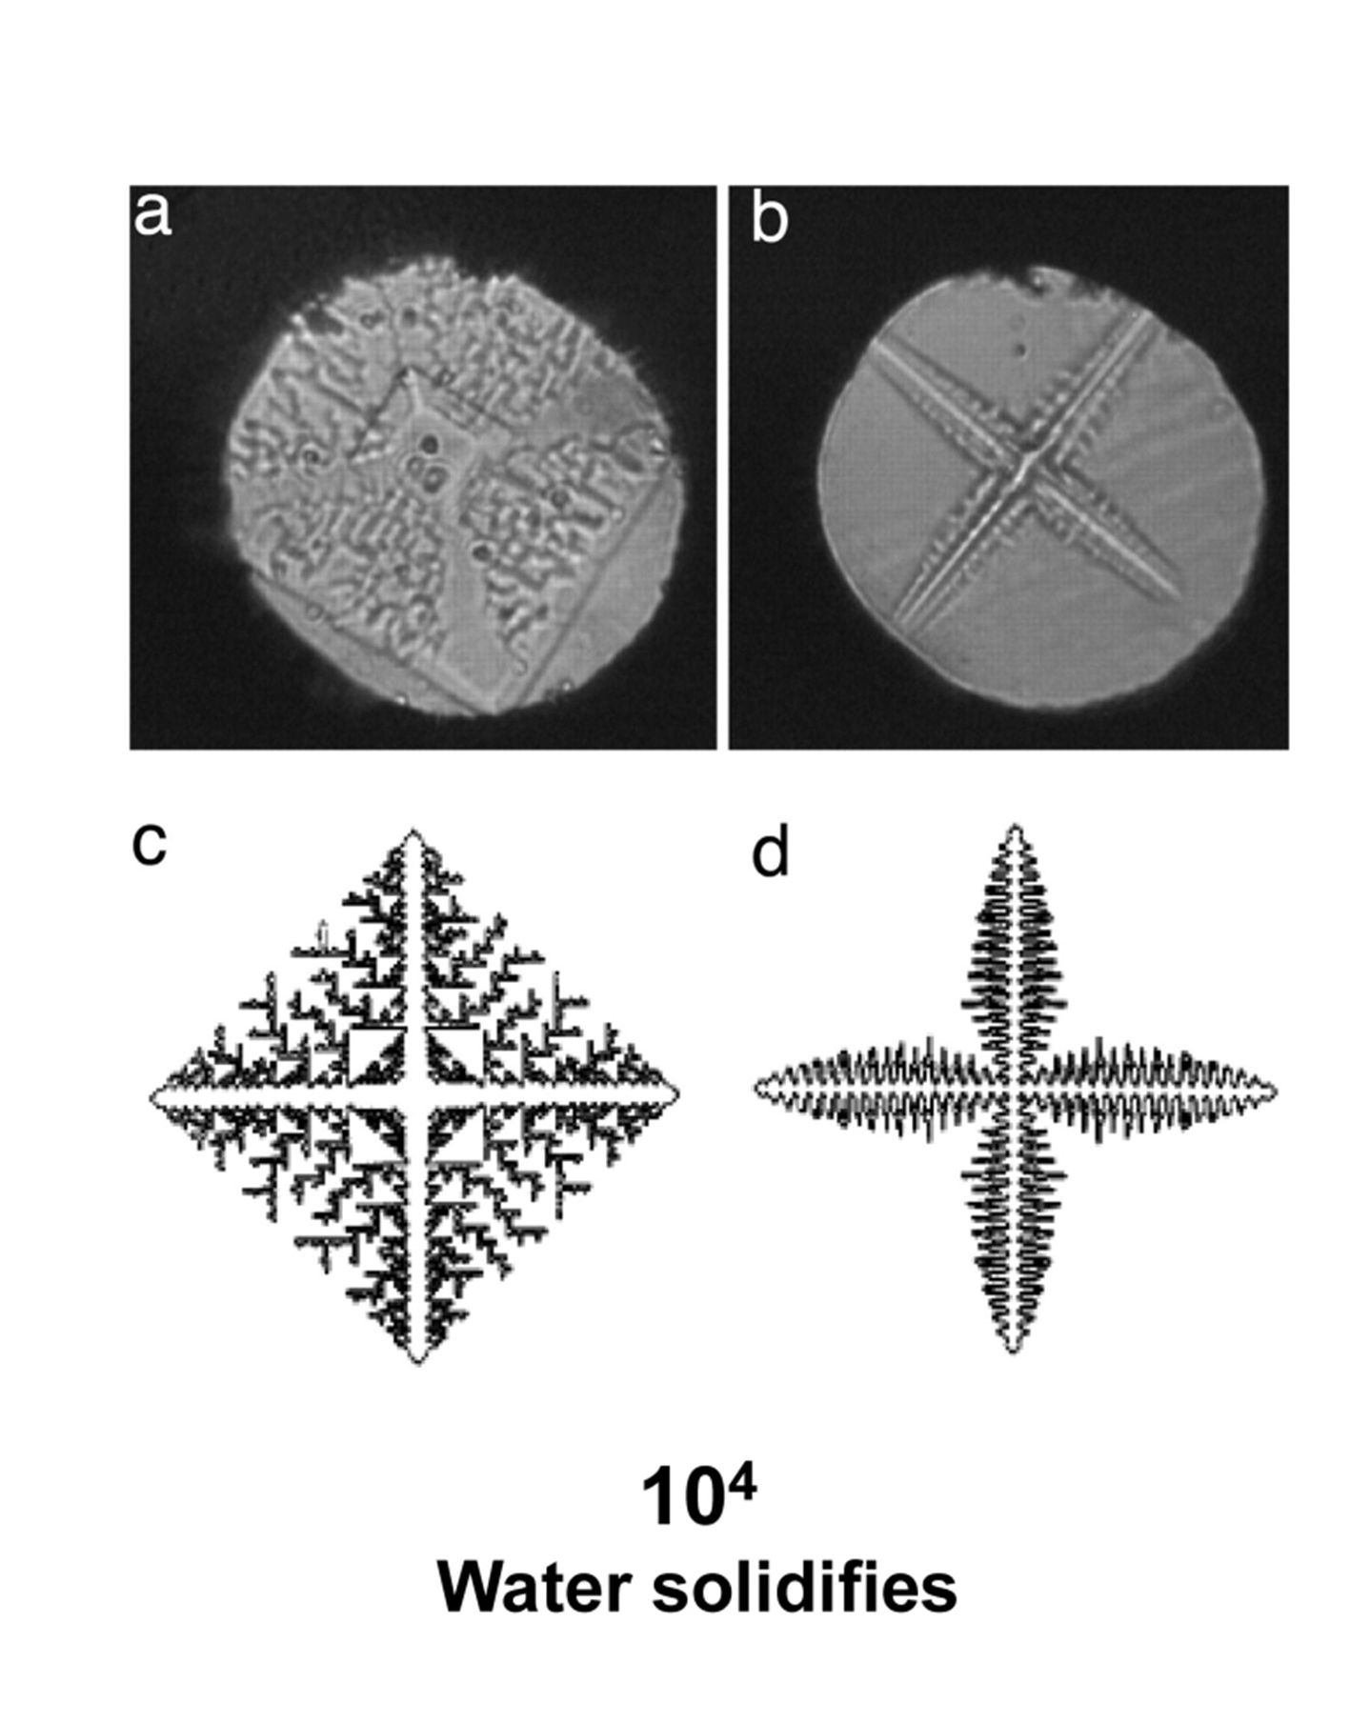
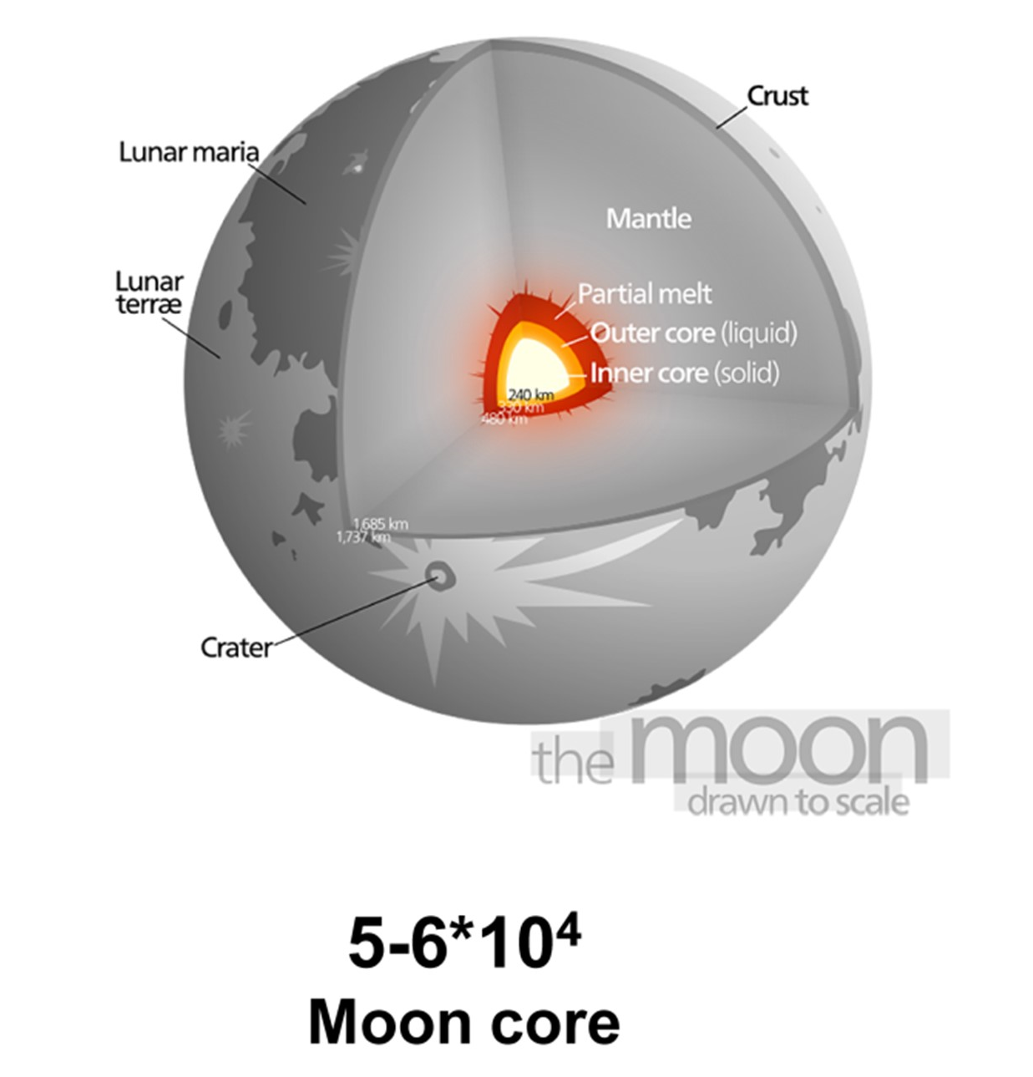
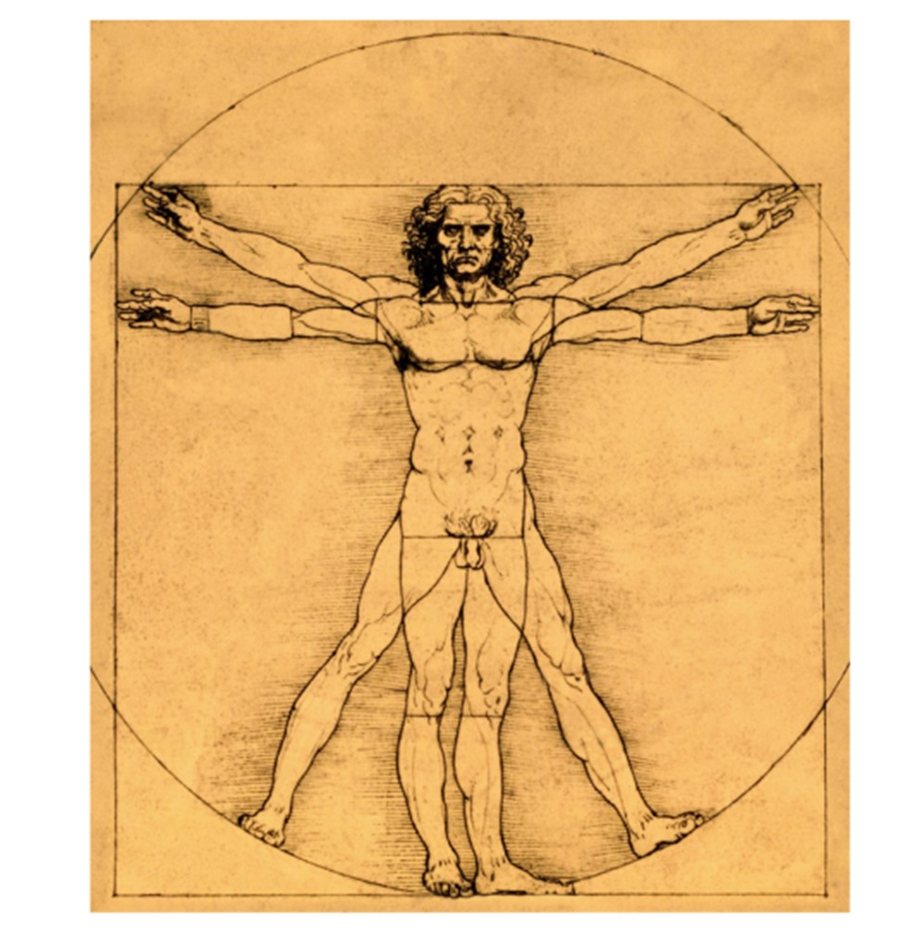
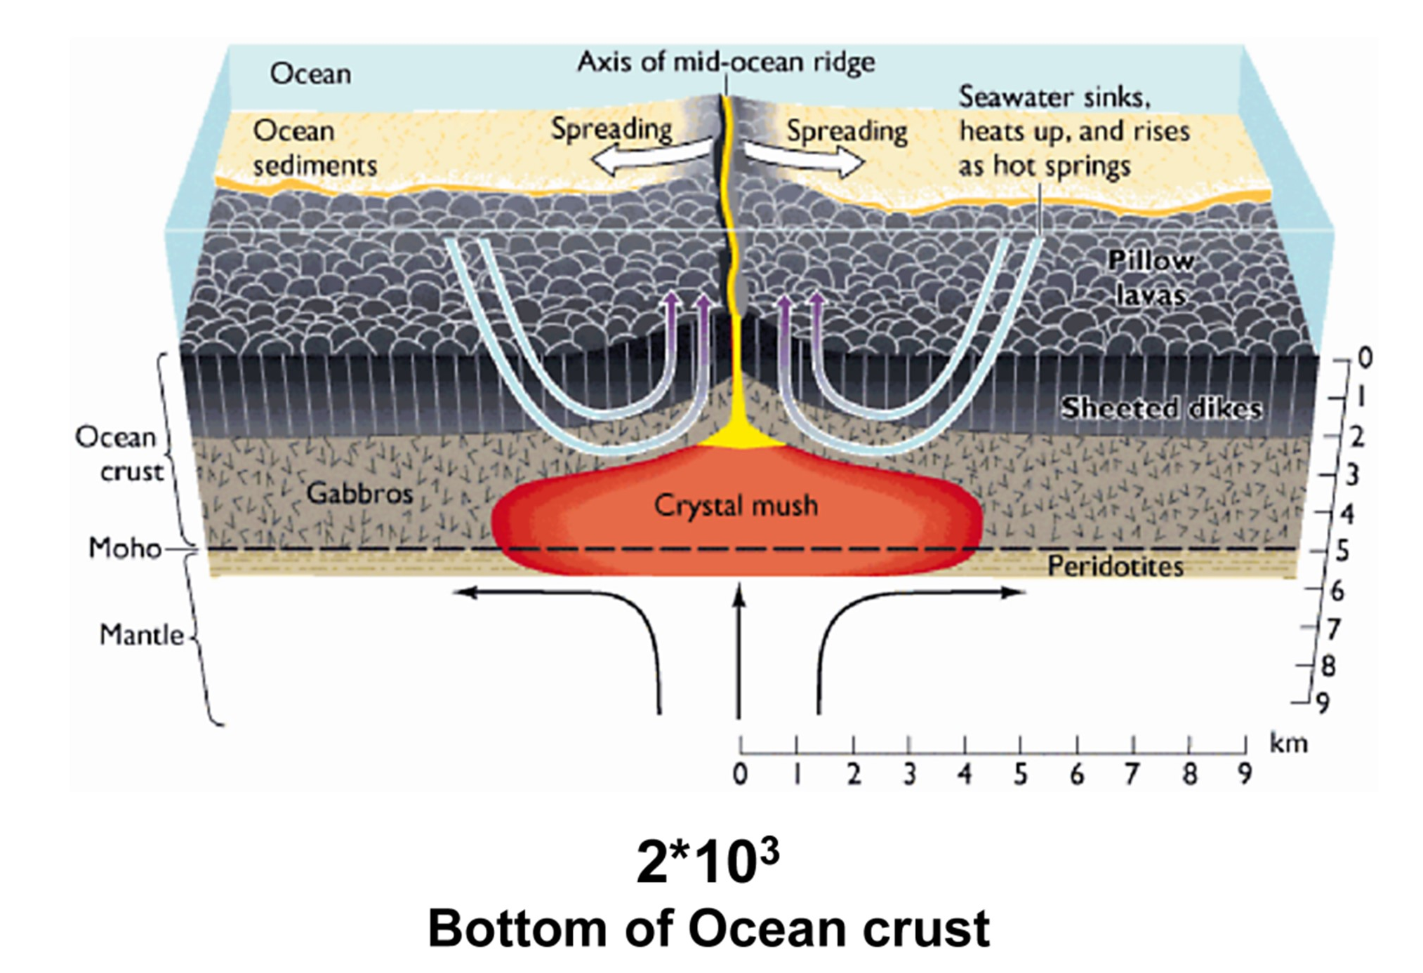
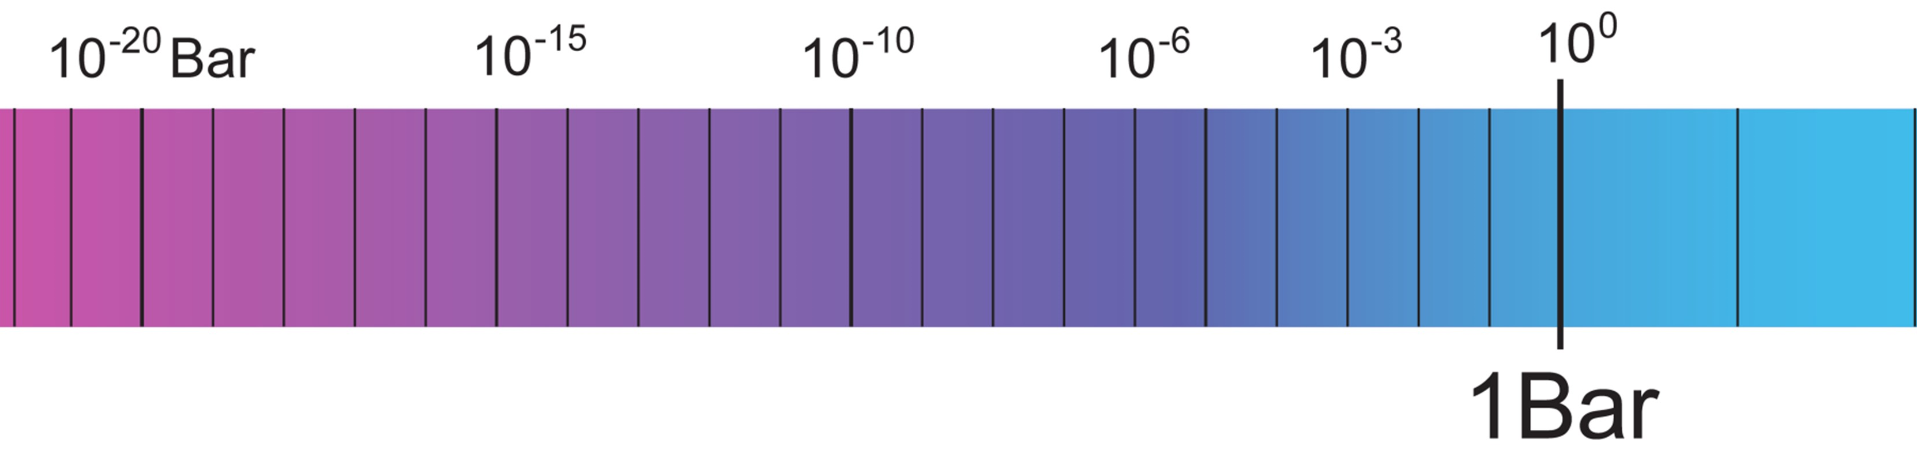
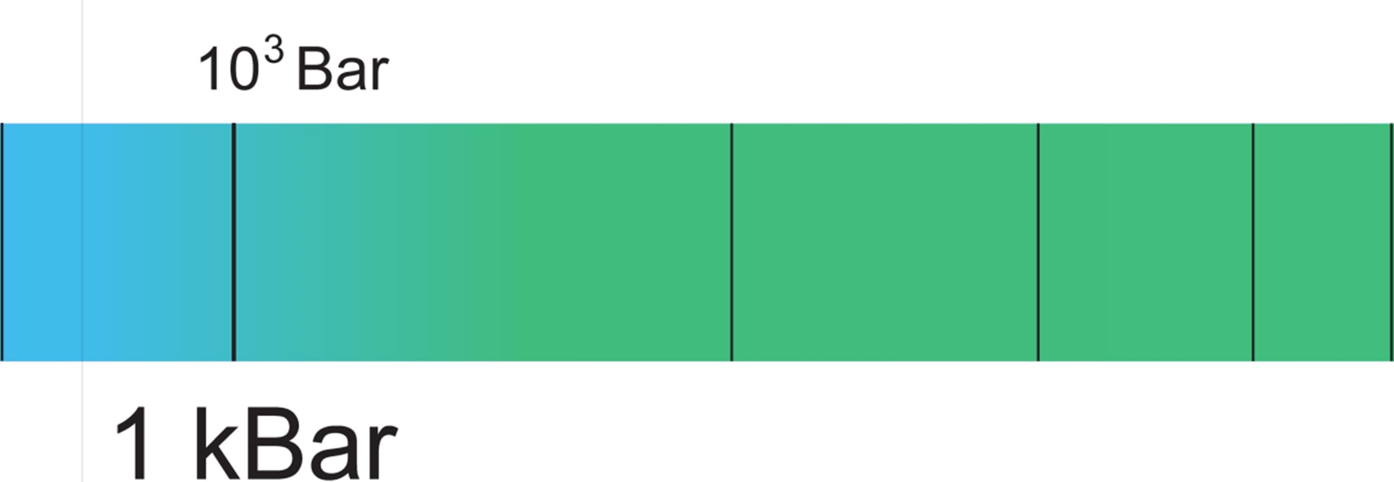

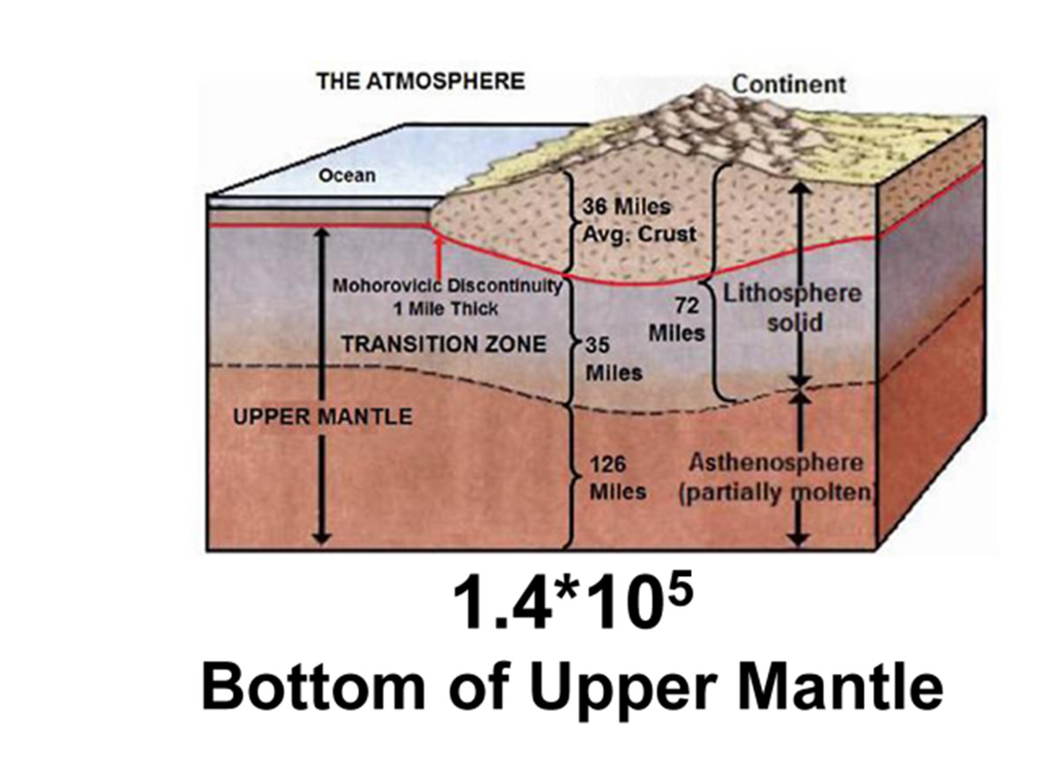
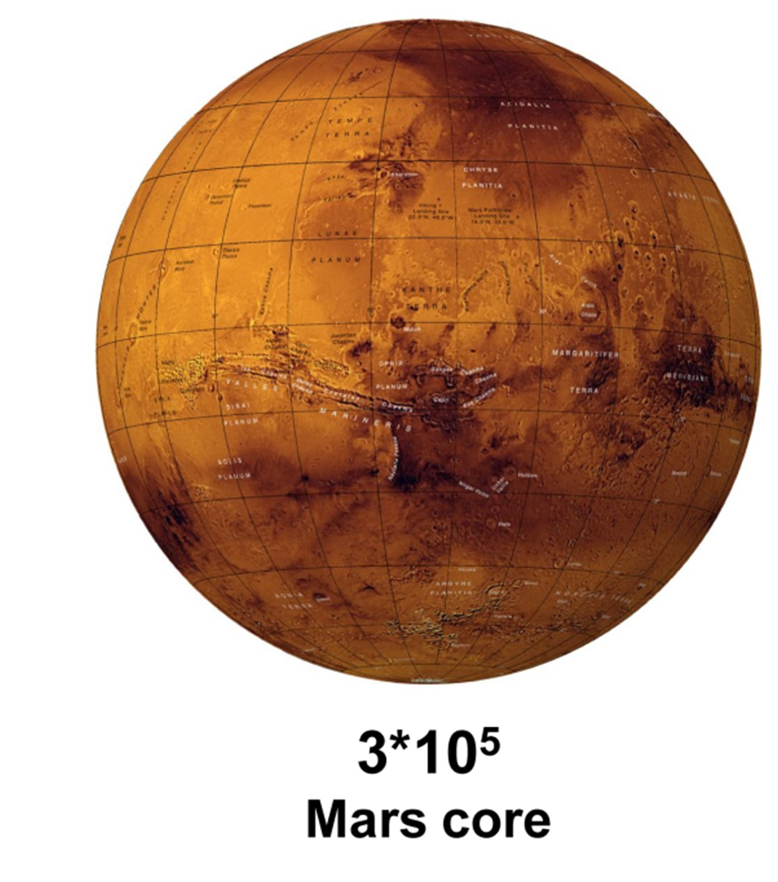
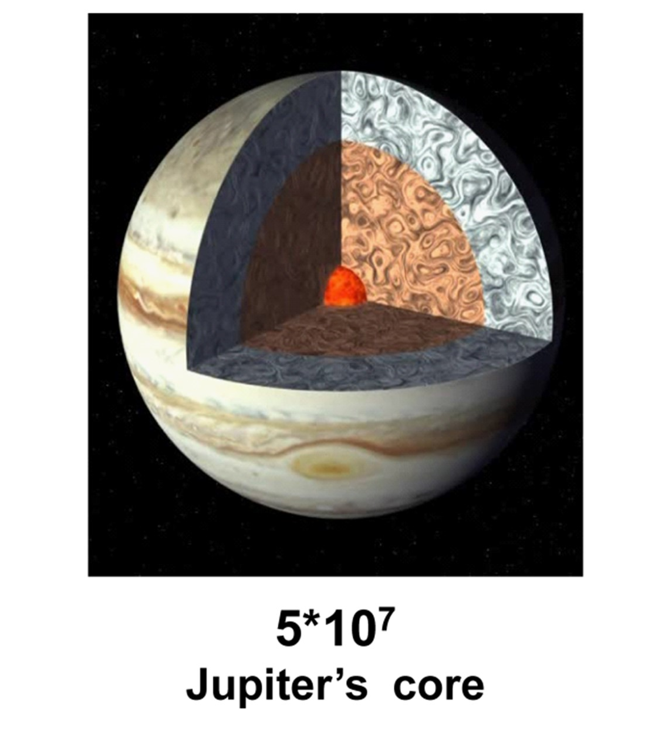


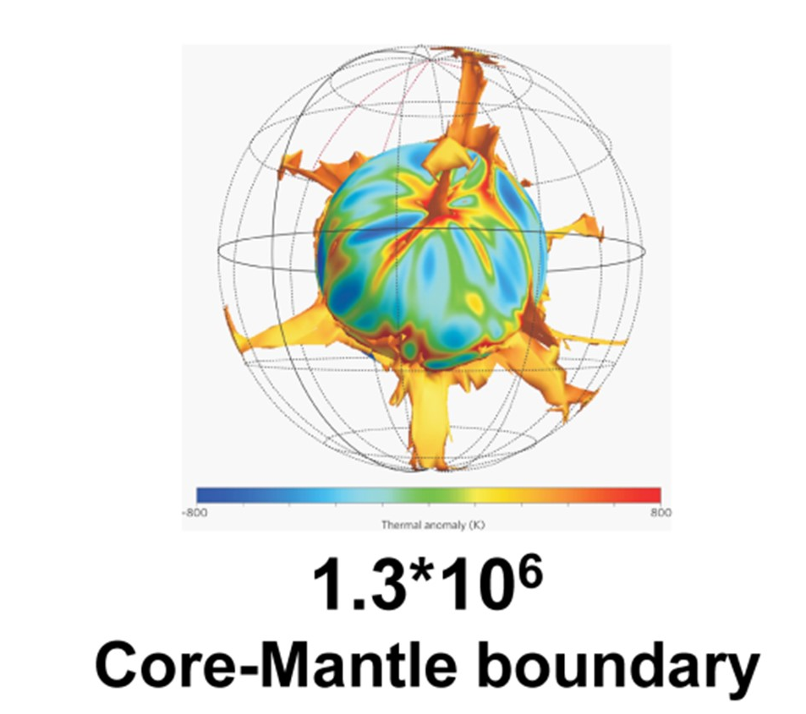

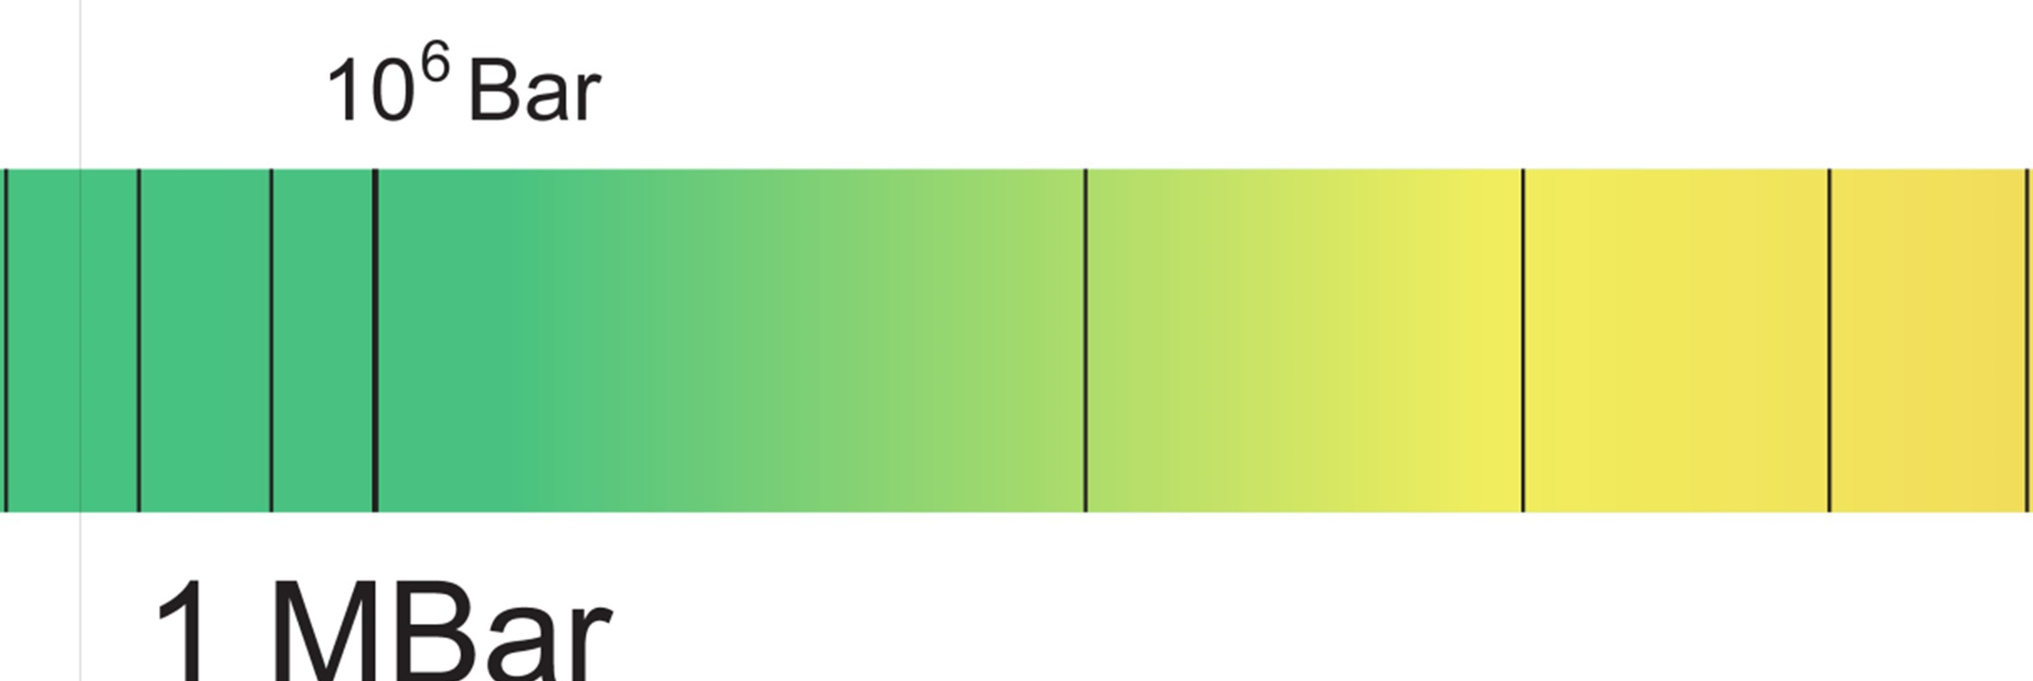
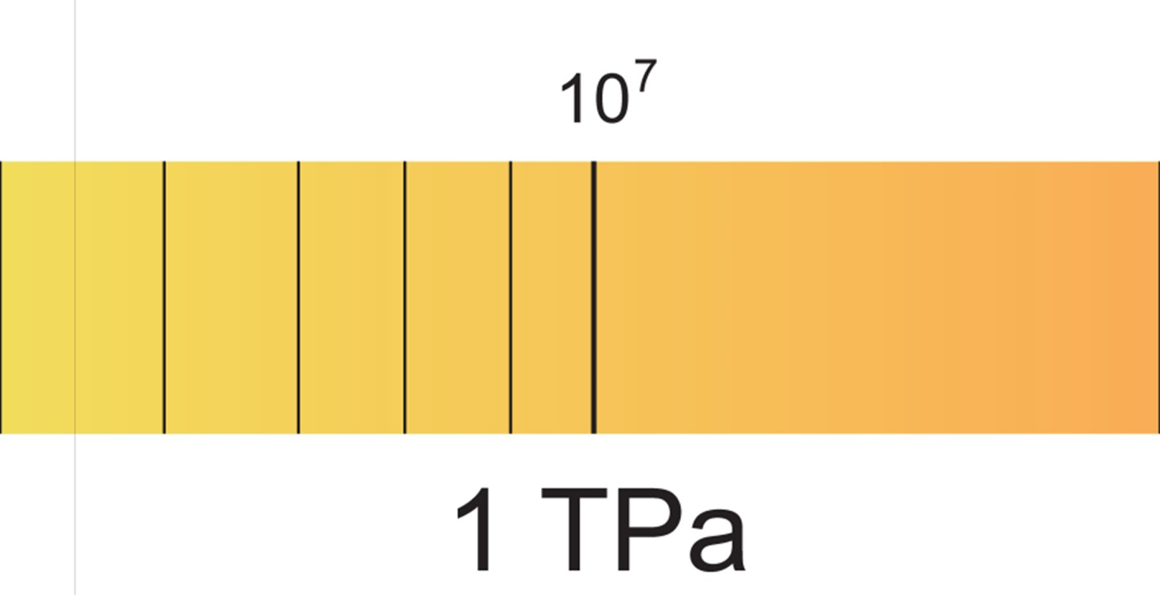
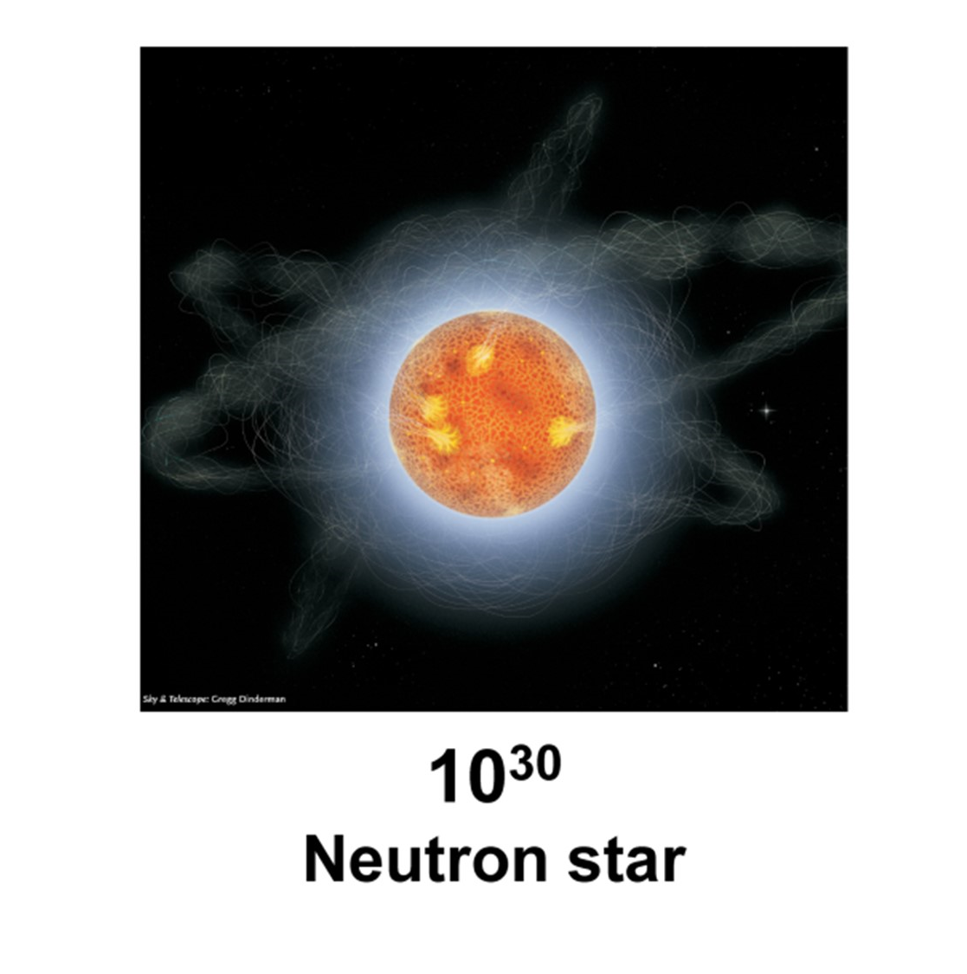
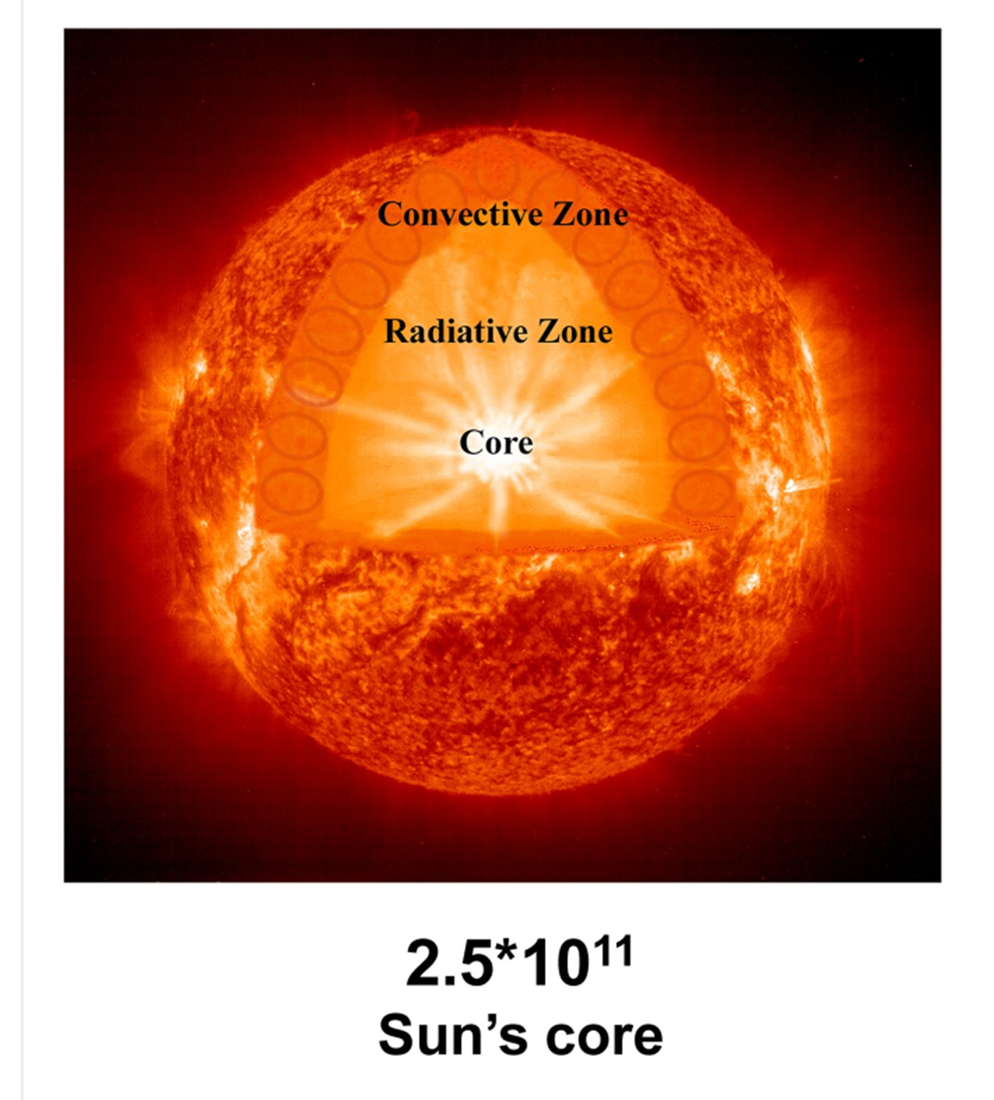
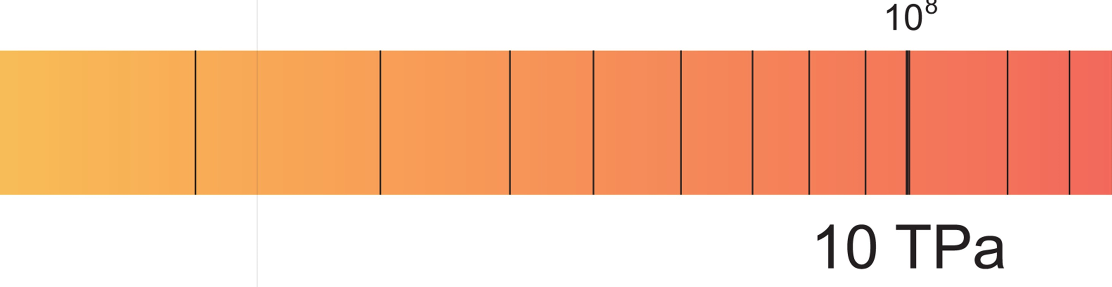
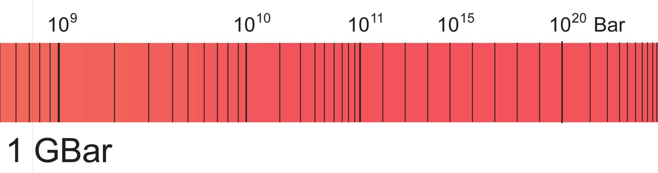
Range of pressure in the universe
=10 KBar
=100 GPa

Slide 7


Pressure: Force/area
1 elephant (5 ton) / 1 pencil (0.5 cm²)
F
P =
S
Woman (63 Kg)
/ heels (1 cm²)
1 GPa= 10⁴ bar
P= 63 bar

Slide 8
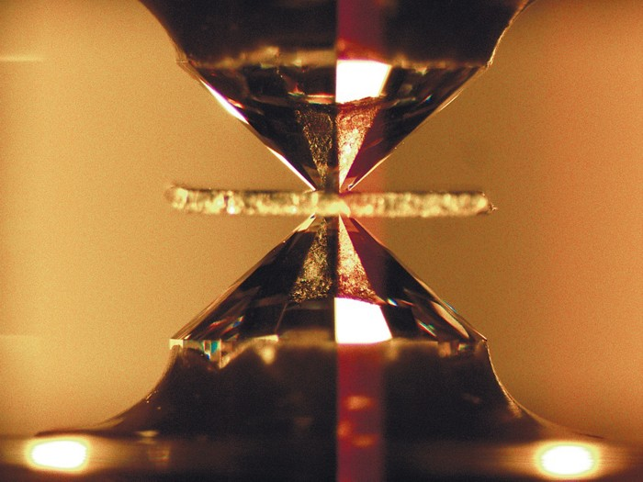
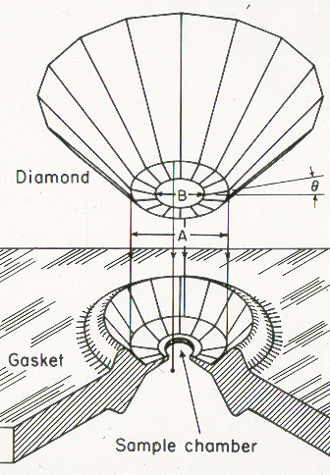


Generating extreme pressure in the laboratory: Diamond Anvil cell (DAC)
2-4 mm
1-3 mm
0.01-0.8 mm
Pressure: ambient to 400 GPa
Temperature: mK to 5000 K
Sample size < 100 um
62 N
1 cat (5Kg)
100 GPa= 10⁶ bar≈
≈
625 μm²
1 diamond (tip diameter=25 μm)

Slide 9


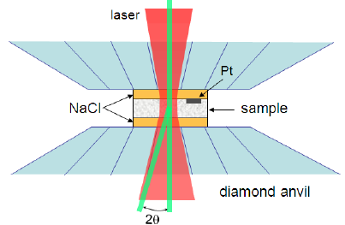


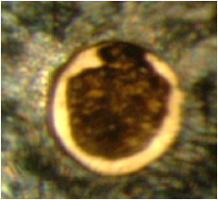
Sample loading
Internal standard (ruby, Pt, Au)
Hydrostatic medium (NaCl, He, H₂, N)
Gasket: stainless steel, Be, Re
Sample size= 80 micron
300 μm
1
2
3
4

Slide 10
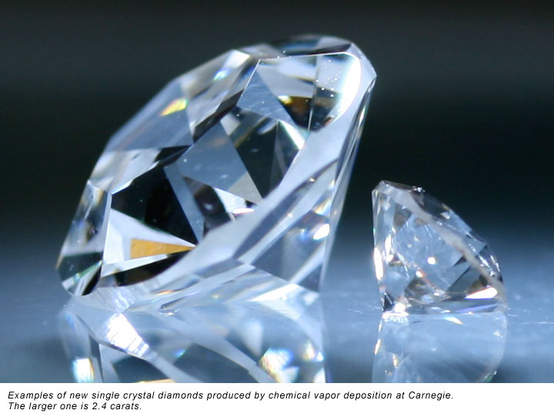
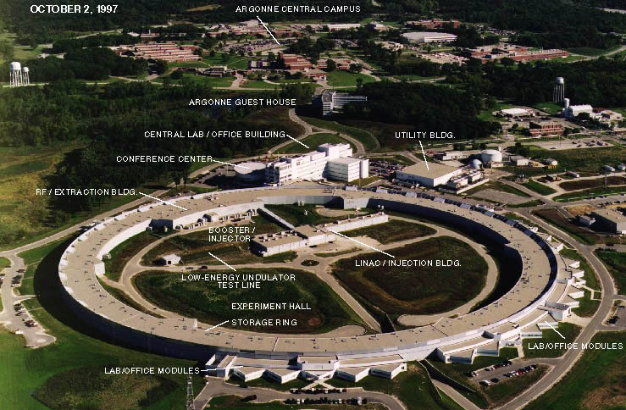
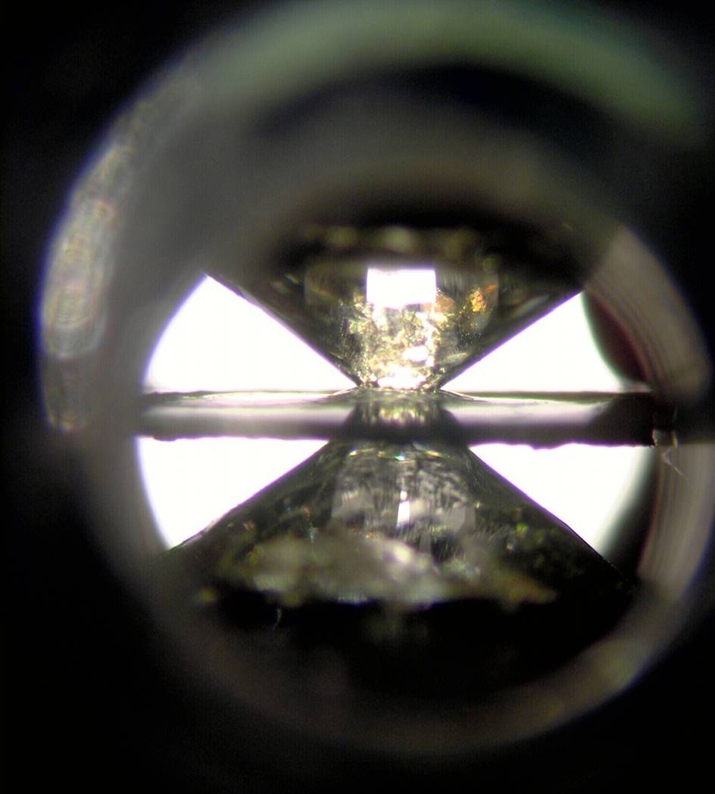
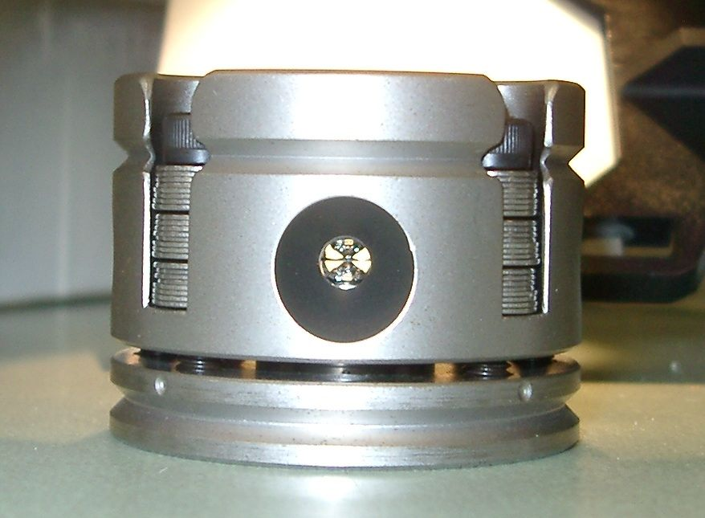
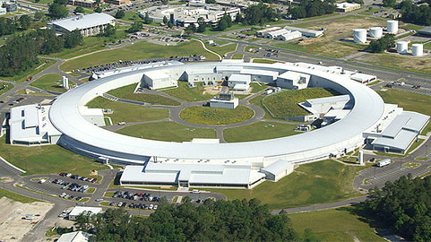
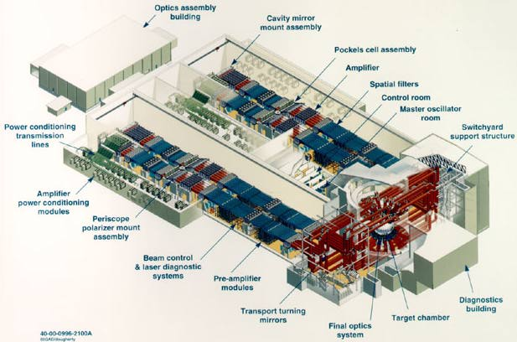
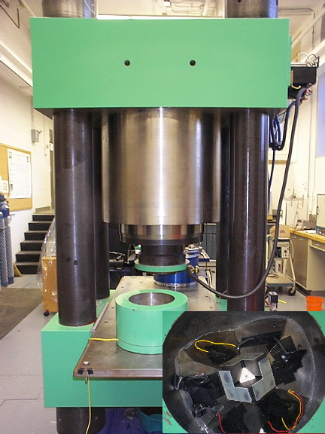
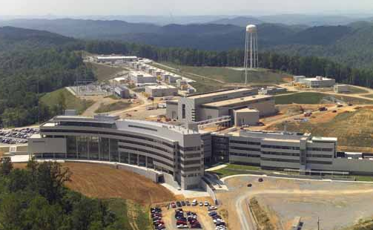
High pressure technology: Myriad of new tools
CVD
CVD

Slide 11
outline
Introduction I – Pressure as a unique variable
Introduction II – Hydrogen metallization and Neil Aschroft’s predictions
Doped hydrogen – molecular compounds, hydrides and superhydrides
H3S – Conventional superconductivity at 203 K
LaH_{x} – where all things seem to come together
Ternary systems and quest for reducing pressures
Acknowledgements

Slide 12
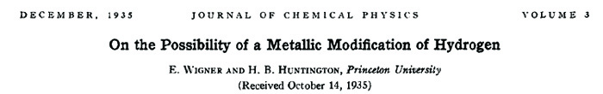
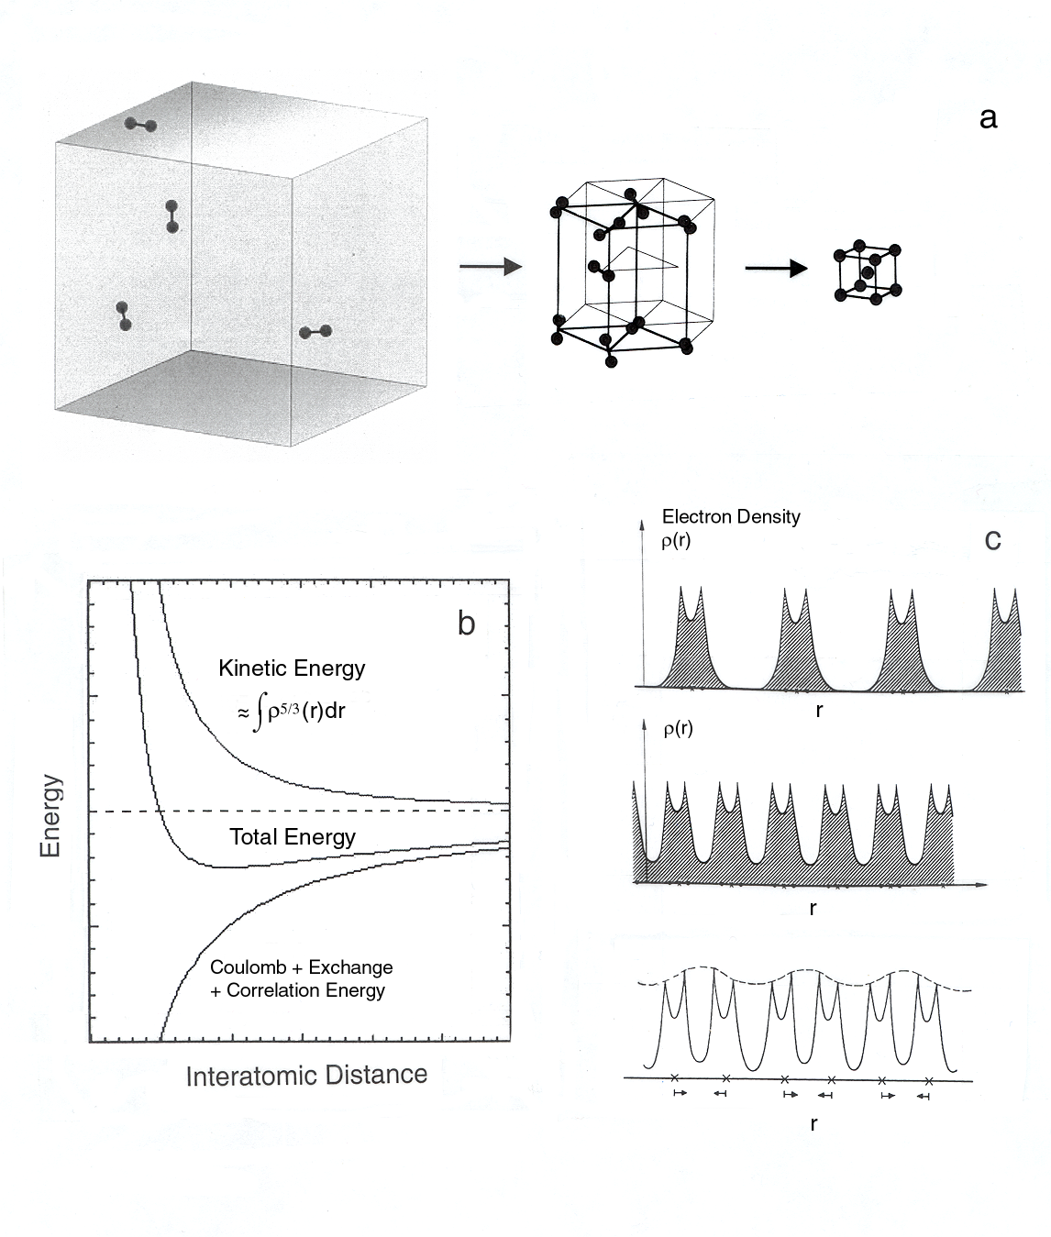
Super Hydrides: Metallic Hydrogen
Predicted at > 25 GPa
solid lattice of protons with delocalized electrons

Slide 13
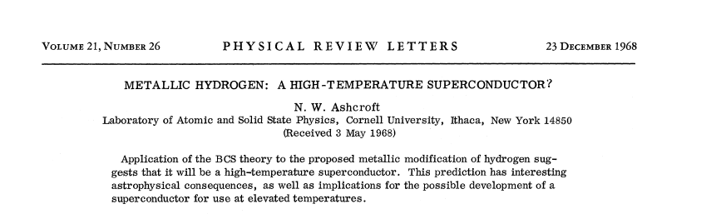
Metallic hydrogen: A high temperature superconductor
high Debye temperature, large electron-phonon coupling, and large
density of states at the Fermi level expected for the atomic alkali-like metal system

Slide 14
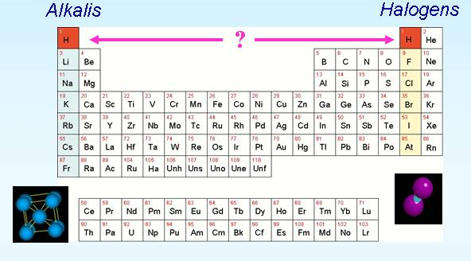
Metallic hydrogen: the holy grail of high pressure science
V. L. Ginzburg was asked ”What problems of physics and astrophysics seem now to be especially important and interesting?”, Room-temperature Superconductivity
and Metallic Hydrogen appeared as number two and three on his list (Ginzburg, Key Problems in Physics and Astrophysics (1982))
Most abundant element
Chemical dichotomy
Tests of fundamental theory
High-T_{c} superconductor?
Fluid ground state?
Superconducting/superfluid?
Energetic material
(400 kJ/mole: 35 x TNT)
Notes:
H behave like an Halogen because of his diatomic structure, but it is often placed on the first column
Well this is actually a bigger problem and understanding hydrogen under pressure is an unsolved problem in science. It is important because it is the most abundant element.
From the standpoint of chemistry again because we think of H as a halogen, this diatomic structure, but in fact most periodic tables put it over here in this column here. So how do we think about this dichotomy of hydrogen as an alkali or a halogen? Well pressure allows us to kind of understand this by looking at the transition form the halogen form to the alkali form, at least in principal.
It is an important test of fundamental theory after all our understanding of the chemical bond started with the treatment of the H molecule. It could be a high temperature superconductor and have a fluid ground state as I have eluded to and it could have some interesting quantum properties that would make it altogether unique state of matter if one could generate this metallic form. It also contains a great amount of energy that is stored in this dense form, you have a very energetic material and understanding it as a function of pressure is also important for understanding or working on the path to inertial confinement, which is a major challenge.
We like to think of hydrogen as a fully quantum system after all one needs to also treat the electrons and the nuclei on the same footing so that gives rise to some of these interesting predicitons basically of altogether new physics of this fully quantum system in regard to the nuclei and the electrons subsystem.

Slide 15
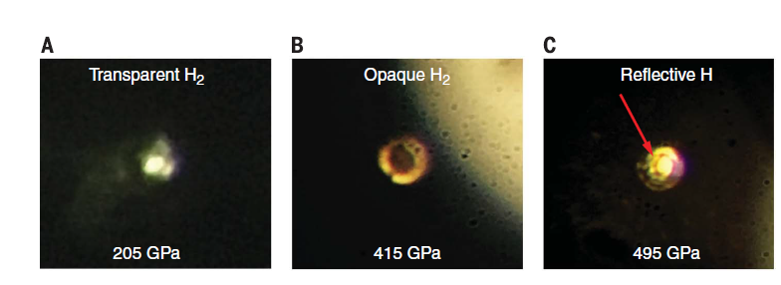
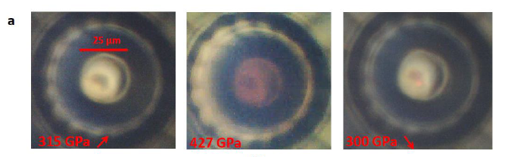
Metallic hydrogen: where are we now?
Observation of the Wigner-Huntington transition to metallic hydrogen
Dias and Silvera, Science 355, 715–718 (2017)
495 GPa
Observation of a first order phase transition to metal hydrogen near 425 GPa
Paul Loubeyre, F. Occelli and P. Dumas, ArXiv June 2019
425 GPa
Metallic Hydrogen remains an unsolved problem in science.
Driven the development of high P-T techniques

Slide 16
The era of Hydrides
Use dopants in the structure?

Slide 17
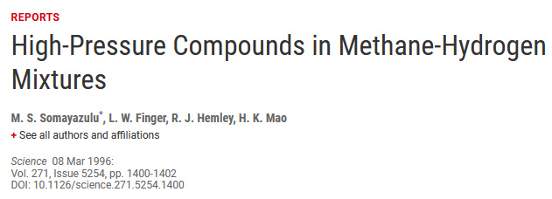
The era of Hydrides
Search for new compounds: oxygen-, carbon-, sulfur-, and rare gas-bearing materials mixed with hydrogen.
H₂O-H₂
CH₄-H₂
H₂S-H₂
Xe-H₂
New chemistry but no dissociation of molecular H₂

Slide 18
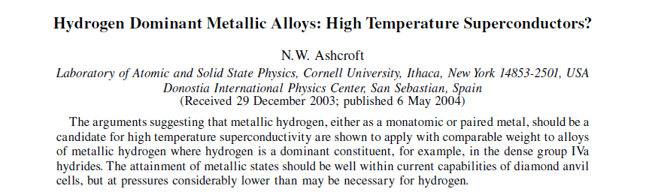
Hydrides as high temperature superconductors
chemical precompression
H₂ molecules in dense structures might be expected to dissociate at pressures well below those required for pure hydrogen
New computational structure-search methods
Density functional theory
Ab initio crystal structure prediction
Notes:
of ‘chemical precompression’,
a proposal in which H2 molecules in dense structures might be expected to
dissociate at pressures well below those required for pure hydrogen. Interest in this possibility in
producing analogs of atomic metallic hydrogen was stepped up with the application of new
computational structure-search methods, which began to identify new structures with very high
predicted critical temperatures in the higher hydrides, starting with the important paper that
predicted a Tc of 235 K in CaH6.19

Slide 19

Qualitative Guideposts for BCS Superconductivity
Bardeen-Cooper-Schrieffer (BCS) theory gives a guide for achieving high Tc and does not put bounds on Tc, all that is needed is a favorable combination of high frequency phonons (ω), strong electron-phonon coupling (λ), and a high density of states.
$$T_{c}=\frac{ω_{ln}}{1.2}exp\left[−\frac{\left.1.04(1+λ\right)}{\left.λ−μ^{∗}(1+0.62λ\right)}{}\right]$$
the best superconductors are covalent metals like hydrides
BCS require a metallic ground state/ covalent metals are rare at ambient conditions

Slide 20
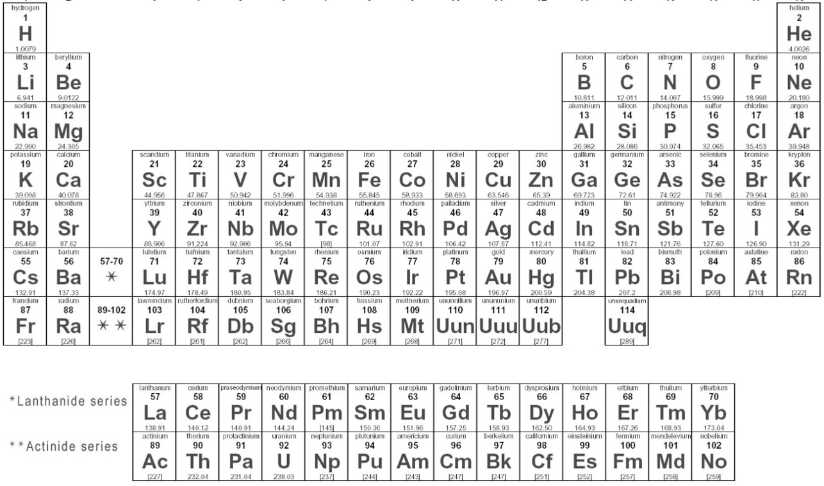
Qualitative Guideposts for BCS Superconductivity
large DOS at E_{F} high phonon frequencies large electron-phonon coupling
covalent metal can be stabilized by high pressures

Slide 21

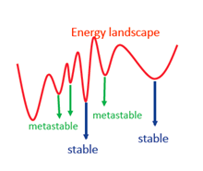
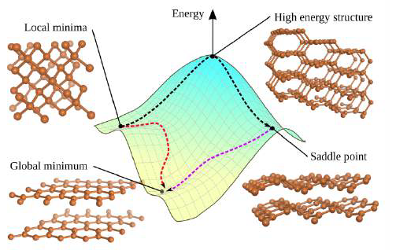
Qualitative Guideposts for BCS Superconductivity
Extreme pressure allows to stabilize chemical
environments which would not exist spontaneously at ambient pressure (forbidden chemistry).

Slide 22
outline
Introduction I – Pressure as a unique variable
Introduction II – Hydrogen metallization and Neil Aschroft’s predictions
Doped hydrogen – molecular compounds, hydrides and superhydrides
H₃S – Conventional superconductivity at 203 K
LaH_{x} – where all things seem to come together
Ternary systems and quest for reducing pressures
Acknowledgements

Slide 23
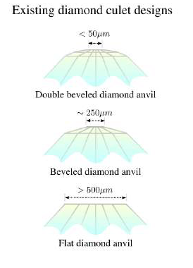
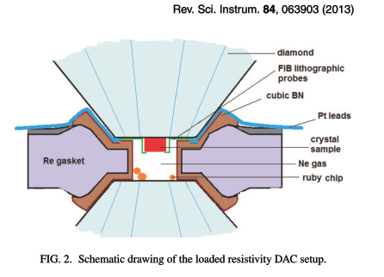
Challenges in Megabar environments
Sputtered electrods
Mbar pressure: samples size is 10-20 μm
H₂ is dangerous for diamonds
Find a good synthesis route: pressure and Temperature
Reproducibility of the results

Slide 24
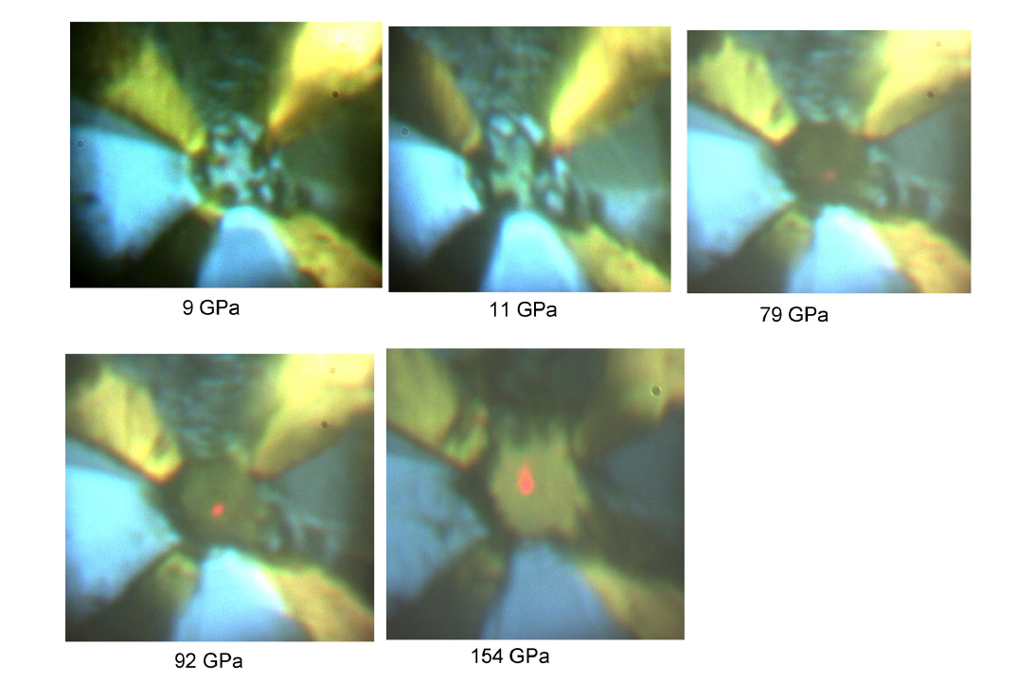

H₃S: T_{c}=203 K
First covalent metal hydrides was synthesized in 2008: SiHx
M. I. Eremets et al. Science:Vol. 319, Issue 5869, pp. 1506-1509
Superconductive H₂S: Tc∼80 K at 160 GPa
Y. Li et al. The Journal of chemical physics 140 (17) (2014) 174712.
Insulated gasket as Teflon, NaCl or CaSO4: No reaction with H₂S
Ti sputtered electrodes
Sample size 25/10 um 1 um thick
Low temperature loading at 200 K: liquid H₂S
Increase P afterwards.
Tc increasing with pressure > 80 K
Reproduce the result
Find a stable route
Prove superconductivity
@Max Planck Institute for Chemistry
A.P. Drozdov, M.I. Eremets, et al. Nature 525:73–76 (2015).

Slide 25


H₃S : Isotope effect
Clear Isotope effect: Shift of Tc to lower temperature for D₂S
Pure sulfur
H₃S experiments
H₃S experiments
H₃S calculation
H₂S
D₂S
Synthesis route:
Increase P at around 150 GPa
Annealing up to room T
Measuring R during cooldown and warm up
Conventional superconductivity
A.P. Drozdov, M.I. Eremets, et al. Nature 525:73–76 (2015).

Slide 26

H₃S : Magnetic field effect
Non magnetic DAC made of Cu:Ti
Up to 7 T
T_{c} shifts to lower values with magnetic fields
Critical field extrapolated using: H_{c}(T)= H_{c0}(1- (T/T_{c})²)
Hc= 70 T with 95% confidence

Slide 27


H₃S : Magnetic field effect
H₃S: cubic Im-3m
Dua et al., SCIENTIFIC REPORTS | 4, 6968 (2014)
Tc=203 K

Slide 28
outline
Introduction I – Pressure as a unique variable
Introduction II – Hydrogen metallization and Neil Aschroft’s predictions
Doped hydrogen – molecular compounds, hydrides and superhydrides
H₃S – Conventional superconductivity at 203 K
LaH_{x} – where all things seem to come together
Ternary systems and quest for reducing pressures
Acknowledgements

Slide 29

Superhydrides RUSh
Ca-H system
Ca+H₂ forms Ca₂H₅ for P < 20 GPa and T > 800 K – monoclinic phase
Ca+H₂ forms CaH₄ for P < 80 GPa and T > 1200 K – tI10 phase
Ca+H₂ forms CaH for P ~ 120 GPa and T > 1800 K, Pm3m structure
Ca+H₂ forms CaH_{x} for P ~ 190 GPa and T > 2000 K, monoclinic phase not predicted by theory.
Mishra, T. Muramatsu, H. Liu, Z. M. Geballe, M. Somayazulu, M.Ahart, M. Baldini,† Y. Meng, E. Zurek, and R.Hemley
J. Phys. Chem. C, 122, pp 19370–19378 (2018)
Relevant issues
Temperature play a critical role
find a good reproducible synthesis route
HPCAT beamline @APS Argonne National Lab.
Geophysical Lab @Carnegie Institution of Washington

Slide 30

Synthesis and Stability of Lanthanum superhydrides
Predictions
Potential high-T_{c} superconducting lanthanum and yttrium hydrides at high pressure
Hanyu Liu, Ivan I. Naumov, Roald Hoffmann, N. W. Ashcroft, and Russell J. Hemley
PNAS July 3, 2017 114 (27) 6990-6995
Hydrogen Clathrate Structures in Rare Earth Hydrides at High Pressures: Possible Route to Room-Temperature Superconductivity
Feng Peng, Ying Sun, Chris J. Pickard, Richard J. Needs, Qiang Wu, and Yanming Ma. Phys. Rev. Lett. 119, 107001, 2017
Superconductivity in LaH10: A New Twist of the Story.
Kruglov, I.A., Semenok, D.V., Szcęśniak, R., Esfahani, M.M.D., Kvashnin, A.G. and Oganov, A.R. (2018) arXiv: 1810.01113
Super-Hydrides of Lanthanum and Yttrium: On Optimal Conditions for Achieving near Room Temperature Superconductivity. Otto, H.H. (2019) World Journal of Condensed Matter Physics 9, 22-26

Slide 31



Superconductivity in LaH_{10-x} (Synthesis)
La
LaHx
WH
W
Au
P =170 GPa predicted phase
Synthesis and Stability of Lanthanum Superhydrides
Zachary M. Geballe ,Hanyu Liu ,Ajay K. Mishra ,Muhtar Ahart, Maddury Somayazulu Yue Meng Maria Baldini , Russell J. Hemley
Angnew. Chemie, 57, 688-692 (2018)
HPCAT beamline @APS Argonne National Lab.

Slide 32



Superconductivity in LaH10-x (Synthesis)
Cubic fcc Fm3m structure
32-atom cage surrounding the rare earth atom
H. Liu et al., Proceedings of the National Academy of Sciences 114 (27) (2017) 6990–6995.
The synthesis has been duplicated
The P-T conditions and the synthesis of higher hydrides and decomposition products have been bracketed in the region 140-240 GPa.
Synthesis and Stability of Lanthanum Superhydrides
Zachary M. Geballe ,Hanyu Liu ,Ajay K. Mishra ,Muhtar Ahart, Maddury Somayazulu Yue Meng Maria Baldini , Russell J. Hemley
Angnew. Chemie, 57, 688-692 (2018)

Slide 33


Superconductivity in LaH_{10-x} (validation)
T_{c}=260 K.
I>2 mA
Critical current density of 5000 A/cm²
NH₃BH₃ ammonia borane: 3 moles of H₂ an cubic BN
Pulse laser heating < 1800 K
Geophysical lab @Carnegie Institution of Washington
Evidence for Superconductivity above 260 K in Lanthanum Superhydrides
Maddury Somayazulu, Muhtar Ahart, Ajay K. Mishra, Zachary M. Geballe, Maria Baldini,
Yue Meng, Viktor V. Struzhkin, and Russell J. Hemley
Physical Review Letter 122, 027001 (2019)
Notes:
Pressure determined by La, Pt, Au Eos seems to be more reliable than that determined by H₂ vibron or diamond Raman.

Slide 34


Superconductivity in LaH_{10-x} (confirmation)
Magnetic field effect
Isotopic effect: superconducting pairing mechanism
Different route
Inhomogeneities in the sample are confirmed in both experiments
Critical factor for stabilizing the phases is temperature: several phases with different Tc
Superconductivity at 250 K in Lanthanum hydride under pressure
P. Drozdov, P. P. Kong,V. S. Minkov, S. P. Besedin, M. A. Kuzovnikov, S. Mozaffari, L. Balicas, F. F. Balakirev, D. E. Graf, V. B. Prakapenka, E. Greenberg, D. A. Knyazev, M. Tkacz and M. I. Eremets
Nature, 569, 528 (2019)

Slide 35
outline
Introduction I – Pressure as a unique variable
Introduction II – Hydrogen metallization and Neil Aschroft’s predictions
Doped hydrogen – molecular compounds, hydrides and superhydrides
H₃S – Conventional superconductivity at 203 K
LaH_{x} – where all things seem to come together
Ternary systems and quest for reducing pressures
Acknowledgements

Slide 36


Hydrides rush
Jose A. Flores-Livasa, Lilia Boerib, Antonio Sannac, Gianni Profetad, Ryotaro Aritae, f, Mikhail Eremets, arXiv:1905.06693

Slide 37

Future Perspective for Hydrides superconductor
Doping of binary phases
Hydrogen Energy materials: well studied at ambient conditions
Playing with metastability: several of those inaccessible phases can be stabilized at lower pressure
Size of chemical landscape
Example: Ternary A_{x}B_{y}H_{n} hydrides (gallates and alanates of alkali metals and alkaline earths) are potential candidates
Tetrahedrally coordinated at ambient conditions
Metastable octahedrally coordinated phases: metallic and superconducting phase below 100 GPa with Tc above liquid nitrogen
Jose A. Flores-Livasa, Lilia Boeri, Antonio Sannac, Gianni Profetad, Ryotaro Aritae, f, Mikhail Eremets, arXiv:1905.06693

Slide 38
Conclusions
Two record breaking superconductor hydrides were discovered: H₃S (2015, 200 K) and LaH₁₀ (2018, 260 K)
Super-hydrides display conventional superconductivity
Extraordinary symbiosis between experimental search and theoretical method: effective way to find new superconductor
Room temperature superconductivity will probably be observed in coming years
Near terms: establish if conventional superconductivity can be observed in ternary, quaternary hydrides
Long terms: establish if pressure can be drastically decreased.

Slide 39












Acknowledgments
Maddury Somayazulu
Zack Geballe
Muhtar Ahart
Ajay Mishra
Yue Meng
Hanyu Liu
Rus Hemley
Viktor Struzhkin
Takaki Muramatsu
Ivan Naumov
Changyong Park
Arun Bmmanavar
George Washington University
Geophysical lab, Carnegie Institution of Washington
HPCAT, Argonne National Lab.

Slide 40




Acknowledgments

Slide 41


Slide 43



Close, but no cigar!
While no dissociation is expected, the disorder in Re-H bonds under pressure causes formation of a ‘poor’ semi-metal that slowly transforms to a metal under annealing. This is paralleled in other hydride superconductors also.
Markapoulos et. al., JACS, 132, 748 (2010)
Takaki et. al., J. Phys. Chem. C, 119, 18007 (2015)
E. Vinitsky et. al. J. Phys. C, (2016)

