Slide 1
Electron cloud studies at Fermilab
Yichen Ji – Illinois Institute of Technology
Jan 28th 2020
Advisor: Linda Spentzouris, Robert Zwaska

Slide 2
Outline
Electron cloud
SEY measurement station
E-cloud build-up simulation (POSINST)
RFA measurement of electron flux
Conclusion

Slide 3
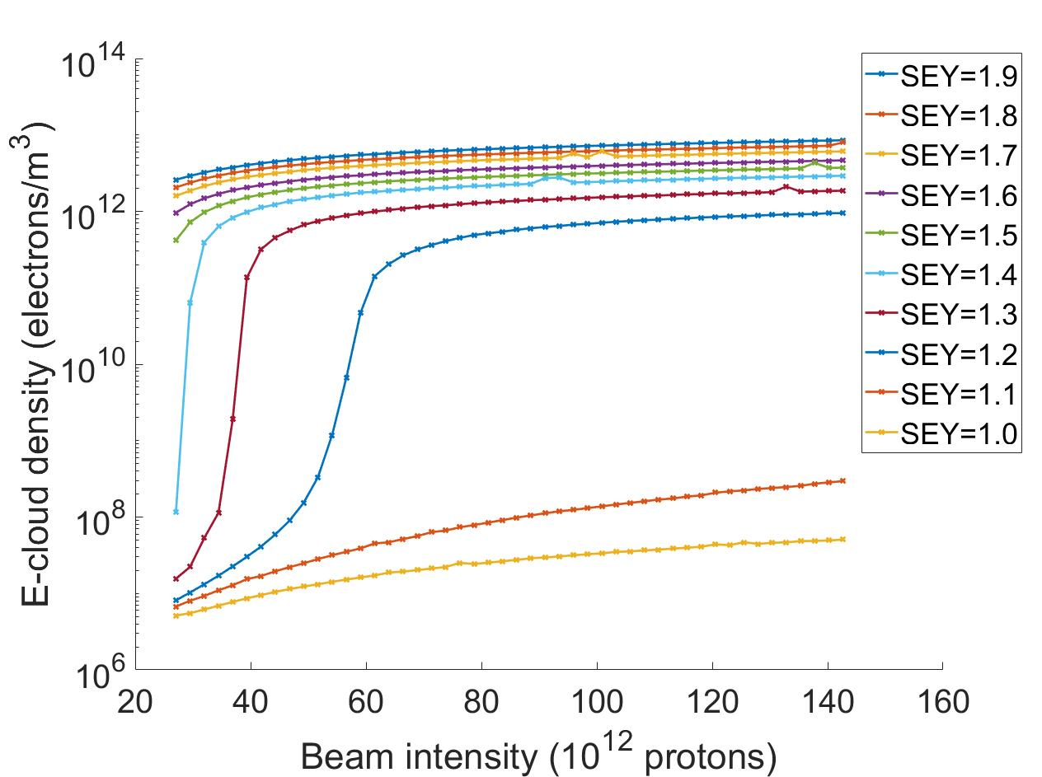
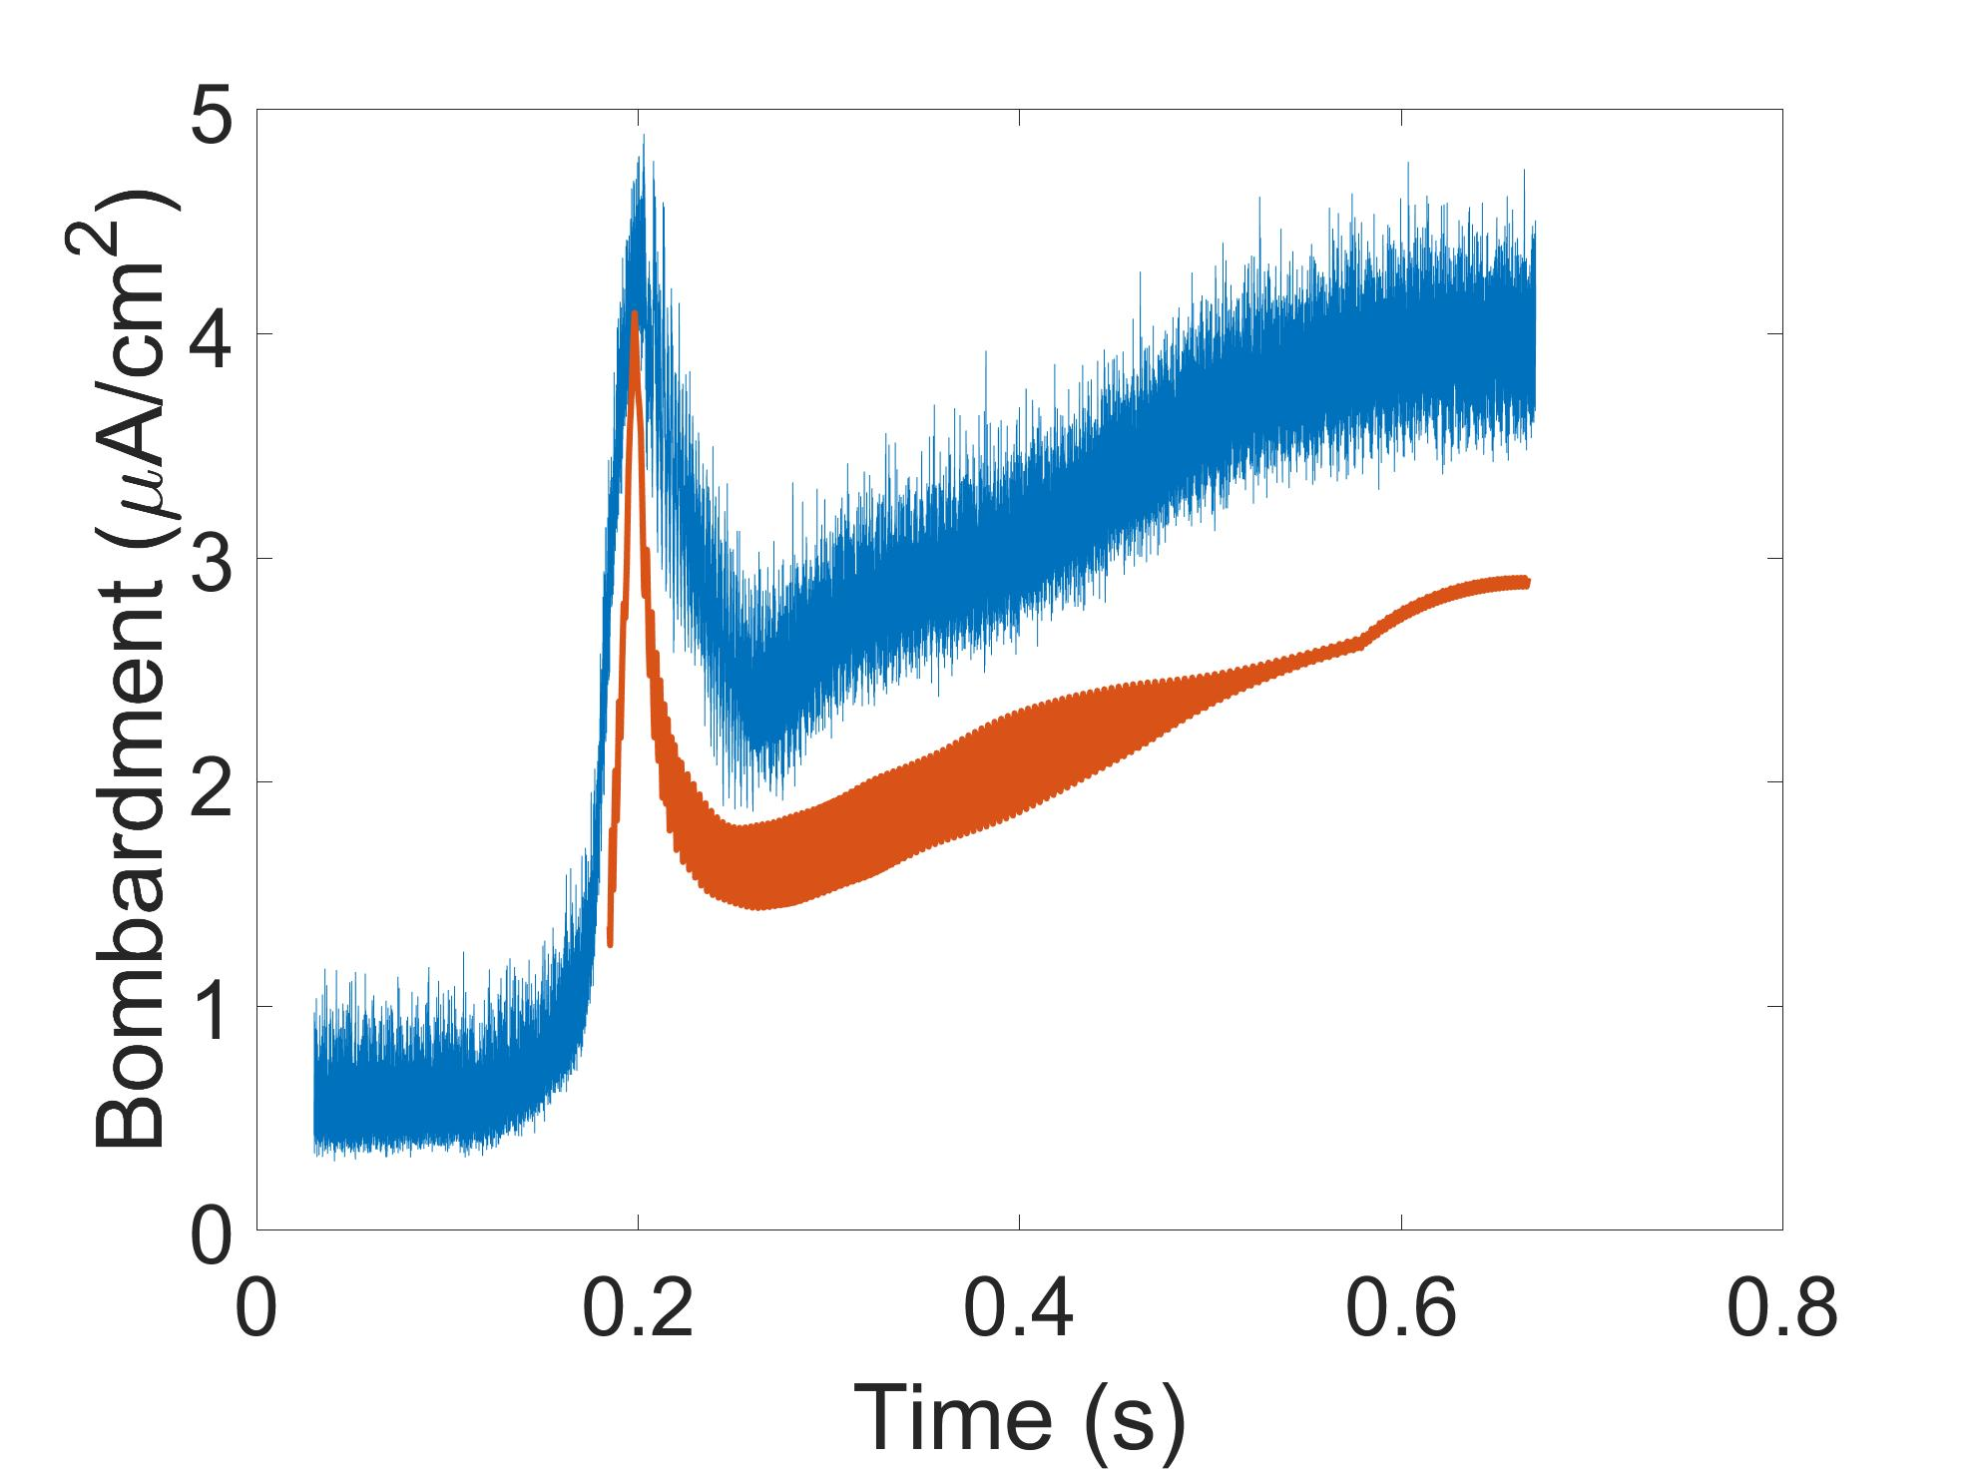
Electron Cloud Generation Effect
E-cloud : exponential generation of unwanted electrons inside beam pipe
  Limits accelerator performance
    E-cloud observed in both MI and RR, instability observed in RR
    E-cloud is observed and causing problem for CERN-LHC, CERN-SPS/PS, BNL-eRHIC, KEKB in Japan, BEPC in Beijing China and other accelerators
    PIP-II intensity (70×10¹² protons) will generate a large electron-cloud
POSINST Simulation Results and RFA measurements
before
now
later
Much later

Slide 4
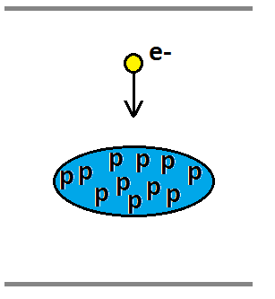
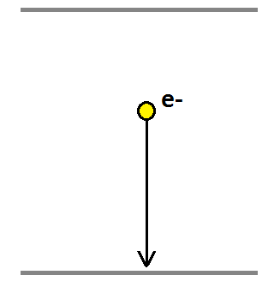
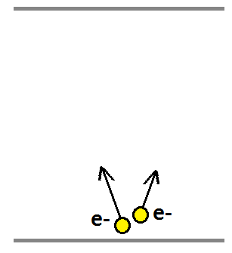
E-cloud Generation Mechanism
Seeding electrons generated by residual gas, synchrotron radiation and lost particle
Seeding electrons get Energized by passing beam bunch
An energetic (few hundreds of eVs) electron hits beam pipe and knocks out more than one electron

Slide 5
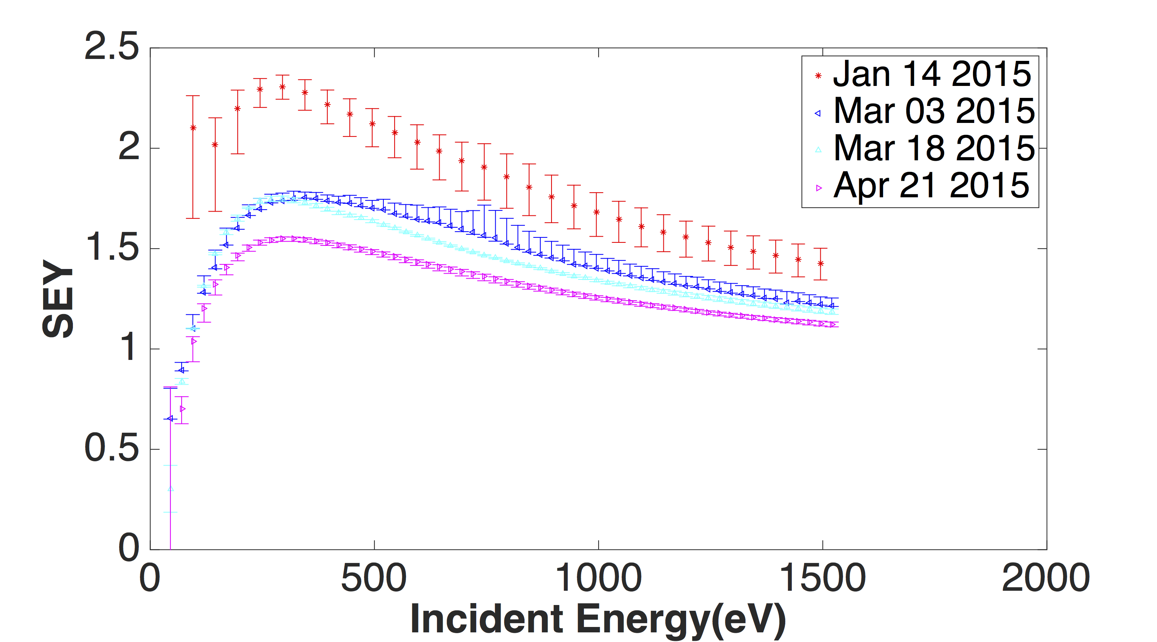

Secondary Electron Yield
Secondary electron yield (SEY): on average, how many electrons are knocked off a surface with one incident electron
$$SEY=\frac{I_{Secondary}}{I_{Incident}}$$
SEY: - Function of incident energy E and incident angle θ
  Affects exponential growth rate and saturation density of E-cloud
  Condition to lower value when exposed to electron bombardment
    In-situ study of SEY based on accelerator operations is necessary

Slide 6
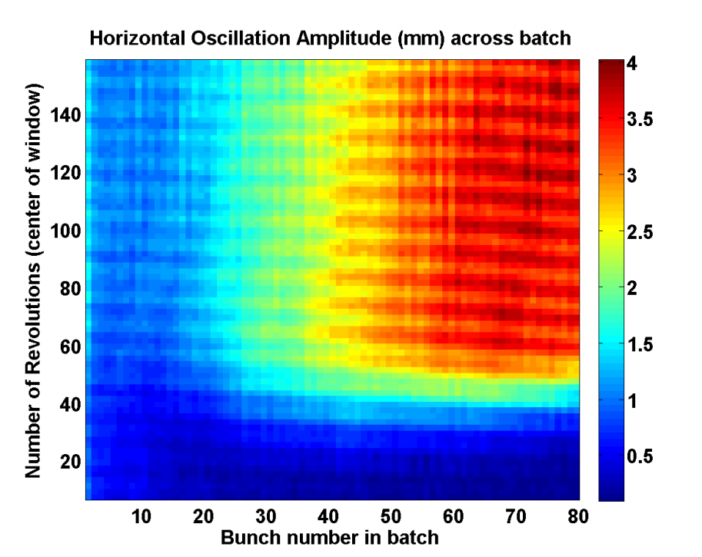
Past E-cloud Study at Fermilab
E-cloud was first measured in 2006 (Bob Zwaska)
E-cloud mitigation with different coating was studied (Michael Backfish)
  Measure E-cloud with RFA for different coatings
  Titanium Nitride(TiN), Amorphous Carbon(A-Carbon) and Diamond Like Carbon(DLC)
  A similar RFA system is also used in my research
Recycler Ring (RR) instability
  Observed in 2015
  Triggered E-cloud measurement study (Jeff Eldred)
  Mechanism was studied (Sergey Antipov)
  Requires a 10¹² electron/m³ average E-cloud density to happen
  Happened in dipole region (combined function magnet)
Figure created by Jeff Eldred

Slide 7
SEY Measurement station

Slide 8
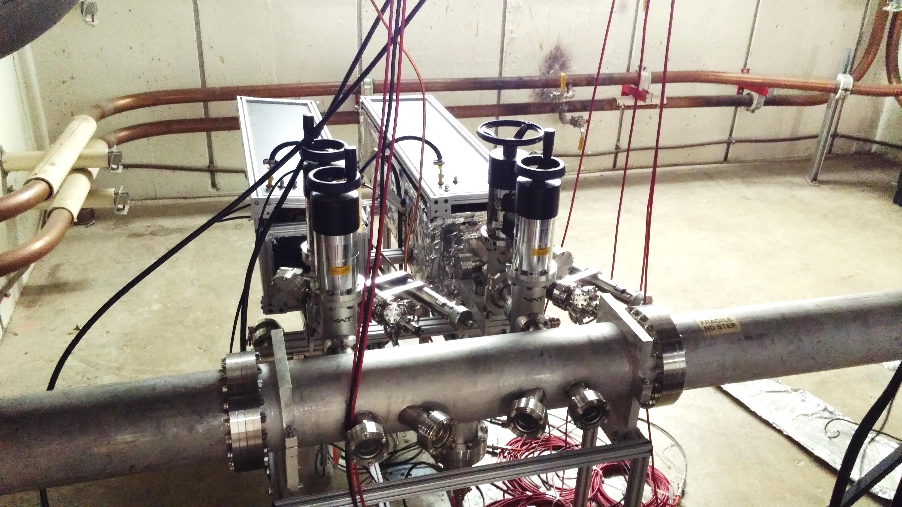
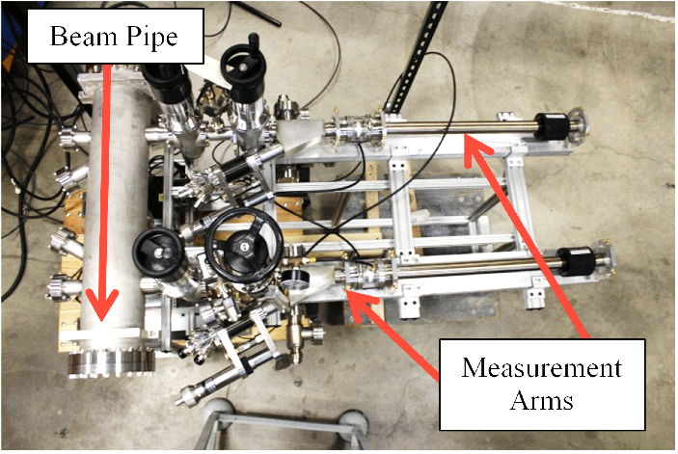
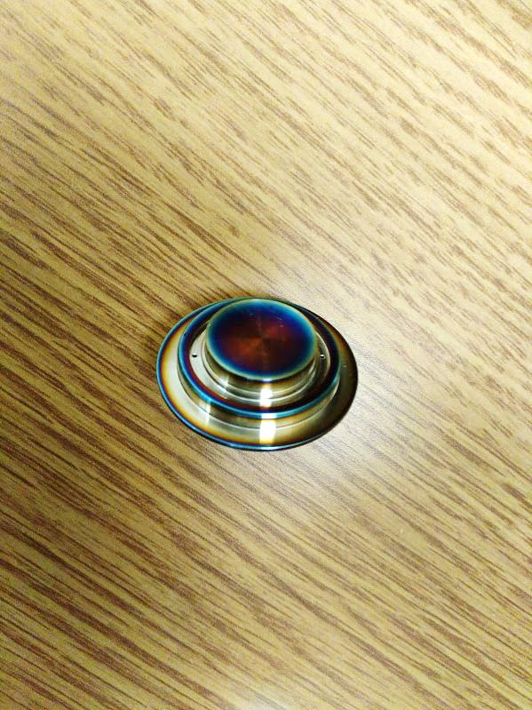
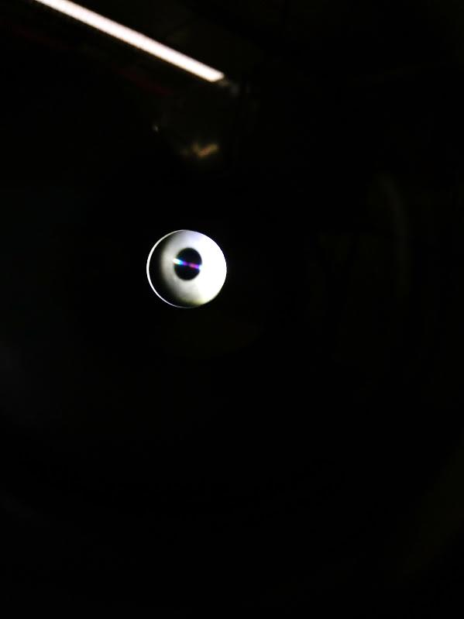
SEY Station at MI-10
Two sample are exposed to the identical environment
A RFA is installed to monitor E-cloud activity
Measurements are limited by operation schedules
TiN A-carbon and SS316L studied
  Start: SS 2.3, TiN 2.1, A-Carbon 1.26
  End: SS 1.25 TiN 1.18, A-Carbon 0.82

Slide 9
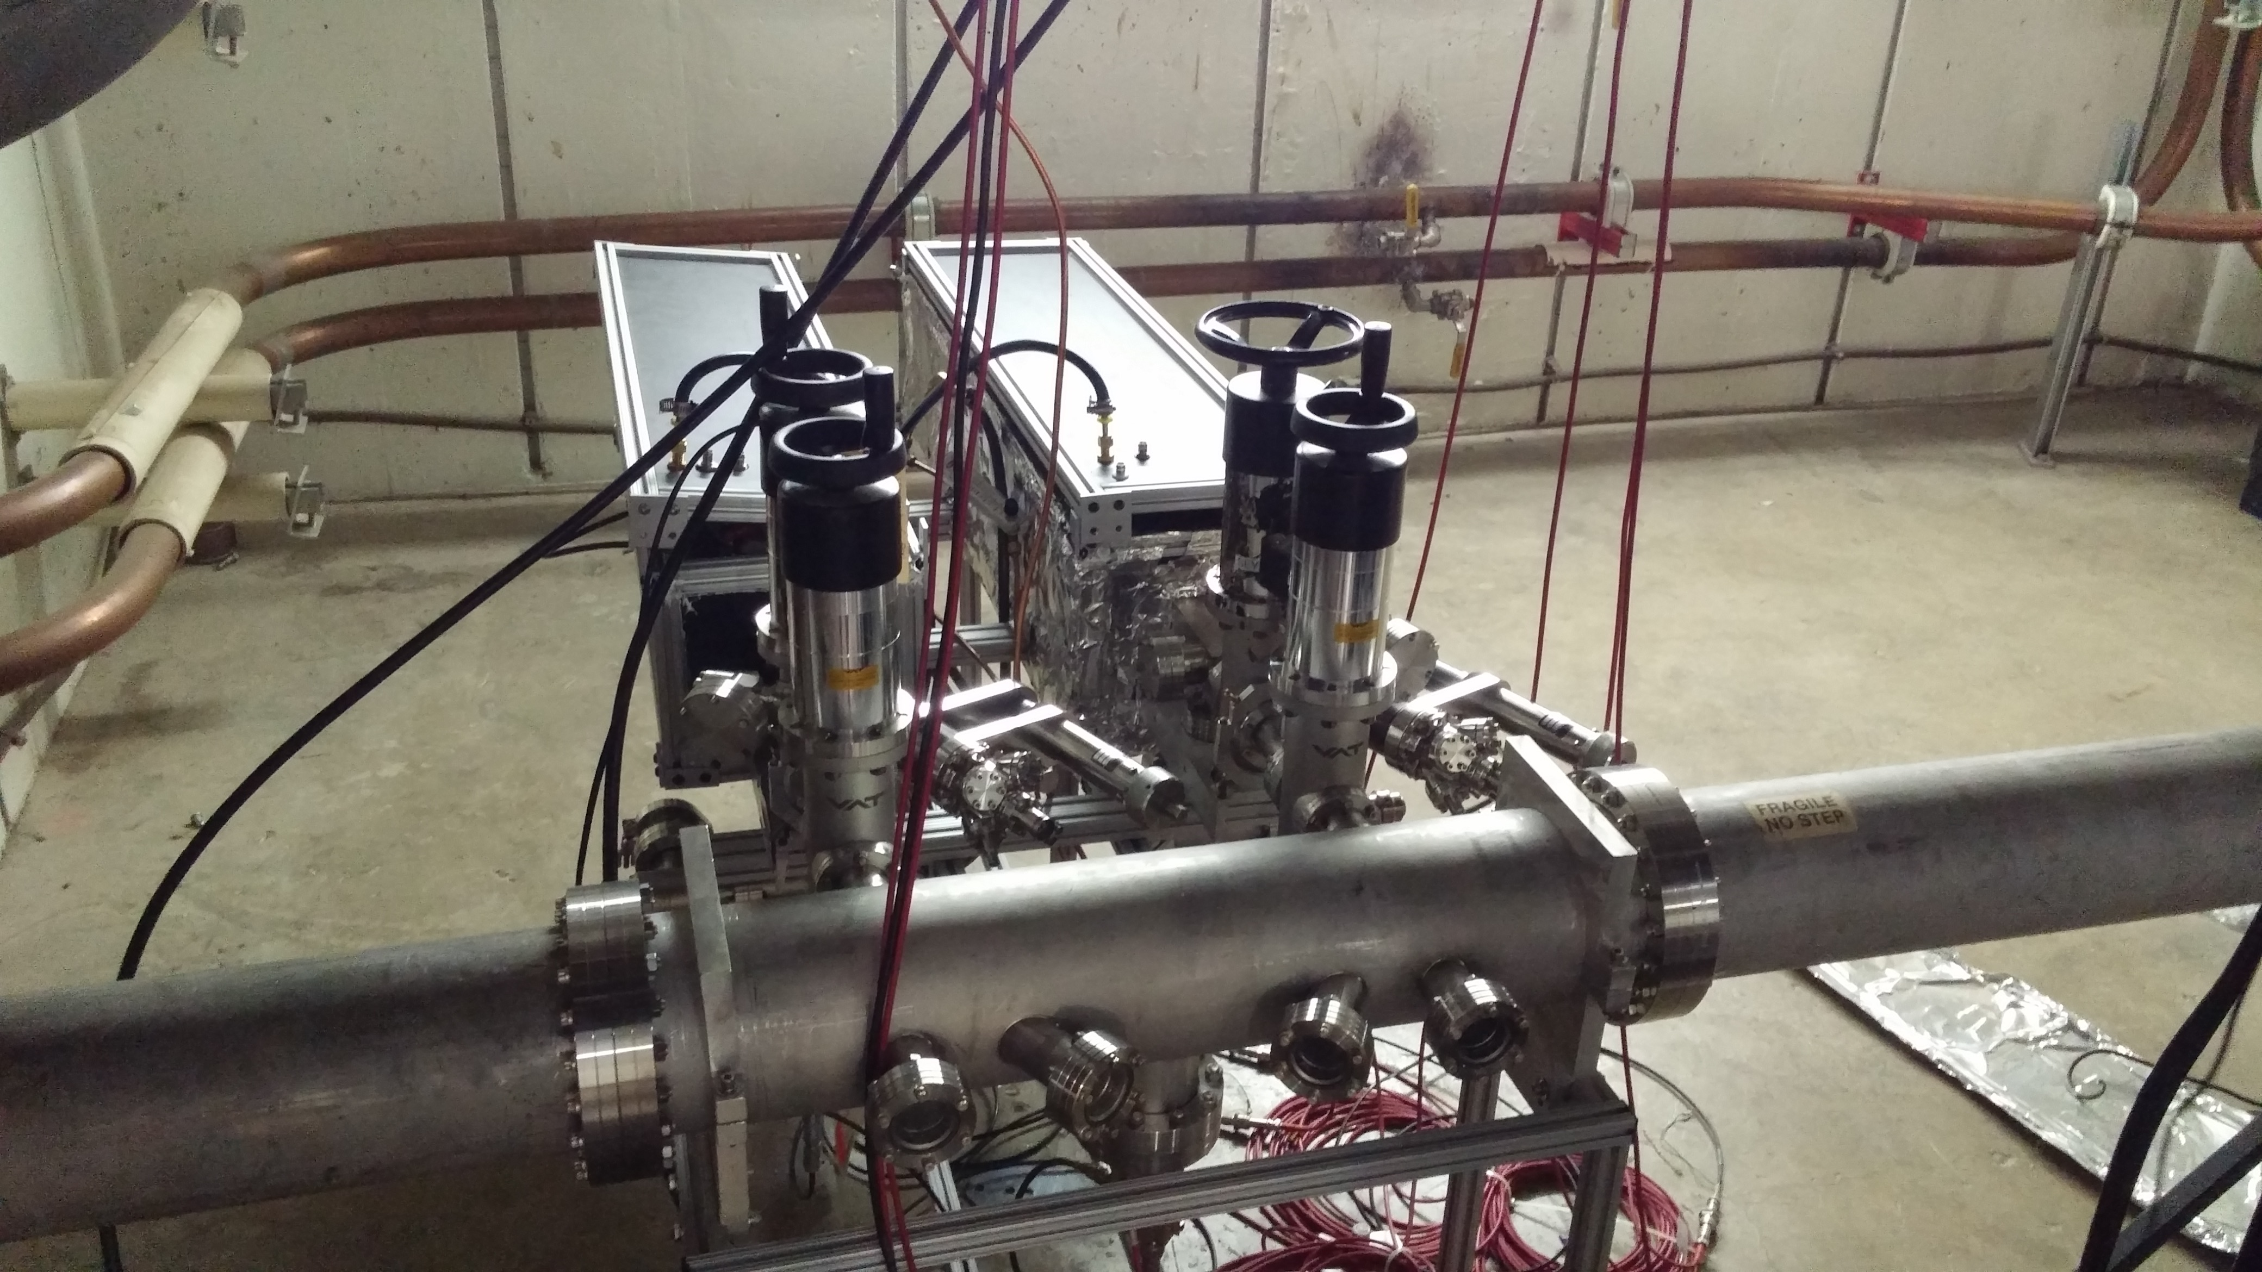
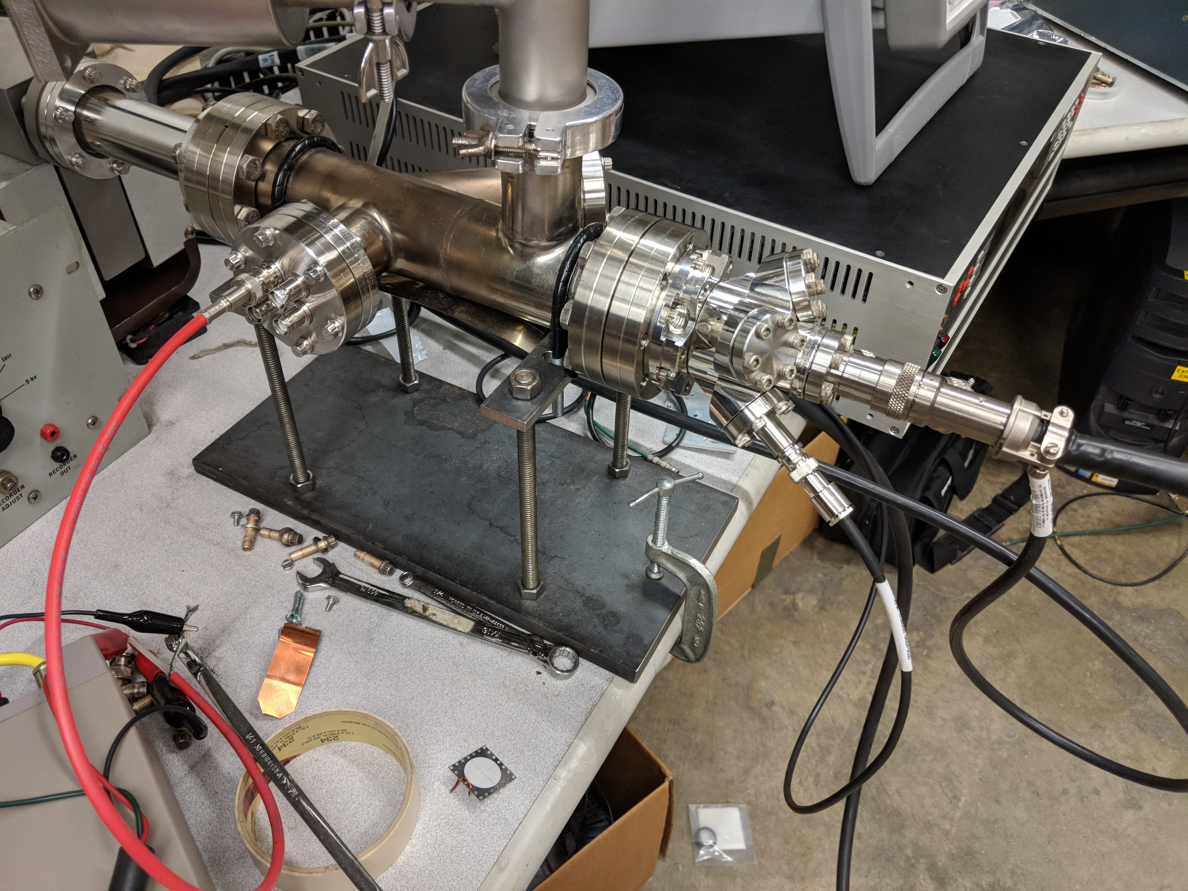
SEY Measurements equipment
Two measurement stands built
  Comparable results
  MI-10 for conditioning measurement, Linac for quick SEY measurement
Take ~0.5 years for conditioning study per sample
Take ~4 hours for one SEY measurement
Less than 5% error

Slide 10
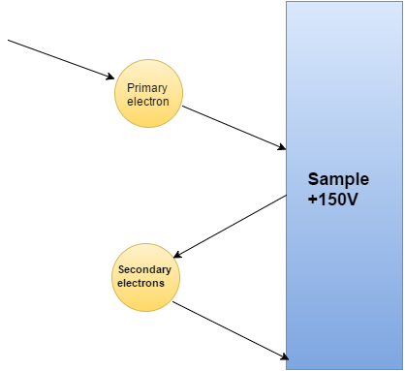
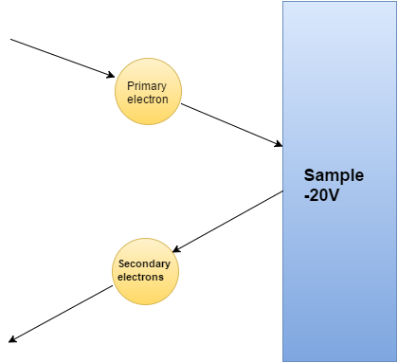

The Station Measurement Principles
Primary current (I_{p}): +150V recapture all secondary electron
Total current (I_{t}): -20V repulse all secondary electrons 9 data points each incident energy
$$SEY=\frac{I_{t}−I_{p}}{I_{p}}$$
I_{p}
I_{t}

Slide 11
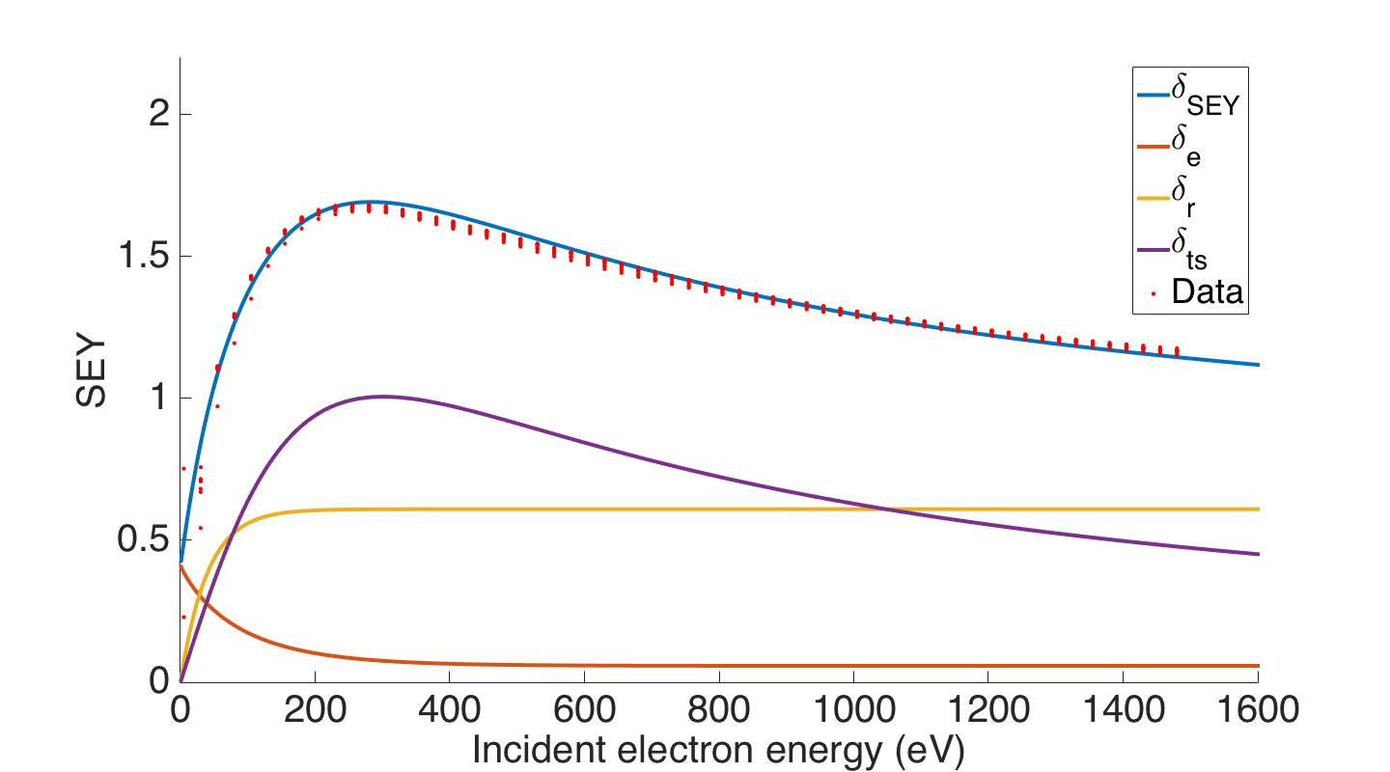
Example Measurement Results
Good case
Bad case
The SEY curve measured is fitted to the Furman-Pivi model
The peak SEYs of the measurements are extracted for conditioning studies

Slide 12
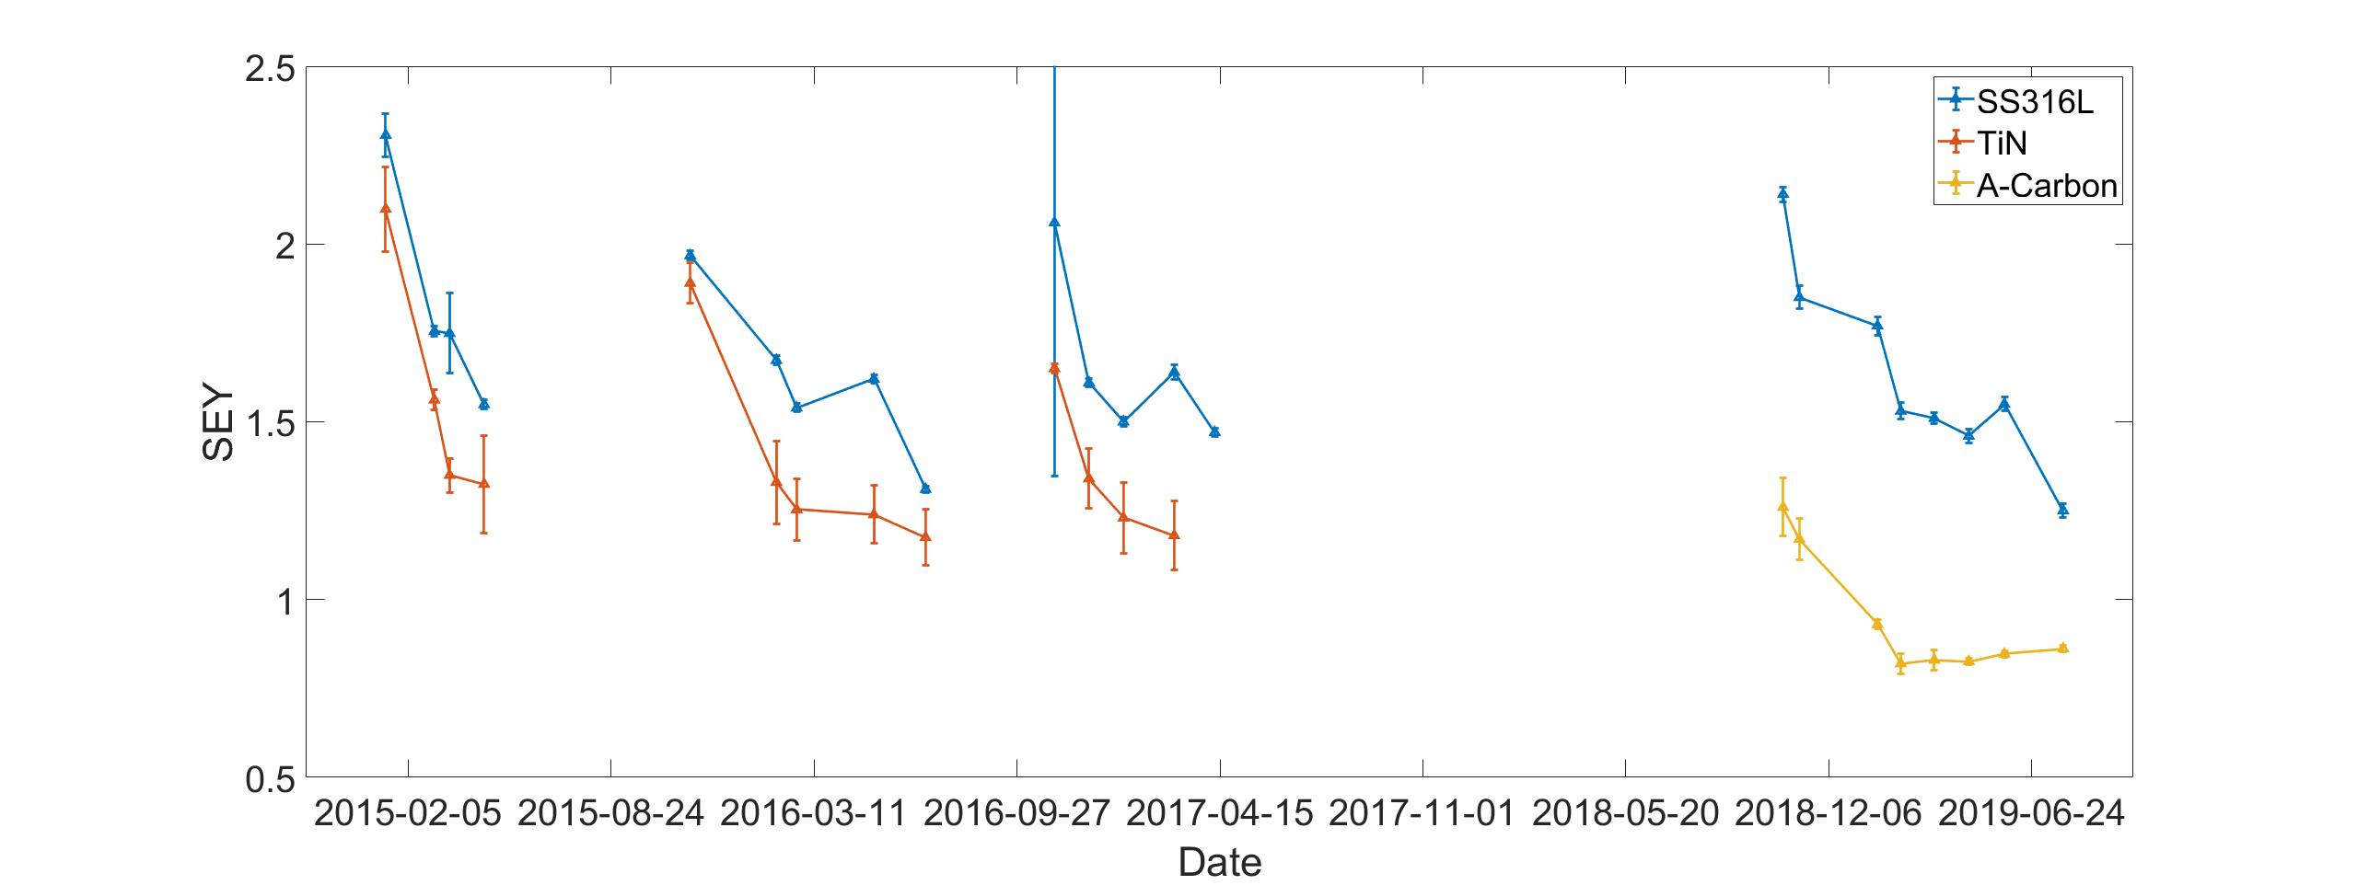
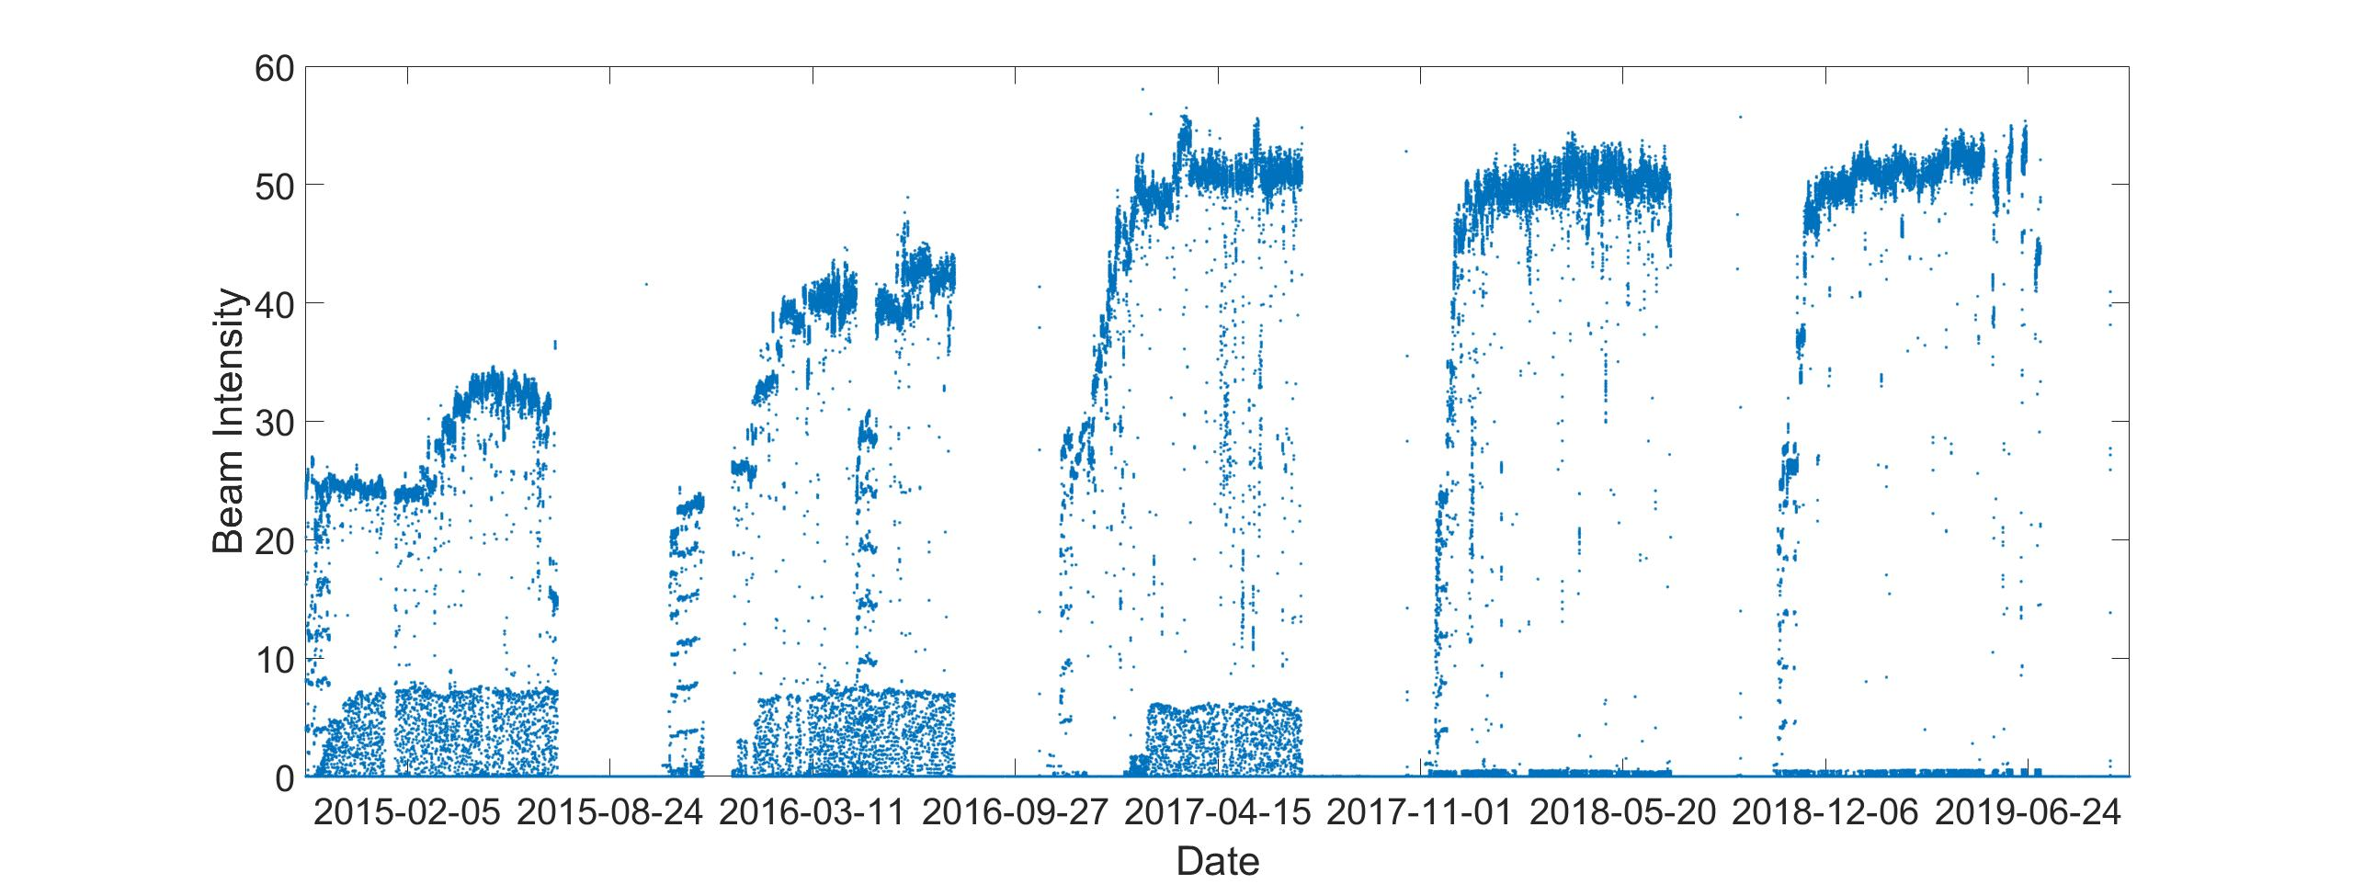
Five Years of SEY Measurements!

Slide 13
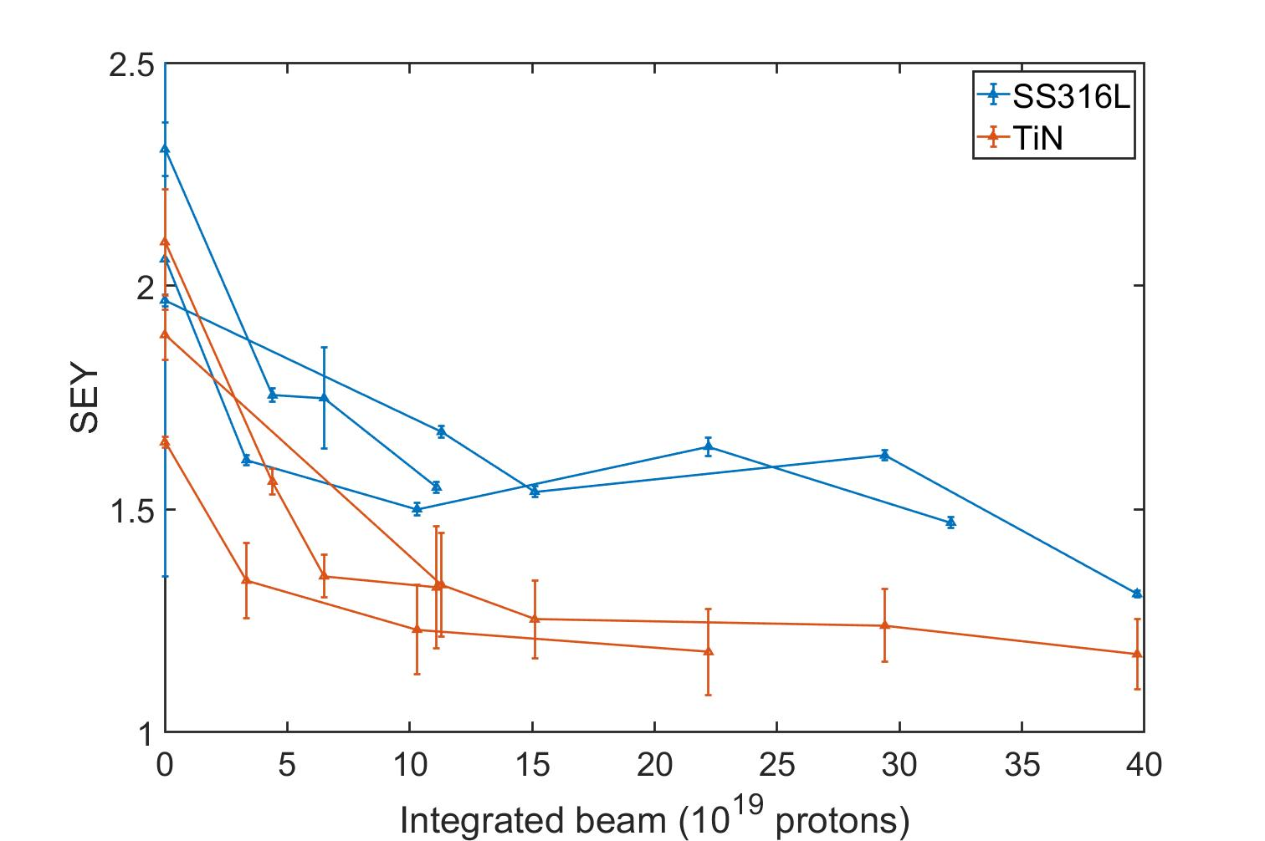
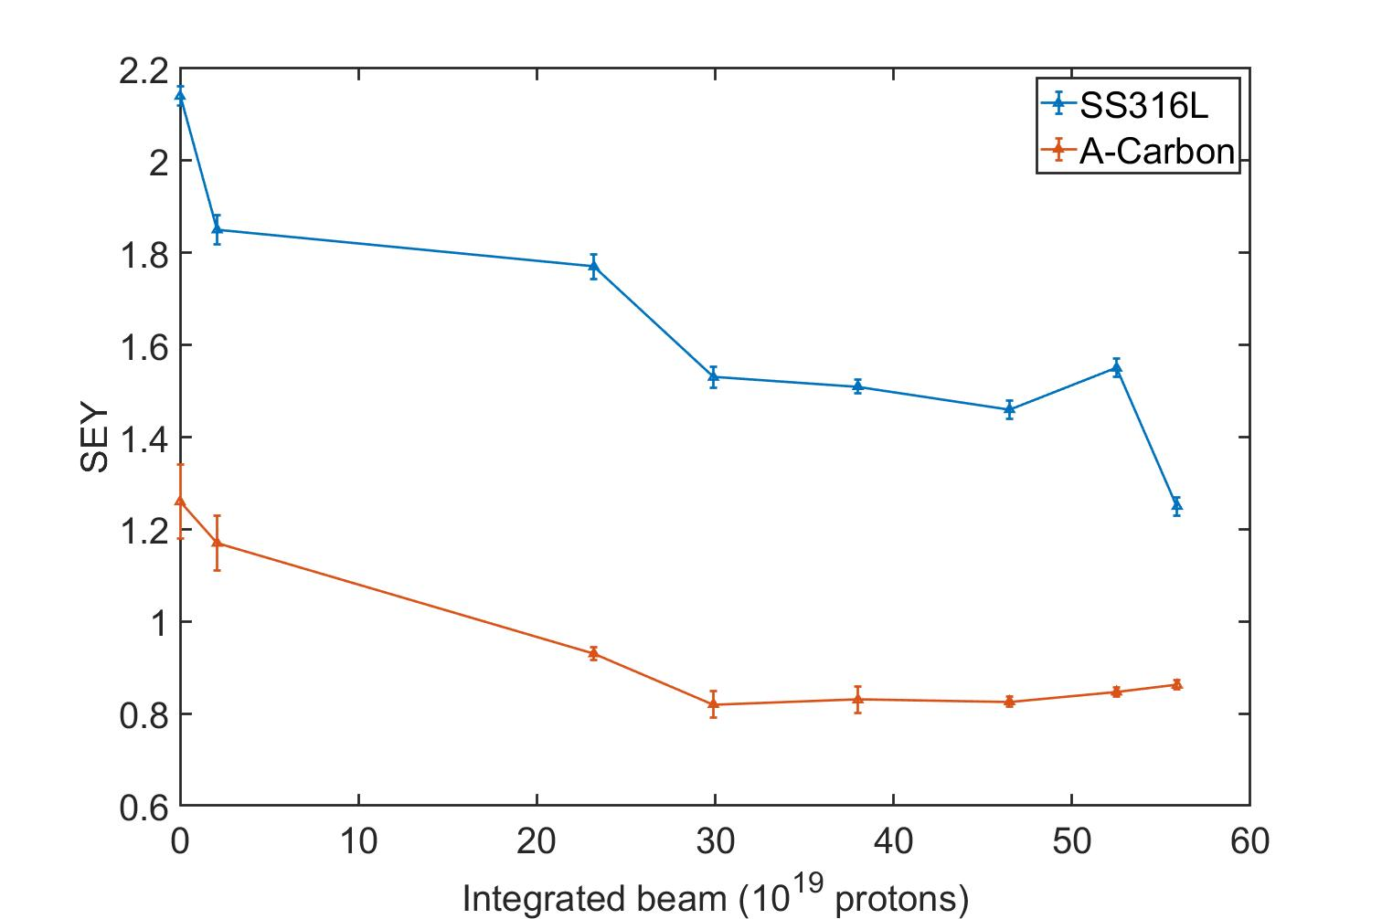
The SEY Measurement Study Results (TiN, A-carbon and SS316L)
 | TiN | A-Carbon | SS316L
Initial | 2.1 | 1.26 | 2.3
Final | 1.18 | 0.82 | 1.25
The conditioning process drastically slowed after the first 10²⁰ protons (first 1 to 3 month depend on operational beam intensity)
Decondition in Stainless steel was due to operational mistake (sample not exposed)
Motivated a detailed study of deconditioning

Slide 14
Deconditioning Measurement During Long Shut Down
2016 Shut Down
2017 Shut Down
2019 Shut Down
Date | TiN | SS316l
Jun 29 | 1.18 | 1.35
Jul 29 | Beam off
Aug 01 | 1.33 | 1.51
Aug 03 | 1.32 | 1.60
Aug 04 | 1.34 | 1.60
Aug 18 | 1.33 | 1.61
Sep 02 | 1.33 | 1.61
Sep 10 | Arm out
Sep 19 | 1.41 | 1.72
Sep 23 | 1.37 | 1.64
Nov 03 | 1.65 | 2.06
Date | TiN | SS316L
Mar 17 | 1.18 | 1.64
Apr 26 |  | 1.47
July 01 | Beam off
Aug 02 | 1.2 | 1.39
Aug 10 | 1.21 | 1.41
Aug 10 | Arm out
Aug 14 | 1.23 | 1.43
Aug 29 | 1.29 | 1.47
Sep 18 | 1.35 | 1.58
Oct 14 | 1.57 | 1.72
Oct 21 | Arm purged
Oct 24 | 1.82 | 1.97
Date | A-Carbon | SS316L
May 28 | 0.82 | 1.55
Jul 03 | Beam off
Jul 25 | 0.862 | 1.25
Aug 8 | 0.865 | 1.45
Sep 10 | Arm out
Oct 03 | 0.886 | 1.6
 | Arm purged
 | 0.9868 | 1.62
Conclusions
The accelerator vacuum chamber preserve conditioning
Surrounding samples with raw surface leads to large deconditioning
Purging the vacuum chamber will cause large amount of deconditioning

Slide 15
Conclusion on The SEY Measurement
The vacuum chamber preserves the conditioned SEY fairly well during shut down
  Unconditioned surface and purge lead to deconditioning
The conditioning generally takes 1 to 3 months to reach a steady level.
  TiN conditions a lot faster than stainless steel
  A-Carbon starts with low SEY
 | TiN | A-Carbon | SS316L
Initial | 2.1 | 1.26 | 2.3
Final | 1.18 | 0.82 | 1.25

Slide 16
POSINST simulations

Slide 17
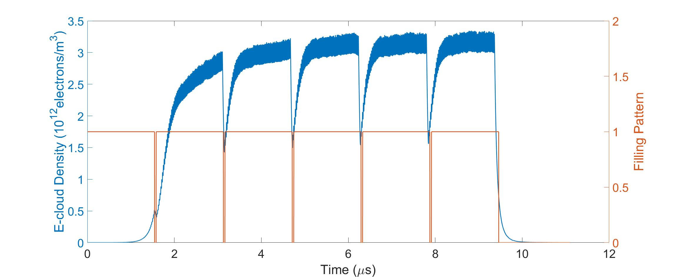
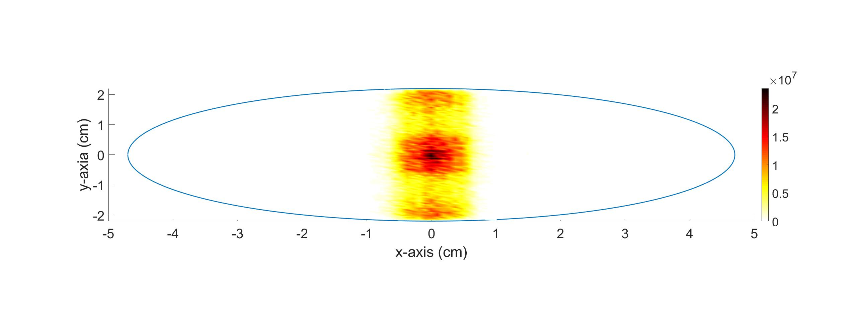
POSINST: E-cloud Build-up Simulation Code
POSINST is written by Miguel Furman (LBNL, retired).
Geometry: Semi-2D: solve field in (x,y) and develop electrons in 3D slice
Particle tracking: Particle in Cell
Secondary emission model: Furman-Pivi probabilistic model
Beam model: Preset static beam with selectable distribution functions
B-field: Solenoid, Dipole, Quadrupole

Slide 18
MI Simulation Parameters
 | Main Injector | Simulation parameters
Circumference [km] | 3.3 | 3.3
Beam Energy [GeV] | 8-120 | 25
RF frequency [MHz] | 53 | 53
Harmonic number | 588 | 588
Filling pattern | 492/588 | 492/588
Bunch spacing [ns] | 19 | 19
Bunch intensity [proton/bunch] | 11×10¹⁰ | 5 - 26×10¹⁰
RMS Bunch length [ns] | 1 | 1
Dipole strength [T] | 0.1-1.38 | 0.234
Beam pipe geometry | Round, elliptical | Round, elliptical
Beam pipe size radius, semi-major/minor axes [cm] | 7.2, 5.8, 2.4 | 7.2, 5.8, 2.4

Slide 19
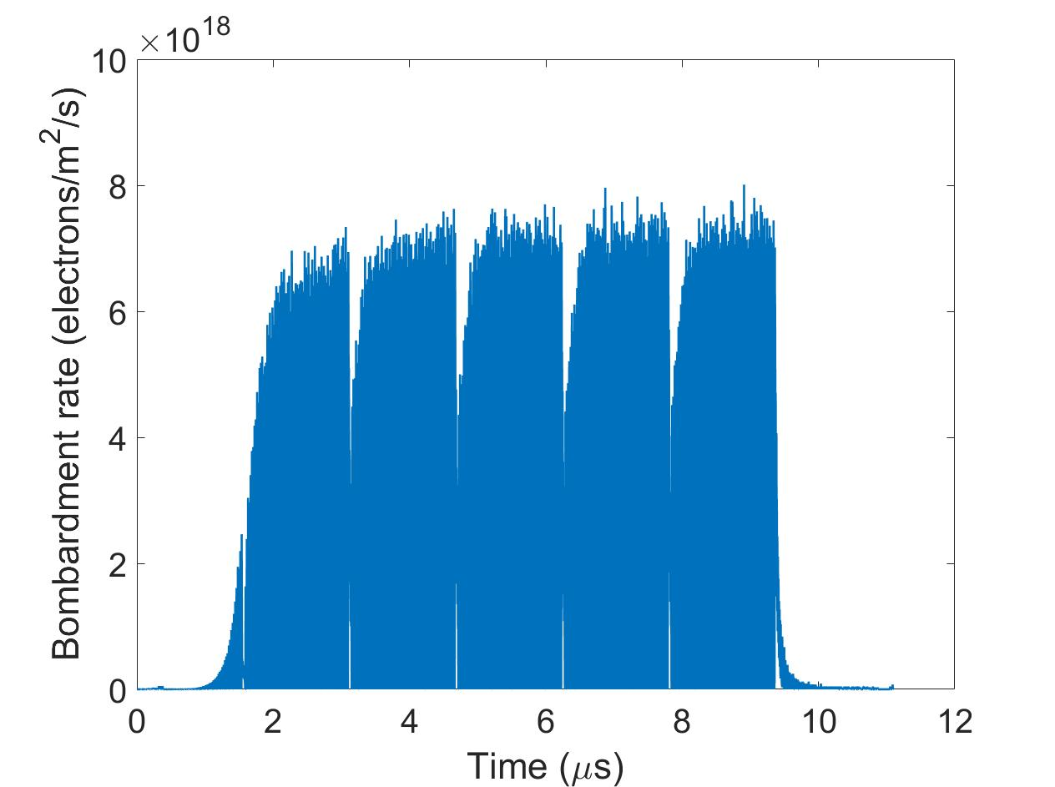
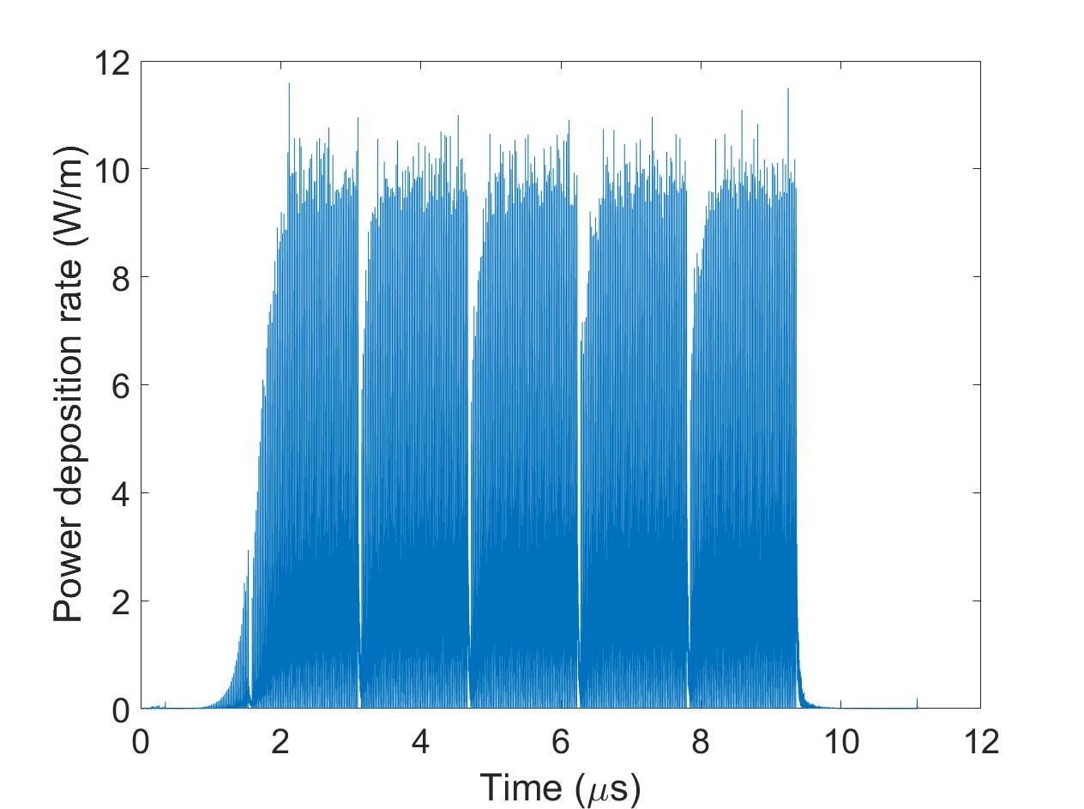
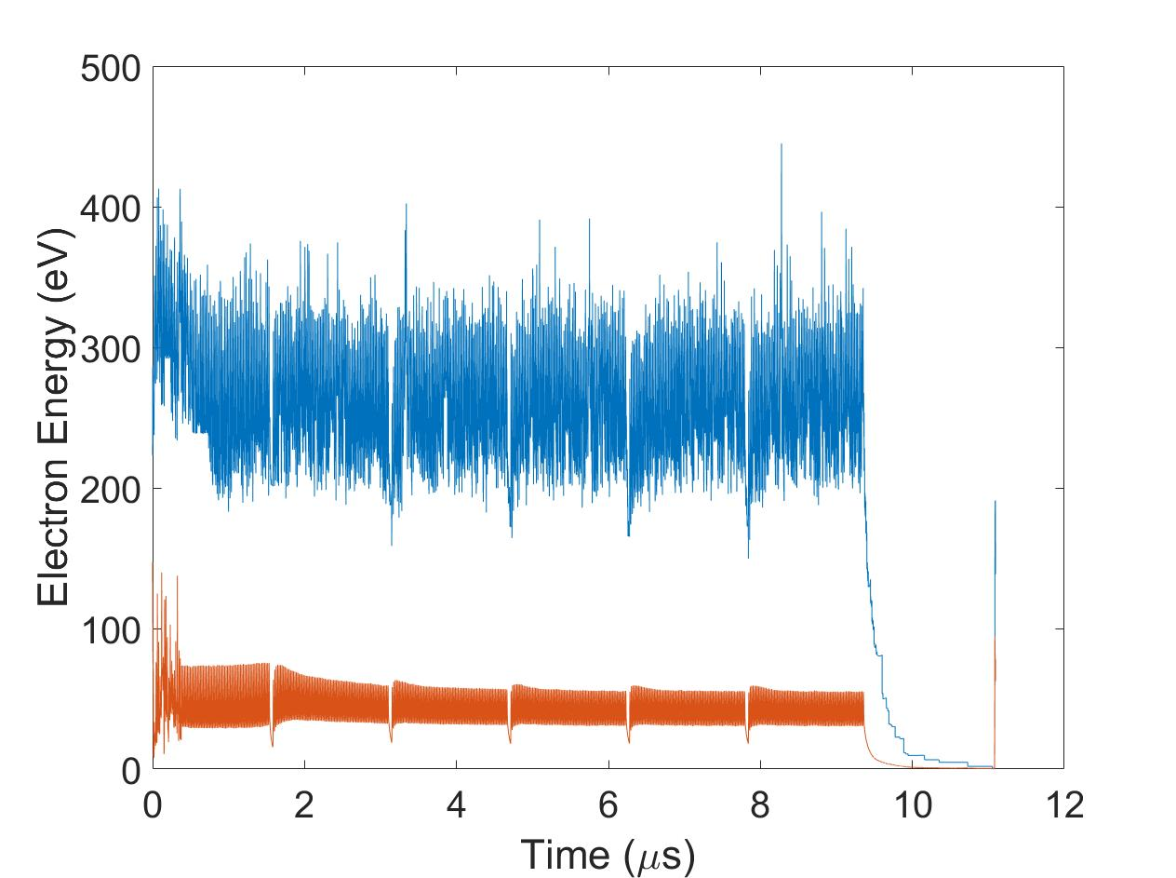
POSINST Simulated E-cloud Density and E-cloud Distribution
E-cloud density
E-cloud distribution
E-cloud distribution at 2 μs
Total E-cloud density
Heat deposition
Bombardment rate
Power deposition rate
Average/maximum Electron energy
The E-cloud reflects the filling pattern
Saturated E-cloud linear charge density is comparable to beam
E-cloud are confined into vertical strip by the dipole field
Average electron energy decreases after saturation is reached

Slide 20
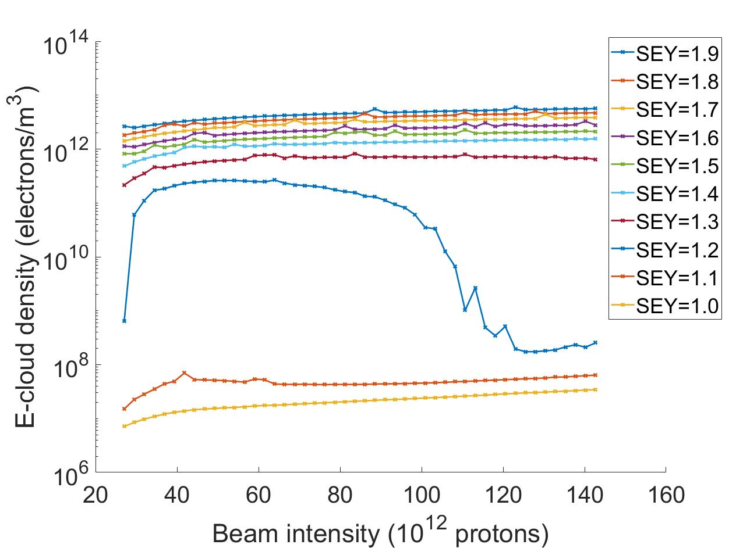
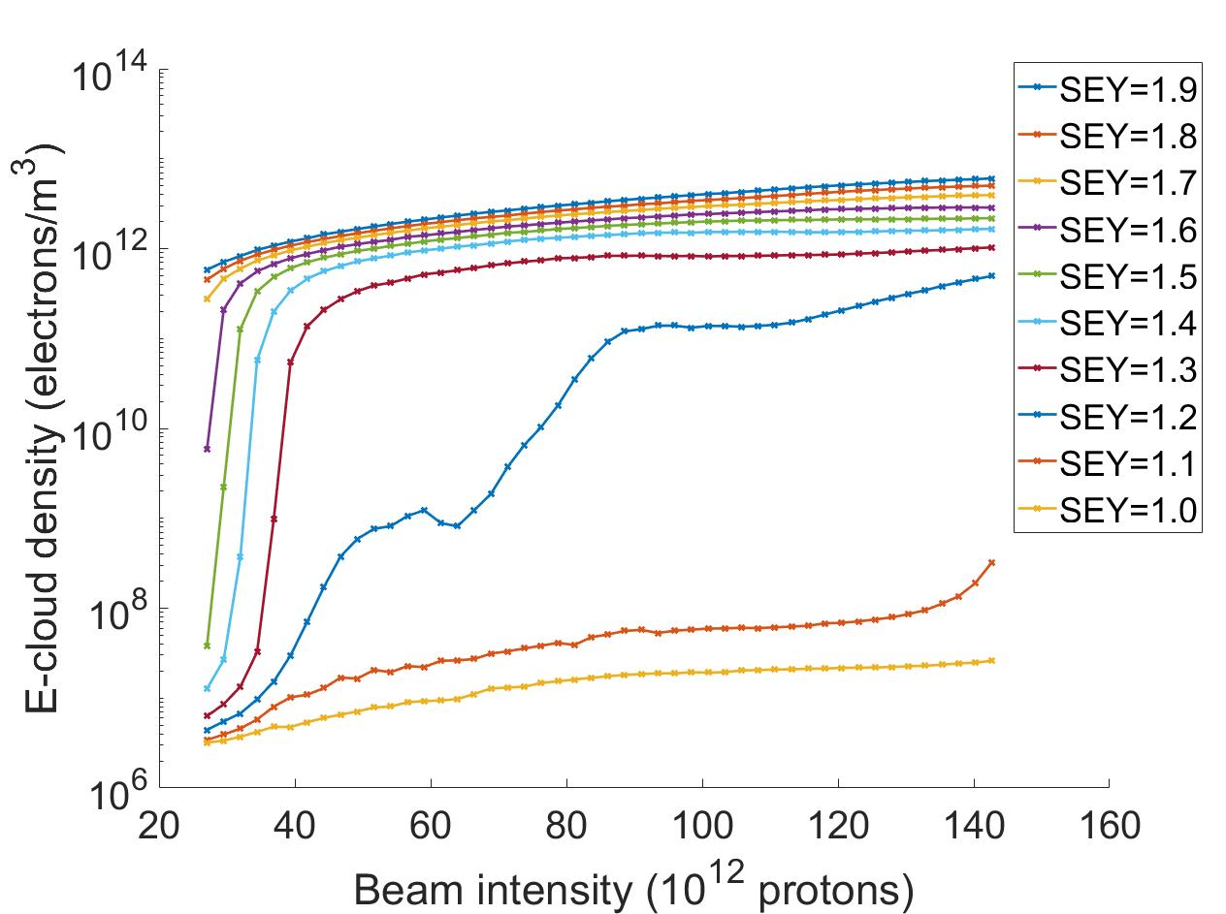
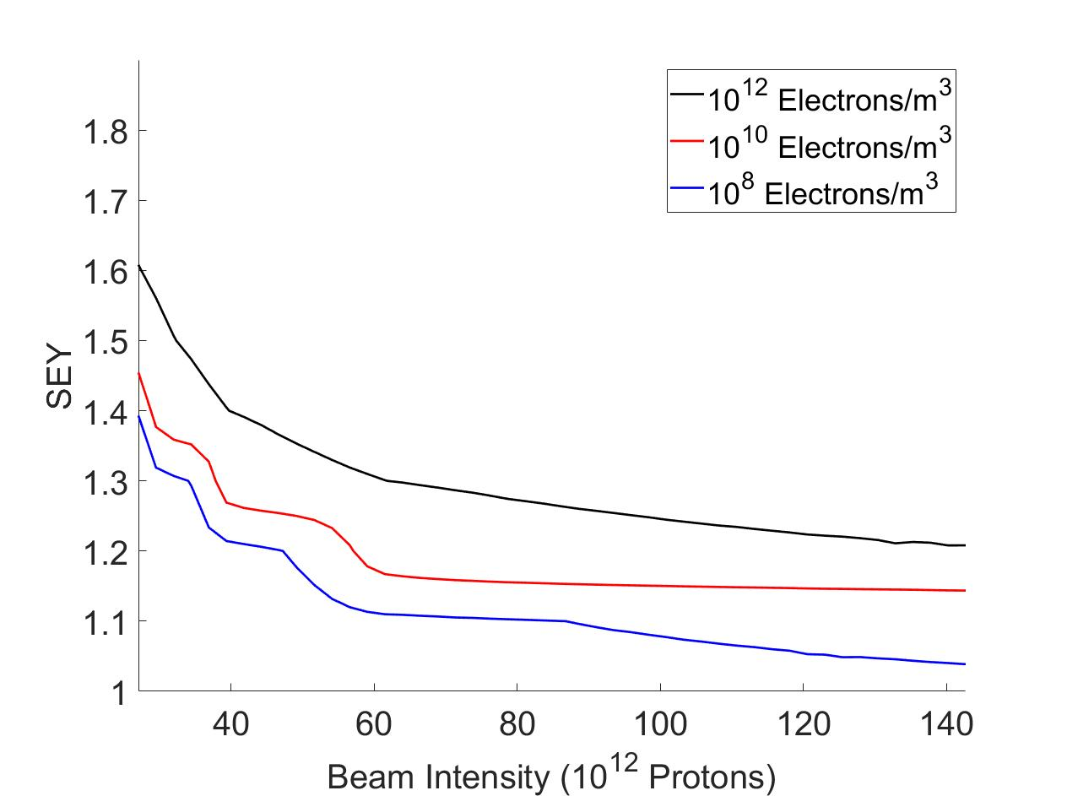
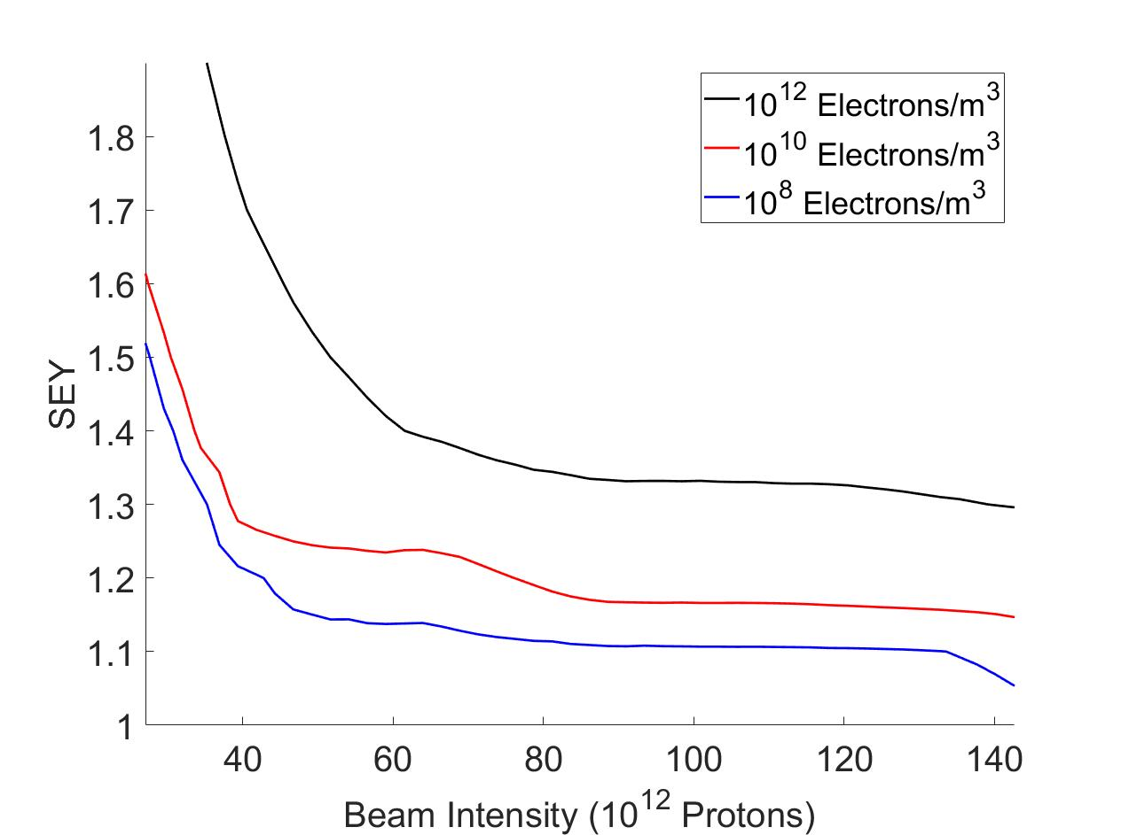
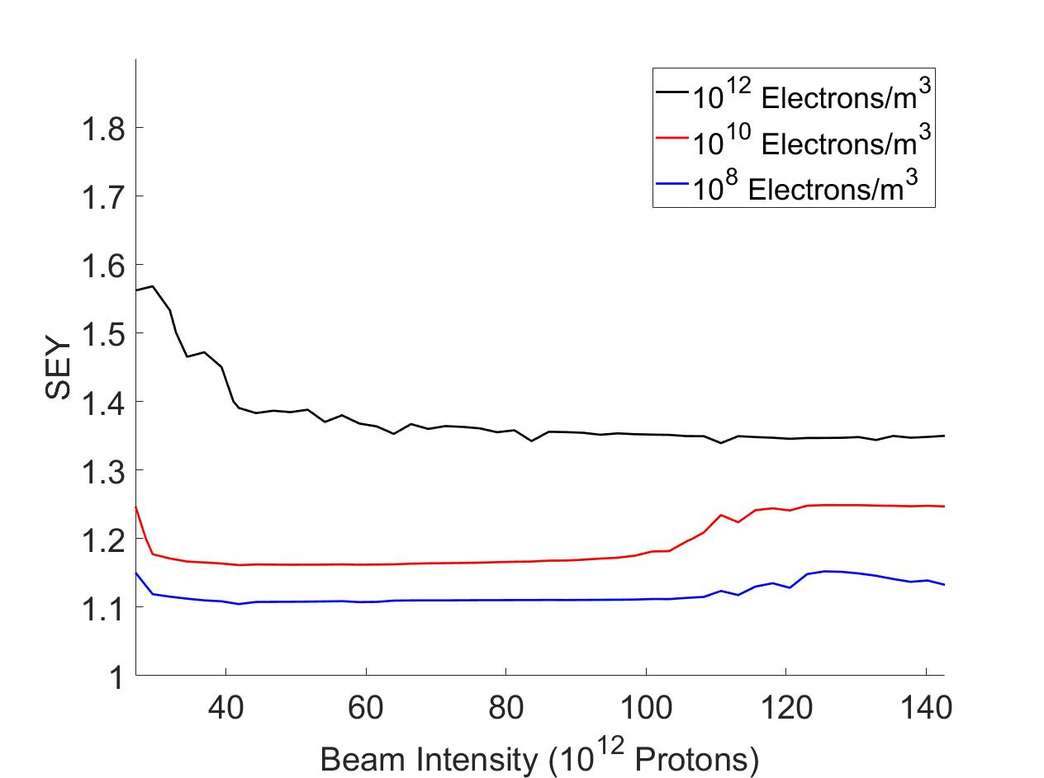
POSINST Simulation for MI with Different SEY and Beam Intensity
SEY and Intensity scan
E-cloud density SEY and Intensity threshold for MI
(10⁸, 10¹⁰, 10¹² electrons/m³)
Field Free region
Elliptical beam pipe
Dipole region
Elliptical beam pipe
Field Free region
Round beam pipe

Slide 21
Conclusion on The POSINST Simulation Results
 | Before PIP-I | PIP-I | Current upgrade | PIP-II
Beam power | 400 kW | 700 kW | 900kW | 1.2 MW
Beam intensity (protons) | 25×10¹² | 50×10¹² | 55×10¹² | 70×10¹²
Danger SEY threshold (10¹² electron/m³ in MI)
Elliptical beam pipe | 1.45 | 1.35 | 1.34 | 1.3
Dipole | 1.57 | 1.39 | 1.39 | 1.37
Round beam pipe | 1.89 | 1.51 | 1.5 | 1.4
Safe operational SEY threshold (10¹⁰ electron/m³ in MI)
Elliptical beam pipe | 1.35 | 1.24 | 1.24 | 1.17
Dipole | 1.25 | 1.17 | 1.17 | 1.17
Round beam pipe | 1.61 | 1.24 | 1.24 | 1.23
Field free region
Dipole region
Round beam pipe
RR instability happened at 10¹² E-cloud density.
10¹⁰ E-cloud density basically mitigates all E-cloud related problem

Slide 22
E-cloud measurement with RFA

Slide 23
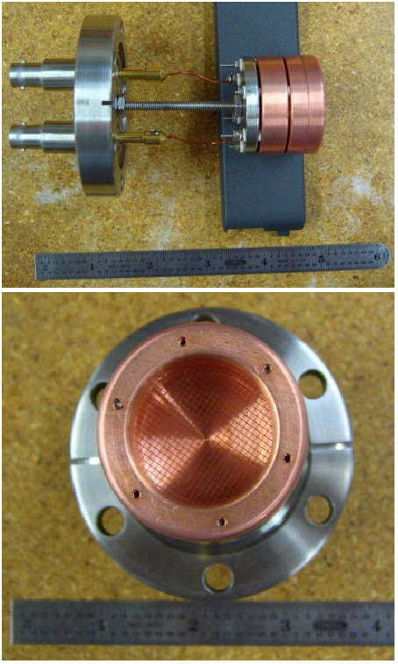
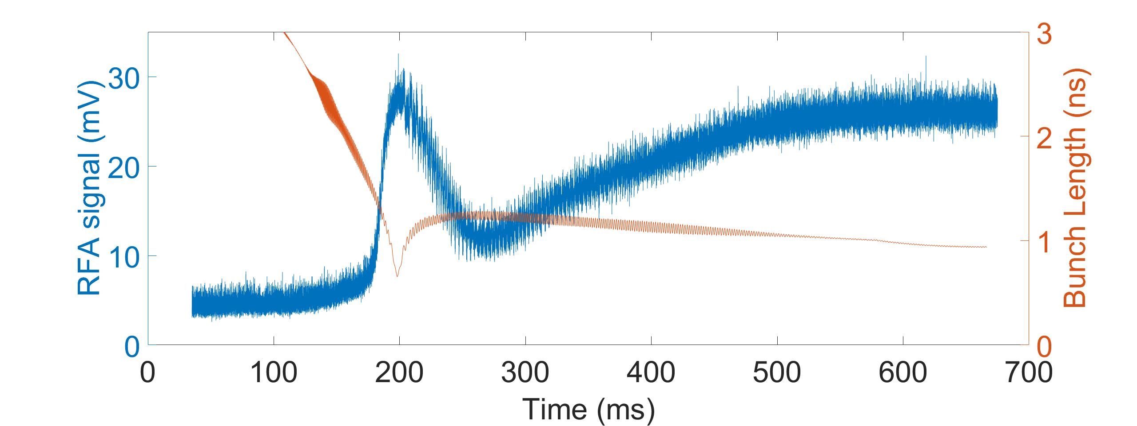
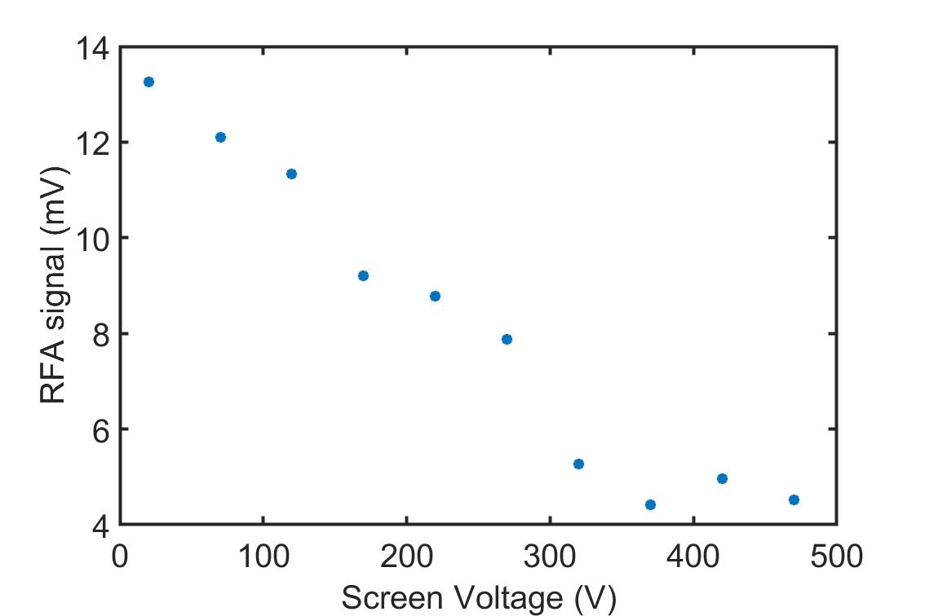
Retarded Field Analyzer (RFA)
RFA screen voltage measurement
A cup that collects incident electrons
Biased screen stops e⁻ from leaving the cup
The screen filters e⁻ below screen voltage
Signal below 5 mV are shadowed by ground level noise for RFA
RFA is installed at the SEY station
1mV convert to 1.87 μA/cm² (not fully calibrated)
  50Ω load
  30dB gain (~31 time signal increase )
  50% electron pass the hole on beam pipe
  90% cup capture efficiency
  Cup surface area roughly 0.82cm²

Slide 24
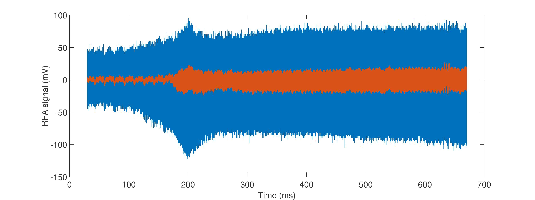
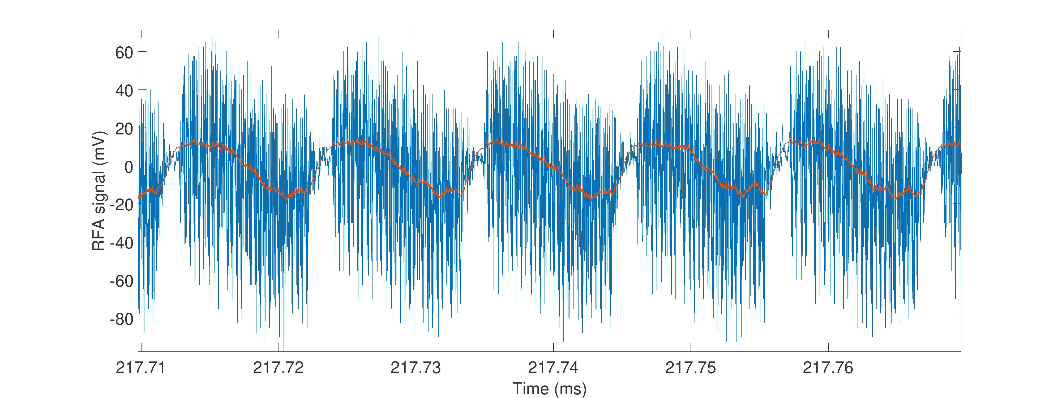
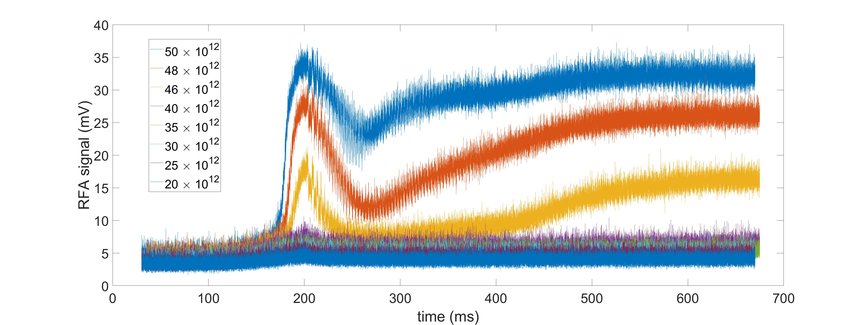
RFA Signal Processing Procedure
Signal covers 0.64s (acceleration is a bout 0.67s) with sample rate of 31.25Mhz
Monitor E-cloud build up on turn to turn time scale
Filter out the high frequency noise (31.25MHz to 500kHz)
Remove low frequency background by calculating E-cloud bombardment amplitude (Max-Min) for each turn
Result show E-cloud development over the acceleration cycle

Slide 25
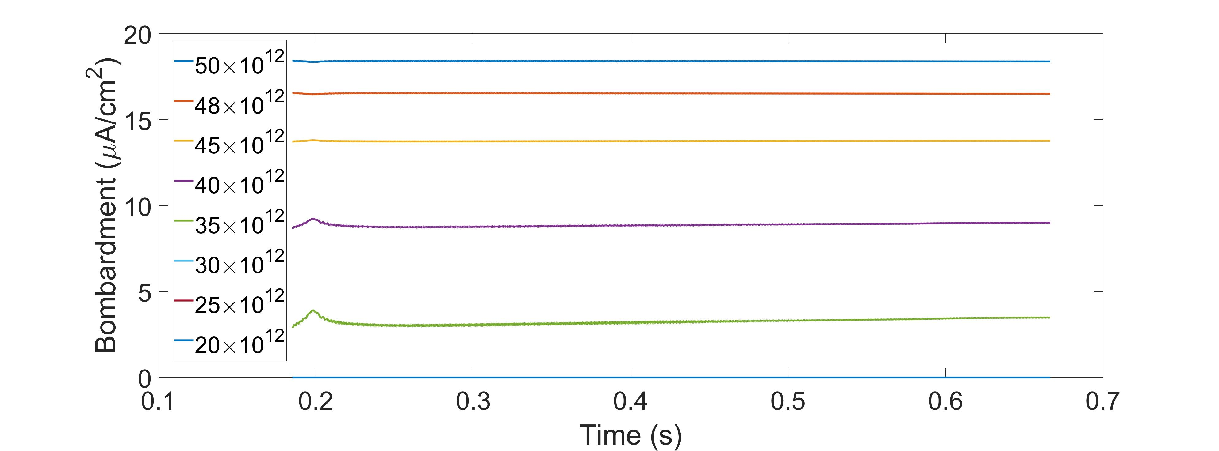
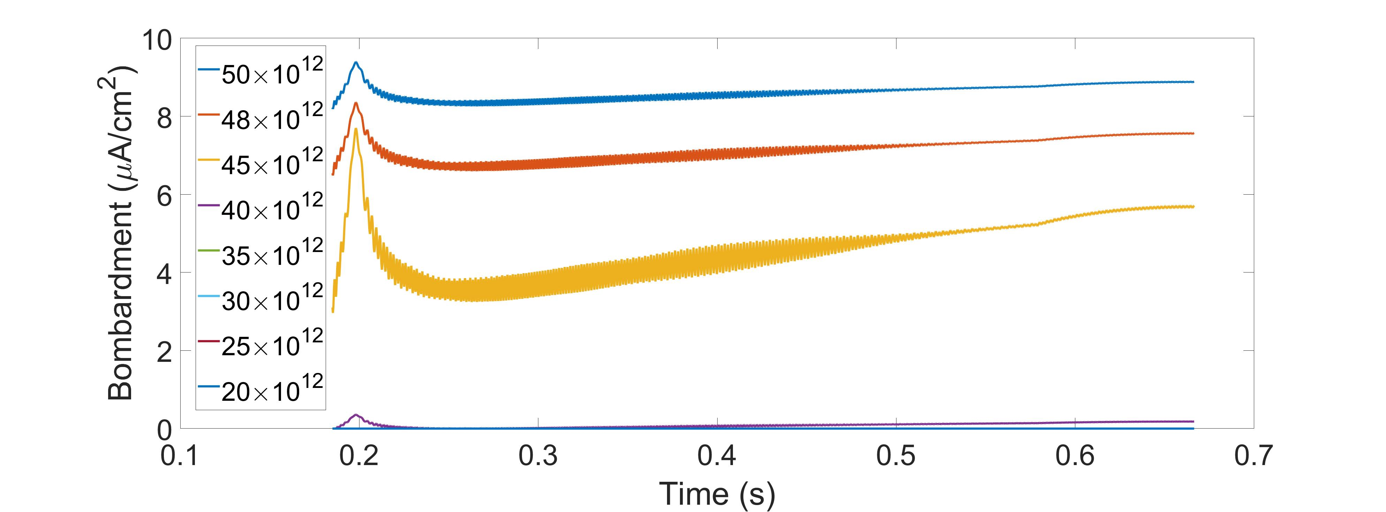
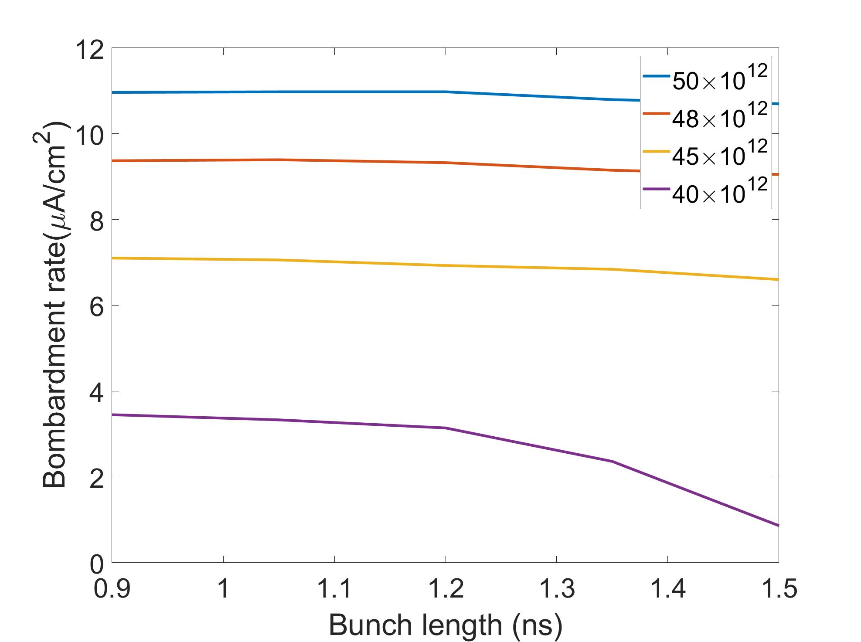
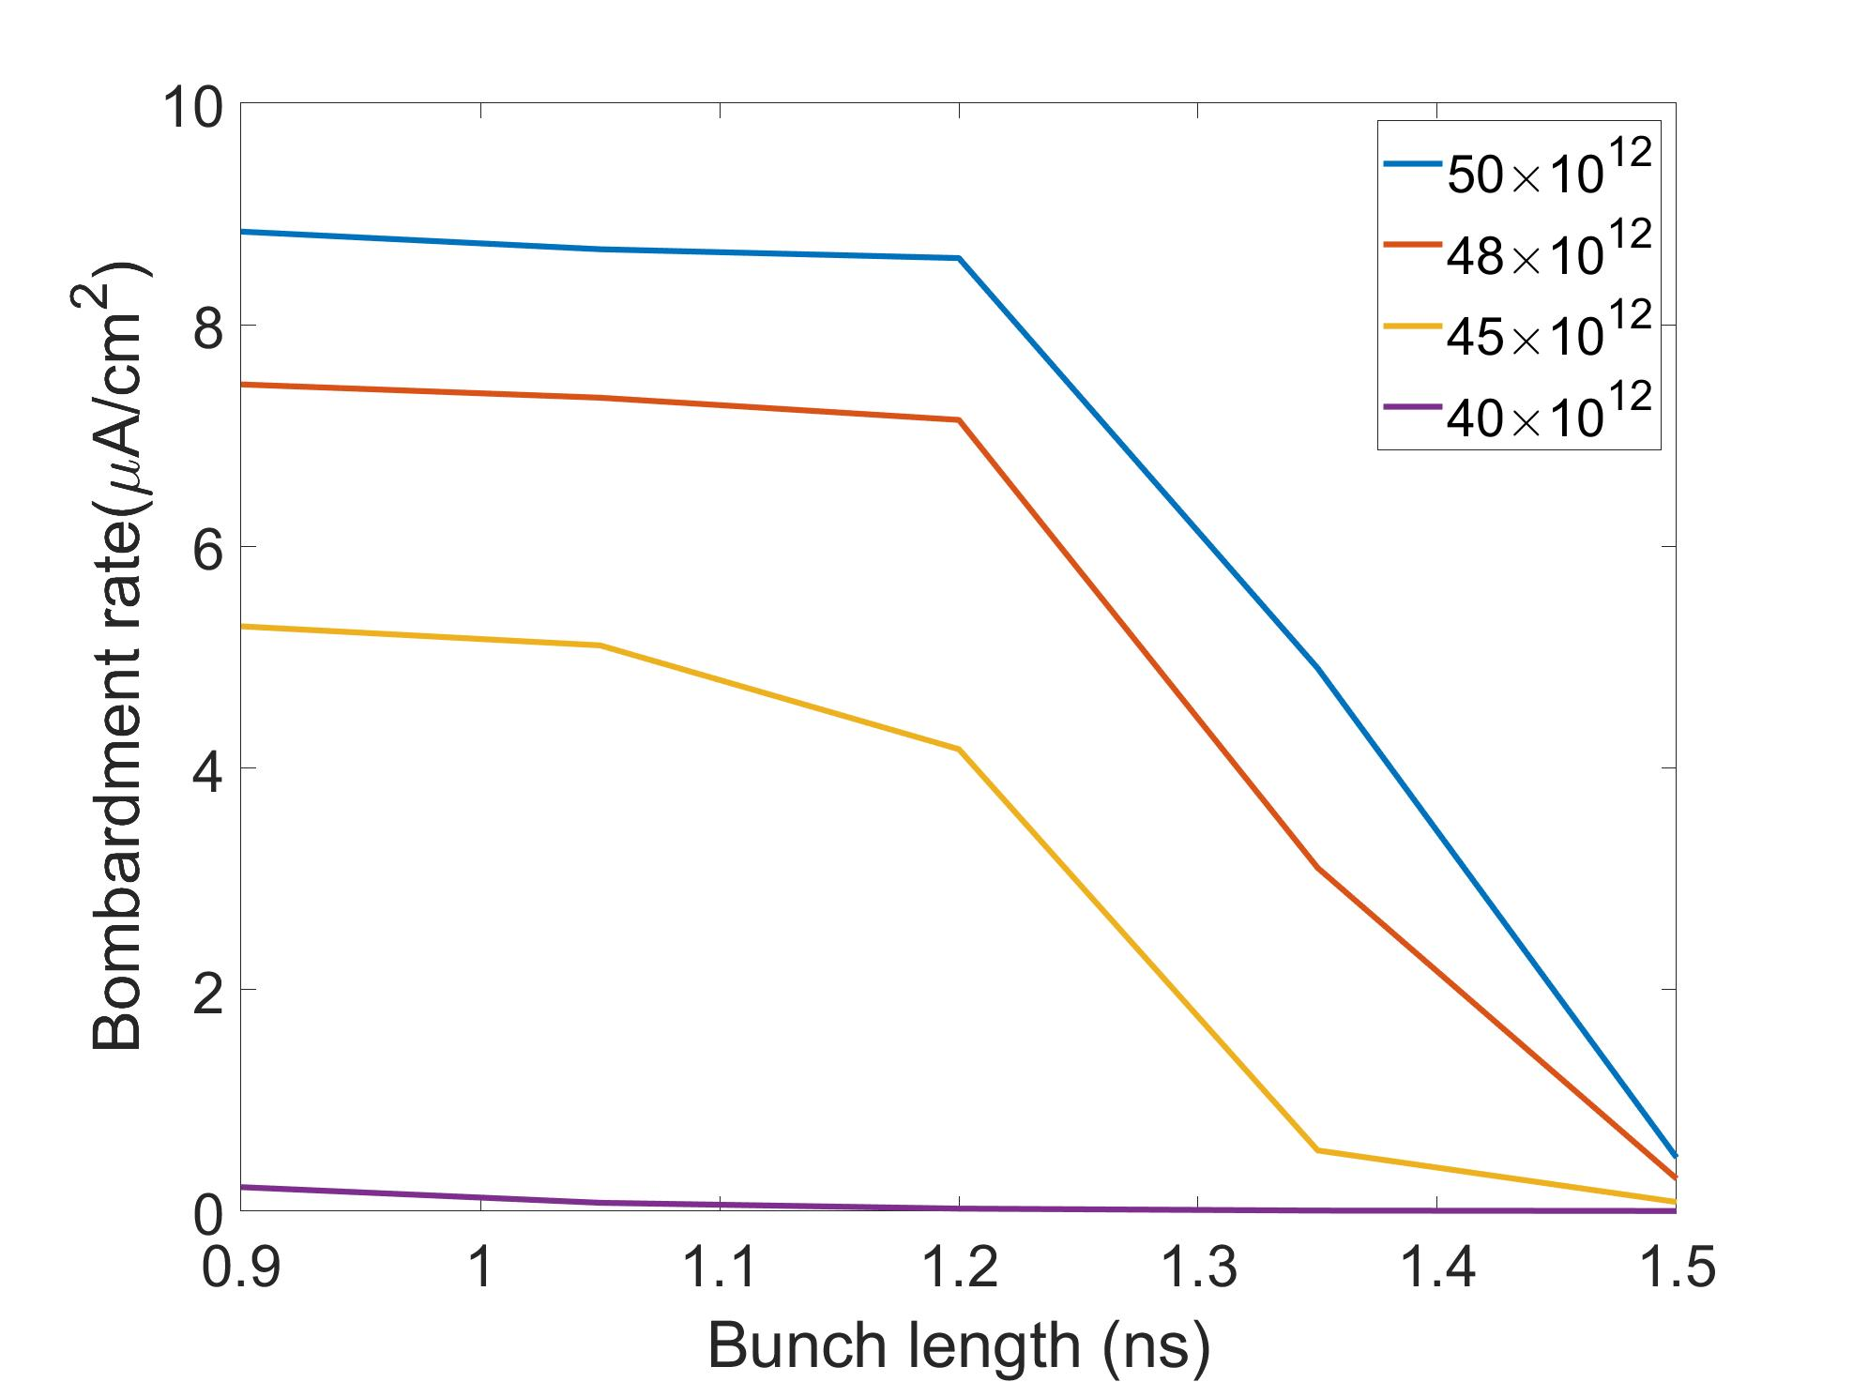
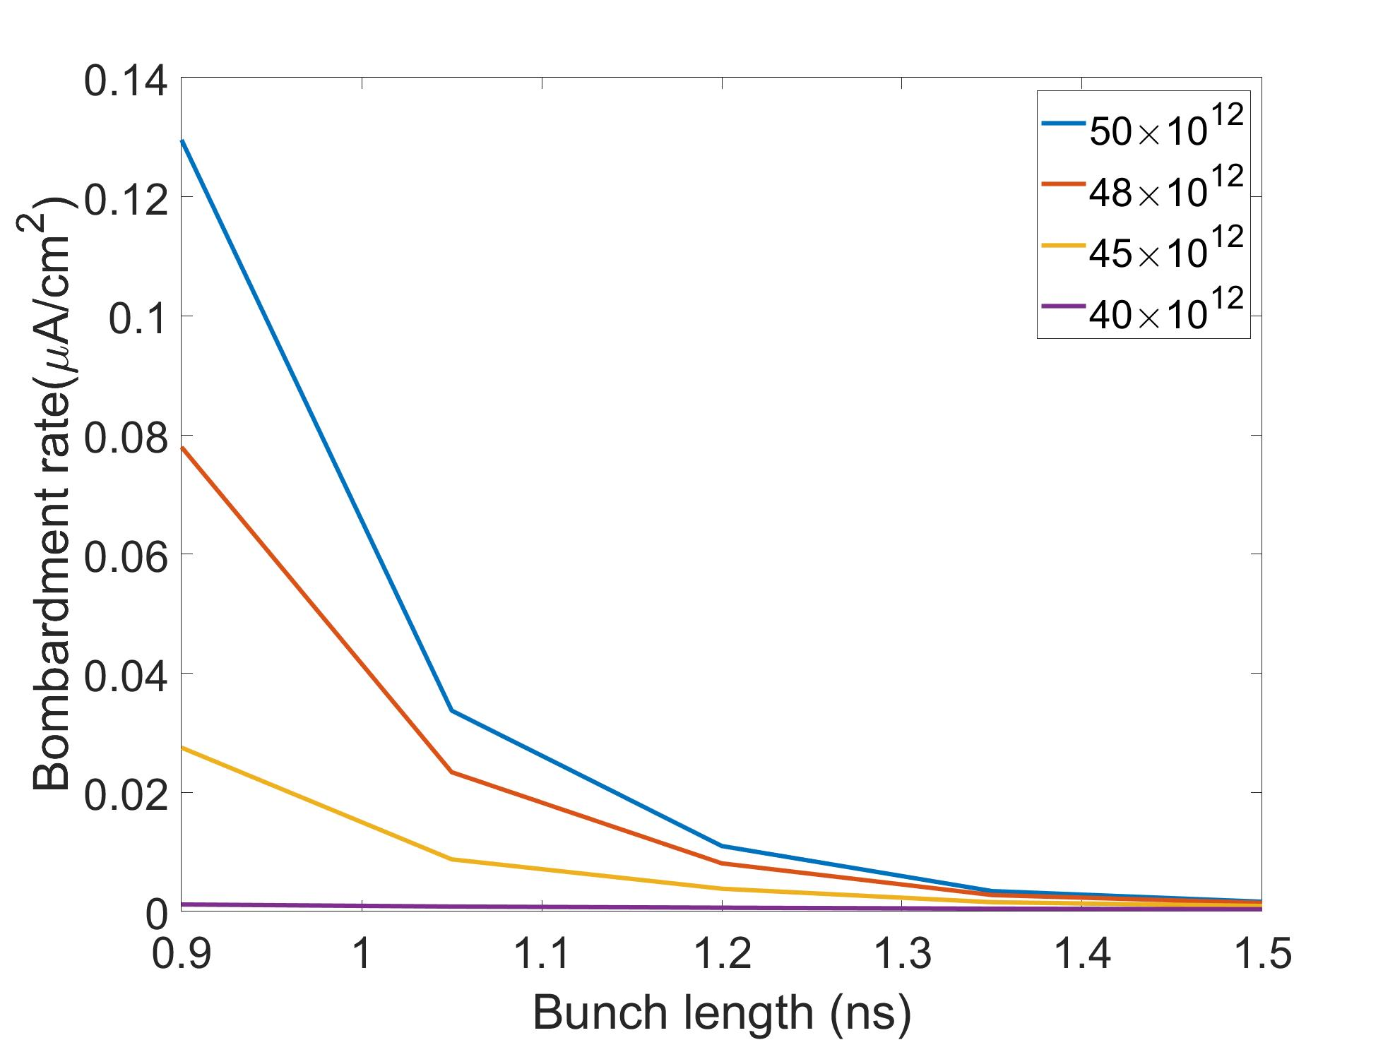
The RFA Trend Happens Because of Saturation Status Change
1.3 SEY
1.25 SEY
1.3 SEY
1.25 SEY
Only for 1.25 SEY show similar trend as the RFA measurements
The SEY measured on July 25th 2019 is 1.25, a month after the measurements
In order to reproduce the RFA trend, bombardment rate must drop drastically between 1 ns and 1.5 ns bunch length
RFA trend can be used to estimate SEY
1.2 SEY

Slide 26
Research Conclusion
 | Before PIP-I | PIP-I | Current upgrade | PIP-II
Beam power | 400 kW | 700 kW | 900kW | 1.2 MW
Beam intensity (protons) | 25×10¹² | 50×10¹² | 55×10¹² | 70×10¹²
SEY threshold danger of E-cloud problems (10¹² electron/m³)
 | 1.57 | 1.39 | 1.39 | 1.37
SEY threshold for safe operation (10¹⁰ electron/m³)
 | 1.25 | 1.17 | 1.17 | 1.17
 | TiN | A-Carbon | SS316L
Initial | 2.1 | 1.26 | 2.3
Final | 1.18 | 0.82 | 1.25
The SEY measurement gives the SEY development over the years of operation.
The POSINST code gives the SEY and intensity threshold
The RFA measurement confirms the POSINST code and gives a conditional limit
1.17 SEY is the safe operation threshold
TiN barely made the limit, A-Carbon will pass the limit
A-Carbon even show below 1 SEY
A-Carbon should be coated

Slide 27
Acknowledgement
Linda Spentzouris, Bob Zwaska, Rob Ainsworth, Jeff Eldred, Adam Watts, Michael Backfish, Phil Adamson, David Capista, Ming-Jen Yang, Kyle Hazelwood, Charles Ryan Montiel, Sergey Antipov, Yuri Alexahin, Cheng-Yang Tan, Duncan Scott Ten Shen,

Slide 28
Back up slides

Slide 29
SEY Data and The Furman-Pivi Model
Comparison between measured and simulated SEY (SS316L)
SEY model components: elastic, rediffused and true secondary electrons

Slide 30
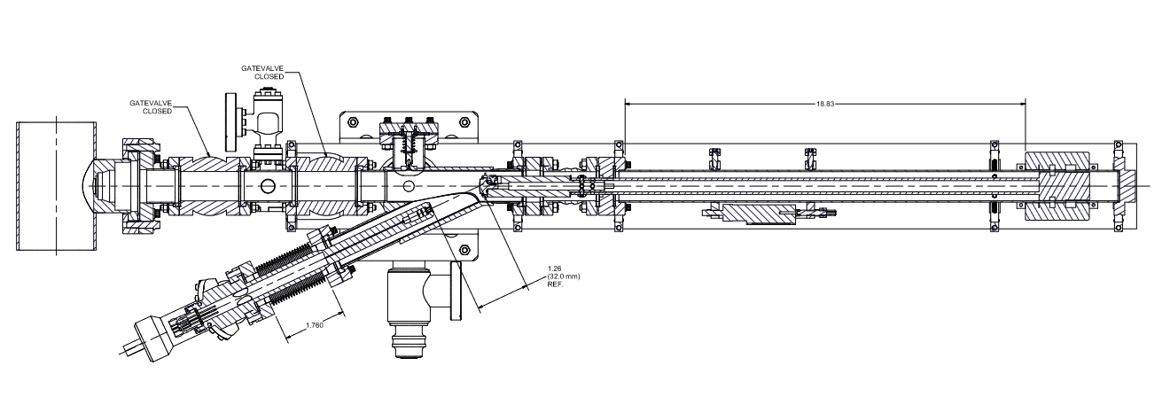
Leak Current: Largest Source of Error
grounded
Biased
Isolating ceramic
Electron gun
sample
Part of the arm is floating with bias voltage (the red box)
  Currents are measured from the biased arm
Leakage current variation introduce error
  Mitigated with Faraday box
Current leak through isolating ceramic (moisture) and isolating stands
  Nitrogen feeding system that dries the ceramic
  Avoid extra contact with the faraday box

Slide 31
How Much Error Does Leak Current Induce
Measurement error due to variation of leakage current
  Leakage current variation 10-200% of the primary current
Even with low absolute leakage current,
a large variation still causes a large error
The error depends on I_{p}, higher I_{p} could greatly reduce error
Example: consider the case of I_{p} = 1 nA
Δδ_{p} | 50pA | 100pA | 150pA
ΔSEY | 0.048 | 0.091 | 0.134
1.8SEY | 2.7% | 5.1% | 7.4%
1.3SEY | 3.7% | 7.0% | 10.3%
Δδ_{t} | 50pA | 100pA | 150pA
ΔSEY | 0.05 | 0.1 | 0.15
1.8SEY | 2.8% | 5.6% | 8.3%
1.3SEY | 3.9% | 7.7% | 11.5%

Slide 32
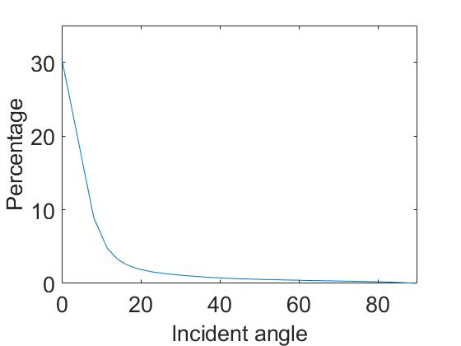
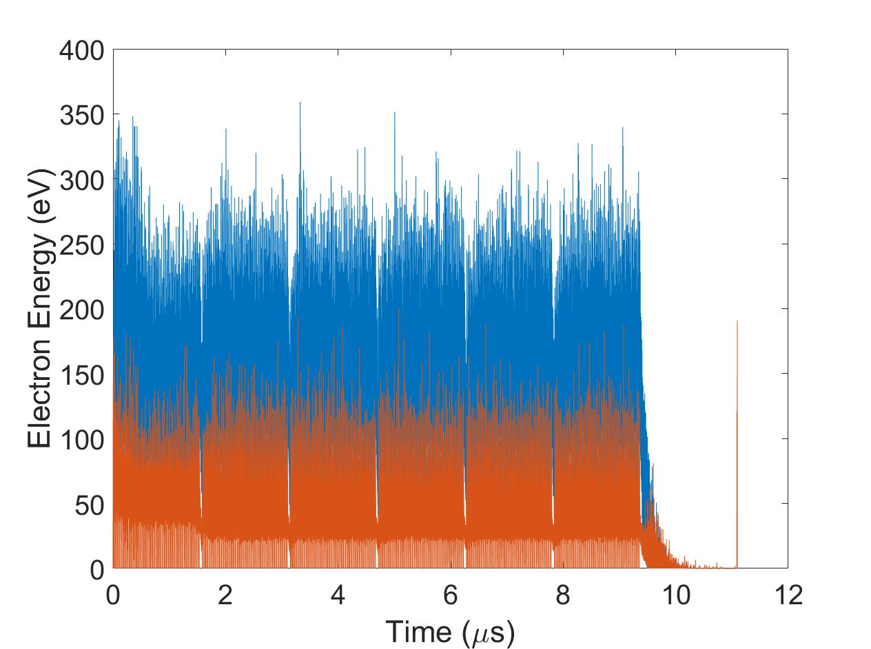
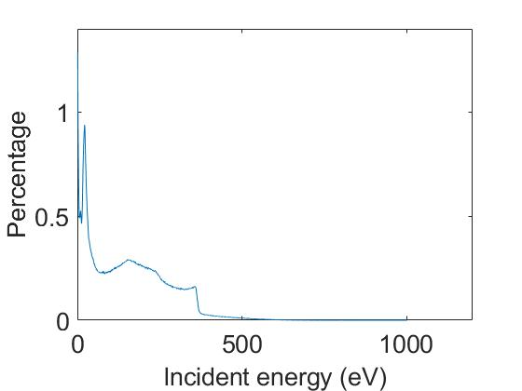
POSINST typical output for MI at 1.3 SEY 50e12 intensity field free region
Bombardment rate
Power deposition rate
Incident angle histogram
Average/maximum Electron energy
Average/maximum wall-collision energy
Incident energy histogram
Average electron energy decreases after saturation is reached
Bombardment rate follow the same trend as E-cloud density

Slide 33
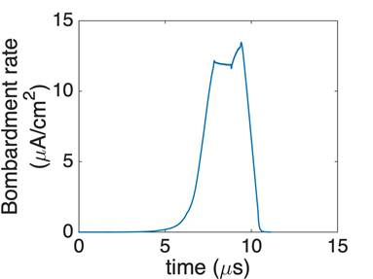
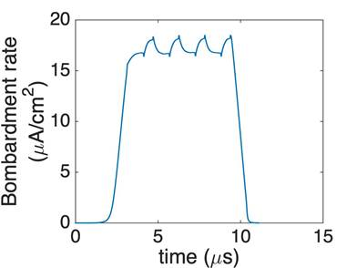
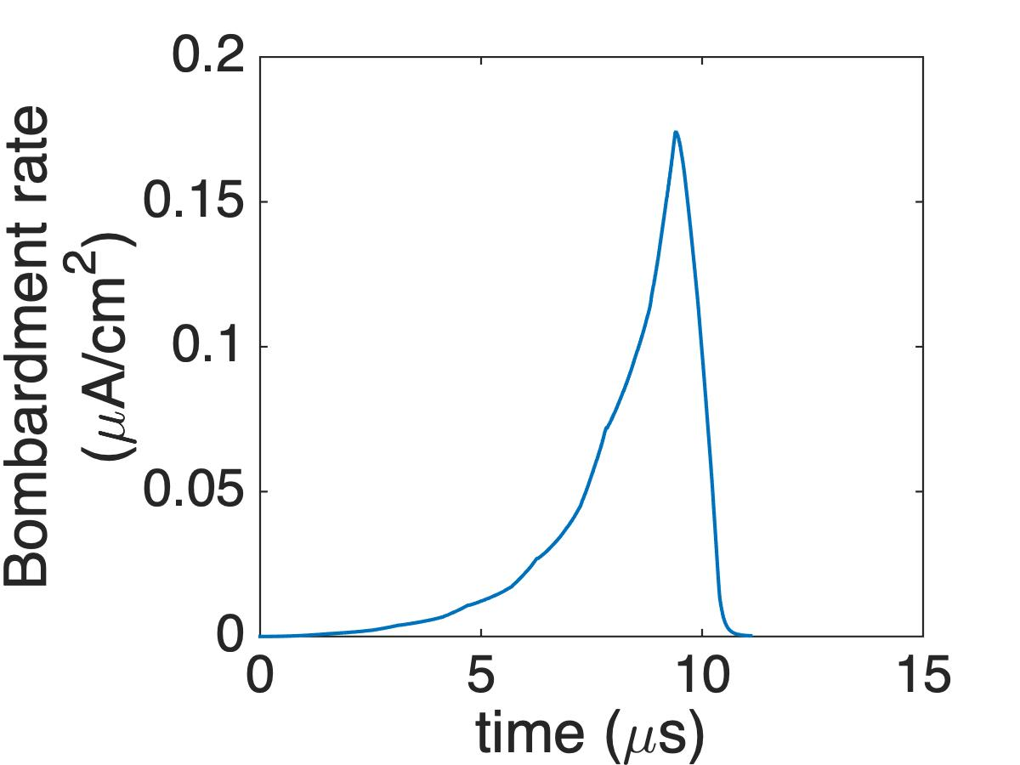

The saturation status difference
The RFA trend happen because of the saturation status
bombardment rate can change up to 5 orders of magnitude between saturation and non-saturation
Saturation Case:
peak bombardment rate is saturated bombardment rate
and bombardment rate is decided by beam intensity and SEY
Build-up Case (no saturation):
Peak bombardment rate is the tip of the saber tooth build up
bombardment rate are very sensitive to all parameters
Non-build up:
Peak bombardment rate dependent on the primary electron counts
In order for the RFA trend to happen, E-cloud have to shift from non-saturation to saturation in the 1 ns to 1.5 ns bunch length range
Slow Saturation
Fast Saturation
Non-Saturation/build up
Non-Build up

Slide 34






RFA signal recreated based on simulation results
Mean to valley
Peak to valley
SEY
1.25
Feed Bunch length data to the POSINST
Bombardment rate data is generated based on POSINST
Only for 1.25 SEY show similar trend as the RFA measurements
The SEY measured on July 25th 2019 is 1.25, a month after the measurements
The bunch length cause noticeable bombardment rate change over the acceleration cycle
Bunch length vary between 1 ns and 1.5 ns after transition
SEY
1.3
SEY
1.35
SEY
1.4

Slide 35

Numerical conversion factor between simulation and RFA signal
50e12 beam intensity
Conversion factor based on circuitry:
1 mV = 1.87 μA/cm²
Conversion factor based on direct comparison at transition bunch length:
1 mV = 0.25 μA/cm²
The simulated bombardment rate is about 7 times smaller than the RFA measurements
Based on the two conversion factor, the 5 mV ground noise level of RFA is :
9.45 μA/cm² based on 1 mV = 1.87 μA/cm²
1.25 μA/cm² based on 1 mV = 0.25 μA/cm²
48e12 beam intensity
45e12 beam intensity

Slide 36





E-cloud bombardment rate dependency on bunch length in range 1 ns to 1.5 ns 50e12, 48e12, 45e12 and 40e12 beam intensity
1.15 SEY
1.175 SEY
1.2 SEY
1.125 SEY
1.225 SEY
1.25 SEY
1.275 SEY
1.3 SEY
E-cloud bombardment is strong enough and show the drop only in 1.225 and 1.25 SEY
POSINST simulation result show basic agreement with RFA measurement

Slide 37

Determine the RFA ground level noise, screen voltage study at the end of acceleration cycle
RFA screen voltage measurement
POSINST wall collision energy distribution
The screen voltage screen out electrons below certain wall collision energy
The simulation and the measurement are one-to-one comparable
Signal below 5 mV are shadowed by ground level noise for RFA

Slide 38


R_{1.43}/R_{0.9} POSINST SEY and beam intensity scan up to PIP-II intensity
Peak to valley
Mean to valley
The R_{1.43}/R_{0.9} from RFA measurement is between 40% to 60% (the yellow and red region in the plot)
The conditioning limit can be estimated up to PIP-II intensity

Slide 39
Screening effect on Electron energy

