Slide 1
Half-Integer Compensation Studies Jan. 22 Study Results
J. Eldred, Y. Alexahin, J. Johnstone, V. Kapin, C.Y. Tan,
Proton Source & Task Force Meeting
Feb. 13, 2020

Slide 2
2
2
Dec. 11 Study (Previous)
Change Qy to 0.54, near vertical half-integer resonance.
- tune-change only for the early part of the cycle.
Vary quad-long offsets in two groups:
Group A: -QL24, +QL01, -QL02, +QL12, -QL13, +QL14
Group B: -QL06, +QL07, -QL08, +QL18, -QL19, +QL20
Scan the two groups of quad-longs to find the best efficiency.
- B:CHGA at 4ms used to measure efficiency.
Measured TBT data at 5 different values of A & B quad-long groups.
Perform 2D Tunescan with and without change to quad-offsets.
See Elog entry: 164410,
See PSP talk: beams-doc-7905
2
Jeffrey Eldred | Dec 11 Half-Integer Study
Notes:
2
2
2
2
2
2

Slide 3
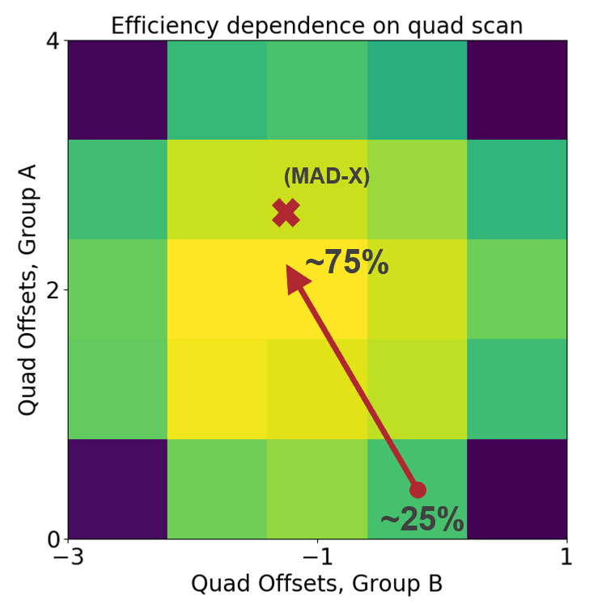
3
Dec. 11 Half-Integer Compensation (Previous)
3
Jeffrey Eldred | Lattice Meeting
Notes:
3
3
3

Slide 4
4
4
Jan. 22 Study Plan
Nominal tunes, 4.7e12 -> 4.4e12 intensity, ~93% efficiency.
- Operational quad-long offsets from Dec. 11 were used.
Scan the two groups of quad-longs to find the best efficiency.
- B:CHGA at 4ms used to measure efficiency.
IPMs emittance measurements were made concurrently.
B:BLMS06 at 10 ms and B:BLM026 at 33 ms were also measured.
Wasn’t able to get $17 multiwires data:
- B:WVD8S reporting values, uncertain relation to profile.
- I didn’t use correct timing to log B:WVD8S.
Took TBT measurements at 13 different values of A & B quad-long groups.
See Elog entry: 167325
4
Jeffrey Eldred | Dec 11 Half-Integer Study
Notes:
4
4
4
4
4
4

Slide 5
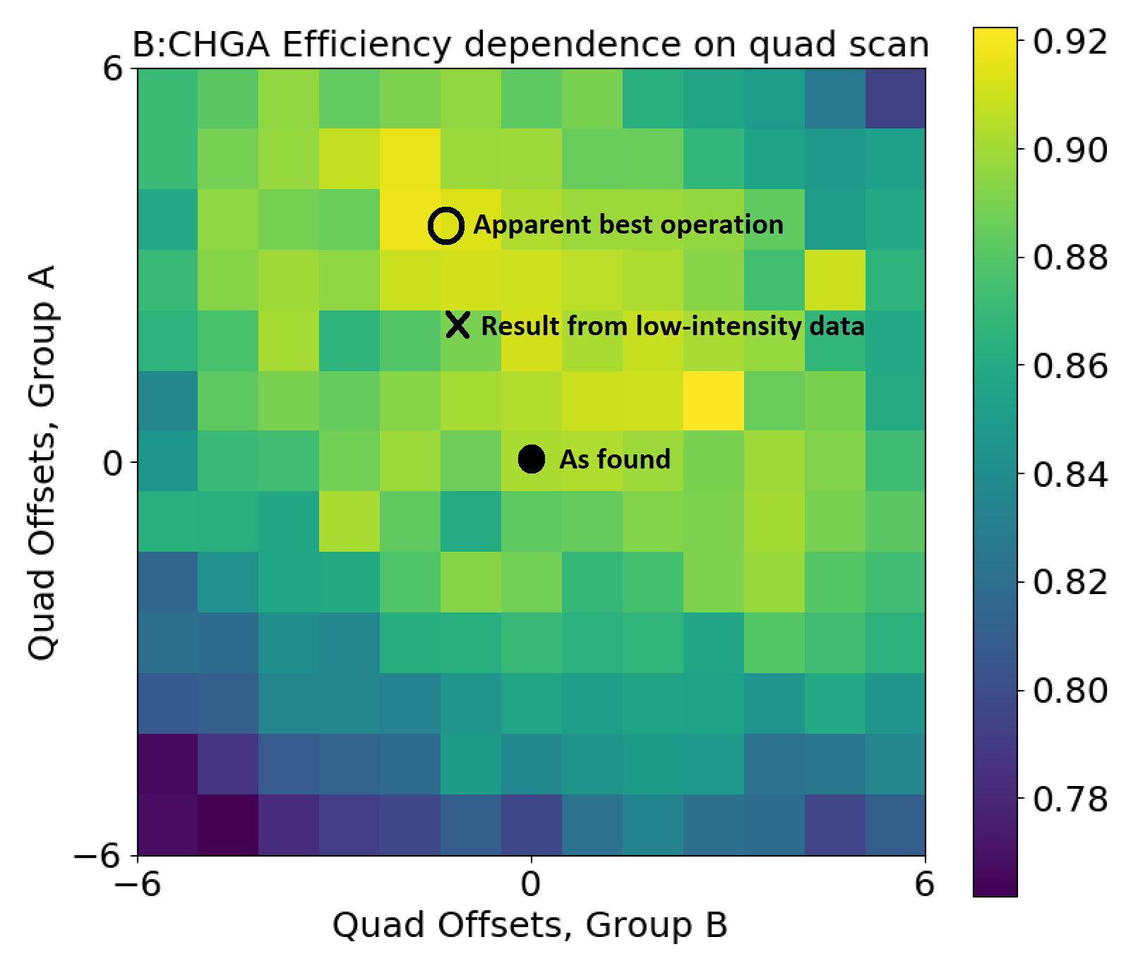
5
Jan. 22 Half-Integer Compensation
5
Jeffrey Eldred | Lattice Meeting
Notes:
5
5
5

Slide 6
6
Jan. 22 Half-Integer Compensation
The quad-scan shows a clear improvement from 90 – 92%!
Except remember operational was ~93%
-because we started from outdated quad-long offsets.
-also we used a different efficiency calculation.
Encouragingly, best efficiency is somewhat near prediction.
However, the efficiency is not round like the previous study:
-losses from quad-scan are distorted by other effects.
6
Jeffrey Eldred | Lattice Meeting
Notes:
6
6
6

Slide 7
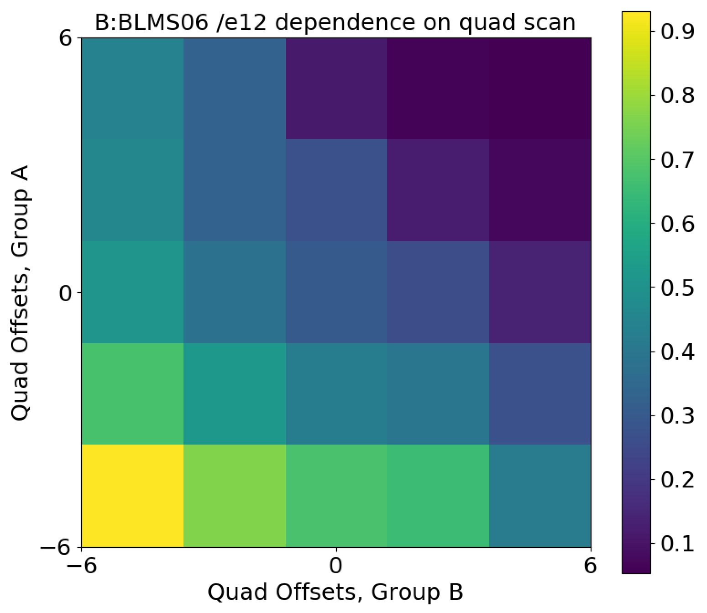
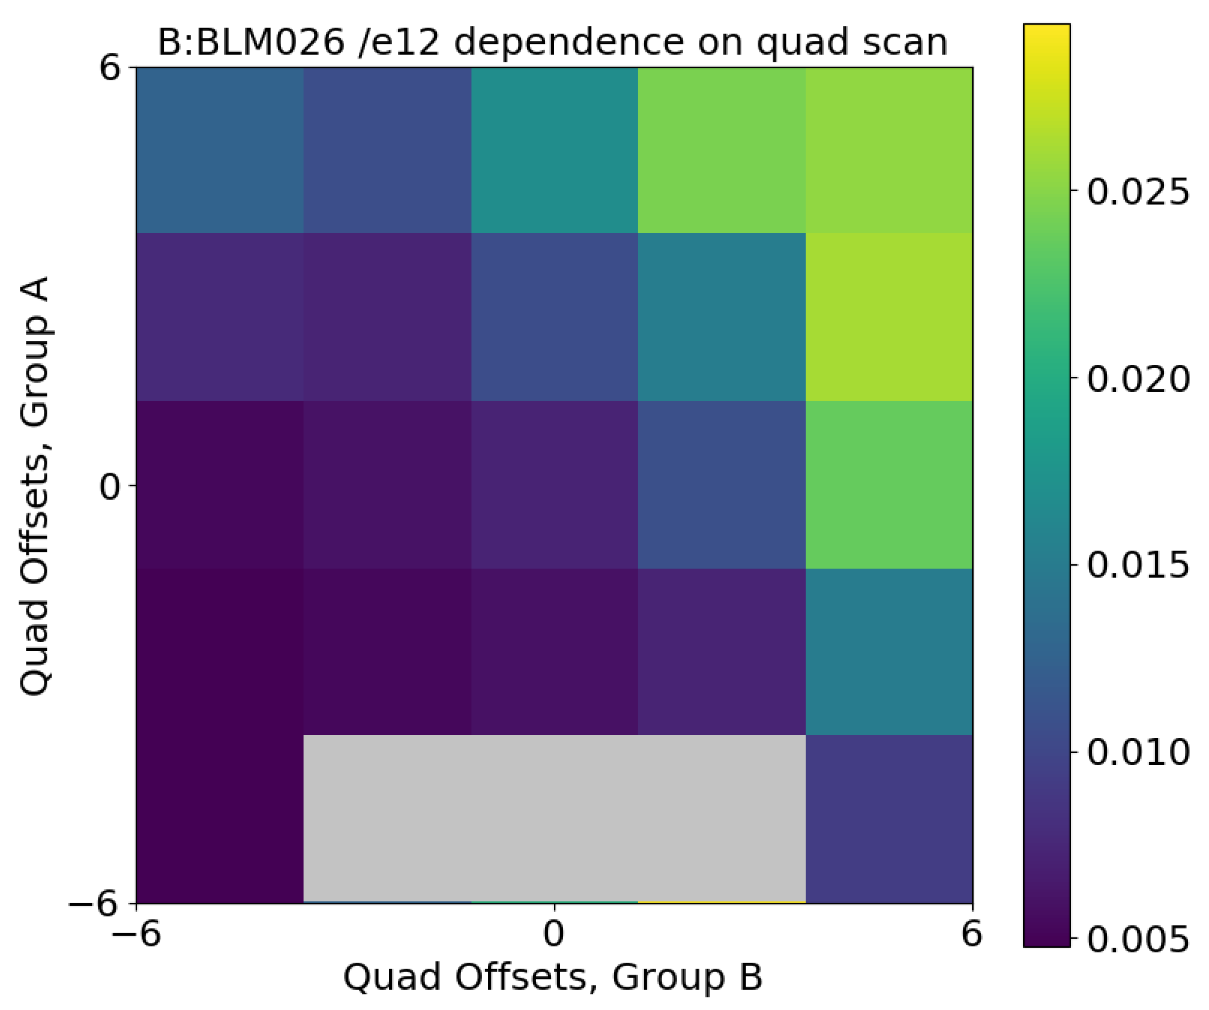
7
Beam-loss Monitors
B:BLMS06 /e12 at 10ms B:BLM012 /e12 at 33ms
The quad long groups also have a strong effect on the loss profile.
We may have to iterate 2Qy with the usual loss profile tuning.
7
Jeffrey Eldred | Lattice Meeting
Notes:
7
7
7

Slide 8
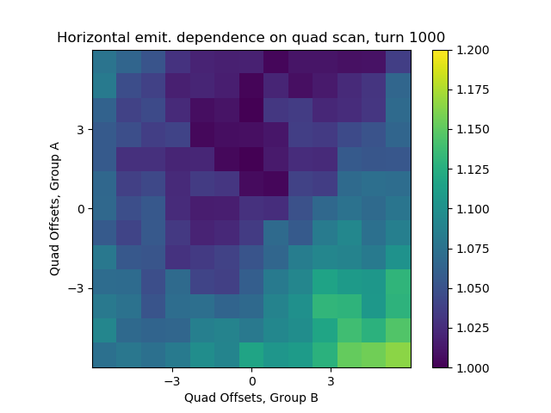
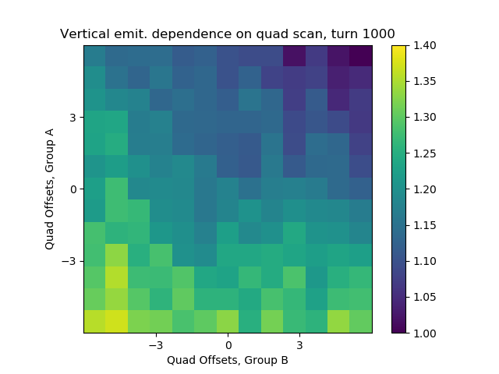
8
IPM Measurements – turn 1000
Horz., turn 1000 Vert., turn 1000
8
Jeffrey Eldred | Lattice Meeting
Notes:
8
8
8

Slide 9
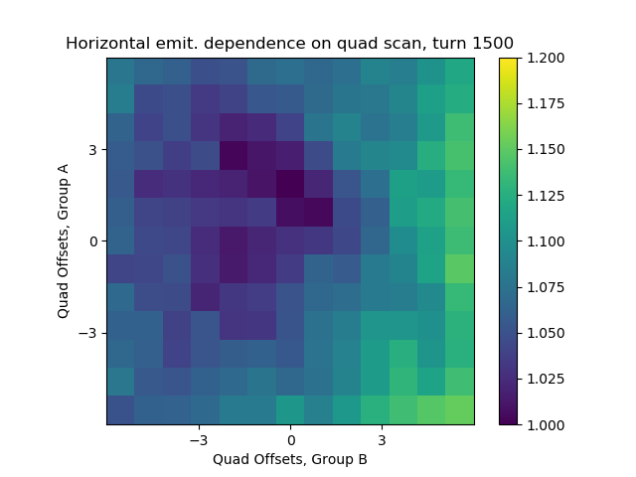
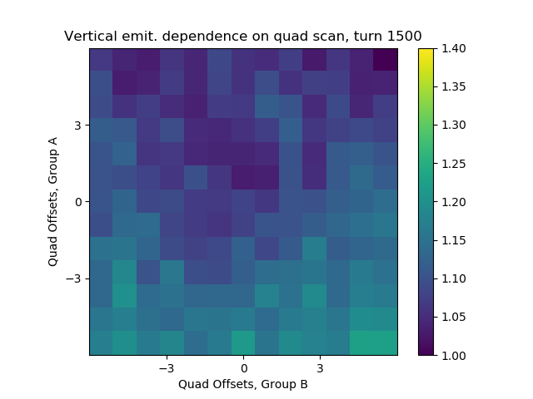
9
IPM Measurements – turn 1500
Horz., turn 1500 Vert., turn 1500
9
Jeffrey Eldred | Lattice Meeting
Notes:
9
9
9

Slide 10
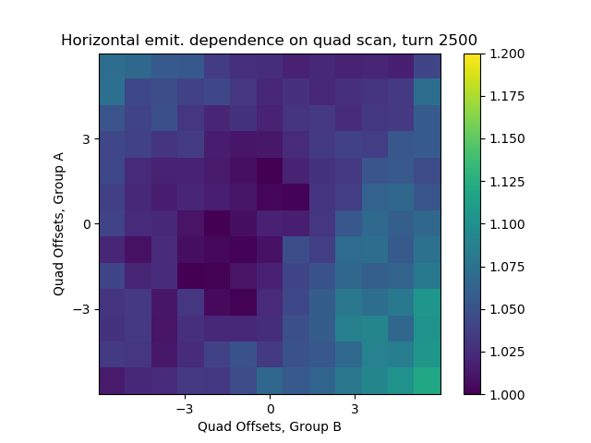
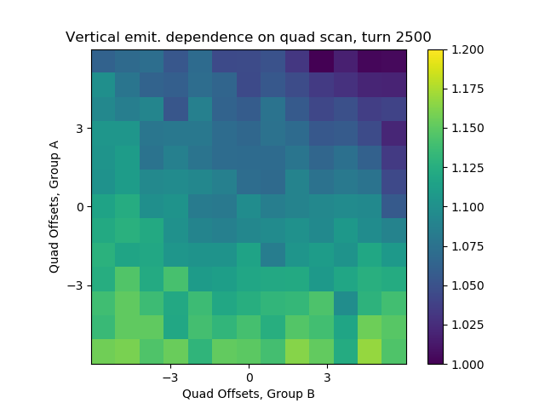
10
IPM Measurements – turn 2500
Horz., turn 2500 Vert., turn 2500
10
Jeffrey Eldred | Lattice Meeting
Notes:
10
10
10

Slide 11
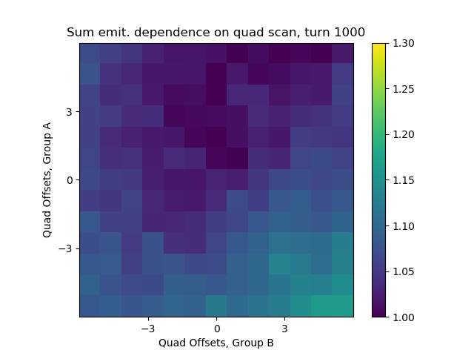
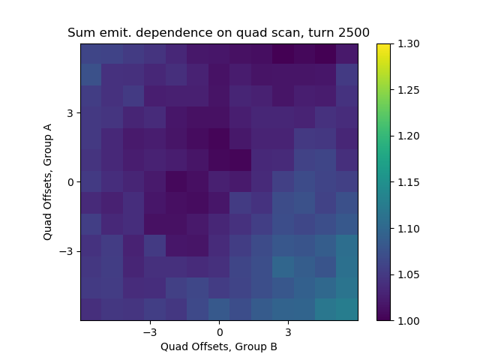
11
IPM Measurements – Horz + Vert
Sum, turn 1000 Sum, turn 2500
11
Jeffrey Eldred | Lattice Meeting
Notes:
11
11
11

Slide 12
12
12
IPM Measurements
Horz & Vert sigmas calculated from IPM data, divided by MAD-X model for beta function, squared, then normalized to lowest value.
Horz data data shows local minimum where we had best efficiency
- About 15-20% variation across the horizontal emittance.
- turn 1500 seems to have a weird edge.
Vert data shows a gradient with 20-35% variation.
- we expected the vertical data would show the minimum.
Emittance improvement consistent with efficiency improvement:
- but not a simple story for vertical half-integer
- is it the impact we have on the horizontal half-integer?
12
Jeffrey Eldred | Dec 11 Half-Integer Study
Notes:
12
12
12
12
12
12

Slide 13
13
13
Summary / Next Study
The half-integer compensation shows potential as an operational knob:
- efficiency improved from 90% -> 92%, but not operational improve.
- significant impact on loss profile.
- worse case scenario we could blindly tune the knob.
- best case scenario it will be purposeful, but still have to be tuned up.
- We want to demonstrate what it’s doing before tuning around it.
Emittance picture could also be clearer. Try again with:
- higher intensity.
- horizontal half-integer compensation.
- multiwire data.
Yuri Alexahin has a method of calculated resonance-driving terms from the turn-by-turn data, but we weren’t able to get complete BPM data.
13
Jeffrey Eldred | Dec 11 Half-Integer Study
Notes:
13
13
13
13
13
13

