Slide 1
Status of the flat Injection beam studies
Kiyomi Seiya, Chandra Bhat ,Howie Pfeffer
FI meeting
02 26 2020

Slide 2
Booster injection field
15Hz operation
PIP-II 20Hz operation
Injection: ~ 40 μsec
Capture: ~200 μsec
Orbit excursion: 2 mm
Injection: ~ 600 μsec
Orbit excursion : 5 mm
*GMPS current amplitude jitter is ~ 50 mA from cycle to cycle
*B field has to be flat and constant.

Slide 3
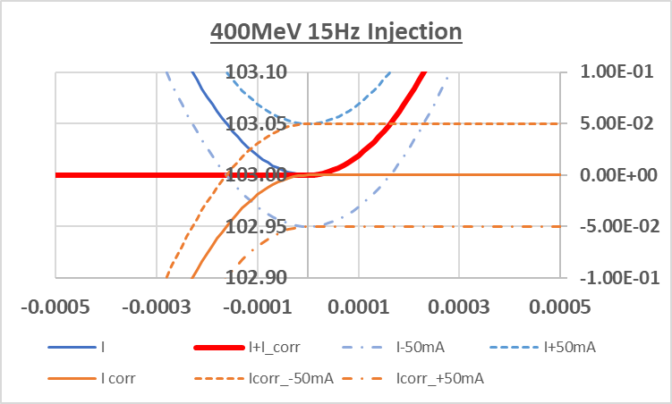
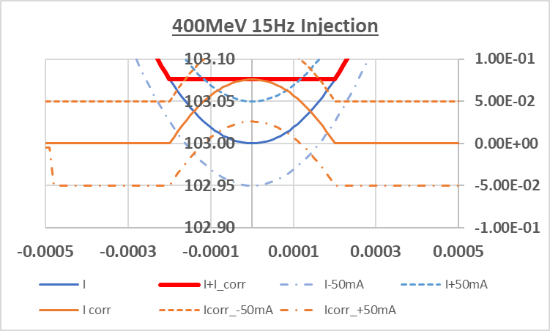
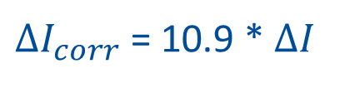
Flatting injection field at 400MeV 15Hz injection
Asymmetric compensation
Symmetric compensation
$∆I_{corr}$ = 10.9 * $∆I$
*The required maximum current is 0.83[A] and the maximum slew rate is 3.00 [Tm/s] which is less than the maximum slew rate 3.24[Tm/s] of the present system.

Slide 4
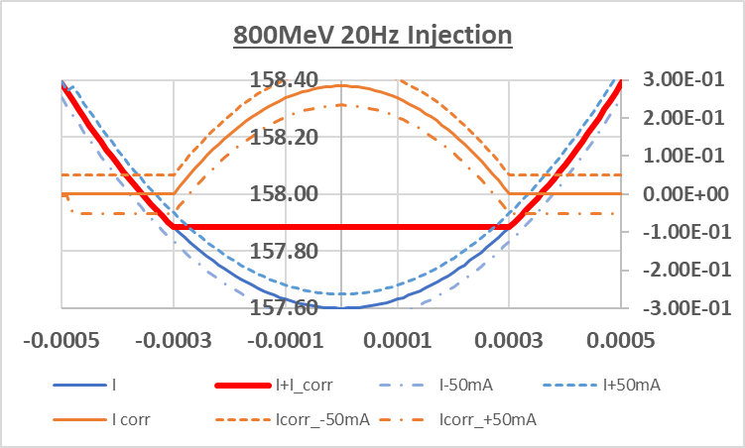

Flatting injection field at 800MeV 20Hz injection
$∆I_{corr}$ = 10.9 * $∆I$
* GMPS amplitude jitter, +/-50 mA, causes < 1mm orbit difference
* The required maximum current is 3.12[A] and the maximum slew rate is 7.55 [Tm/s] which is more than times higher than the maximum slew rate 3.24[Tm/s] of the present system.
* Required flatness depends on injection parameters from Linac.

Slide 5
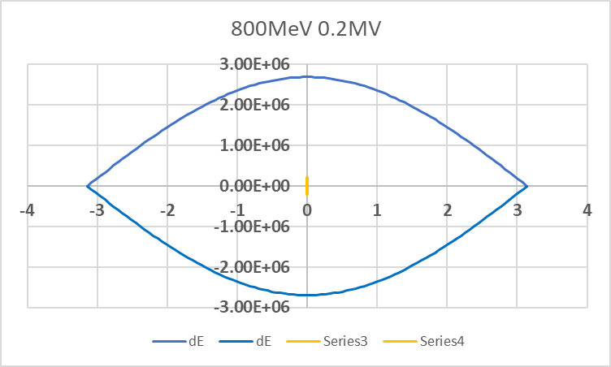
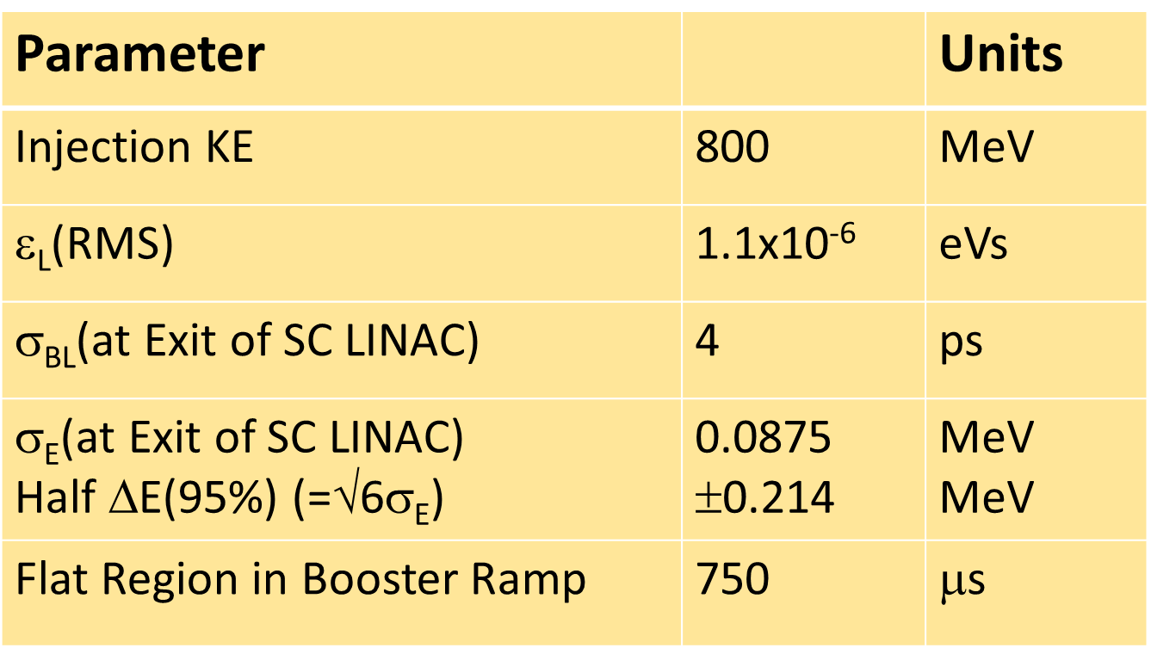
800MeV 0.2MV bucket with flat field
6.2mm
-6.2mm
*We have to know
dp/p from Linac
Injection bunch pattern
Transverse aperture

Slide 6
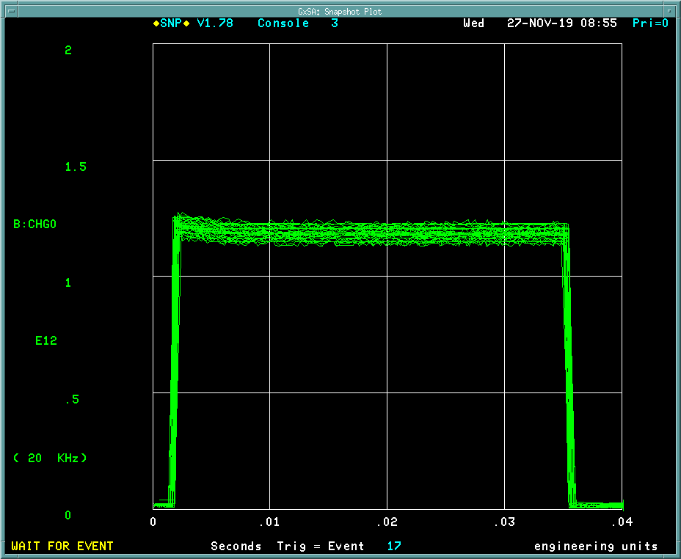
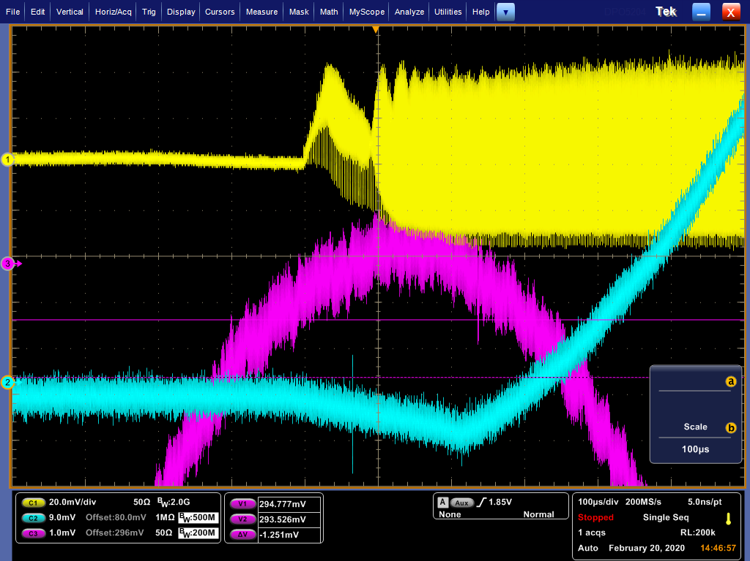
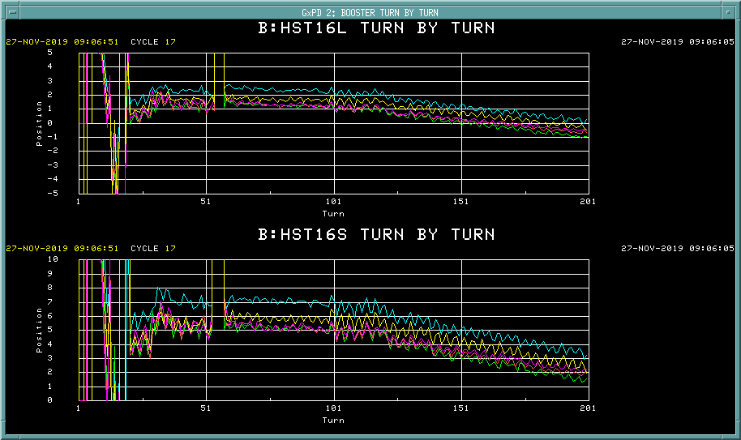
Beam orbit at injection
200usec /div
RWM
GMPS Current
BPM
Frequency
BDOT

Slide 7
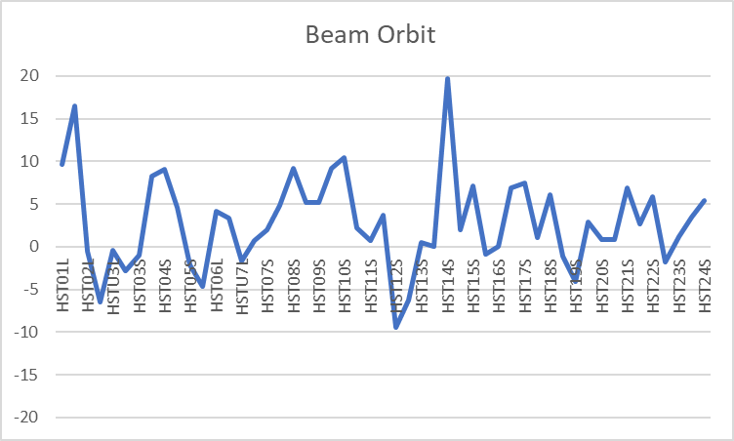
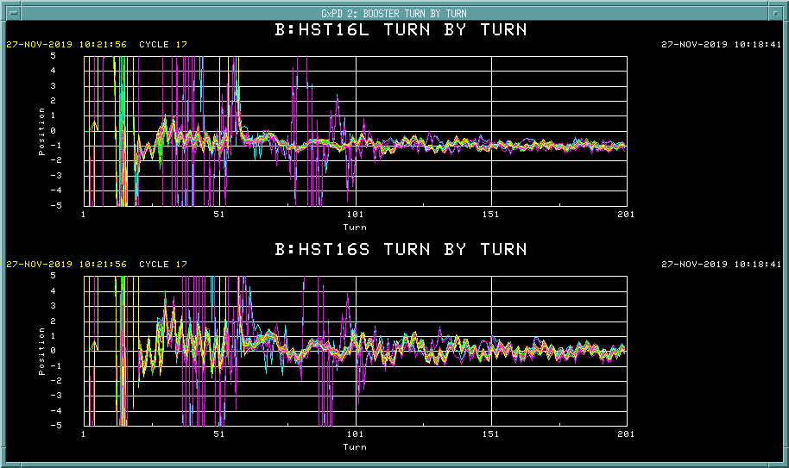
DC study: B field, frequency, energy
Preparation
1: DC Ramp
2: fixed RF voltage (adiabatic capture)
3: No feedback
4: Tuned B field and Rf frequency and minimized the oscillation on BPMs
5: Took all BPM data and averaged from 100 to 200 turns
c

Slide 8
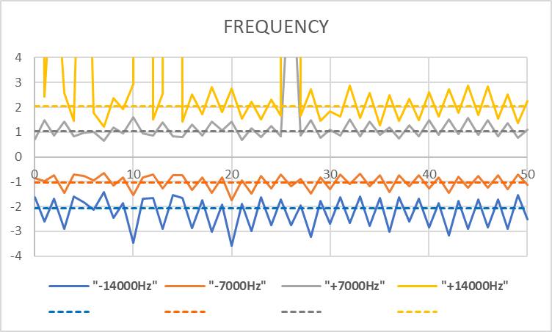
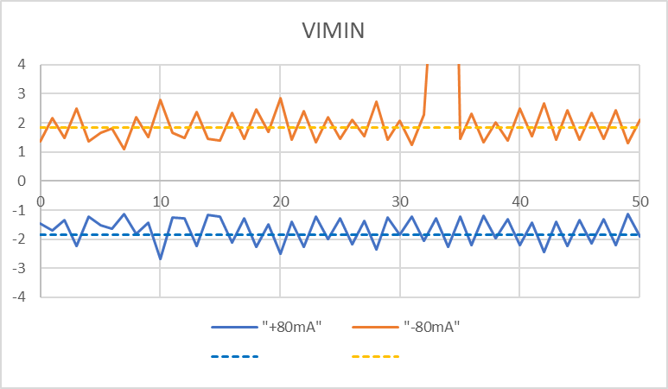
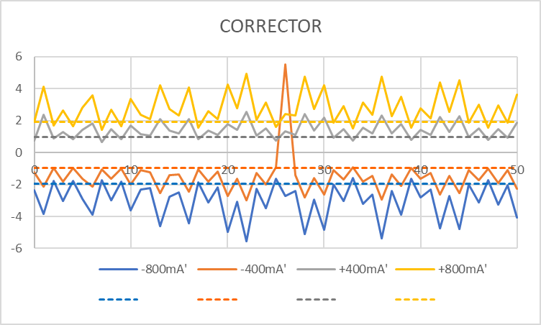
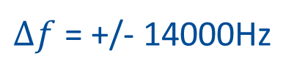
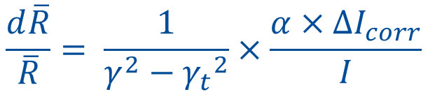
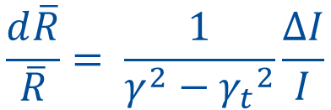
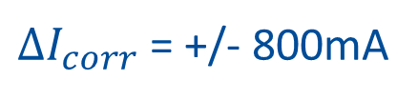
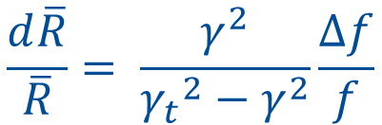
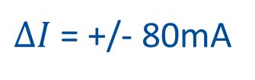
Beam studies with DC field: B field, frequency, energy
$∆f$ = +/- 14000Hz
$$\frac{d\overline{R}}{\overline{R}}= \frac{γ^{2}}{{γ_{t}}^{2}−γ^{2}}\frac{∆f}{f}$$
$$\frac{d\overline{R}}{\overline{R}}= \frac{1}{γ^{2}−{γ_{t}}^{2}}\frac{∆I}{I}$$
$∆I$ = +/- 80mA
$$\frac{d\overline{R}}{\overline{R}}= \frac{1}{γ^{2}−{γ_{t}}^{2}}×\frac{α×∆I_{corr}}{I}$$
$∆I_{corr}$= +/- 800mA

Slide 9
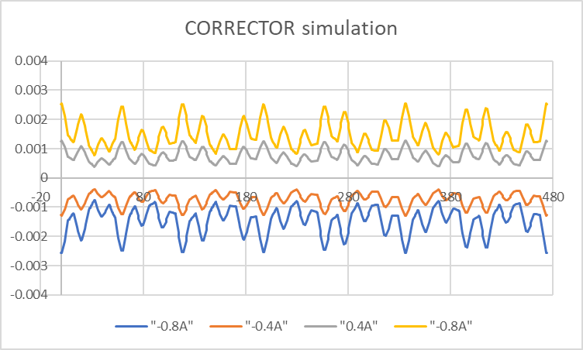
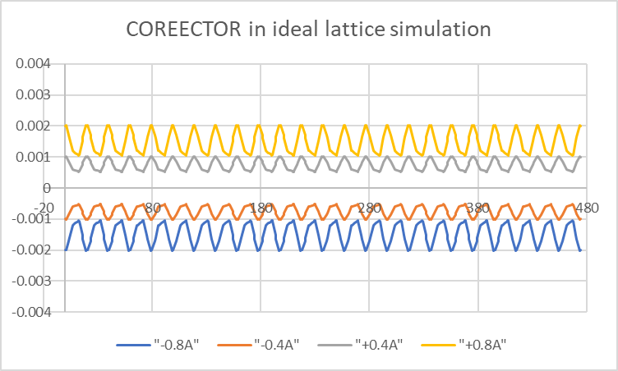
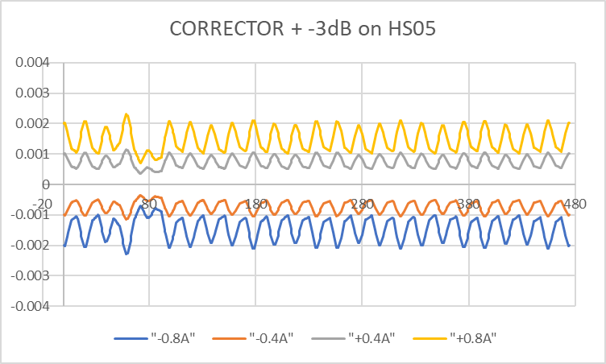
Simulation
Measurement
Ideal lattice
With attenuator
1 dB attenuator on HS05 will reduce the oscillation

Slide 10
Booster Long1 MADX input
6[m]
2.3[m]
2.3[m]
ORBUMP
La’
Lb’
Lc’
Ld’
Le’
ORBUMP
Lf’
θ
ORBUMP
Booster Long3 MADX input
6[m]
0.716[m]
2.7474[m]
0.716[m]
DOG1
DOG4
DOG2
SEPT
DOG3
La’
Lb’
Lc’
Ld’
Le’
Lf’
Lg’
Lh’
Li’
θ

Slide 11
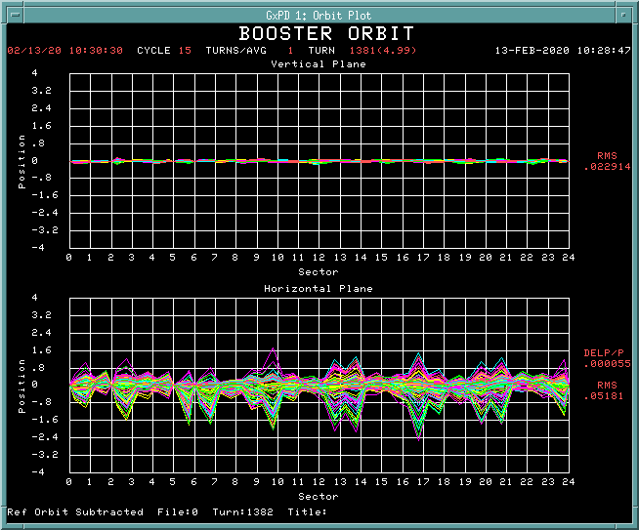
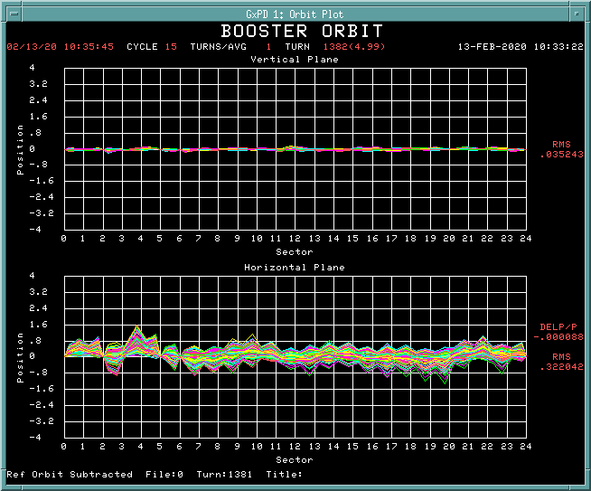
Beam orbit at 5 msec
without attenuator on HS05
1 dB attenuator on HS05
*Variable attenuator will minimize the wave
*Need another DC study to verify

Slide 12
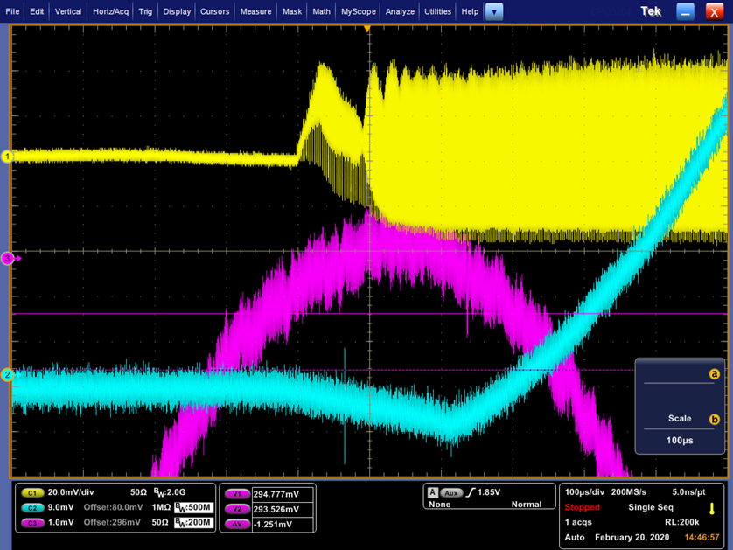
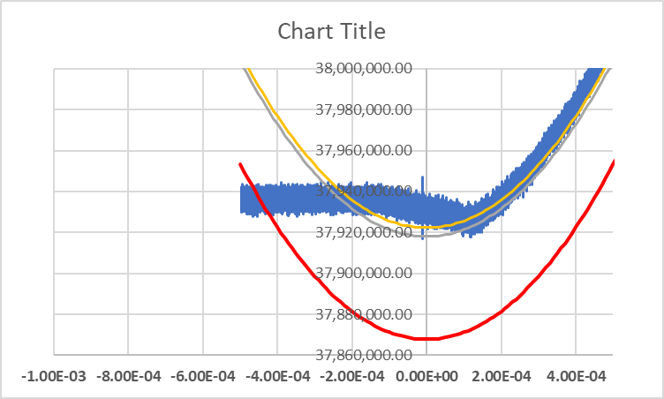
Beam study with ramp
Frequency output from DDS
E_inj = 402MeV
R = 75.37 m
E_inj = 400MeV
R = 75.47 m
Operation:
VIMIN=103.3 – 103.6 A
FREQ= 37.953 – 37.958 MHz
*Frequency curve have to be matched to ramp to maximize the aperture.
DC Study:
VIMIN=119.32944 A
FREQ= 37.955843 MHz

Slide 13
Plan
DC studies
  Dipole correctors – B field
More realistic simulation with real field and frequency
Realtime field compensation with cogging card
GMPS regulation
  Reduce amplitude jitter
Need realistic injection parameters from Linac

Slide 14
