Slide 1
MS2 LCW system reconfiguration
Jennifer Chikelu
June 25, 2020
First presentation.

Slide 2
AGENDA
P&ID
Specifications and operating conditions. Assumptions made.
Heat exchanger sizing
Chiller specification met need?
Instrumentations for the primary and secondary loop.
2” LCW paths between M1&M2

Slide 3
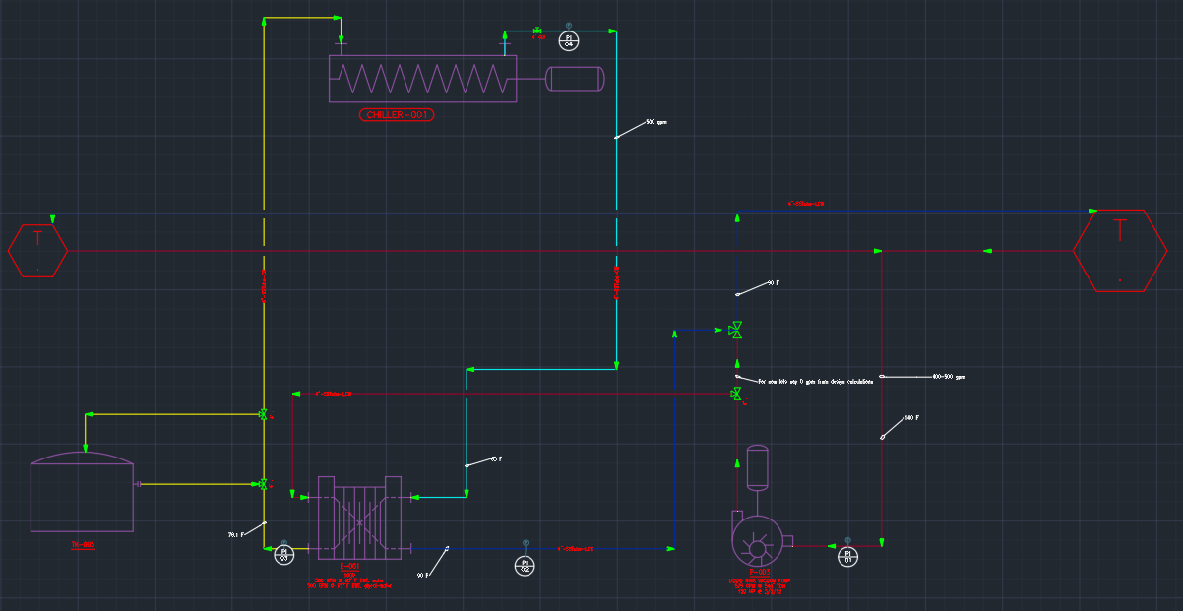
P&ID

Slide 4
Specifications and design calculations
Given;
Total system heat load to be 1MW.
Cooling liquid in secondary loop is 40% by vol glycol and 60% water.
The primary loop is just water, design temperature of water supplied to magnets is 90 F.
The volumetric flow rate in primary and secondary loop is assumed to be 500 gpm for the both loops. Piped in 4” SCH 10.

Slide 5
SIZING HEAT EXCHANGER PLATE AND FRAME
For 1 MW, of heat load on the primary loop the temperature difference is estimated with the formula;
$q_{h}=m_{w}c{ΔT}_{h}$= V$ρc∆T$, c=specific heat capacity= 4.18kj/kg-k, $m_{w}$=mass flow rate
${ΔT}_{h}$= 7.8$℃$ = , therefore $T_{ho}$= 32.2 $℃$=90 $℉$, $T_{hi}$= 40 $℃$ = 104 $℉$
Since the entire heat load will be transferred to the cooling fluid,
$q_{c}=m_{gw}c{ΔT}_{c}$, $m_{gw}$ = mass flowrate of glycol-water mixture. C = 3.47kj/kg-k
$q_{c}$ = $q_{h}$= 1MW.
${ΔT}_{c}$= 8.2 $℃$. Assume initial temp of cooling fluid, $T_{ci}$= 65 $℉$ = 18.3 $℃$, final temp should be $T_{co}=$26.5 $℃$= 79.7 $℉$.
The LMTD for parallel flow in HX was calculated to be, 21.5 $℉$ OR 12 $℃$
The LMTD for counter flow in HX was calculated to be, 24.6 $℉$ OR 13.7 $℃$
Heat transfer coefficient, U= $\frac{1}{R_{tot}A}$ = $\frac{1}{\frac{1}{h_{h}} + \frac{L}{K_{SS}}+ \frac{1}{h_{C}}};$

Slide 6
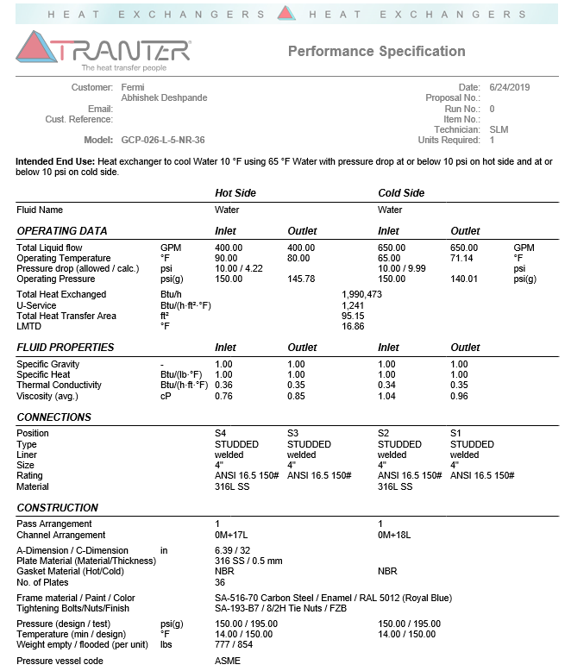
Specifications from plate and frame Heat exchanger formerly used for a 600 KW heat load, having overall heat transfer, U=1241 btu/h.${ft}^{2}$.$℉$ = 7046 W/ $m^{2}$.K, we can determine the total heat transfer area and number of plates needed for 1MW = 3,412,142 Btu/hr heat load.
q$=UA{ΔT}_{LMTD}$,
If counter flow, ${ΔT}_{LMTD}$ = 24.6 $℉$, then A = 112 ${ft}^{2}$ = 42 plates
If parallel flow, ${ΔT}_{LMTD}$ = 21.5 $℉$, then A = 128 ${ft}^{2}$ = 47 plates
Surface area of each plate is 1.42 ${ft}^{2}$.
Recommended are 42 plates of similar specification of HX presented.

Slide 7
Chiller sizing
To size the chiller,
Calculate heat load on chiller, $q_{c}=m_{gw}c{ΔT}_{c}$ = 1 MW = 3,412,142 btu/hr = 284 tons of refrigeration. Hence using 2 *140 ton chillers.
The chiller will have pump sized to meet refrigeration flow needs around the secondary loop.
More information about chiller specifics is listed below.

Slide 8
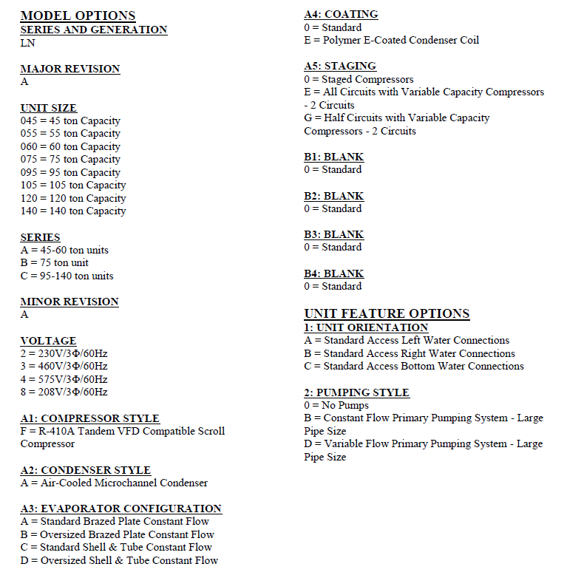
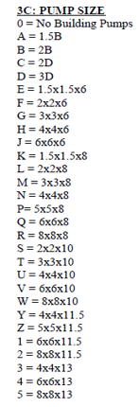

Slide 9
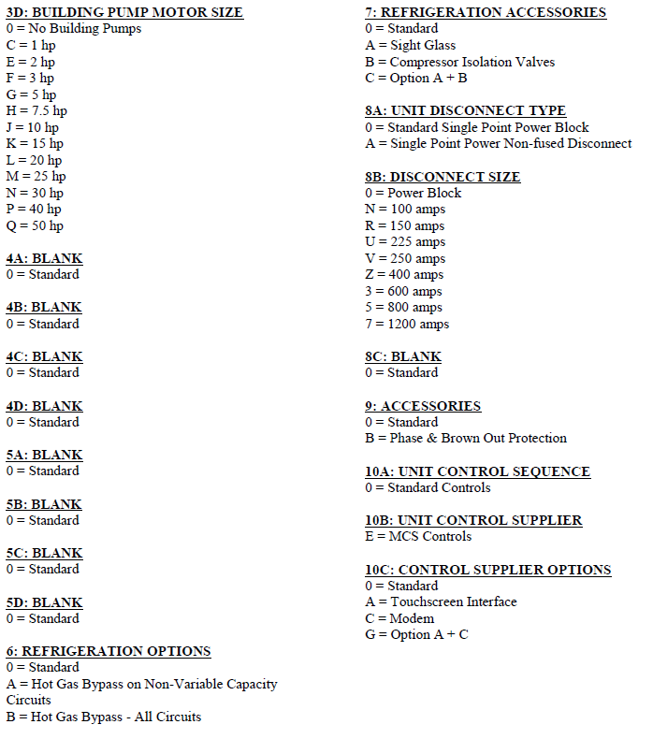
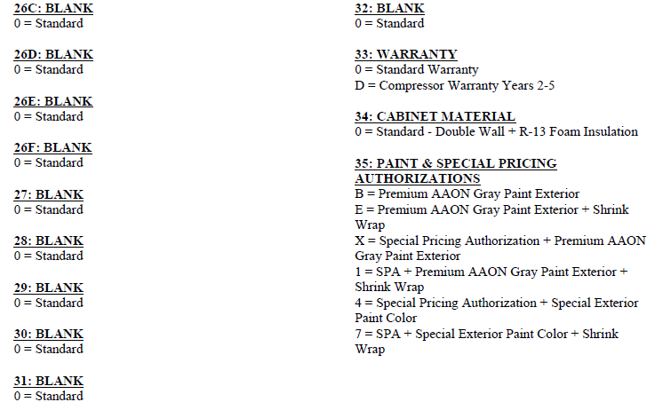

Slide 10
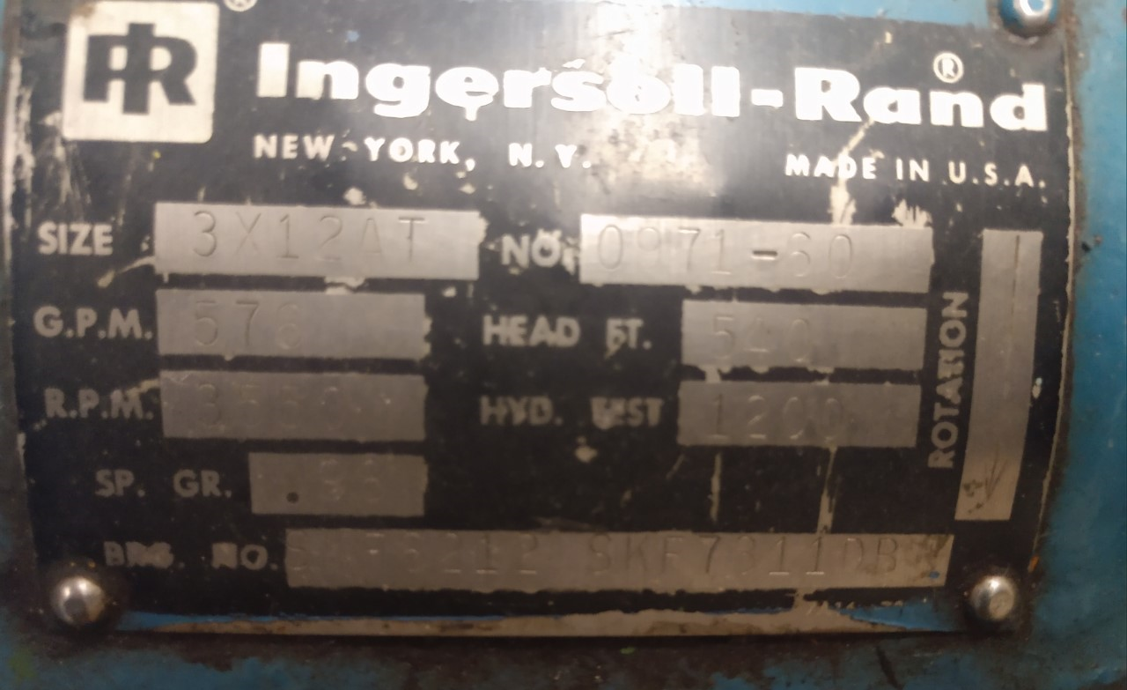
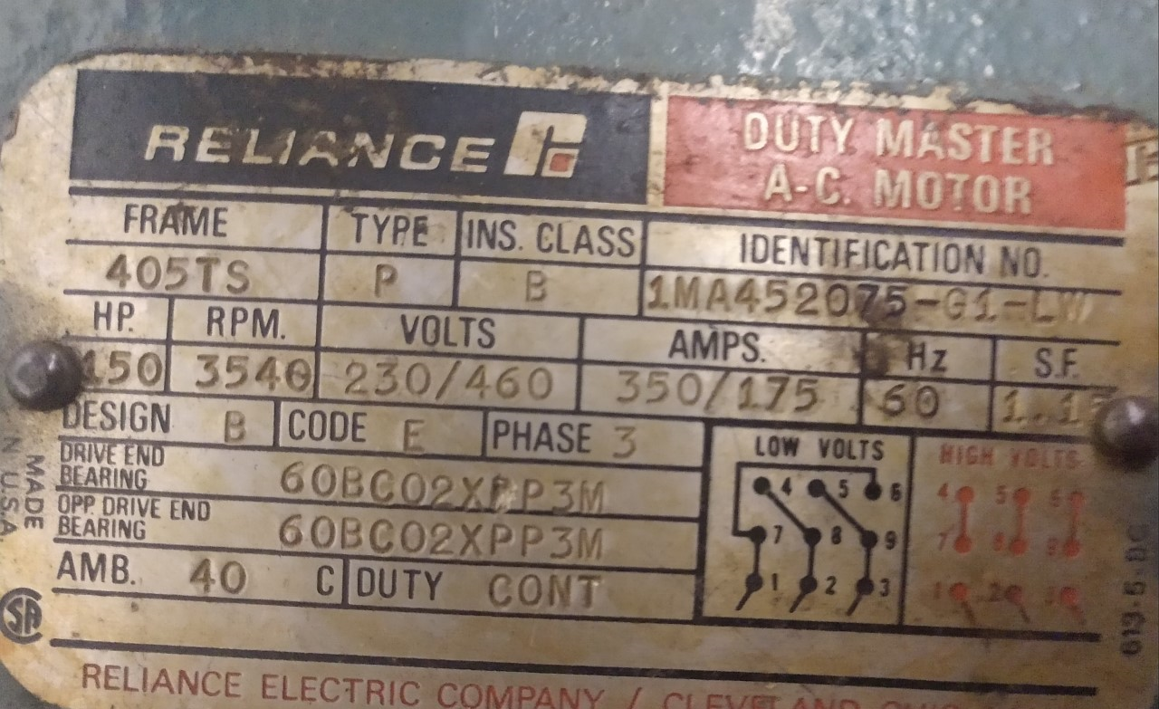
Instrumentation/equipment
The excel sheet provides instrumentations and equipment lists and pricing.
The existing pump, seem it will still be used for the upgrade since it meets specifications.

Slide 11
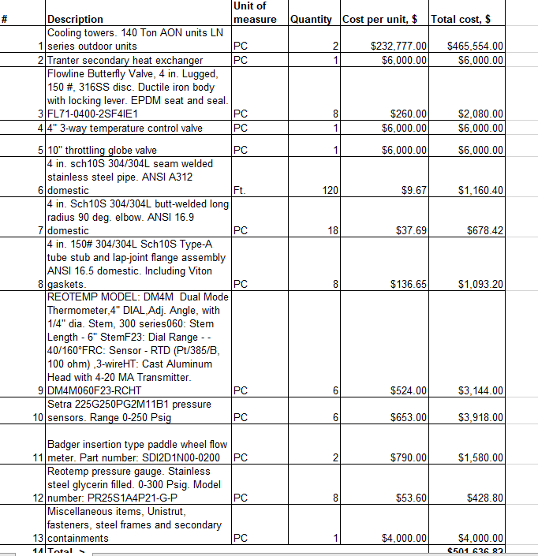

Slide 12
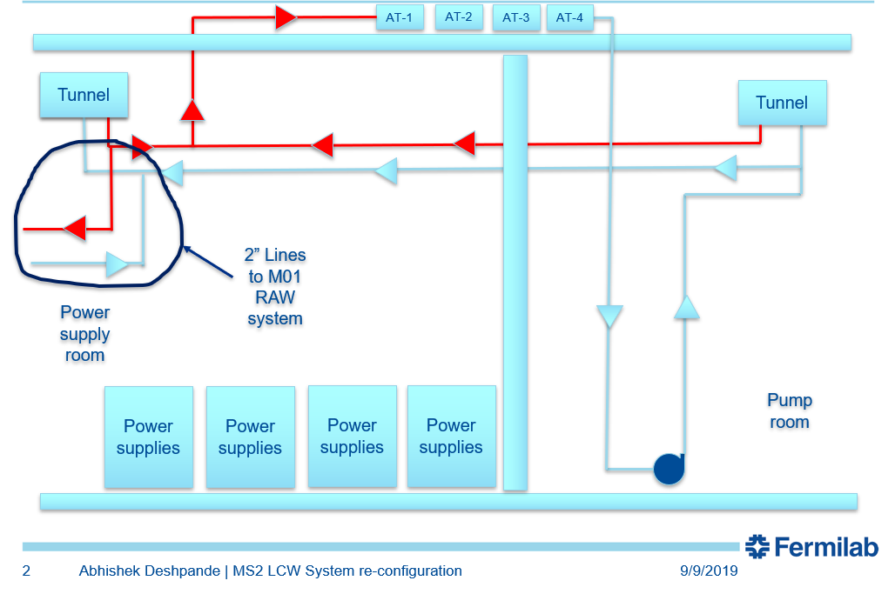
2” line to M-01 design options
From the previous presentation, options to relocate the pipes were;
1. Trench and bury the pipes between service building. How deep can we go as not to interfere with other pipelines or existing installations?
2. Another option is to directional-bore through the downstream MS1 enclosure wall and run pipes through the shielding berm to MS2. The design specifics? Will it be easier to attain compared to the first option?

