Slide 1
Booster Half-Integer Correction Studies
J. Eldred, Y. Alexahin, D. Johnson, J. Johnstone, V. Kapin, C.Y. Tan,
US Japan Teleconference
Mar. 10th, 2020

Slide 2
2
2
Space-charge
Emittance Growth
2
Jeffrey Eldred | Booster Half-Integer Correction
Notes:
2
2
2
2
2
2

Slide 3
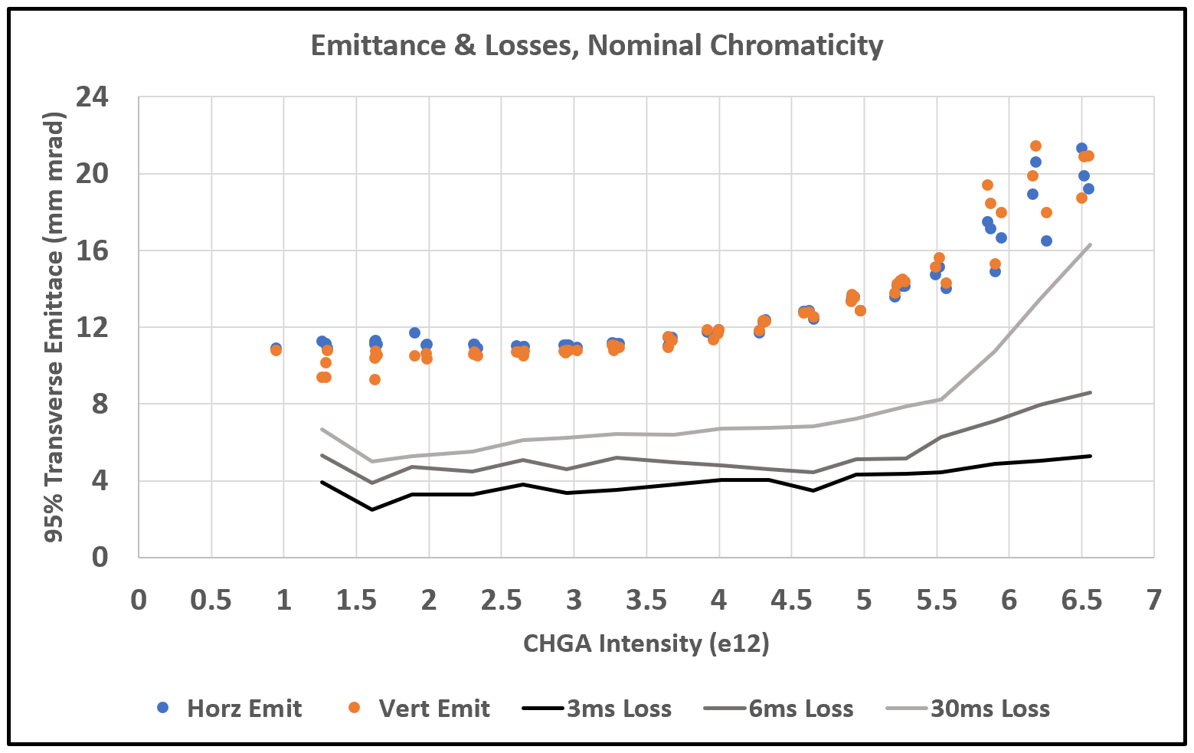
3
Space-charge Emittance Growth Study (June 2019)
J. Eldred, K. Seiya, V. Shiltsev
3
Jeffrey Eldred | Booster Half-Integer Correction
Notes:
3
3
3

Slide 4
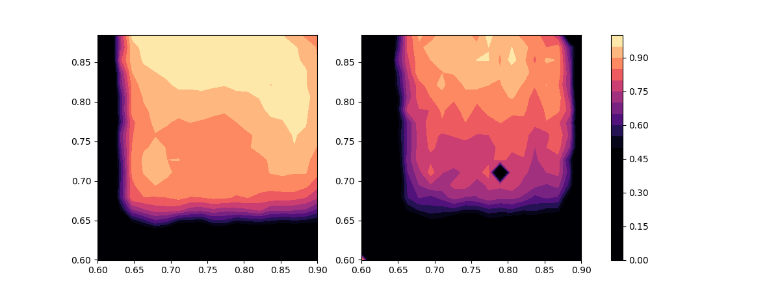
4
Intensity Reduces Tunespace
Transmission
after Capture
Transmission
before Extraction
Qy
Qx
Qx
1/3 nom. intensity, chromaticity -20 at injection
4
Jeffrey Eldred | Booster Half-Integer Correction
Notes:
4
4
4

Slide 5
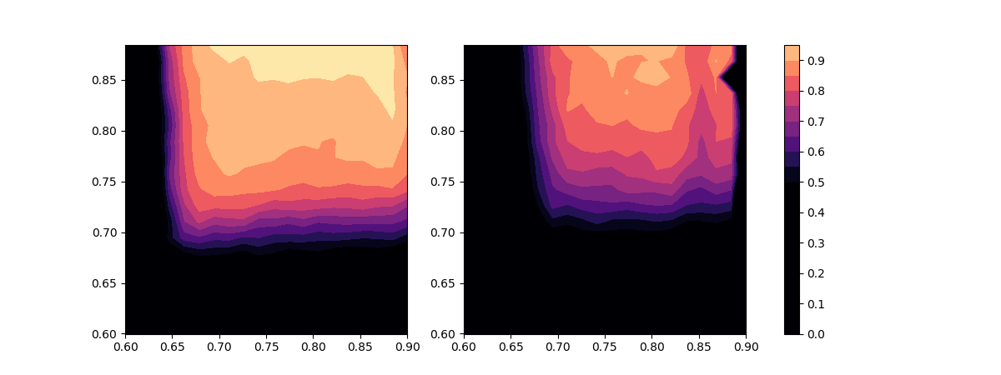
5
Intensity Reduces Tunespace
Transmission
after Capture
Transmission
before Extraction
Qy
Qx
Qx
2/3 nom. intensity, chromaticity -20 at injection
5
Jeffrey Eldred | Booster Half-Integer Correction
Notes:
5
5
5

Slide 6
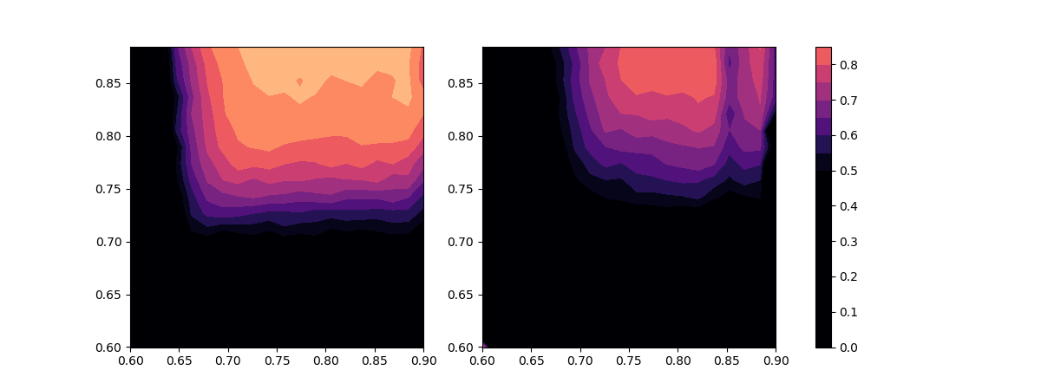
6
Intensity Reduces Tunespace
Transmission
after Capture
Transmission
before Extraction
Qy
Qx
Qx
nominal intensity, chromaticity -20 at injection
6
Jeffrey Eldred | Booster Half-Integer Correction
Notes:
6
6
6

Slide 7
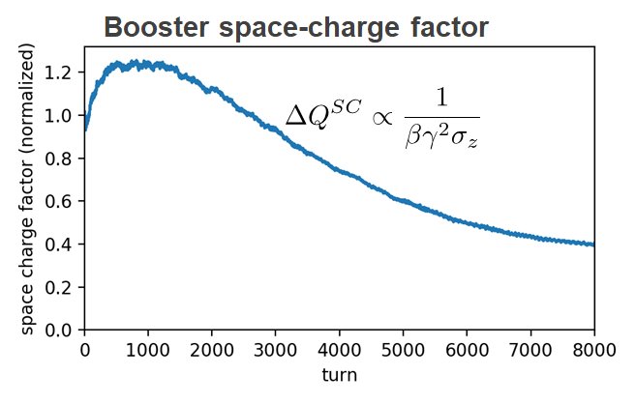
7
Space-charge dominates first 2000 turns ~ 2+4ms
For fixed transverse emittance and intensity, space charge scales as
H. Bartosik, A. Huschauer
7
Jeffrey Eldred | Booster Half-Integer Correction
Notes:
7
7
7

Slide 8
8
8
MAD-X Model
8
Jeffrey Eldred | Booster Half-Integer Correction
Notes:
8
8
8
8
8
8

Slide 9
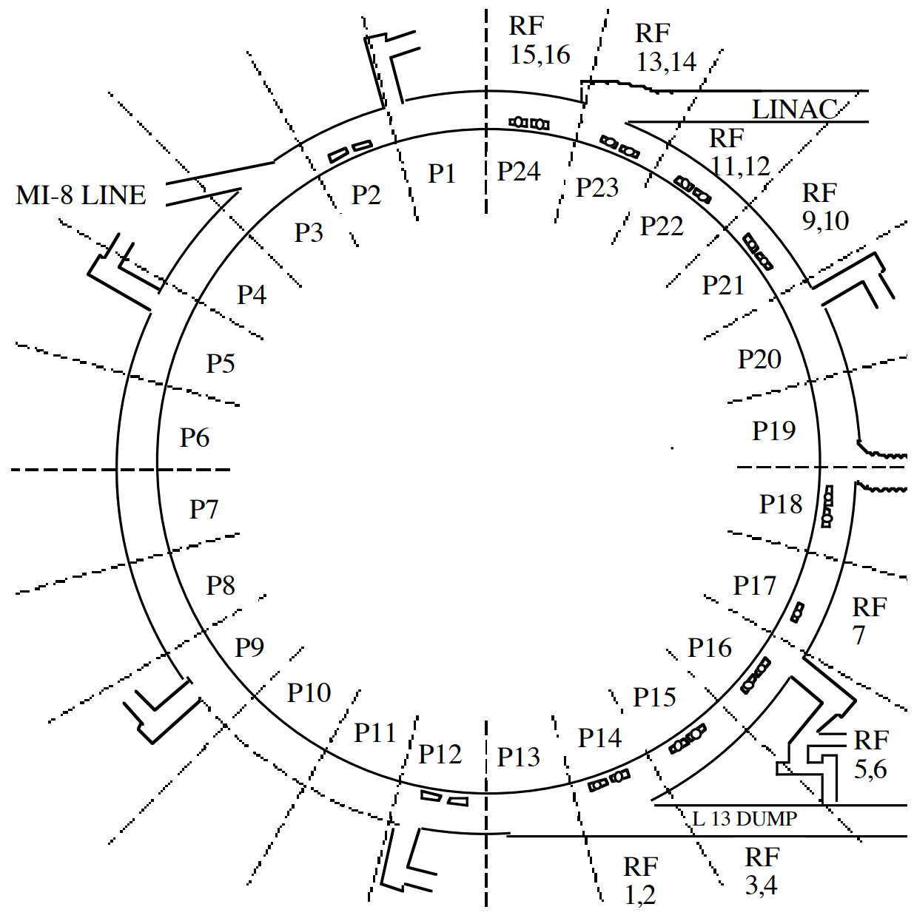
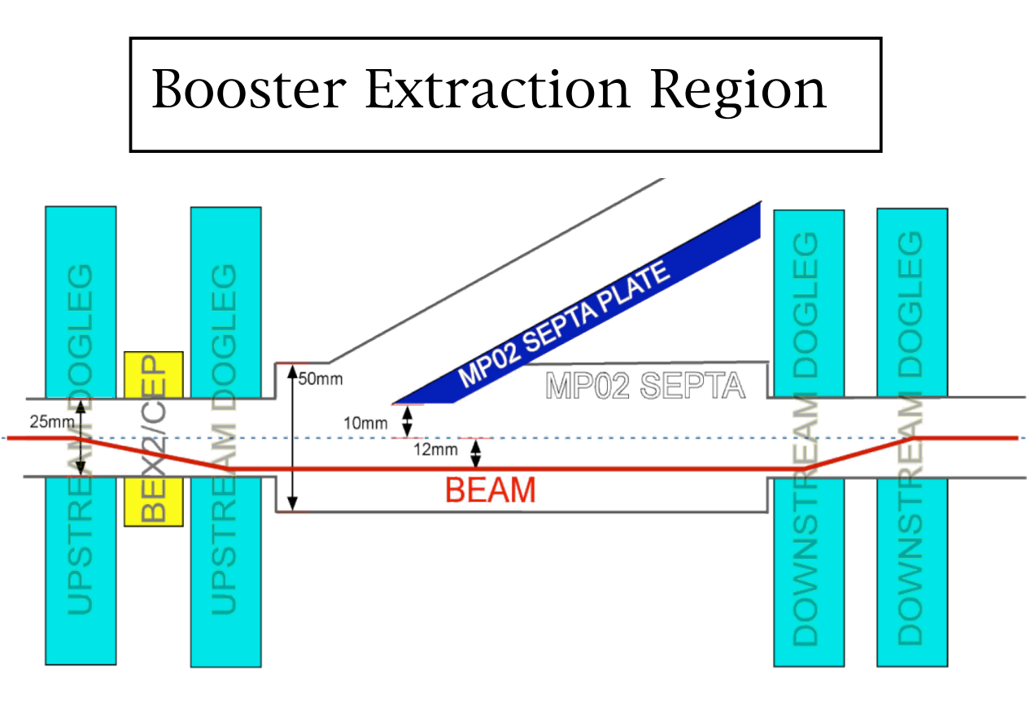
9
Booster Extraction breaks 24-fold Lattice Symmetry
9
Jeffrey Eldred | Booster Half-Integer Correction
Notes:
9
9
9

Slide 10
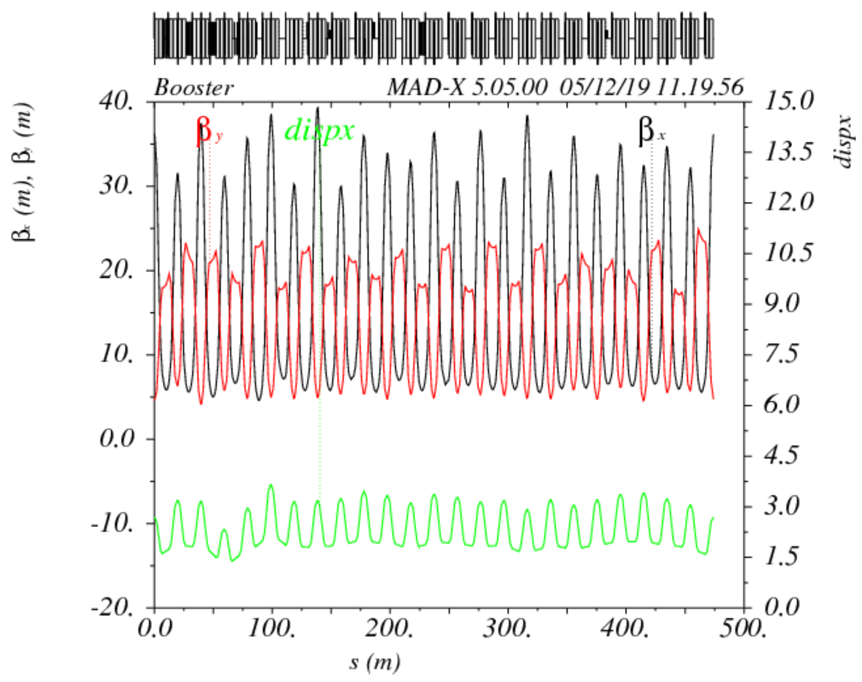
10
MAD-X Model for HEP Lattice
10
Jeffrey Eldred | Booster Half-Integer Correction
Notes:
10
10
10

Slide 11
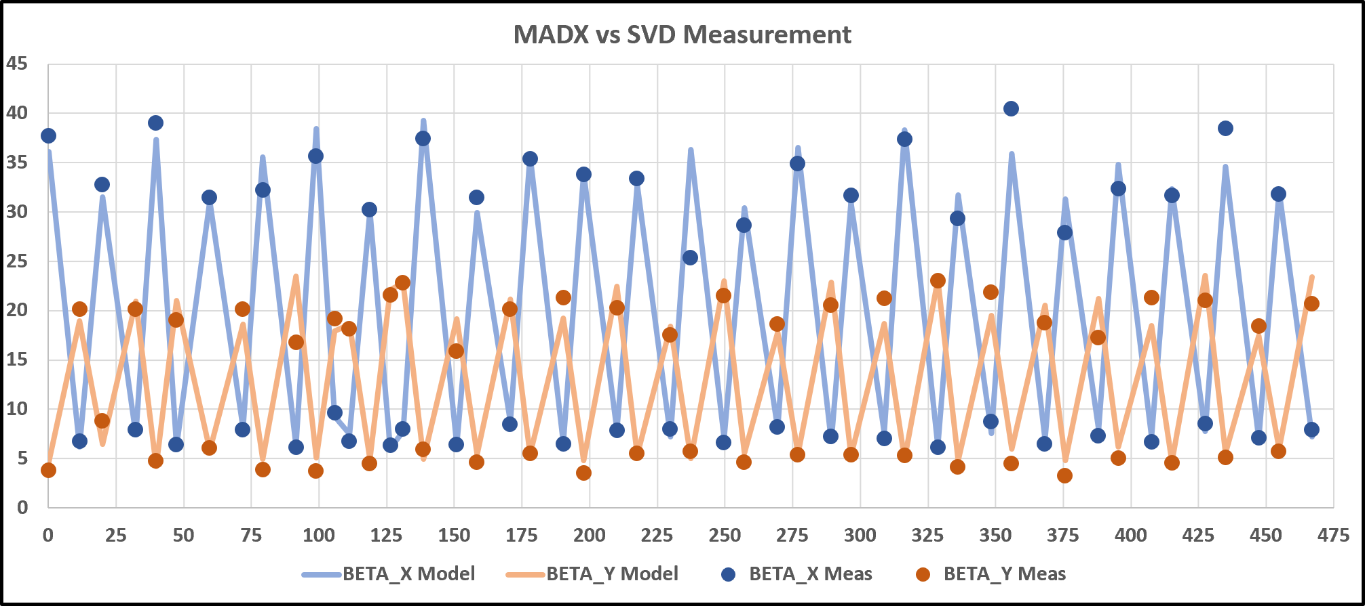
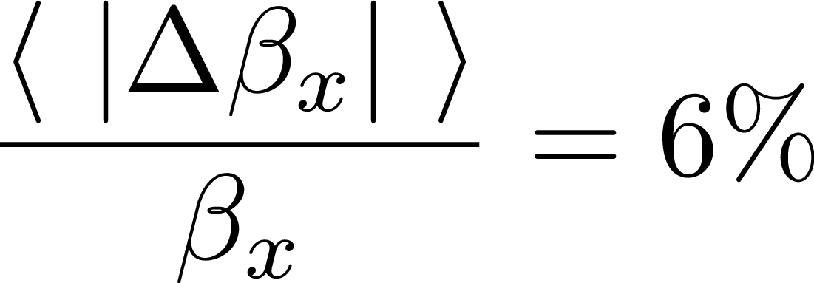
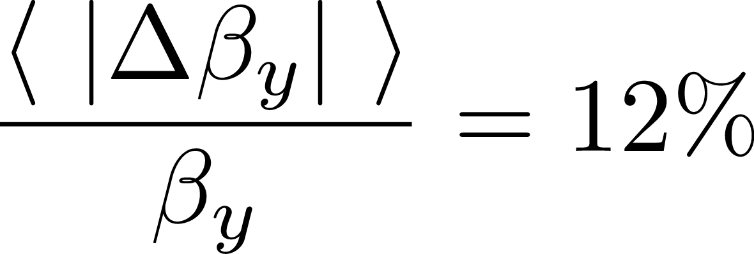
11
MAD-X Model vs. SVD Meas. for HEP Lattice
Average Errors
11
Jeffrey Eldred | Booster Half-Integer Correction
Notes:
11
11
11

Slide 12
12
MAD-X Model for HEP Lattice
12
Jeffrey Eldred | Booster Half-Integer Correction
Notes:
12
12
12

Slide 13
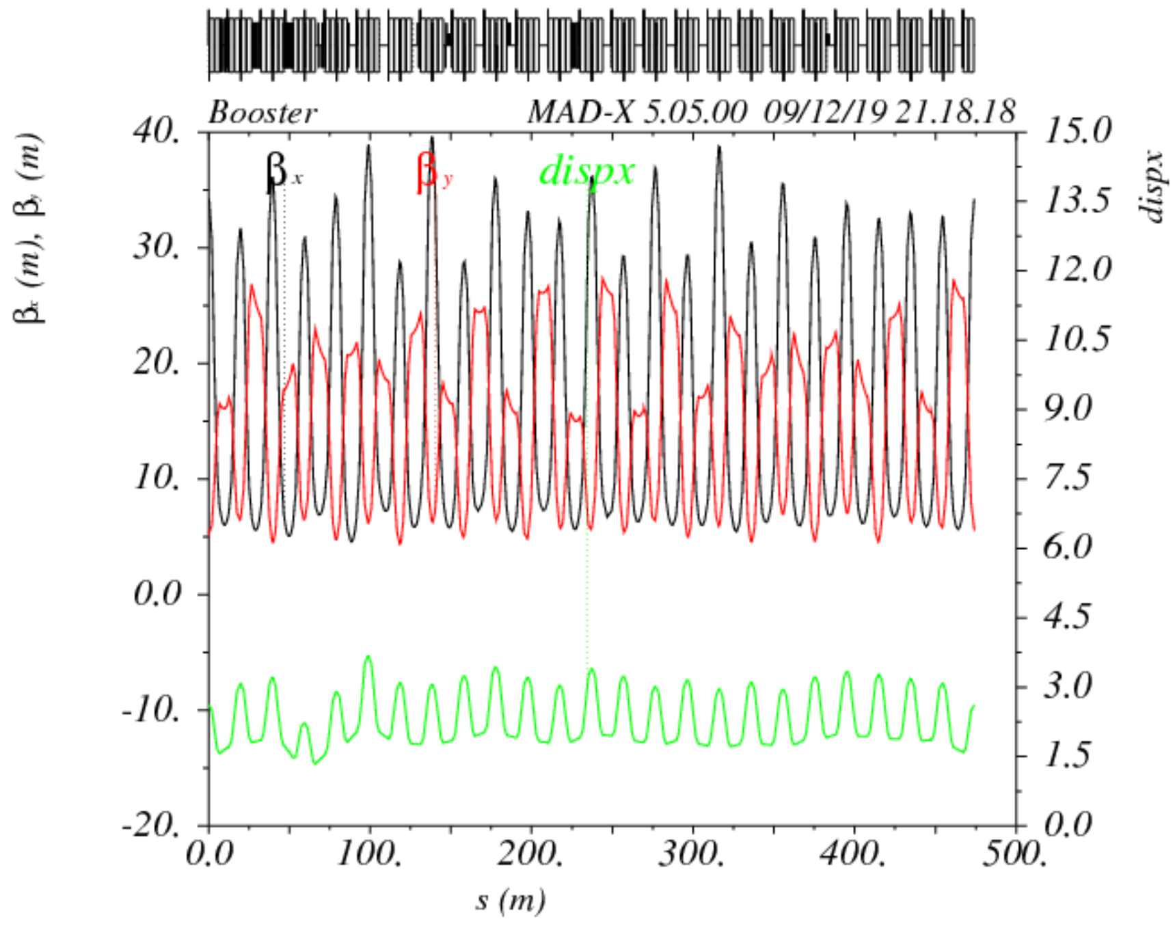
13
MAD-X Model for at Qy =0.6
13
Jeffrey Eldred | Booster Half-Integer Correction
Notes:
13
13
13

Slide 14
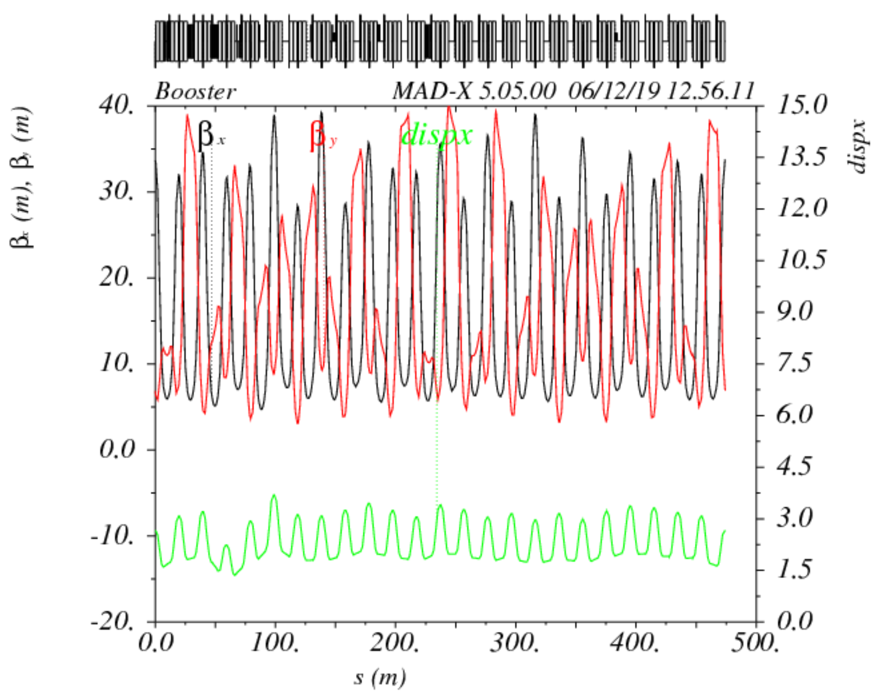
14
MAD-X Model for at Qy =0.53
14
Jeffrey Eldred | Booster Half-Integer Correction
Notes:
14
14
14

Slide 15
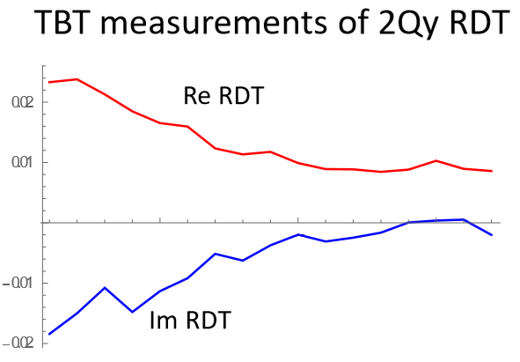
15
2Qy Resonance Driving Term measured over the ramp
The resonance driving term is strongest at injection, and decreases with momentum.
This makes sense, because one of the major sources of the symmery-breaking in the ring is the DC-powered dogleg at extraction.
Y. Alexahin
15
Jeffrey Eldred | Booster Half-Integer Correction
Notes:
15
15
15

Slide 16
16
16
Compensating Half-Integer
The vertical half-integer resonance strength is proportional to
Each linear focusing element makes a contribution proportional to the vertical beta function, and has a complex phase given by twice the phase-advance.
To compensate the vertical half-integer, we need two independent sets of quadrupoles, at high βy locations (i.e. long-straights), with the proper phase-advances to add coherently.
16
Jeffrey Eldred | Booster Half-Integer Correction
Notes:
16
16
16
16
16
16

Slide 17
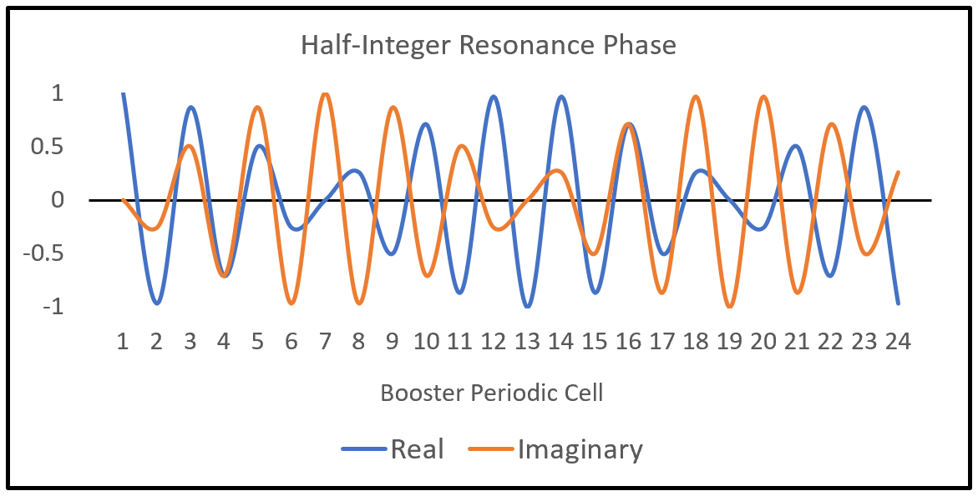
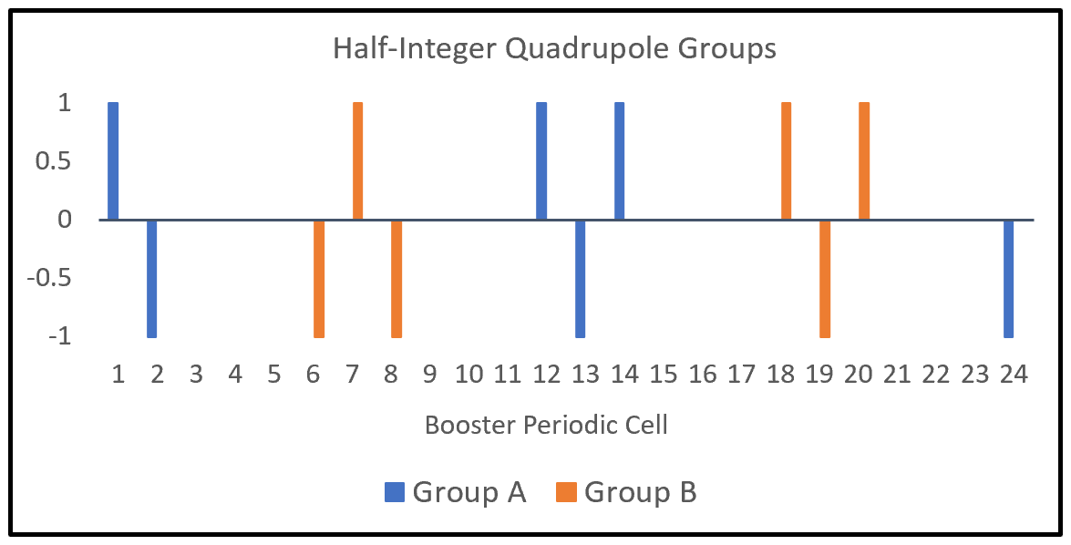
17
17
Compensating 2Qy=13 for 24-period ring
Resonant phase between adjacent Booster cells:
Between 12 Booster cells:
Between 6 Booster cells:
Group A:
-QL24, +QL01, -QL02,
+QL12, -QL13, +QL14
Group B:
-QL06, +QL07, -QL08,
+QL18, -QL19, +QL20
17
Jeffrey Eldred | Booster Half-Integer Correction
Notes:
17
17
17
17
17
17

Slide 18
18
MAD-X Model for at Qy =0.53
18
Jeffrey Eldred | Booster Half-Integer Correction
Notes:
18
18
18

Slide 19
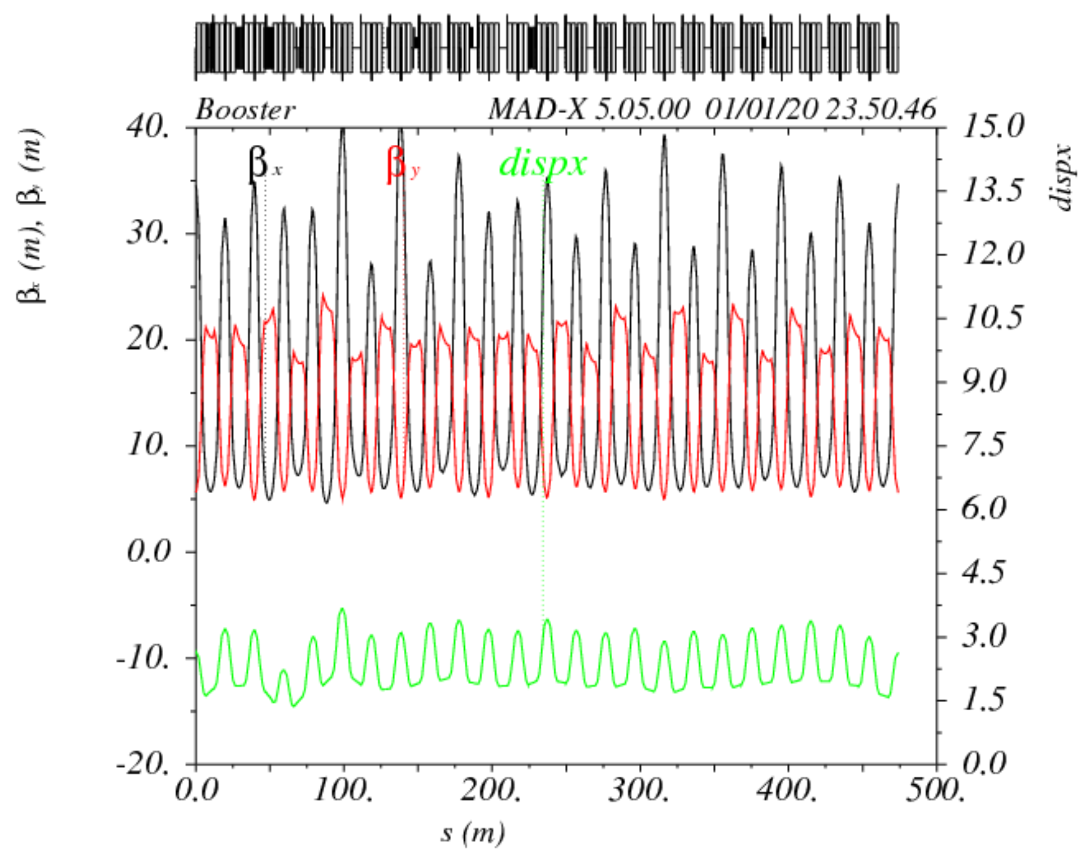
19
MAD-X Model for at Qy =0.53 corrected
19
Jeffrey Eldred | Booster Half-Integer Correction
Notes:
19
19
19

Slide 20
20
20
Dec. 11 Study
“Proof of Principle” near 2Qy
20
Jeffrey Eldred | Booster Half-Integer Correction
Notes:
20
20
20
20
20
20

Slide 21
21
21
Dec. 11 Study
Changing the tune:
- Each of 24 Booster cells has a QL (quad-long) and QS (quad-short).
- Tune shift by changing all QLs together and all QSs together.
- Tune shift only for the earliest 2ms of the cycle.
Scan QL Groups:
- Scan QL currents in two groups of six, which make orthogonal contributions to 2Qy resonance.
- DC current offsets used, to match RDTs and for controls convenience.
Dec. 11 Study:
- Change Qy to 0.54, near vertical half-integer resonance.
- Scan QL groups A & B to improve massive losses.
21
Jeffrey Eldred | Booster Half-Integer Correction
Notes:
21
21
21
21
21
21

Slide 22
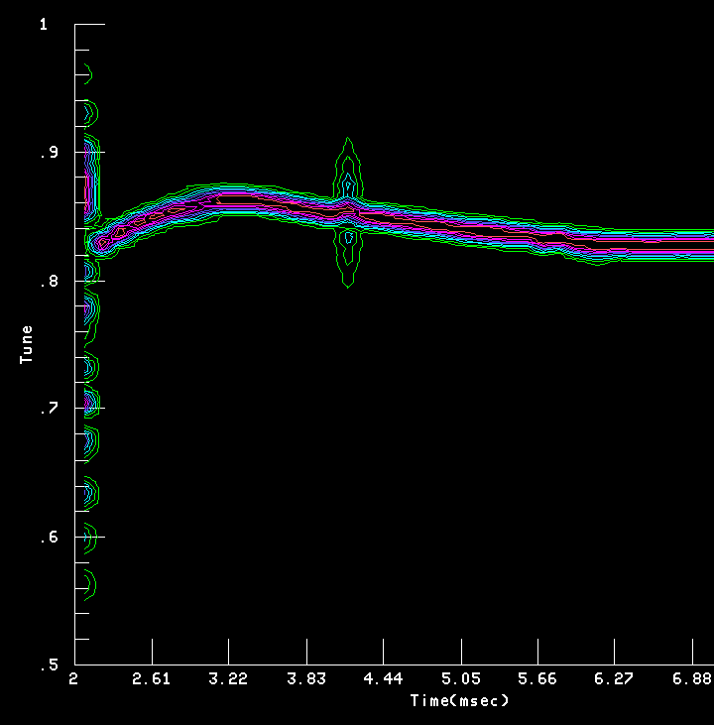
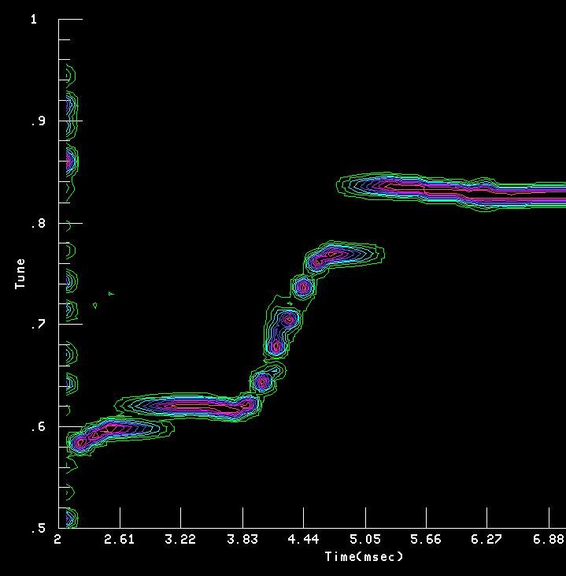
22
22
Vertical Tune at Injection
HEP Tune Ramp
Tune Ramp near Qy=0.6
22
Jeffrey Eldred | Booster Half-Integer Correction
Notes:
22
22
22
22
22
22

Slide 23
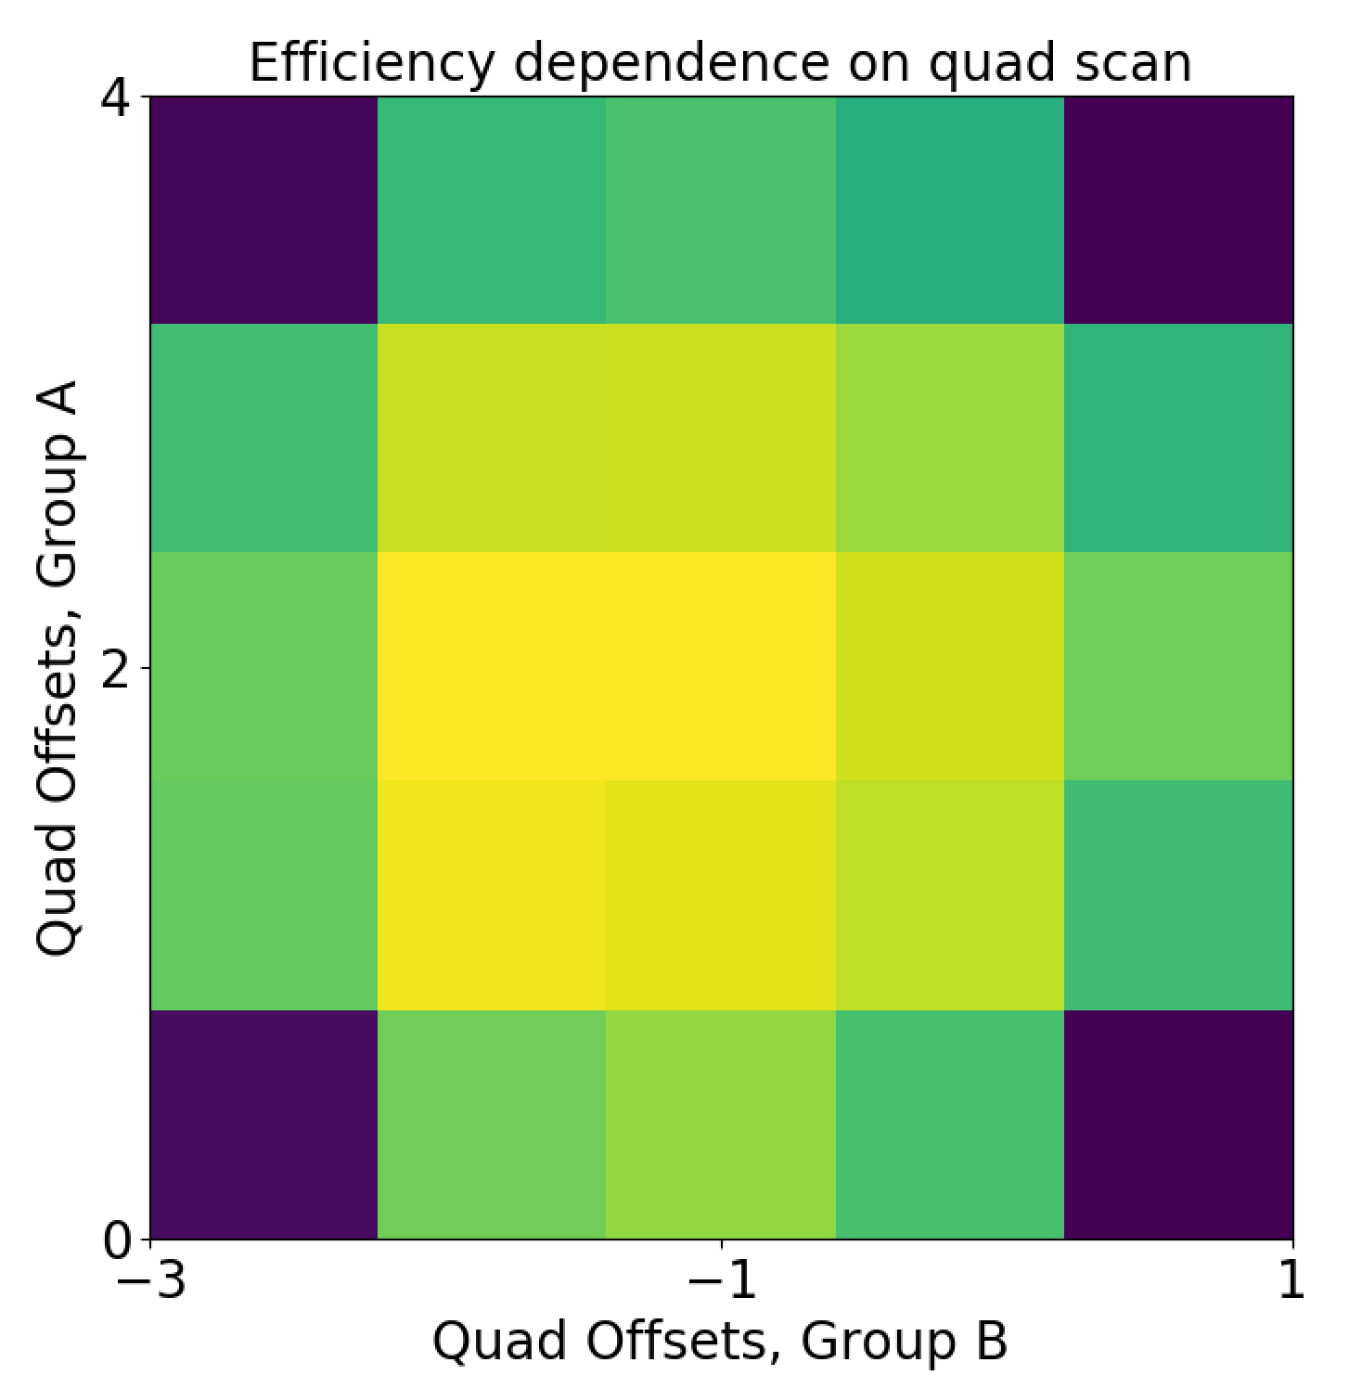
23
23
Half-Integer Compensation
Sweep subsets of quadrupoles with orthogonal contributions to 2Qy.
First study, Dec 11: low-intensity, Qy=0.54, proof-of-principle
Group A:
-QL24, +QL01, -QL02,
+QL12, -QL13, +QL14
Group B:
-QL06, +QL07, -QL08,
+QL18, -QL19, +QL20
Best efficiency:
A= +2.222, B = -1.238
(MAD-X)
~75%
~25%
23
Jeffrey Eldred | Booster Half-Integer Correction
Notes:
23
23
23
23
23
23

Slide 24
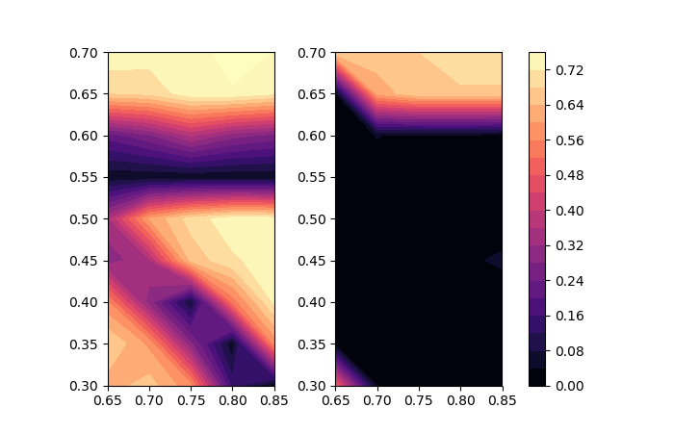
24
Tunescan before Compensation
Before Compensation
Early Transmission
Late Transmission
Qy
Qx
Qx
24
Jeffrey Eldred | Booster Half-Integer Correction
Notes:
24
24
24

Slide 25
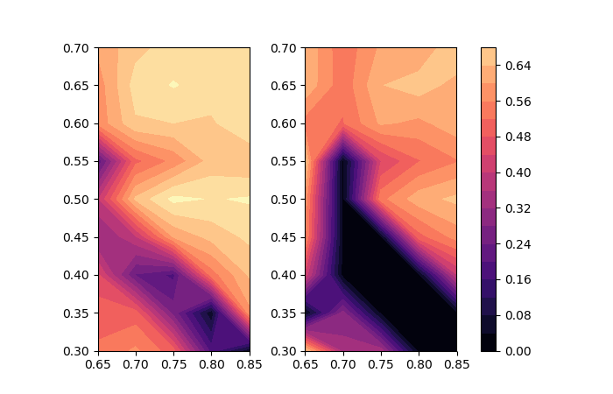
25
Tunescan after Compensation
After Compensation
Early Transmission
Late Transmission
Qy
Qx
Qx
25
Jeffrey Eldred | Booster Half-Integer Correction
Notes:
25
25
25

Slide 26
26
26
Jan. 22 & Feb. 18 Studies
Correction under Nominal case
26
Jeffrey Eldred | Booster Half-Integer Correction
Notes:
26
26
26
26
26
26

Slide 27
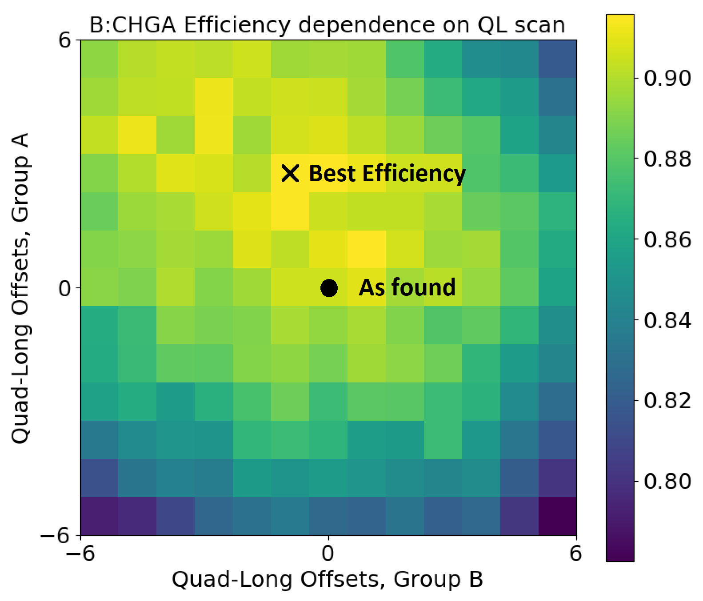
27
2Qy Compensation (Nominal Intensity, Tune)
27
Jeffrey Eldred | Booster Half-Integer Correction
Notes:
27
27
27

Slide 28
28
2Qy Compensation (Nominal Intensity, Tune)
The quad-scan shows a clear improvement from 90 – 92%!
Except remember operational was ~93%
- efficiciency low because of lower rep. rate & higher intensity.
Encouragingly, best efficiency matches results from Qy=0.54 study and prediction from MAD-X model.
However, the efficiency is not round like the previous study:
-losses from quad-scan are distorted by other effects.
28
Jeffrey Eldred | Booster Half-Integer Correction
Notes:
28
28
28

Slide 29
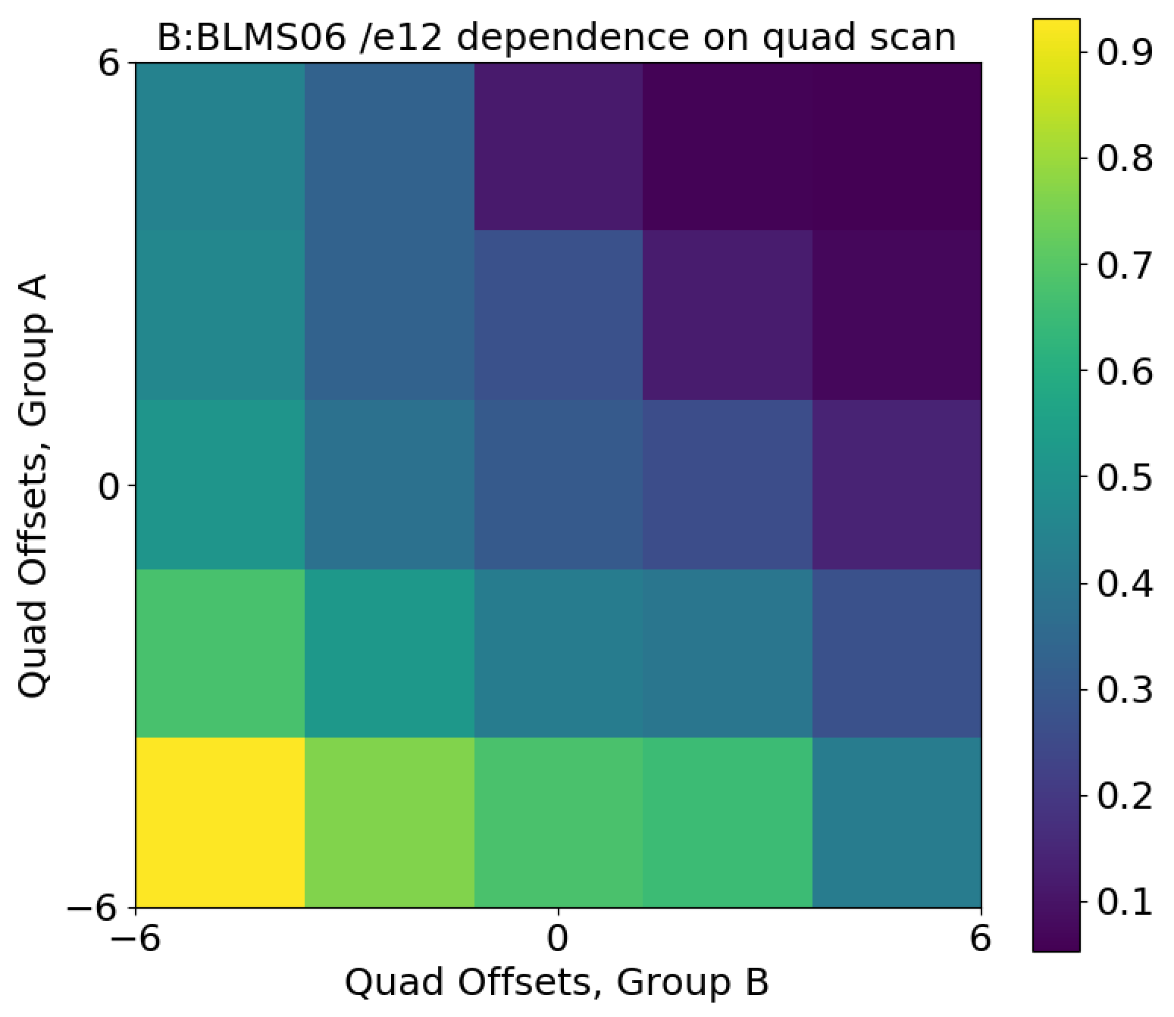
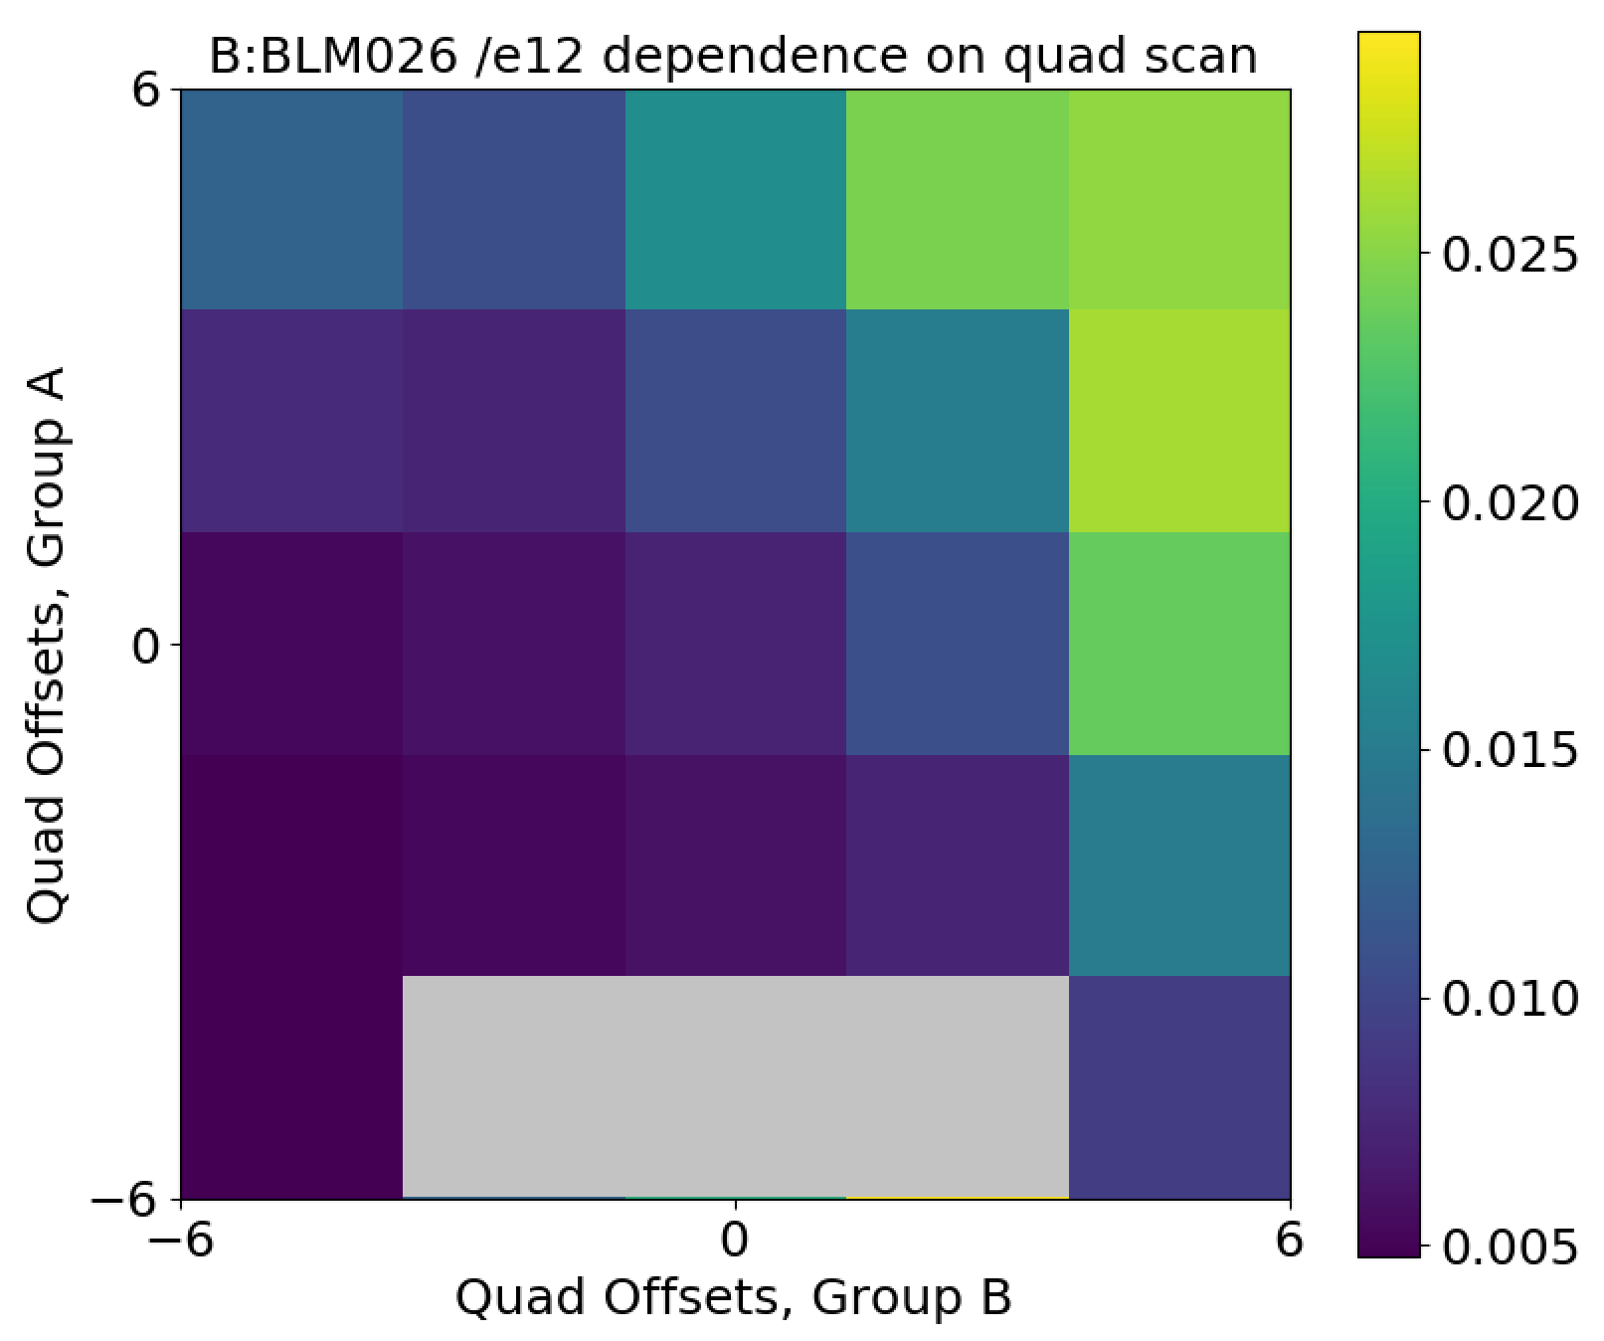
29
Beam-loss Monitors
Col. Loss at 10ms Ext. Dogleg Loss at 33ms
The quad long groups also have a strong effect on the loss profile.
We may have to iterate 2Qy with the other tuning – orbits, injection-matching.
29
Jeffrey Eldred | Booster Half-Integer Correction
Notes:
29
29
29

Slide 30
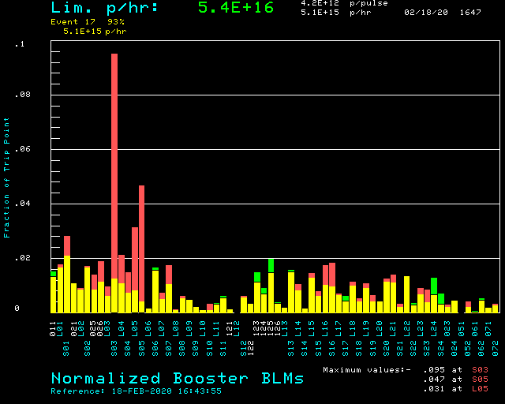
30
Comparison of Loss Profile
Yellow plus Red:
Worse than nominal.
Yellow minus Green:
Better than nominal.
30
Jeffrey Eldred | Booster Half-Integer Correction
Notes:
30
30
30

Slide 31
31
31
Jan. 22 & Feb. 18 Studies
Emittance Measurements
31
Jeffrey Eldred | Booster Half-Integer Correction
Notes:
31
31
31
31
31
31

Slide 32
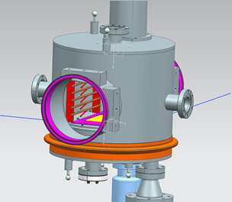
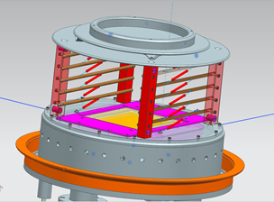
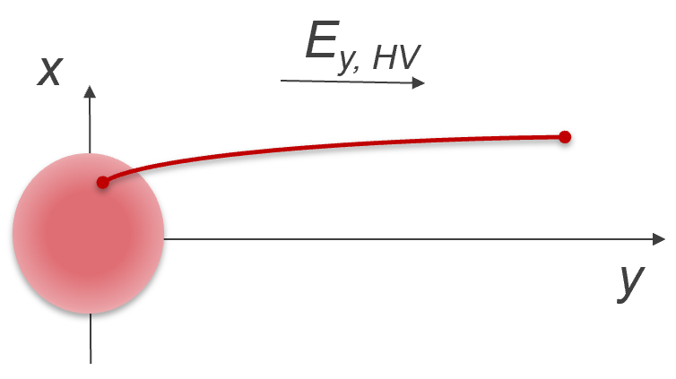
32
IPM Measurements
The Booster has horizontal and vertical ionization profile monitors that use high voltage plates to collect ions from interactions between the beam and residual gas.
The ions collected by micro-channel plates provide the beam profile, with some distortion.
The profile diagnostic provides useful information about beam size within the ramp.
32
Jeffrey Eldred | Booster Half-Integer Correction
Notes:
32
32
32

Slide 33
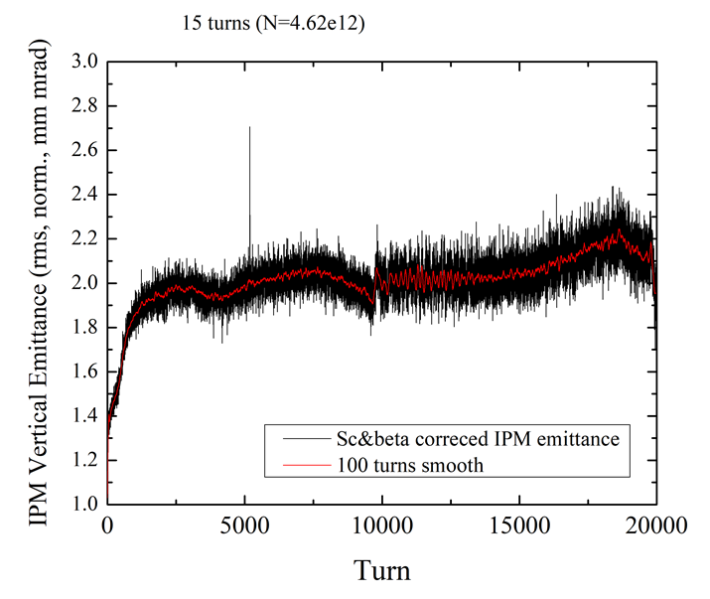
33
Early Emittance Growth
~ +30% Injection
Emittance Growth
~ +10% Acceleration
Emittance Growth
V. Shiltsev
V. Kapin
33
Jeffrey Eldred | Booster Half-Integer Correction
Notes:
33
33
33

Slide 34
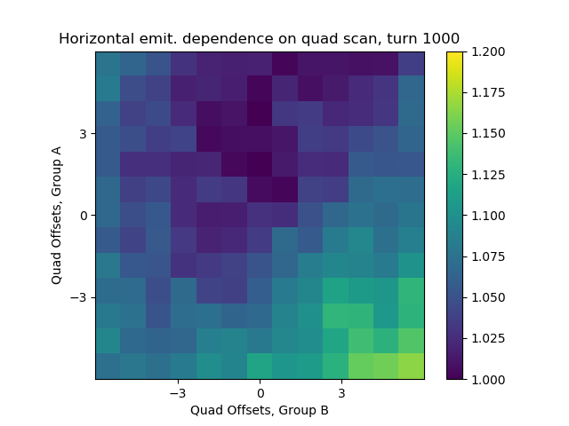
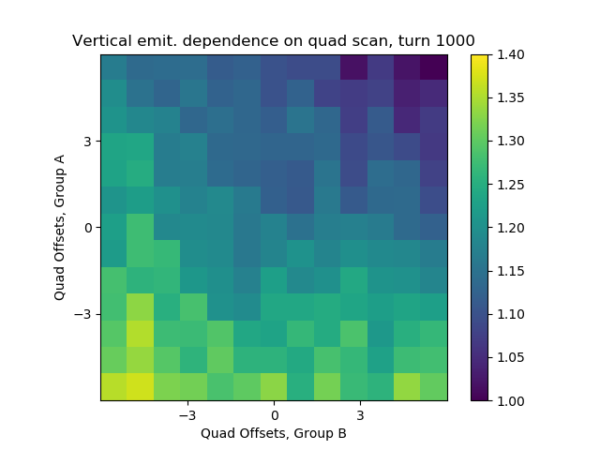
34
IPM Measurements of 2Qy Correction
Horz., turn 1000 Vert., turn 1000
Interestingly, the horizontal emittance shows a local minimum coinciding with the best efficiency case, but the vertical emittance does not.
34
Jeffrey Eldred | Booster Half-Integer Correction
Notes:
34
34
34

Slide 35
35
35
Summary
Summary of Results
- “Proof of Principle” successful – quad scans correct 2Qy resonance.
- Under operational conditions, initial efforts are encouraging but the broader effect on loss profile has to be taken into account.
- Surprisingly, 2Qy correction seems to minimize horizontal emittance.
Future Work
- Tuning to better understand impact on loss profile.
- Instead of a DC-offset compensation, we can try to tailor the compensation to match each part of the ramp.
- Can we isolate the impact of the 2Qy correction circuit from 2Qx res.?
- What explains the pattern of emittance growth?
- Can we correct other resonances?
35
Jeffrey Eldred | Booster Half-Integer Correction
Notes:
35
35
35
35
35
35

Slide 36
36
36
Backup
36
Jeffrey Eldred | Booster Half-Integer Correction
Notes:
36
36
36
36
36
36

Slide 37
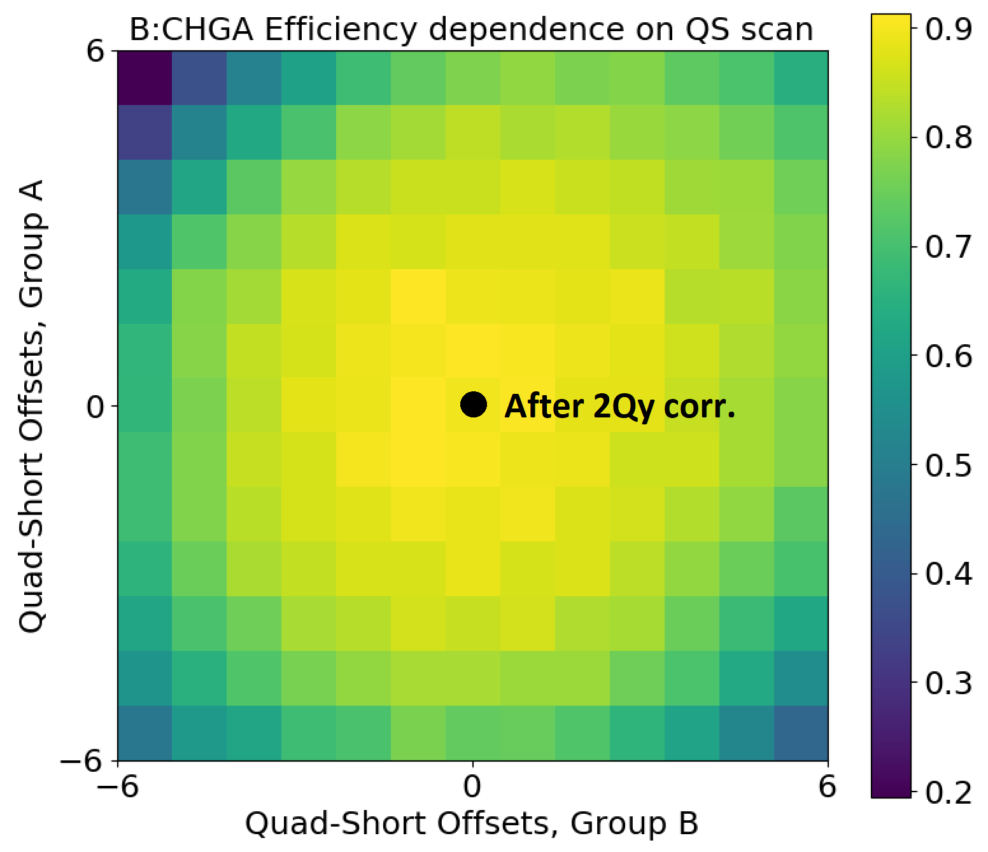
37
2Qx Compensation
The reduction in horizontal emittance from 2Qy made us interested in the effect of our correction on the 2Qx resonance.
We kept the best QL offsets for 2Qy, and scanned QS for 2Qx.
The 2Qx looks like it has already been corrected (within +/- 1 A) after the 2Qy correction.
Further:
- The best efficiency is “round”.
- The collimator loss is minimized
- The horz. emittance is minimized
37
Jeffrey Eldred | Booster Half-Integer Correction
Notes:
37
37
37

