Slide 1
Continuous Delivery
John Diamond, AD/Instrumentation
4/13/2010

Slide 2
Where did this come from?
Continuous Delivery: Reliable Software Releases Through Build, Test, And Deployment Automation (J. Humble, D. Farley)
ICALEPCS 2019 Papers

Slide 3
What is Continuous Delivery?
My quick definition:
Every commit to the repository triggers an automatic deployment to the production environment
Key idea
Problem: developing software involves lots of manual processes in integrating, testing and deployment
Manual processes are error prone, lengthy and applied inconsistently
Solution: automate as much as you can
Automated processes are less error prone, quicker and always applied consistently

Slide 4
But wait, isn’t that dangerous?
Obviously, so we take lots of precautions (that’s the difficult part!)
Automated tests
Unit tests
Acceptance tests
Continuous Integration
Build server with dashboard (Jenkins)
Automated deployments
And roll-backs
Rigorous testing environments
As close to production environment as possible
Code Inspections
Policies

Slide 5
But wait, even with all that, isn’t that still dangerous?
YES and TBH true CD is more of an aspirational goal…
We don’t really want every commit to go straight to production!
What I would really like to achieve:
Comprehensive configuration management
Clean, stable builds
Eliminate integration problems in production
Near-complete test coverage
Completely automated deployments and roll-backs
Stable, sophisticated testing environments that limit the need to test “with beam”
Automated, documented acceptance tests that trace directly to operational requirements
Clear policies that improve software quality

Slide 6
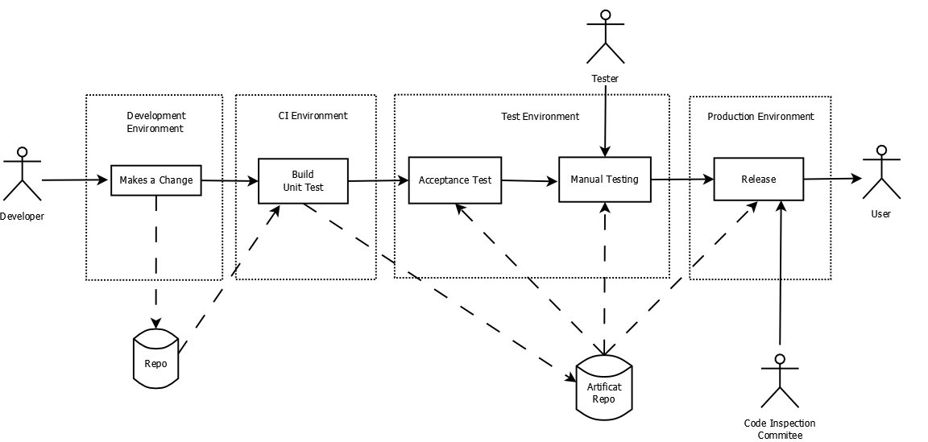
What does it look like?
CD Pipeline
every stage of delivery between the developer and the user

Slide 7
What is comprehensive configuration management?
Git
Start committing right away and commit work as often as you can
Everything gets tracked
Source code, start scripts, deployment scripts, tests
Documentation
Node configurations
Database schemas (DABBEL!)
Policy #1 – every artifact related to the design, construction and operation of the software system must be under version control
Policy #2 – commit early, commit often, limit branches

Slide 8
How do we make sure everything we commit will build?
Best practice is to only commit when your build is working
Policy #3 – Don’t commit anything that breaks the build.
Trickier when you’re working on a library that other projects depend on – your changes can break someone else’s build.
Bigger concern is keeping track of your dependencies
Your build can be broken for months and you wouldn’t know
E.g. MOOC and ACSys/FEF!
Peg your code to specific versions
Good practice, but kicks the problem down the road
Solution: Continuous Integration

Slide 9
What is continuous integration?
My quick definition: every commit and any commit of a dependency triggers an automated rebuild of the project and a run of the test suite on the build server
If the build fails, the commit is marked as bad, the developer is notified and must fix before it is accepted
A test suite should be developed that further verifies the state of the software and is run as part of the CI process
Policy #4 – Every project and it’s dependencies should be tracked by the CI server

Slide 10
Is testing necessary?
We already do manual testing
We spend a lot of time repeating tests
Manual testing is not consistent
Automated testing saves time, ensures that testing is done
Unit test: tests individual software components such as classes, modules or functions
Acceptance test: tests the system as a whole, from the perspective of an end-user and verifies that the software achieves it’s “business” goals
A key metric of testing is test coverage: how much of the code base is executed during the test run
Policy #5 – Every project should include a unit-test suite that achieves at least 80% coverage

Slide 11
After a successful CI build and test, are we done?
NO! Problems occur when the software is deployed due to:
Inconsistencies in provisioning of the target environment
Errors in the manual deployment process
Solution: automation
Automate target provisioning
Automate software delivery
Automate database changes
Automate roll-backs
This is very important – rolling-back if there is a problem should be a simple “one-click” process
Policy #6 – Every software project should include an easy to use, automated deployment and roll-back process

Slide 12
How do we effectively test a system before deployment?
A sophisticated test environment is key
Stable and complete (it’s not a source of spare parts!)
If production includes 10 DAQ modules, test stand should too
Reproduces the production environment as much as possible
This includes simulating conditions that exist in production such as clock events, machine state and “beam”
Development environment includes this stuff too, but a lot more will be simulated
E.g. Use a “mock” DAQ module in place of real hardware
Use a two target approach: the software should run under the development architecture as well as the target architecture
Policy #7 – Every project should maintain a test environment that mirrors the production environment as much as possible

Slide 13
How do we know the software does what the user wants?
Do you know what the user wants? Does the user know?
What the user wants defines the ‘business goals’ of the project
Goals are vague, rarely written down and the verification is done manually and inconsistently
Find out what these are, document them and write tests that verify that the software achieves them consistently
Policy #8 – Every project should include an acceptance test-suite that verifies that the ‘business’ goals are being met
Cucumber & Gherkin are tools that can generate executable acceptance tests from human-readable software specifications

Slide 14
What about tests that we can’t automate?
We shouldn’t expect 100% test automation
Whatever can be, should be
Saves time, guarantees consistencies
Some tests do require a human operator
Write it down in a formal test procedure document
Have a ‘tester’ (not the developer) execute the test
The manual test step is tracked by the CI server and executed by the tester
Once the tester completes the test steps and signs-off on it as a success, the CD pipeline proceeds
Policy #9 – Manual tests should be documented and tracked by the CI server

Slide 15
What are the policies?
Every artifact related to the design, construction and operation of the software system should be under version control
Commit early, commit often, limit branches
Don’t commit anything that breaks the build
Every project and it’s dependencies should be tracked by the CI server
Every project should include a unit-test suite that achieves at least 80% coverage
Every software project should include an easy to use, automated deployment and roll-back process
Every project should maintain a test environment that mirrors the production environment as much as possible
Every project should include an acceptance test-suite that verifies the ‘business’ goals are being met
Manual tests should be documented and tracked by the CI server

