Slide 1
Local Beta Bumps at Fermilab Booster
J. Eldred,
Proton Source Physics Meeting
May 7th, 2020

Slide 2
2
Motivation
We can make a local change to beam orbit – impacting one section of the Booster without impacting the whole Booster ring.
But can we do the same for beta functions?
This required some math, some modeling, and eventually it will require some experimentation.
I will talk about specific applications as we go along.
2
Jeffrey Eldred | Local Beta Bumps for Booster

Slide 3
3
How to Construct a Beta Bump
The transfer matrix for a lattice segment composed of arbitrary transfer matrices T, separated by thin quad kicks Q:
For what values of M & Q is the overall transfer matrix M unaffected by the quad kicks? To the rest of the lattice, the kicks are invisible, the distortion in the beta functions is localized.
A solution requires:
The transfer matrices T will in general be different between horizontal and vertical planes, therefore use for a beta bump to be local in both planes, use only QLs or only QSs.
3
Jeffrey Eldred | Local Beta Bumps for Booster

Slide 4
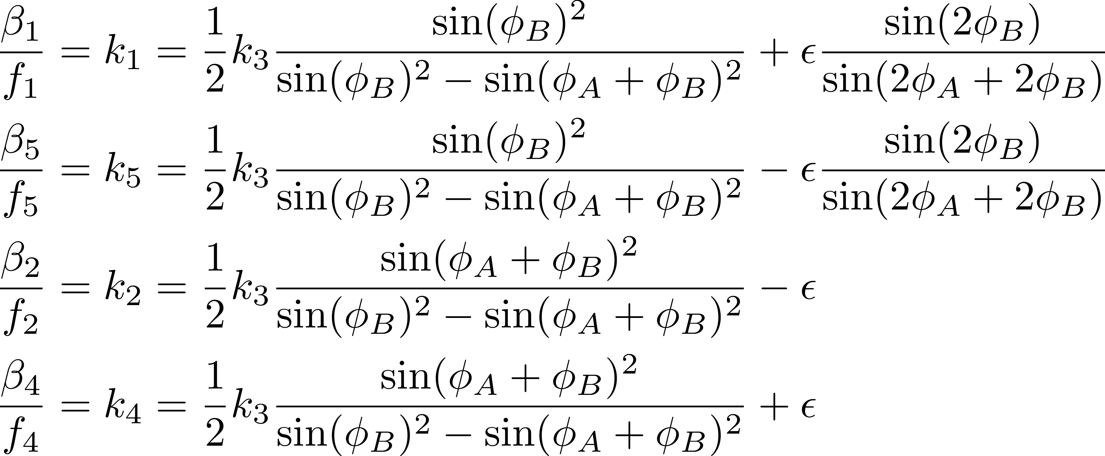
4
How to Construct a Beta Bump (cont.)
A five-quad solution is available, for symmetric but otherwise arbitrary phase-advances φ_{A} & φ_{B}, assuming small quad kicks k:
Where ε is a free parameter.
Full algebraic calculation at beams-8341.
4
Jeffrey Eldred | Local Beta Bumps for Booster

Slide 5
5
MAD-X Model of Beta Bumps
The beta bump may be localized, but what does it actually do?
Use MAD-X model to see changes in the TWISS functions.
For simplicity, I use a simplified Booster with 24 identical cells. The impact on the real Booster will be the mostly the same. The peaks and valleys of the TWISS functions will be changed the same way.
I also use timeslot = 3, because the changes to quad-offsets should be predominately impact injection optics.
Lastly I change the tune to ν_{x} = 6.75, ν_{y} = 6.85 .
5
Jeffrey Eldred | Local Beta Bumps for Booster

Slide 6
6
6
Single QL error
6
Jeffrey Eldred | Local Beta Bumps

Slide 7
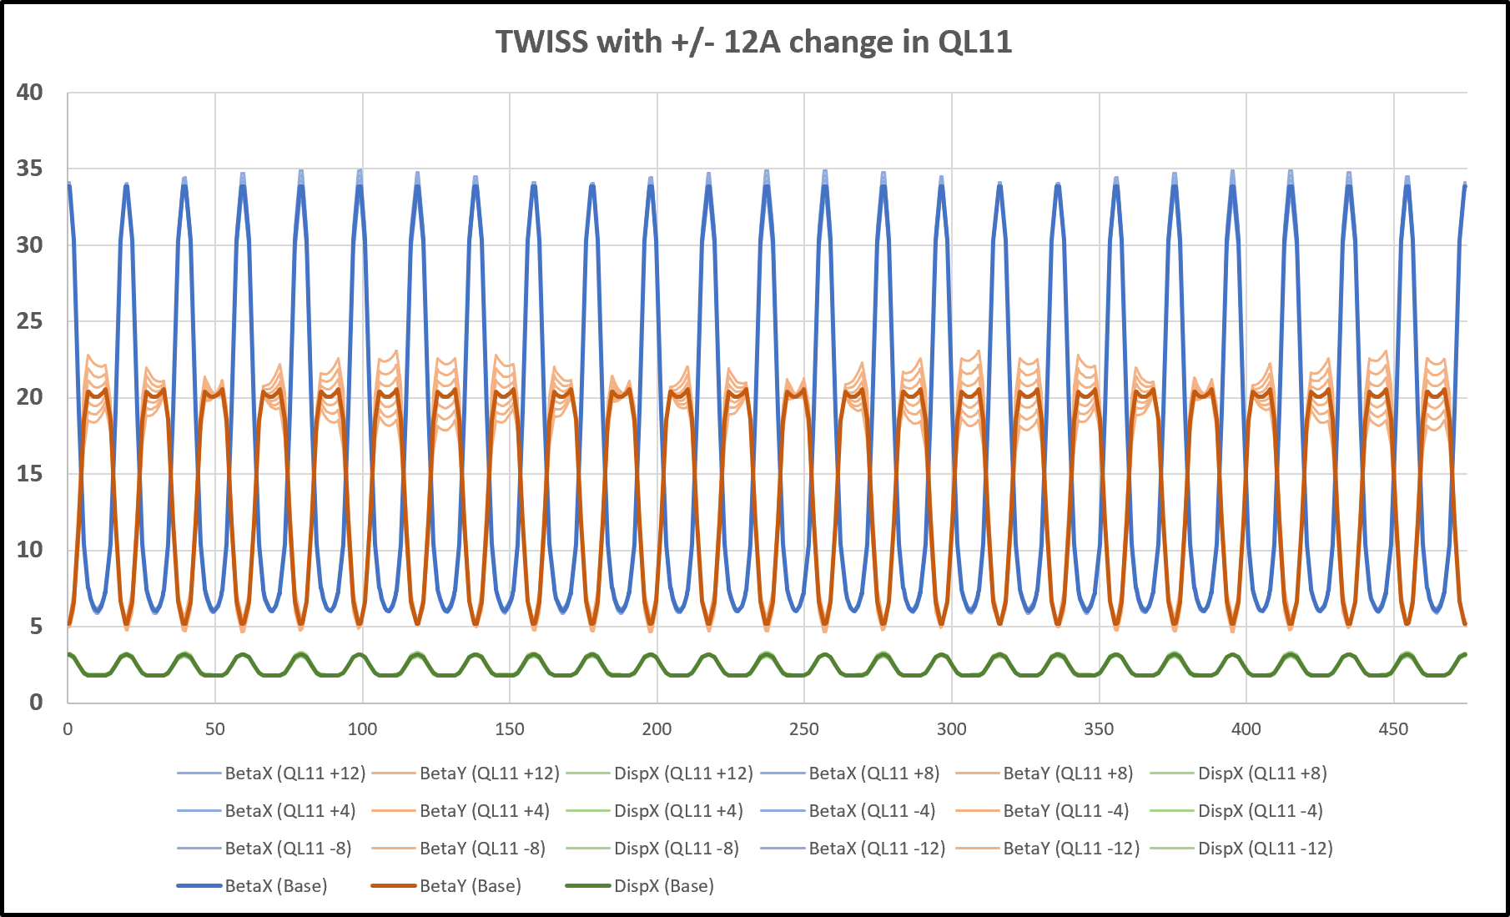
7
TWISS functions (single QL error)
QL11 error
BetaX
BetaY
DispX
Change in QL11 creates a completely nonlocal effect in BetaY.
No strong effect on BetaX or DispX.
7
Jeffrey Eldred | Local Beta Bumps for Booster

Slide 8
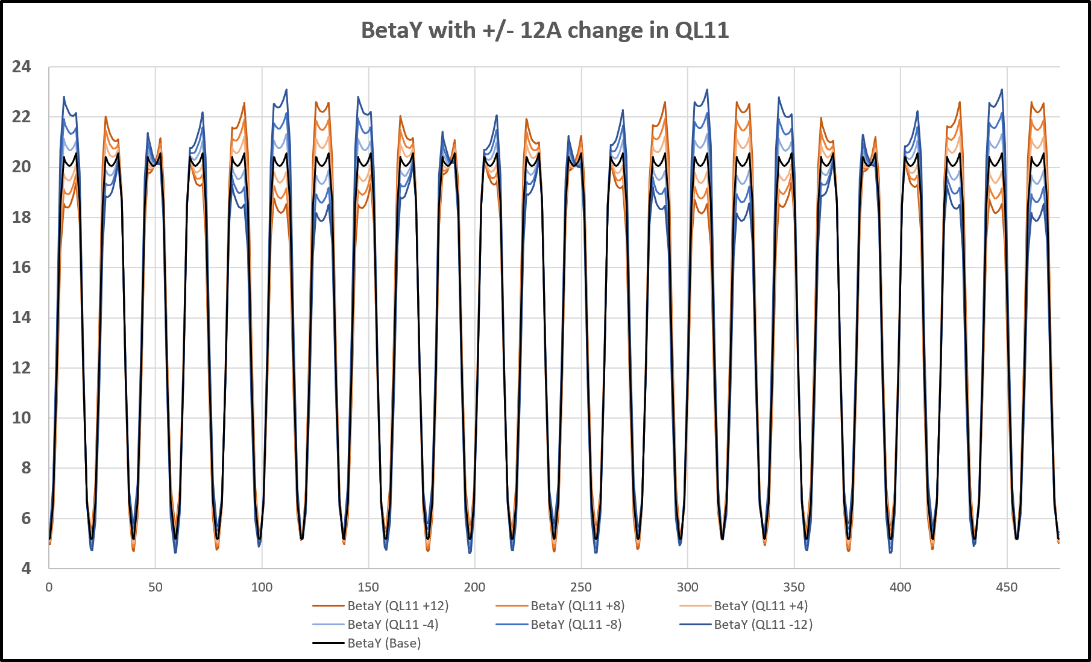
8
BetaY function (single QL error)
QL11 error
Pos. Error
Neg. Error
No Error
(Vert. aperture restriction in short straight.)
Effect on BetaY in long straights alternates increase/decrease.
At injection +/-12 A leads to +/- 10% BetaY around the ring.
8
Jeffrey Eldred | Local Beta Bumps for Booster

Slide 9
9
9
Beta-Y Bump
(5-QL bump)
9
Jeffrey Eldred | Local Beta Bumps
Notes:
9
9
9
9
9
9

Slide 10
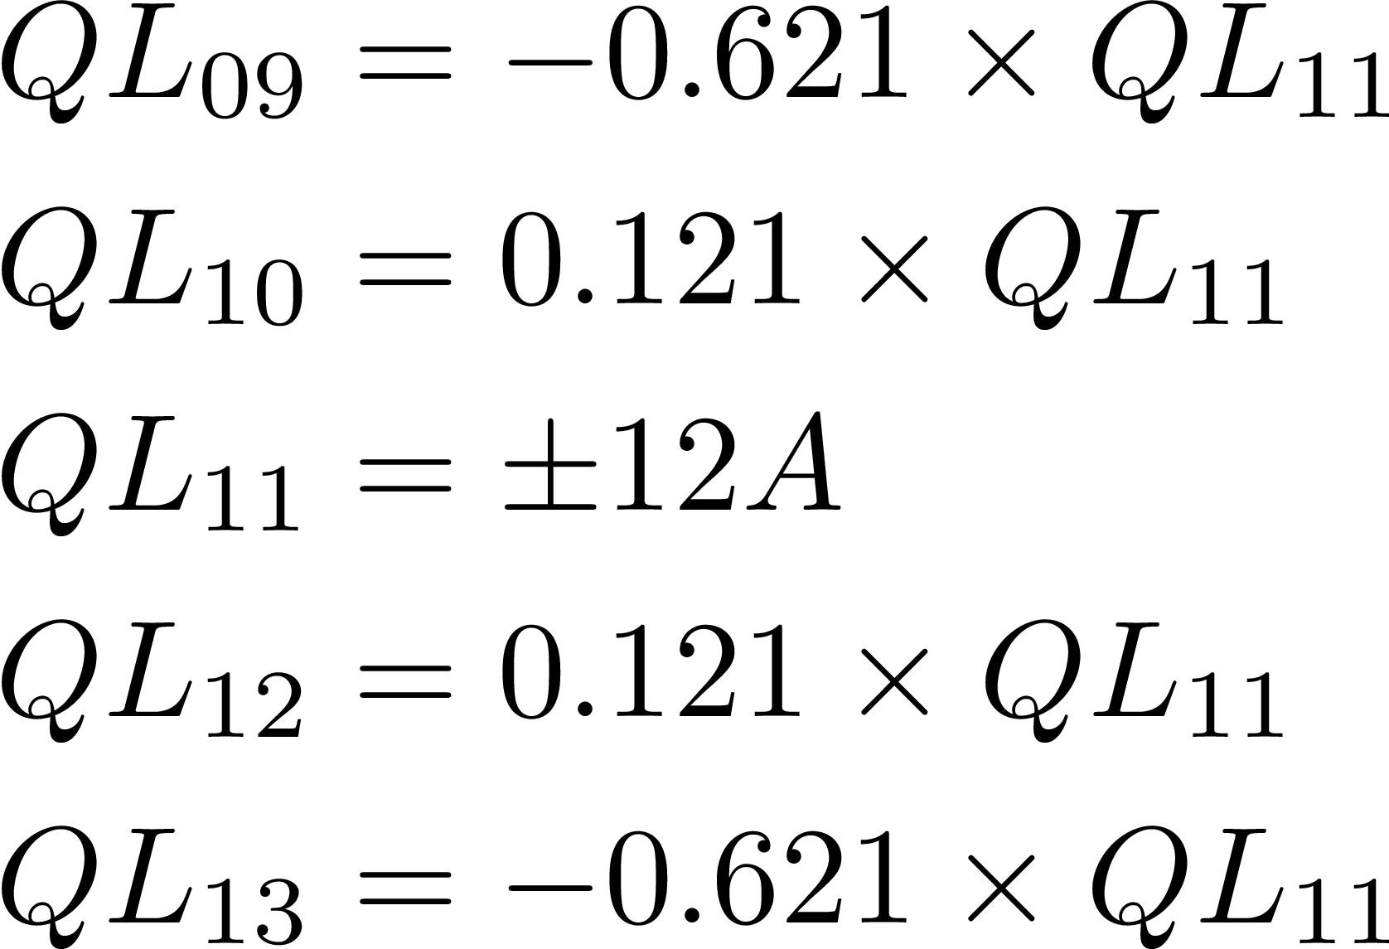
10
Coefficients (5-QL bump for BetaY)
Applying the conditions
for a bump at QL11:
10
Jeffrey Eldred | Local Beta Bumps for Booster

Slide 11
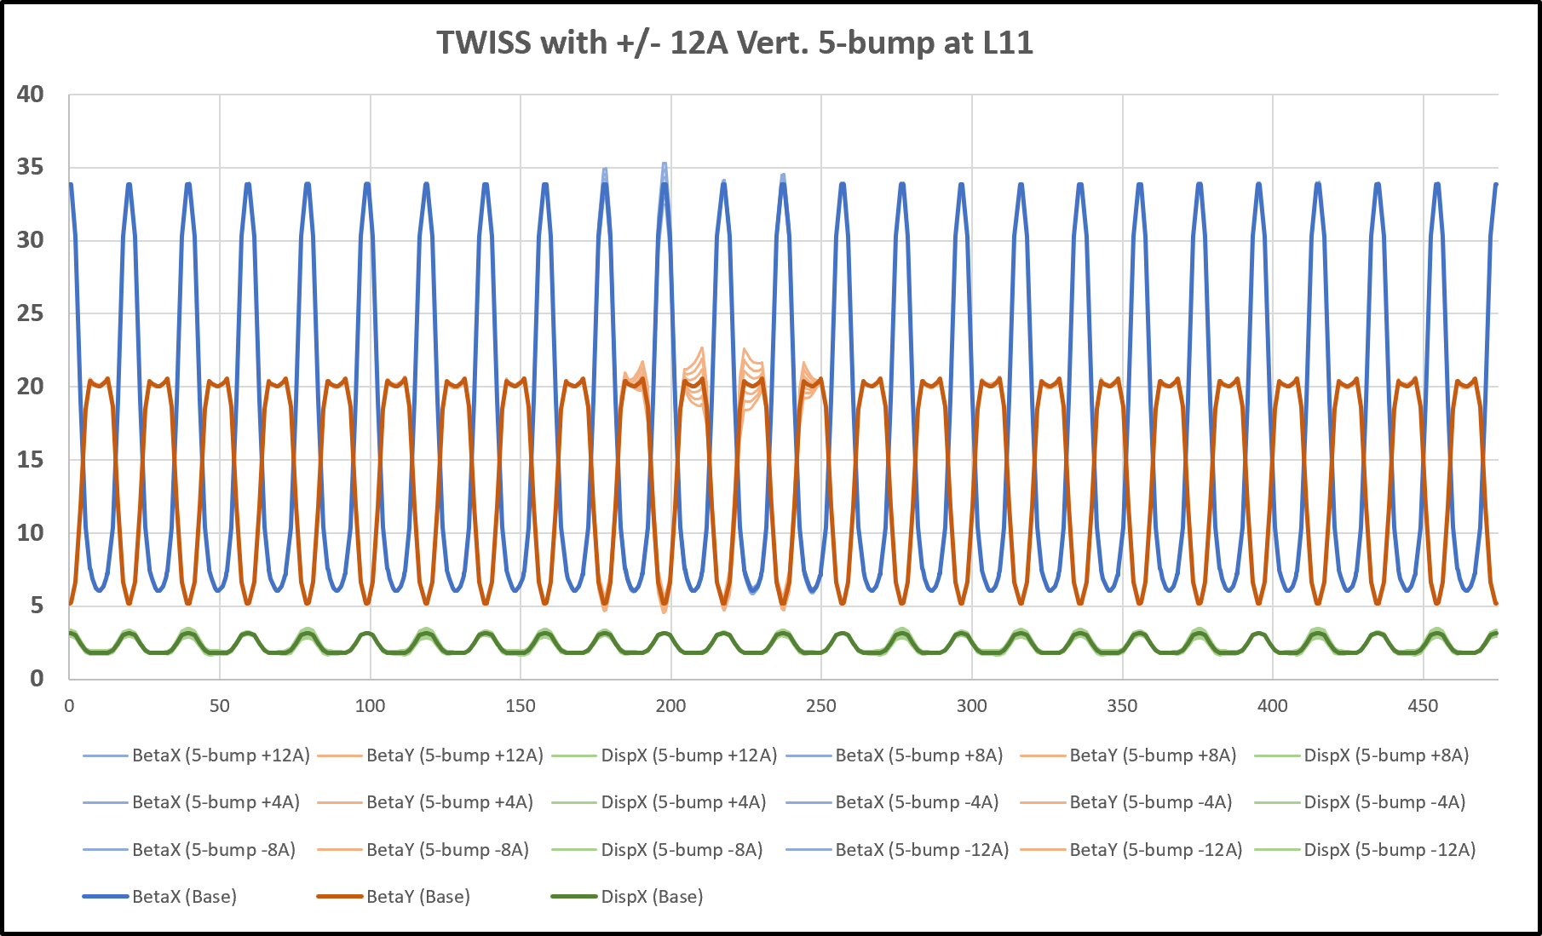
11
TWISS functions (5-QL bump for BetaY)
BetaX
BetaY
DispX
The only significant impact is on BetaY,
small nonlocal effect in DispX.
11
Jeffrey Eldred | Local Beta Bumps for Booster
Notes:
11
11
11

Slide 12
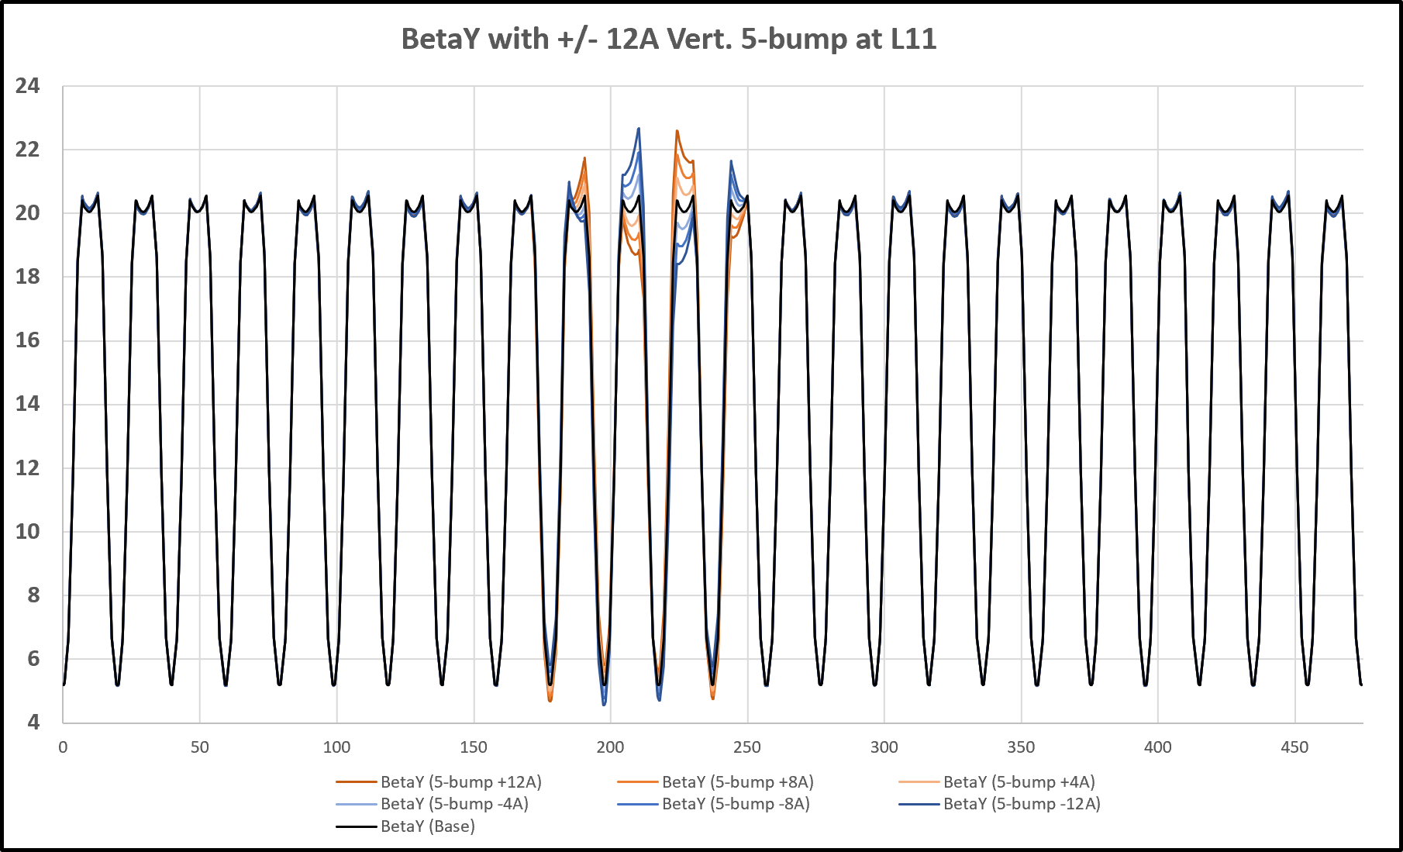
12
BetaY function (5-QL bump for BetaY)
L11 L12
Pos. Bump
Neg. Bump
No Bump
L10
L13
The bump is very well localized in BetaY.
12
Jeffrey Eldred | Local Beta Bumps for Booster
Notes:
12
12
12

Slide 13
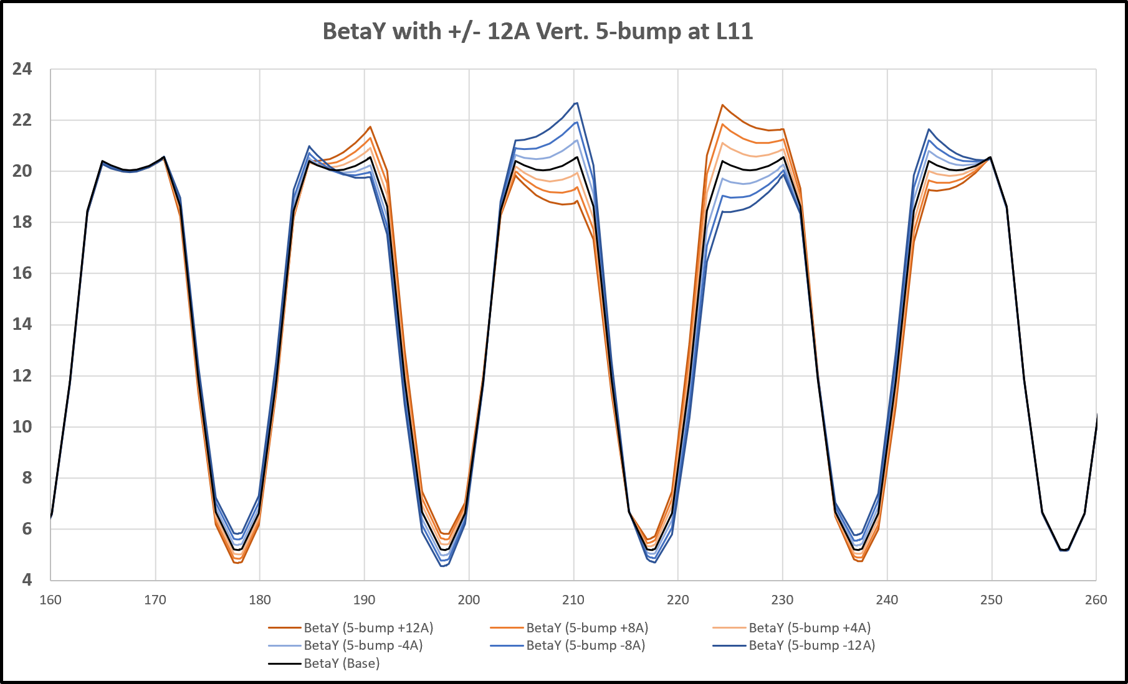
13
BetaY function (5-QL bump for BetaY)
L10 L11 L12 L13
Pos. Bump
Neg. Bump
No Bump
(Vert. aperture restriction in dipoles.)
S09 S10 S11 S12
Increase/Decrease in S10 & S11, L10 & L12,
Increase/Decrease in S09 & S12, L11 & L13.
13
Jeffrey Eldred | Local Beta Bumps for Booster
Notes:
13
13
13

Slide 14
14
Application 1: Vertical/Short Loss Management
Step 1: Tune Beam Orbits.
Step 2: Adjust Vertical Bump.
- reduce losses middle two shorts (S10 & S11).
- watch for losses at outer two shorts (S09 & S12), middle long (L11).
Step 3 (optional): Followup Bumps.
- if losses increase at outer shorts (S09 or S12)
- use adjacent vertical bumps.
- if losses increase (undesirably) at middle long (L11)
- check horizontal orbit.
- recheck vertical orbit.
- try adjacent bumps.
14
Jeffrey Eldred | Local Beta Bumps for Booster

Slide 15
15
Application 2: Injection & Extraction Tuning
Same strategy for Injection & Extraction, except with some complications.
The bump changes many relevant parameters:
beta function at kick (foil-scatter or kicker).
phase-advance between kick and downstream straights.
betas in downstream straights.
Also, need to account for the effect of QL3 corrector displacement.
\
Strategy: tune empirically & itertate model-specific scenarios.
15
Jeffrey Eldred | Local Beta Bumps for Booster

Slide 16
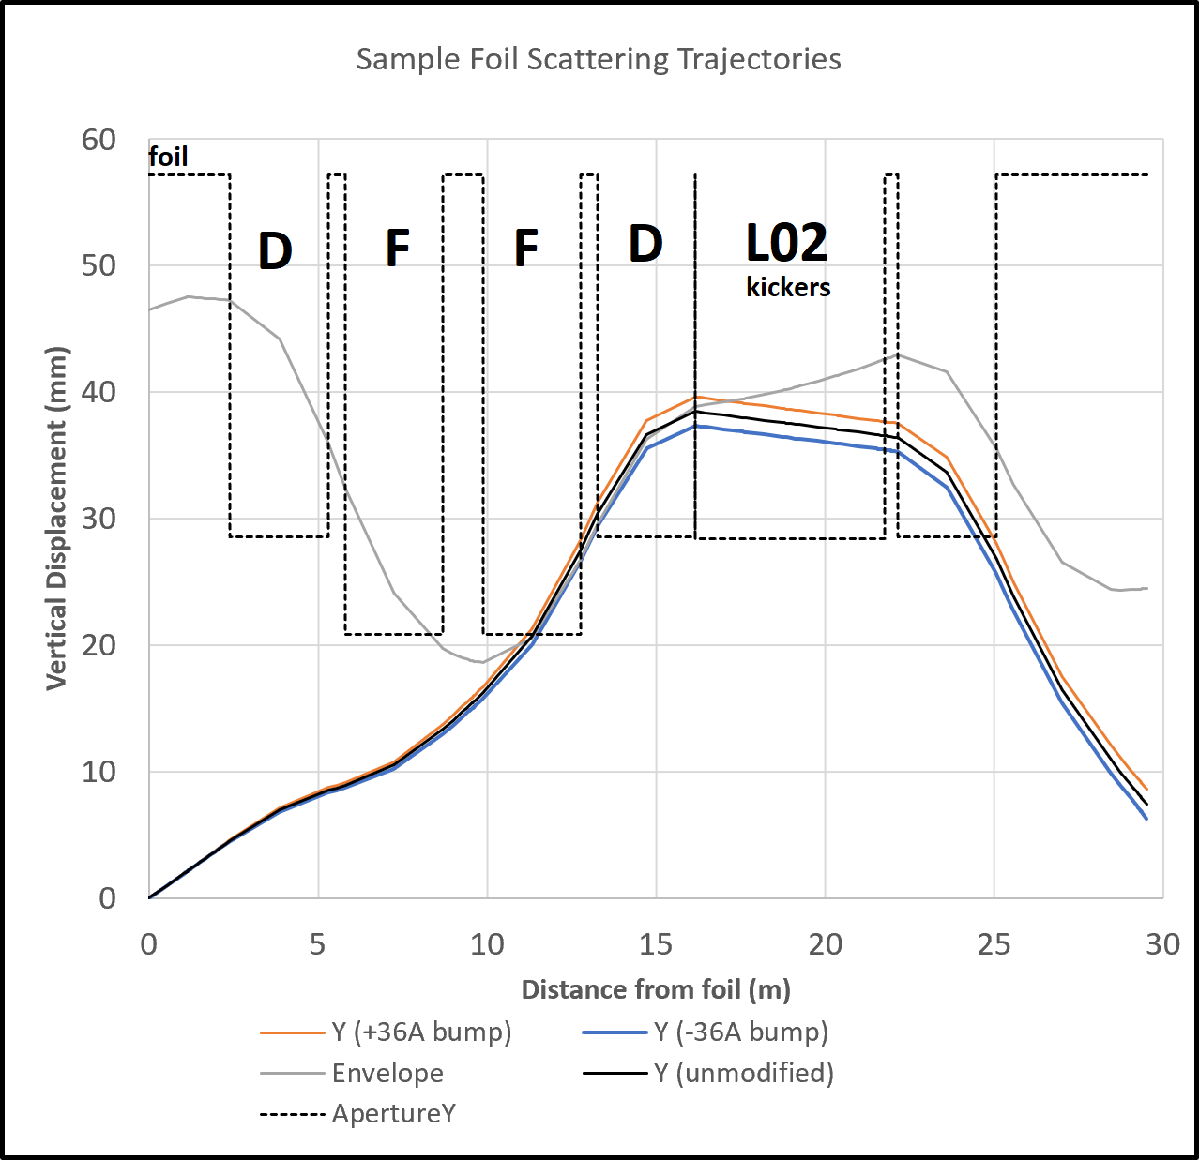
16
Application 2: Injection & Extraction Tuning
A typical trajectory for a particle loss due to foil-scattering (black).
Trajectory modified by
+/- 36A local quad bump
(orange/blue).
The effect is barely perceptible ~1% ?
16
Jeffrey Eldred | Local Beta Bumps for Booster

Slide 17
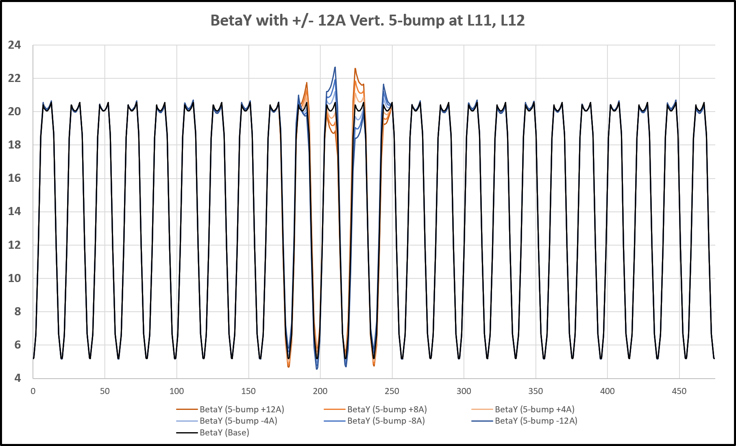
17
Application 3: Missing QL11 Compensation
Suppose that the Booster could be tuned up perfectly, except that it required +/- 12A on QL11 and QL11 was not available (artificial scenario).
The global effect of QL11 could be emulated with QL09, QL10, QL12, QL13, keeping the beta-error to a restricted region between the L9 collimator & notch absorber.
L11 Compensation
Use subsequent local beta bumps to smooth betas at L11 injection and nearby Booster cells.
17
Jeffrey Eldred | Local Beta Bumps for Booster

Slide 18
18
18
Single QS error
18
Jeffrey Eldred | Local Beta Bumps

Slide 19
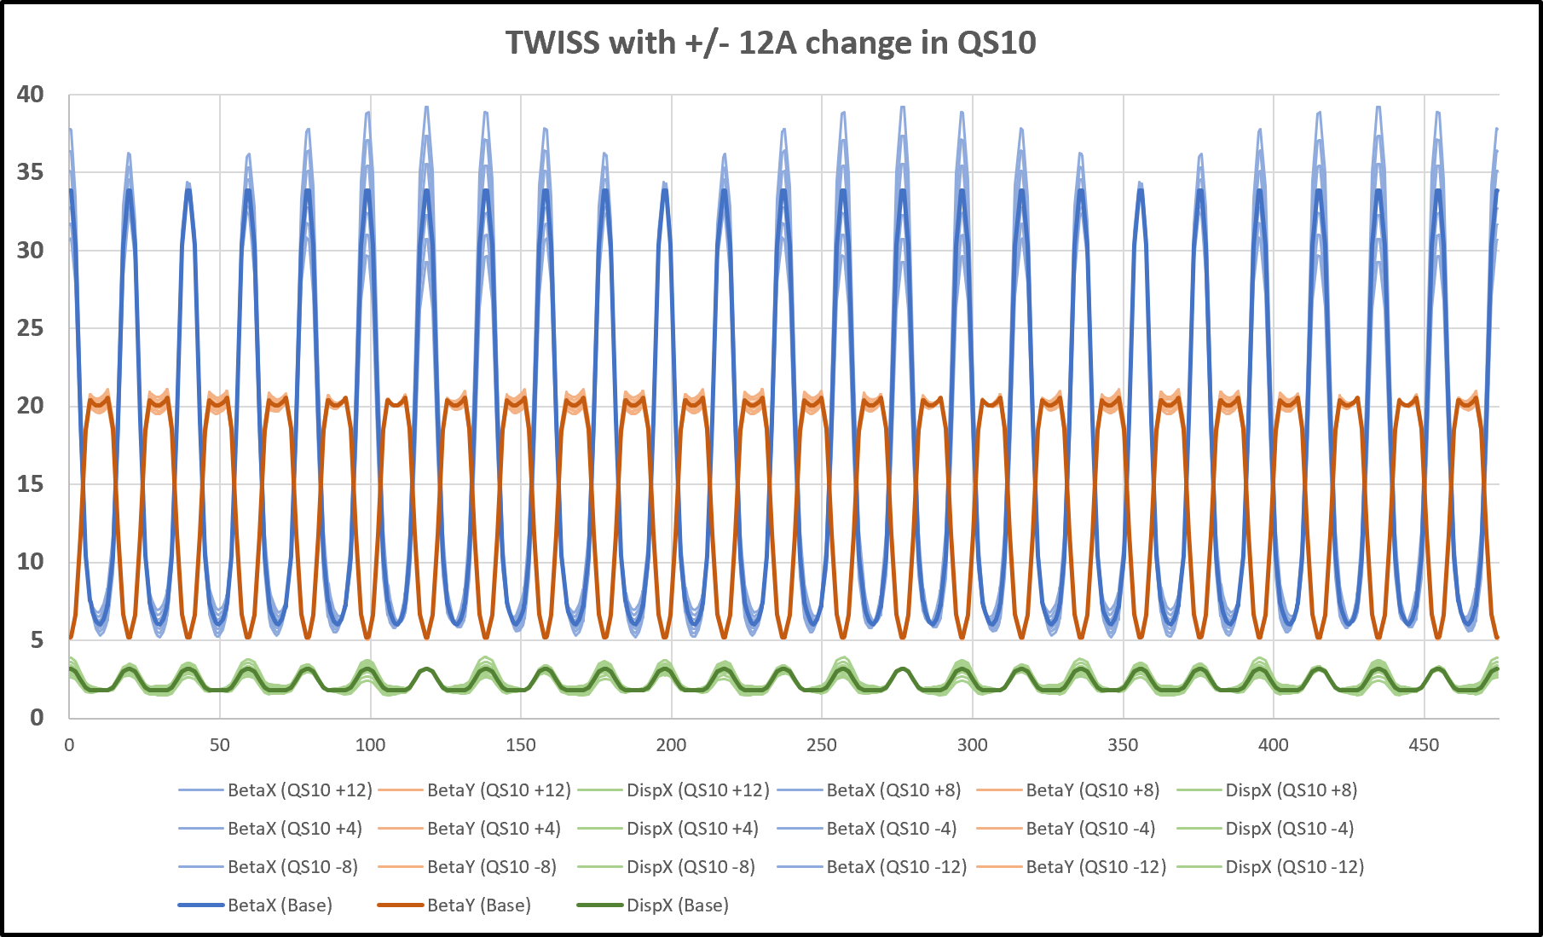
19
TWISS functions (single QS error)
QS10 error
BetaX
BetaY
DispX
Change in QS11 creates a nonlocal effect in BetaX & DispX.
No strong effect on BetaY.
19
Jeffrey Eldred | Local Beta Bumps for Booster

Slide 20
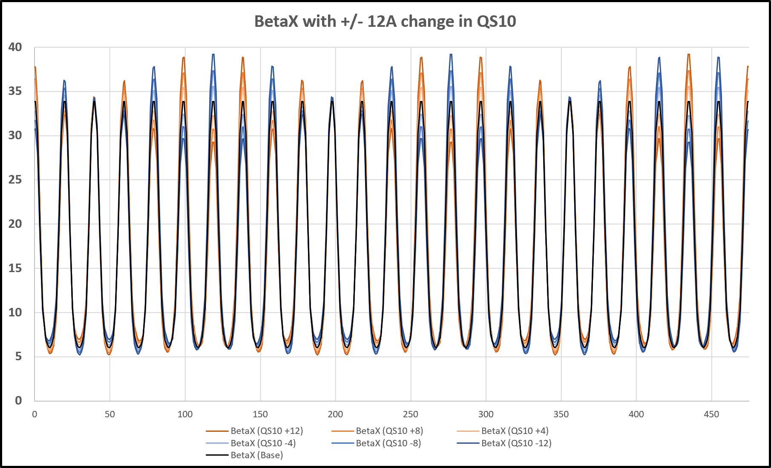
20
BetaX function (single QS error)
QS10 error
Pos. Error
Neg. Error
No Error
(Horz. aperture restriction in long straight.)
Effect on BetaX in short straights alternates increase/decrease.
At injection +/-12 A leads to +/- 15% BetaX around the ring.
20
Jeffrey Eldred | Local Beta Bumps for Booster

Slide 21
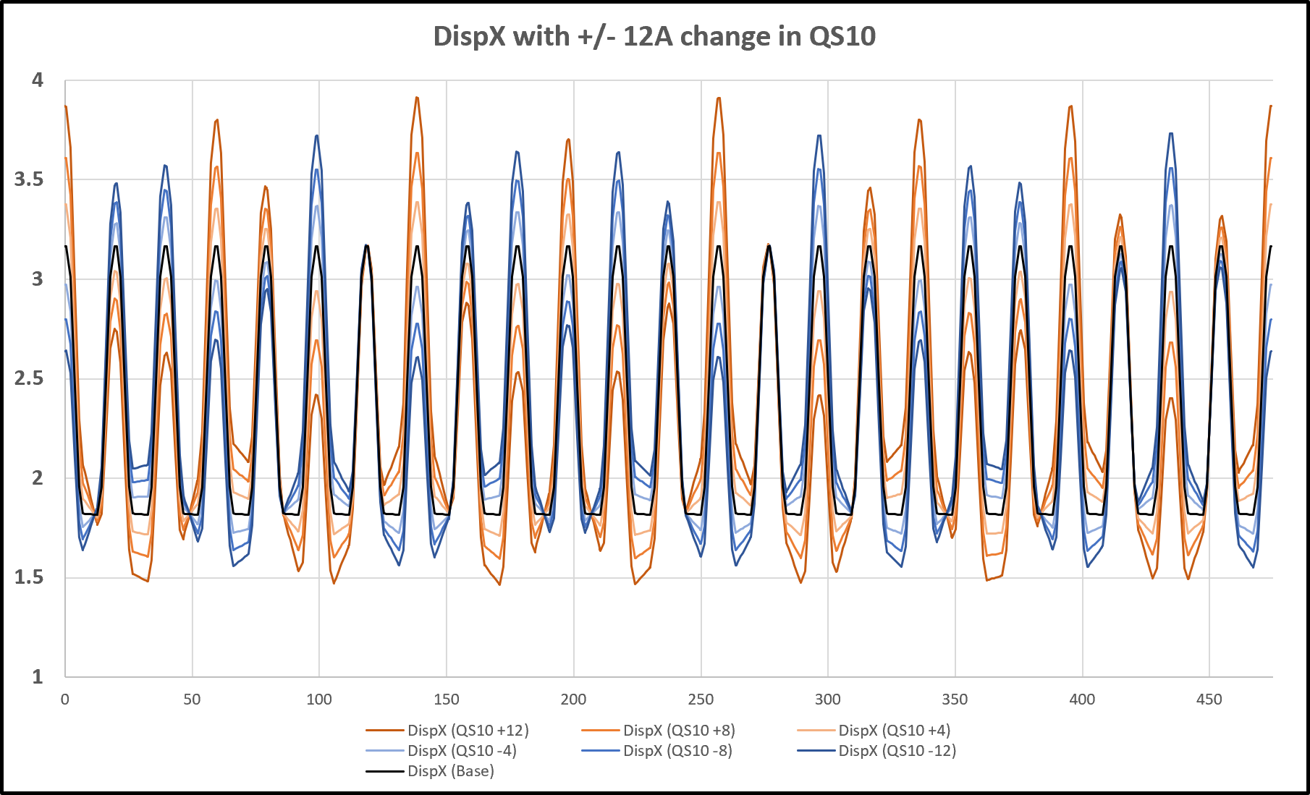
21
DispX function (single QS error)
QS10 error
Pos. Error
Neg. Error
No Error
At injection +/-12 A leads to +/- 20% DispX around the ring.
21
Jeffrey Eldred | Local Beta Bumps for Booster

Slide 22
22
22
Disp-X Bump
(3-QS bump)
(nonlocal Beta-X)
22
Jeffrey Eldred | Local Beta Bumps for Booster
Notes:
22
22
22
22
22
22

Slide 23
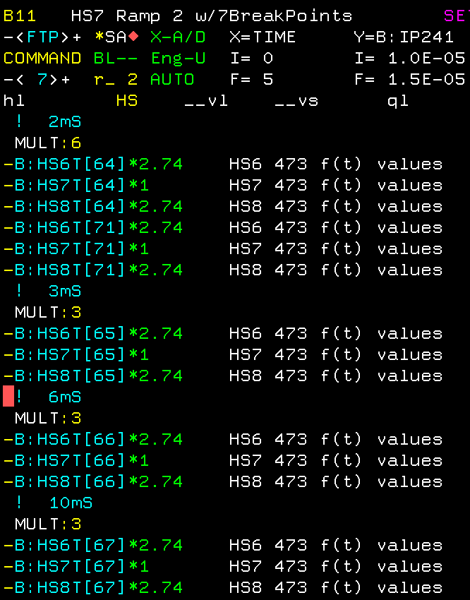
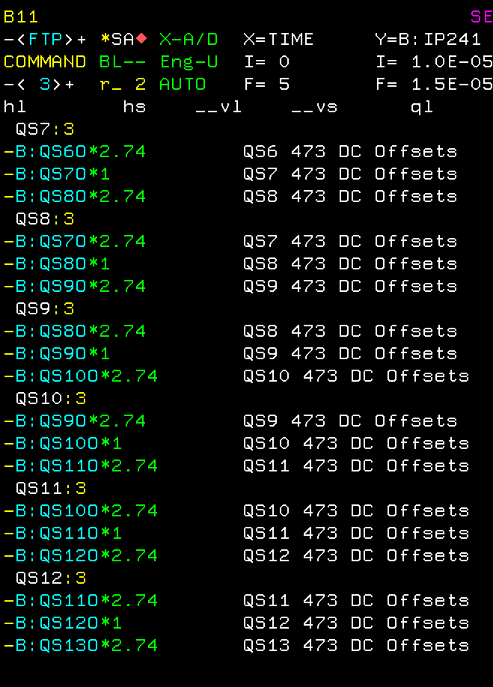
23
Coefficients (DispX Bump)
The quad-kicks also have an effect on dispersion,
similar to the effect that dipoles kicks have on the beam orbit.
Therefore to create a local dispersion bump (someone already did this):
23
Jeffrey Eldred | Local Beta Bumps for Booster

Slide 24
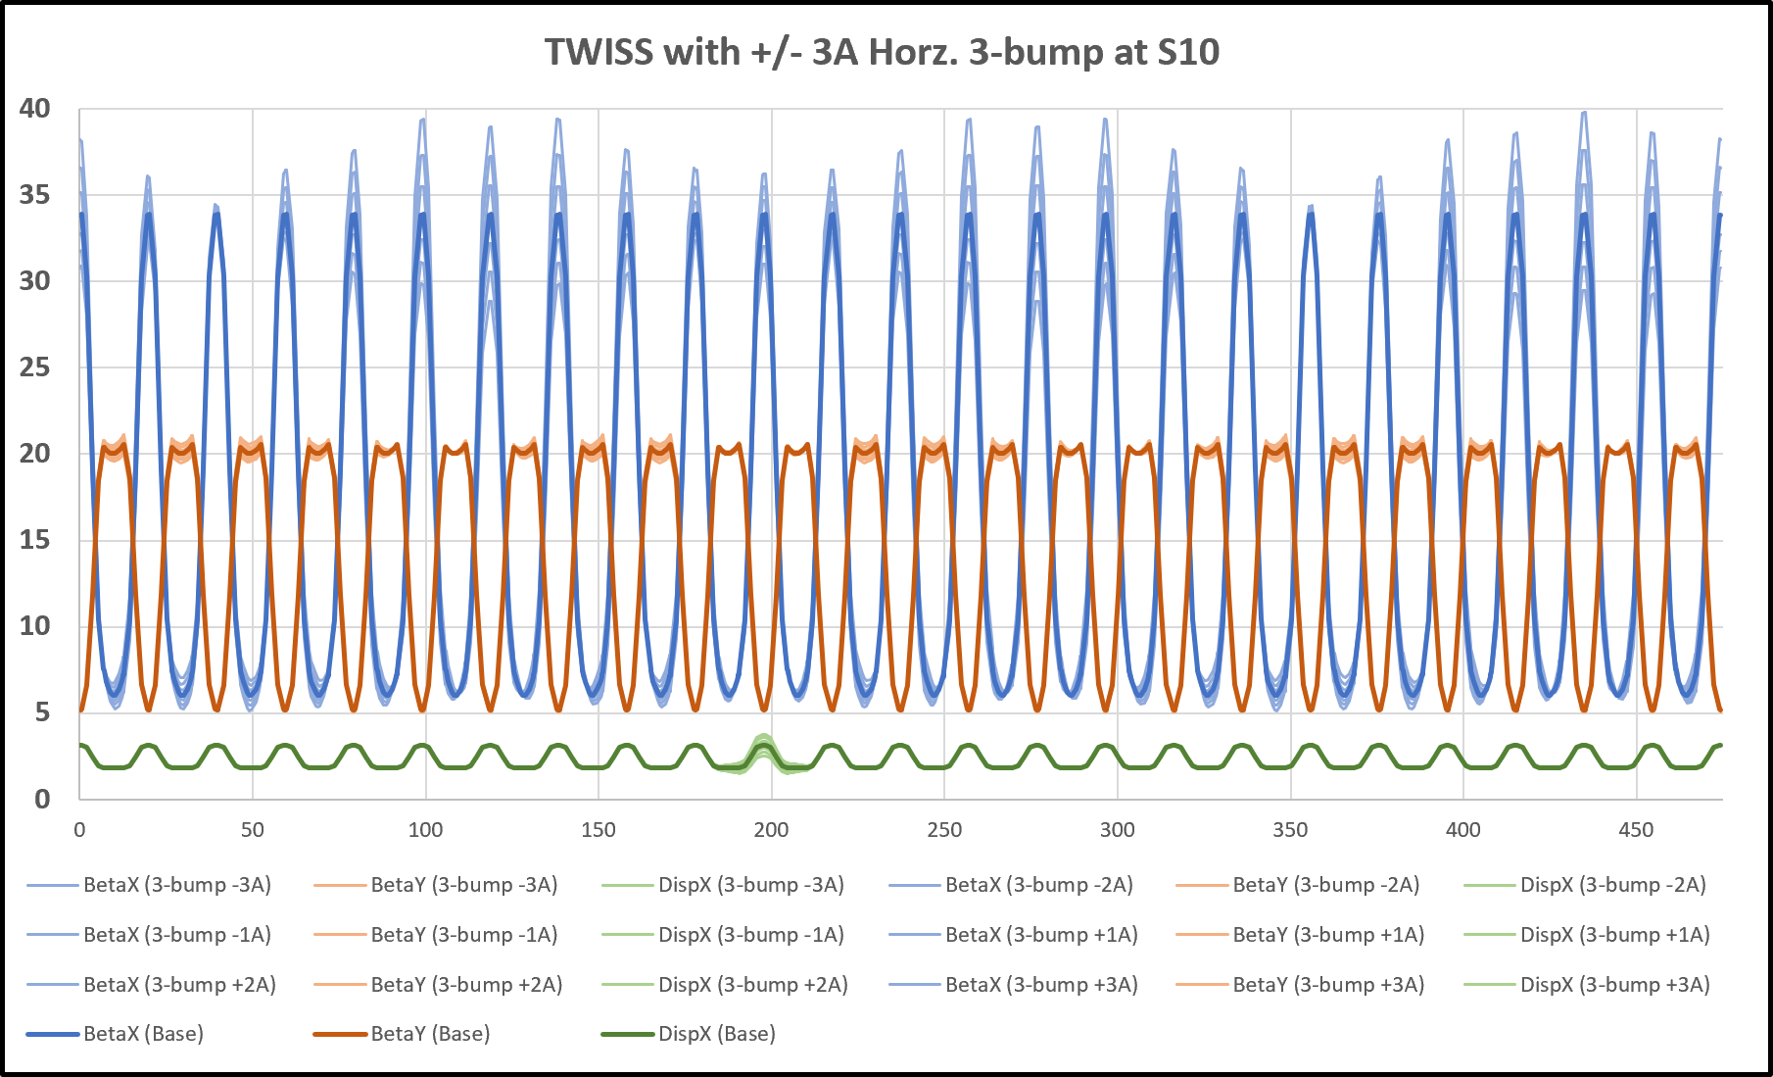
24
TWISS functions (3-QS bump for DispX)
BetaX
BetaY
DispX
The significant local impact on BetaX,
nonlocal effect in DispX.
24
Jeffrey Eldred | Local Beta Bumps for Booster
Notes:
24
24
24

Slide 25
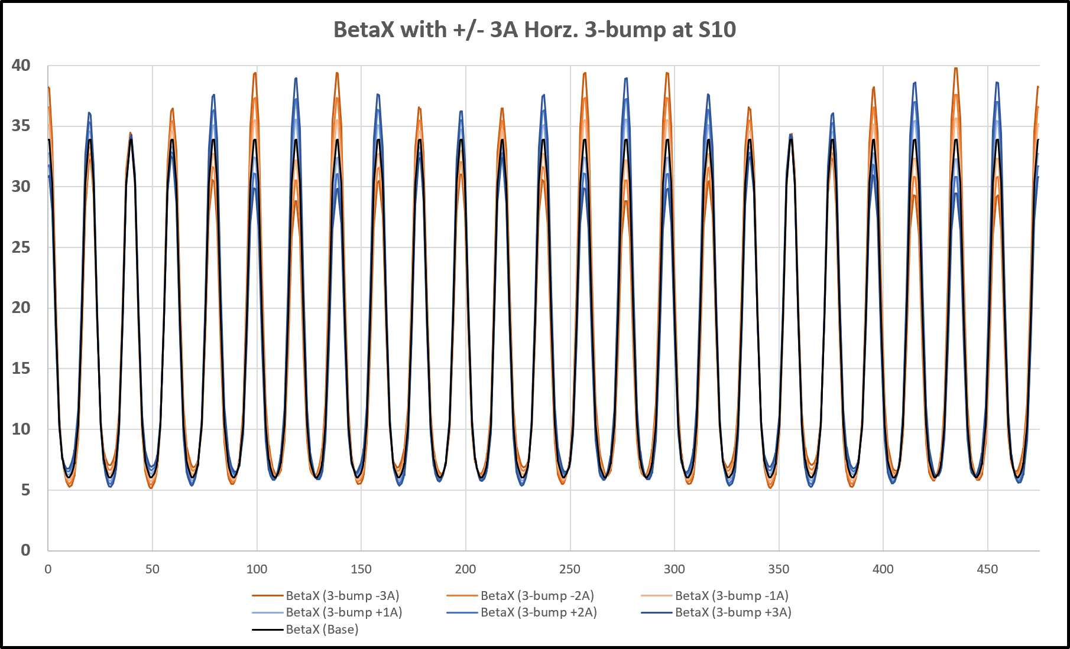
25
BetaX function (3-QS bump for DispX)
S10
Neg. Bump
Pos. Bump
No Bump
Very nonlocal effect in BetaX.
25
Jeffrey Eldred | Local Beta Bumps for Booster
Notes:
25
25
25

Slide 26
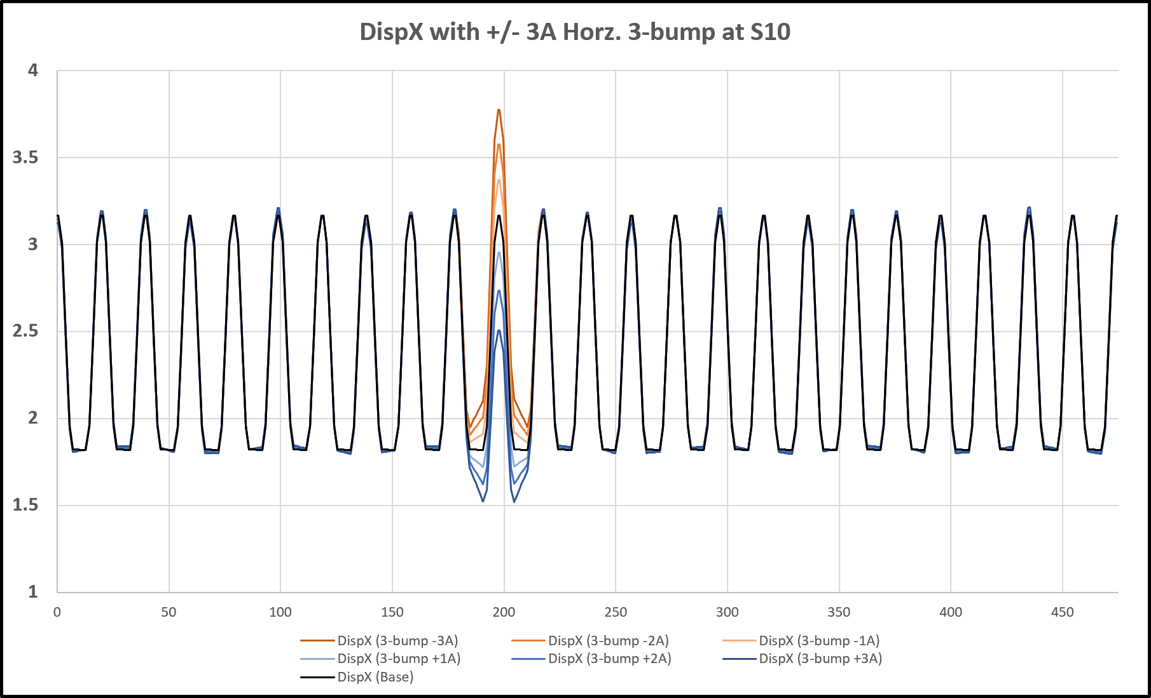
26
DispX function (3-QS bump for DispX)
S10
Neg. Bump
Pos. Bump
No Bump
(Horz. aperture restriction in long straight.)
L10 L11
Increase/Decrease in S10, L10 & L11
26
Jeffrey Eldred | Local Beta Bumps for Booster
Notes:
26
26
26

Slide 27
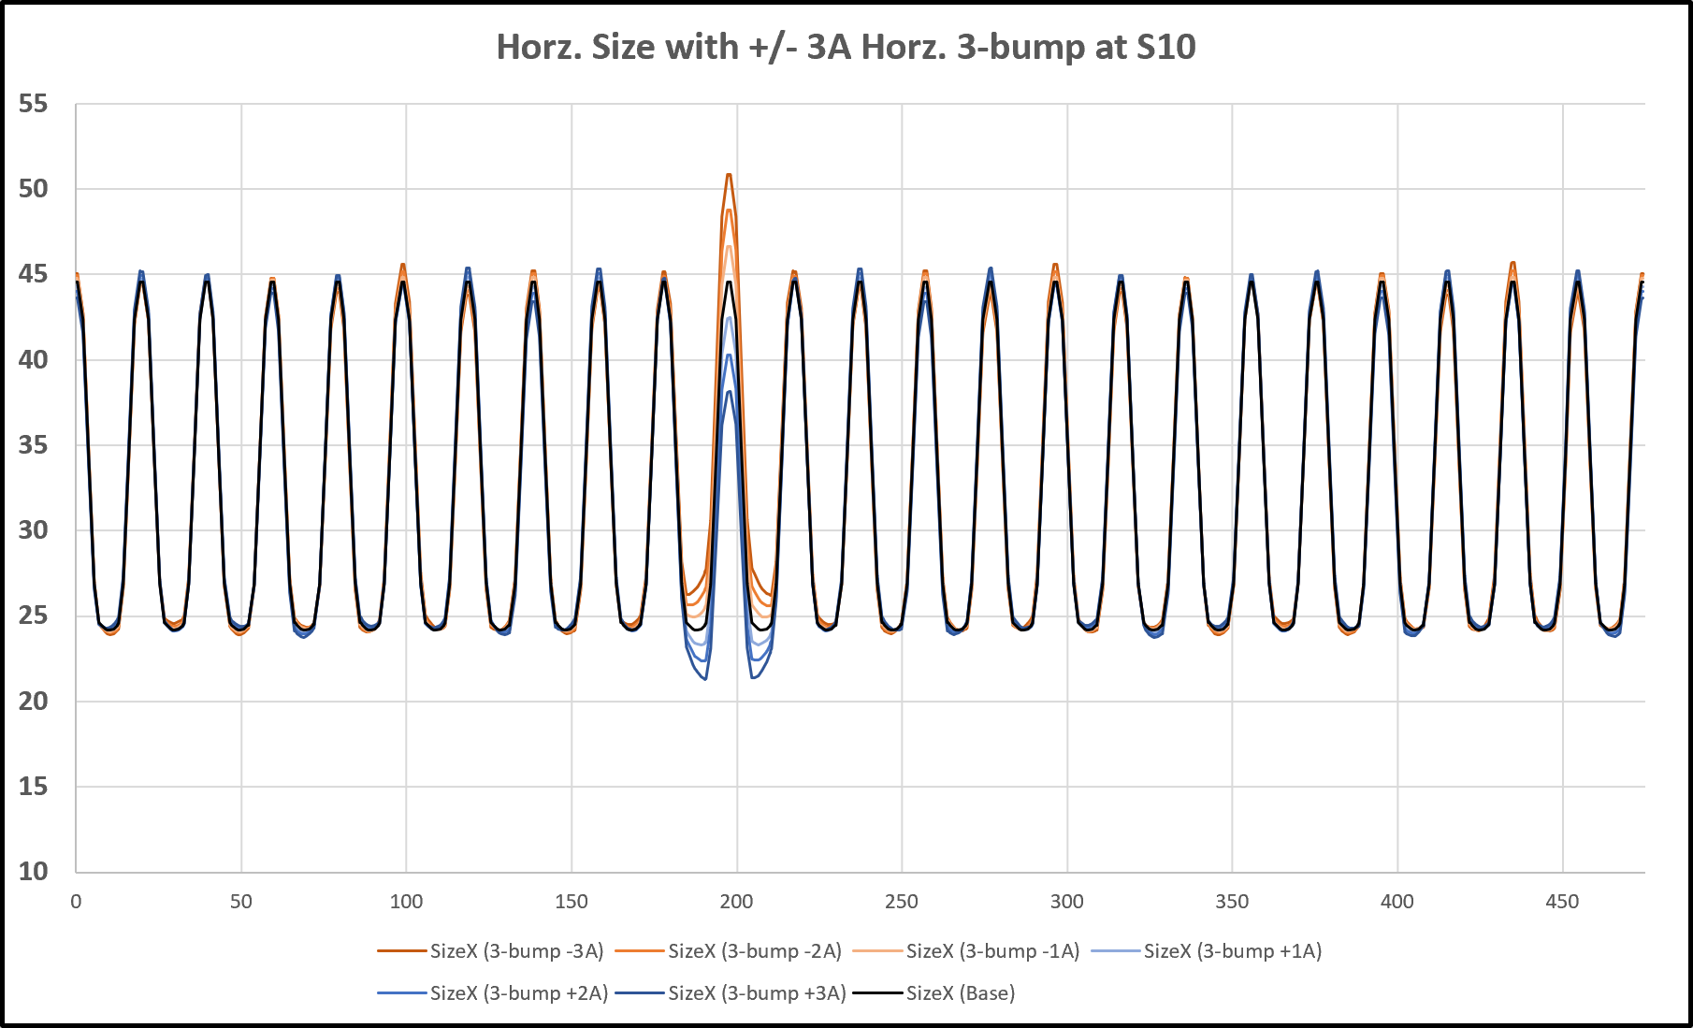
27
Horz. Beam Size (3-QS bump for DispX)
S10
Neg. Bump
Pos. Bump
No Bump
L10 L11
(Horz. aperture restriction in long straight.)
Increase/Decrease in S10, L10 & L11
Horz. beam size dominated by changes in DispX
27
Jeffrey Eldred | Local Beta Bumps for Booster
Notes:
27
27
27

Slide 28
28
Application 4: Horizontal/Long Loss Management
Step 1: Tune Beam Orbits.
Step 2: Adjust Dispersion Bump.
- reduce losses in outer two longs (L10 & L11), inner short (S10).
Step 3: Retune Early Beam Orbits.
- if the energy is mismatched from linac, then changing the dispersion will also affect the early orbit.
28
Jeffrey Eldred | Local Beta Bumps for Booster

Slide 29
29
Next Steps
When Booster comes out of lockdown and shutdown, several studies:
- Implement a large (safe) bump and look for it in TBT data.
- Try targeted loss reduction, esp. at sensitive locations.
- Emulate QL11 tuning with QL09, QL10, QL12, QL13.
Several ways to extend the theoretical work:
- Extend calculation to sets of quads without periodic cells.
- How can we tune a linac without impacting injection matching?
- Express matrix algebra in terms of α, β instead of x, x’
- What quad placement leads to an “efficient” bump?
- John Johnstone may collaborate on this.
Altogether, possibly publishable.
- There will at least be a technical note.
29
Jeffrey Eldred | Local Beta Bumps for Booster

