Slide 1
“Longitudinal Dynamics at Injection Booster”
Chandra Bhat
PSP/Taskforce Meeting
20200702

Slide 2
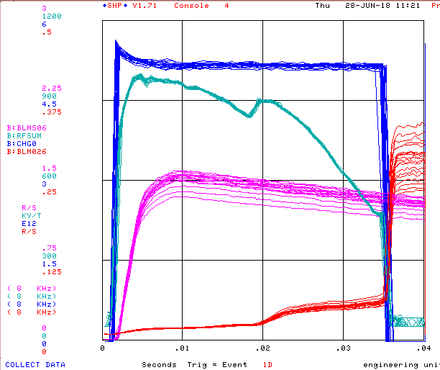
Losses in Booster at Injection and Transition Crossing
Observations:
We see beam losses
Very close to injection (Firing of Booster Notcher)
First ~5 ms
Transition crossing
(Extraction)
Emittance growth in the cycle
Overall Inj-Extr. Cycle-efficiency ≈94% at this intensity as measured by B:IRMCHG. At about 4.3E12ppBc it is ≈ 95%.
Goal:
Mitigate losses and emittance dilution for current and future higher intensity operation, which requires
Understand loss mechanisms
Develop and implement mitigation techniques
Current Opert.
~5-6% beam losses
(This may be far less during PIP-II era.)
5.6E12ppBc
Beam
5.2E12ppBc
@
Exi
@
In
t
j
~0.1%, but contributes to almost all LE growth
RFSUM
BLM1
BLM2

Slide 3
Booster during 700kW, 900kW and 1.2MW era
Specific Goal of the Booster is to extract beam with εL(95%)<0.1 eVs (& εT<16 π-mm-mr) with ring wide beam loss <500 Watt. This implies
Continue to extract ~4.3E12ppp@15Hz with >94% efficiency for 700 kW NoVA operation
Extract ~5E12ppp@15Hz with >96% efficiency for 900 kW NoVA operation
Extract ~6.5E12ppp@20Hz with >98% for 1.2MW LBNF operation
Have a more accurate measurements on beam loss measuremtns
Currently at 400 MeV
The LINAC beam has (dp/p)(95%)~0.0023 (dE(95%) ~1.6 MeV, εL(95%)~0.04 eVs/bunch)
@the end of capture (dp/p)(95%)~0.0069 (dE(95%) ~4.8 MeV, εL(95%)~0.06 eVs/bunch )
@start of acceleration (dp/p)(95%)~0.0069 (dE(95%) ~4.8 MeV, εL(95%)~0.06 eVs/bunch )
Booster momentum acceptance@inj (dp/p)~0.0073 (A(full)~5MeV)
During PIP-II at 800 MeV
(dp/p)(95%)~0.0018 (dE(95%) ~4.2 MeV, εL(95%)~0.06 eVs/bunch ) (dist. from E. Pozdeyev)
@start of acceleration (dp/p)(95%)~0.0068 (dE(95%) ~8.4 MeV, εL(95%)~0.06 eVs/bunch )
Booster momentum acceptance@inj (dp/p)~0.0073 (A(full)~9MeV)
So, it is very important to mitigate emittance dilution and beam losses in entire cycle and, in particular in the early part of the cycle.

Slide 4
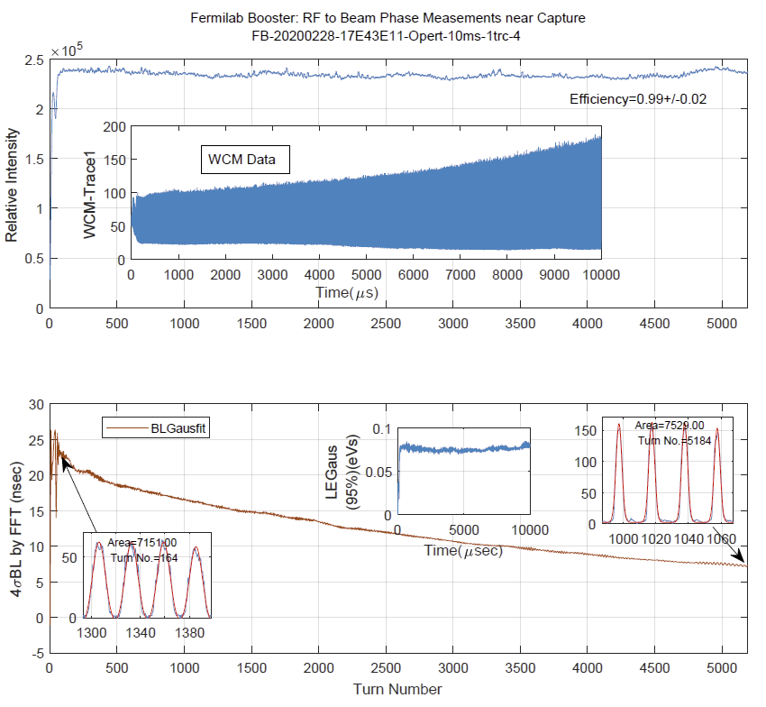
Beam Intensity and BL for the 1st 10ms in the Cycle
Observations
B:IRMCHG indicates that there is ~5-6% beam loss in first 6 ms.
WCM data indicates <1% beam loss during the same time
This needs to be resolved
by further beam studies
TLM/BLM Calibration & use TLM for our beam efficiency measurements

Slide 5
Beam Capture in Booster Prior & Post 2018 Shutdown
Formation of BEAM NECK prior to final beam capture in the Booster is known to be root causes for longitudinal emittance dilution in early part of the beam cycle. An effort to understand this neck led to
Identifying large phase errors among 22 Booster RF cavities and an effort to fix them
Work on digital paraphase system
Both of these are important for beam capture and Booster operation for the entire cycle.
Prior to 2018 long Shutdown: Since 2016 to 2018 long shutdown, using 1-shot beam study cycle, “Monkey Tuning” and simulations a region in parameter space to adiabatically capture injected beam without BEAM NECK was found. Next,
Made it operational before the 2018 long shutdown
With these new parameters beam studies were conducted upto ~20 turns and 6.3E12 ppp
2018 Shutdown: Booster LLRF was upgraded
Post 2018 Shutdown: After the 2018 shutdown “NO BEAM NECK” beam adiabatic capture and beam acceleration without a drop in efficiency always failed
Beam Capture had very similar feature
As soon as beam feed-back system is turned on beam was kicked irrespective of the beam intensity.

Slide 6
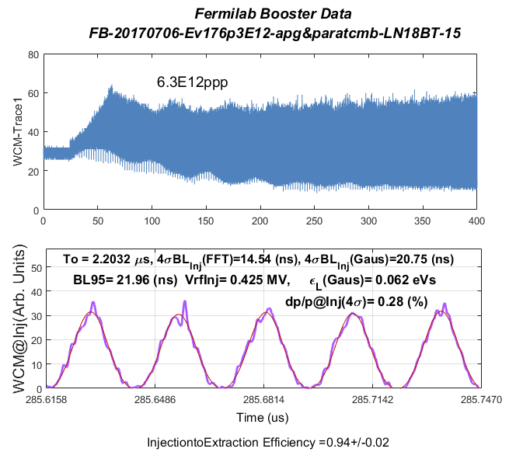
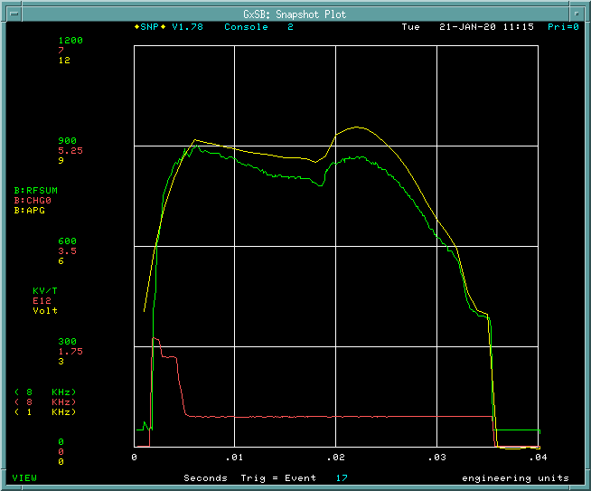
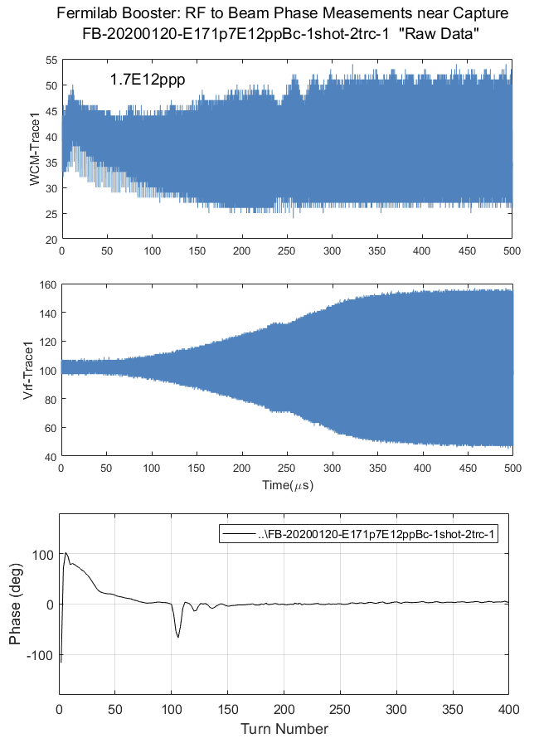
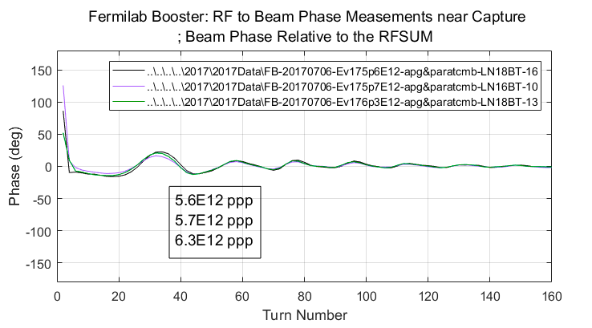
Beam Capture in Booster Prior & Post 2018 Shutdown
Prior
Post
Inj-Ext. Efficiency=0.94±0.02
Some thing went wrong in the Booster LLRF since 2018 shutdown?

