Slide 1
Telework Report March 16- July 2, 2020
Chandra Bhat
Zoom Group Meeting
2020702

Slide 2
Booster Data Analysis
Booster Data collected since 2016 till March16, 2020
Devices
WCM
Types
Cycle
1 and 2 trace (injection and/or extraction- extent of data 0.4 ms to 10ms)
BPM
Types: Cycle
BLM
Types: Cycle H and V
IPM
Types: Cycle H and V and Beam intensity
Ramp Data
1-shot study data
Data taken during Operation
PS-8hr study data
DC Study Data
Issue Addressed using WCM data
Injection, Transition crossing, Extraction, Beam efficiency,
Phase during injection, capture
Bunch length and longitudinal emittances
Study on Coupled bunch instability during the cycle using WCM-cycle data
MATLAB Codes
Many packages are written to analyze the Booster beam data
Beam loading issues for PIP (900kW), PIP-II (1.2MW)
ESME Simulations
PIP revisited
PIP-II (20Hz) –Injection to Extraction beam simulation

Slide 3
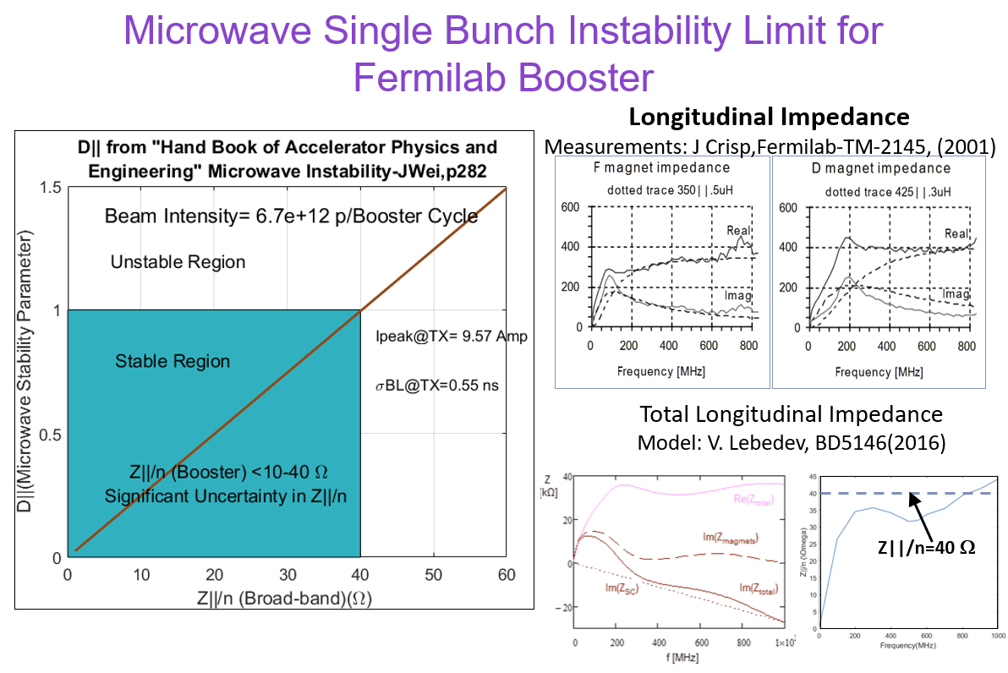
Other Activities
Transition Crossing in Synchrotrons
High intensity beam issues at transition.
Mitigation options
Addressing transition issues in our synchrotrons during high intensity PIP-II era
MATLAB program is written for theoretical analysis of issues related to transition crossing and tried to estimate beam intensity limit
Beam losses due to large dp/p at transition crossing
Non-adiabaticity around Transition Crossing
Johnsen’s effect/non-linear effects
Microwave instability
Negative Mass instability
Literature
Coupled bunch instability
Transition crossing
Documentation
Results from Booster beam data analysis (in progress)
Results from simulations (in progress)
Attended (Virtual)
Mitigation Workshop (GSI) (talk)
IPAC2020 (PARIS)

