Slide 1
CHG0 A discussion of what it is the efforts to maintain it & issues with calibration & signal quality

Slide 2
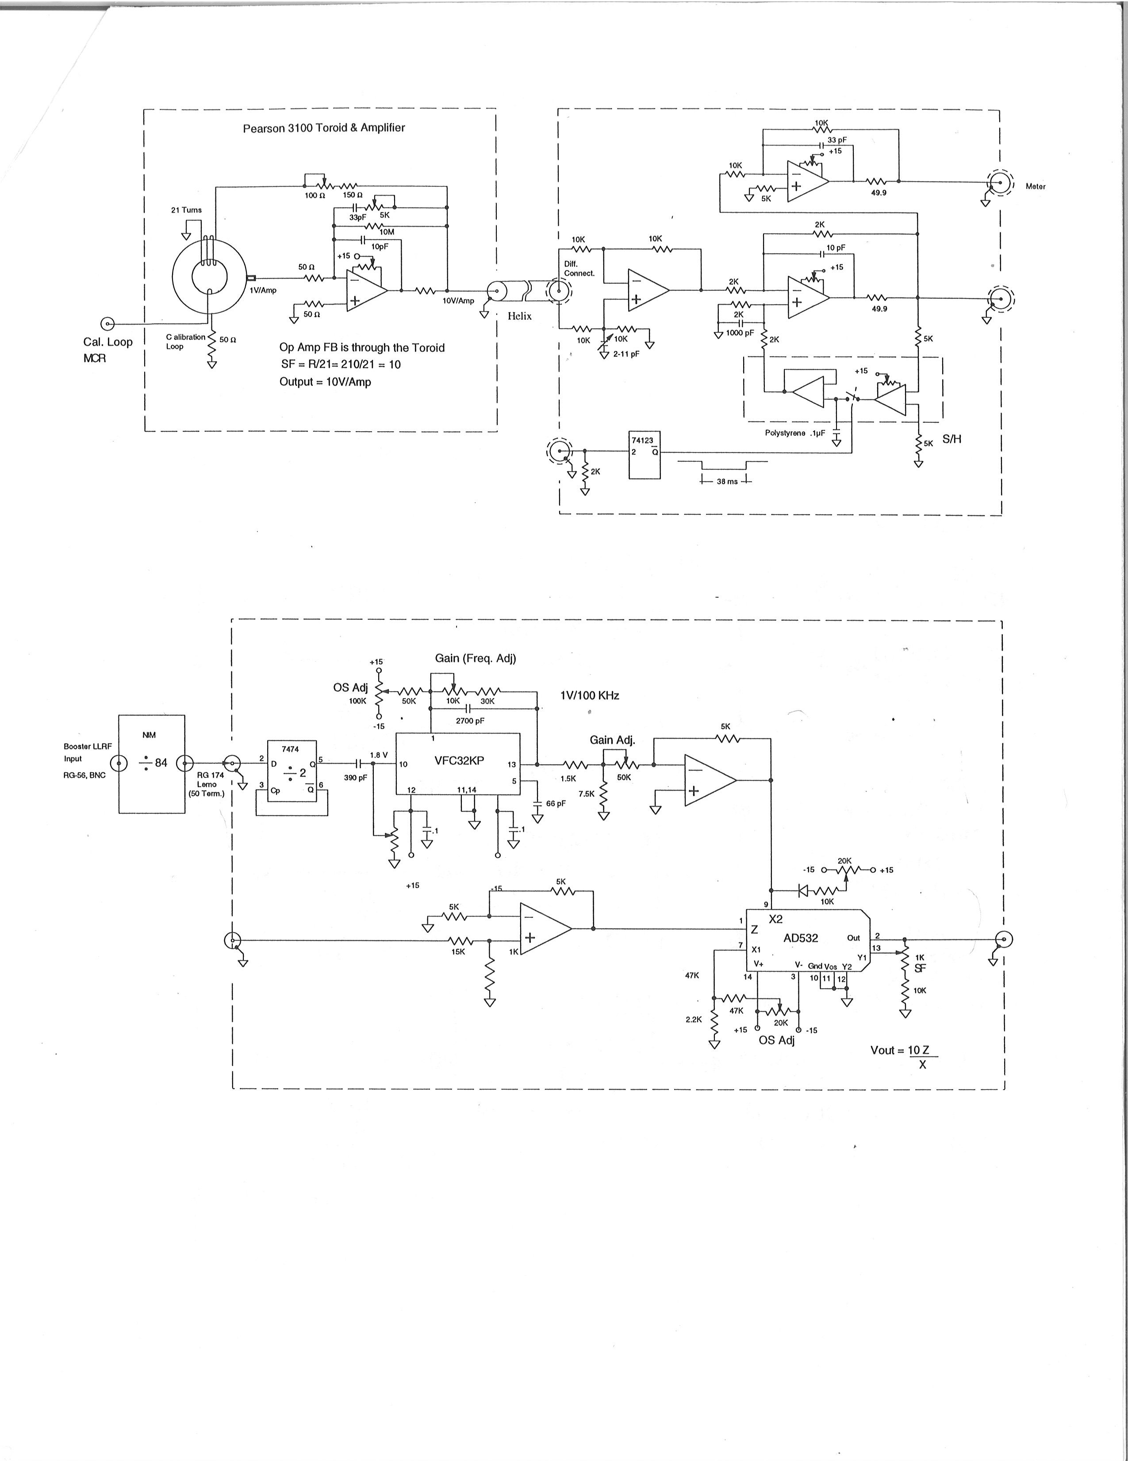
What is CHG0?
Pearson E3100 Current Transformer with external winding and
tunnel amplifier box
Upstairs NIM
Amplifier Module
NIM Normalizer Module
(ED-282121)
This normalized output then goes to two CHG0 distribution boxes
For all CHG0 related distribution

Slide 3
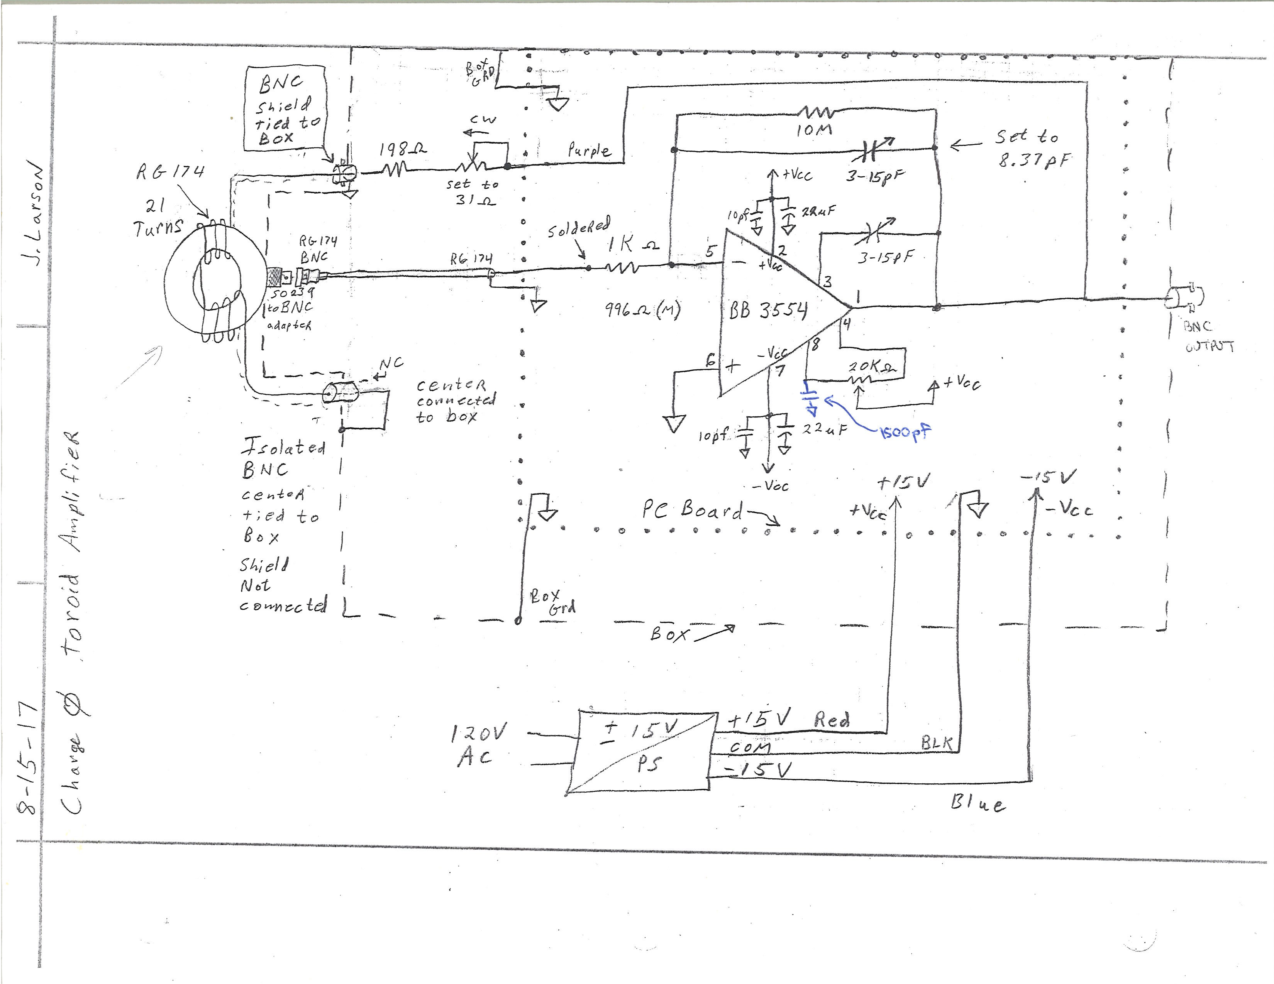
As Found Electrical Diagram of the ‘Original’ Tunnel Electronics at L20

Slide 4
Some CHG0 History
2017
July – Original CHG0 tunnel box brought upstairs for inspection and documentation
August – Another E3100 was prepared for testing CHG0 electronics at TG-7 test cage with BMA corrector
– BRF22 is installed, E3100 at L20 gets moved between RF cavity and BMA
– Another Upstairs Amplifier Module begins to be built (no spare)
– Parts hunt for obsolete CHG0 electronics parts
Sept – 2 homemade boards were made for use with CHG0 tunnel box, begin preparing spare boards
– Testing begins upstairs on the Original CHG0 box
– RC filter band made for L10 install
– Shielding techniques learned at TG-7 are applied to L20 & L10
– Cabling is set up for L10 install back to MCR
– Another E3100 + Spare Box 2 is installed at L10
Oct – Upstairs Amp Module gets a gain adj pot added
2018
April – L10 Spare 2 has a bump at ~ 5mS with real beam, Spare 1 installed at L10 instead
– Beginning to see occasional sag on L20 Original Box after ~10mS
May – Jeff discovers that our CHG0 tunnel board came from Linac RF System Modulator Servo Regulator!
– We are able to get spare boards from Linac and cut them down for use in Tunnel Boxes
Sept – Distribution box calibrations + L10 checks and adjustments
Oct – Original Box at L20 showing more poor response on 1st beam pulse after a null period, CHG0 switch to Box 1 at L10
2019
May – Original Box at L20 replaced by new Spare Box 4
Dec – Tried low pass filter on CHG0 signal to try to help reduce ‘swale’, it didn’t help

Slide 5
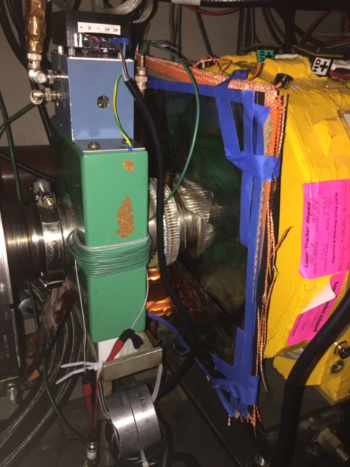
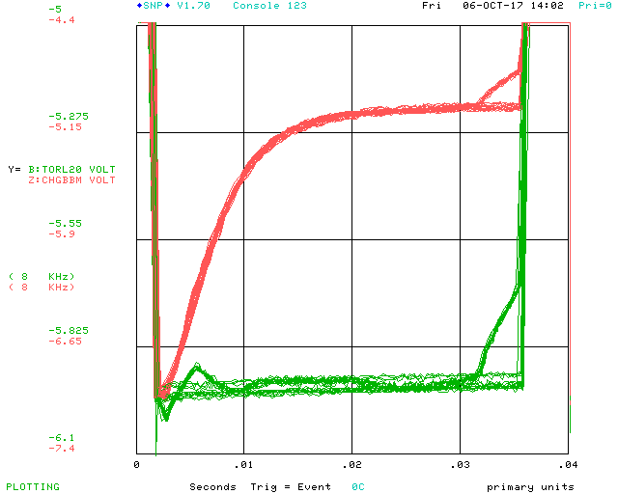
L20 Tunnel Electronics require shielding from BMA Output distortion is due to the corrector ramps
Shielding helped minimize/eliminate this
↑CHG0 L20 Close up comparing corrector ramp and no ramp conditions.
We found the two dipoles at L20 are primarily responsible for the interference.
↑CHG0 L20 Close up comparing corrector ramp and no ramp conditions. We had added a T for scope monitoring as well as driving electronics upstairs. The 3554 was very touchy about this, we had to add a 50 ohm terminator before the scope channel to keep it from oscillating.
↑CHG0 L20 with shielding, and some fiberglass separators added. Note downstream of ceramic. No wall I bypass installed yet.

Slide 6
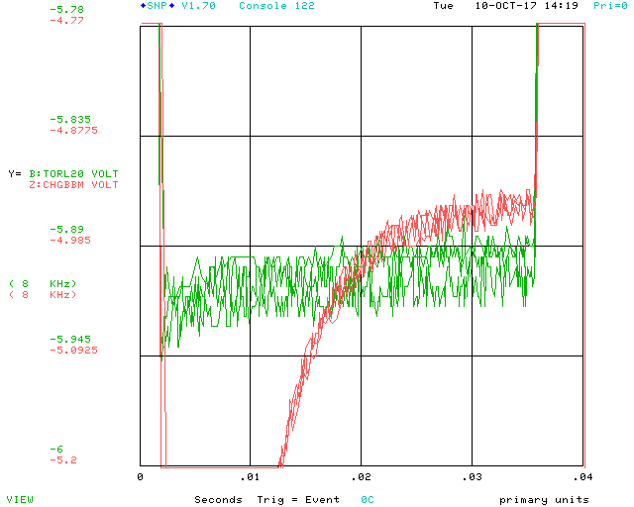
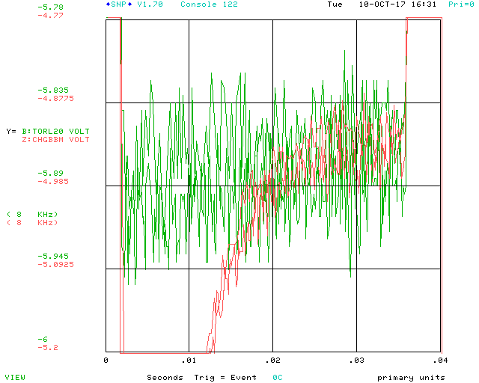
L20 Tunnel Electronics also see the bulk supply switching frequency of 80Khz from BMA
↑CHG0 L20 with standoffs, shielding is removed, bulk is OFF. This is the first time we realize a difference between scale factors = 0 and the bulk being OFF!
↑L20 with standoffs, Shielding is in place (on upstream side of ceramic). Bulk is ON, Scale Factors are set to zero, Offsets are set to zero. The spread in signal is increased. The magnetic shielding doesn’t help this.
↑CHG0 L20 with standoffs, shielding is removed, bulk is ON but the 6 scale factors are all set to 0.

Slide 7
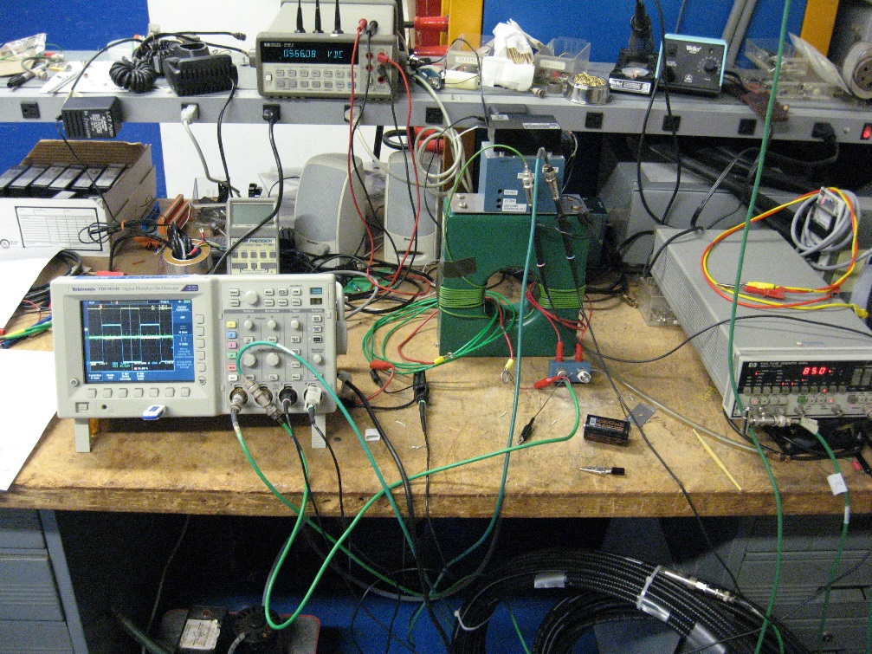
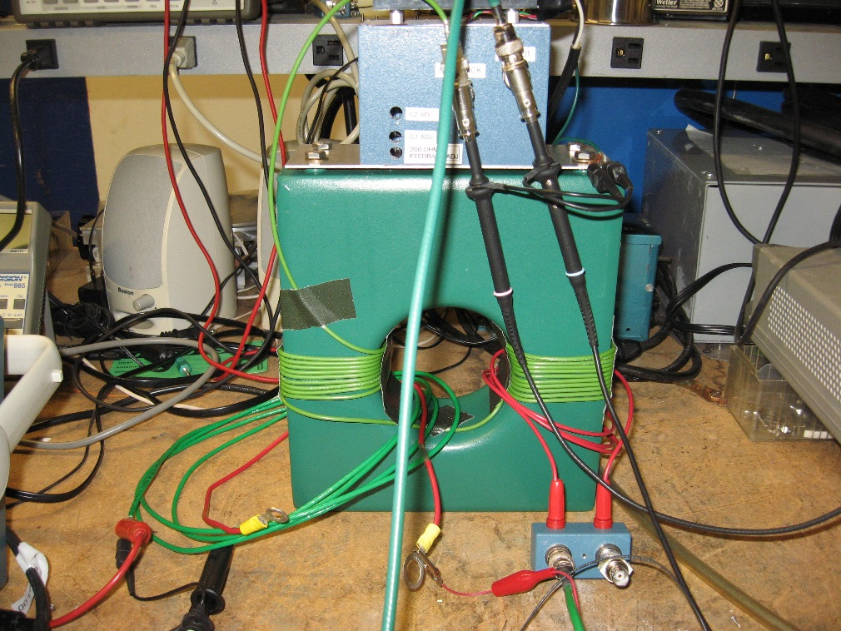
Test Bench Set Up For CHG0 Amplifier Calibration and Testing
Tunnel Box Gain, Offset, & Compensation Adjustments are via the holes in the box cover.
For operational systems, if any of these parameters need adjustment, a tunnel access is required.

Slide 8
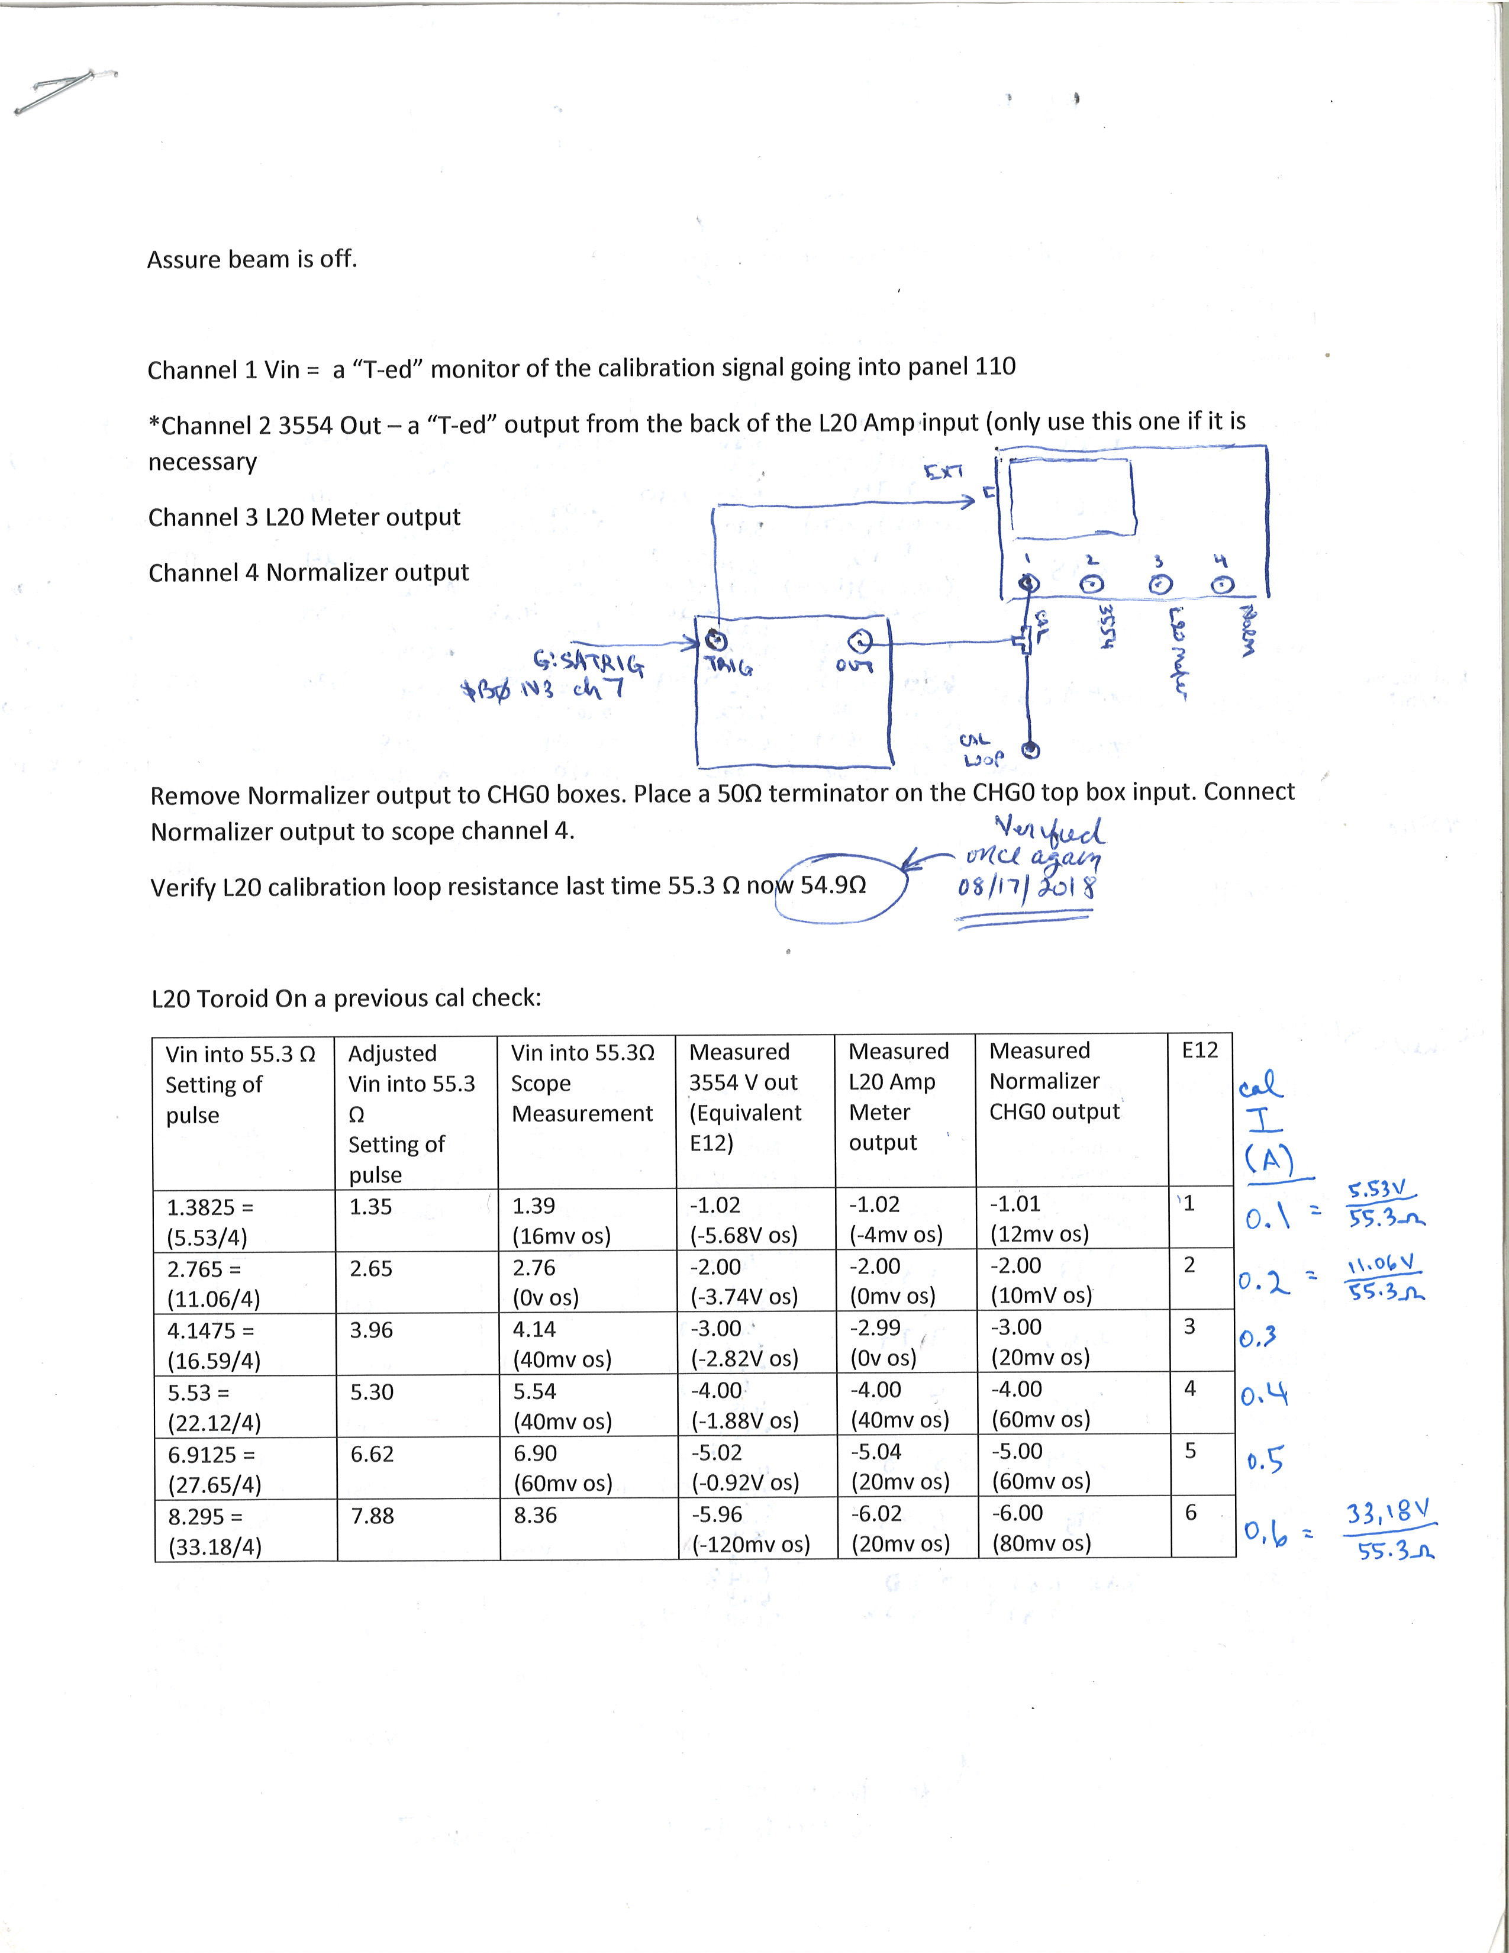
CHG0 Calibration Techniques
First make a careful measurement of the calibration loop resistance. We’ve found using a handheld Megger instrument that delivers 20mA for resistance measurement is stiff enough to provide a reliable resistance check
Knowing the calibration loop resistance, we can now calculate needed voltages to drive the desired calibration currents.
E3100 output is 1 V/A. Tunnel Amp feedback through E3100’s 21 external turns. Gain ~ Rfeedback/21 ~ 210/21 = 10. For the tunnel electronics, output is ~ 10 V/A
Calibration current * Tunnel Gain = Output V
1V -> 1E12, 2V -> 2E12, …, 7V ->7E12 and so on
Set up pulser and scope as shown
Adjust calibration pulse as close as possible to desired level & do measurement.
We chose to use 4 turn calibration loops rather than 1 turn, it helps pulse source meet the demanded V
We always use the end of the normalizer pulse as the measurement point for calibration

Slide 9
Typical Calibration Results
↑Normalizer output via L20 toroid for 1E12. CH1 = cal pulse = 1.35V , CH2 = Normalizer output = -1.01V (12mV os), CH3 = L20 Meter Output = -1.02 (-4mV os), CH4 = 3554 Output = -1.02V (-5.68V os).
↑Normalizer output via L20 toroid for 2E12. CH1 = cal pulse = 2.76V (0V os) , CH2 = Normalizer output = -2.00V (10mV os), CH3 = L20 Meter Output = -2.00 (0mV os), CH4 = 3554 Output = -2.00V (-3.74V os).
↑Normalizer output via L20 toroid for 3E12. CH1 = cal pulse = 4.14V (40mV os) , CH2 = Normalizer output = -3.00V (20mV os), CH3 = L20 Meter Output = -2.99 (0mV os), CH4 = 3554 Output = -3.00V (-2.82V os).
↑Normalizer output via L20 toroid for 4E12. CH1 = cal pulse = 5.54V (40mV os) , CH2 = Normalizer output = -4.00V (60mV os), CH3 = L20 Meter Output = -4.00 (0mV os), CH4 = 3554 Output = -4.00V (-1.88V os).
↑Normalizer output via L20 toroid for 5E12. CH1 = cal pulse = 6.90V (40mV os) , CH2 = Normalizer output = -5.00V (60mV os), CH3 = L20 Meter Output = -5.04 (20mV os), CH4 = 3554 Output = -5.02V (-0.92V os).
↑Normalizer output via L20 toroid for 6E12. CH1 = cal pulse = 8.36V (0mV os) , CH2 = Normalizer output = -6.00V (80mV os), CH3 = L20 Meter Output = -6.02V (20mV os), CH4 = 3554 Output = -5.96V (-0.12V os).

Slide 10
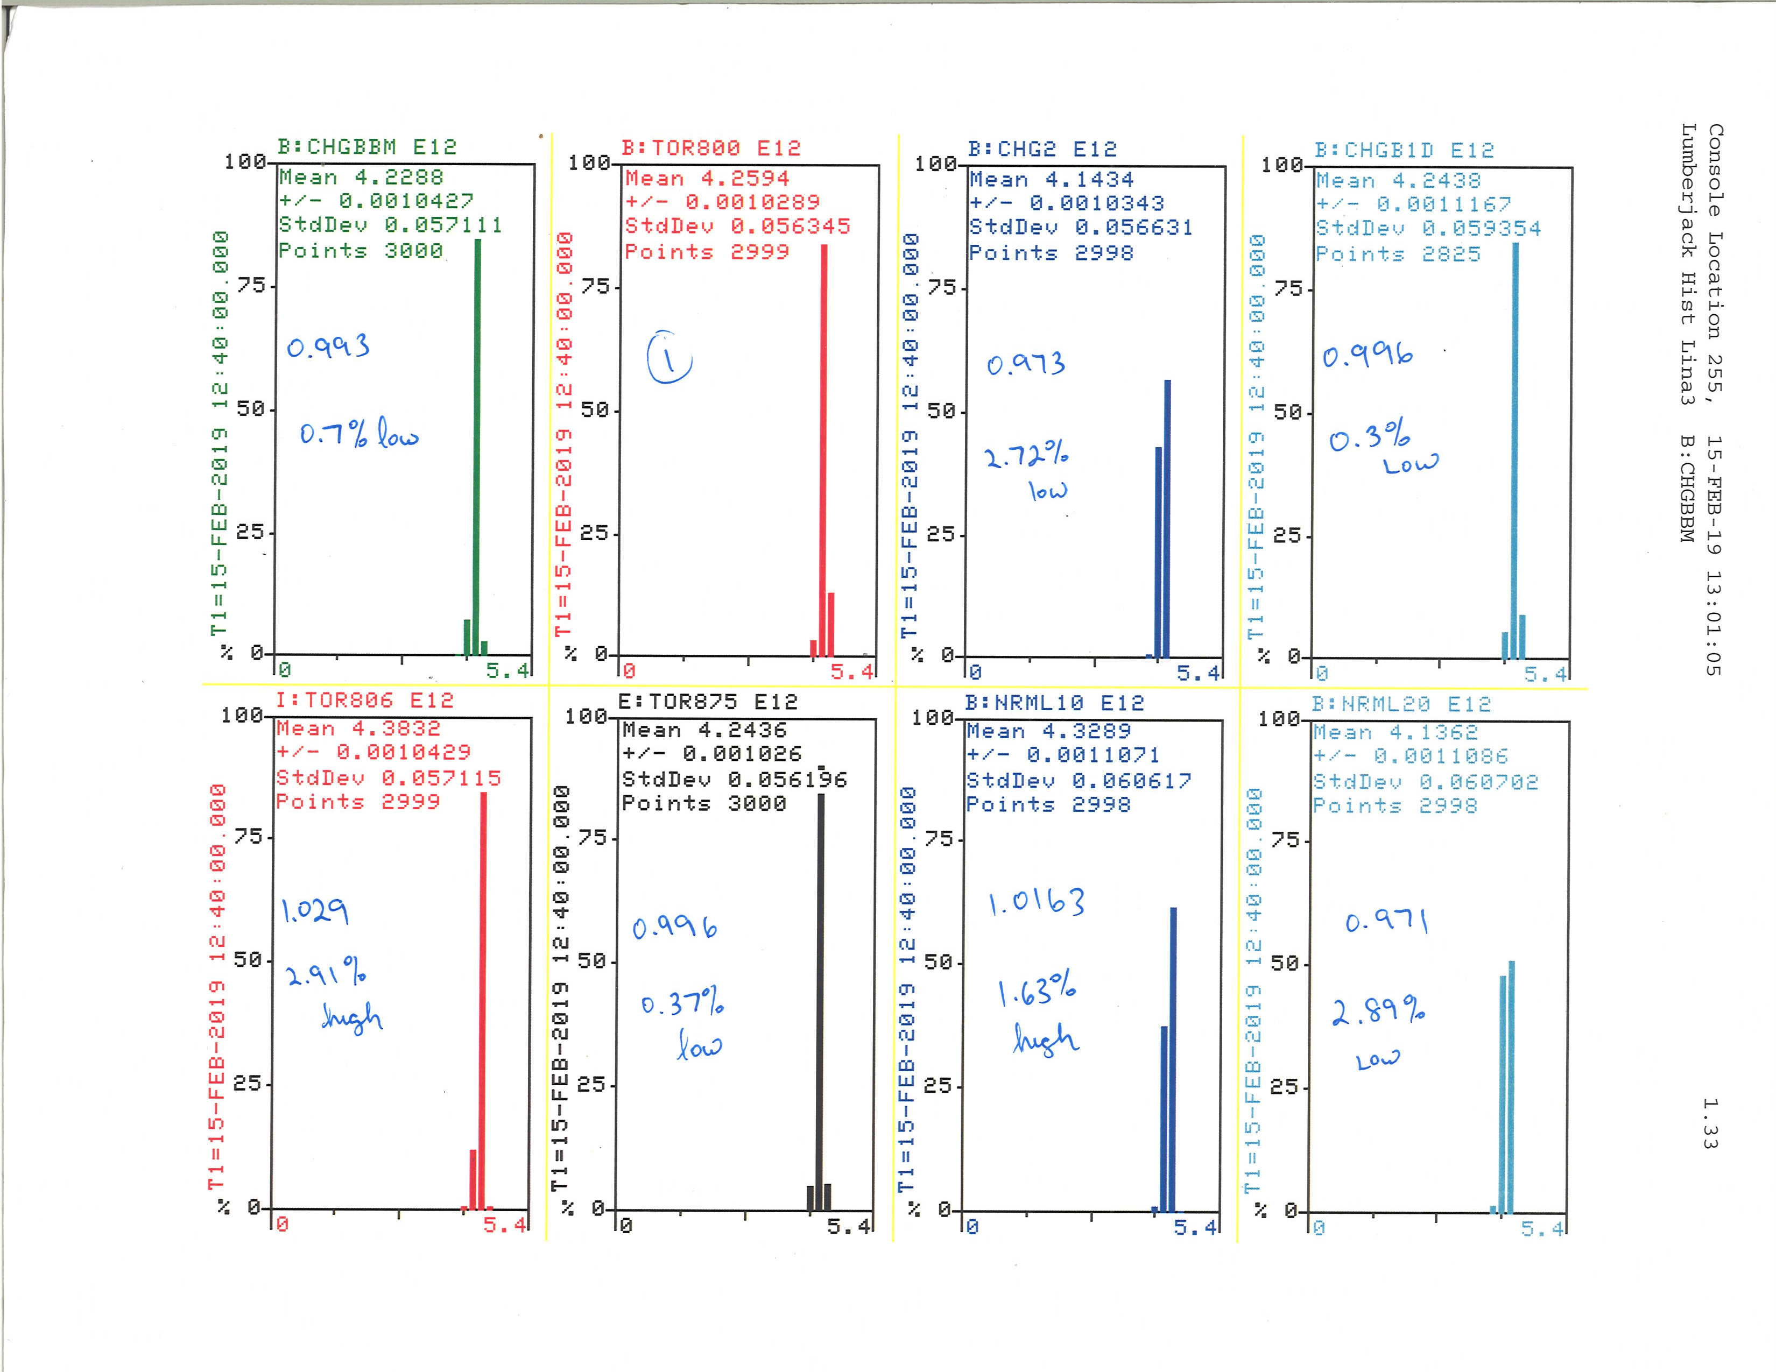
Charge Comparison Numbers Using D44 Histograms
Date | CHGBBM | TOR800 | CHG2 | CHGB1D | TOR806 | TOR875 | NRML10 | NRML20 | CHGBBM/TOR800 | TOR800/TOR800 | CHG2/TOR800 | CHGB1D/TOR800 | TOR806/TOR800 | TOR875/TOR800 | NRML10/TOR800 | NRML20/TOR800
12/24/2018 | 4.015 | 4.1339 | 3.9163 | 3.9998 | 4.2581 | 4.1069 | 4.2592 | 4.0744 | 0.9712 | 1.0000 | 0.9474 | 0.9676 | 1.0300 | 0.9935 | 1.0303 | 0.9856
12/31/2018 | 3.9784 | 4.0875 | 3.8827 | 3.961 | 4.2084 | 4.07 | 4.1977 | 4.0301 | 0.9733 | 1.0000 | 0.9499 | 0.9691 | 1.0296 | 0.9957 | 1.0270 | 0.9860
1/4/2019 | 4.0342 | 4.1508 | 3.9377 | 4.0194 | 4.2768 | 4.1353 | 4.2646 | 4.0928 | 0.9719 | 1.0000 | 0.9487 | 0.9683 | 1.0304 | 0.9963 | 1.0274 | 0.9860
1/28/2019 | 4.3509 | 4.4214 | 4.188 | 4.4332 | 4.4143 | 4.3424 | 4.3786 | 4.2484 | 0.9841 | 1.0000 | 0.9472 | 1.0027 | 0.9984 | 0.9821 | 0.9903 | 0.9609 | L10TOR becomes CHG0
2/15/2019 | 4.2288 | 4.2594 | 4.1434 | 4.2438 | 4.3832 | 4.2436 | 4.3289 | 4.1362 | 0.9928 | 1.0000 | 0.9728 | 0.9963 | 1.0291 | 0.9963 | 1.0163 | 0.9711
5/29/2019 |  |  |  |  |  |  |  |  |  |  |  |  |  |  |  |  | Install Box 4 at L20 replacing Original
9/19/2019 | 4.5753 | 4.4215 | 4.5361 | 4.5687 | 4.5498 | 4.4391 | 4.5701 | 4.4525 | 1.0348 | 1.0000 | 1.0259 | 1.0333 | 1.0290 | 1.0040 | 1.0336 | 1.0070
11/1/2019 | 3.7484 | 3.6788 | 3.6792 | 3.7228 | 3.5494 | 3.6637 | 3.7774 | 3.6615 | 1.0189 | 1.0000 | 1.0001 | 1.0120 | 0.9648 | 0.9959 | 1.0268 | 0.9953

Slide 11
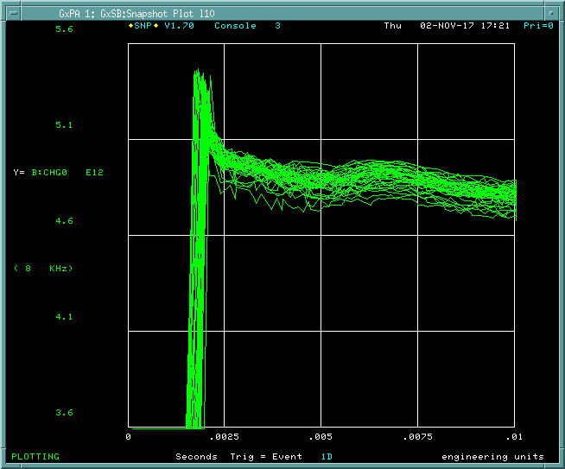
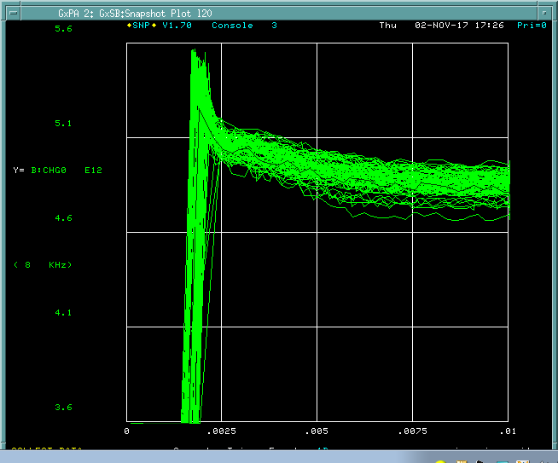
Example of the Spare Box 2 bump at ~5mS
L10 Tor with Spare Box 2
L20 Tor with Original Box
Calibration pulse response is one thing, response to real beam is another…

Slide 12
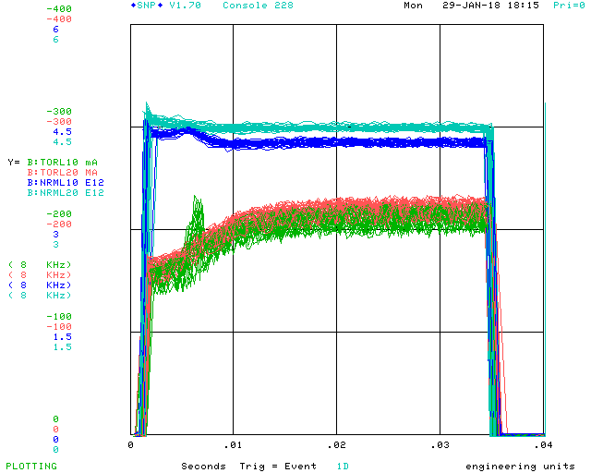
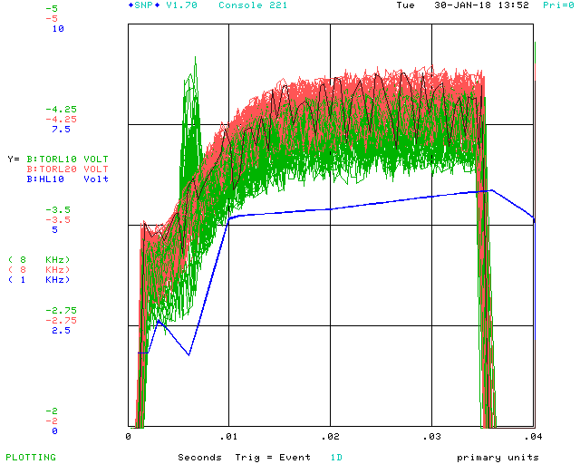
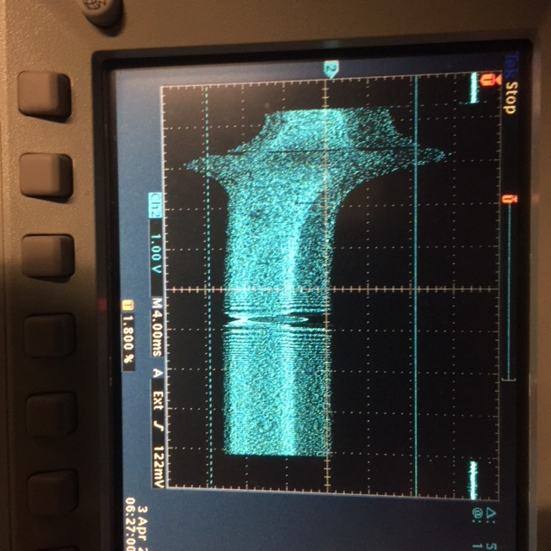
Box 2 installed at L10
Comparing L10 & L20 upstairs amplifier outputs. L10 = spare box 2, L20 = original box.
This is the upstairs amplifier output before normalizer.
Bump @ 7mS seems to correspond to largest dI/dt for HL10. Efforts to place shielding between the toroid and corrector did not help this. Also trying to bump down the correctors here did not help.
TORL10 output into scope w 50Ω at L11. This is coming out of our tunnel box.

Slide 13
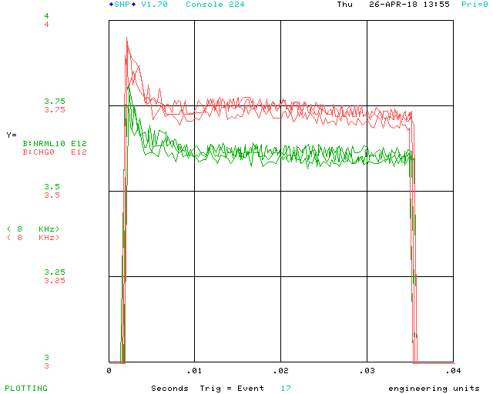
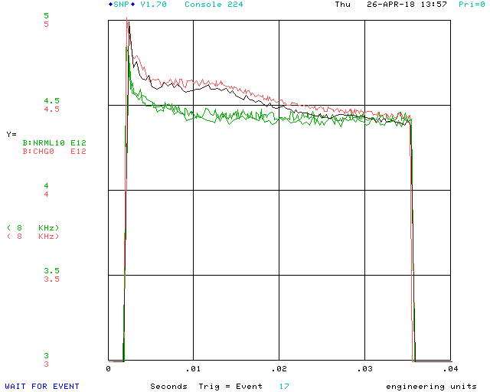
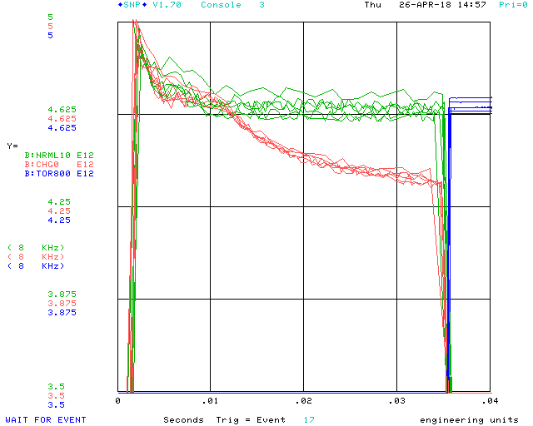
Example of L20 roll off
<- First opportunity to compare NRML20 (CHG0) and NRML10 with real beam, our calibration is low!
As we went up in intensity, TORL20 (NRML20) began to show response rolloff….->
We’ve seen this once or twice before, but it didn’t last long…
Turns out, this effect occurs during low TLG rep rate. Once beam is pulsing more regularly, this rolloff disappears.
<- Adjusted gain via the TORL10 Amplifier module, after all about 4T CCW to increase the gain of the system (thanks Doris for the gain adj pot install). We compared output to TOR800.
This was during a spare Box 1 calibration
Spare box 1 at L10
Original box at L20

Slide 14
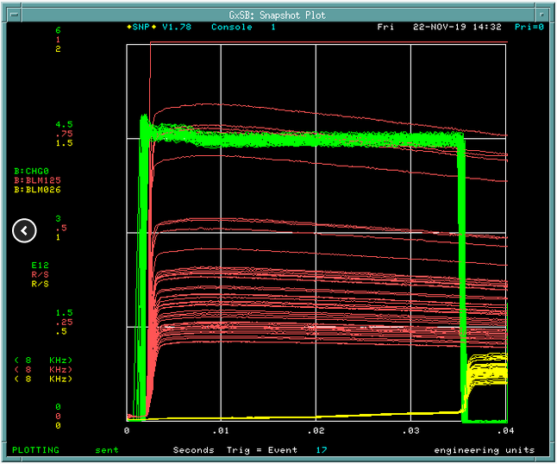
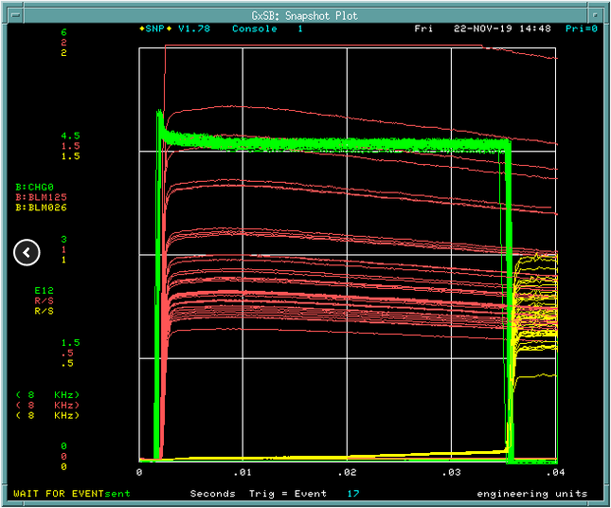
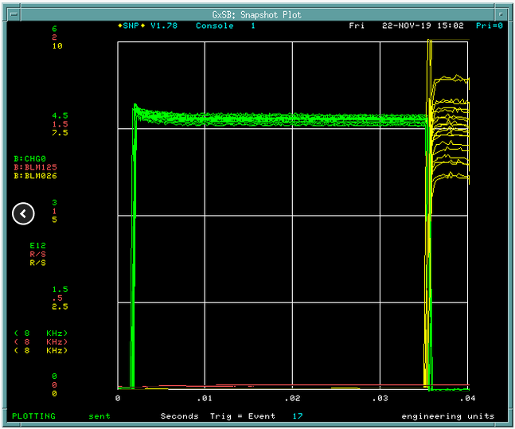
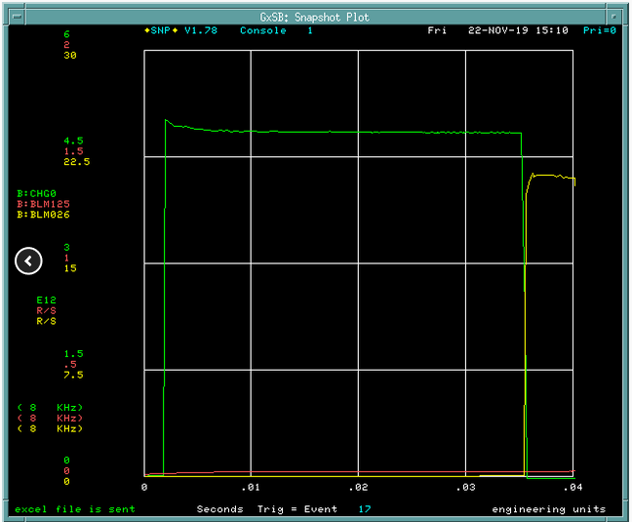
The Beam Notch Affects The CHG0 Profile
Laser Notch ON Booster Notch ON
Laser Notch OFF Booster Notch ON
During Notcher studies, Salah observed that CHG0 lost its ‘wave’ early in the cycle
Laser Notch ON Booster Notch OFF
Laser Notch OFF Booster Notch OFF

Slide 15
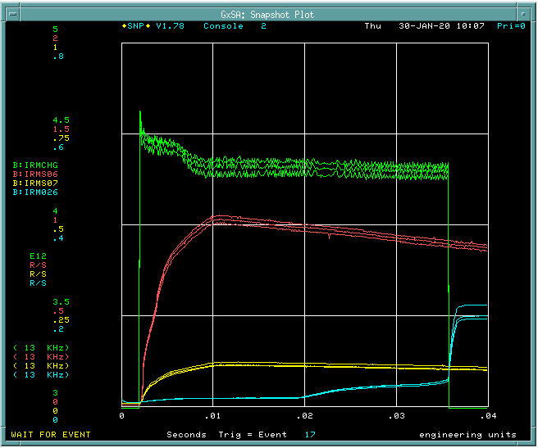
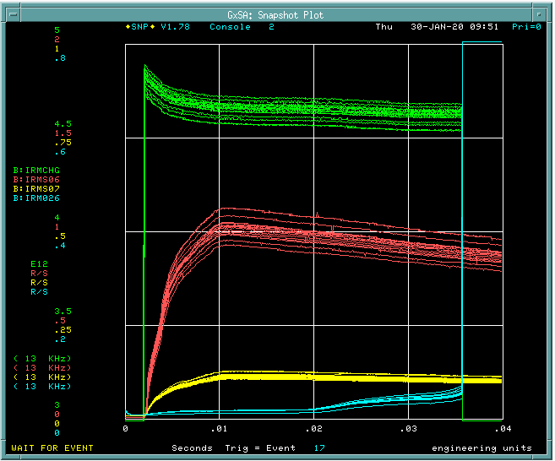
The Beam Notch Affects The CHG0 Profile
Closer View
Notches ON
Notches OFF

Slide 16
This is a 4E12 calibration set up pulsing on $0C (15Hz)
This is a 4E12 calibration set up pulsing on $17 (every 5 s)
CH1) Yel = Calibration Pulse
CH2) Cya = Normalizer Out
CH3) Mag = Upstairs Amplifier Out
CH4) Grn = 3554 Tunnel Amp Out
Note how the Tunnel Amp output pulse beginning and ending levels can differ. With regular repetitive pulsing, they tend to be equal, but with periods of delayed or irregular pulsing, the levels differ.

Slide 17
Here a single calibration pulse is delivered (yellow trace).
Upstairs Amplifier Box S&H circuit continues to get subsequent triggers from TCLK.
CH1) Yel = Calibration Pulse
CH2) Cya = Normalizer Out
CH3) Mag = Upstairs Amplifier Out
CH4) Grn = 3554 Tunnel Amp Out

Slide 18
CHG0 is a zero flux circuit!
CH1) Yel = Tunnel Box Output
CH2) Cya = Calibration pulses
CH4) Grn = secondary monitor coil wound through E3100
See the secondary monitor coil is not picking up any flux change due to calibration pulses.
The 21 turn coil in the feed back path is creating a zero flux condition!
Now power was removed from Tunnel Box, it no longer has output
See the secondary monitor coil is now picking up the flux changes caused by calibration pulses.
No longer a zero flux condition.
Same conditions as previous image, but now a single turn loop is wound through the E3100. Single turn loop is closed to itself.
See how secondary monitor coil ouput still exists, but is heavily damped.
A great example of why one shouldn’t put a shorted loop through a current transformer!
Nice observations by Jeff Larson.

Slide 19
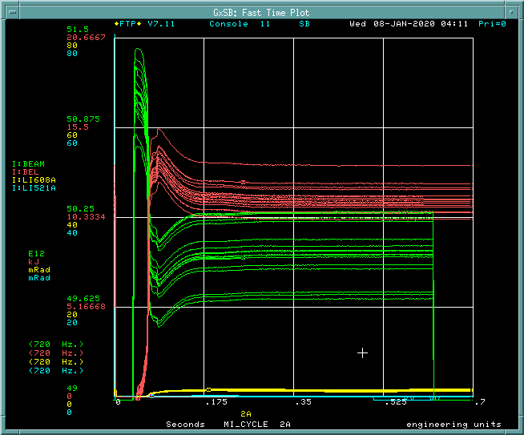
MI DCCT response in January 2020

Slide 20
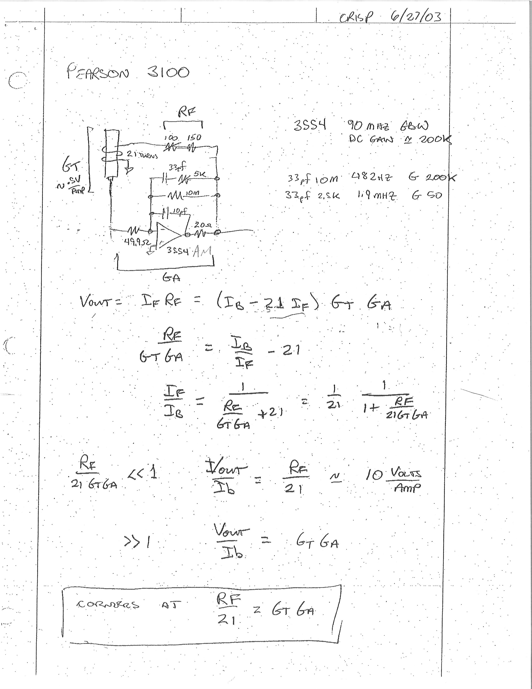
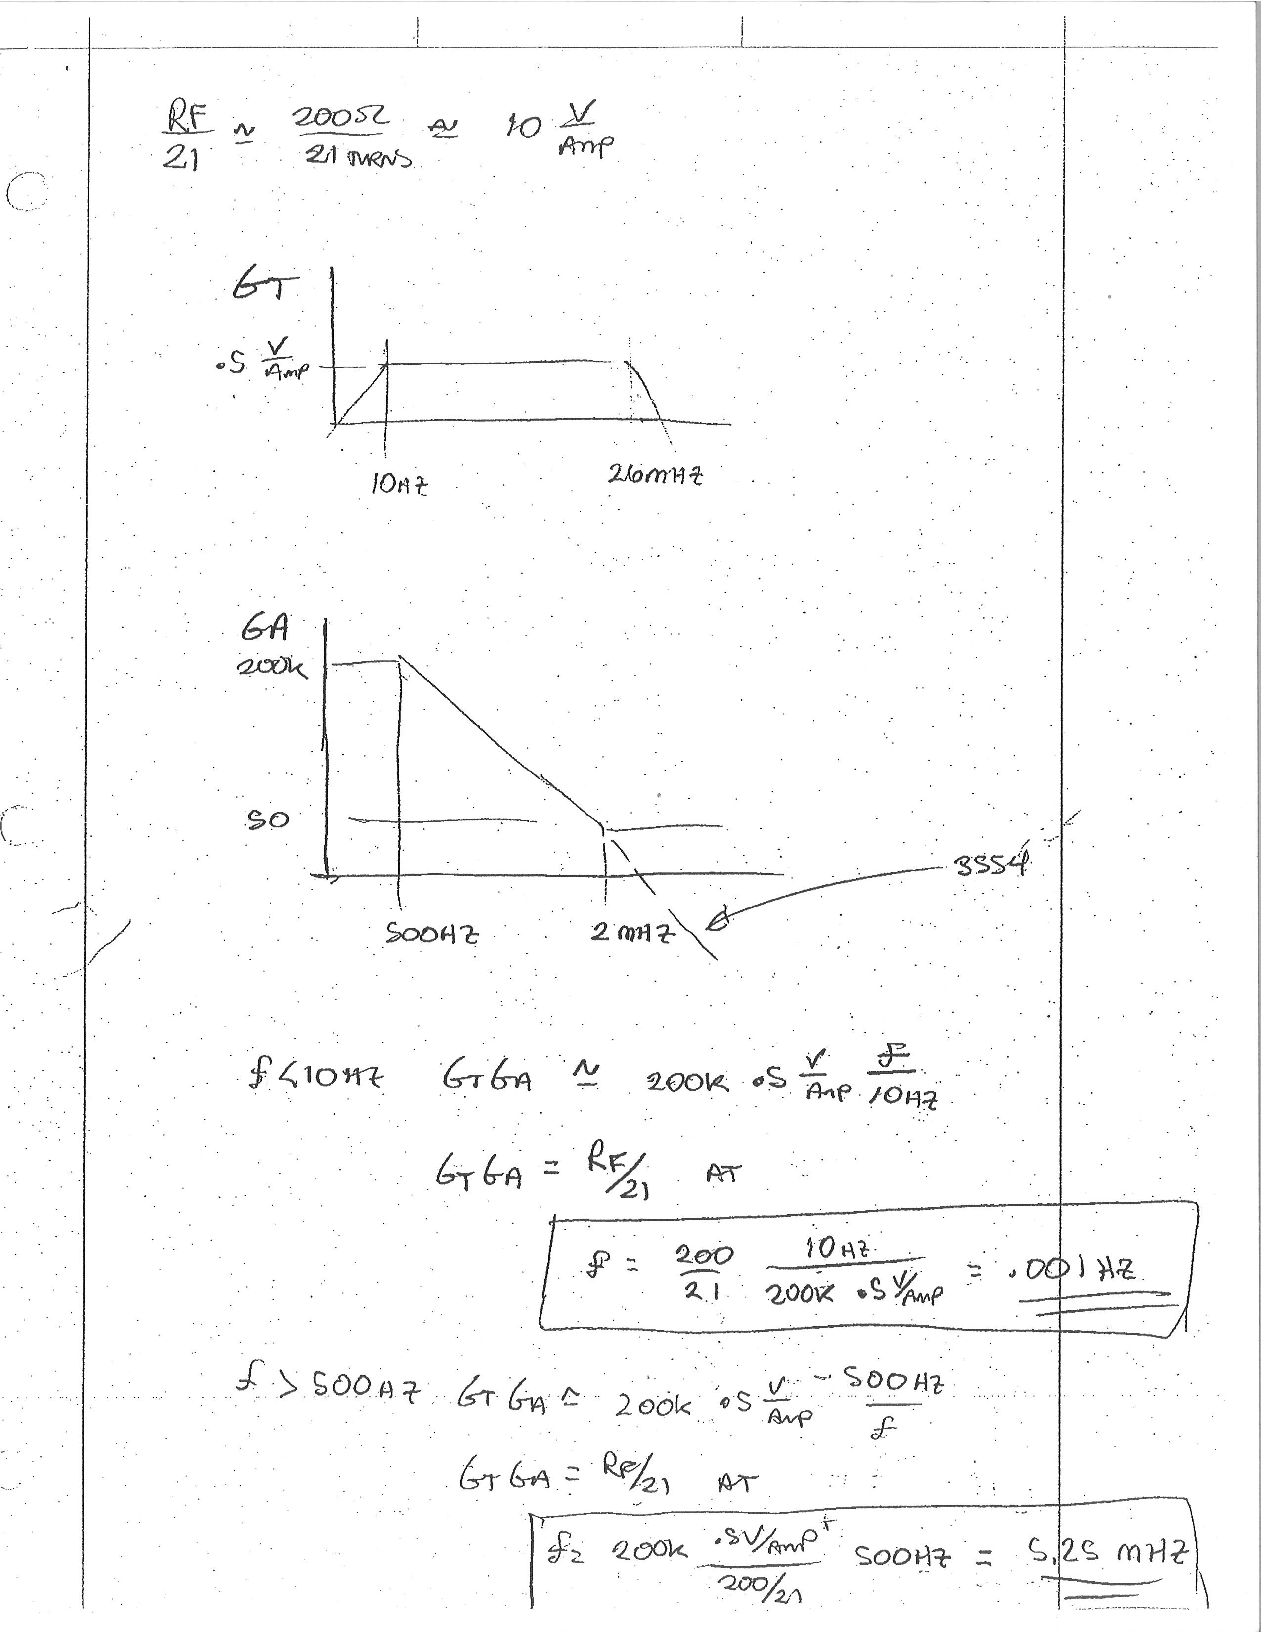
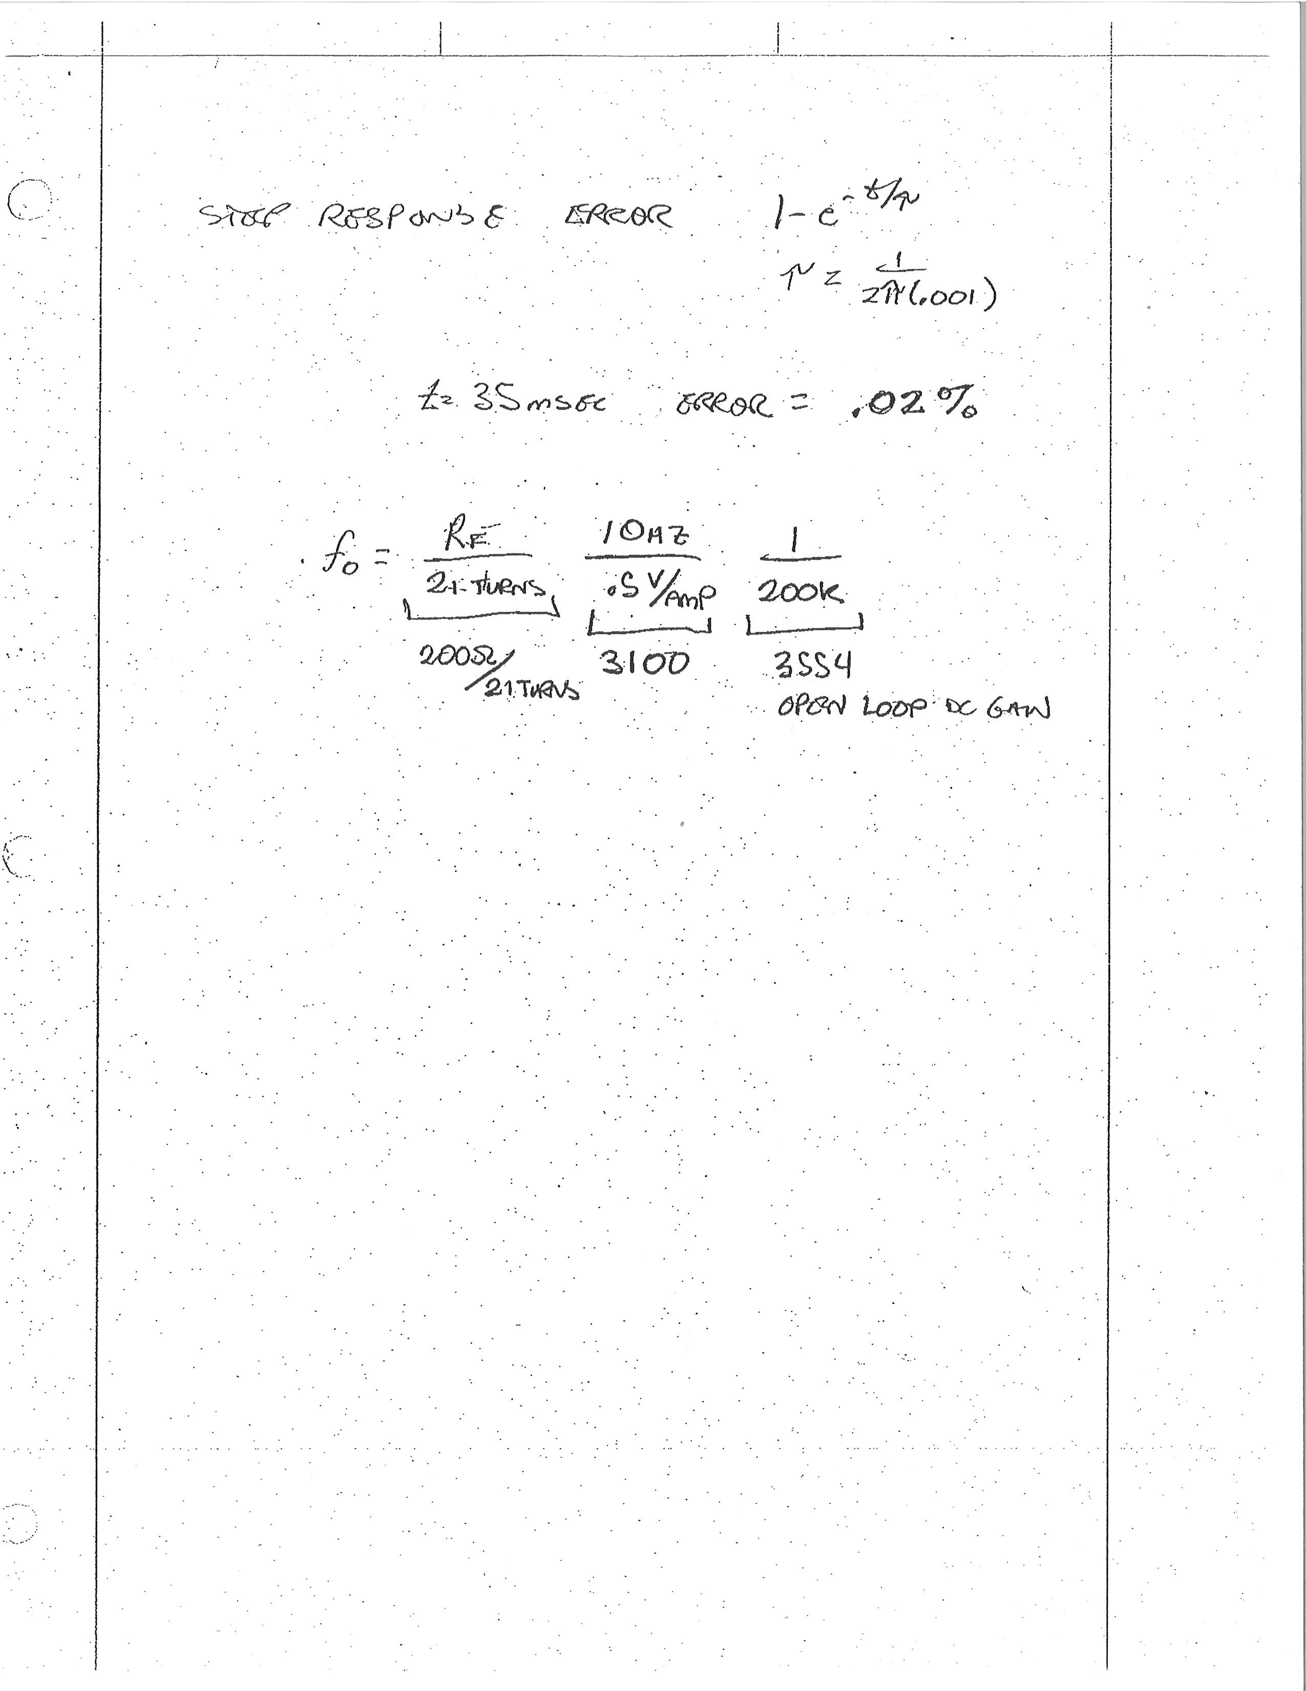
Crisp Calculations
Some cable numbers from 2018:
L20 TDR = 415 ft, 9.6nF @ 1KHz
L10 TDR = 1478 ft, 34.4 nF @ 1KHz

