Slide 1
High Power Testing of 3.25” Bore Booster Cavity
Robyn Madrak
Joint PSP/Task Force Meeting
30 Jul 2020

Slide 2
What was done
John Reid modified bias supply to run up to ~3500 A to cover full tuning range
Normally 2500 A, but the frequency of this cavity is too low and the tuners need to be modified
~1700 A RMS
Cavity is ramped at 15 Hz
Ran cavity at high power on 5 separate days:7/9, 7/14, 7/16, 7/20 and 7/23
Problem with intermittent sparking at the highest voltages
Cavity voltage is (Mod V – scr V) * stepup_ratio*2
Mod V = 26 kV → 57.5 kV/gap
Mod V = 27 kV → 60 kV/gap

Slide 3
3.25”Bore Cavity Section

Slide 4
3.25 Bore Cavity Tuner Ferrite Configuration

Slide 5
3.25” Bore Cavity tuning Curve

Slide 6
Frequency vs Q

Slide 7
Ferrite Bias Supply Ramp with Anode Program
Modulator
Voltage - Std
Booster Curve
Ferrite Bias
Current –3325 Amps
Ferrite Bias
Voltage

Slide 8
Fast Time Plot – Random Sparking @ 60kV
Gap Envelope
Mod Voltage
Bias current
Phase detector
spark

Slide 9
What was done
Day 1: Cavity was tripping on sparks a lot at Mod V = 26 kV
Run at 25 kV, let temp plateau, directly measure temps; all OK
Inspect damper resistors: all OK
Day 2: Ran at 25, 26, then 27 kV. Ran at 27 kV for the longest yet with no sparks (10 min)
Day 3: Ran cavity with Mod V = 27 kV (goal) for several hours
No trips as before, but still some sparking
Take PA off of cavity to inspect

Slide 10
What was done
Day 4
Take PA off; inspect
Screws sticking out into RF volume: Use washers to mitigate
Front tuner outer gasket was not flush with ID of stem opening, will remedy when tuners are modified.
Screws on RF Choke capacitors were not fully tightened. Tightened screws.
Notices that holes in tuner stem for screw heads have sharp edges: suspected that this was the problem; has been seen before but no evidence that this is the cause of arcing
Ran cavity at 26 kV without much problem. Again at 27 kV see random sparks
Could hear snapping sounds from outside of the cave

Slide 11
What was done
Day 5
Run cavity at 27 kV
Go into cave to try to locate sparks; could not locate any in tuner stem (Safety bypassed interlock)
Radiation level slightly higher at upstream end near gap (Smart Ion)
Vacuum activity at every spark
Problem is likely in vacuum part of the cavity
Plan: take apart/open up cavity to inspect
Do stretched wire measurement (requires opening up)

Slide 12
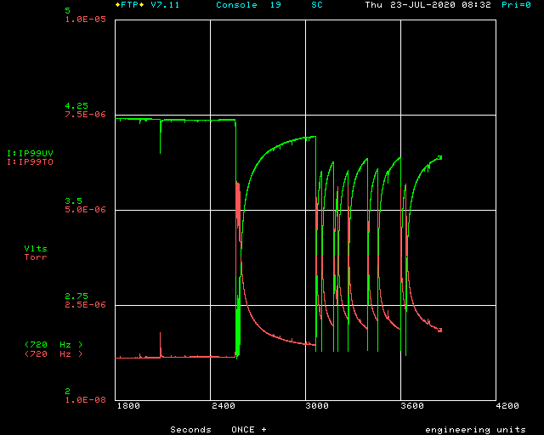
Vacuum activity:
Ion pump V
Pressure

Slide 13
Now
Cavity is (being) taken apart
Efrain is making fixture for stretched wire measurement
Inspect and make stretched wire measurements starting today or next week

