Slide 1
120 GeV Beam to MCenter
G. Koizumi
4 September 2020

Slide 2
120 GeV Beam to MCenter
From Mike Vincent e-mail of 29 July 2020 with corrections sent by him 25 Aug. 2020:
the Addendum to the SY 120 Shielding Assessment for Continued Operation of the Meson Center Beam Line used 6.00E12 120 GeV protons per hour as its normal operating condition. The same document used 120 GeV/c protons at 6.00E14 protons per hour for the accident condition.
However, the P3 line is only approved to deliver 1.02E12 protons per hour to Mcenter. The 1.02E12 protons per hour limit to Mcenter under normal operating conditions is due to the NOvA equipment in MC7. See the memo sent with email of 25 Aug. 2020. The "true" limit on beam to MCenter due to the P3 line shielding is 6.00E12 protons per hour, which is the maximum amount of beam you'll see under normal operating conditions. When NOvA's equipment has been removed from MC7, the MCenter beam permit could thus be changed back to 6.00E12 pph. Any further intensity increase will probably require new shielding assessment.
For LArIAT, normal operating conditions are for incident secondary beam energy to be in the range of 8 to 64 GeV/c, with a maximum intensity of 300,000 particles per four-second spill, and with one spill every 60 seconds.
For the NOvA tertiary beamline, normal operating conditions are for the incident secondary beam energy to be 64 GeV, with a maximum intensity of 3.00E6 particles per four-second spill, and with one spill every 60 seconds.
Secondary beam accident intensity for MC7 is taken to be 4.68E09 particles per 1‑second spill, with beam energy of 85 GeV.
Oh, and the MC6 target pile is limited by surface water considerations to 5.26E16 120 GeV protons per year.

Slide 3
120 GeV Beam to Mcenter MC7 NOvA Beam Intensity Limit 20 Nov. 2018

Slide 4
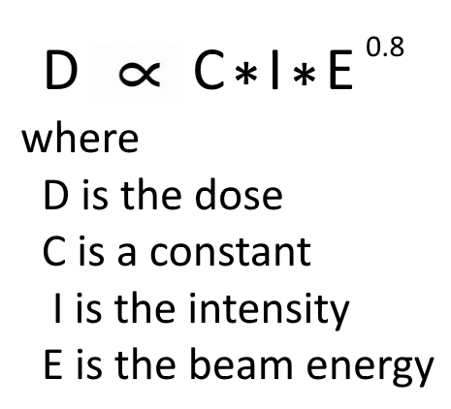
120 GeV Beam to MCenter

Slide 5
120 GeV Beam to MCenter Running Modes for the Meson Center Test Beam Facility Copy of document in “extbeam.bd > Operational Beamlines > Meson > MCenter” by T. Kobilarcik 12/05/2011
Running Modes for the Meson Center Test Beam Facility
T. Kobilarcik
12/05/2011
V1.0
This document will serve as the basis for the Meson Center Shielding Assessment and outline the capabilities of the new facility.
Secondary Beam Mode
In Secondary Beam Mode, primary beam will be targeted at the upstream end of the MC6 enclosure. Uniteracted beam will be absorbed in MC6. Charged secondaries will be transported to MC7 (the Facility). The bend string in the secondary line will be interlocked to allow transport of particles no greater than 85 GeV/c. Secondary rates will be in the kHz range. Secondaries of either charge will be transported depending on the polarity of the bend string. Primary beam will be at most 1×10¹¹ protons over a four second spill. Spills will occur once per minute.
Primary Beam Mode
In Primary Beam Mode, primary beam, at a much reduced rate, will be delivered to MC7 (the Facility). Primary beam rate in the Facility will be limited to approximately 100 kHz (during the spill). Spill time will be four seconds and will occur once per minute. The technical details of this mode have yet to be worked out.
Expected Yields
Figure 1 shows the expected secondary yields based on the MIPP design. This presentation assumes 1×10¹¹ protons over a four second spill. Secondary rates are presented in kilohertz. Clearly, rates in excess of 100 kHz are achievable; secondary rates will be kept in the hundred kilohertz range by adjusting primary proton rate.
Suggested Parameters for the Shielding Assessment
M01-MC6: 1×10¹¹ protons over a four second spill; one spill per minute (6×10¹² protons per hour).
MC7: 120 GeV/c hadrons, 100Hz, 100% duty factor (for a total of 3.6×10⁸ hadrons per hour).
Note that beam will not be transported into MC8.

Slide 6
120 GeV Beam to Mcenter Pin hole collimator in M02, hole apprx. 1/16 x 1/16”, length approx. 59”

Slide 7
120 GeV Beam to Mcenter Relative locations of MC2 pinhole collimator to MT2V trim

Slide 8
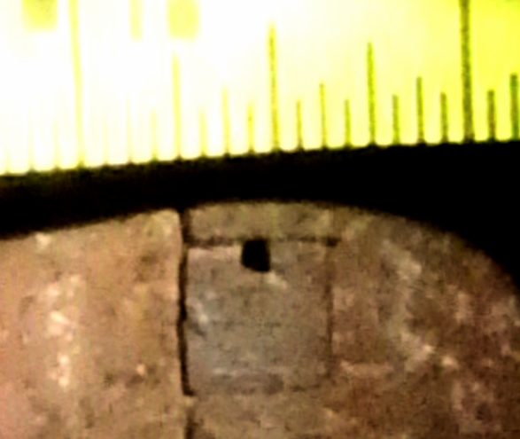
120 GeV Beam to Mcenter Pin hole collimator in M02, hole apprx. 1/16 x 1/16”, length approx. 59”

Slide 9
120 GeV Beam to Mcenter MS2 Pin Hole Collimator Solid Angle
MC2 Pin Hole Solid Angle Calculation
Last update: 0300, 17 Aug. 2020
 |  |  |  | 1/16" inch | pin hole length inch | hypotenuse of triangle with legs 1/16 x 1/16" | max. angle in radians
 | Assume hole cross section = |  |  | 0.0625 |  | 0.088388348 | 0.001498106
 | Assume hole length = |  |  |  | 59
 | This calculation assumes ray from upper left cornor of upstream end of pin hole to lower right corner of downstream end of pin hole.

Slide 10
120 GeV Beam to Mcenter View of lead pile in MC beam at M02 from just downstream of MC2 pinhole collimator (note MBottom quads in a trench located immediately below the MC beam pipe in the region between the MC2 pinhole and the lead. Although these are my guesses, the motivation for locating the MC lead pile where it is may be due to several factors. Placing the lead above any active MB devices would make any work related to the MB devices much more difficult. While the solid angle subtended by the lead pile will be greater for off angle halo attenuation if the given size lead pile was closer to the MC2 pinhole, it would also make the solid angle of the hole in the lead pile (assuming it is the same size as the beam pipe upstream and downstream of the lead, greater. By placing the lead where it is, this may have been an effort to reduce the halo going down the MC beam pipe.

Slide 11
120 GeV Beam to Mcenter MC lead pile at M02

Slide 12
120 GeV Beam to Mcenter MC lead pile at M02

Slide 13
120 GeV Beam to MCenter Note: compressor in MS3 Service Building supplies compressed air to MC2BS & MT3BS Beam Stops

Slide 14
120 GeV Beam to Mcenter

Slide 15
120 GeV Beam to Mcenter

Slide 16
120 GeV Beam to Mcenter

Slide 17
120 GeV Beam to Mcenter

Slide 18
120 GeV Beam to Mcenter Note: Air compressor in Service Building MS3 provides air pressure for MT3BS and MC2BS Beam Stops

Slide 19
120 GeV Beam to Mcenter

Slide 20
120 GeV Beam to Mcenter Note: Service Building MS4 has power supplies. PPD Dept. drawing 2410-ME-171060-6 (last “6” may be “5”)

Slide 21
120 GeV Beam to Mcenter PPD/Mech. Dept. General Meson Detector Building Layout Nov. 2004, 9200.000-LE-435199

Slide 22
120 GeV Beam to Mcenter Mcenter E907 Beam Line Equipment Layout 18Oct 2005 drawing 2907.500-ME_397568

Slide 23
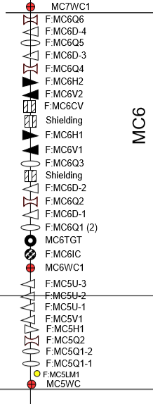
120 GeV Beam to Mcenter Beam Sheet for 100 GeV from E907 (MIPP) Sept. 2003 by Carol Johnstone & MC5-MC6 “Cactus” Plot Note: According to e-log entry of 17 Nov 2014, MC6D-3 replaced due to leak and now is EDBC042

Slide 24
120 Gev Beam to Mcenter E-log entries from 17 May 2005 by C. Johnstone

Slide 25
120 GeV Beam to MCenter Tune @ 120 GeV Up Through MC5, @ 64 GeV Downstream from 27 Jan. 2020.

Slide 26
120 GeV Beam to Mcenter 4Q120 Quadrupole Current vs. Integral B.dl

Slide 27
120 GeV Beam to Mcenter Current vs. Field for EDB00-1 (variant of EDBB)

Slide 28
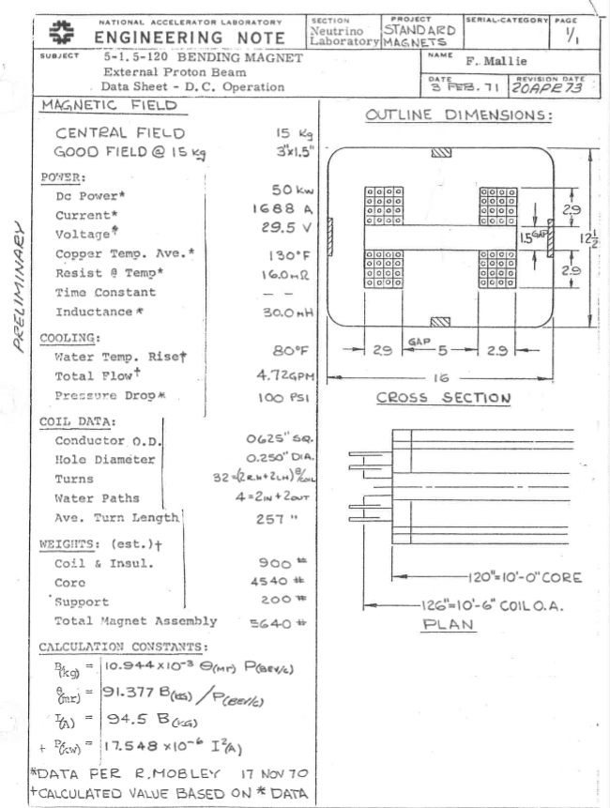
120 GeV Beam to Mcenter 5-1.5-120 (EPB) Dipole Data Sheet

Slide 29
120 GeV Beam to Mcenter J. Lentz Comments on MC6 Power Supplies Run @ Twice 64 GeV Tune of 27 Jan. 2020
On file as "Lentz reply for Running MC6 supplies @ Twice 64 GeV Values"
see e-mail from Julius Lents, 2:59 PM, 5 Aug. 20
 | supply | 64 GeV Amps | twice 64 GeV Amps | Lentz comment if twice current of 64 GeV |  |  | magnet
 | MC6Q1 | 19.4 | 38.8 | ok |  |  | 3Q120
 | MC6D | 472.8 | 945.6 | retapped, may need front porch |  |  | EDBB
 | MC6Q2 | 650.6 | 1301.2 | ramp might be ok, may need front porch |  |  | 4Q120
 | MC6Q3 | 37.19 | 74.38 | should be ok |  |  | 3Q120
 | MC6V1 | 50 | 100 | ok |  |  | trim
 | MC6H1 | 80 | 160 | ok |  |  | trim
 | MC6V2 | 79.99 | 159.98 | not in reply |  |  | trim
 | MC6H2 | 35 | 70 | not in reply |  |  | trim
 | MC6Q4 | 29.49 | 58.98 | ok |  |  | 3Q120
 | MC6Q5 | 577.9 | 1155.8 | ramped might be ok, may need front porch |  |  | 4Q120
 | Mc6Q6 | 60.17 | 120.34 | should be ok |  |  | 3Q120

Slide 30
120 GeV Beam to MCenter 4Q120 Quadrupole

Slide 31
120 GeV Beam to MCenter 4-4-30 Trim Magnet Data Sheet & Cabling

Slide 32
120 GeV Beam to Mcenter Power Supply Consideration for Operation of MC6 Magnets at 120 GeV from J. Lentz, 5 Aug. 2020
MC6Q1 has 2 magnets (2X 19A=38A) PS is 100A/500V OK
MC6D has 4 magnets (2X473A=946A) PS is 5000A/100V if load is ~30mΩ it is ~28VDC ramp might be OK**, if not it can NOT be re-tapped for more voltage, may need a front porch
MC6Q2 has 1 magnet (2X650A=1300A) PS is 5000A/100V if load is a 4Q120 at ~37mΩ it is ~47VDC ramp might be OK**, may need a front porch
MC6Q3 has 1 magnet (2X37A=74A) PS is 100A/500V if load is a 3Q120 at ~2Ω it is 148VDC ramped should be OK
MC6V1 trim has 1 magnet 200A/100V OK
MC6H1 trim has 1 magnet 200A/100V OK
MC6Q4 has 1 magnet (2X30A=60A) PS is 100A/500V if load is a 3Q120 at ~2Ω it is 120VDC ramped should be OK
MC6Q5 has one magnet (2X435=870A) PS is 5000A/100V if load is a 4Q120 at ~37mΩ it is 32VDC ramped might be OK**, may need a front porch
MC6Q6 has one magnet (2X20A=40A) PS is 100A/225V if load is a 3Q120 at ~2Ω it is 80VDC ramped should be OK
MC7AN is a special case PS is 200A/250V (this load was/is a storage ring dipole measured by Doug Jensen)
** only uncertain, may need a front porch
Hope this helps,
Julius

Slide 33
120 GeV Beam to Mcenter Additional power Supply Consideration for Operation of MC6 Magnets at 120 GeV from J. Lentz, 12 Aug. 2020
Cables are of concern!
These cable go through wall penetrations and their current capacity needs to be de-rated.
If offset currents are needed because of a high L*di/dt from an inductance load and limited ramp up time, then the cable protections
need to be considered. I don't know what offset currents might be needed.
Another variable is the quality of the current regulators. The Transrex power supplies MC6D, MC6Q2, and MC6Q5 are the oldest (1971) regulators out there. They don't have nearly as much gain as the modern regulators have, and are usually impossible to adjust to the fast ramp up and make flat top without too much overshoot or undershoot.
The 1151 modules can NOT detect the pre-event meant to ramp up some supplies in Switchyard early for these very same problems.
To rewrite the code for 1151 PROMs and reprogram them would be a major undertaking.
Because it was considered not possible to do, for a long time some supplies have been running DC (not ramped) with today's quick ramp up cycle.
I don't know who may have been adjusting 1151 ramps lately. Some controls people are knowledgeable of the limitations.
It seems to me that with todays ramp some settings were needed in the 1151 ramp so that the ramp doesn't drop to DC from a much longer cycle.
MC6V2 is shown as 0 current so I didn't think that is a concern.
MC6H2 is an old 159 module. I believe it is DC only. At 100A DC on a trim magnet, it will probably over heat the magnet. It's a concern.
Yes! The water experts definitely should be consulted. P=I²R so if the current is doubled, the power is increased 4 times.
Note from GMK: It may be possible to operate a 120 GeV beam to MC using the pin hole collimator(s) without the use of MC6Q2 and MC6Q5 if the beam reaching the experiment is small enough to meet the needs of the experiment. This assumes the use of the pin hole collimator in M02 AND PERHAPS another pinhole collimator further downstream in MC beam line. The calculations to determine the spot size have to be performed to determine this. First calculation will assume only the presence of the M02 pin hole.
Note from GMK:

Slide 34
120 GeV Beam to Mcenter E-log entry, 17 June 2019, for MD6D Power Supply

Slide 35
120 GeV Beam to Mcenter Photos by GMK of MC6 from 17 Nov. 2014 (extbeams > Operational Beamline > Meson > Mcenter > Photos > MC6 Photos 17Nov14 gmk)

Slide 36
120 GeV Beam to Mcenter Mcenter spreadsheet from T. Kobilarcik extbeam.bd>Operational Beamlines>Meson> Mcenter>mcenter
 |  |  |  |  |  |  |  |  |  |  |  |  | cycle | 60 | [s]
 |  |  |  |  |  |  |  |  |  |  |  |  | ramp | 5 | [s]
 |  |  |  |  |  |  |  |  |  |  |  |  | molar hc | 25.1 | [J*mol^-1*K^-1]
 |  |  |  |  |  |  |  |  |  |  |  |  | molar mass | 55.845 | [g/mol]
 |  |  |  |  |  |  |  |  |  |  |  |  | heat capacity | 0.449458 | [J/(g*K)]
 |  |  |  |  |  |  |  |  |  |  |  |  | T_i | 80 | [F]
 | 20 | 40 | 80 | 20 | 40 | 80 |  | Tune to | 85.00 | GeV |  | R | P | <P> | mass | dDt/dt | DT(1hr) | DT(8hr) | T_f | V | S_{top}
 | SET | SET | SET | READ | READ | READ |  | SET | READ |  |  | [Ohm] | [W] | [W] | [kg] | [K/s] | [K] | [F] | [F] | [Volt] | [sq.in.] | [m^2]
MC6Q1 | 13.15 | 26.29 | 52.58 | 13.09 | 26.19 | 52.47 |  | 55.77 | 55.65 |  |  | 1.89 | 5878.956 | 489.913 | 2986.364 | 0.000365 | 1.31 | 18.92 | 98.92 |  | 1560 | 1.01
MC6D | 144.4 | 289.1 | 578.1 | 140.8 | 282.7 | 565.9 |  | 613.63 | 600.74 |  |  | 1.75E-02 | 6589.445 | 549.120 | 2472.727 | 0.000494 | 1.78 | 25.61 | 105.61 |  | 1500 | 0.97
MC6Q2 | 260 | 510.2 | 1120 | 252.5 | 503.7 | 1091 |  | 1097.38 | 1070.36 |  |  | 0.0365 | 43954.568 | 3662.881 | 11590.909 | 0.000703 | 2.53 | 36.45 | 116.45 |  | 2760 | 1.78
MC6Q3 | 21.15 | 42.3 | 84.6 | 21.08 | 42.27 | 84.4 |  | 90.02 | 89.82 |  |  | 1.89 | 15315.271 | 1276.273 | 2986.364 | 0.000951 | 3.42 | 49.29 | 129.29 |  | 1560 | 1.01
MC6Q4 | 20.5 | 41 | 82 | 20.47 | 41.29 | 81.92 |  | 87.76 | 87.74 |  |  | 1.89 | 14556.123 | 1213.010 | 2986.364 | 0.000904 | 3.25 | 46.85 | 126.85 |  | 1560 | 1.01
MC6Q5 | 229.1 | 458.1 | 916.4 | 228.4 | 454.4 | 914.9 |  | 967.69 | 965.60 |  |  | 0.0365 | 34179.679 | 2848.307 | 11590.909 | 0.000547 | 1.97 | 28.34 | 108.34 |  | 2760 | 1.78
MC6Q6 | 13.45 | 26.91 | 53.82 | 13.38 | 26.83 | 53.7 |  | 57.14 | 57.01 |  |  | 1.89 | 6170.065 | 514.172 | 2986.364 | 0.000383 | 1.38 | 19.86 | 99.86 |  | 1560 | 1.01
4-4-30 |  |  |  |  |  |  |  | 20.00 |  |  |  | 0.276 | 110.4 | 9.2 | 462.7273 | 4.42E-05 | 0.16 | 2.29 | 82.29 |  | 247.5 | 0.16
 |  |  |  |  |  |  |  |  | 120.00 | GeV
 |  |  |  |  |  |  |  | 866.30 |  |  |  | 1.75E-02 | 13133.289 |  |  |  |  |  |  | 60.64092

Slide 37
120 GeV Beam to Mcenter Elog Entry by V. Grzelak, 16:14, 29 Aug. 2014 for 32 GeV Tune with MC6D @ 226.1 Amps

Slide 38
120 GeV Beam to Mcenter Fast Time Plot of MC6D Dipole Current @ Approx. 220 Amps from 14Apr14

Slide 39
120 GeV Beam to Mcenter MC6 Plan View (from extbeam.bd>Operational Beamlines > Meson > Mcenter > MC6Plan)

Slide 40
120 GeV Beam to Mcenter MC6 Elevation (from extbeam.bd>Operaional Beamlines>Meson>Mcenter>MC6Elevation)

Slide 41
120 GeV Beam to MCenter MC6TGT photo taken 7 Aug. 2020 by GMK Have to find out how to move this target out of trajectory. Joel Fulgham confirmed the lock in this photo is a radiation safety lock in e-mail to me of 3:08 PM 18 Aug. 2020 There are Acnet parameters F:MC61HV (MC6TGT H avg. pos.) & MC61VA (MC6GTG V avg. pos.)

Slide 42
120 GeV Beam to Mcenter MC6 Ion Chamber Drawing from Dan Schoo 24Aug20

Slide 43
120 GeV Beam to Mcenter Photo of MC6TGT region of 17 Nov. 2014. Note differences from that taken 18 Aug. 2020.

Slide 44
120 GeV Beam to Mcenter Two photos of MC6Q1-2 & MC6D-1 just downstream of it. Looks like cable connections to MC6D-1 can be unbolted and seems accessible.

Slide 45
120 GeV Beam to MCenter F:MC6IC2 doesn’t seem to be working but F:MC6IC seems to work

Slide 46
120 GeV Beam to Mcenter MC6TGT Target (this drawing may not be accurate & needs checking according to Adam Watts)

Slide 47
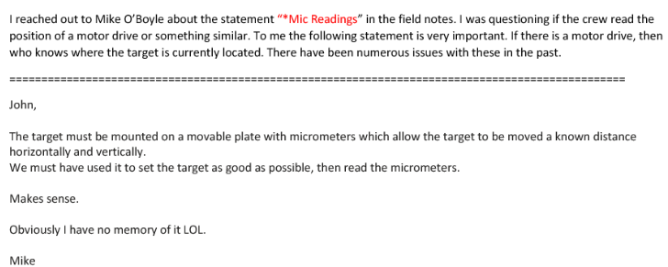
120 GeV Beam to Mcenter Alignment Field Notes from 2/16/04. Target material is Cu in these notes. from e-mail attachment from J. Kyle 18 Aug 2020 “MC6WC1_MC6IC1_MC6TGT.pdf”

Slide 48
120 GeV Beam to Mcenter Archived e-log entries, note entry of 14 & 15 June 2005 by C. Brown for MC6D current @ 120 GeV

Slide 49
120 GeV Beam to Mcenter Note 4th EPB (MC6D-4)Dipole with comment “intermediate coil-to-coil short” FRD20018 Do not know who put in comment about FRD20018 coil-to-coil short

Slide 50
120 GeV Beam to Mcenter Mcenter Critcal Device Controller Logic 25 Aug. 2020

Slide 51
120 GeV Beam to MCenter Detail from drawing 9070.000-ME-365088 “Switchyard Beamline MIPP Beamline Layout” from Aug. 2009 showing how Enclosure MC6 Area was Constructed from Shield Blocks

Slide 52
120 GeV Beam to Mcenter Photo from Nov. 2014 with what appears to be part of the MC6 “roof” shielding blocks removed. Perhaps to change components inside MC6.

Slide 53
120 GeV Beam to Mcenter MC6TGT target drawing of shielding around it. Not yet able to how target is mounted or adjusted. Does not seem to have remote drive. Aluminum box may have micrometer type target adjustments.

Slide 54
120 GeV Beam to Mcenter Detail from drawing 3907.570-ME-421159 showing 1x0.5x48” steel aperture downstream of MC6TGT

Slide 55
120 GeV Beam to Mcenter Detail from drawing 3907.570-ME-421166 showing MC6TGT target and adjustment controls detail

