Slide 1
120 GeV Beam To MCenter (Part 2)
G. Koizumi
3 Sept. 2020

Slide 2
120 GeV Beam to MCenter (Part 2)
Given that my “120 GeV Beam to MCenter” Power Point document is getting very long and large, I’ve decided to make a “Part 2” portion of it that is independent of the first part. This document is a continuation of those documents. The latest version of the initial part is from 27 August 2020 with the title “120 GeV Beam to Mcenter”.

Slide 3
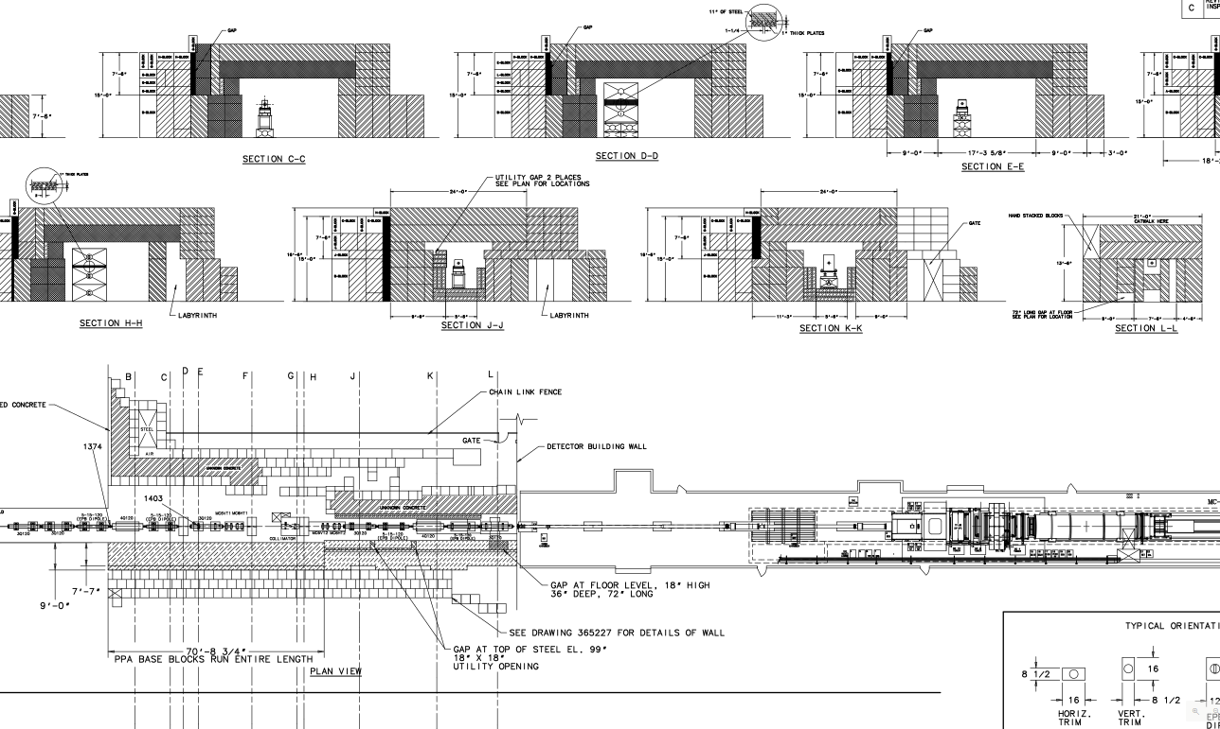
120 GeV Beam to Mcenter
Detail from drawing 9070.000-ME-365088 “Switchyard Beamline MIPP Beamline Layout” from Aug. 2009 showing how Enclosure MC6 Area was Constructed from Shield Blocks

Slide 4
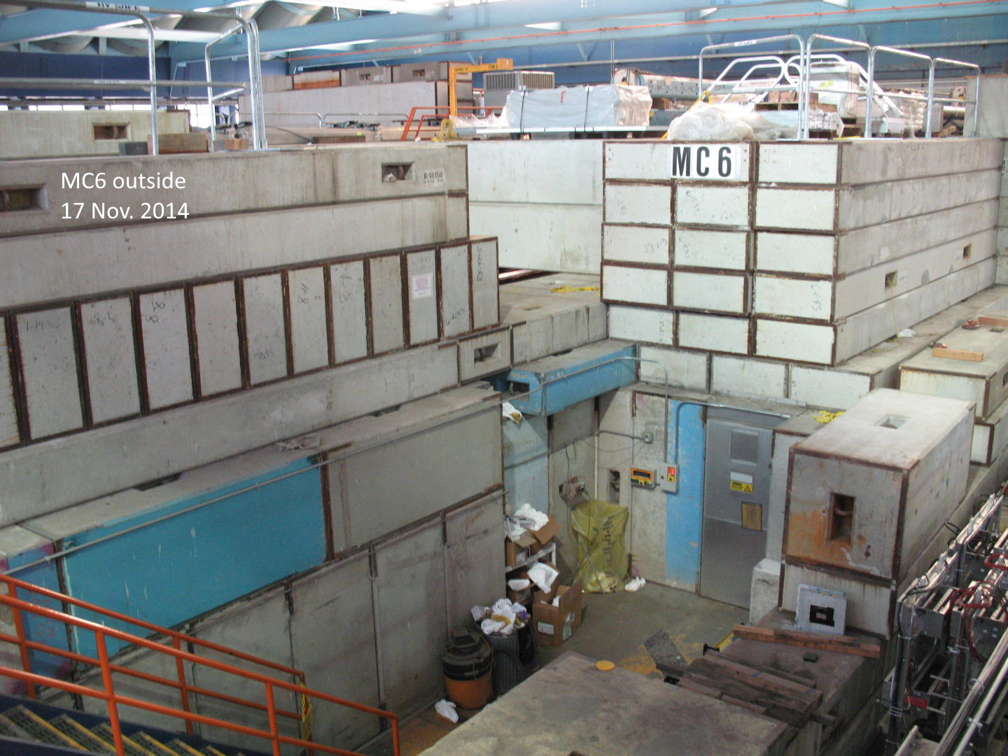
120 GeV Beam to Mcenter
Photo from Nov. 2014 with what appears to be part of the MC6 “roof” shielding blocks removed. Perhaps to change components inside MC6.

Slide 5
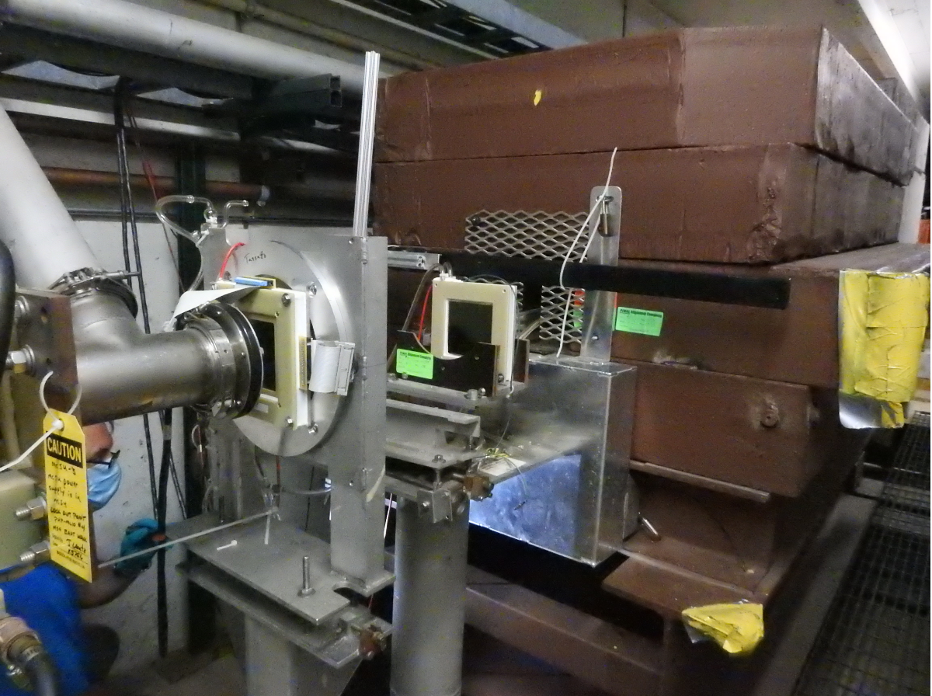
120 GeV Beam to Mcenter
MC6TGT target drawing of shielding around it. Not yet able to how target is mounted or adjusted. Does not seem to have remote drive. Aluminum box may have micrometer type target adjustments.

