Slide 1
PIP-II Energy Spread Growth and Compensation
in BTL
Eduard Pozdeyev
In partnership with:
India/DAE
Italy/INFN
UK/STFC
France/CEA/Irfu, CNRS/IN2P3

Slide 2
Without SC

Slide 3
With SC

Slide 4
Requirements
We do not want to increase the energy spread at all
Errors >1E-4 caused losses in the original injection scheme
On-energy injection (Derwent, Chase) has higher acceptance. Energy spread of 4E-4 will be on the border, leaving no space at all for other errors. Likely, we are going to have losses with this energy spread
Need simulations to simulate injection

Slide 5
Mitigation
RF Gymnastics in the linac
RF gymnastics in the linac – can be difficult without sacrificing quality and energy gain
325 MH Cavity or 650 MHz cavity
Cavity will reduce the energy spread and will stop bunch length from growing
Question is where to put a cavity and what type

Slide 6
PIP-II Layout and Possible Cavity Locations
A good distance, not too far, not too close, but can be busy if collimators added here
Large distance, low voltage
Distance can be too large for large energy spread
Might be too close,
especially, if we add two more cryomodules

Slide 7
Longitudinal Bunch Dynamics
$\frac{dp}{p}$, V
Energy spread reduced
$$ωτ$$
Applying RF voltage before stretching a bunch does not provide desired effect
As the bunch drifts, the energy spread causes particles to slip, bunch elongate, and the energy-phase correlation to appear. RF field can be applied to compensate the energy-phase correlation.
The bunch energy spread is minimal after the energy-phase correlation is compensated. The energy spread is also smaller than that after the linac.
It is important to note that the buncher cavity also removes energy offset same way it removes correlated energy spread.
Phase jitter in the buncher cavity can introduce energy spread. However, it should be small from a practical point of view.

Slide 8
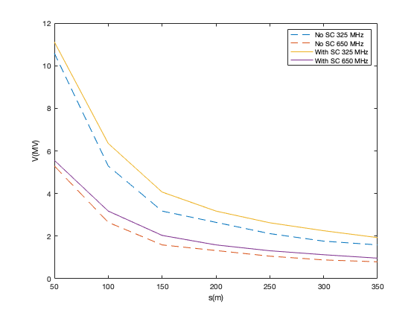
Voltage of a cavity
Assume simplified formula $\frac{σ_{dp/p}}{σ_{z}}$ is the slope to be compensated – ok for long bunches.
Note: Bunch length is ~1 rad of 650 Mhz at the end of BTL
Required voltage
(including TTF)
as function of cavity
position after the linac

Slide 9
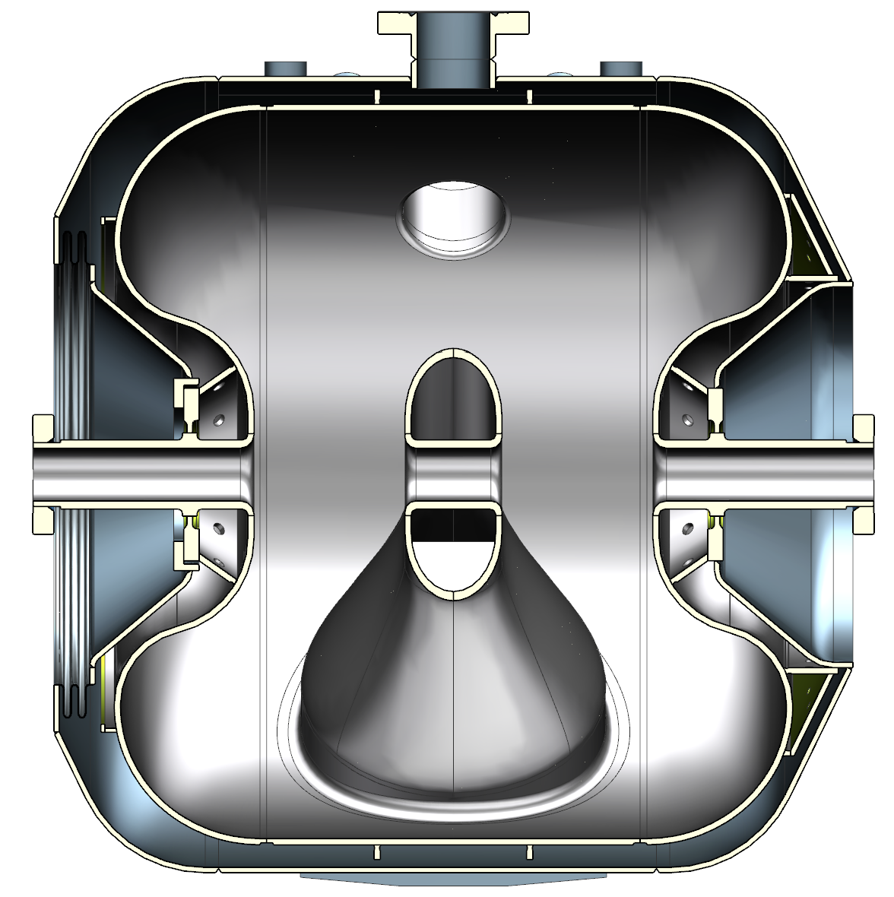
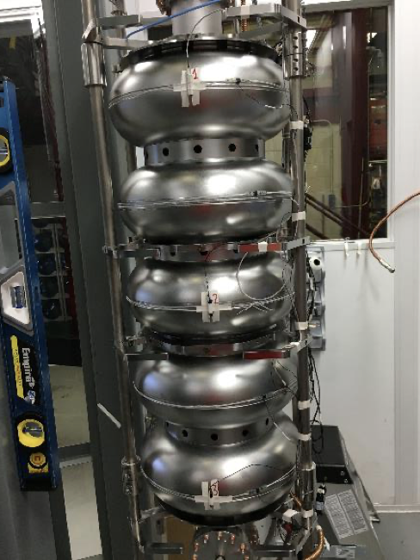
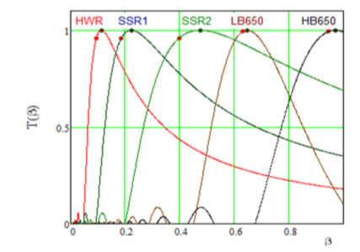
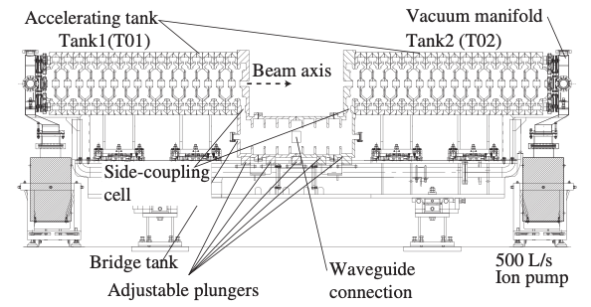
Buncher Cavity Options
PIPI-II SSR2 Cavity, 325 MHz
Energy gain, at $β_{opt}=$5 MeV
TTF at 800 MeV = 0.75
Energy gain at 800 MeV = 3.75 MeV
Superconducting Options at 4K
One consider using 4K, pulsed, dry, cryo-cooler based solutions:
Nb₃Sn – IARC projects
Nb at 4 K pulsed, favors lower frequency
PIP-II HB 650 Cavity, 650 MHz
Energy gain, at $β_{opt}=20$ MeV
TTF at 800 MeV = 0.85
Energy gain at 800 MeV = 17 MeV
A single cavity can be used with
an energy gain of ~3.5 MeV
RT Pulsed Systems Possible
E.g. JPARC ACS Buncher, 972 MHz
Energy gain, $β_{opt}=6.2$ MeV/tank
$β_{opt}$ = 0.6 – needs to be optimized for a higher velocity
1.5 m

Slide 10
Cavity Voltage v.s. Requirements
Required voltage
(including TTF)
as function of cavity
position after the linac
Voltage provided by
a single SSR2 cavity or
single-cell HB650 cavity
(RT solution is not shown)
Single cell-cavity HB650
operating at 25% of
the nominal voltage will
correct energy spread

Slide 11
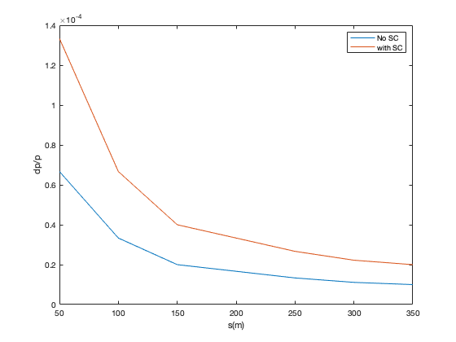
Estimate of the Residual Energy Spread
Assume emittance constant: ${(δp)}_{height}δz=constant$
Assume, dp/p with SC is 4e-4 – simplified approximation
Estimate does not include nonlinearities, need to use simulated distribution

Slide 12
Summary
Reduction of energy spread using a buncher after the linac is feasible
The buncher will also compensate a coherent energy deviation
Possible cavity options and locations
HB650: end of linac, after 1st arc, end of BTL – bunch might be getting too long
SSR2: end of BTL
4K, dry, pulsed SRF systems can be an option, including Nb₃Sn
RT RF cavity (e.g., CCL) maybe even pulsed: everywhere in BTL
Path forward
Need to do simulations with actual disbtrbution

Slide 13
Questions
Will there be a debuncher at the end of the Linac before Booster?
Buncher is needed but it is not part of baseline as of now
If yes, will you be using the debuncher to control the energy of the beam before it enters Booster?
The plan was to use a linac cavity or a set of linac cavities to control the beam energy
If there will not be a debuncher, is there a cavity that will be used to adjust the phase/energy of the beam before it enters Booster?
See above

Slide 14
Questions
Is there a time of flight system at the end of the Linac?
The beam energy will be measured by time of flight (using BPMs, both realtive changes and absolute) and through dispersion (relative changes)
Dispersion function is 4 m in the bends. Specified BPM resolution is 10 um.
How much do you expect the Linac beam energy to drift:
Between 20 Hz and a ~1Hz pulses – ~1e-4
In the long time (>10s) – This needs to specified and addressed
Energy flatness of the beam over the ~550 us injection into Booster – momentum stability should be not worse than 1e-4 r.m.s.

