Slide 1
Telework Report 08/09-09/30/2020
Chandra Bhat
Zoom Group Meeting
20200930

Slide 2
PIP2 ESME simulations revisited
~7E12ppBC beam acceleration from injection to Extraction
Standard phase jump scheme
gammaT-Jump scheme ← Taskforce Talk (may be next
3.25” bore cavity measurements (with Robyn and John Reid)
Previous year’s Booster Data Analysis
Ramp Data
1-shot study data
Data taken during Operation
PS-8hr study data
DC Study Data
Issue Addressed using WCM data
Injection to extraction beam efficiency,
Phase during injection, capture
Bunch length and longitudinal emittances
Study on Coupled bunch instability during the cycle using WCM-cycle data
Literature Study
PS Startup study plan
Plans:
Continue Booster data analysis,
Startup Beam Studies (at the LAB)
Simulations
Literature Studies

Slide 3
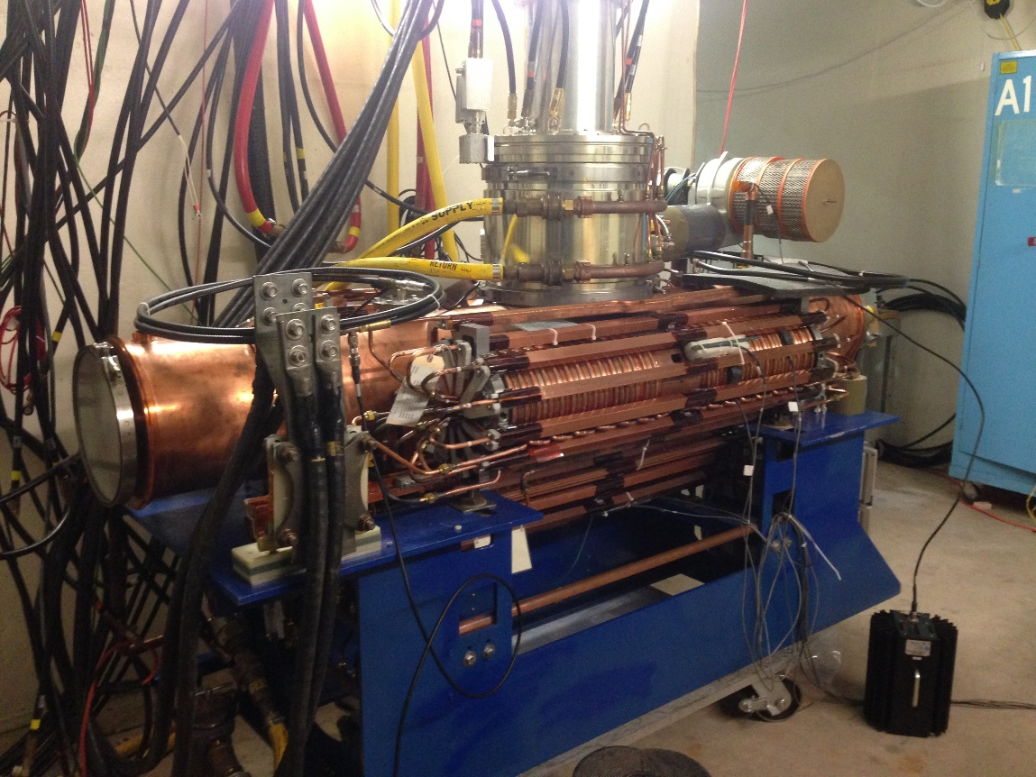
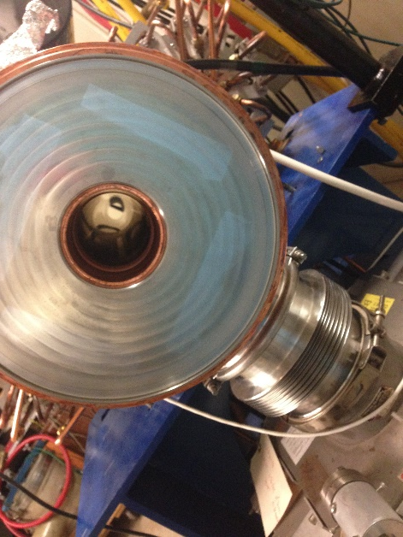
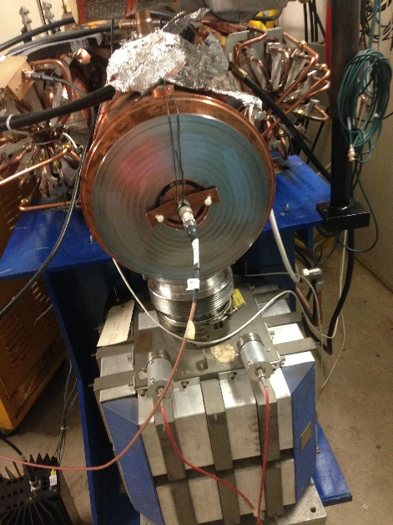
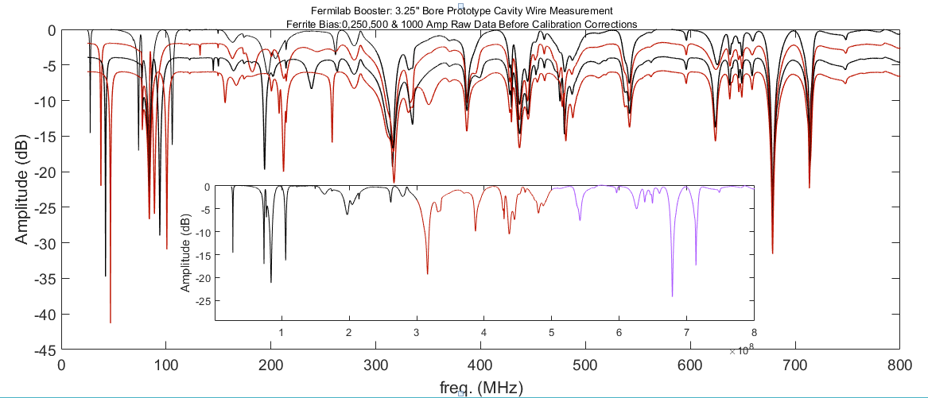
3.25” Bore Booster Cavity
Robyn, John and Chandra
0 Amp
250 Amp
1000 Amp
Ferrite current=0 Amp
500 Amp

