Slide 1
Stretched Wire Measurements on Medium Bore Booster Cavity
Robyn Madrak, Chandra Bhat, and John Reid
Joint PSP/Taskforce Meeting
08 October 2020

Slide 2
Medium Bore Cavity
Needs to be modified (ferrites) to get the necessary f vs. Ibias
  Bias current necessary right now to get to 53 MHz is too high
John temporarily modified the bias supply to go to higher current for a short time so that we could perform measurements
High power test is complete
We measured mode frequencies, Q, and S21

Slide 3
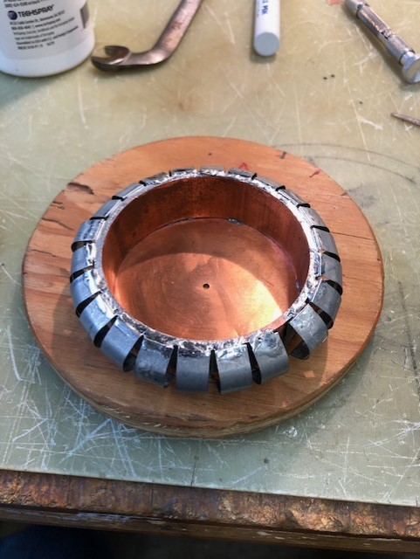
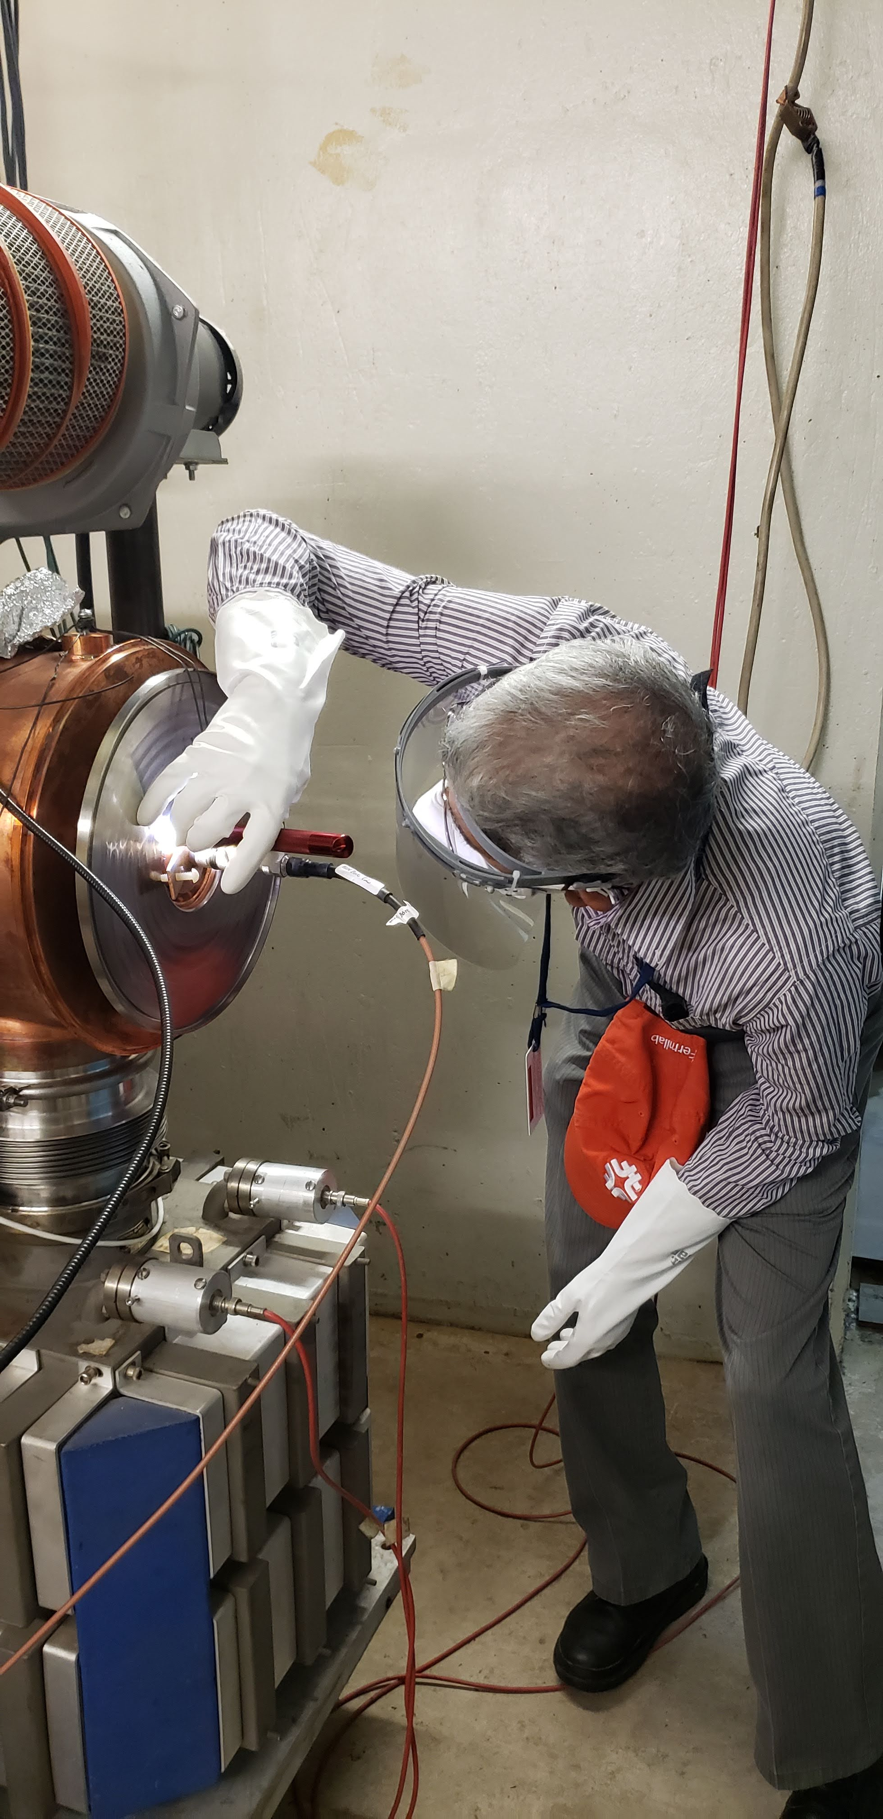
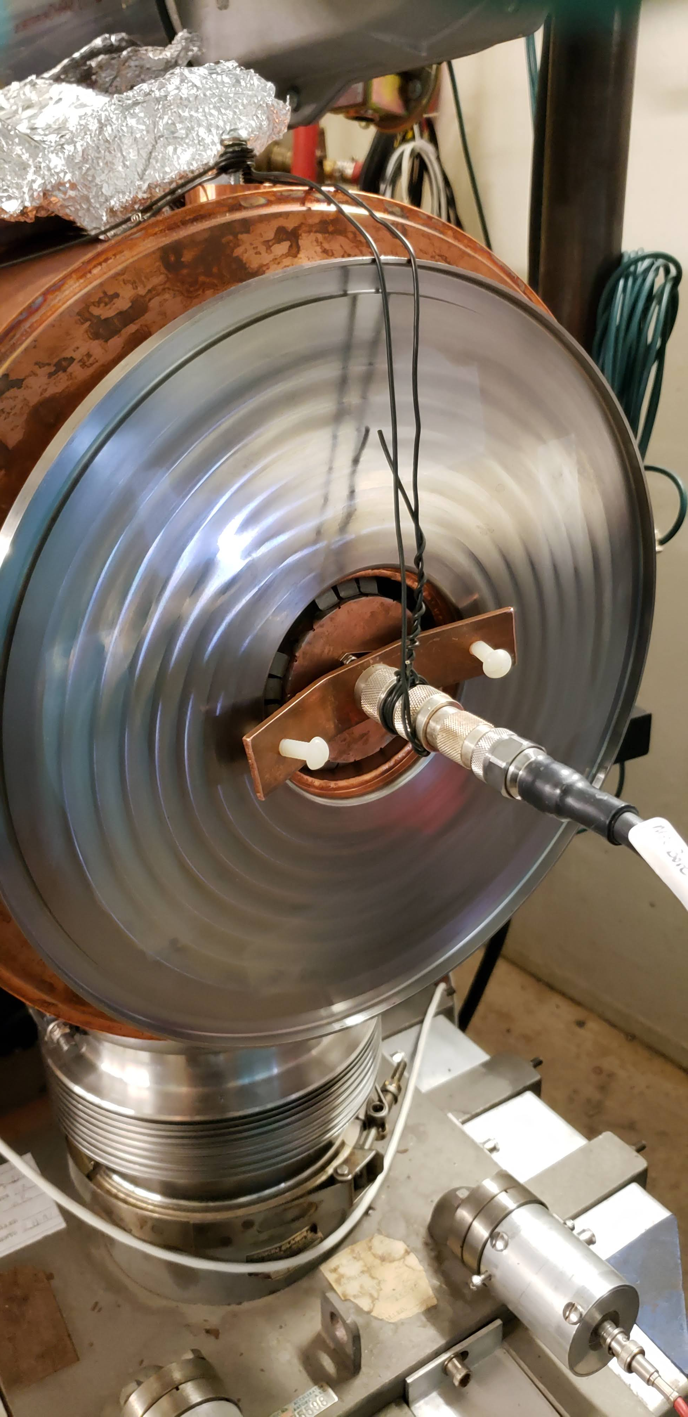
Wires have matching resistors (not shown)

Slide 4
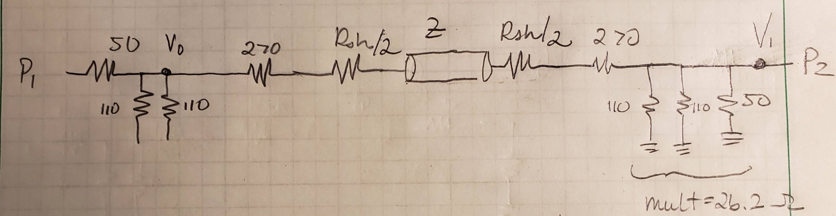
Setup
Rsh(1gap)
Rsh(1gap)
Single gap impedance = Rsh(1gap)
This is the final number which is corrected for everything

Slide 5
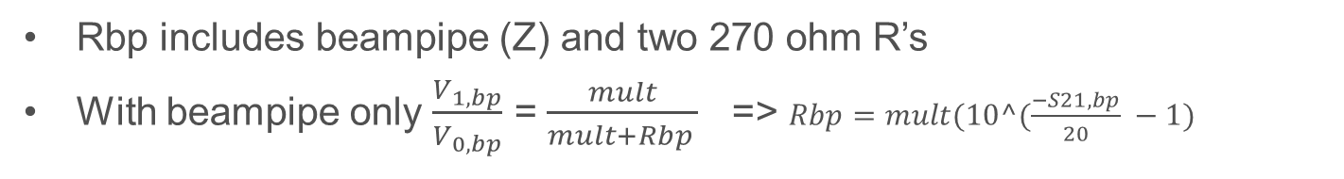
Measurement of S21 with Mock beampipe only
Rsh(1gap)
Rsh(1gap)
Rbp
S21,bp meas was -27.2 in dB
=> Rbp = 574 ohms
Rbp includes beampipe (Z) and two 270 ohm R’s
With beampipe only $\frac{V_{1,bp}}{V_{0,bp}}$ = $\frac{mult}{mult+Rbp }$ => $Rbp=mult(10^(\frac{−S21,bp}{20} −1)$

Slide 6
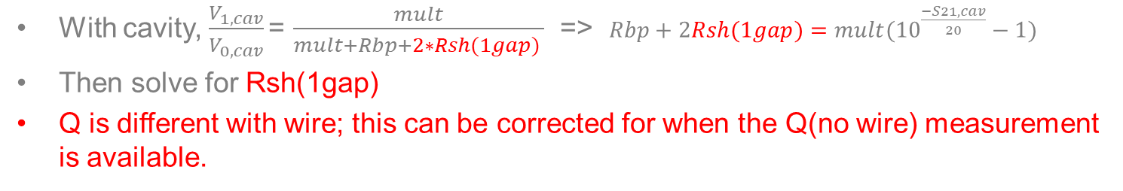
Rsh(1gap)
Rsh(1gap)
Rbp + 2Rsh(1gap)
With cavity, $\frac{V_{1,cav}}{V_{0,cav}}\text{=}$ $\frac{mult}{mult+Rbp+2∗Rsh(1gap) }$ => $Rbp+2Rsh(1gap)=mult({10}^{\frac{−S21,cav}{20}}−1)$
Then solve for Rsh(1gap)
Q is different with wire; this can be corrected for when the Q(no wire) measurement is available.

Slide 7
Tim Berenc PA note
Kathy Harkay thesis

Slide 8
Comparison of Fundamental Mode Results
Note: ferrite mu and losses for same frequency are lower, due to higher bias

Slide 9
Example Q comparison

Slide 10
Legacy Cavity Measurements

Slide 11
Comparison for HOMs up to 210 MHz

Slide 12
Comparison of HOMs above 210 MHz

Slide 13
Conclusion
Fundamental Impedance is higher in medium bore prototype than in legacy cavity at higher currents
  Not surprising since losses are smaller at higher I
It does not appear that HOMs are any worse than in a legacy booster cavity

