Slide 1
Short-range wake fields in plasma acceleration
Sergei Nagaitsev (Fermilab/UChicago)
In collaboration with Valeri Lebedev and Alexey Burov (Fermilab) and
Stephen Webb and David Bruhwiler (RadiaSoft, LLC)
Aug 14, 2018

Slide 2
Acknowledgements
We would like to thank our UCLA (Weiming An) and SLAC colleagues for fruitful discussions and computer simulations.
Some of the results presented in this talk are based on our recent publication, “Efficiency versus instability in plasma accelerators”, Phys. Rev. Accel. Beams 20, 121301 (2017)
This work is funded by the DOE HEP and by a DOE SBIR Phase 1 grant

Slide 3
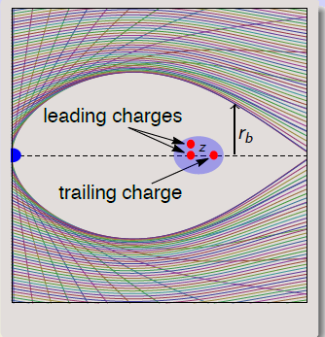
Plasma short-range wakefields
The terminology of wakefields in plasma can be confusing. The original meaning of the wake in plasma is the field generated by the drive bunch, which accelerates the trailing bunch. (The driver could be particle beam or laser)
In this presentation, by wakefields I mean the fields (longitudinal and transverse) with which the trailing bunch acts on itself.

Slide 4
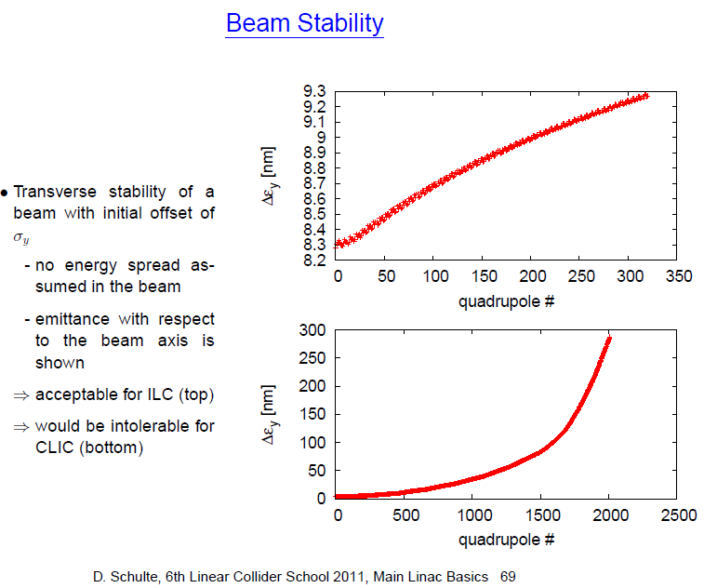
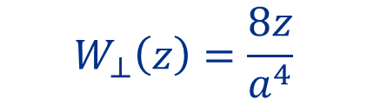
Transverse beam break-up (BBU) instability
Transverse wakes act as deflecting force on bunch tail
  beam position jitter is exponentially amplified
Short-range
transverse wake
(for solid walls)
ILC
$$W_{⊥}\left(z\right)=\frac{8z}{a^{4}}$$
a ≈ 35 mm (ILC)
a ≈ 3.5 mm (CLIC)
What about plasma?
a ~ 0.1 mm (PWFA)
CLIC

Slide 5
BBU illustration
See A. Chao, “Physics of collective beam instabilities in high energy accelerators (Wiley, 1993).”
The growth rate is determined by the ratio of defocusing (wake) force to focusing force (the wake parameter):

Slide 6
The BBU instability development
μ -- betatron phase advance
For and it was solved in:
  C. B. Schroeder, D. H. Whittum, and J. S. Wurtele, “Multimode Analysis of the Hollow Plasma Channel Wakefield Accelerator”, Phys. Rev. Lett. 82, n.6, 1999, pp. 1177-1180.
Approximate solutions (it’s a very good fit, <10% deviation):

Slide 7
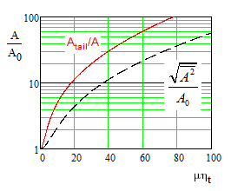
Note that A is a normalized particle amplitude. For a constant plasma density and without instability A would stay constant, while the initial physical amplitude x should decrease as

Slide 8
Beam breakup in various collider concepts
ILC
  Not important; bunch rf phase is selected to compensate for long wake and to minimize the momentum spread
CLIC
  Important; bunch rf phase is selected to introduce an energy chirp along the bunch for BNS damping (~0.5% rms). May need to be de-chirped after acceleration to meet final-focus energy acceptance requirements
PWFA – subject of our study
  Critical;

Slide 9
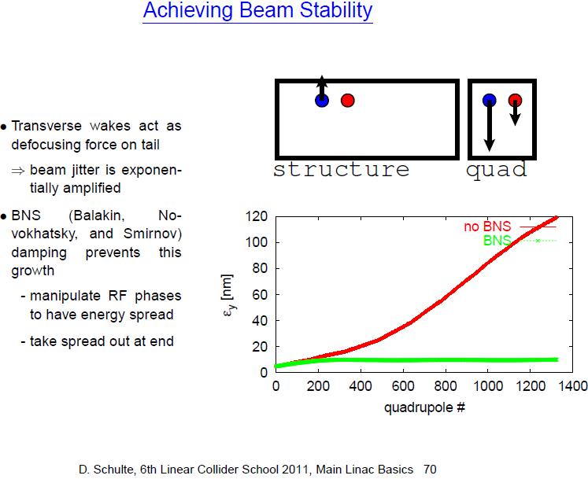
CLIC strategy: BNS damping + < µm alignment of cavities

Slide 10
Strategy was also used at the SLC…

Slide 11
BNS damping: what is it?
Assume a constant long. density of trailing bunch. Chromatic detuning of tail particles allows to keep amplitudes constant
-- Transverse wake parameter
in a PWA blow-out regime
X (ξ)= const →

Slide 12
Acceleration in a plasma blow-out regime
The Q-factor is very low (~1) – must accelerate the trailing bunch within the same bubble as the driver!
Cannot add energy between bunches, thus a single bunch must absorb as much energy as possible from the wake field.
To achieve L ~10³⁴, bunches should have ~10¹⁰ particles (similar to ILC and CLIC). In principle, we can
envision a scheme with fewer particles/bunch and a higher rep rate, but the beam loading still
needs to be high for efficiency reasons.
M. Tzoufras et al., PRL 101, 145002 (2008)

Slide 13
Power transfer from drive to trailing bunches
Trapezoidal charge line density distribution → constant electric field
Example:
50% power transfer
efficiency drive to trailing
See M. Tzoufras et al.,
PRL 101, 145002 (2008)
The power transfer efficiency of 50% and the transformer ratio of 2. For n₀=10¹⁷ cm⁻³ the drive bunch
parameters are chosen to be R_{b}k_{p}=5, L_{d}k_{p}=2.5 yielding the decelerating field of E_{d} = 50 GV/m and N_{d}=3.55·10¹⁰.
The trailing bunch parameters are: r_{t2}=0.518R_{b}, r_{t1}=0.373R_{b}, E_{t} = 100 GV/m, N_{t}=8.86·10⁹.

Slide 14
The efficiency-instability relation in a blowout regime
This formula does not include any details of beams and plasma, being amazingly universal!
Note: this formula is an estimate on a “low side”. On a “high side”, we estimate it as:
Example: →
See: “Efficiency versus instability in plasma accelerators”, PRAB 20, 121301, 2017
→

Slide 15
Examples (FACET-II)
p_{i}=10 GeV/c for both the drive and the trailing bunches, and the final momentum of trailing bunch p_{f}=21 GeV/c, N_{d}=1x10¹⁰ and N_{t}=4.3x10⁹
If one reduces the power efficiency:
Of course, the final momentum is now p_{f}=15.5 GeV/c (for the same number of particles)

Slide 16

Case I: ~50% power efficiency
Courtesy of UCLA

Slide 17
50% power
efficiency

Slide 18
Case II: ~25% power efficiency
Courtesy of UCLA

Slide 19
25% power
efficiency

Slide 20
Mitigation by momentum chirp (classical BNS)
Goal:
X (ξ)= const →
The maximum allowed momentum spread might be determined by the stage-to-stage transition optics
If one can tolerate than
CLIC Design:
→ Therefore, the max power efficiency is

Slide 21
The role of plasma ions
So far, we considered plasma ions to be stationary (constant transverse focusing).
In fact, if the bunch density is high enough, the plasma ions are pulled into the electron bunch and create nonlinear focusing.
Effect was considered first by J. Rosenzweig et al, PRL95, 195002 (2005). Found to be detrimental because of emittance growth.
However, nonlinear focusing might be helpful to suppress the BBU instability (by allowing some emittance growth)
Recent simulations performed by Weiming An (UCLA) et al.
  https://conf.slac.stanford.edu/facet-2-2017/agenda
  PRL 118, 244801 (2017)

Slide 22
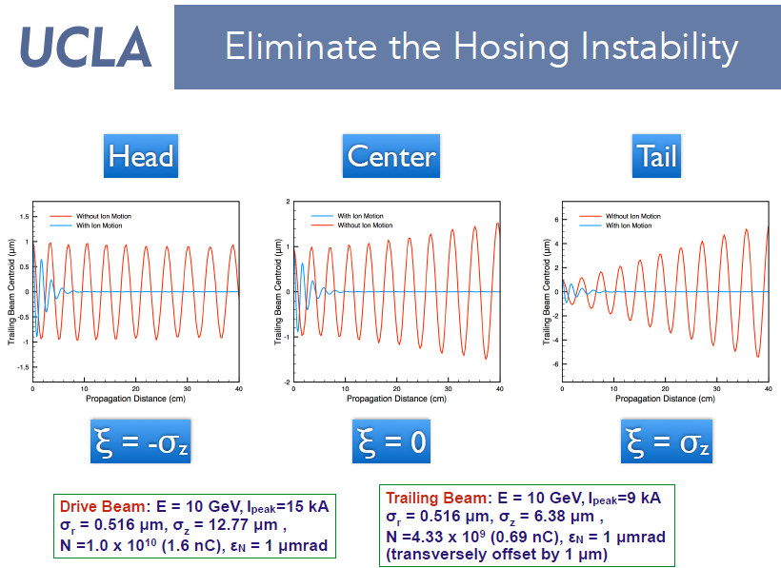
Power efficiency: 50%
Emittance growth: ~a factor of two
See: https://conf.slac.stanford.edu/facet-2-2017/agenda

Slide 23
BNS damping by plasma ions (new idea!)
arXiv:1808.03860
-- the betatron frequency increases
from bunch head to tail
This focusing variation is normally achieved by an energy chirp,
but in PWA, there may be an additional mechanism – plasma ion
mobility
Plasma ions are
pulled into the beam
Trailing bunch
Assuming ion density
variation is small:

Slide 24
Plasma ions at FACET-II….
Since we would like to have
For FACET-II parameters: 10 GeV, n₀ = 4x10¹⁶ cm⁻³
N = 10¹⁰ , L = 5 μm
For the rms norm emittance 1 μm we should observe BNS damping due to ion moblity (at 50% power efficiency)
For the rms norm emittance 10 μm we will not observe BNS damping due to ions (at 50% power efficiency)
Goal:
These examples are based on hydrogen plasma
arXiv:1808.03860

Slide 25
Conclusions
We have found a universal efficiency-instability relation for plasma acceleration. Should allow for tolerance and instability analysis without detailed computer simulations.
  “Efficiency versus instability in plasma accelerators”, PRAB 20, 121301 (2017)
  We considered only ideal “trapezoidal” distributions. Real-life distributions may be worse (from the efficiency perspective).
In a blowout regime, plasma focusing is just strong enough to keep the instability in check for low power efficiencies (<25%)
  Even for such efficiencies, external focusing and hollow channels are very challenging because of transverse BBU instability.
  Presents obvious difficulties for positrons
Classical BNS damping is possible but external optical systems may limit the momentum spread to ~1% max. Thus, the power efficiency (drive to trailing) can not exceed ~18%.
BNS damping may be based on ion mobility for some range of bunch and plasma parameters. Can be tested at FACET-II.
  Preparing an experimental proposal

Slide 26

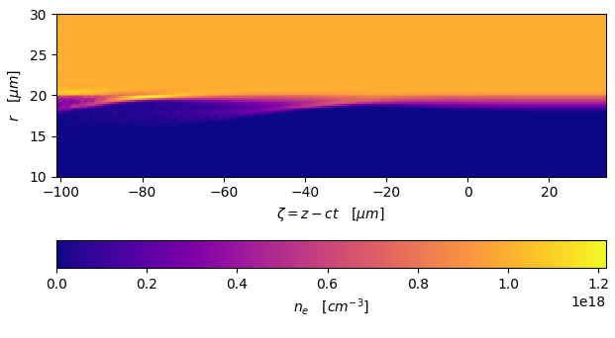
SBIR funded collaboration with RadiaSoft LLC
“Maximizing the efficiency of plasma-based lepton accelerators”
PI: Stephen Webb, Office of High Energy Physics, Award # DE-SC0018718
Phase 1 period of performance: July 2018 to June 2019
Phase 2 vision: Maximize efficiency of plasma-based accelerators
a) help to understand, quantify and mitigate instabilities
b) computational support for experiments at FACET-II
Phase 1 goals:
Assess value of impedance, wake functions in plasma
Demonstrate accurate calculation of impedance via PIC
Benchmark with theory; help to plan FACET-II exp’ts
Working with FBPIC
R. Lehe et al., Comp. Phys. Comm., 203, p. 66 (2016).
On GitHub, https://github.com/fbpic/fbpic
Initial benchmarking results
Started with e- beam driver in hollow channel
C.A. Lindstrom et al., PRL 120, 124802 (2018).
C. Schroeder et al ., PRL 82, p. 1177 (1999).
Quantitative agreement seen for short times
FBPIC simulations of e- beam in hollow channel shows agreement with theory for short times; channel edge evolves, breaking assumptions

Slide 27
Summary
We now have a very interesting proposal for FACET-II to test our findings of emittance growth vs beam loading, and BNS damping vs beam emittance
  Large parameter space to explore (small to large beam emittances, ion motion, plasma bubble size, etc)
Our conclusions require confirmation by computer simulations and by experiments, especially in regimes of smaller bubble sizes.
  Hence our collaboration with RadiaSoft, SLAC, University of Oslo, CERN and UCLA groups.

Slide 28
Extra slides

Slide 29


