Slide 1
Booster 95 LCW System
Past, Present, and Future
PIP-II 2020

Slide 2
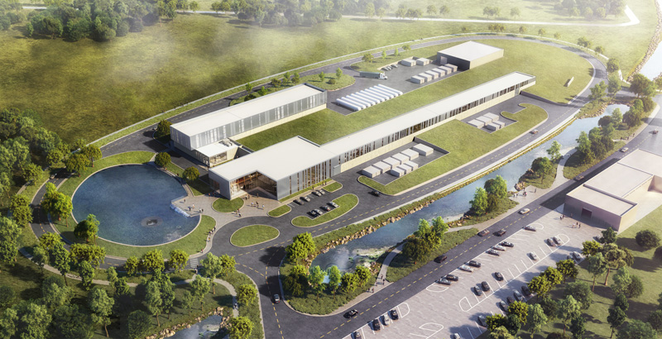
Booster 95 LCW System
System History
Current System
Future System

Slide 3
System History – 1974 to 1980
1974: As-Built drawings show a Booster 95 LCW system designed as one large primary system, with (3) supply pumps, and without return pumps.
System capable of circulating 3,012 GPM at 320 ft. hd. (139 Psi) using (2) pumps operating in parallel.
(2) LCW shell and tube heat exchangers operating together with (1) as stand-by can reject 4,766 kW (16,265 Mbh) of heat at design temperatures of 105.8 deg. F EWT, and 95 deg. F LWT.
1979 – 1980: (2) Return pumps added to system. The returns pumps were probably surplus equipment.
Return pumps are United 6” TC-C Slurry pumps, 1,100 GPM each, and are designed to circulate 2,200 GPM at 78 ft. hd. (34 Psi), using (2) pumps operating in parallel.
Note: Return pumps GPM does not match supply pumps GPM, so the return pumps were actually operating at 3,012 GPM at around 52 ft. hd., far to the right on their pump curve.

Slide 4
System History – 1999 to 2001
1999: (3) original shell and tube heat exchangers replaced with (2) plate and frame heat exchangers (FESS P.N. 11-2-40).
(1) LCW plate and frame heat exchanger with (1) as stand-by can reject 5,035 kW (17,183 Mbh) of heat at design temperatures of 99.85 deg. F EWT, and 88 deg. F LWT, at a flow of 2,900 GPM.
2001: (1) New return pump installed as stand-by to the (2) existing return pumps (FESS P.N. 11-2-52). Return pump is a Goulds 4x6x10H, 1,100 GPM.
Return pumps still designed to circulate 2,200 GPM at 78 ft. hd. (34 Psi), using (2) pumps operating in parallel.
2001: (4) Mason Neilan valves connected to Metasys system. (2) of these valves are located in the east and west Booster Galleries, (1) is at the supply pump bypass in the CUB, and the remaining valve is located in the CUB utility tunnel. The (3) valves in the piping to the Booster Equipment are controlled manually and are locked out to prevent remote operation.

Slide 5
System History – 2002 to 2008
2002: Cooling Towers replaced, pumps added, VFDs added, and piping reconfigured (FESS P.N. 11-2-48).
Cooling tower water (CTW) to the heat exchangers reconfigured into a primary/secondary pumping arrangement.
(2) new CTW pumps with VFDs added.
2002: Most Switchyard beam lines shut-down. LCW flow maintained to prevent condensation in magnets and other equipment. LCW valves to enclosure J closed.
2005: (3) new Booster 95 LCW supply pumps installed to replace the original supply pumps. Supply pumps are Goulds 4x6x11H pumps, 1,680 GPM each, and are capable of circulating 3,360 GPM at 310 ft. hd. (134 Psi), using (2) pumps operating in parallel.
(3) ABB Variable Frequency Drives (VFDs) installed to operate the Booster 95 LCW supply pumps. VFDs are used to soft start the supply pumps.
2008: MTA installed and is using approximately 70 GPM of LCW.

Slide 6
System History – 2007 to 2014
2007 - 2009: Correctors and corrector filters installed in Booster Enclosure
2007 - 2009: LCW return piping in the east and west Booster Galleries upgraded. Larger return piping and butterfly valves installed in preparation for connection back to the CUB.
2009: Valves and flexible connections replaced at LCW return pumps in the CUB.
2009: 1-1/2” manifolds designed for Solid State Driver (SSD) and associated equipment installation in the east and west Booster Galleries.
2012: LCW return piping connections back to the CUB are installed.
2012: LCW return piping connections to the return piping before the return pumps in the CUB are installed.
2014: Flow meters for the LCW supply are installed in the East and West Galleries.

Slide 7
System History – 2015 to 2020
2015: LCW for RF Cavities 21 and 22 installed in the enclosure.
2016: LCW extended to BGW-124 for RF Station install.
2017: Switchyard LCW removed from Booster LCW system and added to Main Ring Remnant system. Old Booster Switchyard flow was approximately 300 GPM.
2017: Old bypass butterfly valve replaced with a new valve. New valve closed. New bypass piping and valve installed. Flow through old bypass valve was approximately 180 GPM. New bypass flow approximately 40 GPM.
2019-2020: MTA area repurposed and is using approximately 40 GPM of LCW.

Slide 8
Current System

Slide 9
Current System
The Booster 95 LCW supply pumps are designed for 1,680 GPM each at 310 ft. hd. (134 Psi), and are capable of circulating 3,360 GPM using (2) pumps operating in parallel.
The current total Booster 95 LCW flow is approximately 2,775 GPM. The LCW supply system is operating at approximately 370 ft. hd. (160 Psi) using (2) pumps operating in parallel.
Approximately 1,455 GPM flow to the Booster Enclosure.
Approximately 600 GPM flow to the West Booster Gallery.
Approximately 545 GPM flow to the East Booster Gallery.
Approximately 130 GPM flow to the lower West Cross Gallery and Linac.
Approximately 45 GPM flow to the lower Transfer Hall and Switchyard.
Approximately 50 GPM is bypass flow directly from the supply piping to the return piping.

Slide 10
Current System
Return pumps still designed to circulate 2,200 GPM at 78 ft. hd. (34 Psi), using (2) pumps operating in parallel.
Note: Return pumps GPM still do not match supply pumps GPM, so the return pumps are actually operating at 3,160 GPM at around 45 ft. hd., far to the right on their pump curve.
The Booster 95 LCW water system currently operates at a temperature difference of 5.7 deg. F. as seen in the CUB.
Amount of heat transferred at the CUB heat exchangers is 2,400 kW.
Maximum amount of heat the CUB heat exchangers can transfer is 5,035 kW based on a temperature difference of 12 deg. F.

Slide 11
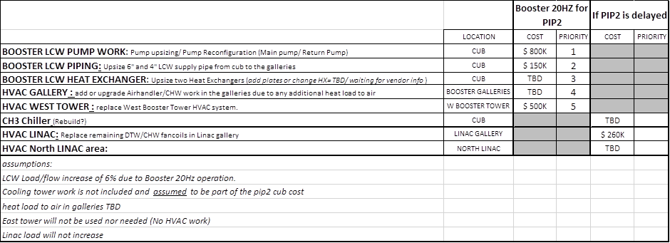
The Future
In 2015, Emil Huedem (FESS Engineering) started a project to determine what upgrades would be needed at CUB in support of Booster for PIP-II:
From: Emil Huedem Sent: Thursday, February 26, 2015 3:27 PM To: Fernanda G Garcia Subject: List
My reduced list so far..and very very rough cost numbers
Still waiting for vendor info on heat exchanger.
As for the implementation, I assumed the booster related items need to be “finished” by 2023.
And the Linac related items “start” when the news of pip2 delay is announced

Slide 12
The Future
In 2020, Emil Huedem’s final costs were retrieved:

