Slide 1
BPM Diagnostic Tool (or PCA Anomaly Detection)
Jeffrey Eldred for Proton Source Dept.
December 15th 2020

Slide 2
2
Intro to Principal Component Analysis (PCA)
PCA also called Spectral Value Decomposition (SVD).
- invented in 1901, theorized in 1873.
Basic idea: you have a few true “principal” signals and several detectors, which pick up the true signals. But the detected signals are a “mix” of the true signals in different proportions. How do you find that true/”principal” signals from the detected/”mixed” signals?
Example: N people in the same room and M microphones scattered around the room. Each microphone picks up all the voices, but not to the same degree. PCA can find the N voices from M audio tracks. Even better, you can then “map” how much each microphone picks up each voice.
2
Jeffrey Eldred | PCA & BPM Diagnostics
Notes:
2
2
2

Slide 3
3
PCA Applied to BPM Data
In our case we have four principal signals for betatron oscillation
1 cosine-like vertical
2 sine-line vertical
3 cosine-like horizontal
4 sine-line horizontal
And we have 2x48=96 BPM signals per cycle. With the horizontal and vertical ping cycles, I we can use 2x96=192 signals. Each signal is about 300 turns starting at the first ping after turn 450.
1. Reconstruct the four betatron signals via PCA.
2. Separate the horizontal from vertical (frequency and ping)
3. Map the cosine-like and sine-like amplitudes across the BPMs
3
Jeffrey Eldred | PCA & BPM Diagnostics
Notes:
3
3
3

Slide 4
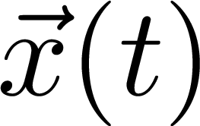
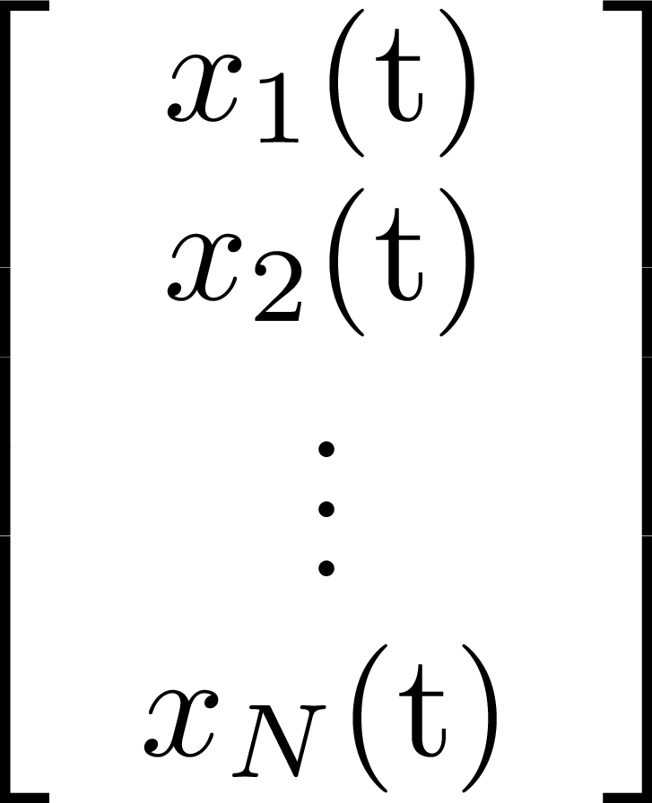
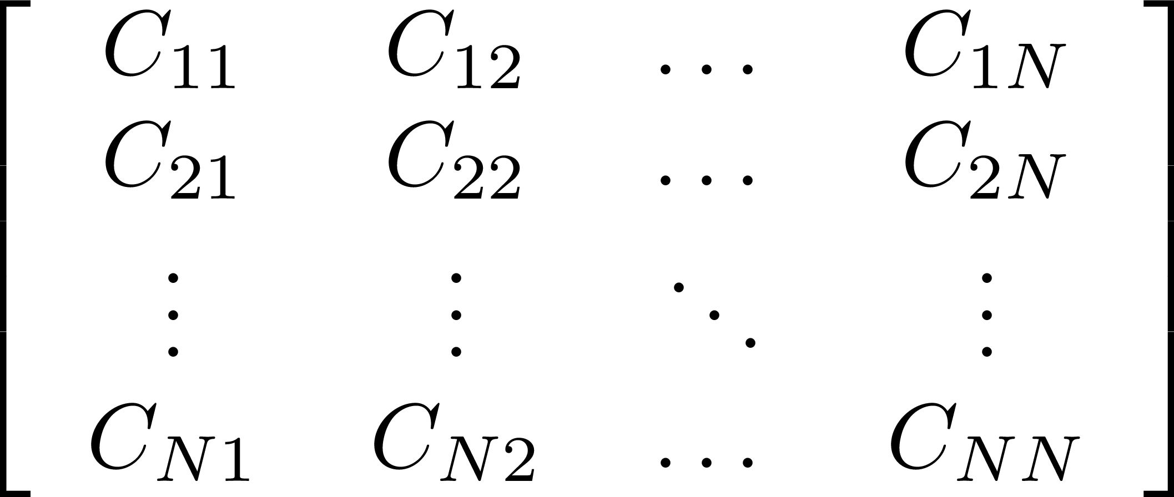
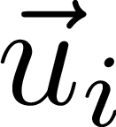
4
PCA Algorithm
x(t) data signals for N detectors,
Find the Covariance matrix C:
Spectral Value Decomposition:
Find principal signals:
Where describes the contributions of the N detectors.
4
Jeffrey Eldred | PCA & BPM Diagnostics
Notes:
4
4
4

Slide 5
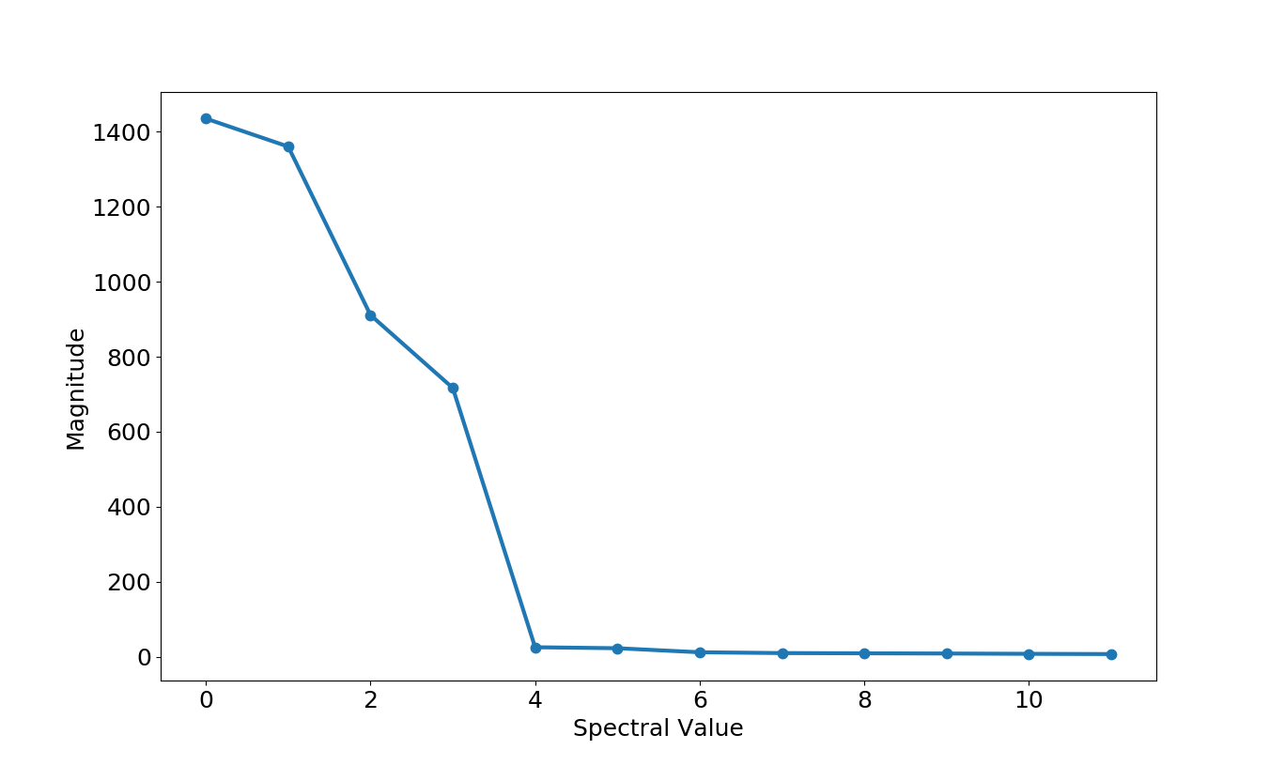
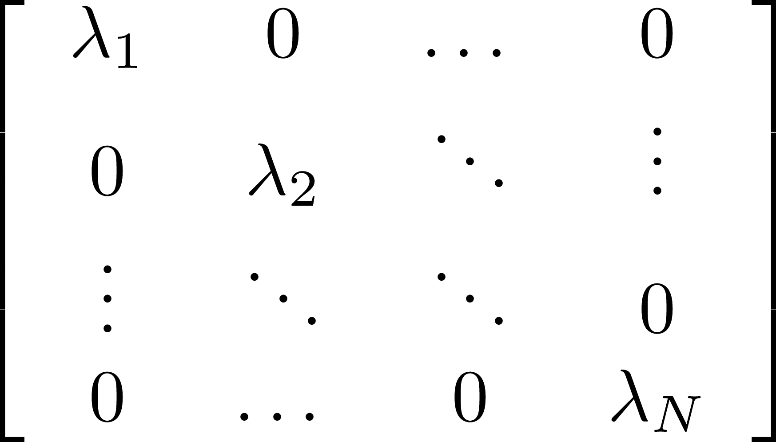
5
Singular Values λ
Betatron Oscillation
Vertical
Horizontal
Mostly Just Noise…
5
Jeffrey Eldred | PCA & BPM Diagnostics
Notes:
5
5
5

Slide 6
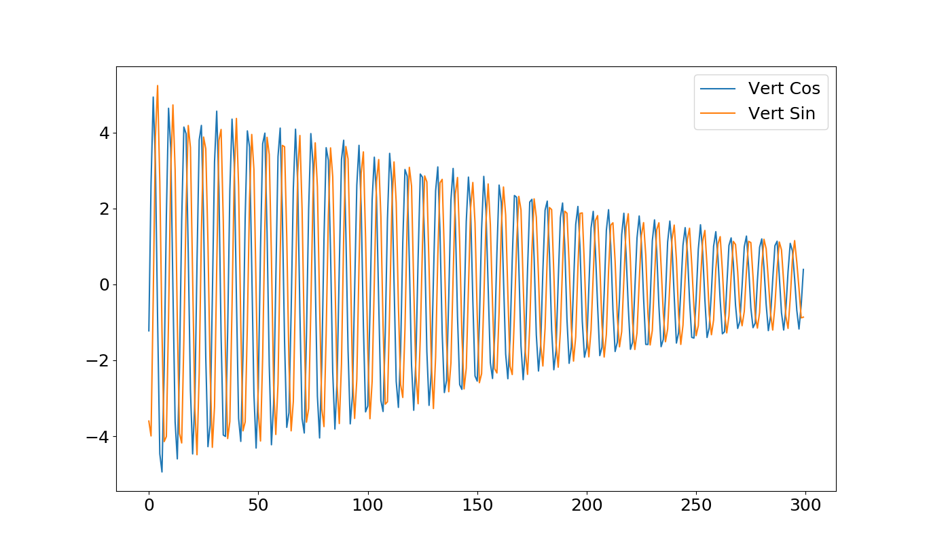
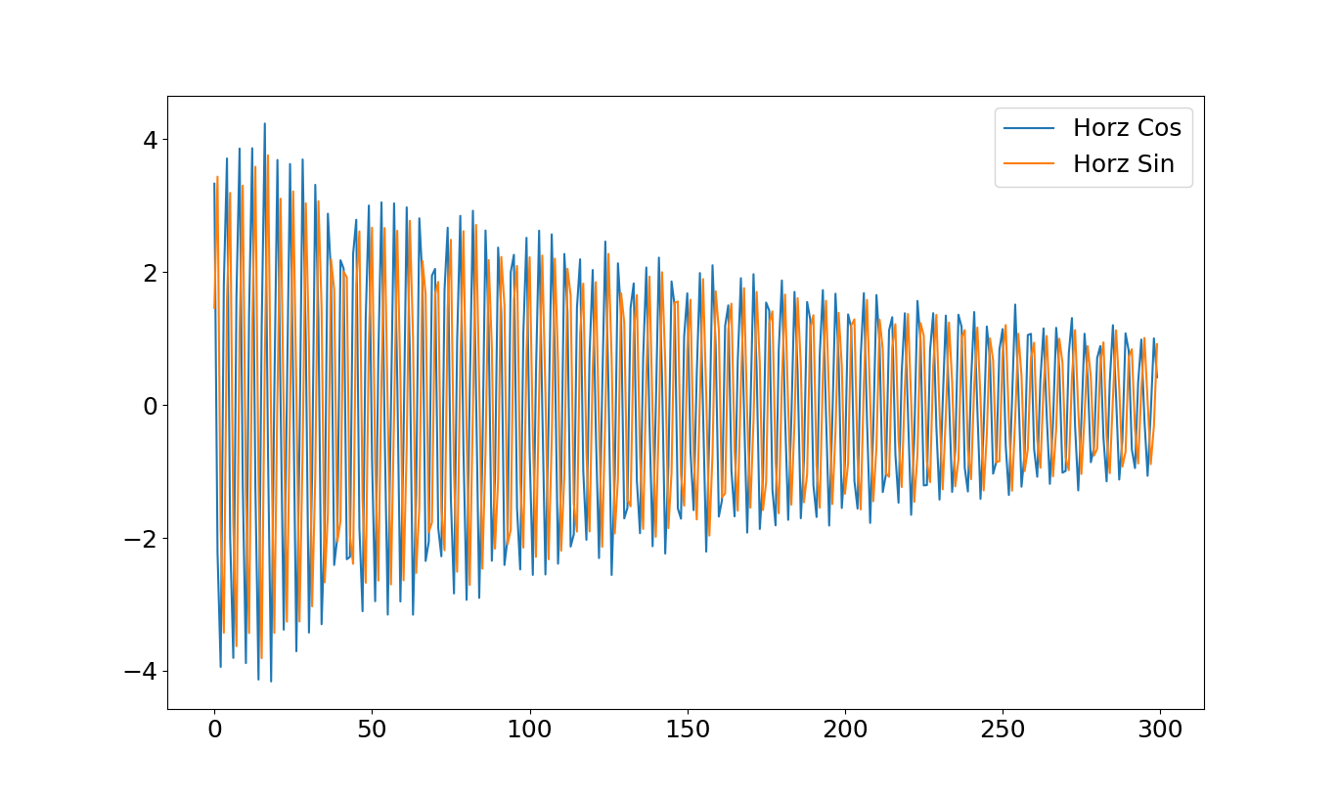
6
Betatron Oscillaton Principal Signals
Reconstructed
Vertical
Signals:
Reconstructed
Horizontal Signals:
6
Jeffrey Eldred | PCA & BPM Diagnostics
Notes:
6
6
6

Slide 7
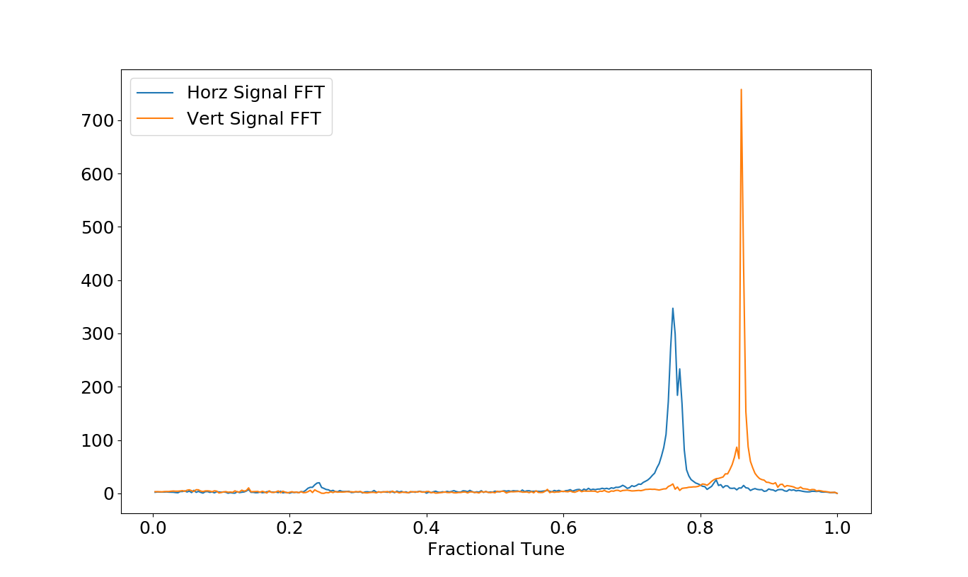
7
Betatron Oscillaton Principal Signals - FFT
7
Jeffrey Eldred | PCA & BPM Diagnostics
Notes:
7
7
7

Slide 8
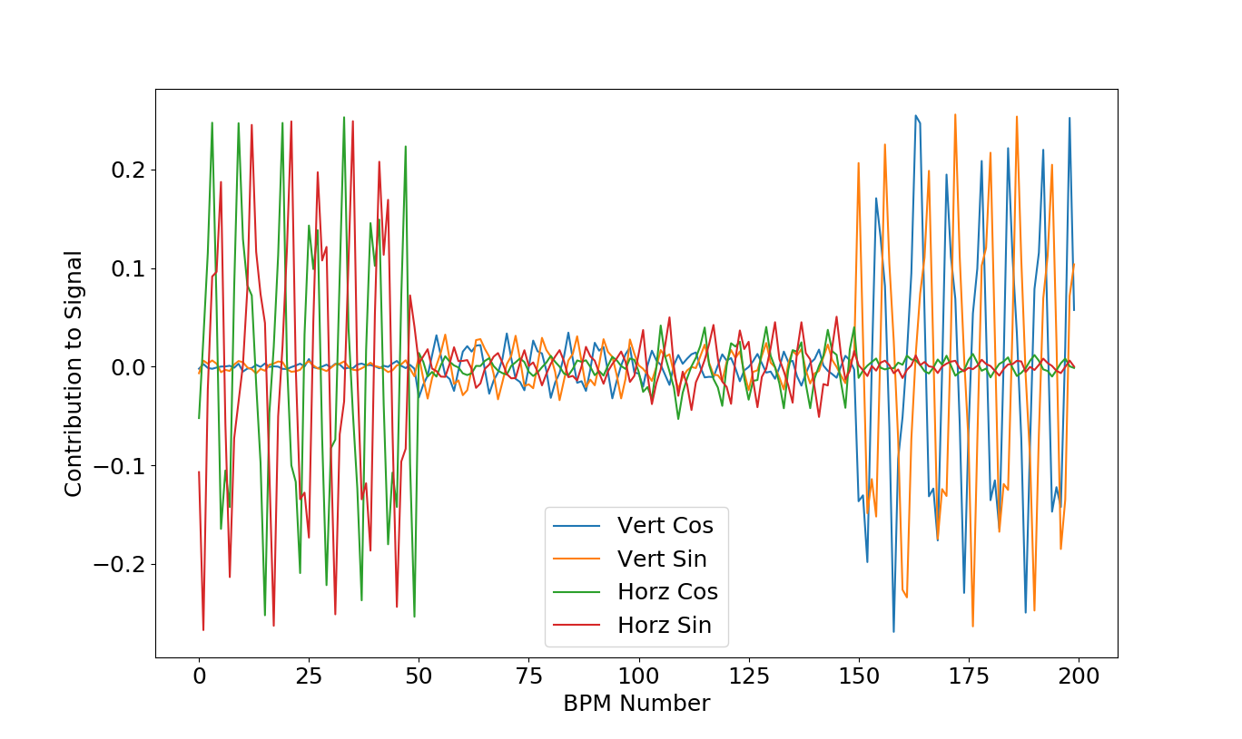
8
Contributions to Principal Signals
Horz Ping
Horz Plates
Horz Ping
Vert Plates
Vert Ping
Horz Plates
Vert Ping
Vert Plates
8
Jeffrey Eldred | PCA & BPM Diagnostics
Notes:
8
8
8

Slide 9
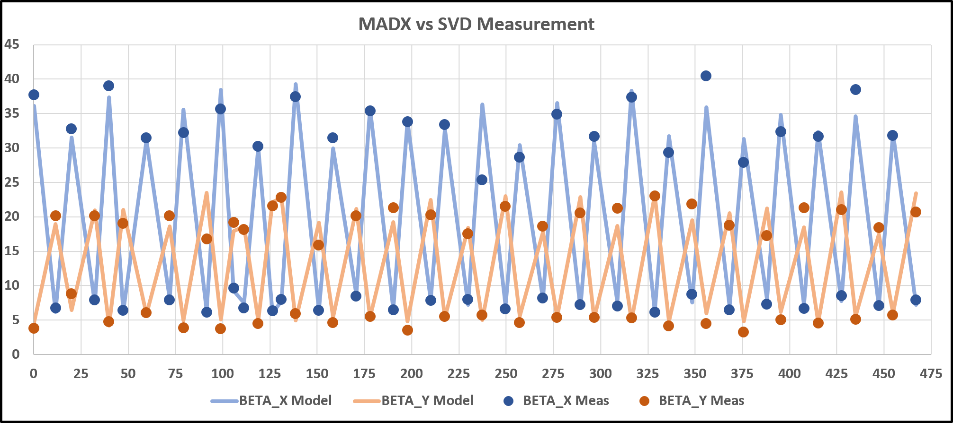
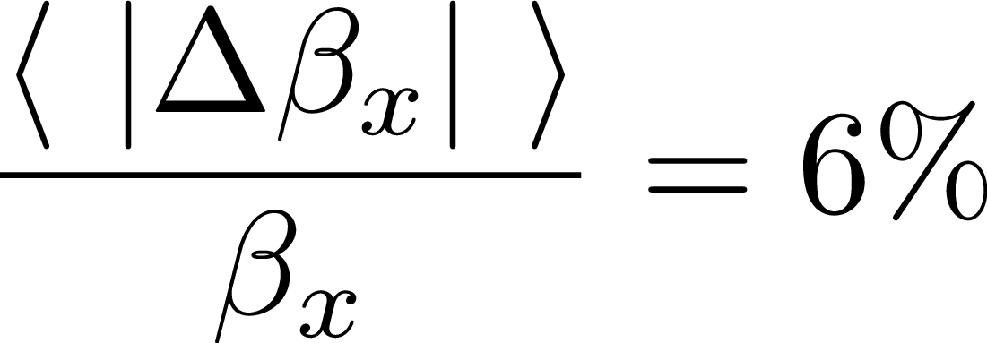
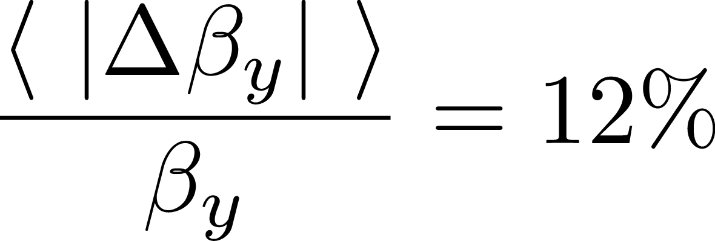
9
PCA/SVD Beta Functions
9
Jeffrey Eldred | PCA & BPM Diagnostics
Notes:
9
9
9

Slide 10
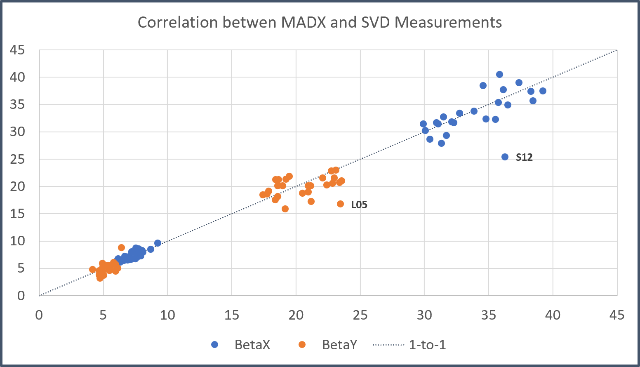
10
PCA/SVD Beta Functions - Correlations
10
Jeffrey Eldred | PCA & BPM Diagnostics
Notes:
10
10
10

Slide 11
11
PCA Applied to BPM Data
1. Reconstruct the four betatron signals via PCA.
2. Separate the horizontal from vertical (frequency and ping)
3. Map the cosine-like and sine-like amplitudes across the BPMs
4. Assign a relative phase for each BPM
- complex argument of cosine-line and sine-like contributions.
5. Calculate the phase-advances between consecutive BPMS
6. Compare to MAD-X model
- initial phase is arbitrary, should be synced.
- last few BPMs and first few BPMs are same house.
7. Analysis
- look for missing BPM data, inadequate amplitudes.
- look for off-by-one-turn phase-errors.
- look for single-BPM phase-errors.
11
Jeffrey Eldred | PCA & BPM Diagnostics
Notes:
11
11
11

Slide 12
12
Betatron Oscillaton Principal Signals
Reconstructed
Vertical
Signals:
Reconstructed
Horizontal Signals:
12
Jeffrey Eldred | PCA & BPM Diagnostics
Notes:
12
12
12

Slide 13
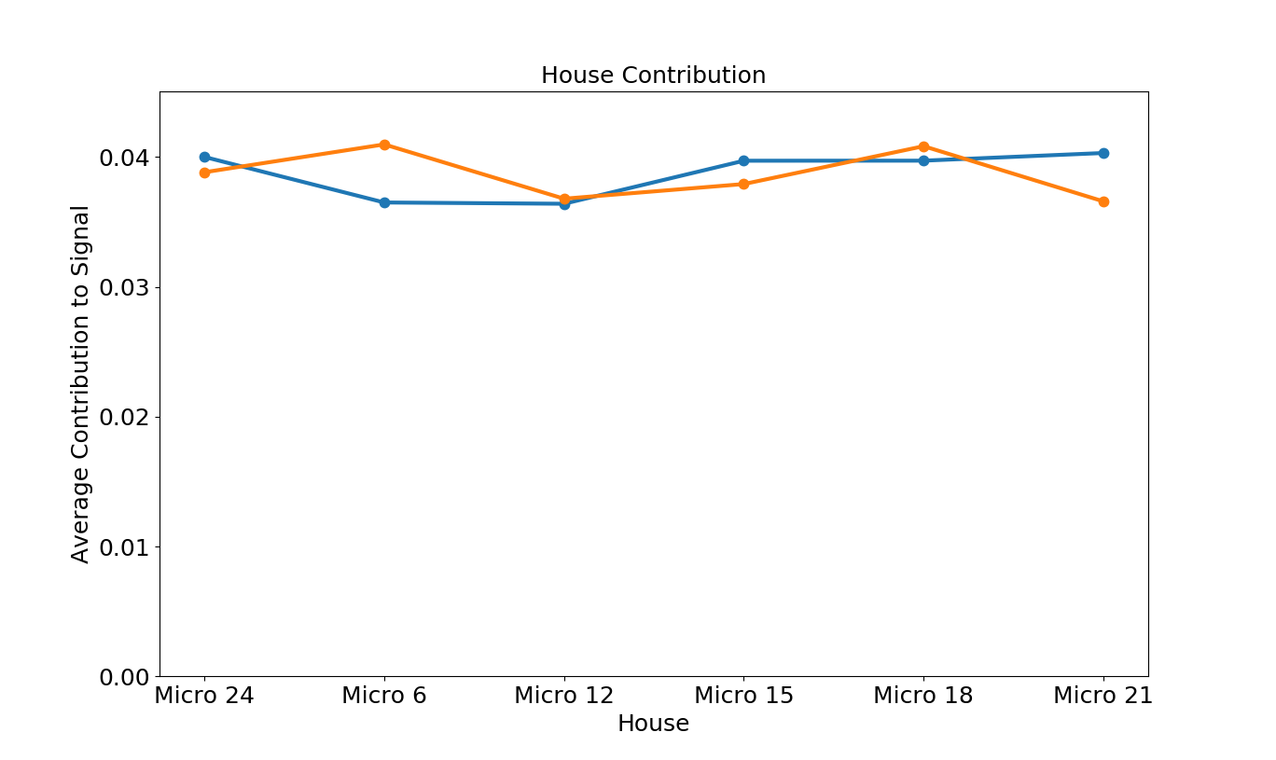
13
Contributions to Principal - Amplitude by House
Horz
Vert
13
Jeffrey Eldred | PCA & BPM Diagnostics
Notes:
13
13
13

Slide 14
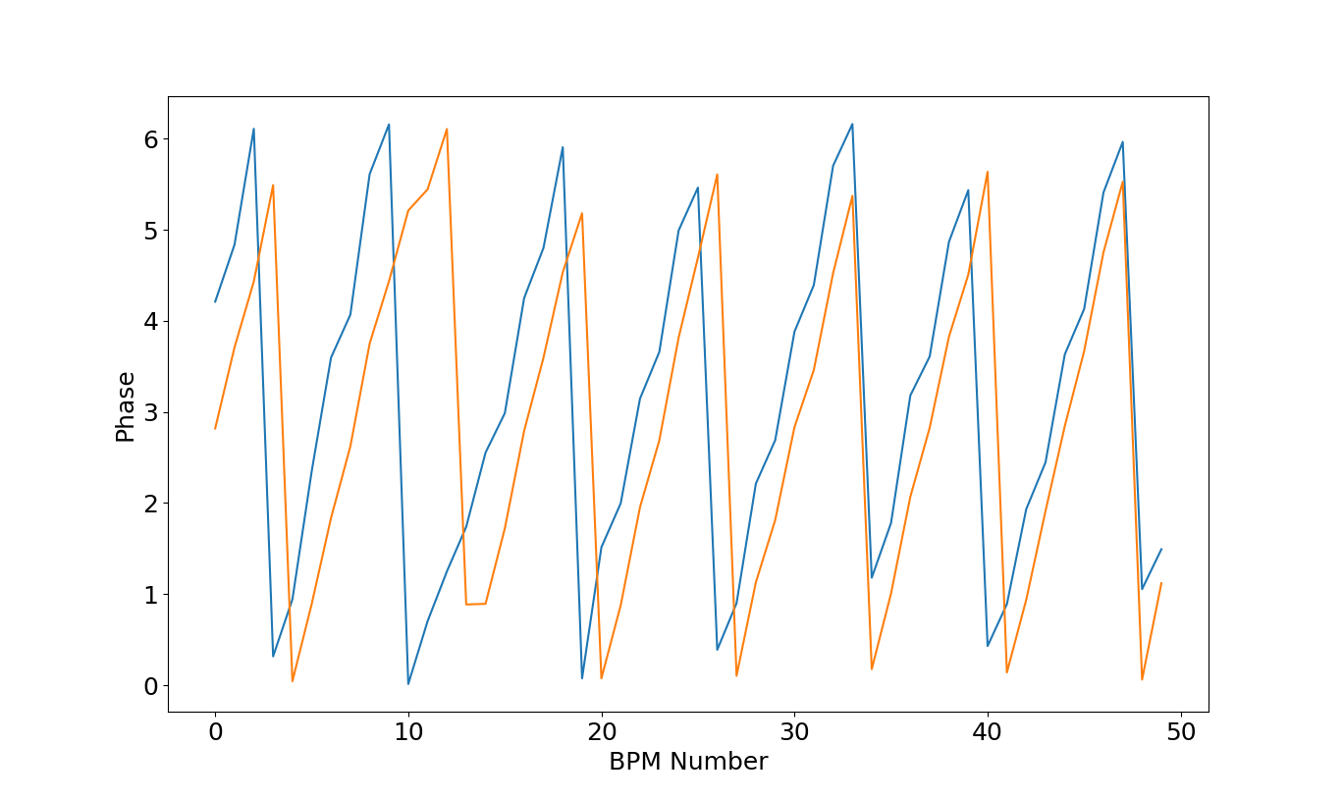
14
Raw Phases by BPM
Horz
Vert
14
Jeffrey Eldred | PCA & BPM Diagnostics
Notes:
14
14
14

Slide 15
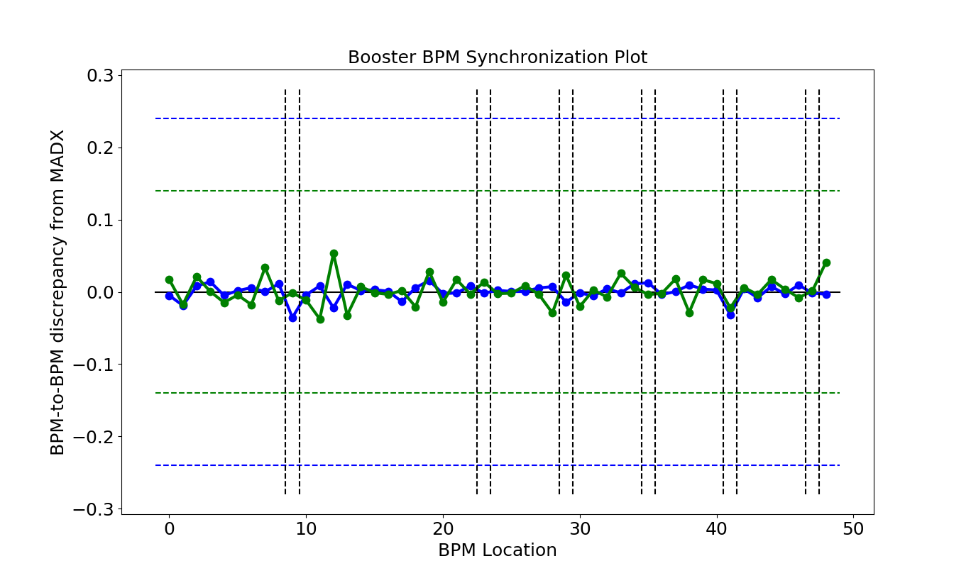
15
Phase Comparison to MADX
Horz
Vert
15
Jeffrey Eldred | PCA & BPM Diagnostics
Notes:
15
15
15

Slide 16
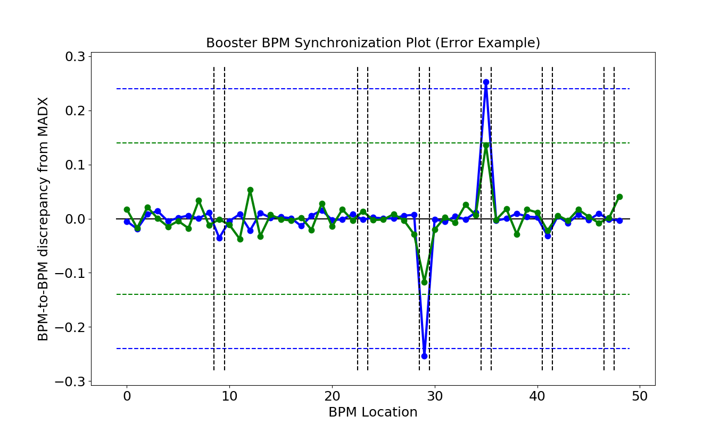
16
BPM Synchronization – House Error
Horz
Vert
16
Jeffrey Eldred | PCA & BPM Diagnostics
Notes:
16
16
16

Slide 17
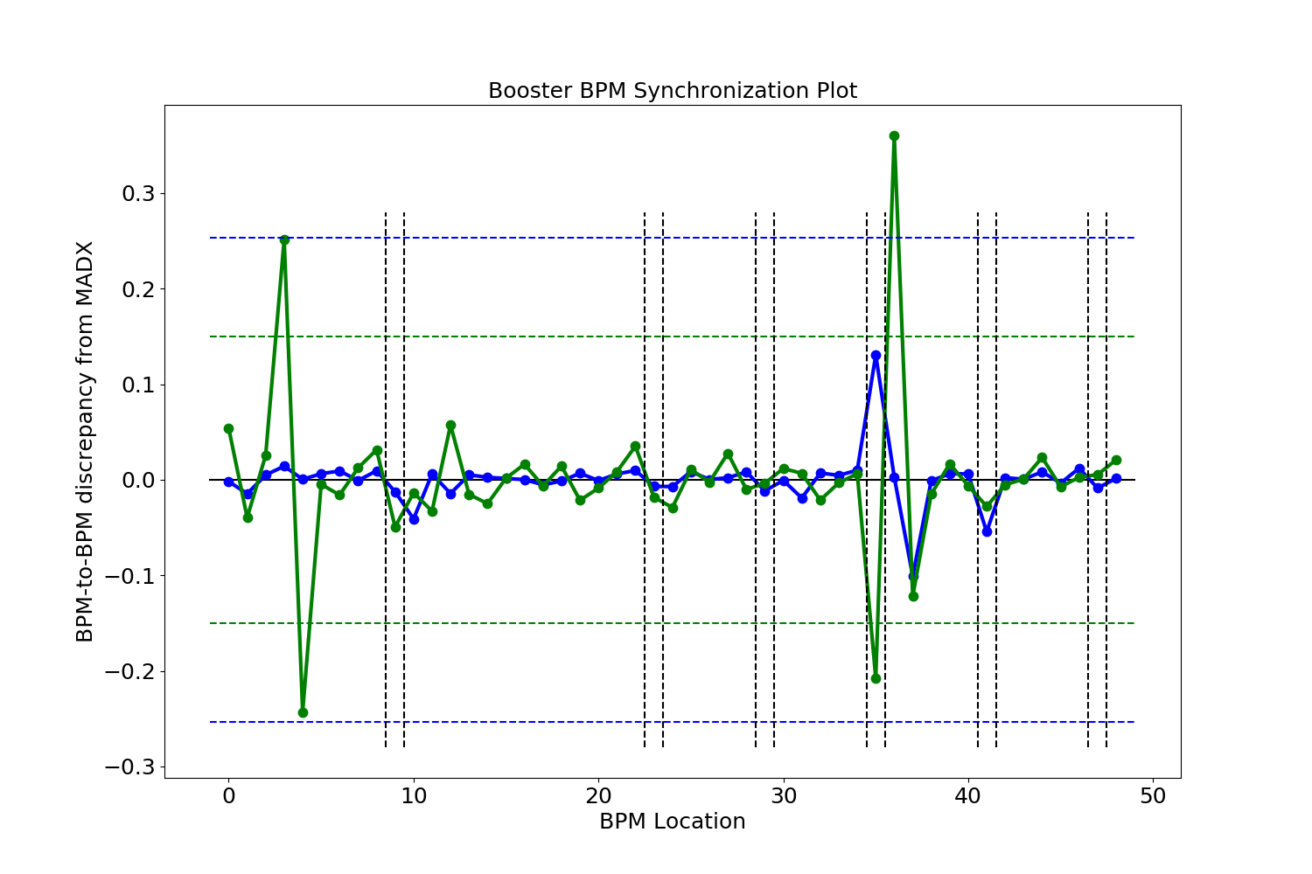
17
BPM Synchronization – Single BPM Errors
Horz
Vert
17
Jeffrey Eldred | PCA & BPM Diagnostics
Notes:
17
17
17

Slide 18
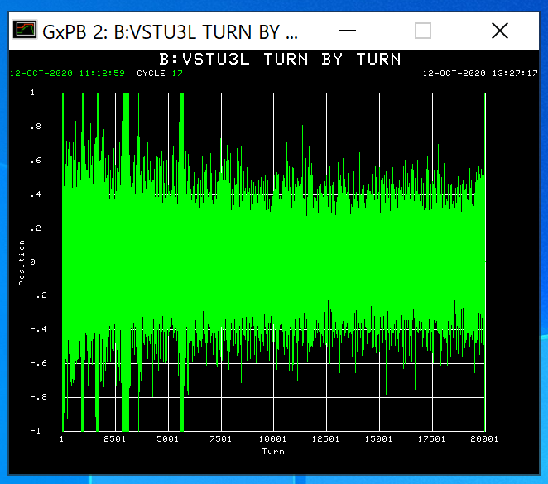
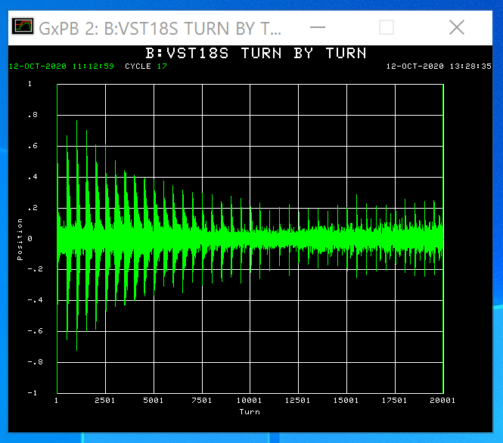
18
Motivates Closer Inspection
Vertical U3L
Vertical 18S
Turned out to be bad
Turned out to be okay
18
Jeffrey Eldred | PCA & BPM Diagnostics
Notes:
18
18
18

Slide 19
19
BPM Synchronization – Single BPM Errors
Horz
Vert
19
Jeffrey Eldred | PCA & BPM Diagnostics
Notes:
19
19
19

Slide 20
20
BPM Synchronization – Single BPM Errors
Horz
Vert
20
Jeffrey Eldred | PCA & BPM Diagnostics
Notes:
20
20
20

Slide 21
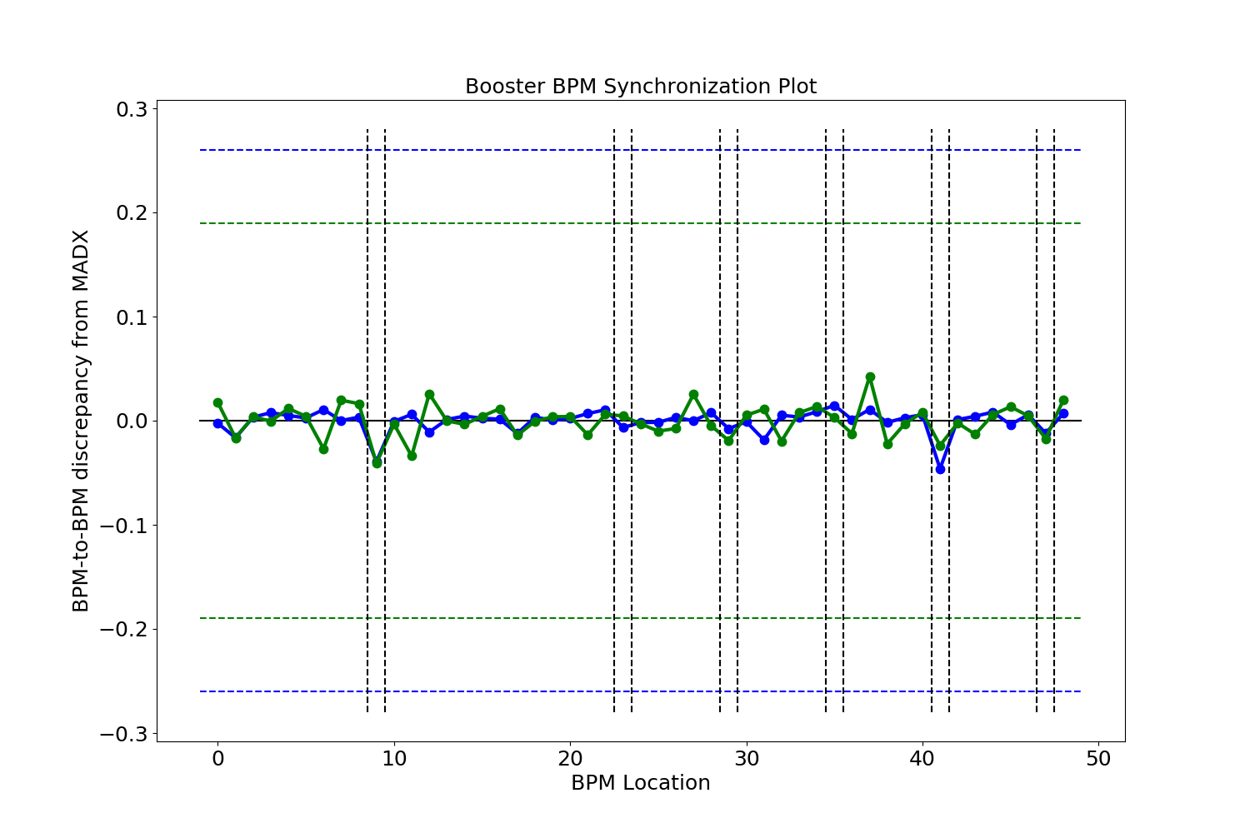
21
BPM Synchronization – Single BPM Errors (Fixed)
Horz
Vert
21
Jeffrey Eldred | PCA & BPM Diagnostics
Notes:
21
21
21

Slide 22
22
Remaining Questions
How repeatable are the beta/phase measurements?
- cycle-to-cycle, throughout ramp, at other settings.
How does SVD method compare to N-BPM method?
How should we handle linear coupling?
And let me also say a few words on anomaly detection in general.
22
Jeffrey Eldred | PCA & BPM Diagnostics
Notes:
22
22
22

Slide 23
23
Generalized Anomaly Detection
Anomaly Detection is:
1 Develop a model of “normal”.
- Simulation code, previous measurements, etc.
2 Compare incoming data to model.
- Check periodically, or real-time monitoring.
3 An anomaly is when data deviates from model too much.
- Define a threshold for intervention.
4 Use model to map anomaly by data stream, timestamp.
- Where does it deviate -> troubleshooting response.
23
Jeffrey Eldred | PCA & BPM Diagnostics
Notes:
23
23
23

Slide 24
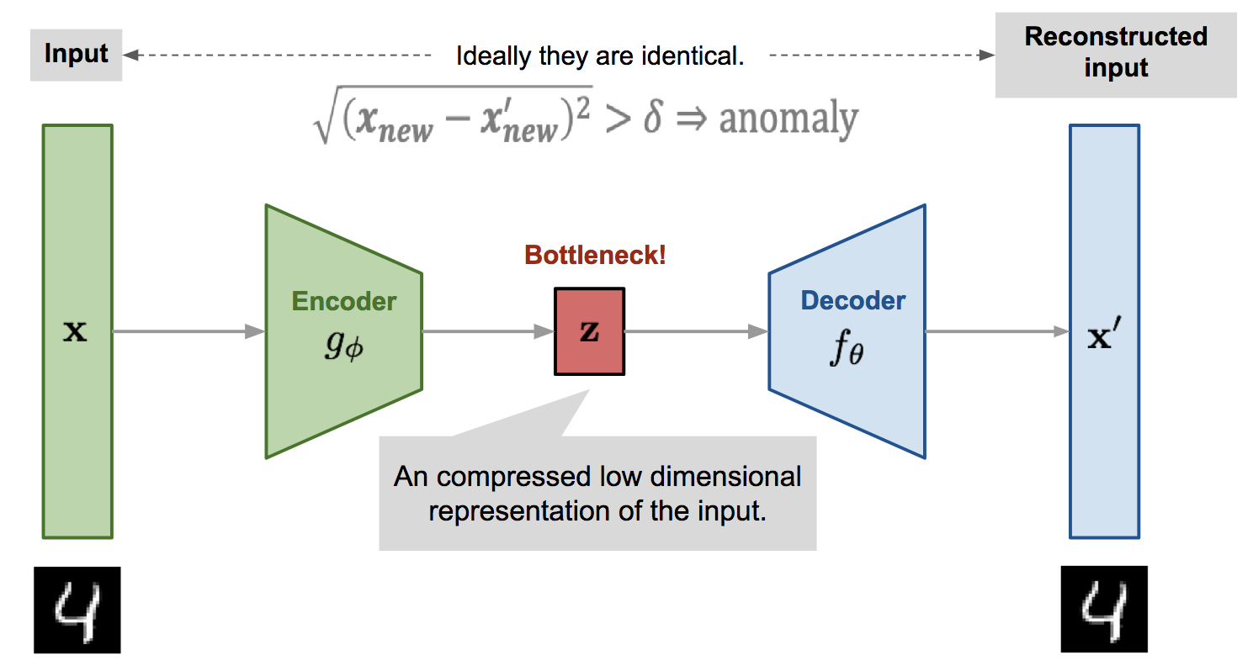
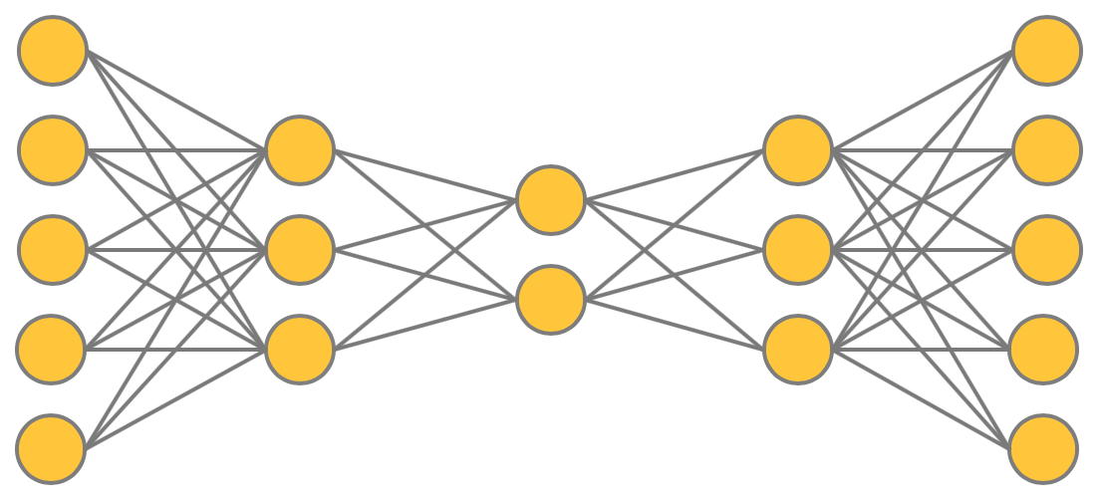
24
Machine Learning Autoencoder Anomaly Detection
Jon Edelen recorded seminar on how to build a ML autoencoder for the particle accelerator anomaly detection.
24
Jeffrey Eldred | PCA & BPM Diagnostics
Notes:
24
24
24

